Slide 1
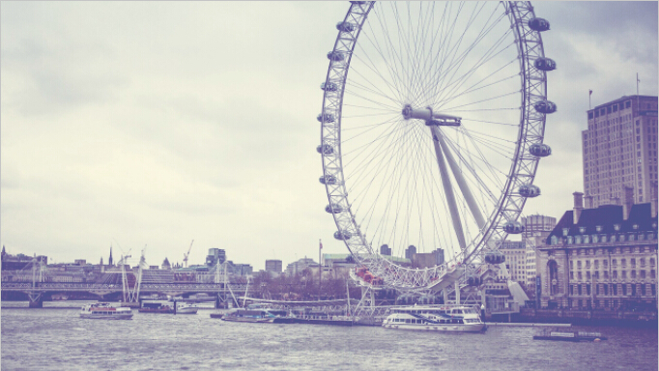



Resume

Slide 2

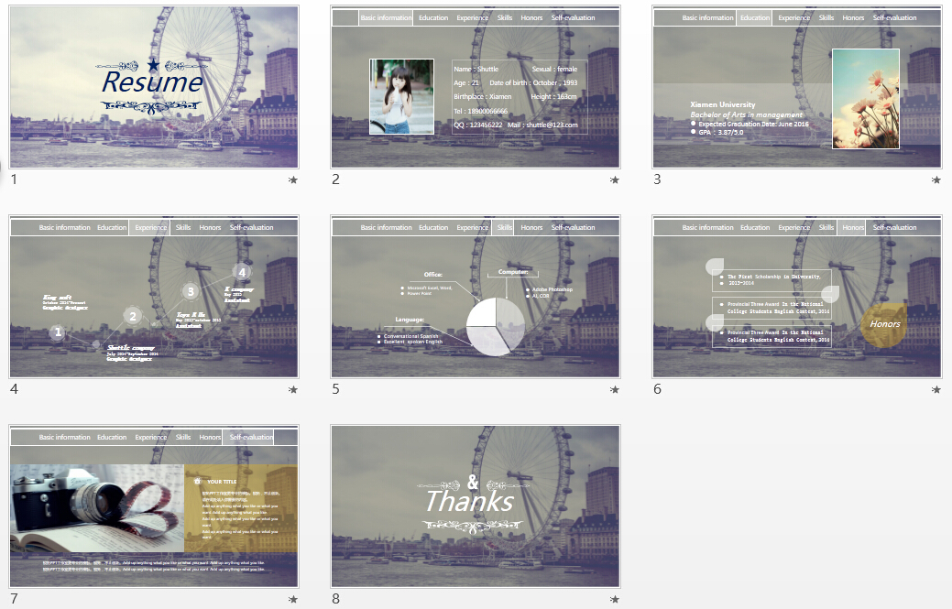

英文简历 朦胧风
图片 文字均可编辑改动
更多作品
梭拓

Slide 3
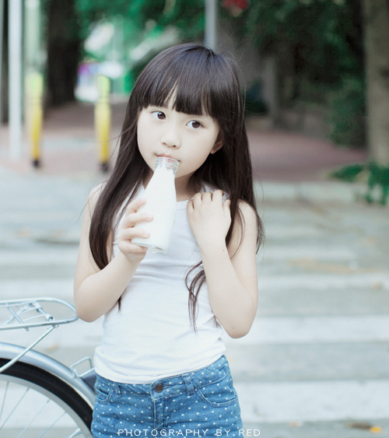
Basic information Education Experience Skills Honors Self-evaluation
Name：Shuttle Sexual：female
Age：21 Date of birth：October，1993
Birthplace：Xiamen Height：163cm
Tel：18900066666
QQ：123456222 Mail：shuttle@123.com

Slide 4

Basic information Education Experience Skills Honors Self-evaluation
Xiamen University
Bachelor of Arts in management
Expected Graduation Date: June 2016
GPA：3.87/5.0

Slide 5
Basic information Education Experience Skills Honors Self-evaluation
4
3
K company
May 2013
Assistant
King soft
October 2014-Present
Graphic designer
2
Toys R Us
May 2013-october 2013 Assistant
1
Shuttle company
July 2014-September 2014
Graphic designer

Slide 6

Basic information Education Experience Skills Honors Self-evaluation
Office:
Computer:
Microsoft Excel, Word,
Power Point
Adobe Photoshop
AI, COR
Language:
Conversational Spanish
Excellent spoken English

Slide 7
Basic information Education Experience Skills Honors Self-evaluation
The First Scholarship in University,
2013-2014
Provincial Three Award In the National College Students English Contest,2014
Honors
Provincial Three Award In the National College Students English Contest,2014

Slide 8

Basic information Education Experience Skills Honors Self-evaluation
YOUR TITLE
梭拓PPT工作室更专业的模板。梭拓，不止创新。请在此处填入你需要的内容。
Add up anything what you like or what you want. Add up anything what you like.
Add up anything what you like or what you want.
Add up anything what you like or what you want.
梭拓PPT工作室更专业的模板。梭拓，不止创新。Add up anything what you like or what you want. Add up anything what you like.
梭拓PPT工作室更专业的模板。梭拓，不止创新。Add up anything what you like or what you want. Add up anything what you like.

Slide 9
Thanks

