Slide 1
Object-Oriented Patterns in XiangShan CPU’s BPU

Slide 2

Hello!
I AM ZPY
https://github.com/zpy2001

Slide 3
What’s XiangShan Project
1
Introduction to what I have read

Slide 4
RISC-V的一大优势——形成“竞争前合作”，实现各界联合开发开源CPU架构
国内外现有开源RISC-V项目尚不满足业界对高性能处理器的需求
用于研究和验证芯片敏捷设计方法、流程与工具

Slide 5
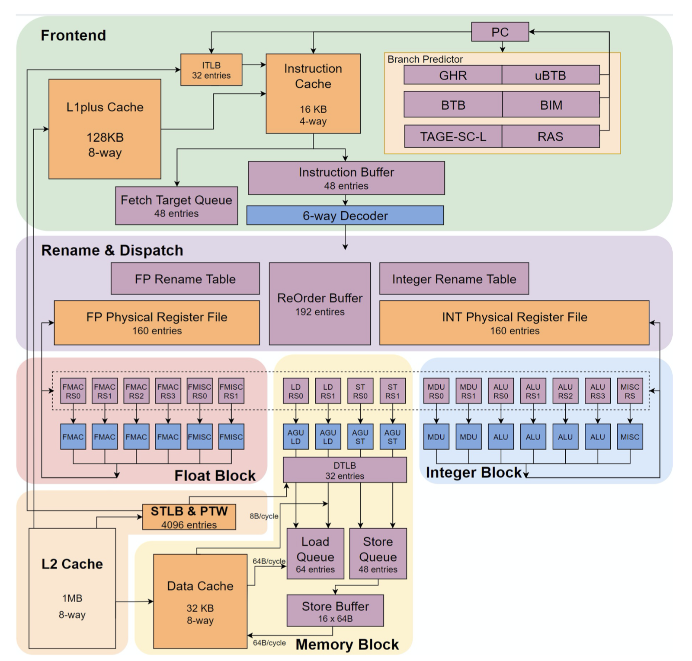
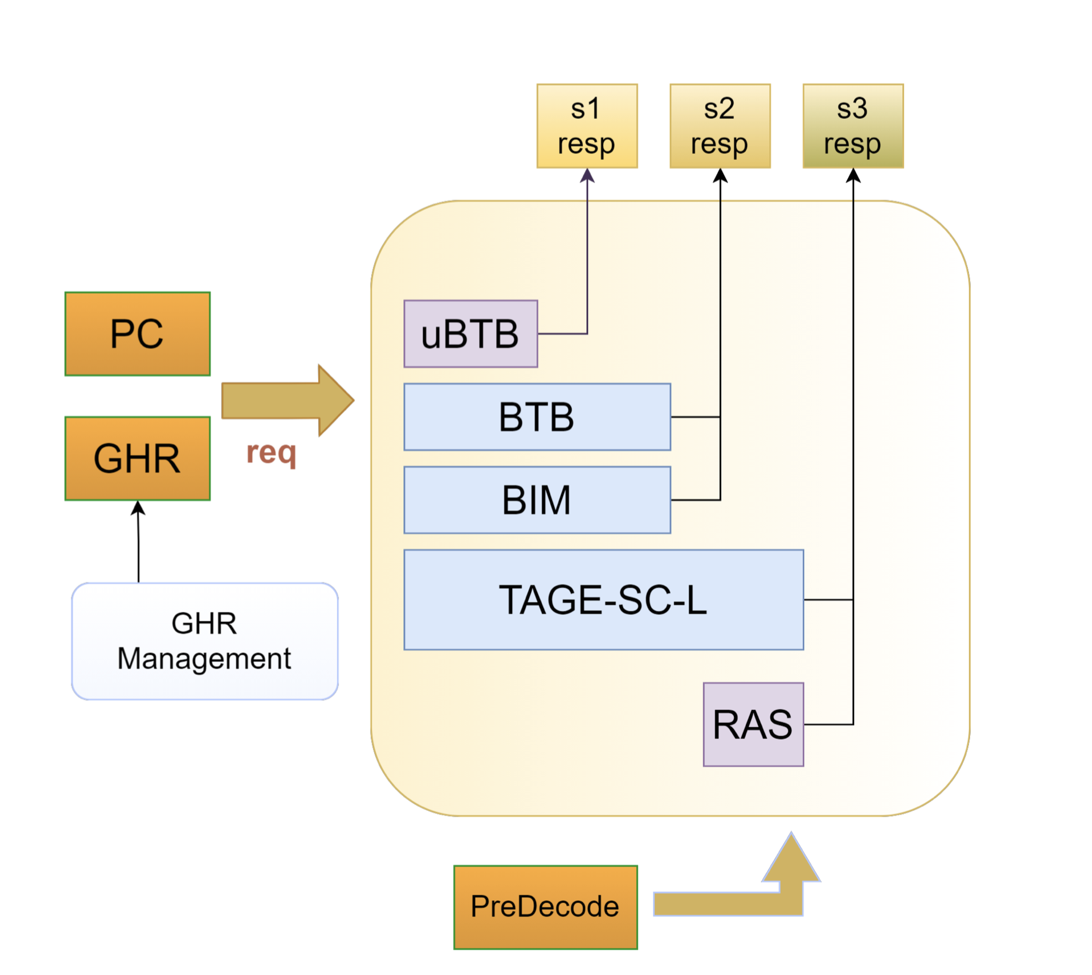
CPU & BPU
* version 1.0

Slide 6
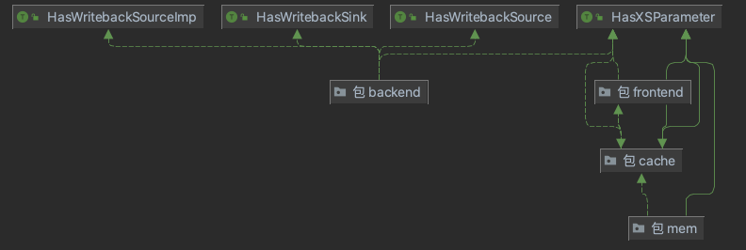
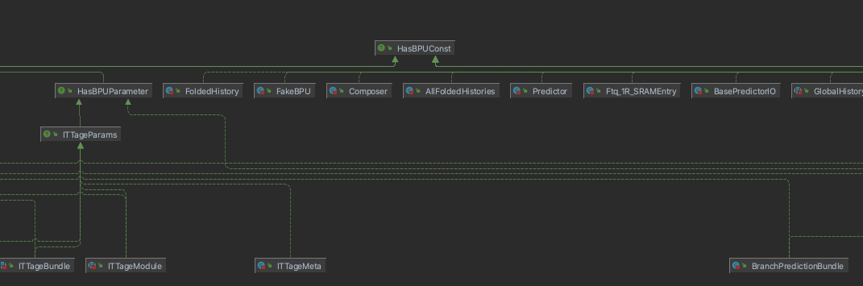
UML
Black

Slide 7
Specific Process
Starting with a PC taken out of IFU

Slide 8
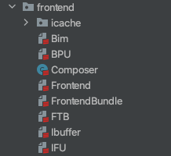
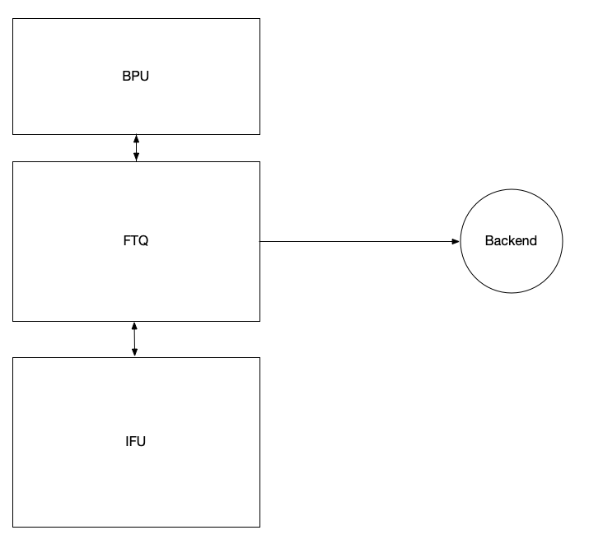
Macro Perspective
BPU
(Branch Predictor)
FTQ
(Fetch Target queue)
IFU
(Inst Fetch)

Slide 9
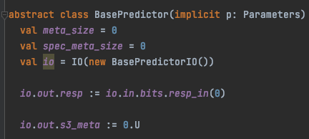
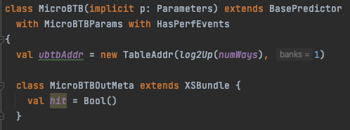
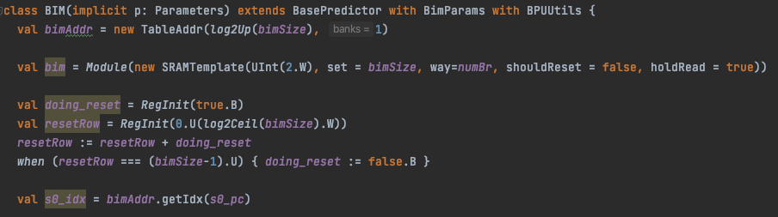
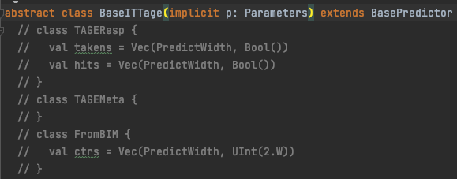
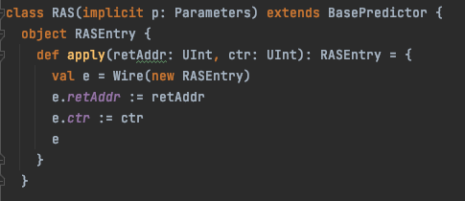
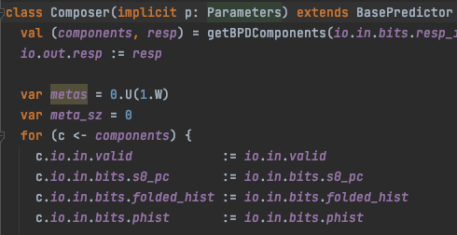
A FEW KEY CLASSES
BasePredictor
uBTB(跳转地址预测)
BIM（跳转方向预测）
TAGE/ITTAGE（高级）
RAS（return 特化）
COMPOSER/PRIDICTOR

Slide 10

Object-Oriented Patterns

Slide 11
OO BASIC ELEMENTS
封装
继承/多态
混入

Slide 12

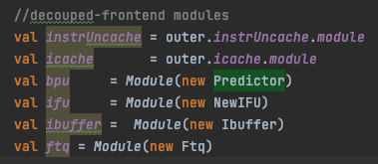

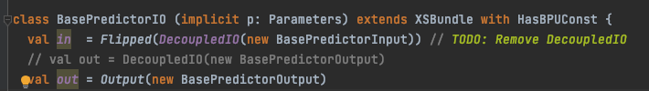
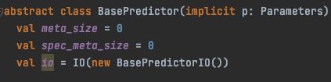
OO BASIC ELEMENTS
封装

Slide 13
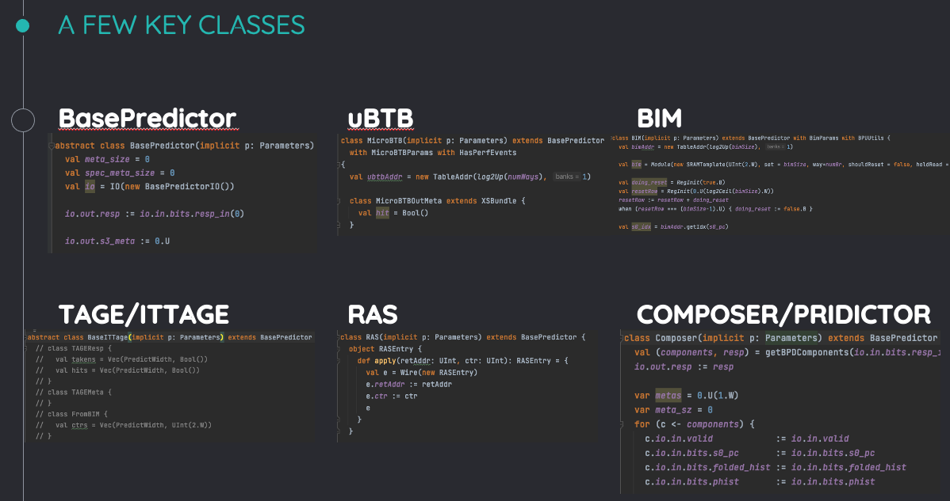

OO BASIC ELEMENTS
继承/多态

Slide 14
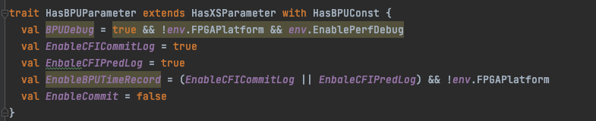
OO BASIC ELEMENTS
混入

Slide 15
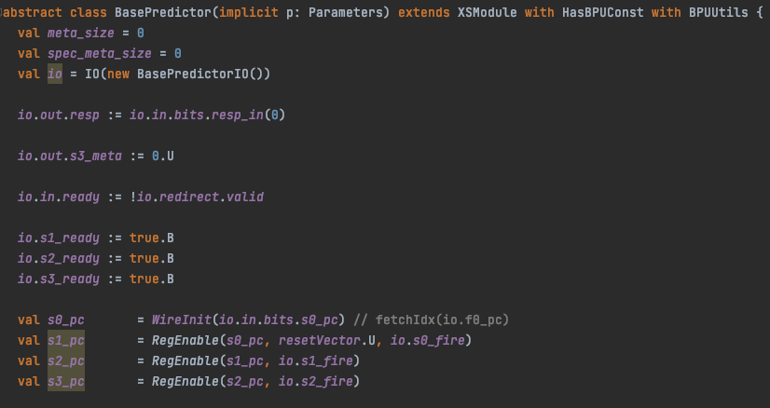
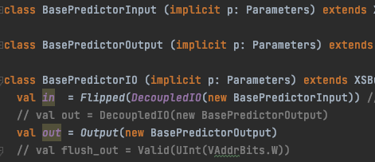
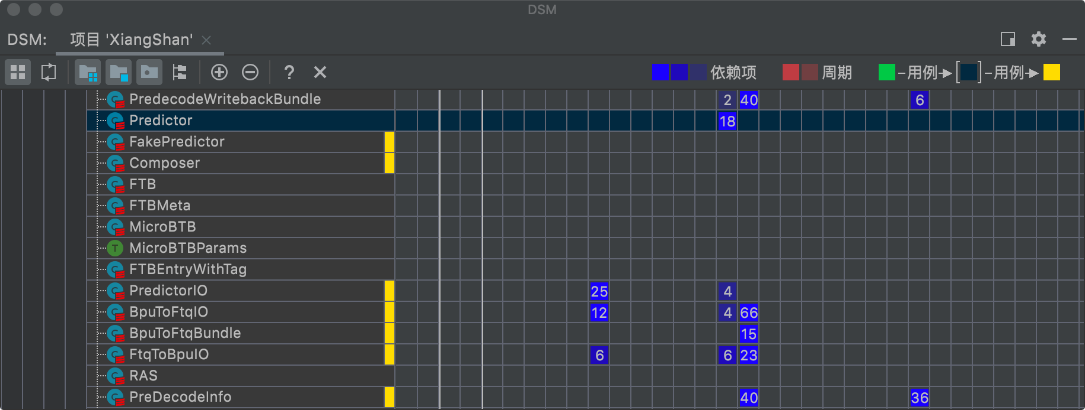
OO DESIGN PRINCIPLES
单一职责
开放关闭
接口隔离
迪米特原则

Slide 16
Summary & Outlook
Experiences and lessons learned from this semester's reading of the Xiangshan Project

Slide 17
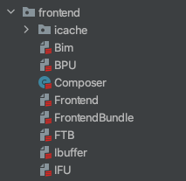
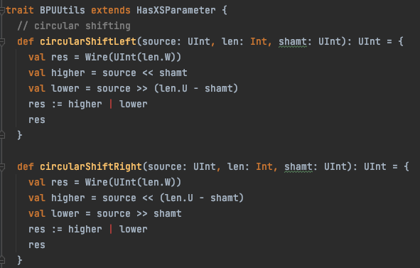
LESSONS
稳定的版本
OOP？OOD？OO？

Slide 18
Thanks!
ANY QUESTIONS?
You can find me at
zhoupengyu19@mails.ucas.ac.cn

