Slide 1
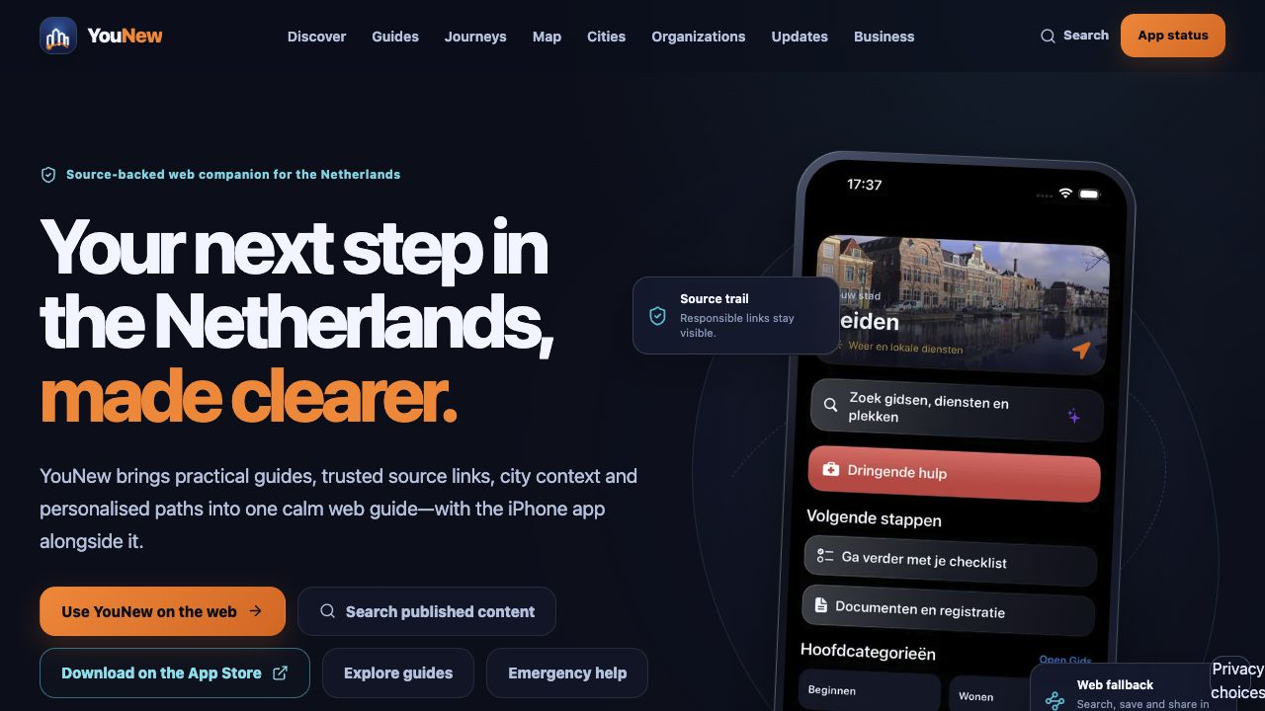
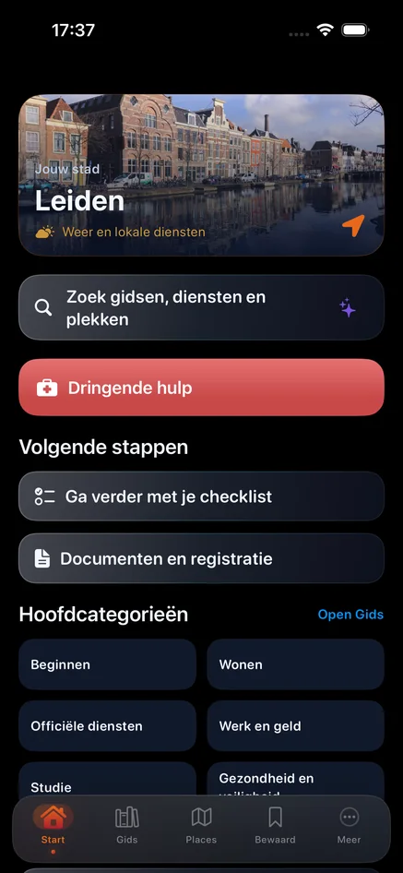
YouNew
A working
ecosystem for a
clearer start
iOS · Web · Admin · Supabase · AI · Workspace
Product showcase · Release candidate
30 July 2026 · Netherlands
Notes:
Opening: YouNew is shown as a working multi-surface ecosystem and release candidate.
[Sources]
- https://younew.nl/ — live page screenshot captured 2026-07-30.
- /Users/ivan/Desktop/Developer:YouNew/YouNew/release-artifacts/presentation-2026-07-30/assets/web-home.png

Slide 2
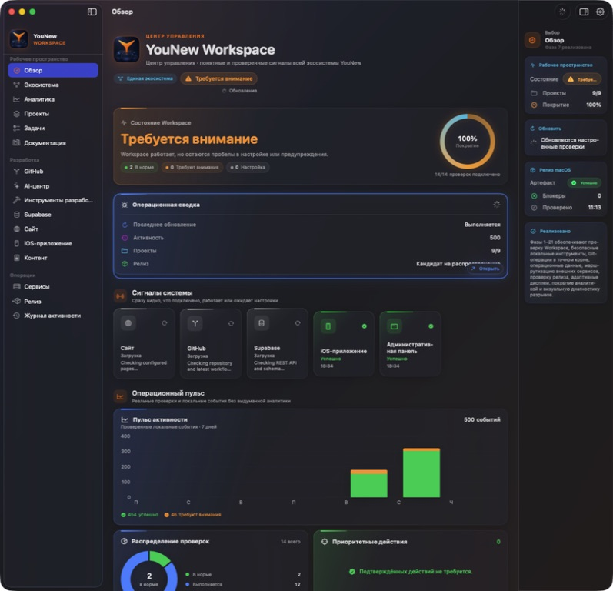
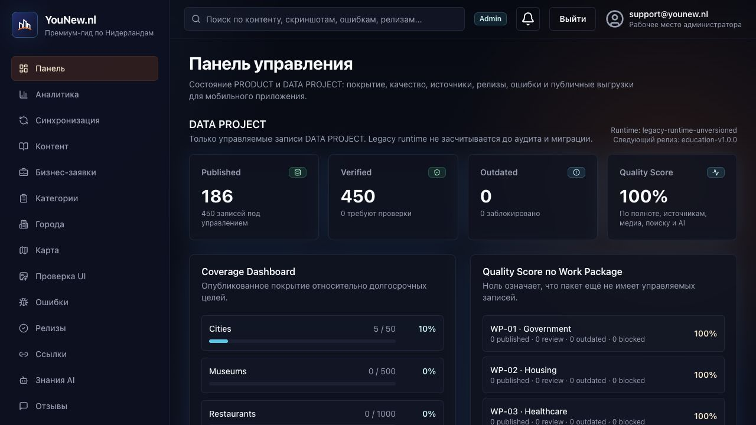
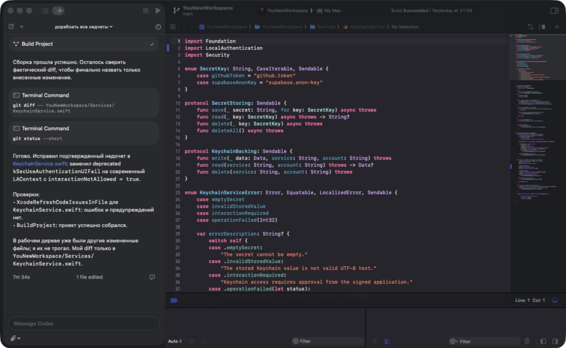
ONE CONNECTED PRODUCT
Every surface serves the same product system
iOS
Public Web + Admin
Workspace + Engineering
YouNew · Product ecosystem · 30 July 2026
02
Notes:
[Sources]
- https://younew.nl/ — live public website capture.
- https://admin.younew.nl/dashboard — authenticated Admin capture.
- https://younew.nl/images/app-home-nl.webp — current published app UI asset.
- /Users/ivan/Applications/YouNew Workspace.app — local workspace capture.
- Xcode local workspace — local engineering surface capture.

Slide 3
PUBLIC PRODUCT
The web product is live, discoverable and usable
A source-backed companion for newcomers in the Netherlands — with search, profiles, guides, cities, organizations, maps, saved content and emergency routes.
585
575
186
static routes
indexable URLs
published records
Live smoke test: PASS · 83 web tests: PASS
YouNew · Product ecosystem · 30 July 2026
03
Notes:
[Sources]
- https://younew.nl/ — captured 2026-07-30.
- /Users/ivan/Desktop/Developer:YouNew/YouNew/release-artifacts/presentation-2026-07-30/assets/web-home.png
- /Users/ivan/Desktop/Developer:YouNew/YouNew/release-artifacts/presentation-2026-07-30/../sale-readiness-2026-07-30/verification-summary.json — 585 routes, 575 indexable URLs, 186 published records and 83 passing tests.

Slide 4
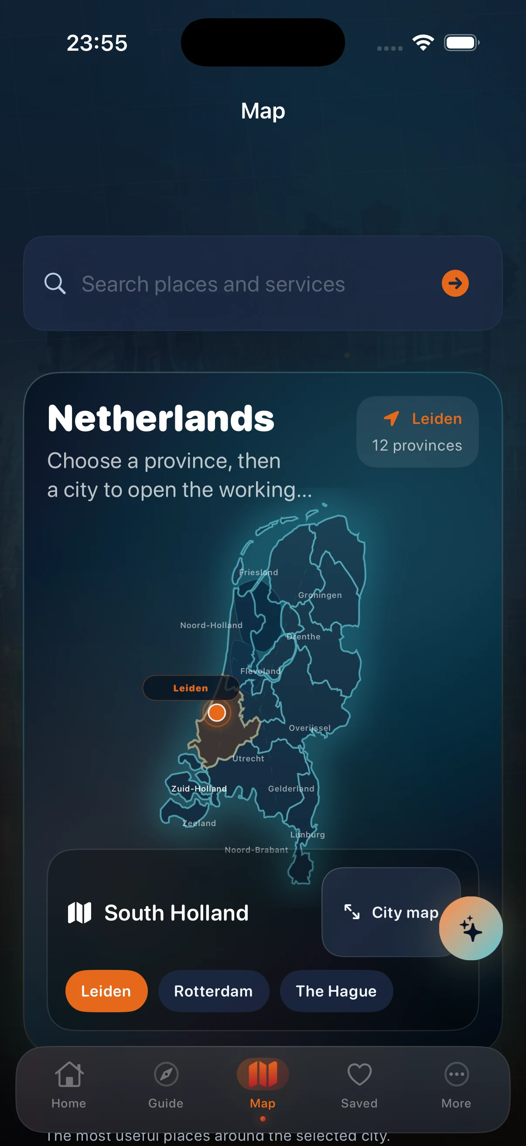
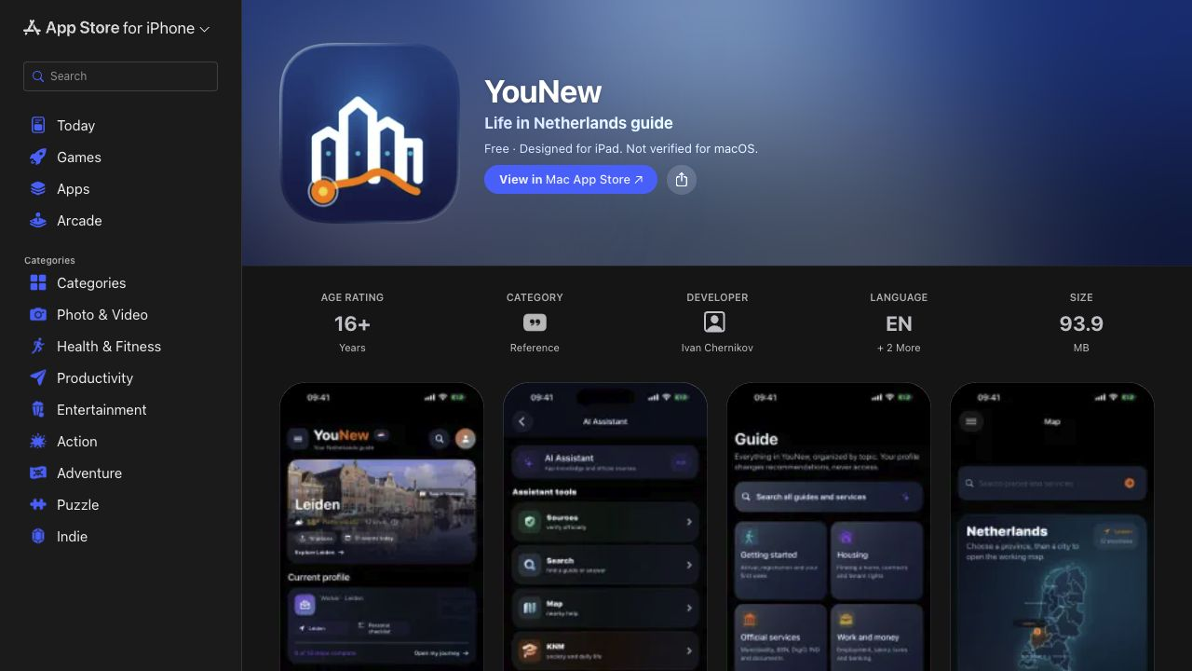
IPHONE PRODUCT
A public App Store product with a coherent mobile experience
The public listing, navigation, city context, search, guide entry points and map experience already share one visual language.
Unsigned generic-device Release: BUILD SUCCEEDED
YouNew · Product ecosystem · 30 July 2026
04
Notes:
The two standalone app screens are current published UI assets, not screenshots from the blocked Simulator installation attempt.
[Sources]
- https://apps.apple.com/app/id6782617312 — public listing captured 2026-07-30.
- https://younew.nl/images/app-home-nl.webp — published current iPhone UI asset.
- https://younew.nl/images/app-map-en.webp — published current iPhone UI asset.
- /Users/ivan/Desktop/Developer:YouNew/YouNew/release-artifacts/presentation-2026-07-30/../sale-readiness-2026-07-30/verification-summary.json — unsigned generic-device Release BUILD SUCCEEDED.

Slide 5
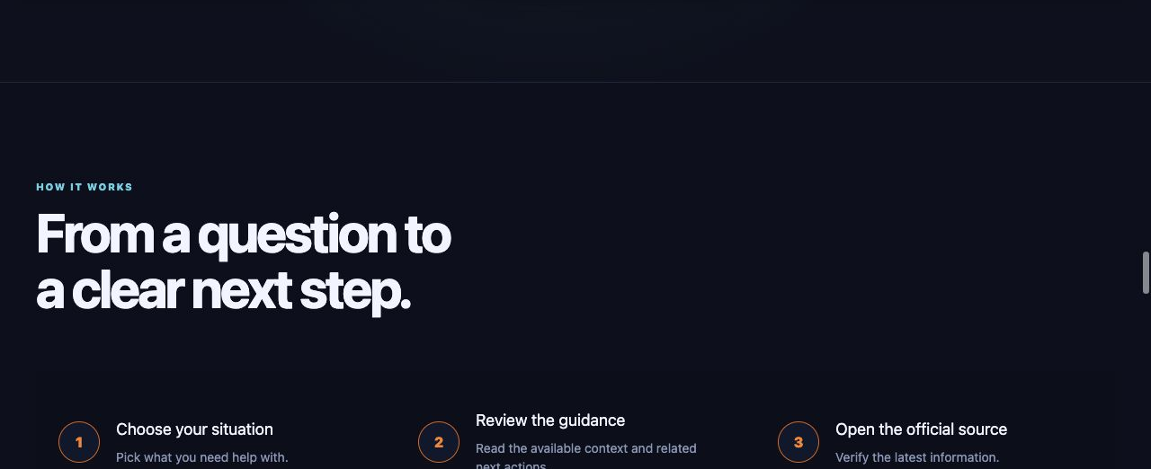
USER JOURNEY
From question to verified next step
YouNew · Product ecosystem · 30 July 2026
05
Notes:
[Sources]
- https://younew.nl/ — live How it works section captured 2026-07-30.
- /Users/ivan/Desktop/Developer:YouNew/YouNew/release-artifacts/presentation-2026-07-30/assets/web-home-features.png

Slide 6
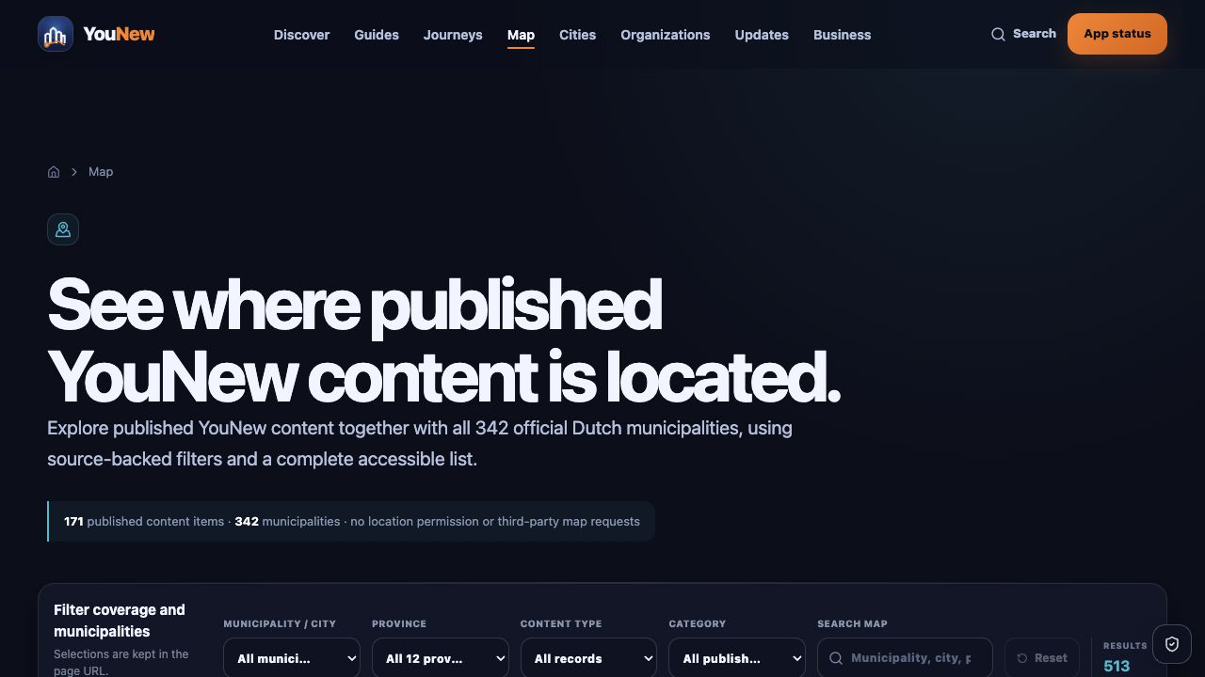
LOCATION LAYER
The same geography powers web discovery and iPhone context
342 municipalities · 171 located published items · accessible list fallback
YouNew · Product ecosystem · 30 July 2026
06
Notes:
[Sources]
- https://younew.nl/map/ — live map page captured 2026-07-30; visible page reports 342 municipalities and 171 located published items.
- https://younew.nl/images/app-map-en.webp — published iPhone map UI.

Slide 7
CONTROL PLANE
Admin turns content, quality and releases into operations
Content lifecycle
Published, review, outdated and blocked states.
Governed data
Sources, media, links, coordinates and AI summaries.
Protected actions
Approved roles, audit log and explicit release surfaces.
YouNew · Product ecosystem · 30 July 2026
07
Notes:
[Sources]
- https://admin.younew.nl/dashboard — authenticated live capture 2026-07-30.
- /Users/ivan/Desktop/Developer:YouNew/YouNew/release-artifacts/presentation-2026-07-30/assets/admin-dashboard.png
- /Users/ivan/Desktop/Developer:YouNew/YouNew/release-artifacts/presentation-2026-07-30/../sale-readiness-2026-07-30/verification-summary.json — Admin lint, typecheck, 10 tests and production build passed.

Slide 8
OPERATIONAL WORKSPACE
One desktop surface links operations and engineering
Project health, external services, release artifacts, activity and source-level engineering stay visible without collapsing safety boundaries.
YouNew · Product ecosystem · 30 July 2026
08
Notes:
[Sources]
- /Users/ivan/Applications/YouNew Workspace.app — Overview screen captured 2026-07-30.
- Xcode local workspace — real code and successful build surface captured 2026-07-30.
- /Users/ivan/Desktop/Developer:YouNew/YouNew/release-artifacts/presentation-2026-07-30/assets/workspace-overview.png
- /Users/ivan/Desktop/Developer:YouNew/YouNew/release-artifacts/presentation-2026-07-30/assets/xcode-project.png

Slide 9
SYSTEM ARCHITECTURE
How YouNew works — end to end
GitHub + CI
source, checks, builds
App Store + web deploy
signed delivery
Supabase
Public Web + iOS
YouNew Workspace
Admin
Postgres · RLS
Edge Functions
analytics · AI context
discover · guides · map
search · save · share
source verification
health · tools · releases
safe operational view
content · quality
review · release
Privacy-safe analytics + feedback
bounded signals return to Admin
One governed data model · explicit trust boundaries · auditable release path
YouNew · Product ecosystem · 30 July 2026
09
Notes:
Native PowerPoint shapes illustrate the verified system boundaries. The diagram is intentionally simplified for a product audience.
[Sources]
- /Users/ivan/Desktop/Developer:YouNew/YouNew/docs/SYSTEM_MAP.md — component and data-flow source.
- /Users/ivan/Desktop/Developer:YouNew/YouNew/docs/COUNTRY_PACK_CONTRACT.md — governed expansion contract.
- /Users/ivan/Desktop/Developer:YouNew/YouNew/docs/COMPLIANCE_CONTROL_MATRIX.md — trust and release controls.

Slide 10
VERIFICATION EVIDENCE
Quality is visible in the numbers and the gates
450
186
97.8%
170
106
governed records
published records
freshness compliant
assets rights-checked
passing web/admin/AI tests
PUBLIC WEB
ADMIN + EDGE
iOS RELEASE
Predeploy PASS · live routes reviewed
Build PASS · function typecheck PASS
Unsigned device build: SUCCEEDED
YouNew · Product ecosystem · 30 July 2026
10
Notes:
106 is the sum of 83 public web tests, 10 admin tests and 13 backend AI proxy tests; iOS tests are not included.
[Sources]
- /Users/ivan/Desktop/Developer:YouNew/YouNew/release-artifacts/presentation-2026-07-30/../sale-readiness-2026-07-30/verification-summary.json — 450 governed, 186 published, 97.8% freshness, 170 inventoried assets and passing tests.
- /Users/ivan/Desktop/Developer:YouNew/YouNew/RELEASE_READINESS_2026-07-30.md — release checks and bounded limitations.

Slide 11
RELEASE POSTURE
Ready for controlled release-candidate handoff
7.8
Already proven
Final release gates
• Live public web
• Public App Store listing
• Authenticated Admin
• Healthy Supabase runtime
• Successful unsigned Release build
• Clean source SHA + green CI
• Signed archive + runnable iOS tests
• Encrypted backup + isolated restore
• Authenticated Admin E2E
• Flagship guides production-ready
technical readiness
out of 10
Operational today. Final release authority remains tied to explicit, testable evidence.
YouNew · Product ecosystem · 30 July 2026
11
Notes:
This slide deliberately distinguishes working product readiness from unconditional release authority.
[Sources]
- /Users/ivan/Desktop/Developer:YouNew/YouNew/release-artifacts/presentation-2026-07-30/../sale-readiness-2026-07-30/verification-summary.json — decision and component evidence.
- /Users/ivan/Desktop/Developer:YouNew/YouNew/RELEASE_READINESS_2026-07-30.md — open release gates.

Slide 12
YouNew
A working ecosystem
built to scale
Product experience, governed data, operational control and release evidence — connected in one system.
Next milestone: flagship practical guides + clean release identity
Notes:
[Sources]
- https://younew.nl/ — live page screenshot captured 2026-07-30.
- /Users/ivan/Desktop/Developer:YouNew/YouNew/docs/COUNTRY_PACK_CONTRACT.md — repeatable expansion boundary.
- /Users/ivan/Desktop/Developer:YouNew/YouNew/RELEASE_READINESS_2026-07-30.md — highest-value remaining release actions.

