Slide 1
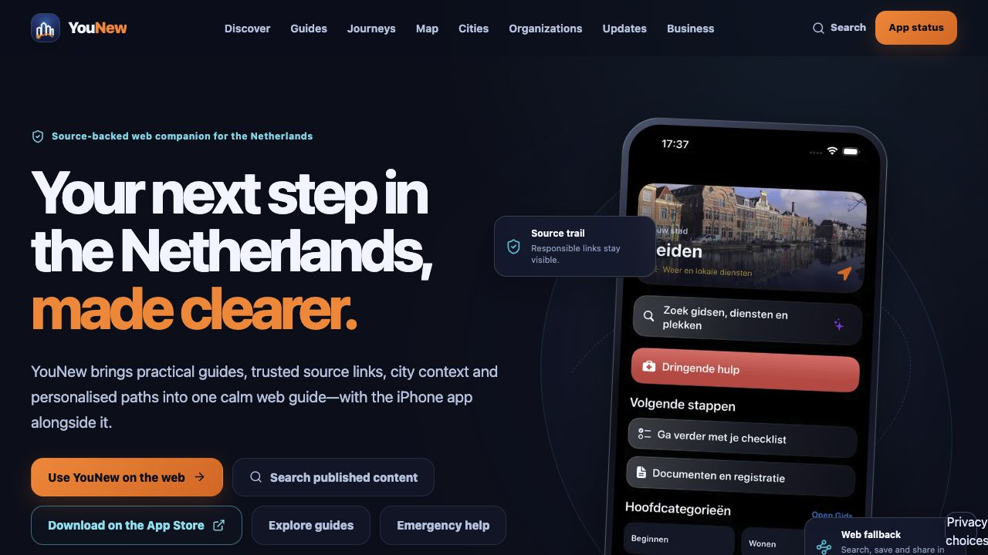
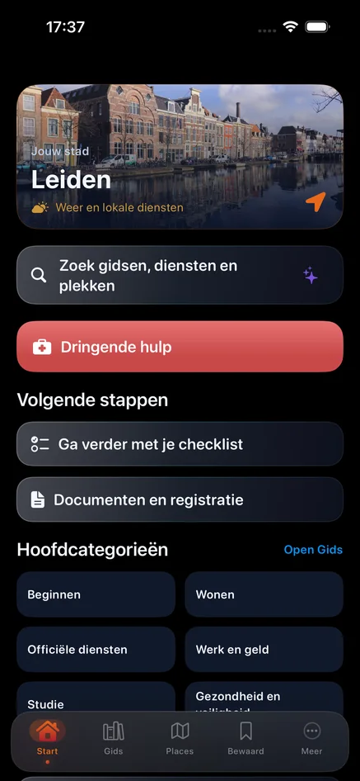
PRODUCT SHOWCASE · RELEASE CANDIDATE
YouNew
A working ecosystem
for a clearer start.
iOS · Web · Admin · Supabase · AI · Workspace
LIVE WEB · PUBLIC APP · AUTHENTICATED ADMIN
YouNew · Product ecosystem
01 / 05
Notes:
[Sources]
- https://younew.nl/ — live screenshot captured 2026-07-30.
- /Users/ivan/Desktop/Developer:YouNew/YouNew/release-artifacts/presentation-2026-07-30/assets/web-home.png

Slide 2
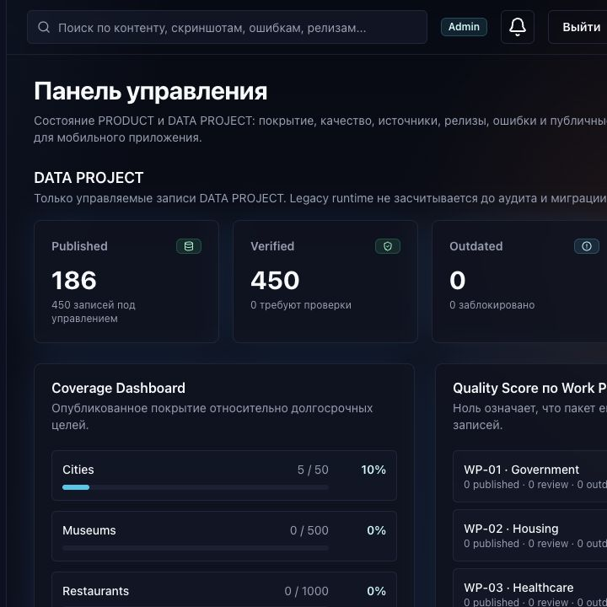
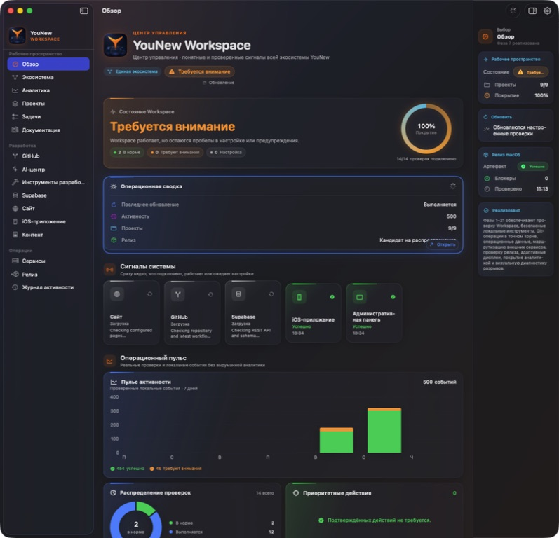
ONE CONNECTED PRODUCT
Every surface serves
the same system.
iOS
One identity · one governed data model · one release path
YouNew · Product ecosystem
02 / 05
Notes:
[Sources]
- /Users/ivan/Desktop/Developer:YouNew/YouNew/release-artifacts/presentation-2026-07-30/assets/app-home-nl.png
- /Users/ivan/Desktop/Developer:YouNew/YouNew/release-artifacts/presentation-2026-07-30/assets/web-home.png
- /Users/ivan/Desktop/Developer:YouNew/YouNew/release-artifacts/presentation-2026-07-30/assets/admin-dashboard.png
- /Users/ivan/Desktop/Developer:YouNew/YouNew/release-artifacts/presentation-2026-07-30/assets/workspace-overview.png

Slide 3
LIVE PRODUCT · VERIFIED EVIDENCE
Quality is visible
in the numbers.
585
575
186
106
static routes
indexable URLs
published records
passing web / admin / AI tests
LIVE SMOKE TEST: PASS · PREDEPLOY: PASS
YouNew · Product ecosystem
03 / 05
Notes:
[Sources]
- /Users/ivan/Desktop/Developer:YouNew/YouNew/release-artifacts/sale-readiness-2026-07-30/verification-summary.json
- 106 = 83 public web tests + 10 Admin tests + 13 backend AI proxy tests.

Slide 4
SYSTEM ARCHITECTURE
How YouNew works —
end to end.
GitHub + CI · YouNew Workspace
Admin
content · quality · review · release
Supabase
Postgres · RLS · Edge Functions · AI context
Public Web + iOS
discover · guides · map · search · save · source verification
Privacy-safe analytics + feedback return to Admin
YouNew · Product ecosystem
04 / 05
Notes:
[Sources]
- /Users/ivan/Desktop/Developer:YouNew/YouNew/docs/SYSTEM_MAP.md
- /Users/ivan/Desktop/Developer:YouNew/YouNew/docs/COMPLIANCE_CONTROL_MATRIX.md

Slide 5
RELEASE POSTURE
Operational today.
Evidence before claims.
7.8
Already proven
✓ Live public web
✓ Public App Store listing
✓ Authenticated Admin
✓ Healthy Supabase runtime
✓ Successful unsigned Release build
technical readiness
out of 10
Final release gates
• Clean source SHA + green CI
• Signed archive + runnable iOS tests
• Encrypted backup + isolated restore
• Authenticated Admin E2E
• Flagship guides production-ready
Next milestone: flagship practical guides + clean release identity
YouNew · Product ecosystem
05 / 05
Notes:
[Sources]
- /Users/ivan/Desktop/Developer:YouNew/YouNew/release-artifacts/sale-readiness-2026-07-30/verification-summary.json
- /Users/ivan/Desktop/Developer:YouNew/YouNew/RELEASE_READINESS_2026-07-30.md

