Slide 1
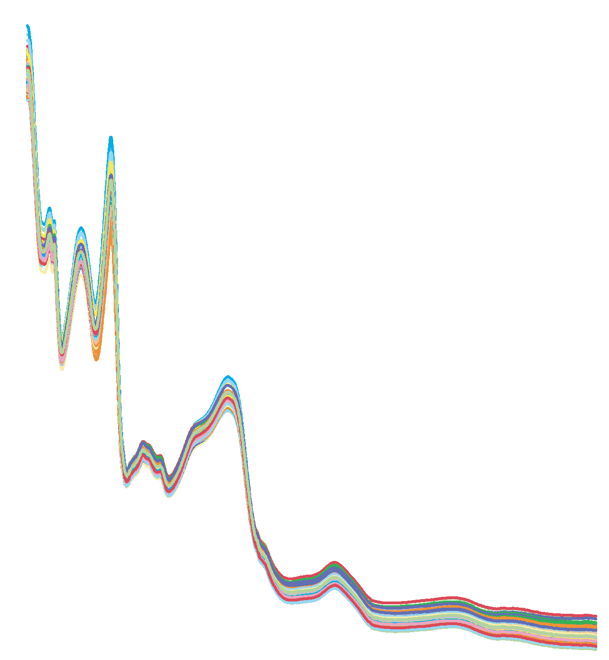
RiceQuant-NIR
Result display
Rice variety
Amylose Content
Protein Content
Input Data

Slide 2
RiceQuant-NIR
Result display
Amylose Content
Protein Content
Input Data

Slide 3
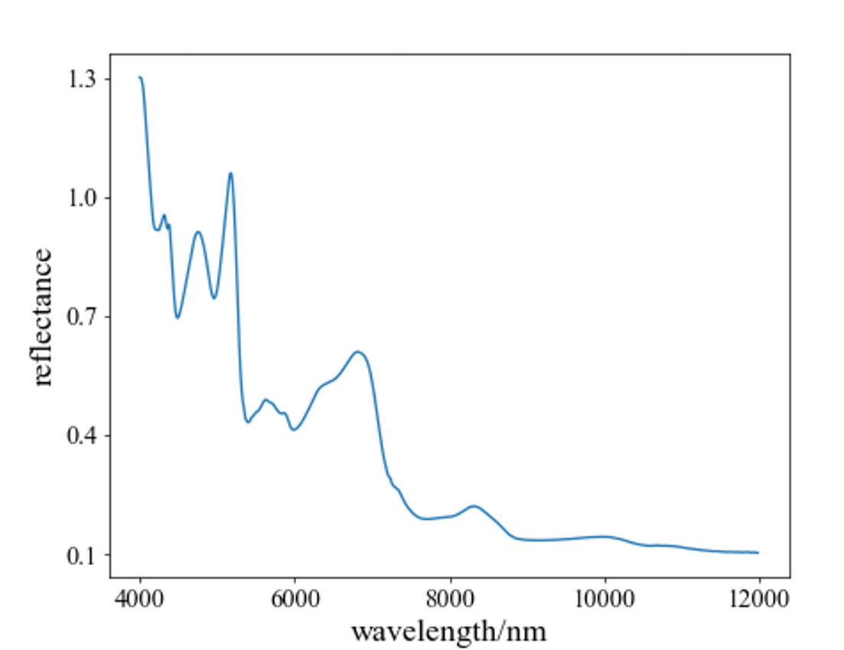
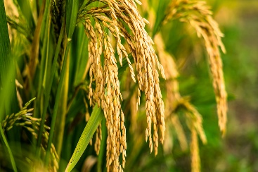
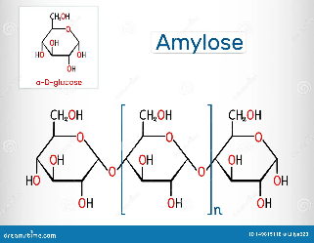
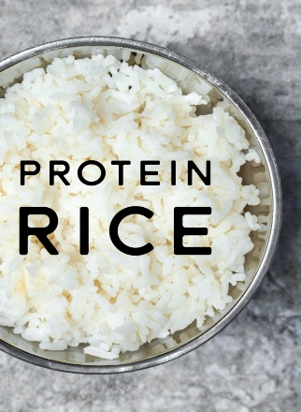
RiceQuant-NIR
Rice variety
Geng 粳稻
Japonica
Amylose Content
Protein Content
Spectral Data

Slide 4
Back
RiceQuant-NIR
Amylose Content
Protein Content
Spectral Data

Slide 5
RiceQuant-NIR
Prediction indicators
Amylose Content
Protein Content

