Slide 1

A Local-Ratio-Based Power Control Approach for Capacitated Access Points in Mobile Edge Computing
Qinghui Zhang, Weidong Li, Qian Su, Xuejie Zhang*
Yunnan University
zhangqinghui@mail.ynu.edu.cn, {weidong, suqian, xjzhang}@ynu.edu.cn

Slide 2
01
Background
02
Our Approach
03
Experiments
04
Conclusion

Slide 3
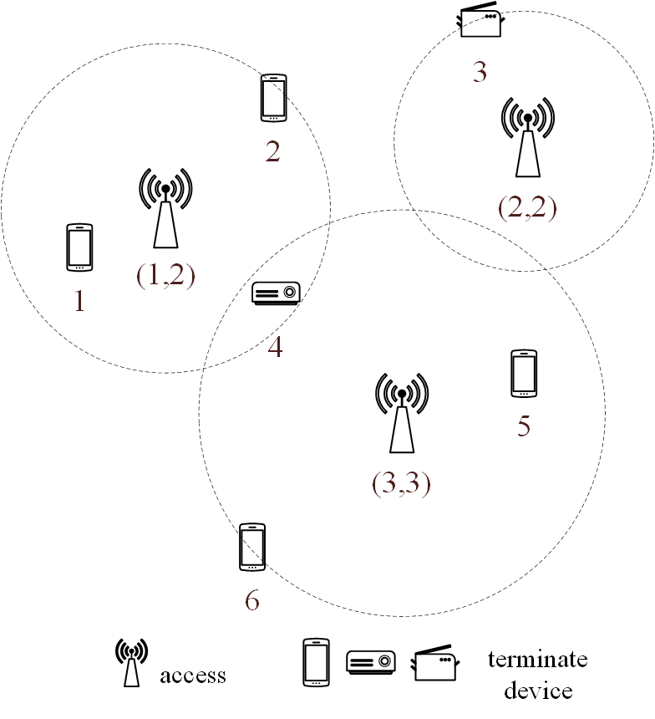
Background
With the rapid development of beyond 5G/6G and the Internet of Things, increasing number of terminal devices (TD) are being deployed at the edge of networks.
A TD usually establishes network connection with edge server through its access point (AP).
Larger signal coverage disk needs more power

Slide 4
Background
Task: Determine the power assignment in MEC such that APs with limited capacity can cover all TDs and minimize the total power. We define this problem as the minimum power capacitated cover (MPCC) problem.
Challenges: MPCC is a fundamental minimum power coverage (MPC) problem. It’s challenging to solve optimally even without capacity constraints.

Slide 5
Related Work
Different power control method for different wireless networks:
Cellular Network
Sum Spectral Efficiency (SE), Maximize system sum-rate
Wireless Sensor Network
Lowest transmission power to respect quality requirements
Set Cover
MPPC
Minimum power partial cover
SC
set cover
MWSC
minimum weight set cover
MPC
minimum power cover
MPCC
minimum power capacitated cover

Slide 6
Motivation
Power control for wireless signal transmission, considering the limited resources of edge servers, is a considerable research topic.
The minimum power cover problem has rarely been considered for capacity constraints.

Slide 7
Our Contribution
MPCC and Resource Allocation Model
Local-Ratio-Based Algorithm
Performance Evaluation

Slide 8
01
Background
02
Our Approach
03
Experiments
04
Conclusion

Slide 9
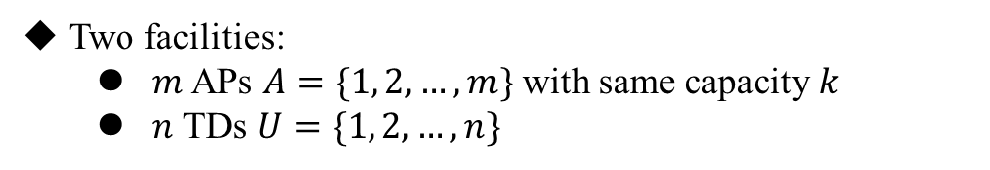
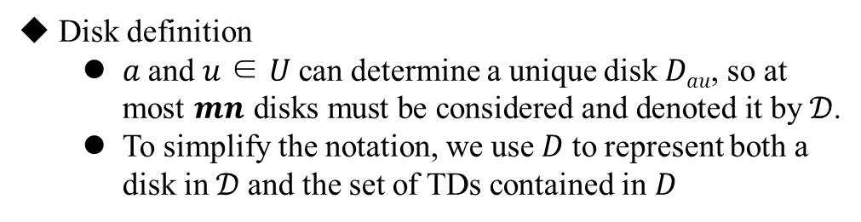

System Model
Two facilities:
$m$ APs $A=\{1, 2, …, m\}$with same capacity $k$
$n$ TDs $U=\{1, 2, …, n\}$
Power formula
$$p\left(a\right)=c∙{r\left(a\right)}^{α}, aεA$$
Disk definition
𝑎 and 𝑢 ∈ 𝑈 can determine a unique disk 𝐷_{𝑎𝑢}, so at most $mn$ disks must be considered and denoted it by 𝒟.
To simplify the notation, we use 𝐷 to represent both a disk in 𝒟 and the set of TDs contained in $D$
2

Slide 10
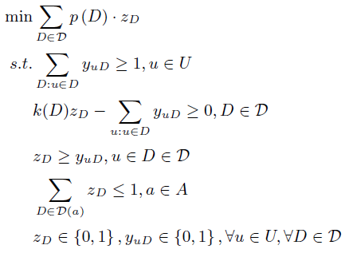
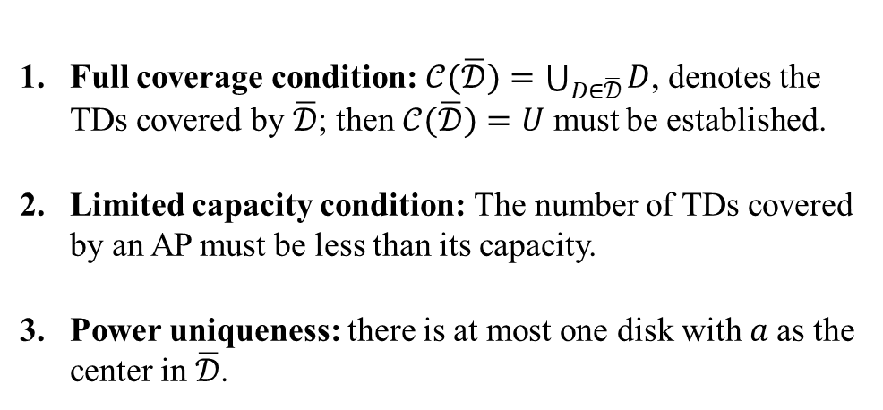
Integer Program
For a subset $\overline{𝒟}$ of 𝒟, $\overline{𝒟}$ is a feasible solution to the MPCC problem and must meet the following conditions:
Full coverage condition: $𝒞(\overline{𝒟})=\bigcup_{D∈\overline{𝒟}}{D}$, denotes the TDs covered by $\overline{𝒟}$; then $𝒞(\overline{𝒟})=U$ must be established.
Limited capacity condition: The number of TDs covered by an AP must be less than its capacity.
Power uniqueness: there is at most one disk with 𝑎 as the center in $\overline{𝒟}$.

Slide 11
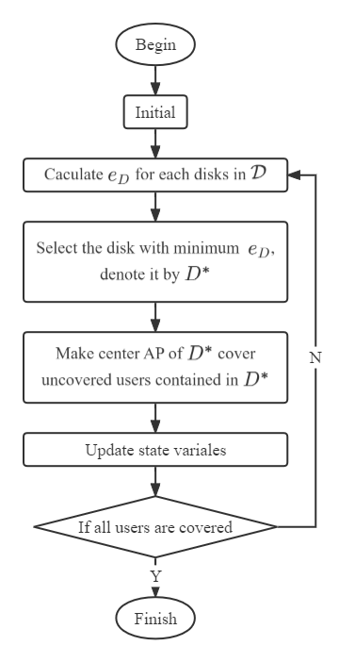


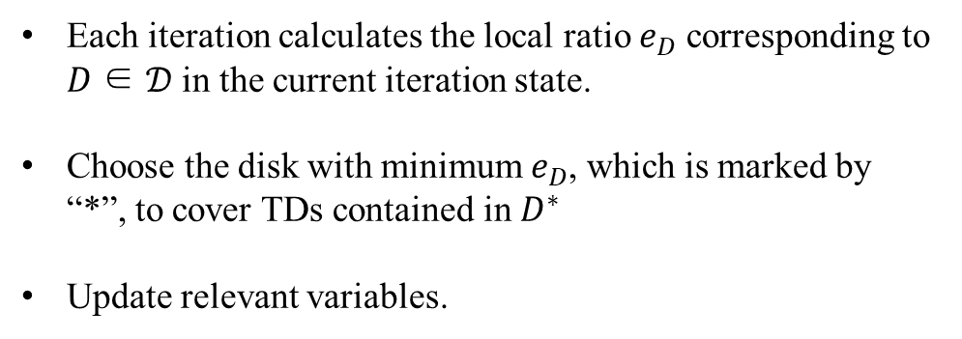
Minimum Local Ratio (MLR) Algorithm
Local Ratio:
$e_{D}$ = ${\hat{p}}_{D}$/ min(${\hat{k}}_{D}$, $d_{D}$), ∀𝐷 ∈ 𝒟.
Each iteration calculates the local ratio $e_{D}$ corresponding to 𝐷 ∈ 𝒟 in the current iteration state.
Choose the disk with minimum $e_{D}$, which is marked by “*”, to cover TDs contained in $D^{∗}$
Update relevant variables.
${\hat{p}}_{D}$ ← ${\hat{p}}_{D}$− $e_{D∗}$ min(${\hat{k}}_{D}$, $d_{D}$), ∀𝐷 ∈ 𝒟.

Slide 12
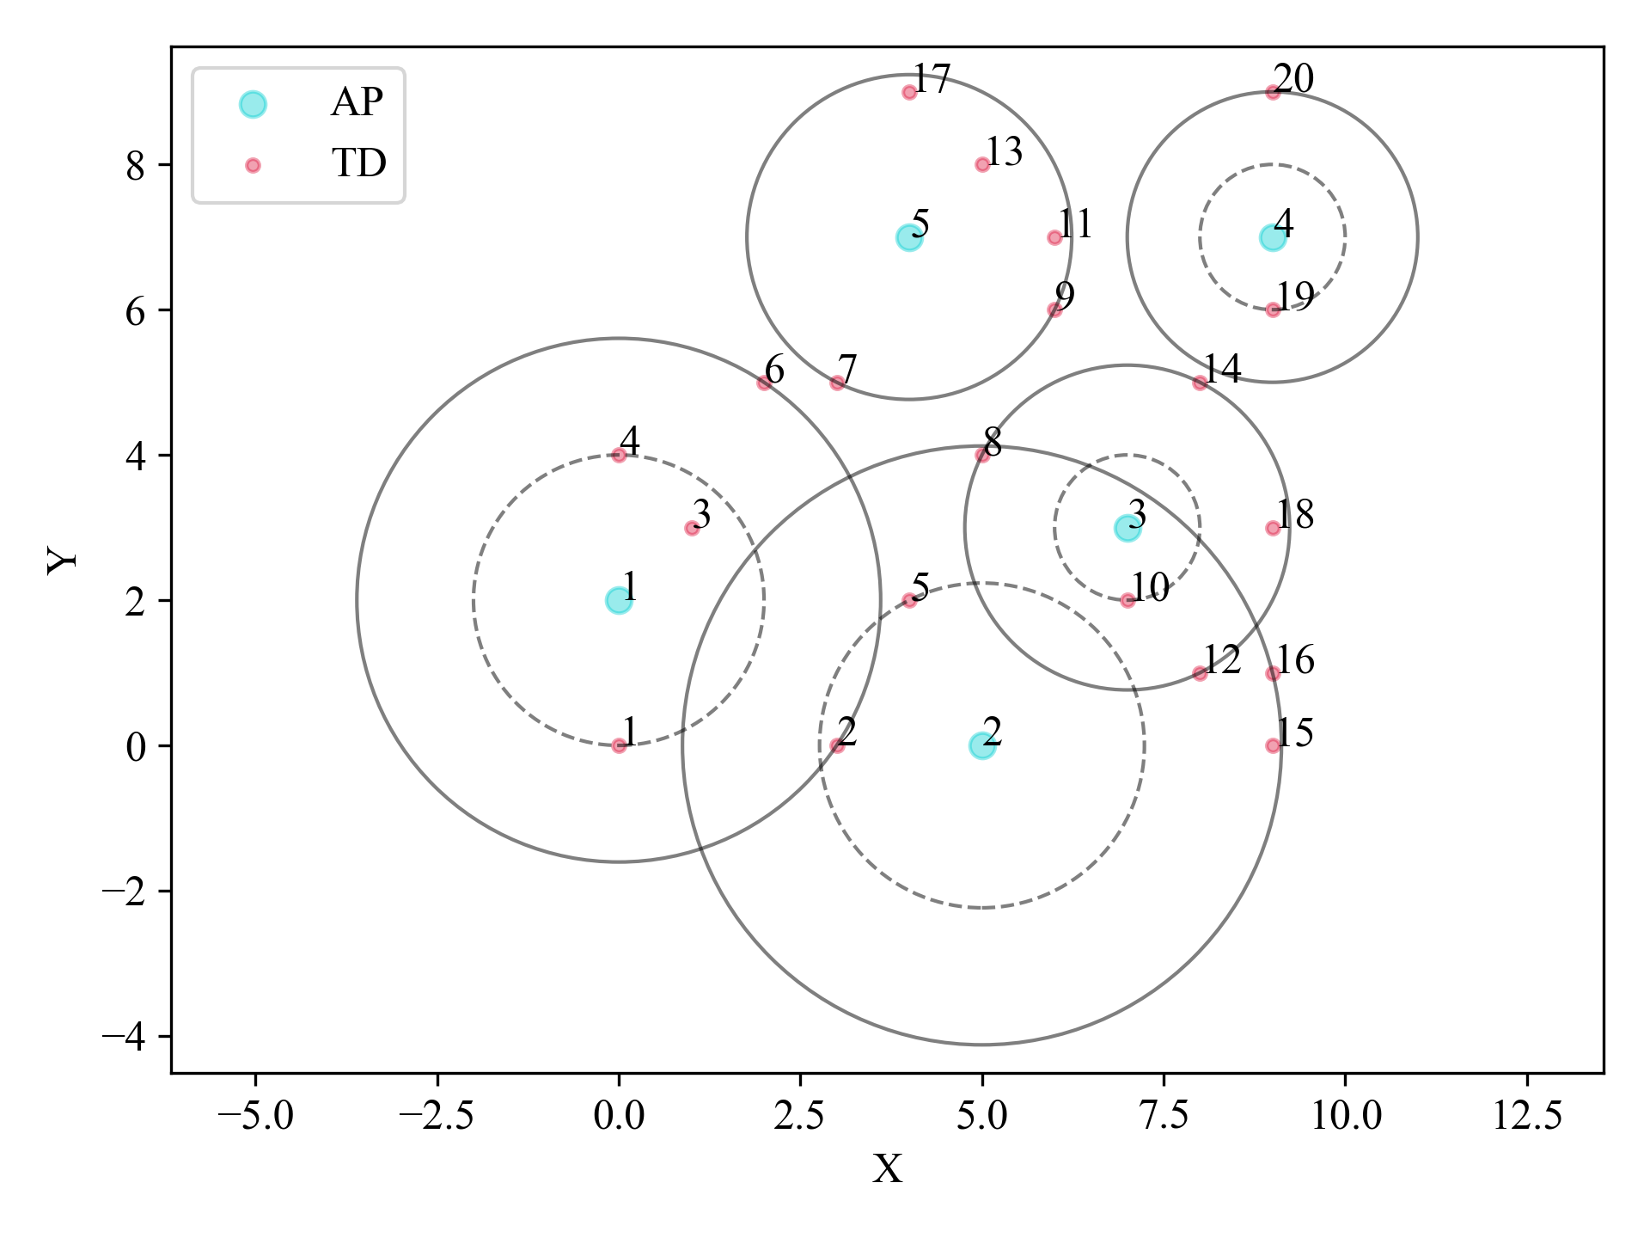
An Instance
𝑈 = {1, 2, ..., 20}, 𝐴 = {1, 2, 3, 4, 5} and 𝑘 = 5.

Slide 13
01
Background
02
Our Approach
03
Experiments
04
Conclusion

Slide 14
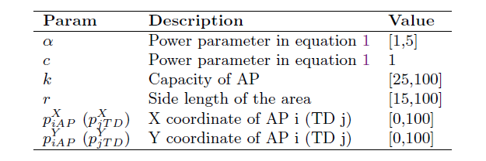
Experiment
Specific experimental settings
Two comparison methods
NCA (nearest capable access)
OPT (optimal solution)

Slide 15
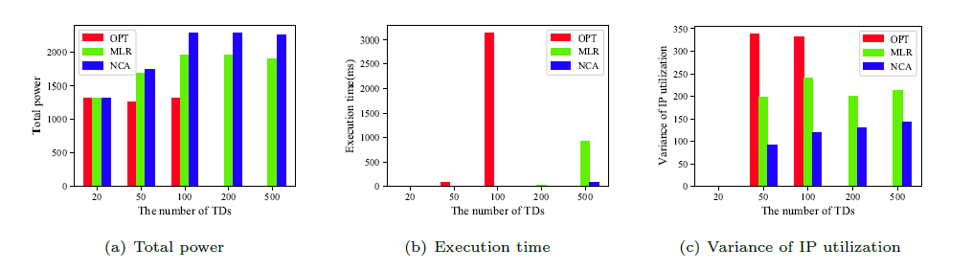
Experiment
Impact of the Number of TDs
The number of TDs gradually increases from 20 to 500, and all facilities are distributed in an area with a side length of 40. The ratio between the number of TDs and APs is maintained at 25:1, and the capacity of each AP is 𝑘 = 40. For the two constants in equation (1), the values are 𝑐 = 1 and 𝛼 = 2.
More power efficiency
Acceptable execution time
More harmonious assignment

Slide 16
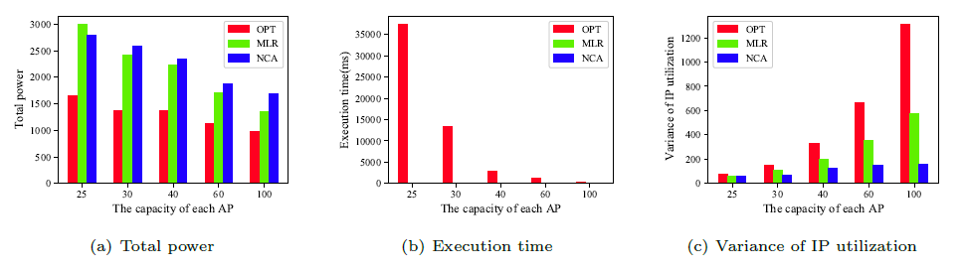

Experiment
Impact of 𝑘
𝑚 = 4 and 𝑛 = 100, side length is 40, $k=\{25, 30,40,60,100\}$
Benefits from increasing $k$.

Slide 17
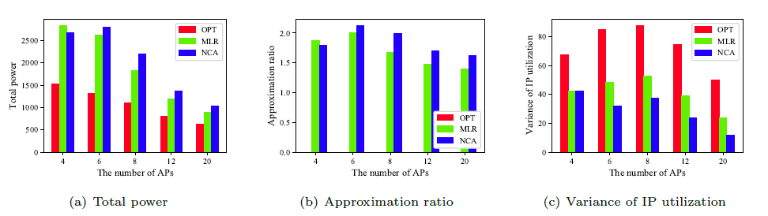
Experiment
Impact of the number of APs with 𝑘 = 25
𝑚 = 4 and $k$ = 100, side length is 40, $m=\{4, 6,8,12,20\}$
More APs, lower power requirements

Slide 18
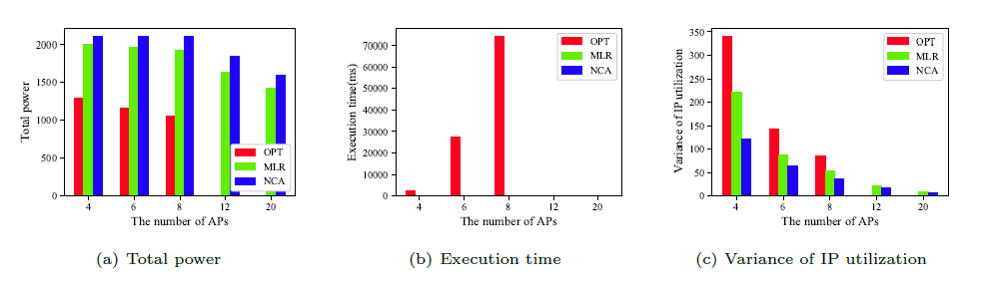
Experiment
Impact of the number of APs with 𝐾 = 160
$n =100$and $K$ = 160, side length is 40, $m=\{4, 6,8,12,20\}$
More APs, lower power requiements

Slide 19
01
Background
02
Our Approach
03
Experiments
04
Conclusion

Slide 20
Conclusion
Contribution
We consider the signal coverage process in edge networks as a minimum power coverage problem and define this problem as an MPCC problem.
Modeling this problem in MEC.
We propose a local-ratio-based approach to solve the MPCC problem.
Future works
Another approach to solve MPCC problem.
Considering heterogeneous APs and TDs’ natural number requirements (not just 1)

Slide 21
Thank you for listening!

Slide 22
Thank you for listening!

