Slide 1
Title slide + image
Invited Lecture – CPSS (China), Hitachi Energy, University of Nottingham
The Evolution of EV Charging and Its Impact on the Grid
Dr. Zian Qin
Associate Professor
Delft University of Technology, Netherlands

Slide 2
This work is part of the research outcomes from the project ECS4DRES
ECS4DRES is supported by the Chips Joint Undertaking under grant agreement number 101139790 and its members, including the top-up funding by Germany, Italy, Slovakia, Spain and The Netherlands.

Slide 3
Power conversion
Duties of DC/DC
To control charging current
To ensure high efficiency even the battery voltage varies a lot
Duties of AC/DC
To ensure low harmonics
To ensure high power factor
Grid support (advanced)
@Kempower
Source: Z Qin, et al, Innovative electric vehicle charging infrastructure for european transportation electrification: megawatt charging hubs with battery energy storage and solid-state transformers for medium-voltage
grid integration, IEM, 2025

Slide 4
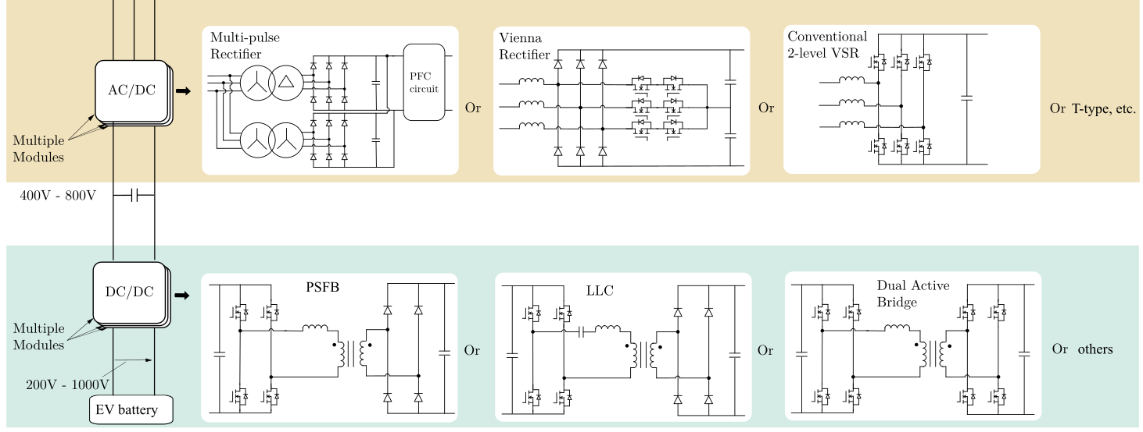
Power electronics topologies
Low cost
Unidirectional
Medium cost
Unidirectional with limited Q power controllability
High cost
Bidirectional (V2G enabled)
High controllability
ZVS, difficult in lagging leg
high conduction loss
Unidirectional
ZVS
low conduction loss
Unidirectional
Narrow voltage range
ZVS
high conduction loss
Bidirectional (V2G enabled)
Simple bidirectional power control
Source: L Wang, et al., “Grid Impact of Electric Vehicle Fast Charging Stations: Trends, Standards, Issues and Mitigation Measures-An Overview”, IEEE-OJPE, 2021

Slide 5
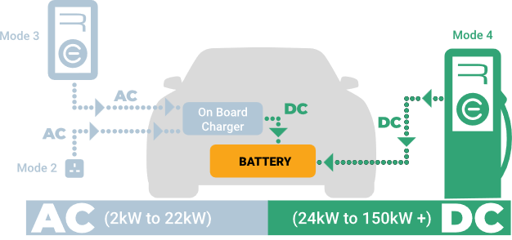

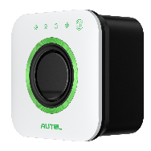
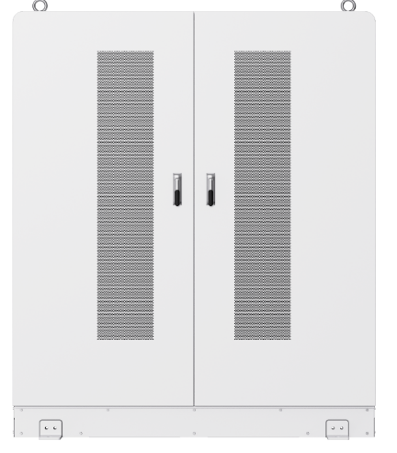
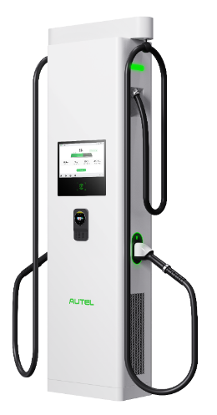
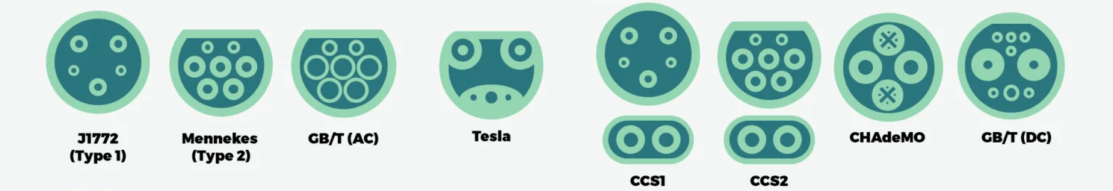
AC vs DC chargers
Residential AC charger
Commercial AC charger
NA
JP
EU
&
rest MKT
CN
NA
EU
&
rest MKT
JP
CN
DC fast charger
@Autel
@Replenishh
Source: Z Qin, et al., “Electric vehicle charging technology and its control”, Control of Power Electronic Converters and Systems V4, Academic Press, 241-307, 2024

Slide 6
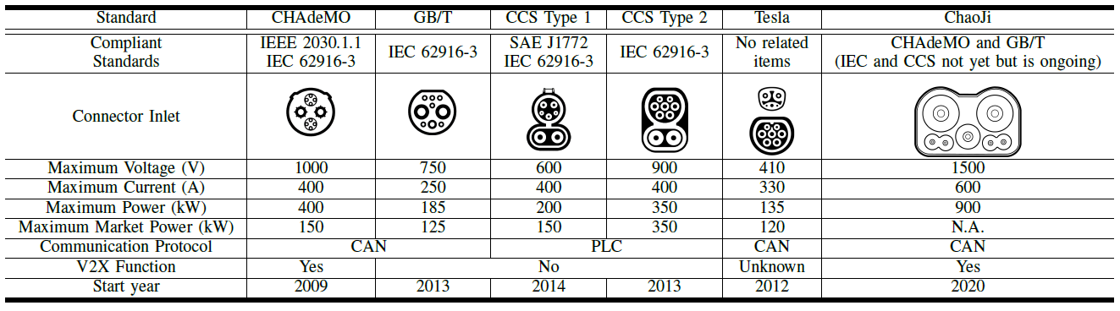
Charger plugs
Source: Netherlands Enterprise Agency, The Electric vehicle charging – Definitions and explanations, version January 2019

Slide 7
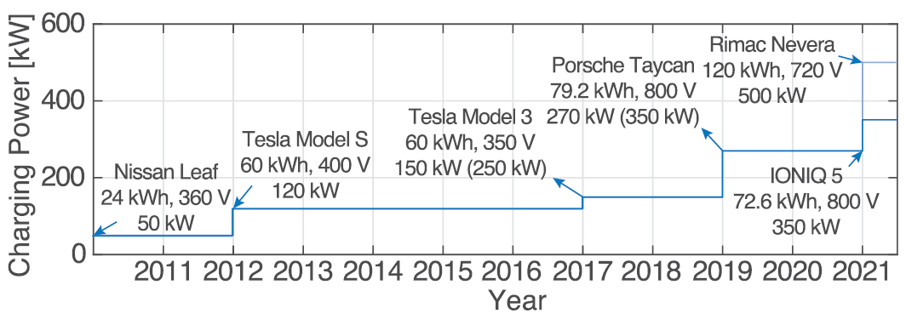

Charging power is increasing
[1]
Normally, 20 kWh per 100 km
Around 1.8 MW charging power!!!
Source: [1] Rivera et al., Charging Infrastructure and Grid Integration for Electromobility, Proceedings of IEEE, 2023

Slide 8

Battery voltage is increasing
EVs with 800V batteries are increasing in numbers. Chargers that can cover 300V~900V will have a good market
900V
full
Porsche: Taycan
Tesla: Cyber truck
Kia: EV6, EV9
Hyundai: IONIQ 5/6
BYD: ATTO 3, Dolphin, etc.
XPeng: G9
etc.
EV with 800 V battery
600V
empty
emerging
500V
full
EV with 400 V battery
300V
mainstream
empty

Slide 9
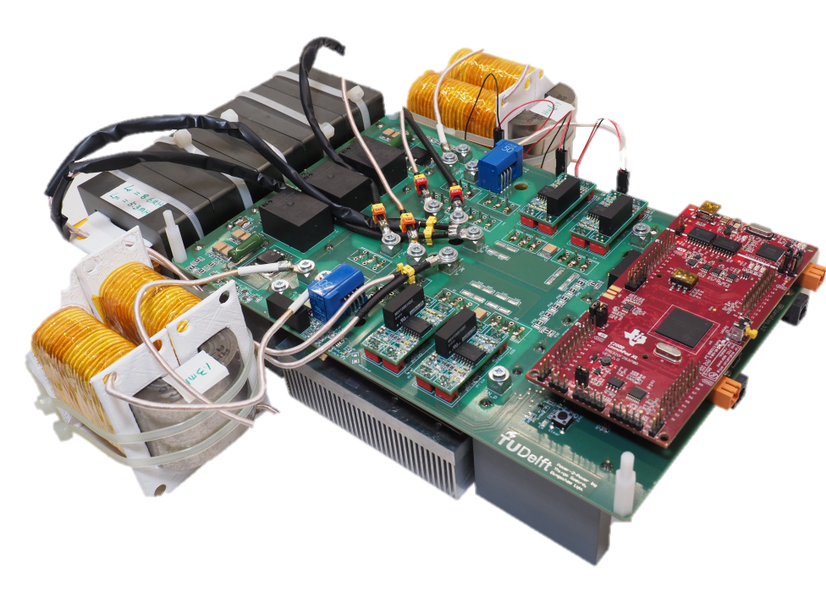
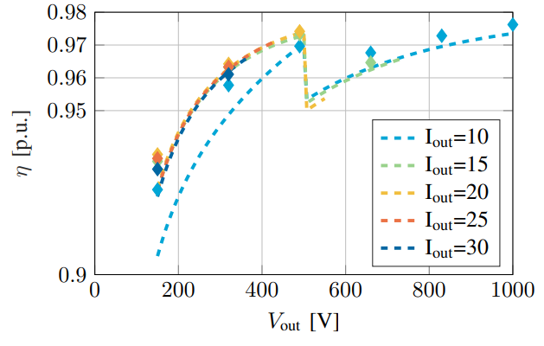
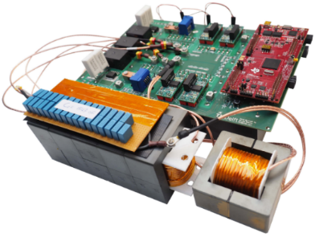
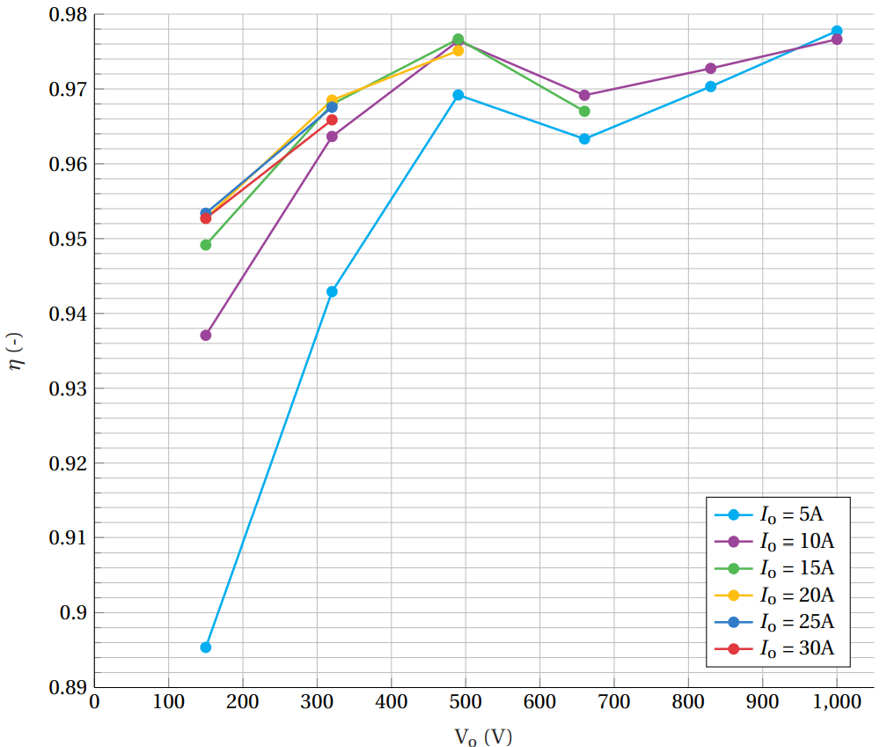
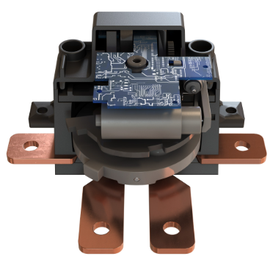
Reconfigurable topology
Switching between parallel and series to maintain a steady operation condition of each port
10 kW FSFB module
640-840V V_{in}
200-1000 V_{out}
30A I_{out(max)}
10 kW LLC module
640-840V V_{in}
200-1000 V_{out}
30A I_{out(max)}
@Eaton BCS
Source: D Lyv, et al., “Design and Implementation of a Re-configurable Phase-Shift Full-Bridge Converter for Wide Voltage Range EV Charging Application,” TTE, 2022

Slide 10
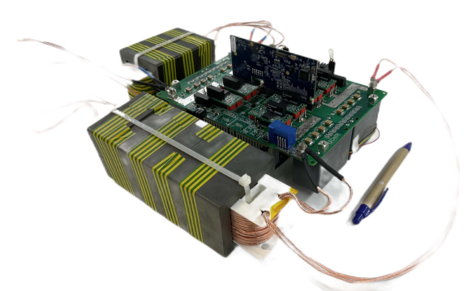
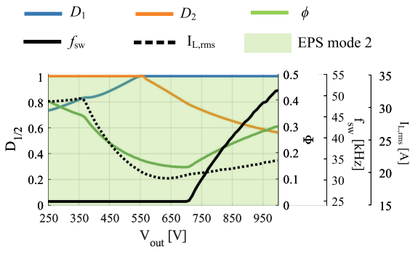
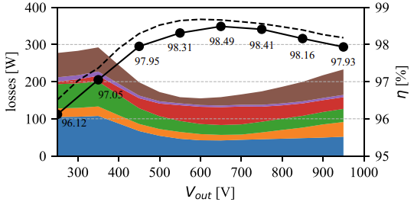
Hybrid operation mode
Hybrid modulation strategies and variable switching frequency
Maximize the ZVS region and minimize switching loss
11 kW DAB module
Source: D Lyv, et al., “ZVS-Optimized Constant and Variable Switching Frequency Modulation Schemes for Dual Active Bridge Converters,” IEEE OJPEL, 2023

Slide 11
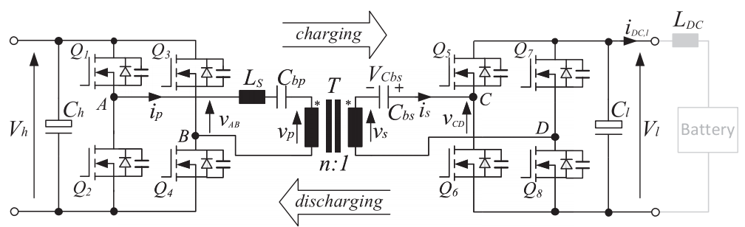
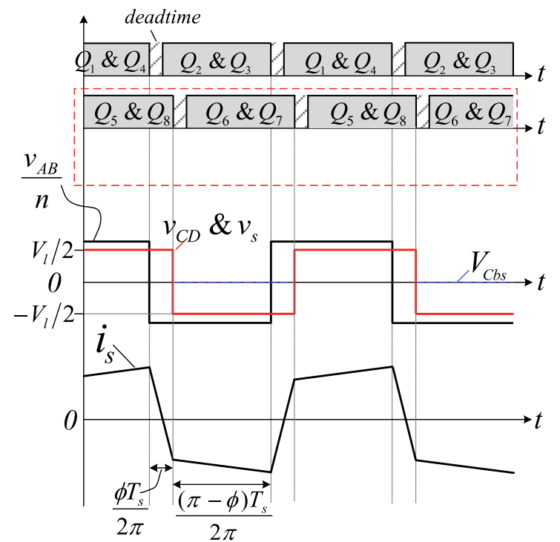
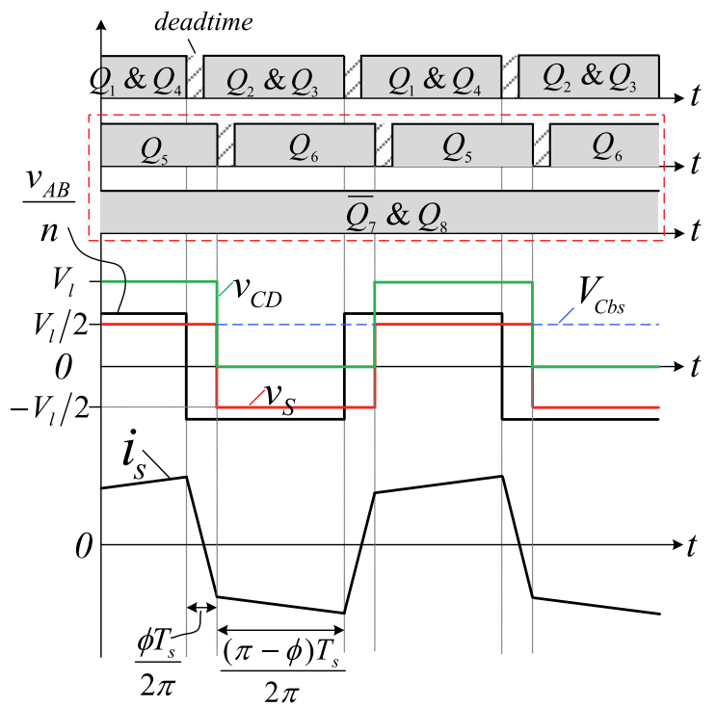
Hybrid operation mode
DC blocking capacitor voltage control
Operation switching between the full and half-bridge mode
Change hard-switching to soft-switching
Reduce core loss
@ low V_{batt}, full bridge mode, V_{cbs} = 0
@ high V_{batt}, half bridge mode, V_{cbs} = V_{batt}/2
Source: Z Qin, et al., “A Dual Active Bridge Converter With an Extended High-Efficiency Range by DC Blocking Capacitor Voltage Control,” IEEE TPEL, 2018

Slide 12
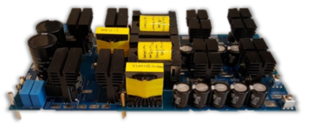
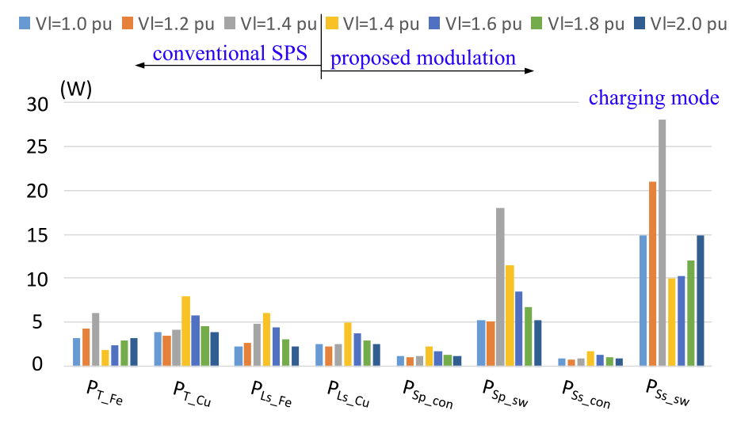
Hybrid operation mode
DC blocking capacitor voltage control
Operation switching between the full and half-bridge mode
Change hard-switching to soft-switching
Reduce core loss
5 kW DAB module
Full bridge mode
Half bridge mode
0.95
Efficiency
0.90
0.85
0.5
1
V_{l} (p.u.)
Full bridge mode
Half bridge mode
Loss breakdown
Source: Z Qin, et al., “A Dual Active Bridge Converter With an Extended High-Efficiency Range by DC Blocking Capacitor Voltage Control,” IEEE TPEL, 2018

Slide 13



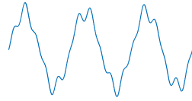
Power Quality Issues
EV charging is associated with power quality issues, especially flickers and supraharmonics
(Inter/Supra)
Harmonics [2]
PLC interfered [3]
Joints age faster
f
Higher RCD tripping current [4]
Flickers [1]
Source:
[1] https://teslamotorsclub.com/tmc/threads/lights-in-house-flicker-while-charging-new-model-3.149841/
[2] T Slangen, V Ćuk, S Cobben, “Summation of supraharmonic currents (2–150 kHz) from EV fast charging stations,” Electric Power Systems Research 220, 2023
[3] L Hasselgren, G Mademlis, Å Lindbeck, et. al. “Inverter Interference on Charging Communication System during 400 V DC Charging of Vehicle,” EMC Europe, 2022
[4] T Slangen, B Lustenhouwer, JFG S Cobben, et. al. “The Effects of High-Frequency Residual Currents on the Operation of Residual Current Devices,” in the Proc. Of ICREPQ 2021

Slide 14
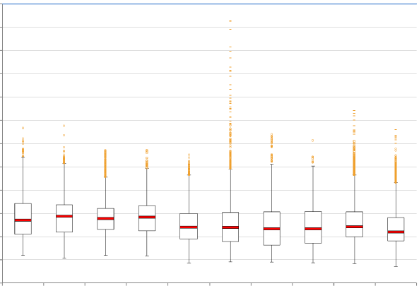
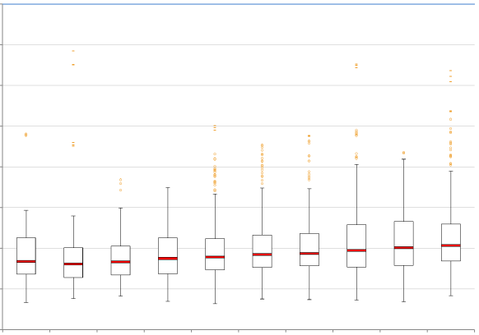
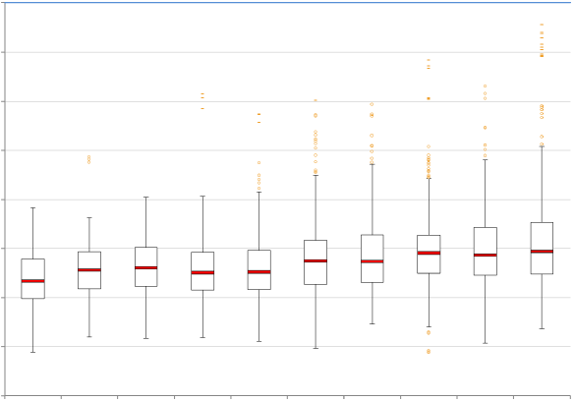
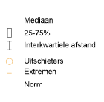
Power Quality Issues
Harmonics are reducing in high voltage grids, and increasing in low and medium voltage grids
Harmonics
LF range
Conducted RF range
50Hz
2/2.5kHz
9kHz
150kHz
30MHz
60Hz
2.4/3kHz
Regulated range
Not fully regulated range
HS: ≥35kV, ≤150kV
MS (>1kV, <35kV)
LS (≤1kV)
5%
Jaartal THD 95% (2011~2020)
[1]
Source: [1] Spanningskwaliteit in Nederland - Resultaten 2020

Slide 15




Gray box impedance modelling
White box modelling needs the hardware and control parameters as input, but usually unavailable
Black box modelling doesn’t need the parameters, but cannot cover the whole operation range
Gray box modelling has advantages of both of them
Grid Emulator
$$\hat{v}$$
Charger
$$\hat{i}$$
Black box modelling
$$z= \frac{\hat{v}}{\hat{i}}$$
parameters x
F(x)
$$z$$
White box modelling
Measured Z
Gray box modelling [1]
F₀(x)
F₁(x)
...
F_{k}(x)
…
F_{k}(x) with updated x
F_{k}(x)
-
+
YES
F_{k}(x) is the extracted analytical model
Loss
<E_{TH}?
Iterative optimization
NO
A model library
YES
Step 1: make a good guess of the model
Step 2: extract the parameter values
x updating
N_{Epoch}<N_{max}?
k=k+1
NO
Source: [1] L Wang, et. al. “A gradient-descent optimization assisted gray-box impedance modeling of ev chargers,” TPEL, 2023

Slide 16
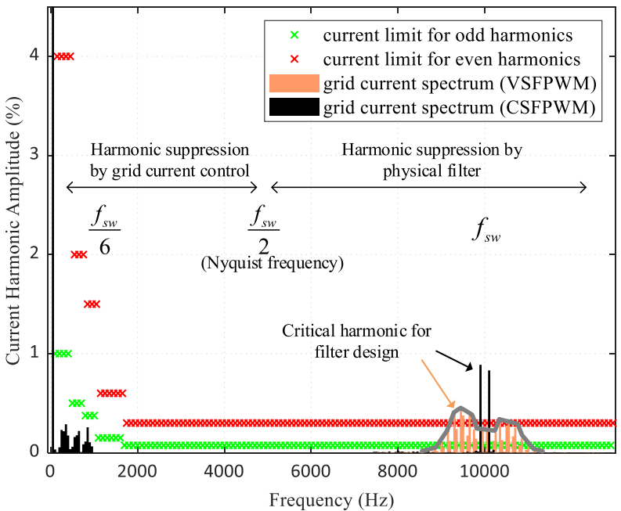
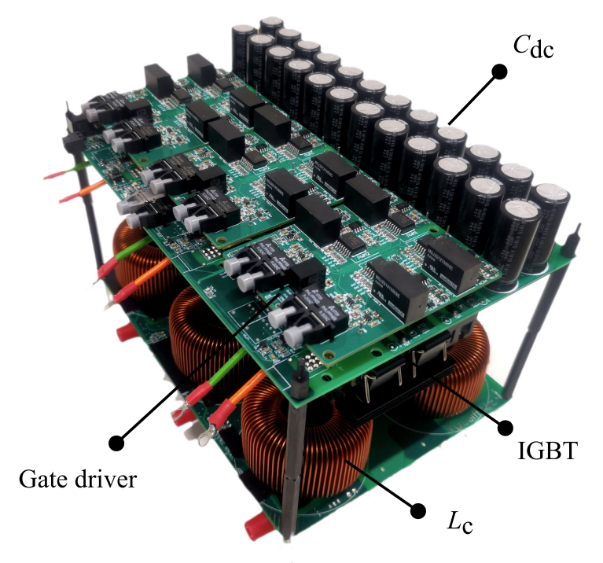
Supraharmonics mitigation
Fixed switching frequency creates harmonics with high peak
Variable switching frequency will spread out the harmonics.
THD is still the same
10 kW rectifier module
Peak efficiency 98.6%
IEEE-519 harmonic current standard and typical grid current harmonic spectrum with CSFPWM and VSFPWM.
Source: Y Wu, et. al. “Frequency Design of Three-phase Active Front-End Converter with Reduced Filter in EV Chargers,” TTE, 2024

Slide 17
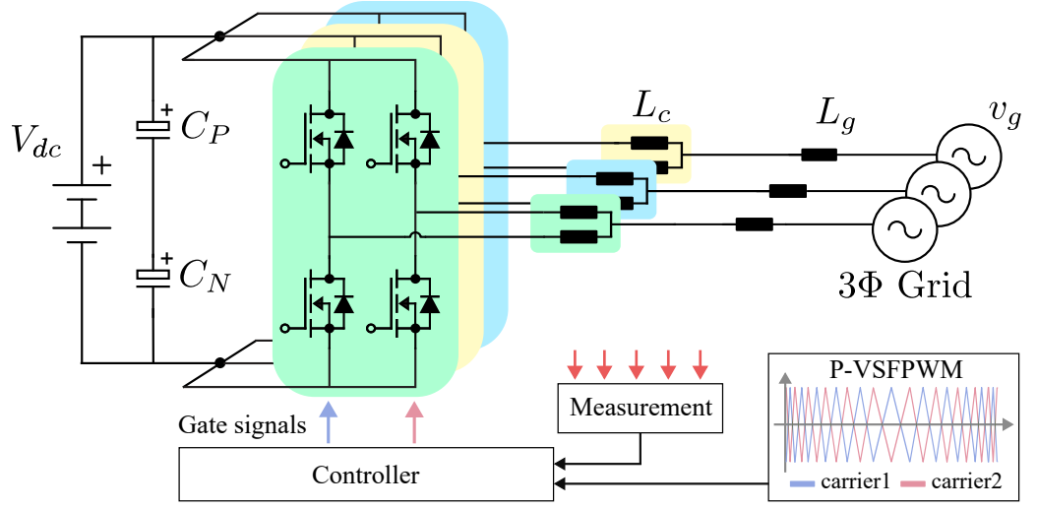
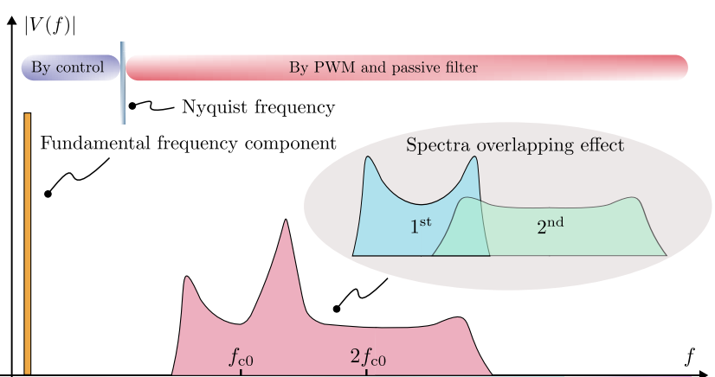
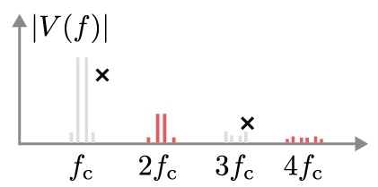
Supraharmonics mitigation
Fixed switching frequency creates harmonics with high peak
Variable switching frequency will spread out the harmonics.
THD is still the same
The spead out of the harmonics may have overlap with each other and create peak again
Interleaving will solve the problem
Source: Y Wu, et. al. “Frequency Design of Three-phase Active Front-End Converter with Reduced Filter in EV Chargers,” TTE, 2024

Slide 18
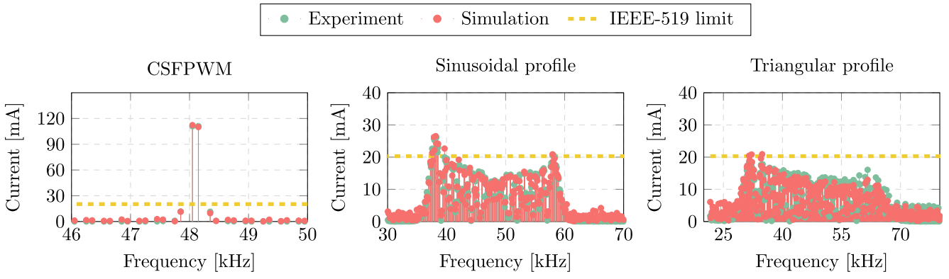
Supraharmonics mitigation
Fixed switching frequency creates harmonics with high peak
Variable switching frequency will spread out the harmonics.
THD is still the same
Triangle profile
Sinusoidal profile
Source: Y Wu, et. al. “Frequency Design of Three-phase Active Front-End Converter with Reduced Filter in EV Chargers,” TTE, 2024

Slide 19
More challenges to grids

Slide 20
Ten-T
By 2025, < 60 km interval, > 150 kW charger
By 2030, < 100 km interval, > 350 kW charger
By 2030, most maritime ports should offer shore power
Trans-European Transport Network (TEN-T)
Source: European Commission, DG MOVE, TENtec Information System, based on Reg. 2024/1679

Slide 21
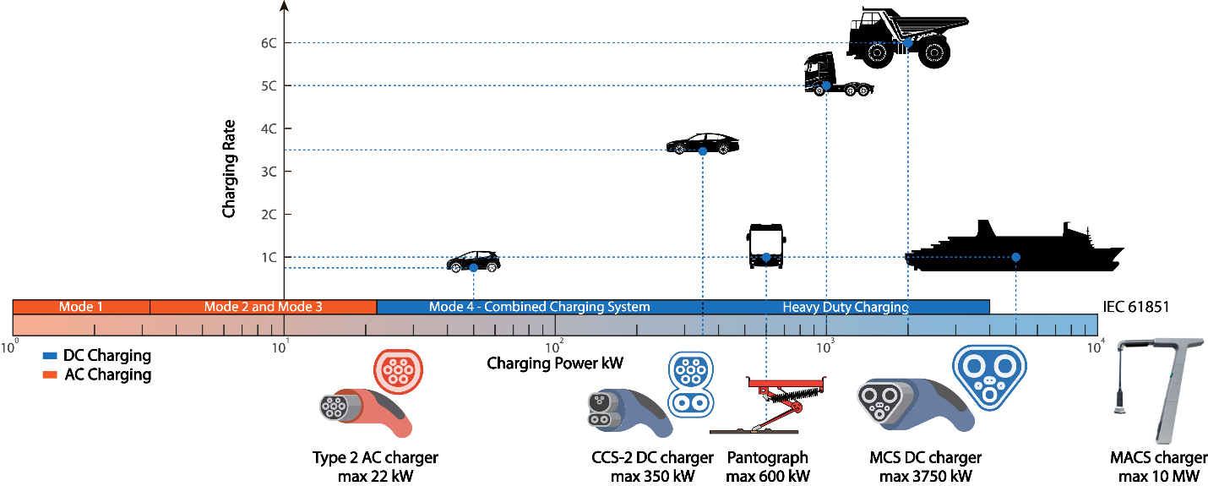
Mega watt charging
Source: Z Qin, et al, Innovative electric vehicle charging infrastructure for european transportation electrification: megawatt charging hubs with battery energy storage and solid-state transformers for medium-voltage
grid integration, MELE, 2025

Slide 22
Grid congestion
Source: Netbeheer Nederland
In Netherlands, any user larger than 60 kW needs to wait around 7 years to get a new grid connection

Slide 23
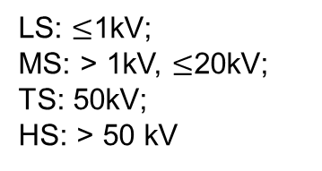
Grid fee
Connection capacity | One-off connection fee (€) | Annual fee to maintain the connection (€)
> 175 kVA to 630 kVA via LS measurement | 34002 | 1455
> 630 kVA to 1000 kVA via LS measurement | 36000
> 1000 kVA to 1750 kVA via MS measurement | 58000
> 1750 kVA to 5000 kVA | 330000 | 3642
LS: $≤$1kV;
MS: > 1kV, $≤$20kV;
TS: 50kV;
HS: > 50 kV
Contracted transport capacity | Transportation service
 | Fixed charge | Variable tariff
 | Transport per month (€) | kW contract per month per kW (€) | Double tariff per kWh (€) | Reactive power consumption per kVARh (€)
151 to 1500 kW | 36.75 | 2.0250 | 0.0198 | 0.017
> 1500 kW | 230 | 1.8958 | 0.0198 | 0.017
When connected to grid, you pay not only per kWh, but also per kW
You pay more with higher peak grid power, even with fixed average grid power
Source: published data from Stedin – A DSO in Netherlands. The data is for year 2025

Slide 24
Mega watt charging
Total charging load: 3.5 MW
W/O BESS: grid connection 3.5 MW
With BESS: grid connection 1 MW, battery 2.5 MW / 2.5 MWh
Battery service life 11.2 years
13 %
Grid fee keeps increasing
Battery cost keeps decreasing
18 %
7 %
Source: A Ahmad, et. al. “Techno-economic analysis of energy storage systems integrated with ultra-fast charging stations: A dutch case study,” eTransportation, 2025
Z Qin, et al, Innovative electric vehicle charging infrastructure for european transportation electrification: megawatt charging hubs with battery energy storage and solid-state transformers for medium-voltage
grid integration, MELE, 2025

Slide 25
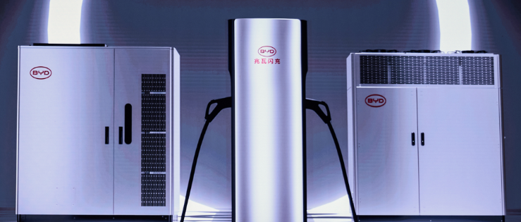


Pilot projects/products
6 Chargers x 320 kW
Grid maximum power 200 kW
2.45 MWh used battery
24 charges per day around 800 kWh
Source: BYD, Super e-Platform
Source: Audi charging hub

Slide 26
How to control the bess
BESS in grid following control
When grid connection has a capacity much lower than the charging hub capacity, charging load change can induce significant grid voltage variation. Grid voltage forming control will be necessary

Slide 27
How to control the bess
BESS in grid forming control
When X/R is low, the voltage will be significantly influenced by both active and reactive power. The grid forming control needs to be adapted

Slide 28
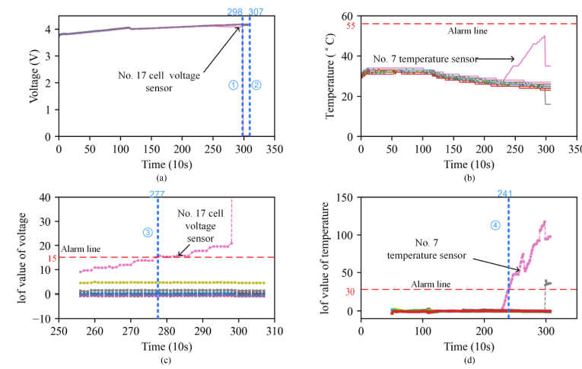
Battery fault detection
LOF value helps identify the problematic cell
Source: Z Sun, et. al, An Online Data-Driven Fault Diagnosis and Thermal Runaway Early Warning for Electric Vehicle Batteries, TPEL, 2022

Slide 29
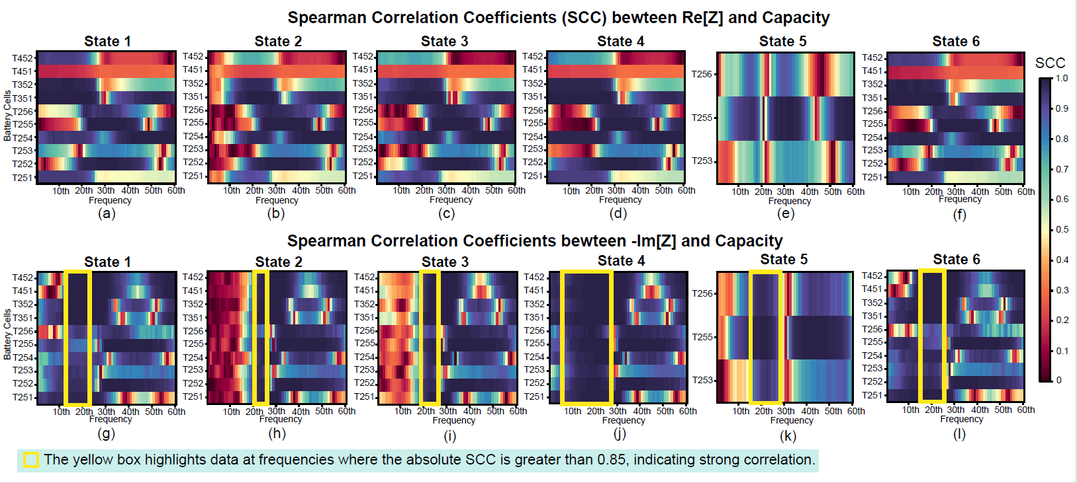
EIS based approach for SOH estimation
Source: R. Liu, et. al, “A Transformer-Enhanced Framework for Lithium-ion Battery Capacity Estimation Using Limited Imaginary Impedance Feature”, Journal of Energy Storage, 2025

Slide 30
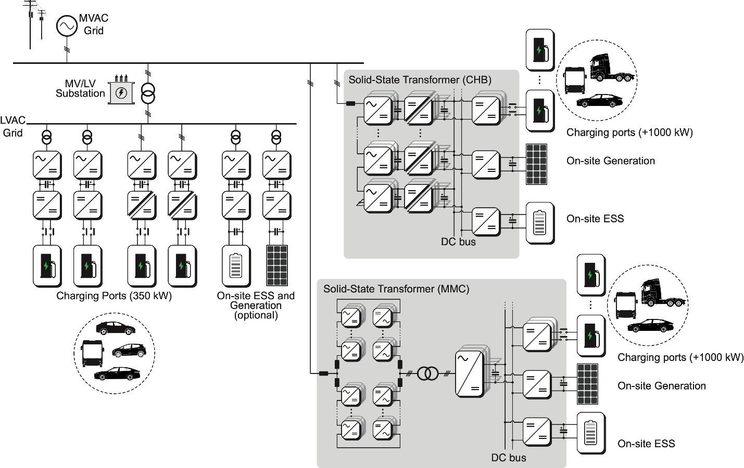
Medium voltage grid integration
Source: Z Qin, et al, Innovative electric vehicle charging infrastructure for european transportation electrification: megawatt charging hubs with battery energy storage and solid-state transformers for medium-voltage
grid integration, MELE, 2025

Slide 31
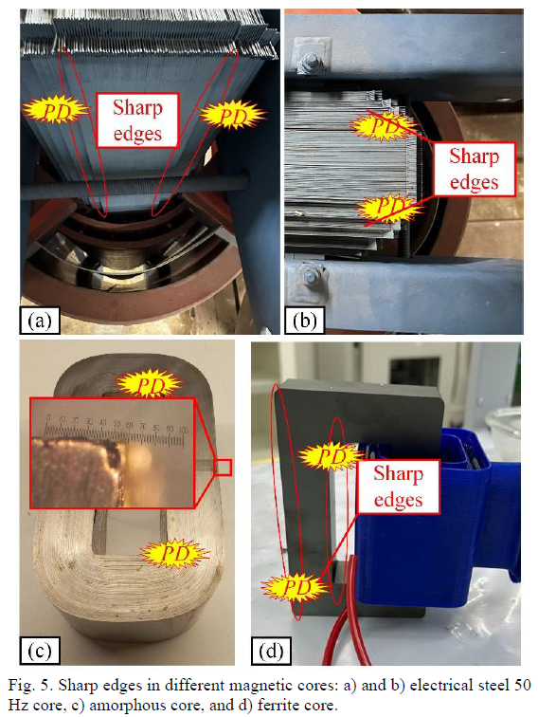
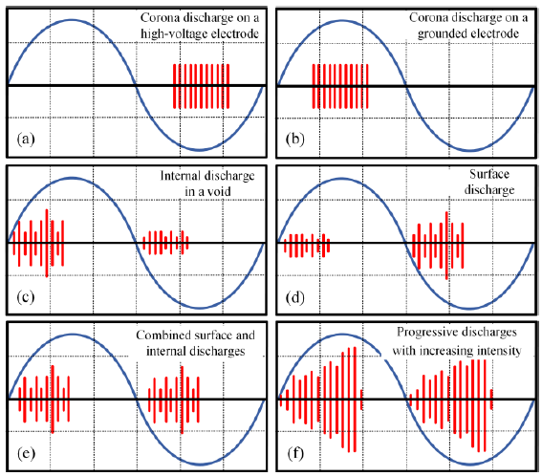
Partially discharge
Source: Reza Mirzadarani, et. Al., Partial Discharge Mitigation of Medium-Voltage, Medium-Frequency Dry-Type Transformers Using Semiconductive Screening, OJPEL, 2026

Slide 32
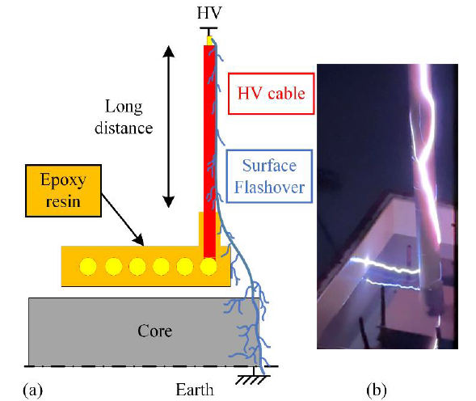
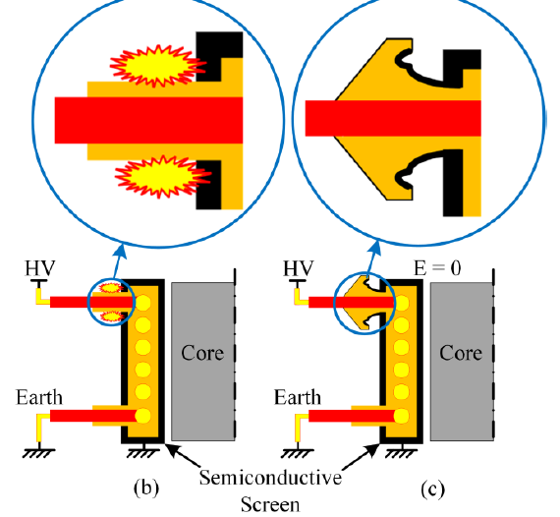
Surface flash over long distance
Source: Reza Mirzadarani, et. Al., Partial Discharge Mitigation of Medium-Voltage, Medium-Frequency Dry-Type Transformers Using Semiconductive Screening, OJPEL, 2026

Slide 33
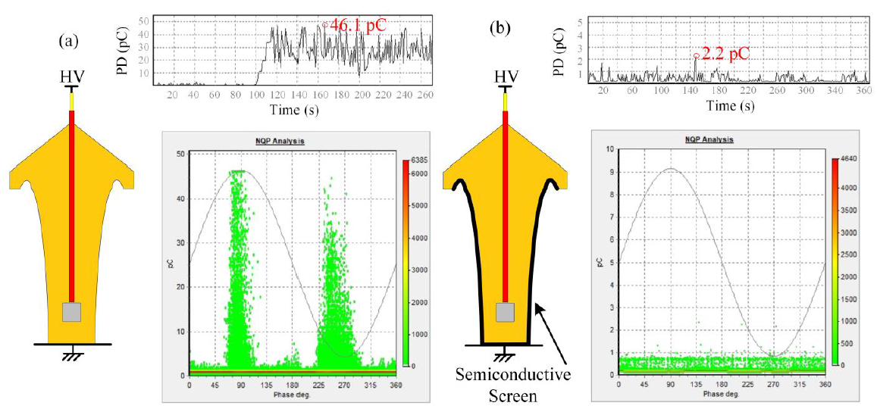
Proposed stress cone and semicon screening
Source: Reza Mirzadarani, et. Al., Partial Discharge Mitigation of Medium-Voltage, Medium-Frequency Dry-Type Transformers Using Semiconductive Screening, OJPEL, 2026

Slide 34
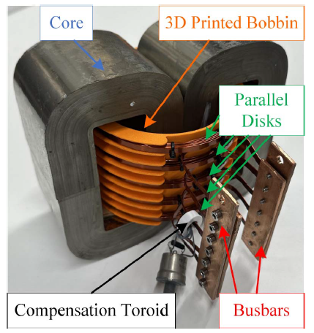
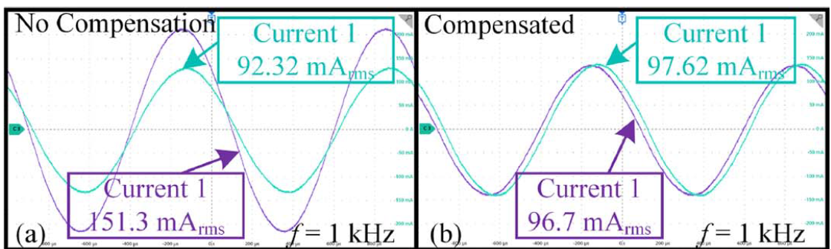
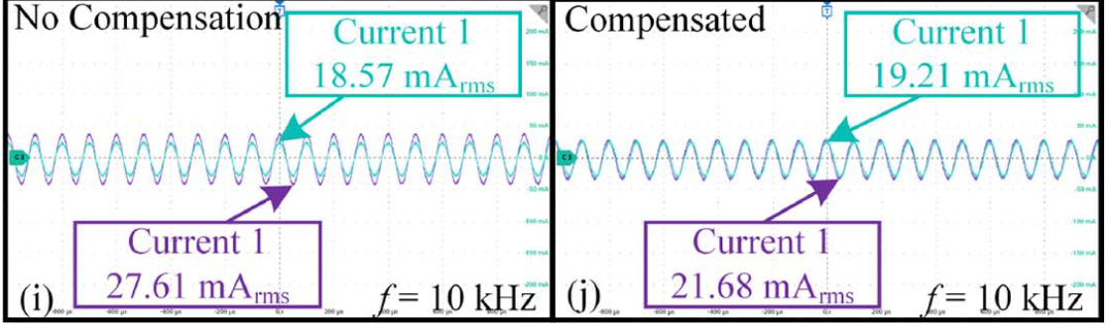
Parallel disk winding and proposed solution
Source: R Mirzadarani, et. Al., Current Balancing Technique for the High-Current Windings of Medium-Frequency Transformers, TIE, early access

Slide 35
Key takeaways
Transportation electrification is rapidly developing, and charging power has reached the megawatt level.
Grid is getting congested, and the charging load is making the situation worse. To further improve the level of transportation electrification, this issue must first be resolved.
Charging loads are characterized by high peak power and low average power. Integrating battery energy storage into charging hubs can effectively ease grid congestion and reduce grid connection costs.
However, lithium batteries still face issues such as large errors in state monitoring and difficulty in extinguishing fires once they start. High-precision battery management systems that can accurately estimate battery state and predict battery failures are urgently in need of technological breakthroughs.
With DC bus-based charging hubs, solid-state transformers can demonstrate greater advantages. Meanwhile, as the energy sector undergoes electrification, the rising cost of raw materials for traditional transformers and increasingly longer lead time are creating favorable conditions for the adoption of solid-state transformers. Insulator design and partially discharge are the remaining challenges in medium voltage power electronics.

Slide 36
For further reading
Z. Qin, S. Rivera, H. Yu, et al, Innovative EV Charging Infrastructure for European Transportation Electrification: MW charging hubs with battery energy storage and solid-state transformers for medium voltage grid integration, IEEE Electrification Magazine, vol. 13, no. 3, pp. 6-16, 2025
Z. Qin, T.B. Soeiro, J. Dong, et al, Chapter 9-Electric vehicle charging technology and its control, Control of Power Electronic Converters and Systems, Editor: F. Blaabjerg, Academic Press, vol. 4, pp.241-307, 2024
L. Wang, Z. Qin, T. Slangen, et al, Grid Impact of Electric Vehicle Fast Charging Stations: Trends, Standards, Issues and Mitigation Measures - An Overview, IEEE Open J. of Power Electron., vol. 2, pp. 56-74, 2021.
L. Wang, Z. Qin, P. Bauer, A gradient-descent optimization assisted gray-box impedance modeling of EV chargers, IEEE Trans Power Electron 38 (7), 8866-8879, 2023
A. Ahmad, Z. Qin, T. Wijekoon, et al, An overview on medium voltage grid integration of ultra-fast charging stations: current status and future trends, IEEE Open Journal of the Industrial Electronics Society 3, 420-447, 2022
Z Li, R Mirzadarani, MG Niasar, et al, Medium-Voltage Solid-State Transformer Design for Large-Scale H2 Electrolyzers, IEEE Open Journal of Power Electronics 5, 936-955, 2024
R Mirzadarani, Z Li, Z Qin, et al., Partial Discharge Mitigation of Medium-Voltage, Medium-Frequency Dry-Type Transformers Using Semiconductive Screening, IEEE Open J. of Power Electron., early access
R Mirzadarani, Z Li, Z Qin, et al., Current Balancing Technique for the High-Current Windings of Medium-Frequency Transformers, IEEE Trans. Industrial Electronics, early access
A. Ahmad, J. Meyboom, P. Bauer, Z. Qin, Techno-economic analysis of energy storage systems integrated with ultra-fast charging stations: A Dutch case study, eTransportation 24, 100411, 2025.
R Liu, D Zhang, L Wang, CC Mi, P Bauer, Z Qin, A transformer-enhanced framework for lithium-ion battery capacity estimation using limited imaginary impedance feature, Journal of Energy Storage 122, 116313, 2025
D Zhang, Z Wang, P Liu, Q Wang, C She, P Bauer, Z Qin, Multistep Fast Charging-Based State of Health Estimation of Lithium-Ion Batteries, IEEE Trans Transportation Electrification. 10(3), pp. 4640-4652, 2024
Z Sun, Z Wang, P Liu, Z Qin, An Online Data-Driven Fault Diagnosis and Thermal Runaway Early Warning for Electric Vehicle Batteries, IEEE Trans Power Electron 37(10), pp. 12636-12646, 2022
N Gan, Z Sun, Z Zhang, S Xu, P Liu, Z Qin, Data-Driven Fault Diagnosis of Lithium-Ion Battery Overdischarge in Electric Vehicles, IEEE Trans Power Electron 37(4), pp. 4575-4588, 2022
Z Sun, Y Han, Z Wang, Y Chen, P Liu, Z Qin, et al, Detection of voltage fault in the battery system of electric vehicles using statistical analysis, Applied Energy 307, 118172, 2022

Slide 37
Acknowledgement goes to:
Dr. Lu Wang
Dr. Dingsihao Lyu
Dr. Yang Wu
Dr. Haoyuan Yu
Dr. Zhengzhao Li
Dr. Zhenyu Sun
Ms. Ruijun Liu
Mr. Adnan Ahmad
Mr. Reza Mirzadarani
Contact: z.qin-2@tudelft.nl
This work is part of the research outcomes from the project ECS4DRES
ECS4DRES is supported by the Chips Joint Undertaking under grant agreement number 101139790 and its members, including the top-up funding by Germany, Italy, Slovakia, Spain and The Netherlands.

