Slide 1


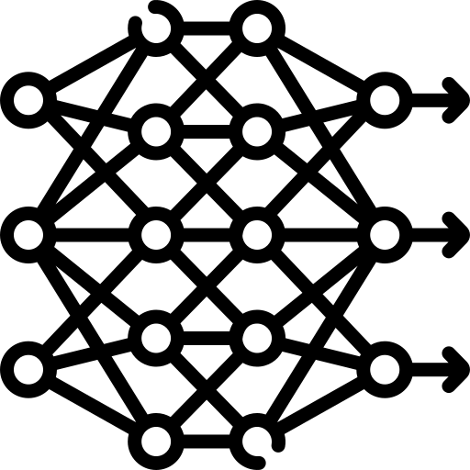






$$LPIPS=d( , )$$
$$Z_{1}$$
$$Z_{interp}$$
$$Generator$$
$$ϵ$$
$$Z_{2}$$

