Slide 1
GIT Introduction and Solo
Adrian Yuan- XVM683

Slide 2
Agenda
GIT Introduction
GIT history and usage in industry
GIT advantage and disadvantage
GIT VS ClearCase
GIT deployment status in MSI(2015/4/15)
GIT Solo
Basic concept in GIT
Installation and basic configuration
Top 10 commands for daily working

Slide 3
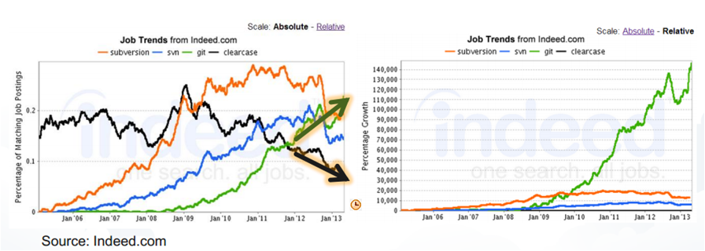
GIT Introduction
GIT -- The distributed version control system
GIT -- The most widely adopted version control system for software development
GIT -- Everything is local

Slide 4
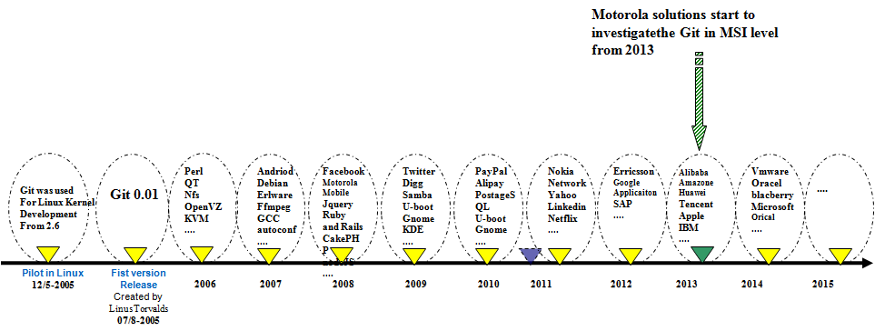
GIT history

Slide 5

GIT usage in industry

Slide 6
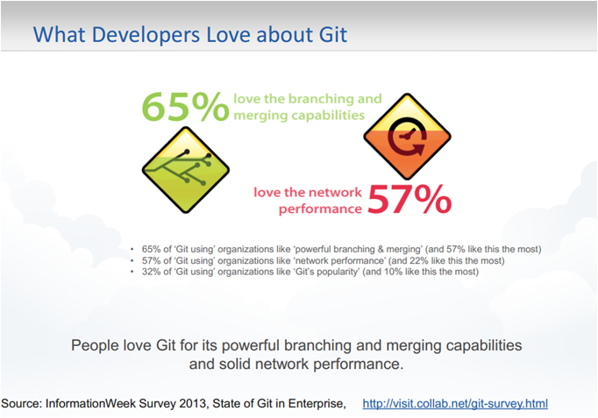

Slide 7
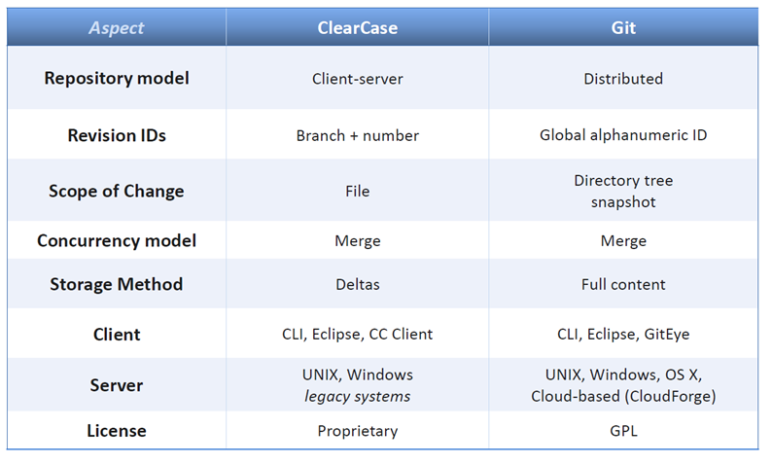
ClearCase VS GIT

Slide 8
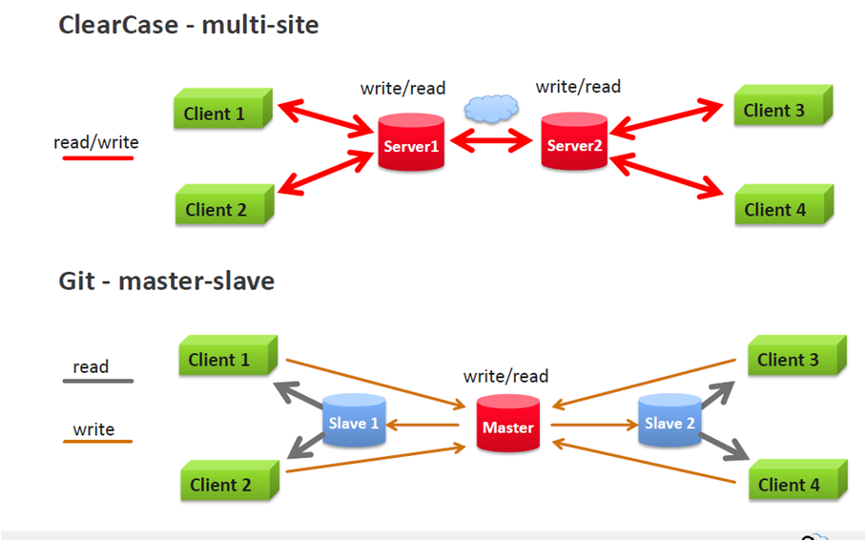

Slide 9
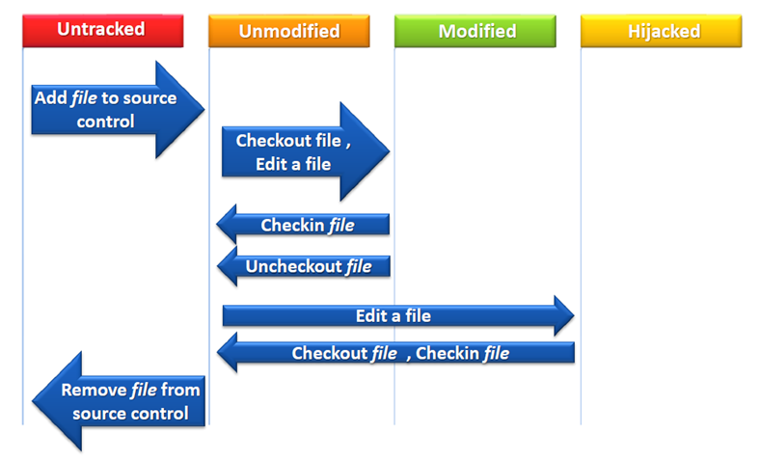
ClearCase handle files in VOB

Slide 10
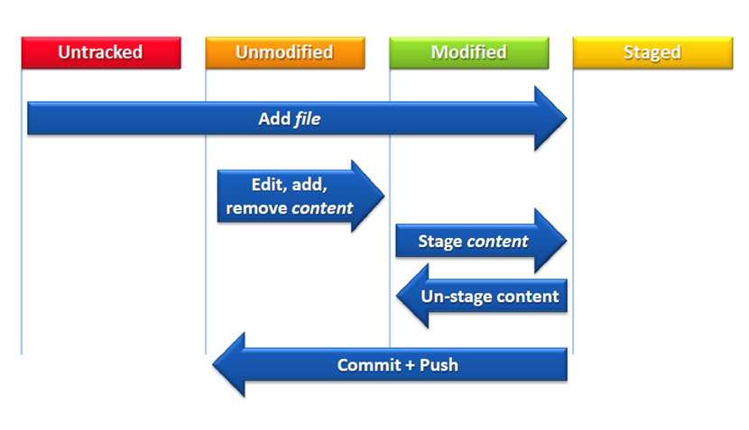
GIT handle files in Repository

Slide 11
MSI GIT deployment
Global tools team handle the Git deployment in MSI level.
Git as the open source VCS, are using for internal project version control.
Not any subscriber product line have been deployed Git
CDC SCM team take the task to learn Git and as the expert of Git in Global SCM team;
ASTRO have the draft plan to deploy GIT in product line from 7.17(starting)
TETRA transition from KRK to Asia. NO plan to migrate from manager team
PCR manager team are working for detail Plan.

Slide 12
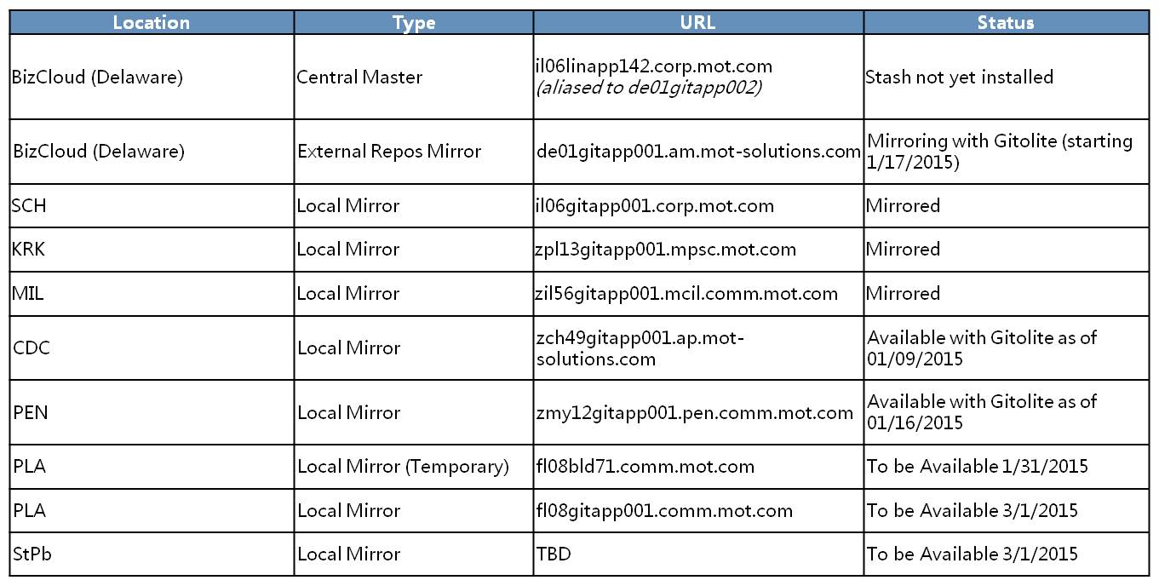
GIT mirrors in MSI
Git infrastructure center server will be setup in US, each site will setup the Mirror server for data sync. deployment group

Slide 13
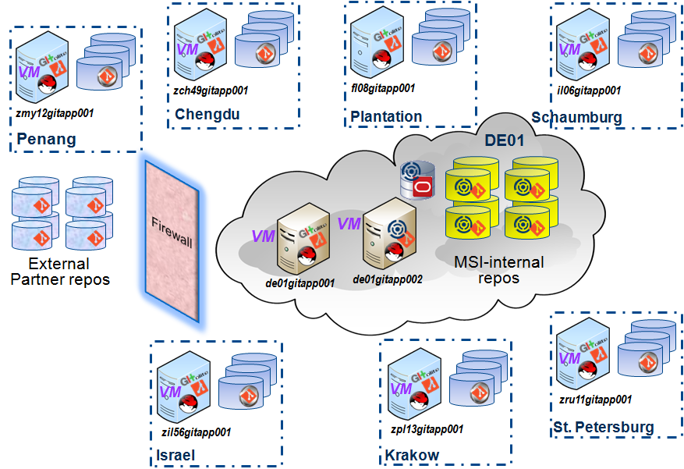
GIT repo infrastructure

Slide 14
GIT Solo

Slide 15
Basic concept in GIT
Repository:
bare, mirror and normal. all shared repo should be bare repository
data type: blob and tree, commit, tag(git cat-file -t <commit>)
workspace: staging area, working tree.
master,HEAD,tag,Branch,SHA1

Slide 16
HEAD/master/TAG
A head is a reference to a commit object.The “current head” is called HEAD
This results in a linear graph: A B C … HEAD
master is the default branch for each repository
TAG: lightweight tag,Annotated tags, tags with GPG

Slide 17
SHA1
SHA-1 produces a 160-bit (20-byte) hash value. A SHA-1 hash value is typically rendered as a hexadecimal number, 40 digits long.
normally. 7 digits long will be enough. GIT u
xvm683@zch49ts01.pts/1 ~ % printf xvm683|sha1sum
28fa6d1455770412d5a99df2968f5c8d2f163739 -

Slide 18
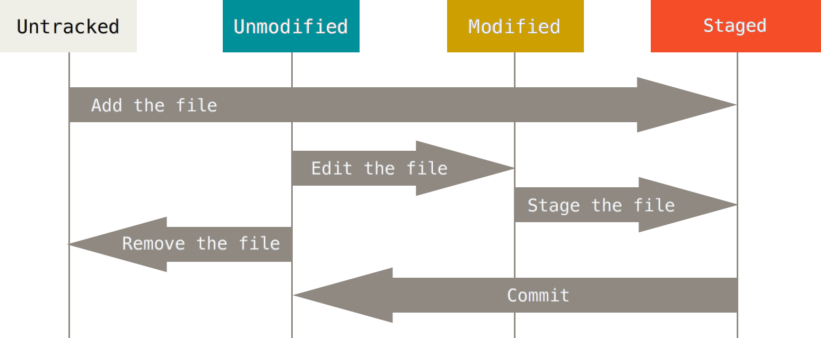
The lifecycle of files in GIT

Slide 19
Installation and basic configuration
Unix:
https://github.com/git/git
Windows:
Install package:
\\zch49scm02\DeployArea\GIT\Git-1.9.5-preview20150319.exe
SourceTree:
\\zch49scm02\DeployArea\GIT\SourceTreeSetup_1.6.14.exe

Slide 20
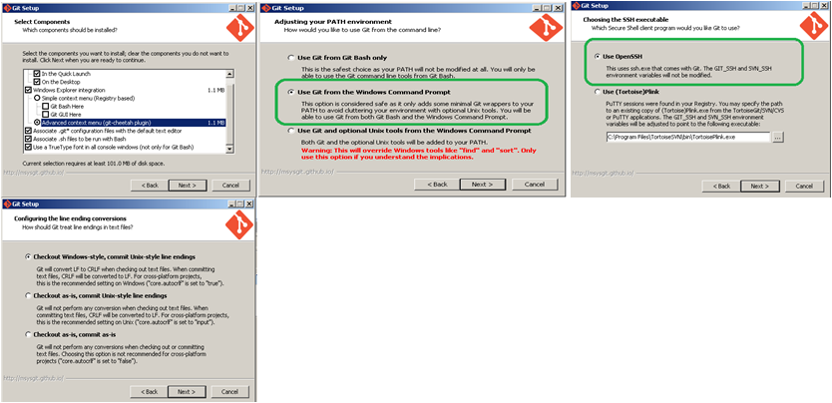
Windows installation

Slide 21
Unix installation
IT will handle the Unix side GIT installation and configuration
Dependency libs:
yum install curl-devel expat-devel gettext-devel \
openssl-devel zlib-devel docbook-style-xsl xmlto \
ImageMagick-c++.x86_64 compat-gcc-34-c++.x86_64 \
gcc-c++.x86_64 gcc-objc++.x86_64 \
libstdc++.i686 libstdc++.x86_64 libstdc++-devel.i686 libstdc++-devel.x86_64
binary file with v2.4.0-rc1:

Slide 22
Configuration for GIT
There are 3 levels config for GIT client
current repository level: Git config( default will update current repo)
current user level: git config --global(it’ll update ~/.gitconfig)
current system level: git config --system (you can’t do it if you are not root)
gitignore file
This file will be used to limit which files will not add into repository. template file

Slide 23
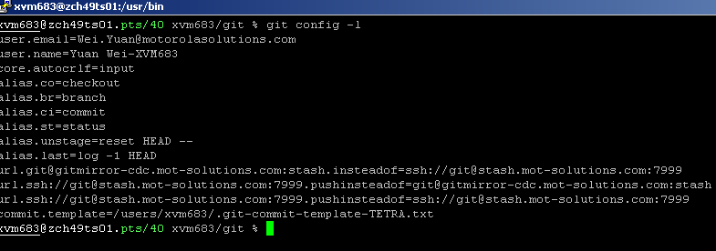
config alias
git config --global alias.ci commit -m
git config --global alias.co checkout
demo:

Slide 24
Configuration for Windows user
Xming for GUI
Change the default editor
Change the default diff tool
Change the default merge tool.

Slide 25
Practice for configuration
1: Add the config file for each users
2: Rename the user email/ name. then fix the git line
3: Demo to use msysgit and source tree

Slide 26
Basic workflow with GIT
initial/Clone the repository
Add files/update files
add to index
Commit
push to Central
repository

Slide 27
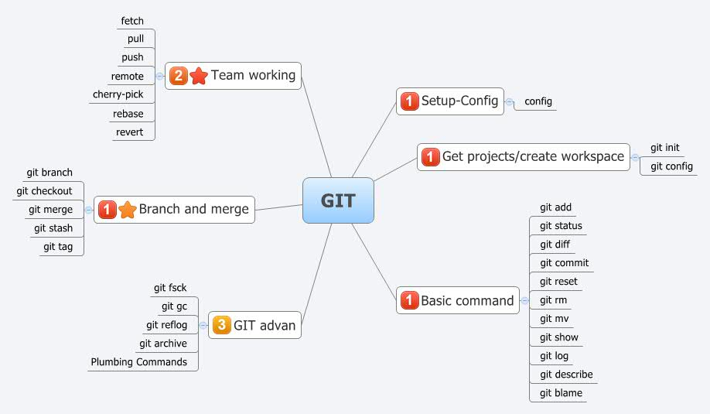

Slide 28
GIT basic commands
git init-- initial the new repository
git clone -- clone the existing repository(git init+git fetch)
git add -- stage the file for commit
git commit -- commit the staged changes into local repository
git push -- upload the local repo into remote repository.

Slide 29
basic commands
Removing file.
rm delete.txt;git add ; git commit -m “remove file delete.txt” = git rm delete.txt git commit
Rename/move file
git mv file1.txt file2.txt

Slide 30
Top 10 Commands
git status
git pull/fetch
git branch
git checkout
git grep
git stash
git diff
git commit
git reset
git log
git rebase

Slide 31
GIT Status
Check the current status:
git status -s -b
-s the short show
-b current working branch name

Slide 32
GIT pull/fetch+merge
git pull: fetch and integration from remote repository to local branch.
git fetch: download the remote objects

Slide 33
GIT branch
create,list,remove branch
git branch branch_name: create the branch
(git checkout branch_name to switch)
git branch -d branch_name: remove the branch
git branch -m <old_name> <new_name>
git checkout -b branch_name: create the branch and switch on it

Slide 34
GIT checkout
switch to one branch/commit/path in working tree
git checkout -- filename: overwrite the file from stage area to work space.
git checkout -- : overwrite all files from staged
git checkout branch_name: switch to branch.
git checkout <commit> filename: overwrite to specified commit

Slide 35
GIT grep
find the any info in repository
eg:
git grep ‘zch49’ origin/fl08_sr7_17_mackinaw_main

Slide 36
GIT stash
Store the changes in local working directory
git stash : will save all changes and make working directory to HEAD.
git stash pop: get back
git stash show: list the stashed files.
git stash clean clean all stashed files

Slide 37
GIT diff
show different between commits, commit,working tree.
git diff: will show different between working tree and index
git diff --cached/--staged. it’ll show different between index with commit/HEAD
git diff HEAD: show different between working tree and HEAD
git diff branch_a branch_b: show the different between 2 branch
git diff SHA1 SHA2: show the different between 2 commits

Slide 38
GIT commit
git commit -m “comments” (comments message is very important for team working)
git commit --amend . it’ll help to update the latest commit
git commit -a it’ll commit the all changes directly without git add (Don’t do that)

Slide 39
Git commit message
When you commit, you must provide a one-line message stating what you have done
example:
#fix defect: id:ccmpd
#add feature: id:ccmpd
#enhance: id:ccmpd

Slide 40
GIT reset
Reset the current HEAD to specified state
reset to specified commit
git reset -- filename cancel the change in stage area
git reset --hard <commit> all back to commit
git reset --soft <commit> HEAD to commit.

Slide 41
GIT log
git log is very useful command to check the commit history:
git log --oneline it’ll show each commit with oneline.
git log --graph simple tree for merge and branch.
git log --pretty=raw it’ll show all detail info for each commit

Slide 42
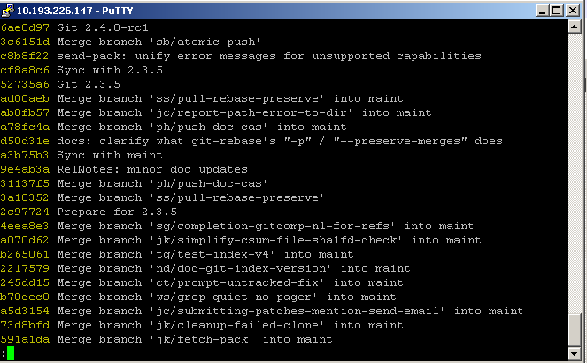
git log --oneline

Slide 43
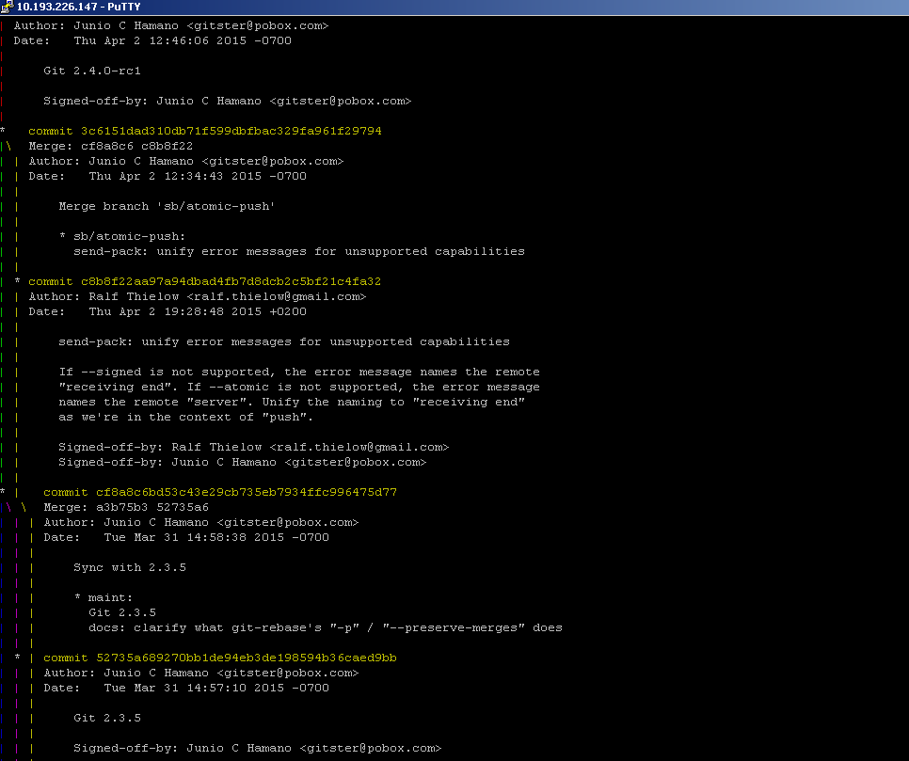
git log --graph

Slide 44
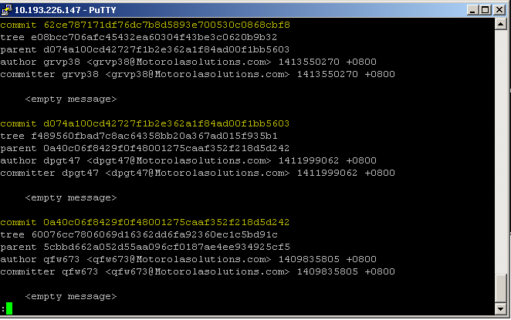
git log --pretty=raw

Slide 45
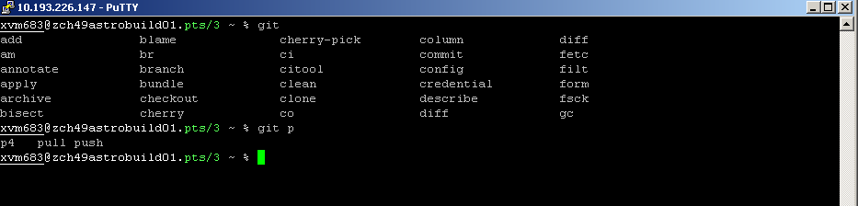
Tips(A)
how to get the GIT command with TAB?
Git command automation completion:
ASTRO and TETRA build server is ready.
git <TAB> or git letter<TAB>

Slide 46
Tips(B)
how to cancel the staged file:
git reset HEAD --
How to drop the specified one commit before the push?
1: git log to find the working commit
2: git reset to this commit
3: make change then git add .

Slide 47
Tips(B)
How to clean my repository to baseline version?
git reset --hard <commit>

Slide 48
Tips(C)
How to check the HEAD content:
git cat-file commit HEAD
Who make my code failed?
git blame will tell you true story.
eg :git blame -C -L 10,15 Makefile

Slide 49
Tips(D)
What kind of content will be push into central repo?
git log origin/master..HEAD
how to list the removed files?
git clean -nd

Slide 50
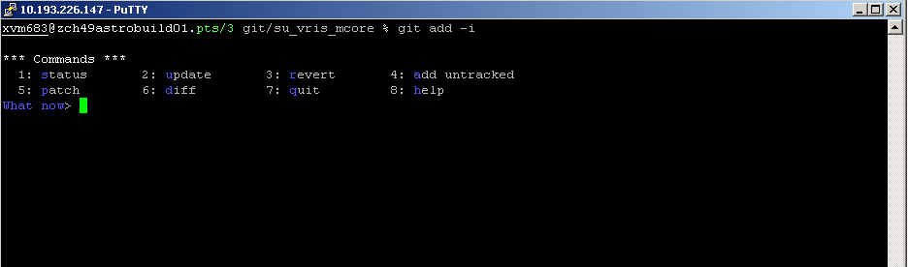
Tips(E)
Interactive use git from git add -i

Slide 51
Practice after the training
To Install the GIT on Windows and try to find the favorite GUI GIT for yourself.
To init/clone one project and add/update/rm file
To make five branches for different idea. then merge them together on master
To find the colleagues to share your repository and working together

Slide 52
Reference
Official GIT document :
git-scm-book:http://git-scm.com/book/en/Getting-Started (Chinese:http://git-scm.com/book/zh )
git-command-manual:http://git-scm.com/docs
MSI GIT group:
https://converge.motorolasolutions.com/groups/git-scm
CDC GIT ebook:
http://zch49view01.ap.mot-solutions.com/SCM/git.html
CDC GIT coverage group

