Slide 1
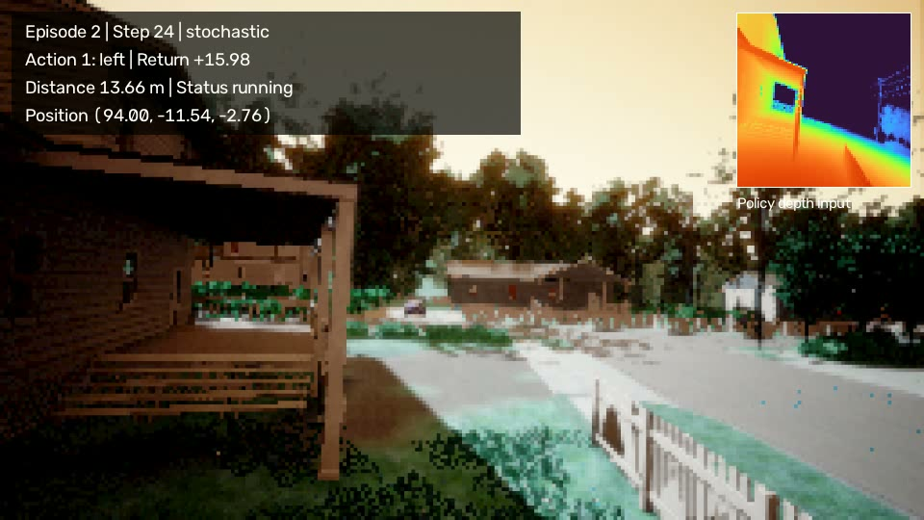
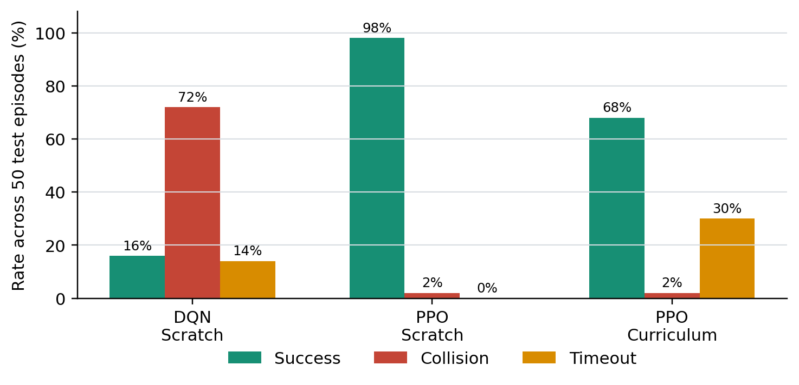
Autonomous Drone Navigation
with Deep Reinforcement Learning
COMP9444 Project Team
Visual depth | DQN | PPO | Curriculum
Notes:
Introduce the project as visual point-to-point navigation without a map.
State the comparison: vanilla DQN, PPO from scratch, and PPO curriculum.
[Sources]
- D:\AirSim\rl_drone_navigation\README.md
- D:\AirSim\rl_drone_navigation\experiments\airsimnh\validated_comparison_seed7_test_seed20007.csv

Slide 2
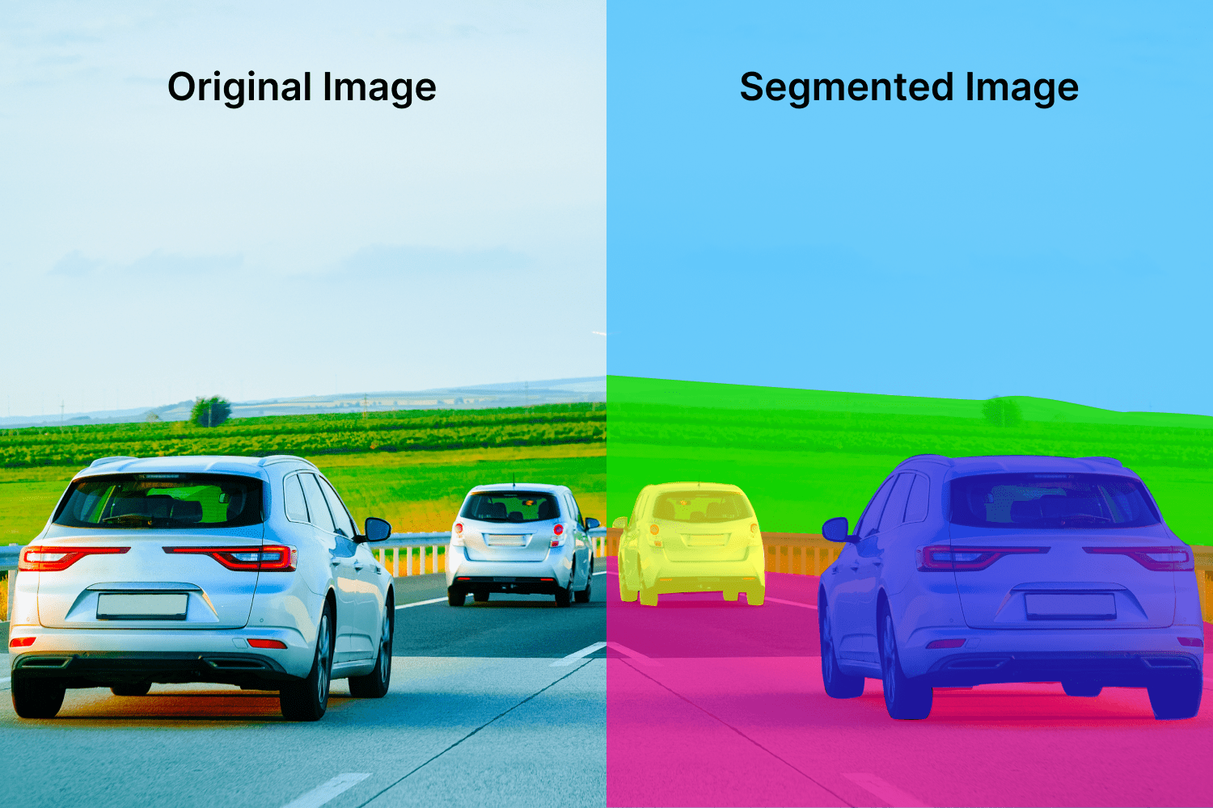
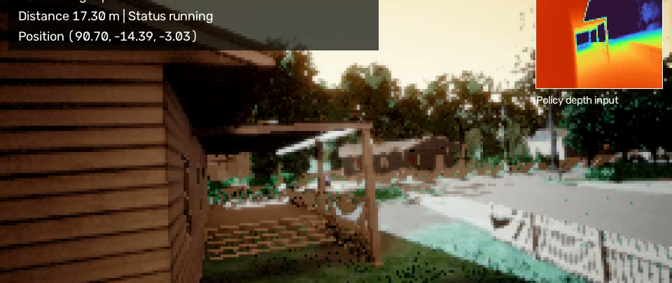
Depth replaces a stored obstacle map
Goal: travel 32.55 m through AirSimNH and stop within 2 m
No map or explicit obstacle coordinates
Input: front depth + relative goal + velocity
Six discrete body-frame actions every 0.35 s
Safety failures terminate the episode
Presenter: COMP9444 Project Team
Notes:
Explain that the route contains a house that blocks direct goal pursuit.
The policy must infer free space from depth while still following relative target direction.
[Sources]
- D:\AirSim\rl_drone_navigation\src\airsim_drone_env.py
- D:\AirSim\rl_drone_navigation\experiments\airsimnh\ppo\curriculum_stage02_23m_10k_seed7_stable_v2_stage2_pilot\recordings

Slide 3
AirSim enables learning; DQN is the baseline
AirSim [1]
Unreal Engine visuals, multirotor physics, cameras and collision queries
Repeatable interaction without risking physical hardware
Deep Q-Network [2]
Learns discrete action values from image features
Replay buffer + target network improve training stability
Our baseline deliberately remains vanilla DQN
Presenter: COMP9444 Project Team
Notes:
Delineate prior work from our implementation.
AirSim and DQN are established foundations; our contribution is the navigation environment and controlled comparison.
[Sources]
- https://arxiv.org/abs/1705.05065
- https://www.nature.com/articles/nature14236

Slide 4
PPO limits updates; curriculum orders tasks
Proximal Policy Optimisation [3]
Clipped surrogate objective limits destructive updates
Actor-critic learning supports stochastic discrete control
Curriculum learning [4]
Orders easier tasks before harder tasks
Our curriculum increases target distance: 10 m -> 23 m -> 33 m
Question: does curriculum help under the same 45k interactions?
Presenter: COMP9444 Project Team
Notes:
PPO is selected because the action space is discrete and policy stability matters.
Curriculum is a hypothesis, not an assumed improvement; the experiment tests it.
[Sources]
- https://arxiv.org/abs/1707.06347
- https://icml.cc/2009/papers/119.pdf

Slide 5
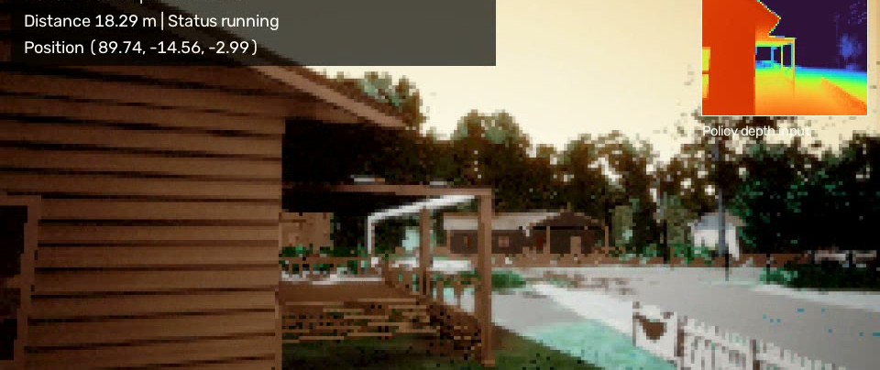
AirSim supplies online experience
Observation
84 x 84 front depth, target offset and velocity
Pre-processing
Clip depth at 40 m; resize; convert near obstacles to high intensity
Challenge
Sparse +100 goal reward, unsafe exploration, partial observability
No classes, train/test images, SLAM or obstacle labels
Presenter: COMP9444 Project Team
Notes:
Relate this slide directly to the rubric's data or RL task analysis.
The depth inset is the policy input; RGB is recorded only for human inspection.
[Sources]
- D:\AirSim\rl_drone_navigation\src\airsim_drone_env.py
- D:\AirSim\rl_drone_navigation\experiments\airsimnh\ppo\curriculum_stage02_23m_10k_seed7_stable_v2_stage2_pilot\recordings

Slide 6
A shared CNN keeps the algorithm comparison controlled
Common perception
3 convolution layers -> 3,136 visual features
DQN
Replay + epsilon-greedy -> six Q-values
Stable PPO
LayerNorm, Tanh, orthogonal initialisation
Actor logits + critic value
84 x 84
Depth
6-D Goal
+ Velocity
CNN 3,136 + State 6
= 3,142 features
FC 512 -> LayerNorm -> Tanh
Actor
6 logits
Critic
V(s)
Presenter: COMP9444 Project Team
Notes:
Emphasise that DQN and PPO see the same representation and action set.
Layer normalisation was added before Tanh after diagnosing hidden-feature saturation.
[Sources]
- D:\AirSim\rl_drone_navigation\src\dqn_agent.py
- D:\AirSim\rl_drone_navigation\src\ppo_agent.py

Slide 7
Validation selects; a fresh seed tests once
Fair budget
45,000 interactions per method
Same final task
Start, target, reward and max 150 steps
Metrics
Success, collision, timeout, reward
Steps, path length, final distance, min depth
Training seed: 7 | Test seed: 20007
All checkpoints
5 episodes each
Seed 7
Top 3 checkpoints
30 episodes each
Seed 10007
Selected model
50 final-test episodes
Seed 20007
Presenter: COMP9444 Project Team
Notes:
Explain why selection and final testing are separated.
The test seed is independent, but the route geometry remains fixed.
[Sources]
- D:\AirSim\rl_drone_navigation\run_checkpoint_selection.ps1
- D:\AirSim\rl_drone_navigation\experiments\airsimnh\validated_comparison_seed7_test_seed20007.csv

Slide 8
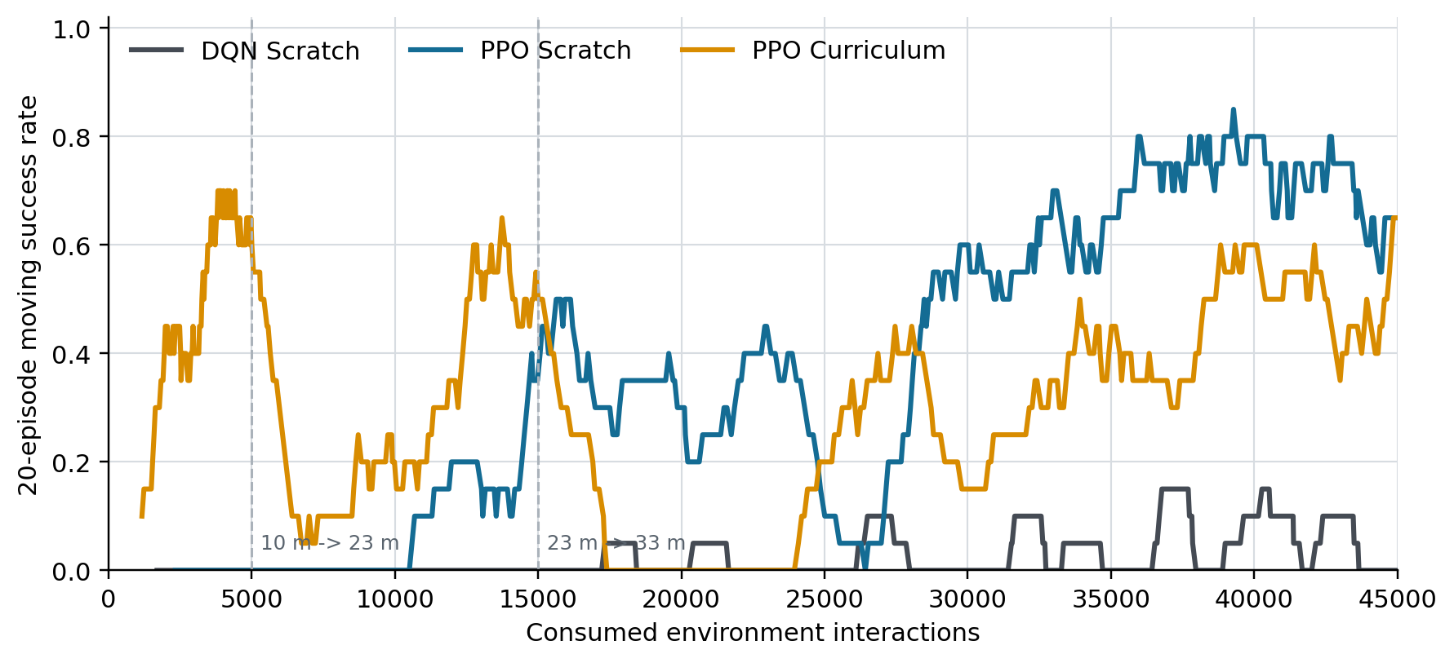
Scratch PPO improves late; curriculum lags
Scratch PPO reaches 0.7-0.8 moving success late in training
DQN remains mostly near zero despite epsilon exploration
Curriculum changes the target at 5k and 15k interactions
Easy-stage success is not final-route success
All curves remain noisy: checkpoint selection matters
Presenter: COMP9444 Project Team
Notes:
Do not compare raw curriculum rewards across stages because route lengths differ.
The plot uses 20-episode moving success and marks curriculum target changes.
[Sources]
- D:\AirSim\rl_drone_navigation\experiments\airsimnh\dqn\scratch_33m_45k_seed7_stable_v3_scratch\results\training_log.csv
- D:\AirSim\rl_drone_navigation\experiments\airsimnh\ppo\scratch_33m_45k_seed7_stable_v3_scratch\results\training_log.csv

Slide 9
PPO Scratch reaches 98% success
PPO Scratch
98% success | 2% collision | 0% timeout
Selected checkpoint
42,500 interactions
Efficiency
52.28 steps | 38.27 m path
Mean reward: 141.1
Presenter: COMP9444 Project Team
Notes:
This is the primary deterministic comparison from 50 final-test episodes.
PPO Scratch succeeds in 49/50 episodes; the single failure is a collision.
[Sources]
- D:\AirSim\rl_drone_navigation\experiments\airsimnh\validated_comparison_seed7_test_seed20007.csv

Slide 10
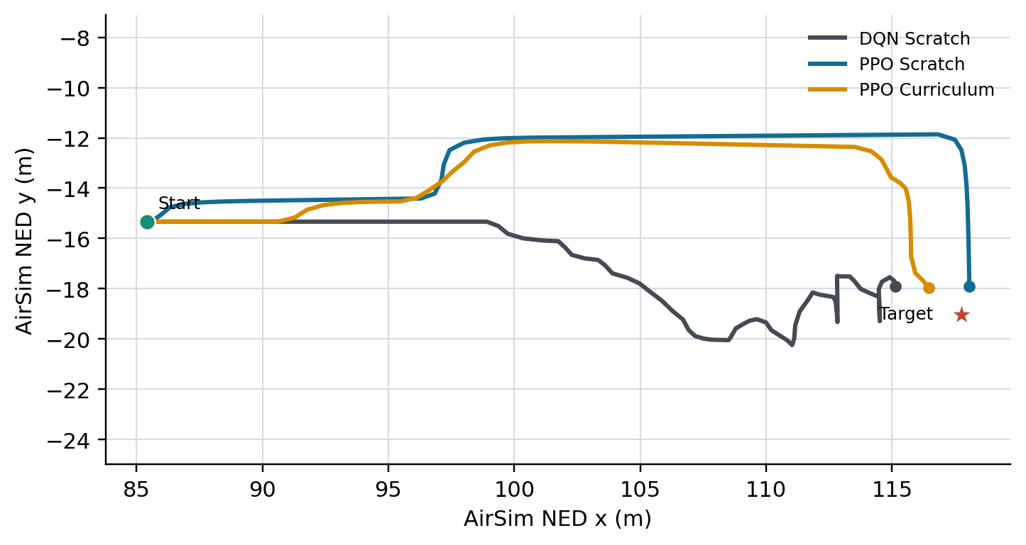
The three policies fail in different ways
DQN: direct pursuit and 72% collision; mean min depth 0.37 m
Curriculum PPO: only 2% collision, but 30% timeout
Scratch PPO learns a repeatable lateral detour
Sampling exposes residual uncertainty
PPO Scratch: 98% deterministic -> 66% stochastic
PPO Curriculum: 68% deterministic -> 46% stochastic
Presenter: COMP9444 Project Team
Notes:
The trajectory figure uses deterministic Episode 1 from each selected model.
Explain that deterministic is the deployment policy; stochastic sampling is a diagnostic.
[Sources]
- D:\AirSim\rl_drone_navigation\experiments\airsimnh\validated_comparison_seed7_test_seed20007.csv
- D:\AirSim\rl_drone_navigation\experiments\airsimnh\ppo\scratch_33m_45k_seed7_stable_v3_scratch_validated_test_seed20007\results\evaluation_deterministic_trajectory.csv

Slide 11
Strong on one route; generalisation remains open
What worked
Stable PPO learned a safe, efficient detour: 98% success and 2% collision
What did not
Vanilla DQN collided; curriculum PPO preserved a short-horizon timeout bias
What we can claim
Strong fixed-route AirSimNH performance under a controlled budget
What we cannot claim
Generalisation to unseen routes, scenes or real drones
Next: 3-5 seeds, route perturbations, second scene, multi-route training
Presenter: COMP9444 Project Team
Notes:
Close by separating evidence from future hypotheses.
The recommended inference model is pretrained/airsimnh/ppo_scratch_seed7.pt.
[Sources]
- D:\AirSim\rl_drone_navigation\README.md
- D:\AirSim\rl_drone_navigation\pretrained\airsimnh\ppo_scratch_seed7.pt

Slide 12
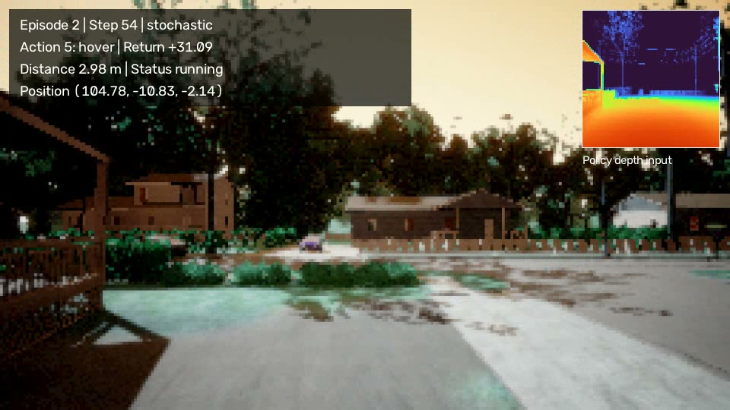
Questions
Notes:
Invite questions on reward design, checkpoint selection, policy modes, and generalisation.
[Sources]
- D:\AirSim\rl_drone_navigation\experiments\airsimnh\ppo\curriculum_stage02_23m_10k_seed7_stable_v2_stage2_pilot\recordings

