Slide 1
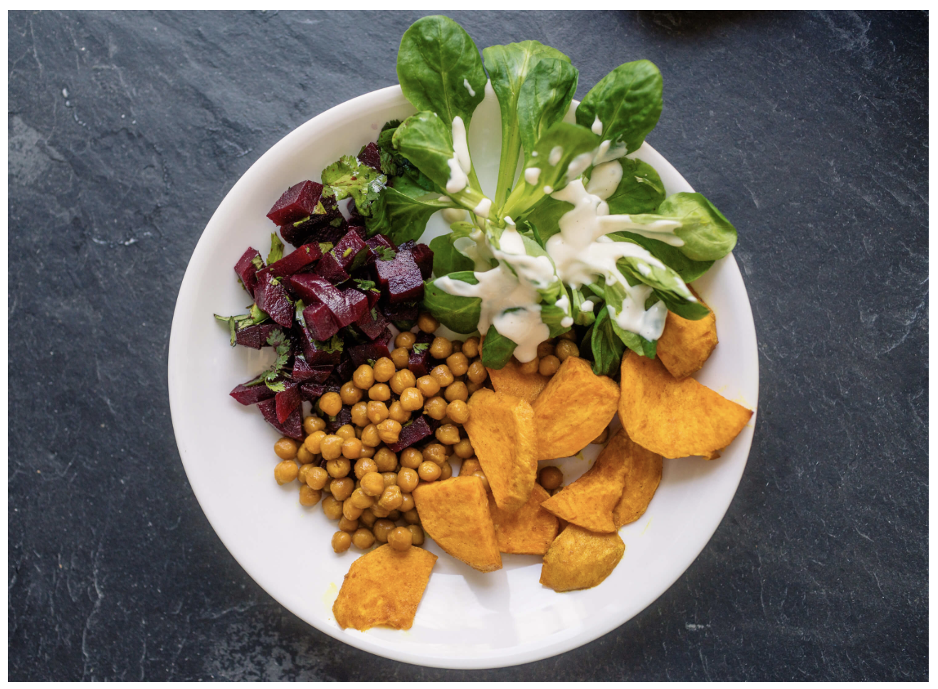
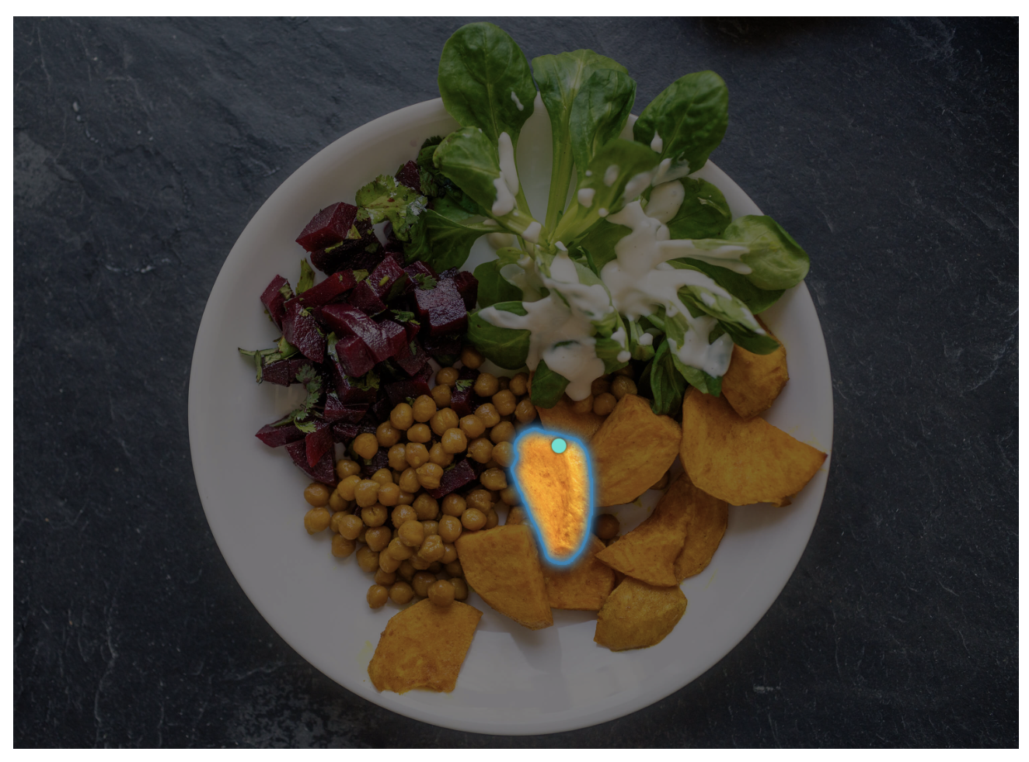
Project Title
Team Name
Alan Blair (zxxxxxxx)
Fatemeh Morgani (zxxxxxxx)
Hao Xue (zxxxxxxx)
Jingying Gao (zxxxxxxx)
Zahra Donyavi (zxxxxxxx)

Slide 2
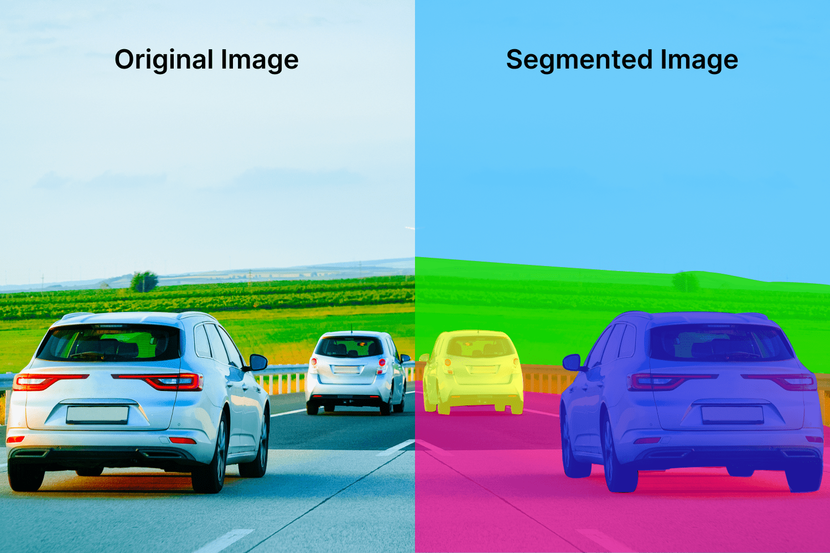
Motivation
This is just an example, please change images and content as per the project. Also, change Presenter’s name and zID for the final project presentation
Image Segmentation: Identifying which image pixels belong to an object
One of the core tasks in computer vision
Broad array of applications:
Medical Image Analysis
Scientific imagery
Editing photos
Autonomous Vehicles
Robotics
Agriculture
…
Presenter: Alan Blair (zxxxxxxx)

Slide 3
Problem Statement
Write here
Presenter: Alan Blair (zxxxxxxx)

Slide 4
Literature Review
Just provide summary in 2 slides of relevant papers
Presenter: Fatemeh Morgani (zxxxxxxx)

Slide 5
Dataset(s)
Provide details about the dataset or the RL tasks
Presenter: Hao Xue (zxxxxxxx)

Slide 6
Data Analysis
Briefly provide details here …
Presenter: Hao Xue (zxxxxxxx)

Slide 7
Method(s)
Details here …
Presenter: Jingying Gao (zxxxxxxx)

Slide 8
Results
Details here …
Presenter: Zahra Donyavi (zxxxxxxx)

Slide 9
Discussion
Details here …
Presenter: Zahra Donyavi (zxxxxxxx)

Slide 10
Conclusion
Write here
Presenter: Zahra Donyavi (zxxxxxxx)

Slide 11

This Photo by Unknown Author is licensed under CC BY-SA

