Slide 1
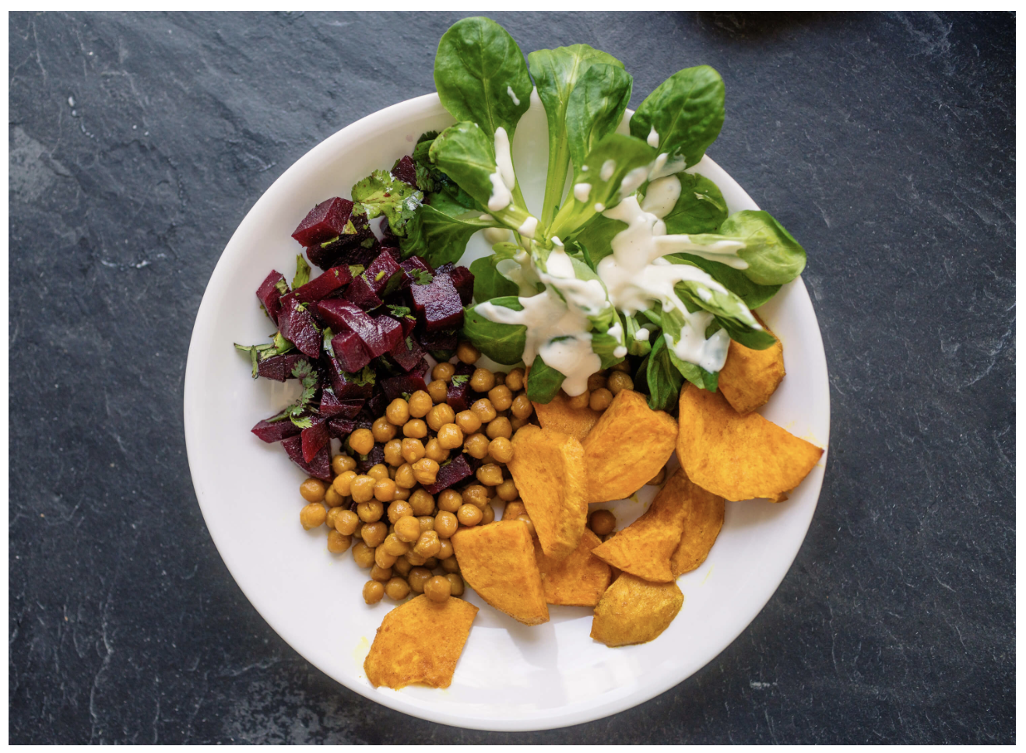
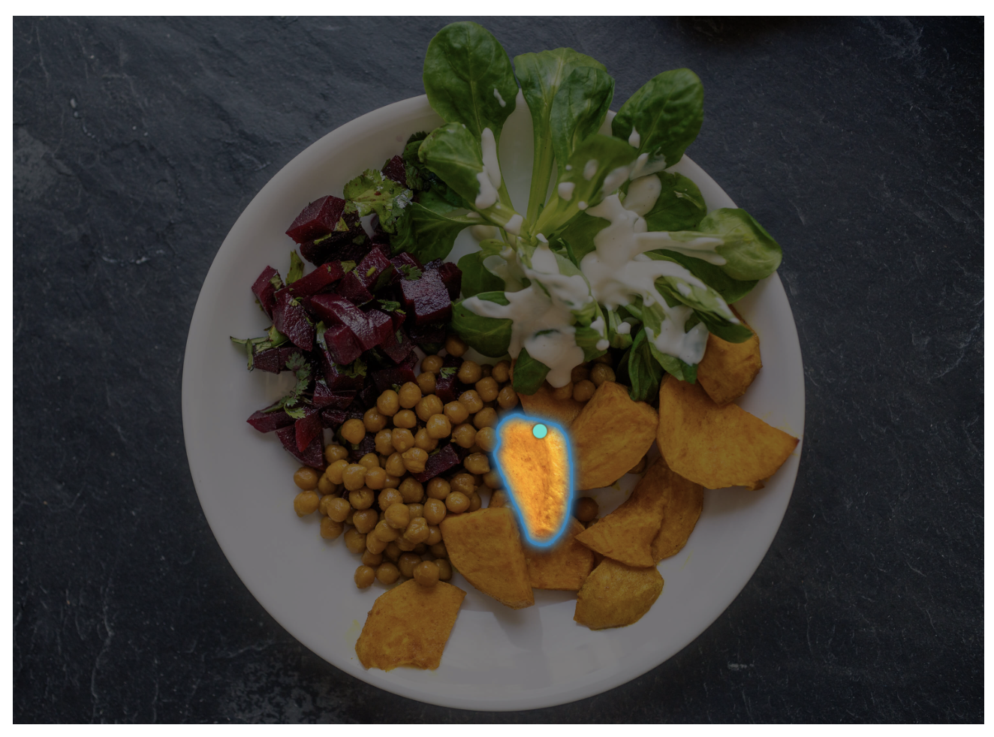
Project Title
Team Name
Alan Blair (zxxxxxxx)
Fatemeh Morgani (zxxxxxxx)
Hao Xue (zxxxxxxx)
Jingying Gao (zxxxxxxx)
Zahra Donyavi (zxxxxxxx)

Slide 2
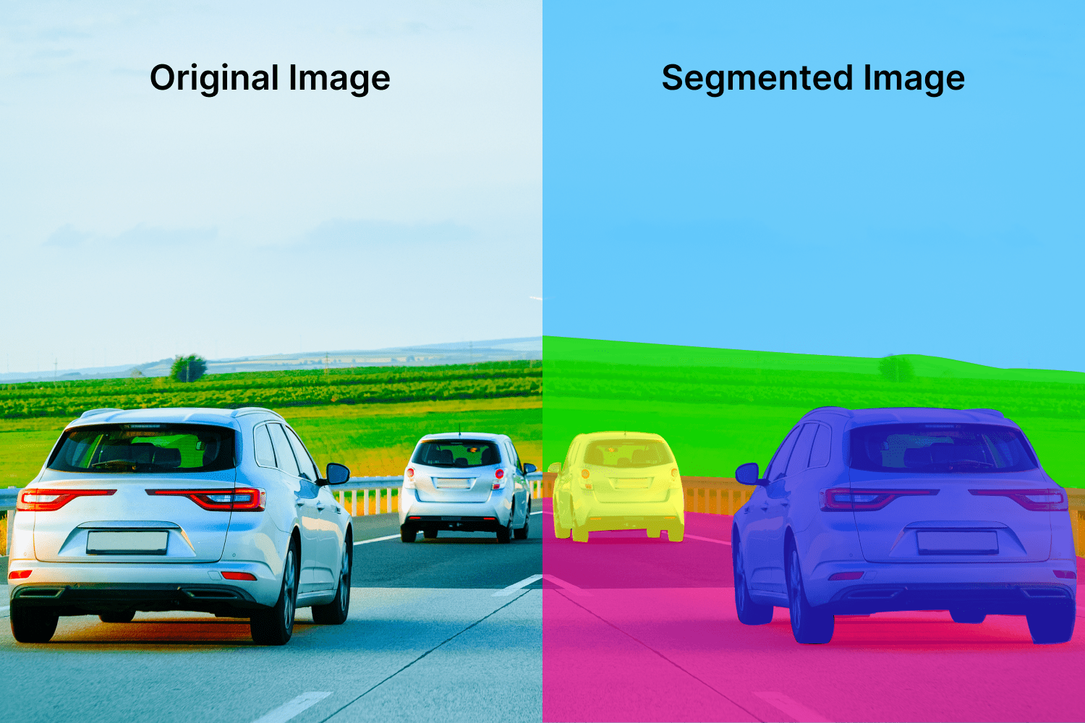
Motivation
This is just an example, please change images and content as per the project. Also, change Presenter’s name and zID for the final project presentation
Image Segmentation: Identifying which image pixels belong to an object
One of the core tasks in computer vision
Broad array of applications:
Medical Image Analysis
Scientific imagery
Editing photos
Autonomous Vehicles
Robotics
Agriculture
…
Presenter: Alan Blair (zxxxxxxx)

Slide 3
Literature Review
Just provide summary in 2 slides of relevant papers
Presenter: Fatemeh Morgani (zxxxxxxx)

Slide 4
Literature Review
Just provide summary in 2 slides of relevant papers
Presenter: Fatemeh Morgani (zxxxxxxx)

Slide 5
Motivation
This is just an example, please change images and content as per the project. Also, change Presenter’s name and zID for the final project presentation
Image Segmentation: Identifying which image pixels belong to an object
One of the core tasks in computer vision
Broad array of applications:
Medical Image Analysis
Scientific imagery
Editing photos
Autonomous Vehicles
Robotics
Agriculture
…
Presenter: Alan Blair (zxxxxxxx)

Slide 6
Method(s)
Details here …
Presenter: Jingying Gao (zxxxxxxx)

Slide 7
Data Analysis
Briefly provide details here …
Presenter: Hao Xue (zxxxxxxx)

Slide 8
Motivation
This is just an example, please change images and content as per the project. Also, change Presenter’s name and zID for the final project presentation
Image Segmentation: Identifying which image pixels belong to an object
One of the core tasks in computer vision
Broad array of applications:
Medical Image Analysis
Scientific imagery
Editing photos
Autonomous Vehicles
Robotics
Agriculture
…
Presenter: Alan Blair (zxxxxxxx)

Slide 9
Results
Details here …
Presenter: Zahra Donyavi (zxxxxxxx)

Slide 10
Motivation
This is just an example, please change images and content as per the project. Also, change Presenter’s name and zID for the final project presentation
Image Segmentation: Identifying which image pixels belong to an object
One of the core tasks in computer vision
Broad array of applications:
Medical Image Analysis
Scientific imagery
Editing photos
Autonomous Vehicles
Robotics
Agriculture
…
Presenter: Alan Blair (zxxxxxxx)

Slide 11
Conclusion
Write here
Presenter: Zahra Donyavi (zxxxxxxx)

Slide 12

This Photo by Unknown Author is licensed under CC BY-SA

