Slide 1
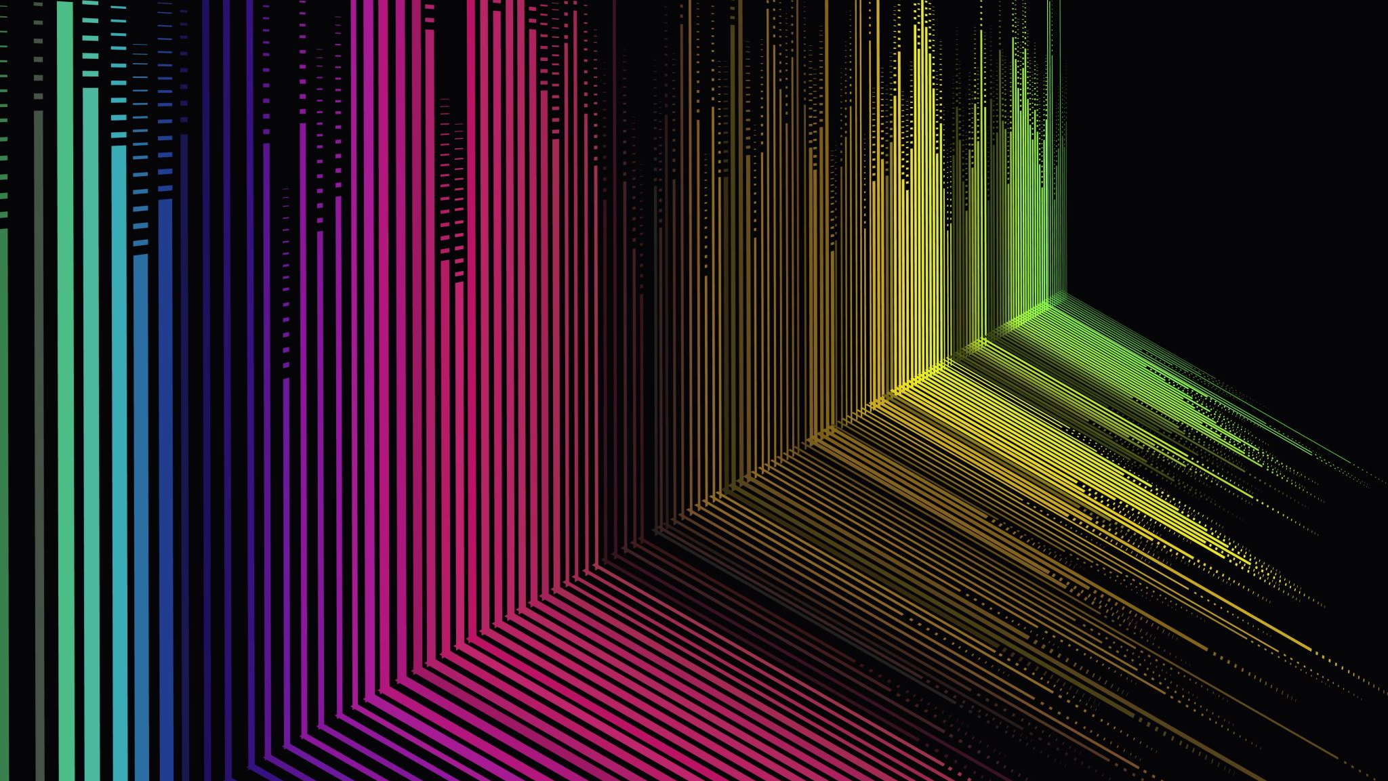
Fine-Tuning Language Models with Just Forward Passes
Source: https://arxiv.org/abs/2305.17333
Qitong Zhao

Slide 2
Introduction
Fine-tuning pre-trained models (LMs) has been the dominant methodology for solving many language tasks, adapting to specialized domains, or incorporating human instructions and preferences.
However, we are facing a problem that when LMs are scaled up, computing gradients for backpropagation requires a huge amounts of memory. It could reach up to 12 times more memory than inference. The reason is that it needs store activations during the forward pass, gradients during the backward pass, and also store gradient history, in the case of Adam.

Slide 3
ZO-SGD
A classical zeroth-order optimization method (ZO-SGD) uses only differences of loss values to estimate the gradients
ZO methods have but not to directly optimize large-scale models.

Slide 4
Our work
Memory-efficient zeroth-order optimizer (MeZO): It adapts the classical ZO-SGD algorithm and reduces its memory consumption to the same inference.
Generally, we apply MeZO to fine-tune large LMs and show that MeZO can successfully optimize LMs with billions of parameters. More specifically…

Slide 5
More Specifically…
In MeZO, we adapt the ZO-SGD algorithm and a number of variants to operate in-place on arbitrarily large models with almost no memory overhead.
We conduct comprehensive experiments across model types (masked LM and autoregressive LM), model scales (from 350M to 66B), and downstream tasks (classification, multiple-choice, and generation). MeZO consistently demonstrates superiority over zero-shot, ICL, and linear probing. Moreover, with RoBERTa-large, MeZO achieves performance close to standard fine-tuning within 5% gap; with OPT-13B, MeZO outperforms or performs comparably to fine-tuning on 7 out of 11 tasks, despite requiring roughly 12× less memory
We demonstrate MeZO’s compatibility with full-parameter tuning and PEFT.
Further exploration showcases that MeZO can optimize non-differentiable objectives such as accuracy or F1 score, while still requiring only the same memory as inference.
Our theory suggests that adequate pre-training ensures the per-step optimization rate and global convergence rate of MeZO depend on a certain condition number of the landscape instead of numbers of parameters. This result is in sharp contrast to existing ZO lower suggesting that the convergence rate can slow proportionally to the number of parameters.

Slide 6
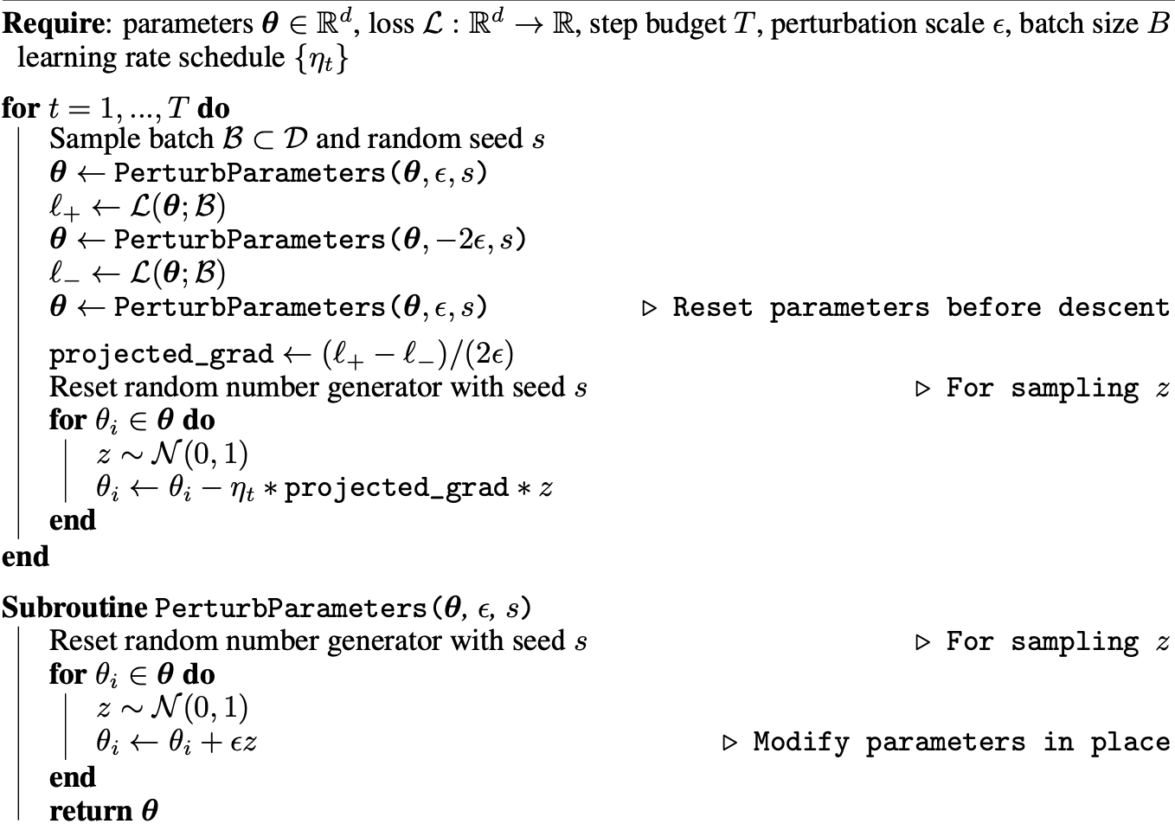
MeZO Pseudo-code

Slide 7
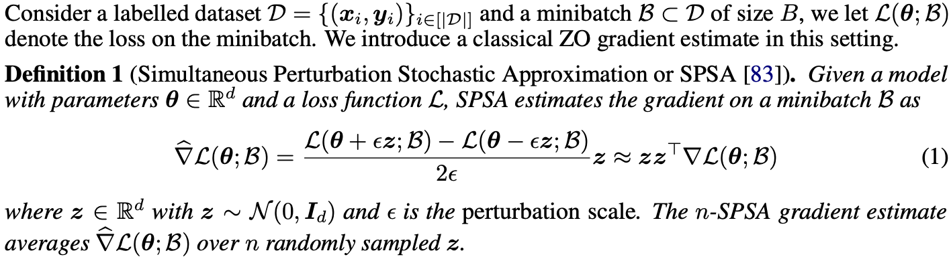
SPSA and ZO-SGD

Slide 8
Experiment 1 from RoBERTa-large
Process: We conduct comprehensive experiments on both medium-sized masked LMs (RoBERTa-large, 350M) and large autoregressive LMs (OPT-13B, 30B, 66B) in few-shot and many-shot settings with prompts. We also explore both full-parameter tuning and PEFT including LoRA and prefix-tuning. We compare MeZO with zero-shot, in-context learning (ICL), linear-probing (LP), and fine-tuning with Adam (FT). MeZO uses substantially less memory than FT but requires significantly more training steps.
Goal: We first show that MeZO improves substantially over zero-shot, ICL, and LP across model types, sizes, and task types. Moreover, MeZO performs comparably to FT over a number of tasks, while drastically reducing the memory cost by, for example, 12× on OPT-13B. Further experiments demonstrate that MeZO can optimize non-differentiable objectives, such as accuracy and F1 score. We compare the memory consumption of ICL, FT, LP, and MeZO in the following figures.

Slide 9
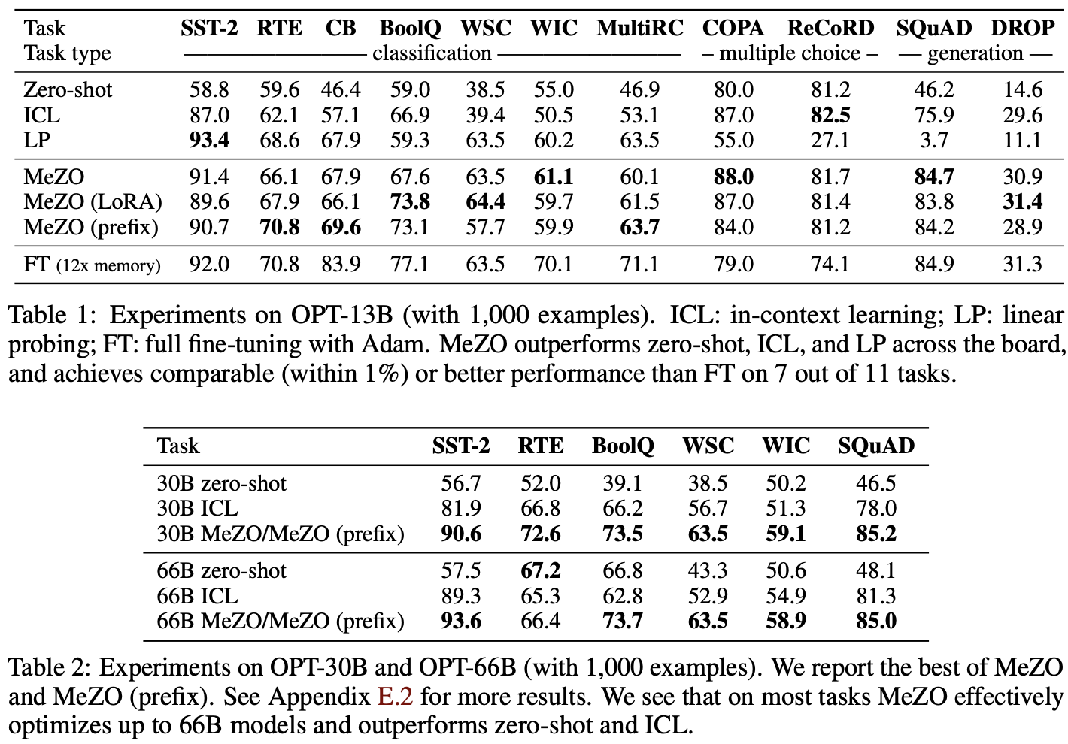
Results

Slide 10
Results Summary
MeZO works significantly better than zero-shot, linear probing, and other memory-equivalent methods.
With enough data, MeZO achieves comparable performance (up to 5% gap) to FT.
MeZO works well on both full-parameter tuning and PEFT.

Slide 11
Experiment 2 from OPT Family
we extend MeZO to the OPT family, on a scale of 13B, 30B, and 66B. We select both SuperGLUE tasks4 (including classification and multiple-choice) and generation tasks. We randomly sample 1000, 500, and 1000 examples for training, validation, and test respectively for each dataset.

Slide 12
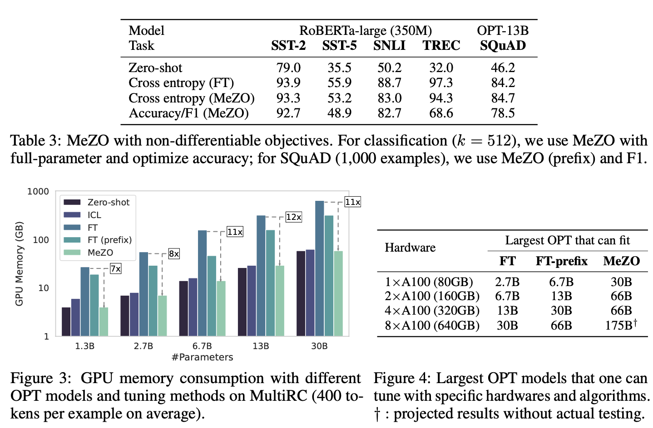
Results

Slide 13
Results Summary
MeZO outperforms memory-equivalent methods and closely approaches fine-tuning results.
MeZO exhibits strong performance across classification, multiple-choice, and generation tasks.
MeZO Scales up to 66 billion parameter models: While directly fine-tuning models at such scales are extremely costly, MeZO can effectively optimize these models and outperform zero-shot and ICL.

Slide 14
Theory
Highlights that MeZO can optimize large LMs, although optimization should be catastrophically slow when training so many parameters.
When the loss landscape exhibits favorable conditions, we can derive a convergence rate independent of the number of parameters.
The loss decreases per step at a rate independent of the parameter dimension d, and that, under stronger conditions, the algorithm converges in time independent of d.

Slide 15
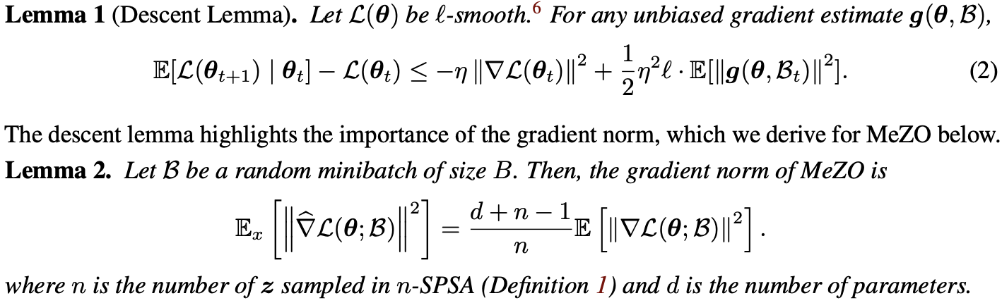
Some Definitions and Lemmas

Slide 16
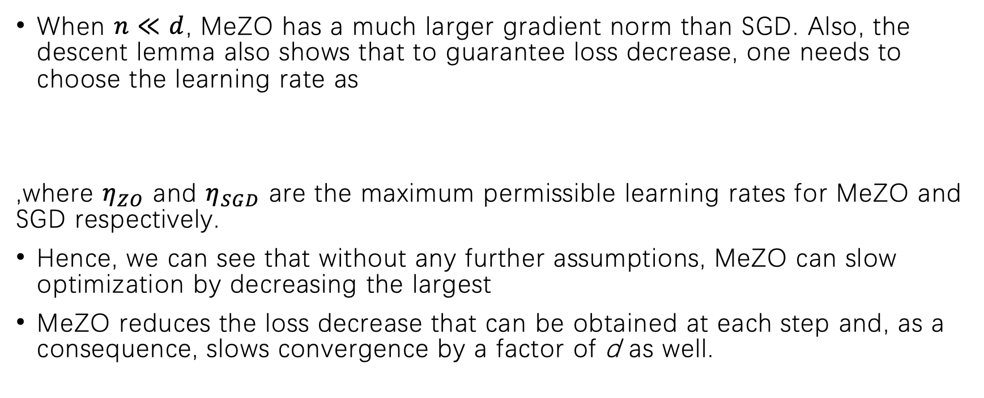
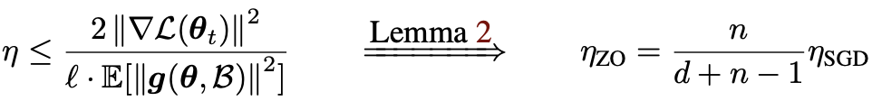
Analysis

Slide 17
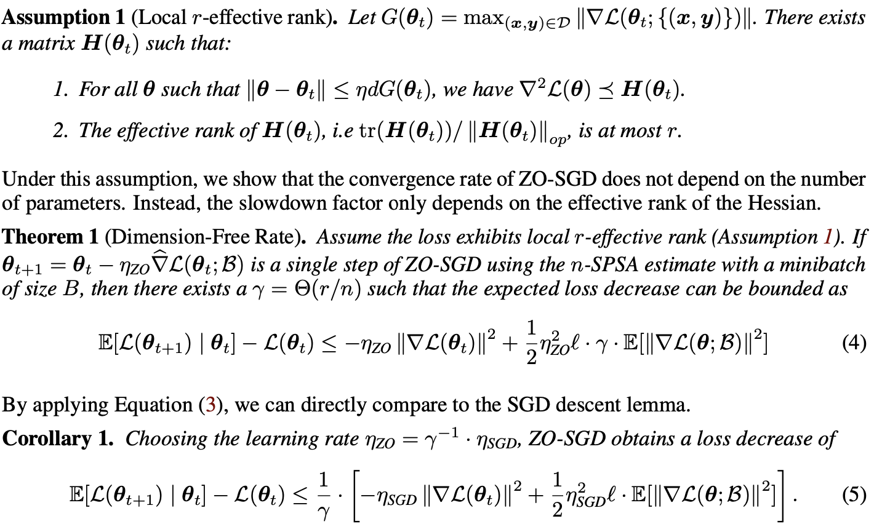
Continued…
Here we see that comparing to SGD, the slowdown factor of ZO-SGD scales with the local effective rank r, which we argue is much smaller than the number of parameters d.

Slide 18
Global Convergence Analysis
The global convergence rate also slows by a factor proportional to the local effective rank under stronger assumptions about the loss landscape.
We assume that the landscape obeys the classical PL inequality: the gradient norm grows quadratically with the suboptimality of the iterate.

Slide 19
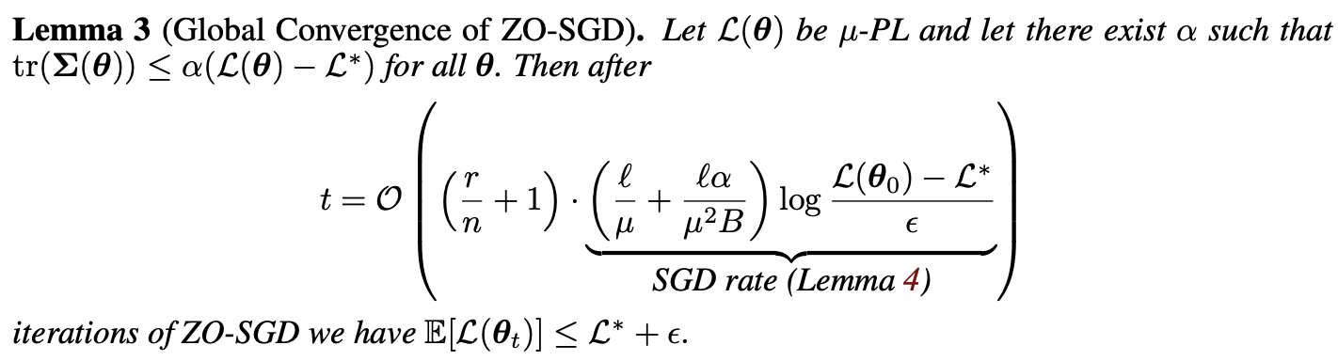
Global Convergence Analysis

Slide 20
Related Work
Zeroth-order optimization
Memory-efficient backpropagation
Gradient-free adaptation of large language models

Slide 21
Conclusion
MeZO can effectively optimize large LMs across many tasks and scales.
Experiments suggest that MeZO can optimize non-differentiable objectives, which backpropagation usually cannot do.
Our theory illustrates why MeZO is not catastrophically slow when tuning billions of parameters. As a limitation, MeZO takes many steps in order to achieve strong performance.

