Slide 1
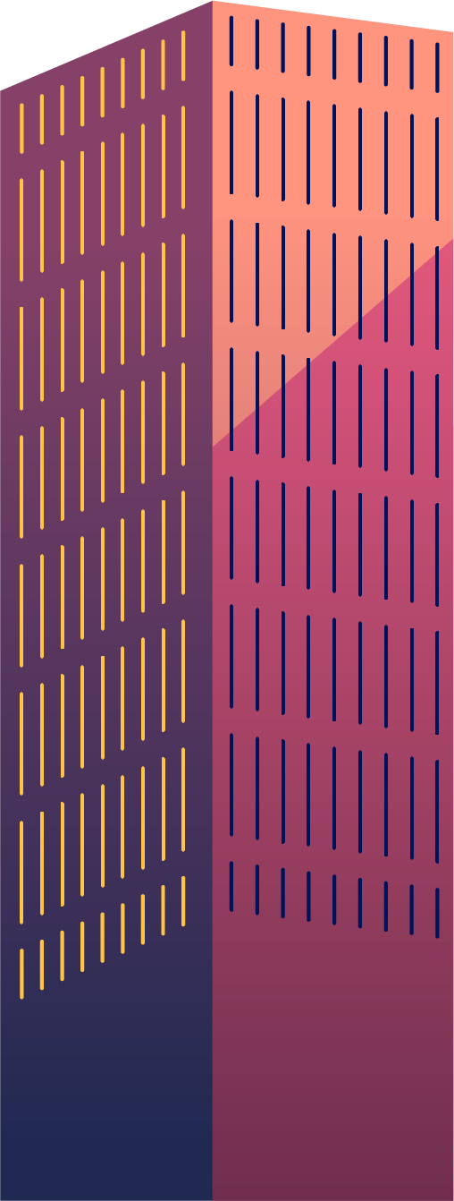
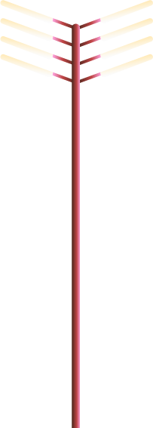
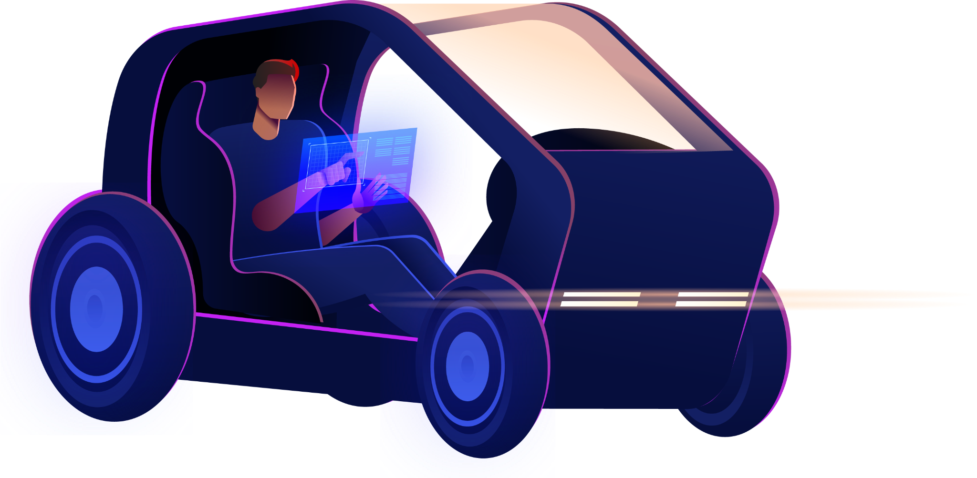

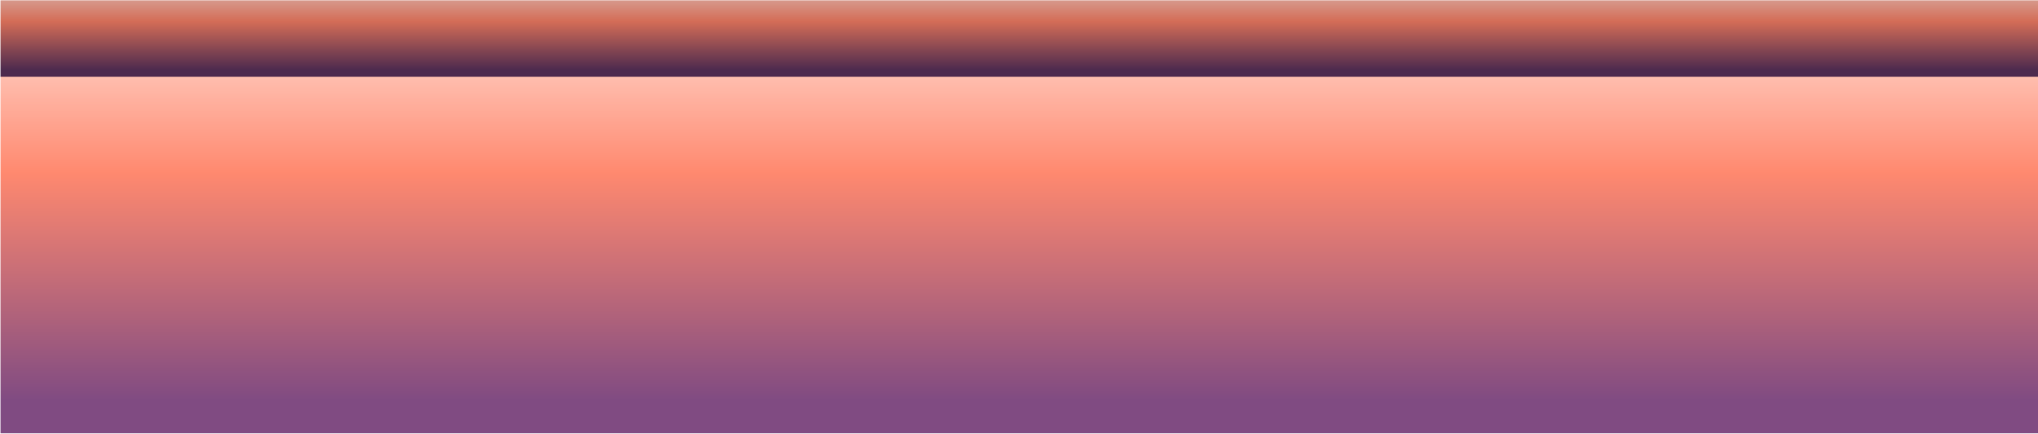
Vehicle Price Prediction in Australia
Group 1:
Zonia Quiroga
Julian Ravelo

Slide 2
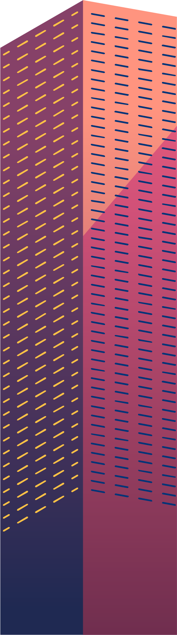
Table of contents
01
04
02
05
03
06
Introduction
Supervised learning
Resources
Web application
Data engineering
Conclusion

Slide 3
Introduction
Overview
Objective
Using a dataset with prices of vehicles sold in Australia since 2023 found in Kaggle, we aimed to create a website that allowed users to search for specific car details and get an estimated price for the car. Behind this website, we are running a Decision Tree Regressor model and a Random Forest Regressor model from the Scikit Learn Python library that predicts car prices depending on the historical prices of cars sold. Additionally, the website shows insights into the dataset used as a reference for the user regarding the truthfulness of the price predicted depending on their specific context.
Allow car buyers to validate the fairness of the price of a car they are aiming to buy based on historical prices of cars sold in 2023.

Slide 4

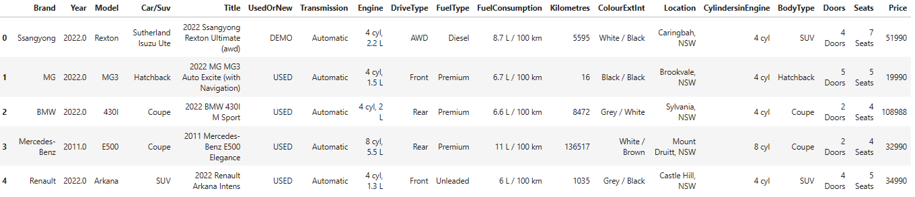
Resources
The dataset contains the latest information on car prices in Australia for 2023. The dataset includes information such as brand, year, model, used/new, transmission, engine, kilometres, location, and price. The dataset has over 16,000 records of car listings from various online platforms in Australia.

Slide 5

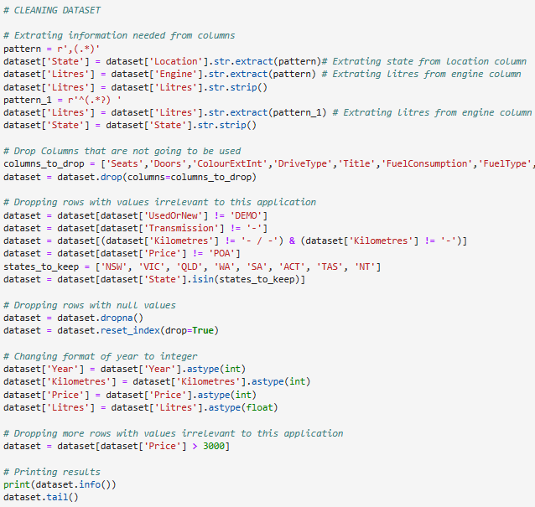
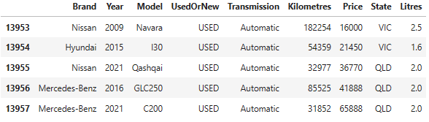
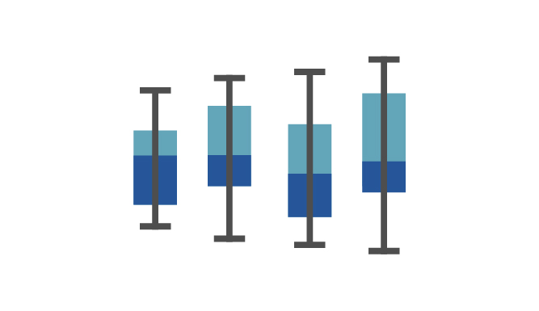
Data Engineering

Slide 6


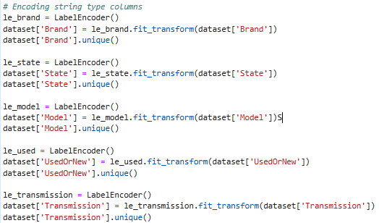
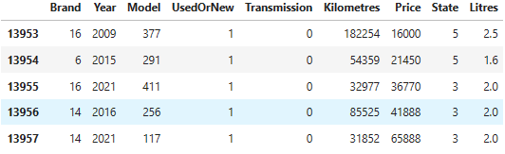
Data Engineering

Slide 7
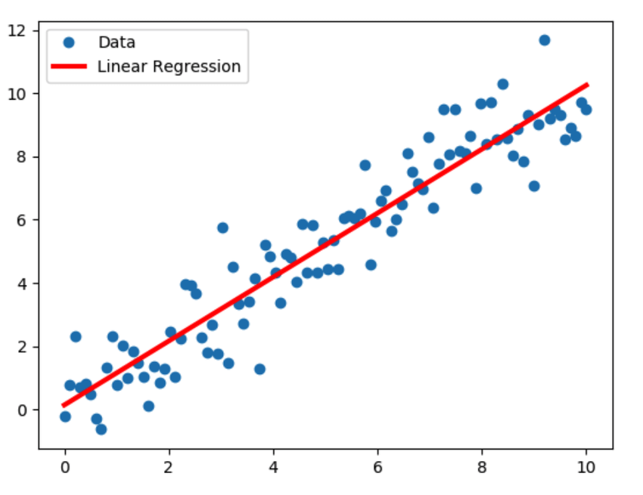
Supervised learning
1. Linear Regression Model
Linear Regression Model
Score:
57.60%
RMSE:
$9,808.92
STD:
$15,064.59

Slide 8
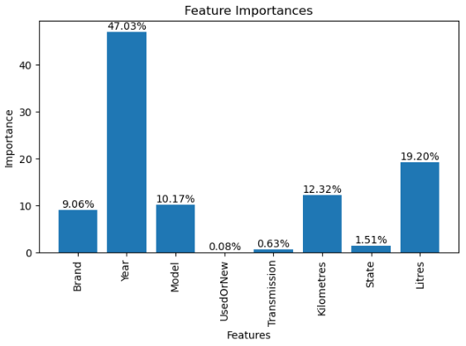
Supervised learning
2. Decision Tree Regressor Model
Decision Tree Regressor
Score:
99.94%
RMSE:
$338.06
STD:
$15,064.17

Slide 9
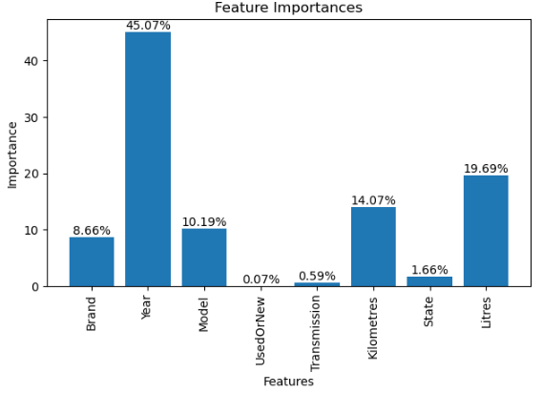
Supervised learning
3. Random Forest Regressor Model
Decision Tree Regressor
Score:
98.18%
RMSE:
$2,032.14
STD:
$15,064.17

Slide 10

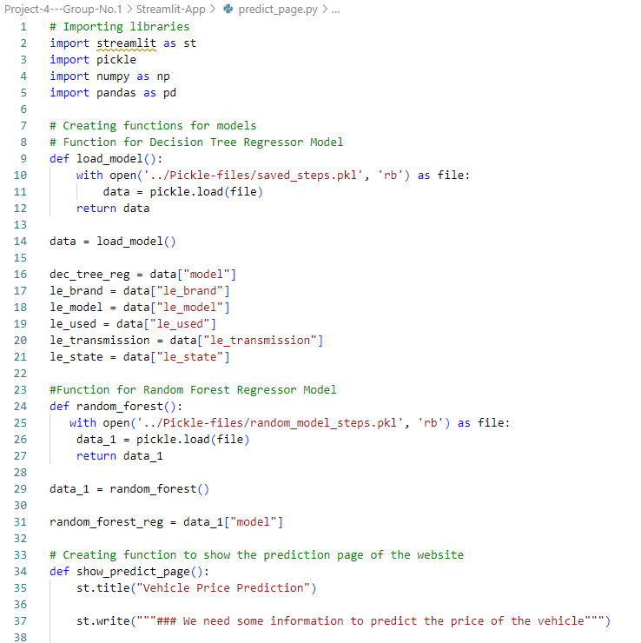
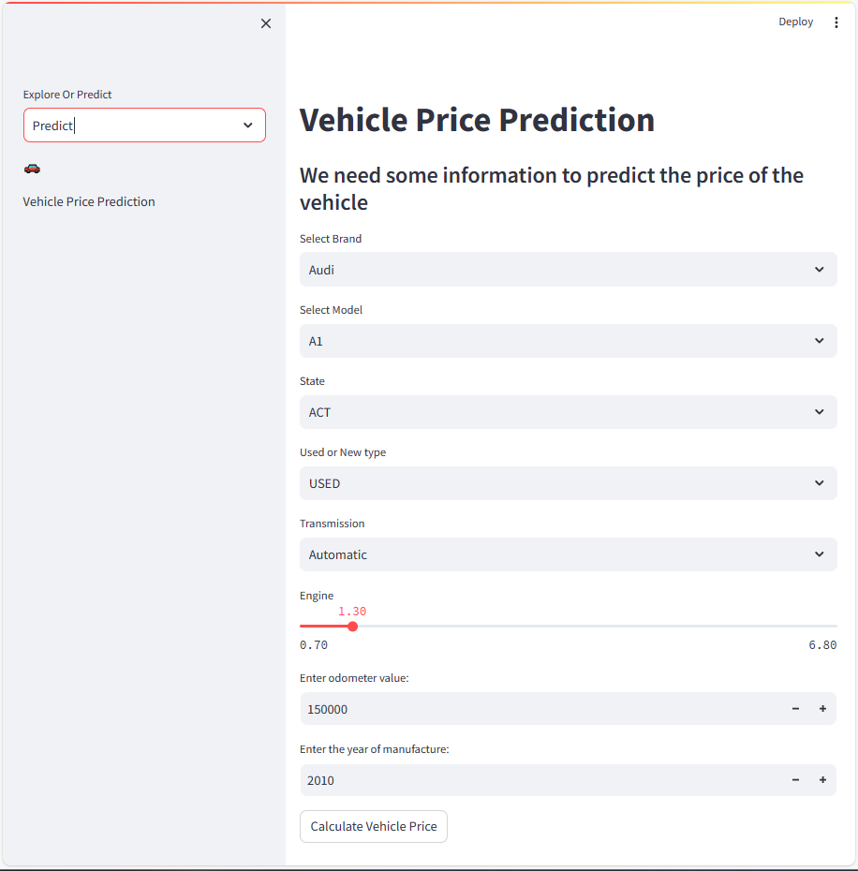
Web application
Predict page: Main page to allow users to input values of the possible car to buy and check the predictions of the model.

Slide 11
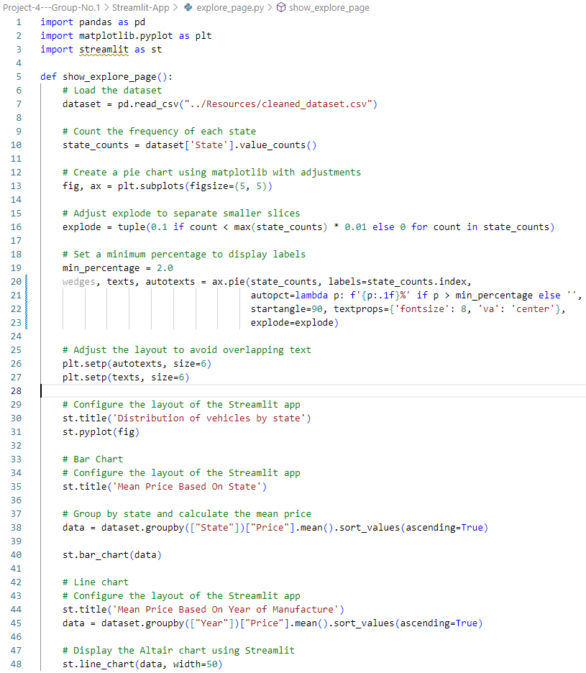
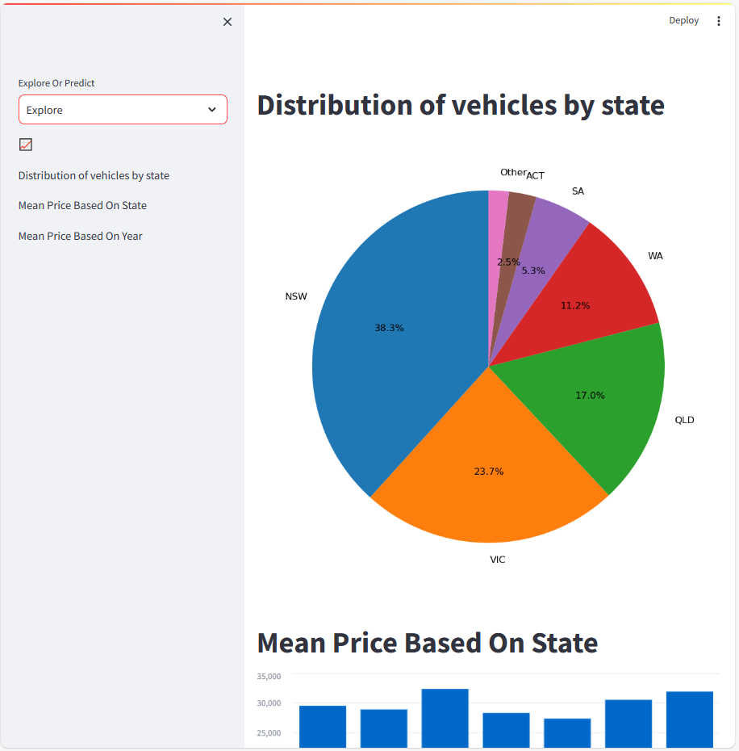
Web application
Explore page: Graphs showing demographics of the dataset used.

Slide 12
Conclusions
The Decision Tree Regressor model and the Random Forest Regressor model allowed us to predict vehicle prices based on a dataset with the latest information on car prices in Australia for 2023.
Even though the predictions showed scores of 99% and 98% for both models respectively, the mean squared error is significantly different ($338 and $2053) and might be relevant when buying cars with a low budget (below $10,000).
The main feature used by both models is the year of manufacture (almost 50%), followed by engine, kilometres, model and brand in that order. It is debatable as when buying a car in real life, features like "Used or New" or "Transmission" of the car tend to change the price of a car, but they are not used by the models.

Slide 13

Thanks!
Do you have any questions?

