Slide 1
Multi-Intent Natural Language Understanding
2019.4.19
朱祺

Slide 2
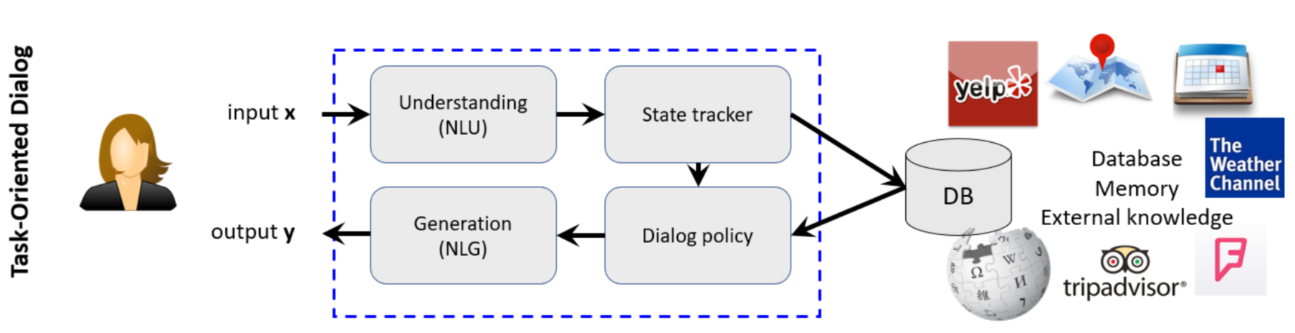
Introduction
Natural language understanding.
Input: user utterance.
Ouput: dialog act, like ‘Hotel-Inform:[[Price, cheap], [Star, 4]]’.
Gao, J., Galley, M., & Li, L. (2018). Neural Approaches to Conversational AI. international acm sigir conference on research and development in information retrieval,, 1371-1374.

Slide 3
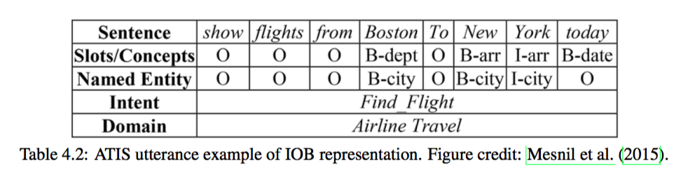
Introduction
Domain, Intent: sentence classification.
Slot-value: sequence tagging.
Gao, J., Galley, M., & Li, L. (2018). Neural Approaches to Conversational AI. international acm sigir conference on research and development in information retrieval,, 1371-1374.

Slide 4
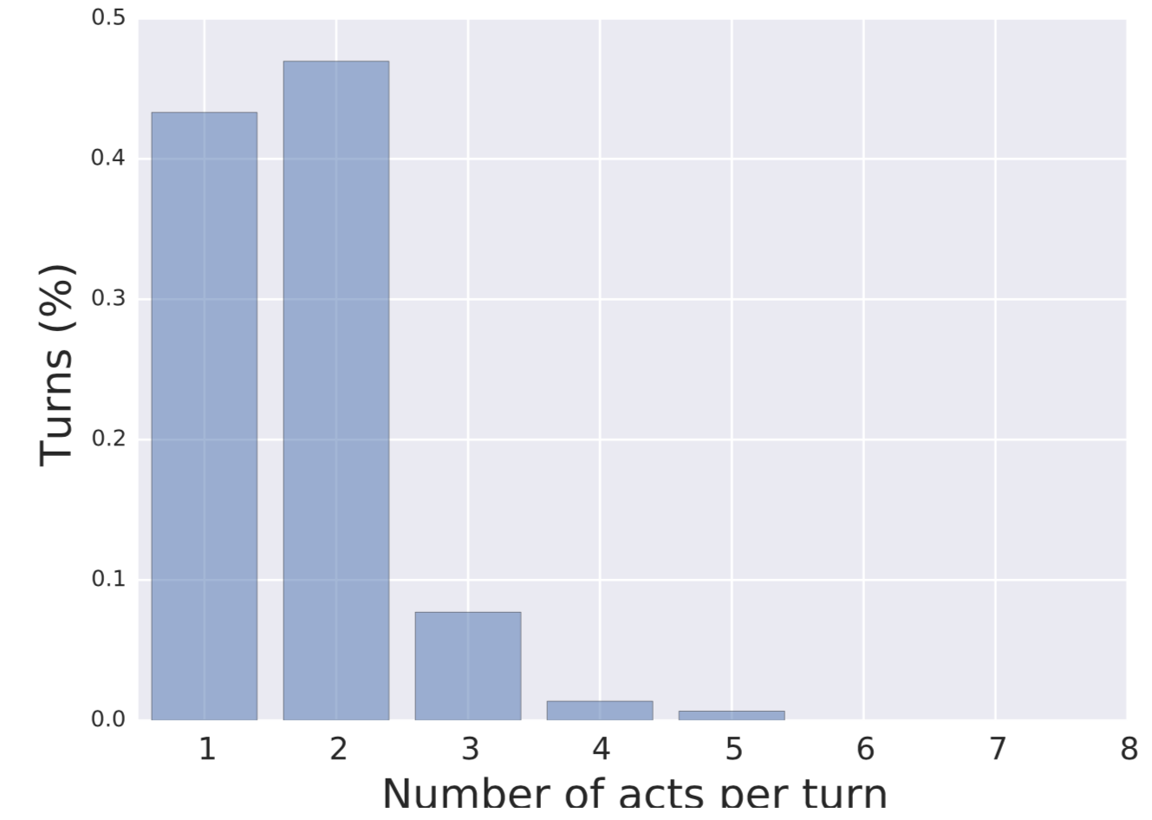
Dataset
Multiwoz
Large scale: 115,424 turns (5 times the size of others)
Complicate dialog act
>50% of utterance have >1 dialog acts
Others: one dialog act per utterance
31 intent, 200+ (intent, slot)

Slide 5
Dataset
Example
Yes I have pizza hut city centre located at regent street city centre . Would you like to make a table reservation ?
Restaurant-Inform, Name
Restaurant-Inform, Area
Booking-Inform

Slide 6
Related Works
SVM NLU (2009, 2012): Multiple independent classifiers on n-grams features.
JointNLU (2016): RNN/RNN+CRF. Joint model for Intent classification and slot tagging.
Seq2Seq (2014): generate serialized dialog act.

Slide 7
Baseline
 | Precision | Recall | F1
SVM | 0.81 | 0.47 | 0.60
Seq2Seq | 0.68 | 0.67 | 0.68
Copy | 0.70 | 0.69 | 0.69
JointNLU | 0.80 | 0.65 | 0.72
LSTM-CRF | 0.79 | 0.73 | 0.76

Slide 8
Model
Multi-Intent => Segment + Single-Intent
Segment:
Initial: split by period(.)
Single-Intent:
Slot-tagging for slot-value detection: LSTM+CRF
Intent classification: use golden slot label and word embedding as segment RNN input.
Max-pooling over segments to get multi-intent prediction.
Challenge: no segment label

Slide 9
Model
Multi-Intent => Segment + Single-Intent
Joint learning or iterative ?
Joint learning: how to BP? (Gumbel softmax?)
Iterative: RL (fix classifier) (Ask Gaoxin)
Related works of semantic segmentation in CV ?

