Slide 1
MACHINE LEARNING · COURSE 5787
Introduction to AI
From rule-based programs to machines that learn — and generate
Lecture 1 · Opening lecture
Anna Levant PhD

Slide 2

YOUR INSTRUCTOR
Anna Lea Levant, PhD
Algorithm group manager at Applied Materials.
20 years in hi-tech — 10 of them in medical image and signal processing.
PhD in Applied Mathematics, Weizmann Institute of Science.
Teaching AI seminars for 7 years.
Mother of five sweet kids.
GET IN TOUCH
rapanya@gmail.com
Machine Learning · Course 5777 · Anna Levant PhD
2

Slide 3
AGENDA
What we'll cover today
01
AI is everywhere
02
What is AI, really?
Where AI already touches medicine, driving, finance and creative work.
AI, machine learning and deep learning — the nesting and the timeline.
03
The three ways to learn
04
Why deep learning, now
Supervised, unsupervised and reinforcement learning, with quizzes.
Data, GPUs, ImageNet — the three things that had to arrive first.
05
Inside a neural network
06
Generative AI
An intuition for layers, weights and why depth buys you power.
From recognising patterns to creating new content — and what's still hard.
Machine Learning · Course 5777 · Anna Levant PhD
3

Slide 4
THE YEAR AHEAD
Where today sits in the course
BLOCK ONE · MACHINE LEARNING
Small data, hand-chosen features, methods you can inspect
01
Regression
02
Classification
03
Unsupervised
Linear, multi-linear and polynomial. Predicting a number, and the idea of fitting.
Predicting a category. Decision boundaries, and how we measure being right.
PCA and clustering. Finding structure when nobody supplies the answers.
BLOCK TWO · DEEP LEARNING & COMPUTER VISION
Large data, learned features, and the models behind today's systems
01
02
03
04
05
06
07
CV basics
FNN
CNN
YOLO & U-Net
GANs
Transformers
Multimodal
Filters, edges, convolution
The feed-forward network
Convolutional networks
Detection, segmentation
Generative models
NLP and vision
Text, image, audio together
Today is the map, not the territory — every box above gets its own lecture. Nothing today will be assessed; everything today will be assumed.
Machine Learning · Course 5777 · Anna Levant PhD
4

Slide 5
BEFORE WE START
What I will assume you already know
Linear algebra
Calculus
Probability
Python
Vectors and matrices, and how to multiply them
Transpose, inverse, dot product, norms
Eigenvalues and eigenvectors
Reading an equation written in matrix form
Derivatives
Mean, variance, standard deviation
The normal distribution
Functions, loops, lists — fluently
NumPy arrays and vectorised operations
Plotting with matplotlib
Jupyter notebooks — we use them throughout
WHAT YOU DO NOT NEED
Any previous machine learning
Any experience with neural networks
The ability to prove theorems
We start from zero. That is the point of Lecture 1.
You will build your first one in this course, not before it.
We use the mathematics. We do not derive it from first principles.
Machine Learning · Course 5777 · Anna Levant PhD
5

Slide 6
PRACTICALITIES
How the course runs, and how it is graded
EVERY WEEK
ALONG THE WAY
AT THE END
Two hours of theory
Homework + two surprise tests
One exam per semester
Taught by me, in person. This is where the ideas are introduced — the homework is where they become yours.
Regular problem sets across the semester, plus two unannounced multiple-choice tests. Come to class prepared.
A written exam closing each semester, covering everything from that half of the course.
YOUR FINAL GRADE
30%
Homework
25%
Tests
50%
Exam
Accumulated across the problem sets — the half of your grade you control week by week.
Sat at the end of each semester — the half that rewards understanding, not recall.
The homework is not optional and it is not busywork — it is half your grade, and it is where the learning actually happens.
Machine Learning · Course 5777 · Anna Levant PhD
6

Slide 7
PART I
WHERE YOU ALREADY MEET IT
AI is everywhere
Medicine, driving, money, art
Machine Learning · Course 5777 · Anna Levant PhD
7

Slide 8

AI IS EVERYWHERE · CREATIVE WORK
Type a sentence, get a picture
THE PROMPT
“Ten Jewish men in different clothes, kippot of different sizes and styles, some with a shtreimel. The camera looks at them from behind. They stand on the edge of a cliff, looking at Jerusalem in the distance. Watercolour style. Hands on each other's shoulders. Make some of them younger, and make them inspired.”
Generated by Gemini 3 from the prompt on the left
Nobody drew this. A model was asked, in plain language, and it produced something that had never existed.
Machine Learning · Course 5777 · Anna Levant PhD
8

Slide 9

AI IS EVERYWHERE · CREATIVE WORK
And now the picture moves
THE INSTRUCTION
“Make the men hug each other and dance around.”
That is the entire input. No keyframes, no rigging, no animator.
WHY IT MATTERS
Three years ago this was science fiction
Text-to-video went from unusable to convincing faster than almost any technology in computing history. Understanding how that happened is what this course is about.
Generated by Gemini 3 — the still image above, animated from a one-line instruction
The tools change every few months. The ideas underneath them change very slowly — so we will learn the ideas.
Machine Learning · Course 5777 · Anna Levant PhD
9

Slide 10
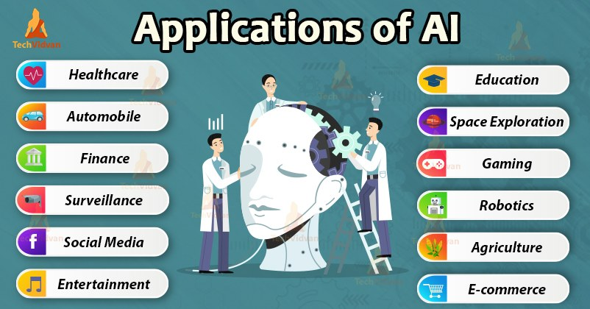
AI IS EVERYWHERE
It is already in the ordinary parts of the day
Healthcare
Screening, diagnosis, treatment design
Mobility
Perception and control in self-driving cars
Finance
Credit scoring, fraud detection, trading
Everyday apps
Search, translation, recommendations, photos
A partial map — and it grows every year
We will look at three of these closely — because in each one, the same handful of ideas is doing the work.
Machine Learning · Course 5777 · Anna Levant PhD
10

Slide 11
AI IS EVERYWHERE · 01
Healthcare: finding what a human might miss
THE PROBLEM
WHAT AI ADDS
BEYOND DIAGNOSIS
Cancer is still hard to catch early
A second reader that never tires
Designing the treatment too
Detection depends on a specialist noticing a small, ambiguous pattern in a large image — under time pressure, thousands of times a year.
Models now assist screening for prostate and cervical cancer, flagging suspicious regions for a clinician to confirm.
The same modelling approach is being used to search for candidate drugs and to personalise treatment plans.
Consistency
Seconds
24/7
the model reads the ten-thousandth scan exactly as carefully as the first
for a model to review a scan that takes a specialist minutes
availability — the constraint becomes review capacity, not reading capacity
The point is not that the machine is smarter. It is that it is consistent, and it scales.
Machine Learning · Course 5777 · Anna Levant PhD
11

Slide 12
AI IS EVERYWHERE · 02
Autonomous vehicles: sensing, then understanding
1
2
3
4
SENSE
›
FLOOD
›
UNDERSTAND
›
ACT
Cameras, radar, lidar, GPS and inertial sensors, all running at once.
Those sensors produce gigabytes per hour. No human could read it live.
Models turn raw signal into objects, lanes, intentions and risk.
Steering, braking and acceleration decisions, many times per second.
A car does not need to be intelligent. It needs to be right about the next two seconds, every two seconds.
We will come back to this in the computer-vision lectures — object detection is exactly this problem.
Machine Learning · Course 5777 · Anna Levant PhD
12

Slide 13
AI IS EVERYWHERE · 03
Finance: a number that decides your loan
WHAT GOES IN
CREDIT SCORE
Work history
How long, how stable, which sector
300 – 850
Total income
And how reliably it arrives
A single number that stands in for “how likely is this person to repay?” The higher it is, the cheaper money becomes for you.
Transaction patterns
What you spend on, and when
It is produced by a mathematical model — not by a person reading your file.
Existing obligations
Loans, cards, payment history
Which raises the question we will keep returning to: if a model refuses you, can anyone explain why?
Machine Learning · Course 5777 · Anna Levant PhD
13

Slide 14
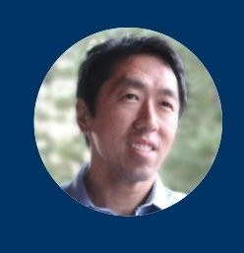
FRAMING
“AI is the new electricity”
“Just as electricity transformed almost everything 100 years ago, today I actually have a hard time thinking of an industry that I don't think AI will transform in the next several years.”
Andrew Ng — former chief scientist at Baidu, co-founder of Coursera
General-purpose
Like electricity, it isn't one product — it's an input to almost every product.
Invisible when it works
You don't think about the grid. Soon you won't think about the model either.
Slow, then sudden
Decades of groundwork, then a decade where everything changes at once.
Machine Learning · Course 5777 · Anna Levant PhD
14

Slide 15

PART II
DEFINITIONS BEFORE DEMOS
What is AI?
Or: where does the magic actually live?
Machine Learning · Course 5777 · Anna Levant PhD
15

Slide 16
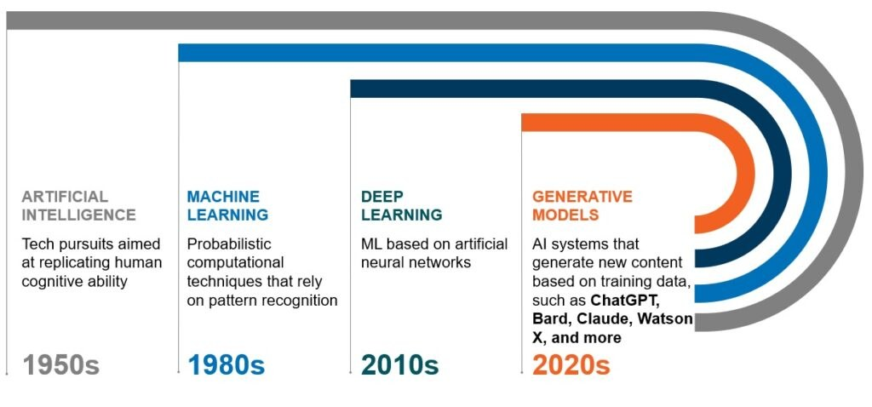
WHAT IS AI · TIMELINE
Four eras, each one built on the last
READ IT AS NESTING
Not four rivals
Deep learning is a kind of machine learning. Machine learning is a way of doing AI. Generative models are deep networks pointed at a new task.
Credit: CB Insights / CrossCountry Consulting
1950s
1980s
2010s
2020s
Artificial Intelligence
Machine Learning
Deep Learning
Generative Models
Any technique aimed at replicating human cognitive ability.
Probabilistic methods that rely on pattern recognition rather than rules.
Machine learning built on artificial neural networks, many layers deep.
Systems that generate new content — ChatGPT, Claude, Gemini, Midjourney.
Machine Learning · Course 5777 · Anna Levant PhD
16

Slide 17
WHAT IS AI · THE SHIFT
Traditional programming: a handcrafted recipe
INPUT
THE RECIPE
OUTPUT
Information
→
CODE
→
Answer
1 0 1 0 1 0
Written by a person, line by line
0 1 0 1 0 1
The person invents the recipe. The computer only follows it — quickly, and without ever improving it.
Works beautifully when
the rule is knowable: tax brackets, sorting, physics simulation.
Falls apart when
the rule exists but nobody can write it down — “is there a cat in this photo?”
Machine Learning · Course 5777 · Anna Levant PhD
17

Slide 18
WHAT IS AI · THE SHIFT
Machine learning: the machine finds the recipe
INPUT
THE LEARNER
OUTPUT
Examples
→
ML model
→
The recipe
Many pairs of (information, answer)
Adjusts itself until its answers match
A rule that also works on data it never saw
Your job stops being “write the rule” and becomes “find good examples, and check the rule that comes out.”
What you supply
Data, a model family, and a definition of what “wrong” means.
What you get back
Parameters — numbers that encode a rule nobody explicitly wrote.
Machine Learning · Course 5777 · Anna Levant PhD
18

Slide 19
THE WORDS WE WILL USE ALL YEAR
Eight terms, defined once
Feature
Label
Model
Parameters
One measured property of an example.
The correct answer for an example.
The rule that maps features to a prediction.
The numbers inside the model that training adjusts.
Height, pixel value, word count.
“Duck”. “Spam”. ₪1.4M.
A line, a tree, a network.
Slope and intercept. Weights.
Loss
Training
Inference
Generalisation
A number saying how wrong a prediction was.
Repeatedly adjusting parameters to reduce loss.
Using the trained model on new data.
Performing well on data never seen in training.
Small loss = good prediction.
The part that takes the GPU time.
The part that runs in production.
The only thing that actually matters.
If a sentence in this course confuses you, it is usually one of these eight words being used loosely. Ask.
Machine Learning · Course 5777 · Anna Levant PhD
19

Slide 20
PART III
SAME MACHINERY, DIFFERENT QUESTIONS
How machines learn
Supervised · Unsupervised · Reinforcement
Machine Learning · Course 5777 · Anna Levant PhD
20

Slide 21
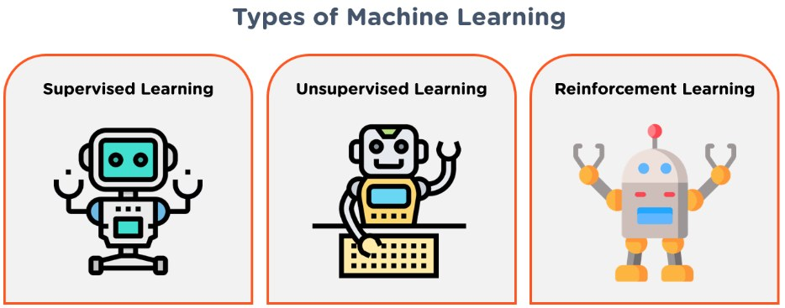
THREE WAYS TO LEARN
Three questions you can ask of data
Supervised
Unsupervised
Reinforcement
“Here are the answers — learn the pattern.”
“No answers — find the structure.”
“No answers — but I'll tell you how you did.”
Every training example carries a label. The model learns the mapping from input to label, then applies it to new inputs.
Only inputs, no labels. The model groups, compresses or ranks by similarity, and you interpret what came out.
An agent acts, receives reward or penalty, and updates its policy to maximise reward over time.
Machine Learning · Course 5777 · Anna Levant PhD
21

Slide 22
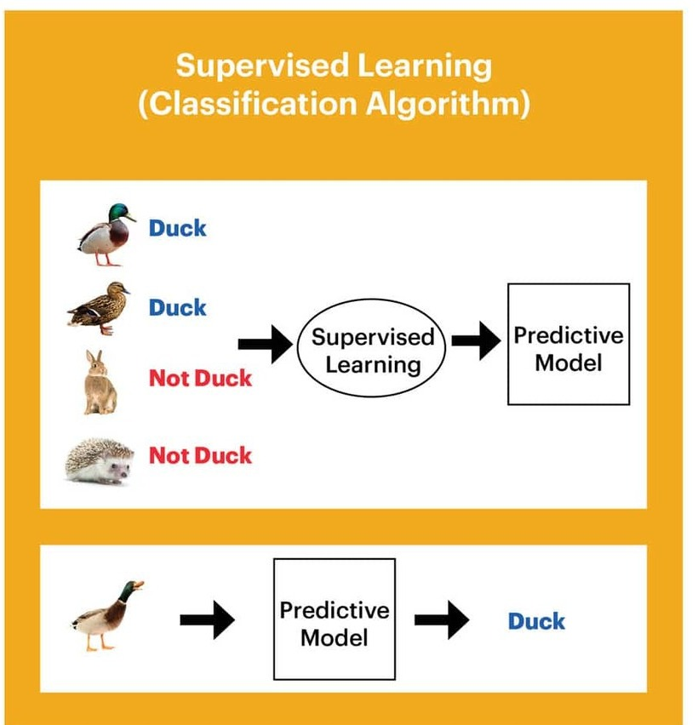
THREE WAYS TO LEARN · 01
Supervised learning: learning from labels
Every training example arrives with the right answer attached — “duck”, “not a duck”.
The model makes a guess, is told how wrong it was, and adjusts.
After enough examples it produces a predictive model.
That model is then shown data it has never seen, and must get it right.
CLASSIFICATION
REGRESSION
Which category?
How much?
Output is one of a fixed set of labels. Spam or not spam. Duck or not duck.
Output is a number on a continuous scale. Tomorrow's price. Next month's demand.
Diagram: Western Digital
Machine Learning · Course 5777 · Anna Levant PhD
22

Slide 23
THREE WAYS TO LEARN · 01
Where supervised learning shows up
01
Spam detection
02
Diabetes diagnostics
Millions of emails already marked spam or not. The label is free — users generated it.
Patient measurements paired with a confirmed diagnosis. Labels are expensive and expert-made.
03
Stock price prediction
04
Face recognition
History is the label: what actually happened next. Cheap labels, very noisy signal.
Photos tagged with identity. The label comes from people tagging their own photos.
In every case the hard part is not the algorithm. It is getting labels that are plentiful, correct and unbiased.
Machine Learning · Course 5777 · Anna Levant PhD
23

Slide 24
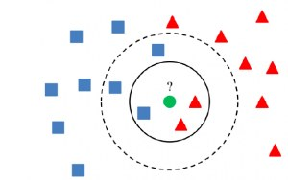
THREE WAYS TO LEARN · 01
The simplest classifier there is
age
Plot every labelled example as a point — here, height against age.
A new, unlabelled point arrives. We want to know its class.
Look at its k closest neighbours and take a vote.
That's it. No training phase, no parameters to fit.
d(xᵢ, xⱼ) = √( (a1 − a2)² + (h1 − h2)² )
The whole method rests on one choice: what “close” means. Change the distance and you change the classifier.
■ boys
■ girls
height
Machine Learning · Course 5777 · Anna Levant PhD
24

Slide 25
THE RULE THAT MATTERS MOST
Never test on what you trained on
Training 70%
Validation 15%
Test 15%
One dataset, split once, before you look at any of it.
Training set
Validation set
Test set
The model sees these examples and adjusts its parameters to fit them. This is the only data it learns from.
Used while you develop — to choose k, or the depth, or how long to train. The model never learns from it, but you do.
Locked in a drawer until the very end. Touched once. The moment you tune against it, it stops being a test.
OVERFITTING
Memorising instead of learning
Training error
Test error
The gap between them
keeps falling
starts rising
is the diagnosis
A model with enough parameters can reproduce its training set perfectly — and still be useless.
Every method in this course — regression, trees, CNNs, transformers — can overfit. The defences differ; the disease is the same.
Machine Learning · Course 5777 · Anna Levant PhD
25

Slide 26
QUIZ 1
Which of these is a supervised problem?
a
Given a history of houses — number of rooms, district, year built — and the prices they sold for, predict the price of the house you want to sell.
b
You have a set of photos with information about what is in them, and you train a model to recognise what is in new photos.
c
Given a set of images of different shapes, cluster them into triangles, ovals and rectangles.
Machine Learning · Course 5777 · Anna Levant PhD
26

Slide 27
QUIZ 1 · ANSWER
Both (a) and (b) — and here is why (c) is not
a
Regression. Every past house comes with the price it actually sold for. That price is the label, and we predict a number.
SUPERVISED
b
Classification. Each photo carries information about what is in it. That information is the label, and we predict a category.
SUPERVISED
c
No labels anywhere. Nobody says “this one is a triangle” — the algorithm must discover the groups itself. That is clustering.
UNSUPERVISED
Machine Learning · Course 5777 · Anna Levant PhD
27

Slide 28
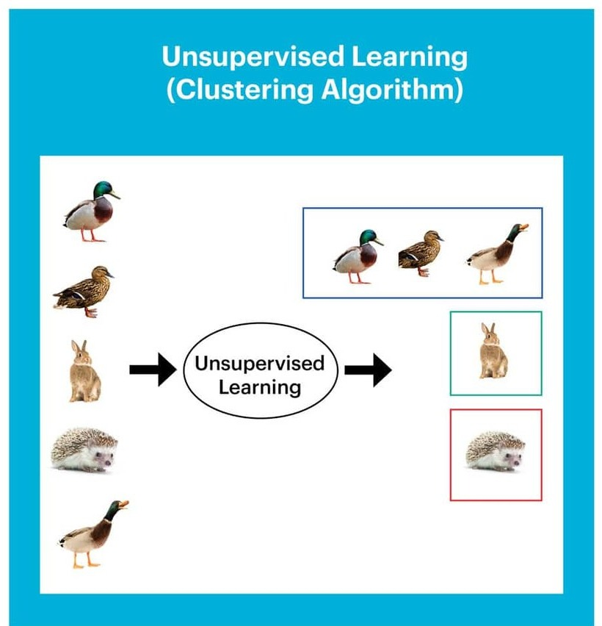
THREE WAYS TO LEARN · 02
Unsupervised learning: structure without answers
No labels at all — just a pile of inputs.
The model groups things that resemble each other.
It never learns the word “duck”. It learns that these five things belong together.
Naming the clusters is your job, not the model's.
CLUSTERING
DIMENSIONALITY REDUCTION
Which things go together?
What can we throw away?
Group by similarity. Customer segments, article topics, cell types.
Describe the data with fewer numbers while keeping what matters.
Diagram: Western Digital
Machine Learning · Course 5777 · Anna Levant PhD
28

Slide 29
THREE WAYS TO LEARN · 02
Where unsupervised learning shows up
01
Recommendation engines
02
Data compression
Group users who behave alike, then suggest what the rest of the group enjoyed.
Find the few dimensions that carry most of the signal, and drop the rest.
03
Customer segmentation
04
Fraud detection
Discover the segments that actually exist in your data — not the ones marketing assumed.
Learn what normal looks like, then flag the transactions that don't fit it.
Unsupervised results are proposals, not verdicts. Someone still has to decide whether a cluster means anything.
Machine Learning · Course 5777 · Anna Levant PhD
29

Slide 30
QUIZ 2
Which of these is an unsupervised problem?
a
Given emails labelled as spam or not spam, learn a spam filter.
b
Given a set of news articles found on the web, group them into sets of articles about the same story.
c
Given a dataset of patients diagnosed as either having diabetes or not, learn to classify new patients.
Machine Learning · Course 5777 · Anna Levant PhD
30

Slide 31
QUIZ 2 · ANSWER
Only (b) — the other two arrive with labels
a
The emails are already marked spam or not spam. A label is present, so this is supervised classification.
SUPERVISED
b
Nobody has told us which stories exist. The algorithm must find that articles cluster around the same event, on its own.
UNSUPERVISED
c
Each patient already carries a confirmed diagnosis. Again a label, again supervised classification.
SUPERVISED
Machine Learning · Course 5777 · Anna Levant PhD
31

Slide 32
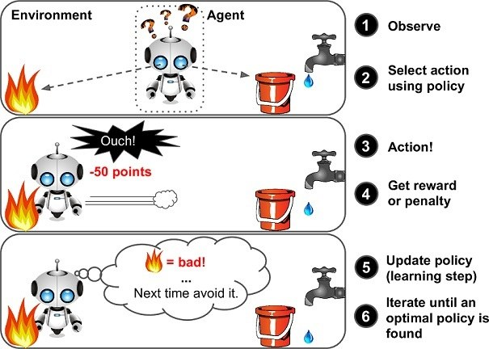
THREE WAYS TO LEARN · 03
Reinforcement learning: learning by consequence
An agent takes actions in an environment in order to maximise cumulative reward.
1
Observe
Read the current state of the world.
2
Act
Choose an action according to the current policy.
3
Get reward
A number: good, bad, or nothing at all.
4
Update
Shift the policy toward actions that paid off.
Repeat until the policy stops improving. Nobody ever showed the agent a correct answer — only a score.
Machine Learning · Course 5777 · Anna Levant PhD
32

Slide 33
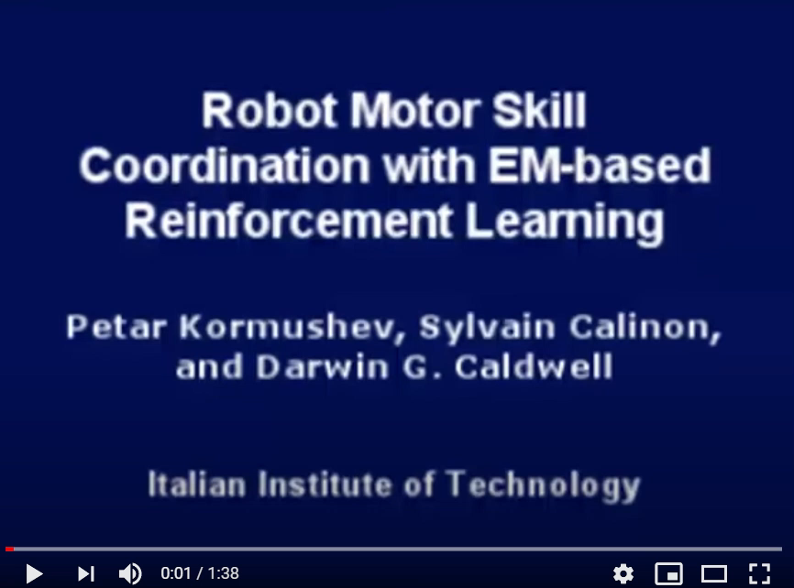
THREE WAYS TO LEARN · 03
A robot that learns to flip pancakes
THE TASK
One motion, wildly unforgiving
Toss height, wrist rotation and catch timing all have to be right together. Being close is being wrong.
WHY NOT JUST PROGRAM IT?
Because dough is not a rigid body
The physics changes with every pancake. A fixed trajectory works once and then stops working.
WHAT IT DOES INSTEAD
About 50 attempts
Kormushev, Calinon & Caldwell — Italian Institute of Technology
It tries, drops the pancake, gets a low reward, and adjusts. Success comes from failure, cheaply repeated.
Machine Learning · Course 5777 · Anna Levant PhD
33

Slide 34
QUIZ 3
Which of these is a reinforcement problem?
a
Predict a stock price based on its price history.
b
Given a photo album of hundreds of photographs, identify those that include the same person.
c
Teach a computer to play “damka” (checkers).
Machine Learning · Course 5777 · Anna Levant PhD
34

Slide 35
QUIZ 3 · ANSWER
Only (c) — the only one with a reward, not an answer
a
Regression on historical prices. The “right answer” is what the price actually did next, so the label exists in the data.
SUPERVISED
b
Grouping photos by person. Unsupervised if the identities are unknown, supervised if the photos are already tagged — either way, no reward signal.
NOT REINFORCEMENT
c
Nobody can label the correct move in every position. The agent plays, wins or loses, and shifts its policy toward moves that won.
REINFORCEMENT
Machine Learning · Course 5777 · Anna Levant PhD
35

Slide 36
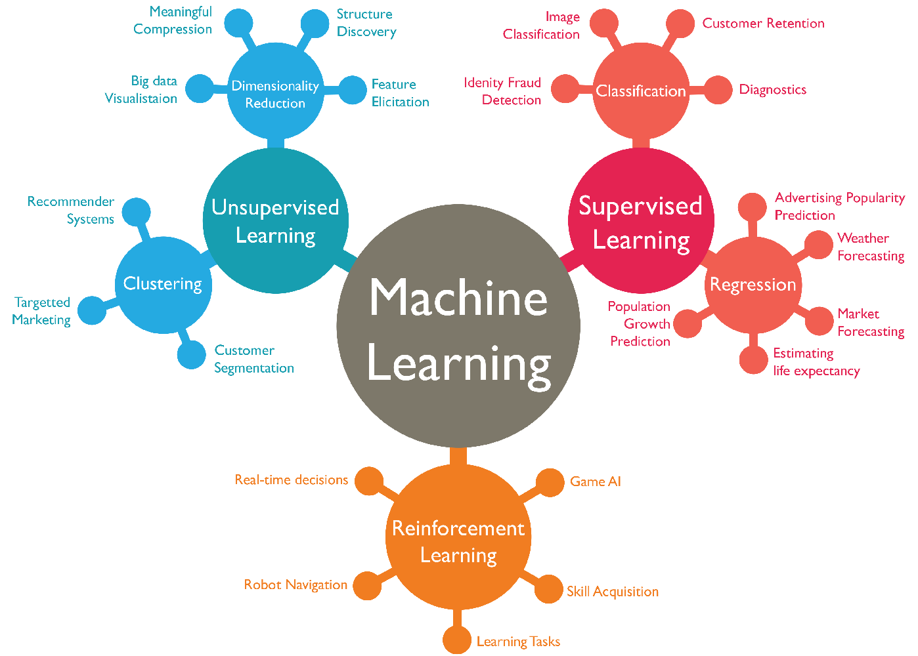
THREE WAYS TO LEARN
The whole landscape, on one page
Machine Learning · Course 5777 · Anna Levant PhD
36

Slide 37
PART IV
THE IDEA IS OLD — THE RESULTS ARE NOT
Why deep learning, and why now?
Three things had to arrive first
Machine Learning · Course 5777 · Anna Levant PhD
37

Slide 38
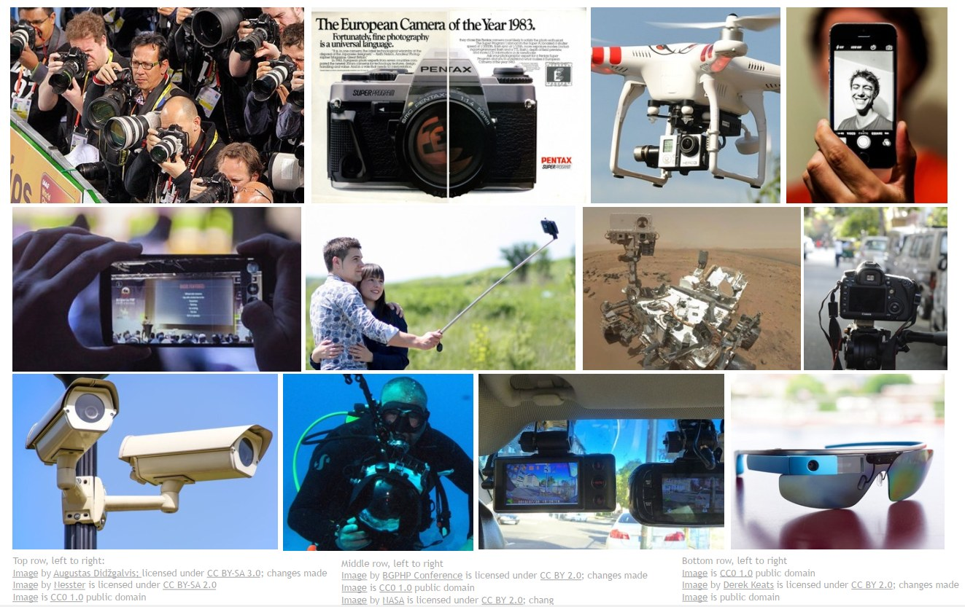
WHY NOW · 01 DATA
How many images are taken today?
Every one of these is a sensor.
Phones, dashcams, security cameras, drones, microscopes, satellites, glasses. Each of them produces training data, whether or not anyone intended it to.
Slide credit: CS231n, Stanford University
Machine Learning · Course 5777 · Anna Levant PhD
38

Slide 39
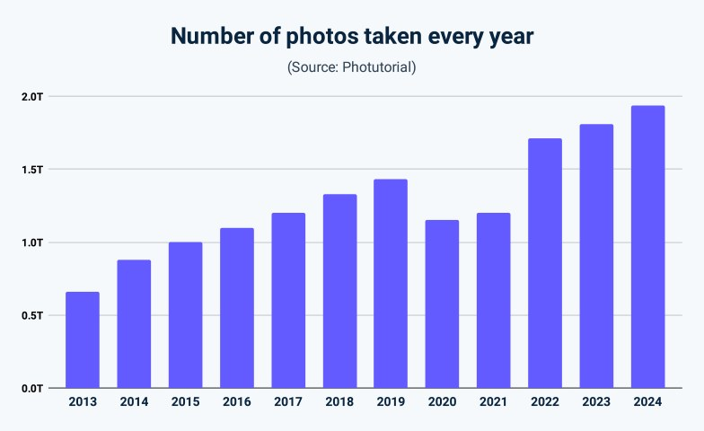
WHY NOW · 01 DATA
The numbers are hard to hold in your head
1.93T
5.3B
12.4T
94%
photos taken worldwide in 2024
photos per day — 61,400 every second
photos in existence, in total
of them taken on a smartphone
Roughly 136 billion images are indexed by Google Image Search.
The average person in the US takes about 20 photos a day.
None of this existed when neural networks were first proposed.
Deep learning is data-hungry. For the first time in history, we are not short of data.
Number of photos taken every year (source: Photutorial)
Machine Learning · Course 5777 · Anna Levant PhD
39

Slide 40
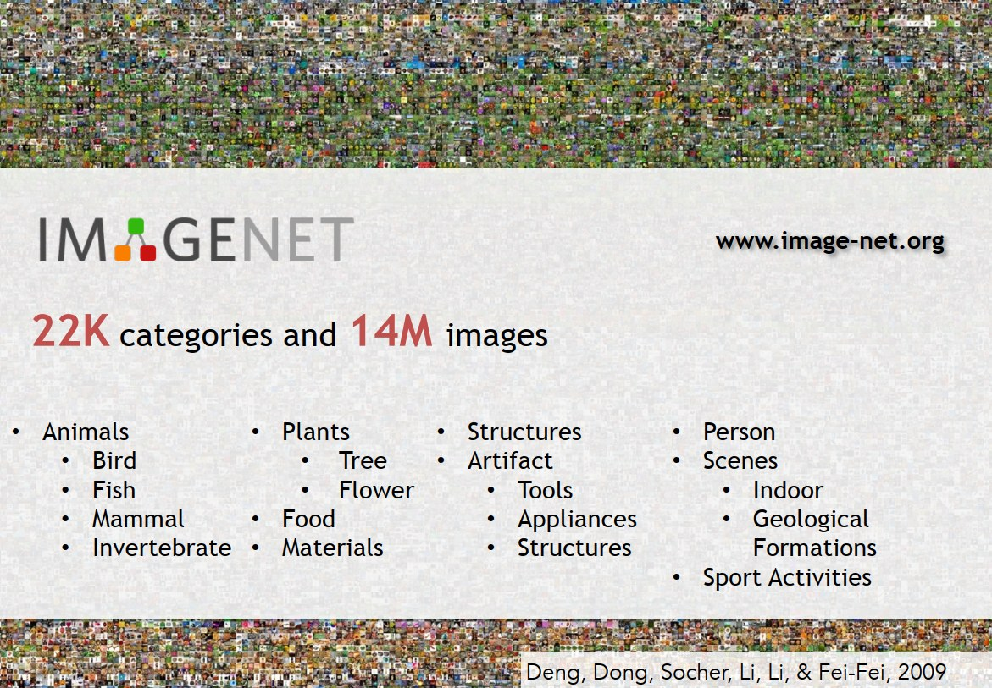
WHY NOW · 01 DATA
ImageNet: someone had to label it all
22,000 categories. 14 million labelled images.
Assembled by crowdsourcing the labelling, over years.
Animals, plants, food, tools, structures, scenes, appliances, sport.
Free to download, for anyone, anywhere.
WHY THIS MATTERED
A shared, honest scoreboard
Before ImageNet, every group tested on its own data and everyone claimed to be winning. A common benchmark made progress measurable — and made it obvious when something genuinely worked.
Deng, Dong, Socher, Li & Fei-Fei, 2009
Machine Learning · Course 5777 · Anna Levant PhD
40

Slide 41
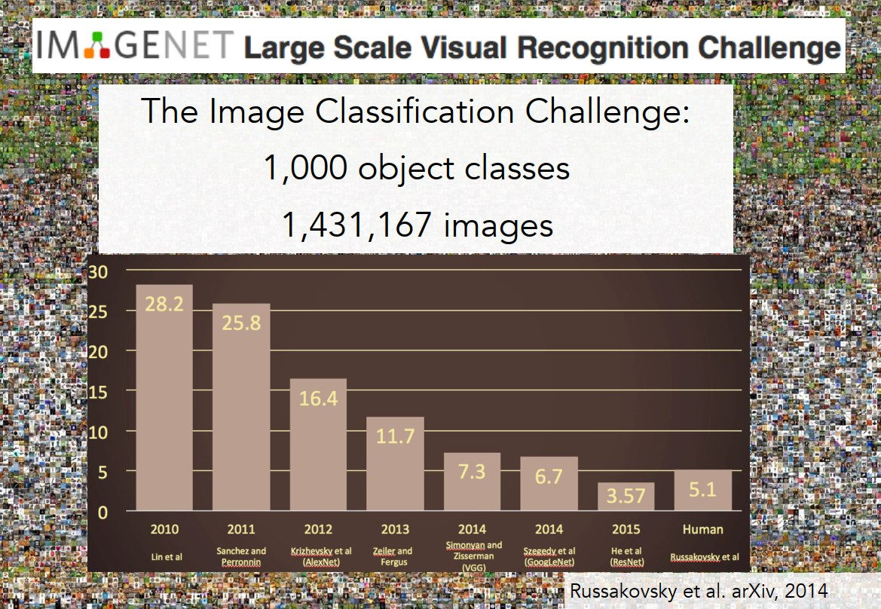
WHY NOW · 01 DATA
What happened here?
1,000 classes.
1,431,167 images.
One error rate.
2012
The year the bar drops off a cliff — and never comes back up.
That is the moment a deep convolutional network entered the competition. Ask the room what changed before you answer.
Russakovsky et al., arXiv 2014
Machine Learning · Course 5777 · Anna Levant PhD
41

Slide 42
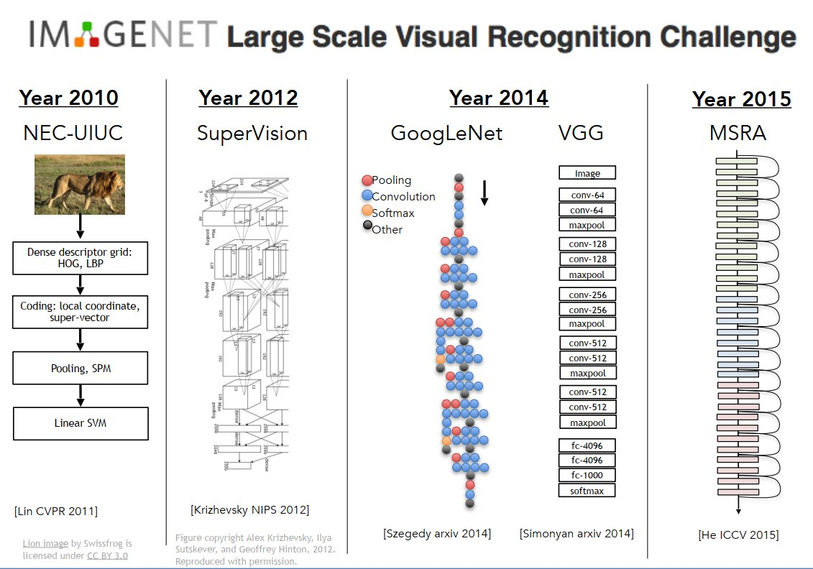
WHY NOW · 01 DATA
Five years, five architectures, one benchmark
2010: hand-designed features, shallow classifier.
2012 — SuperVision (AlexNet): deep, and it wins.
2014 — GoogLeNet and VGG: deeper still.
2015 — MSRA (ResNet): depth stops being a problem to solve.
Notice what does not change: the data, the task, the metric. Only the architecture.
Slide credit: CS231n, Stanford University
Machine Learning · Course 5777 · Anna Levant PhD
42

Slide 43
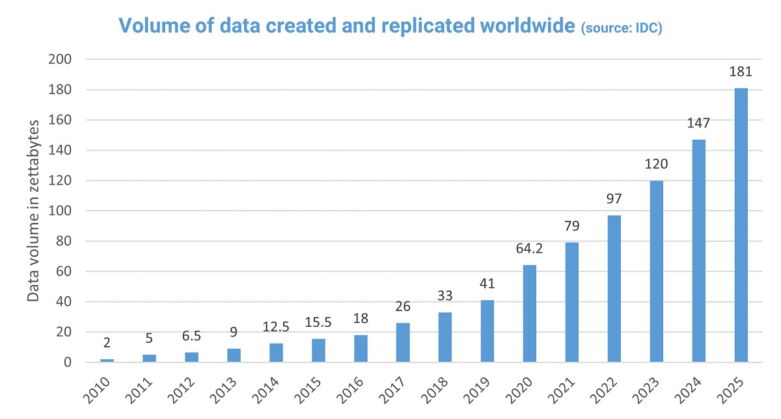
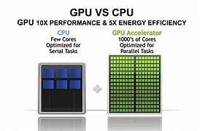
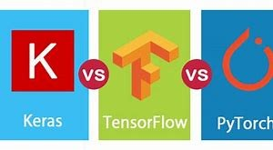
WHY NOW · SUMMARY
Three things had to arrive at once
Data
Hardware
Software
Volume of data created worldwide, in zettabytes
GPUs and TPUs
Keras, TensorFlow, PyTorch
The digital era produced the fuel. Images, video, text and sensor readings, in quantities that make deep networks trainable.
Graphics cards turned out to be built for exactly the parallel arithmetic that neural networks need. Training went from months to hours.
Open-source frameworks put a working deep-learning stack on any laptop, for free. The barrier to entry collapsed.
Plus two more that are easy to forget: algorithmic advances (backpropagation, better optimisers) and sustained investment.
Machine Learning · Course 5777 · Anna Levant PhD
43

Slide 44
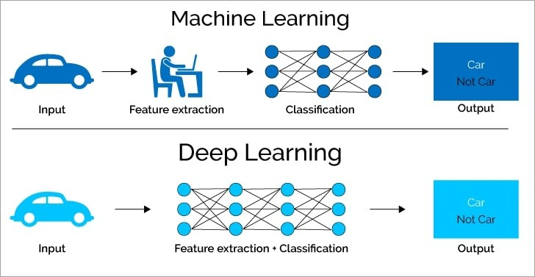
MACHINE LEARNING VS DEEP LEARNING
The difference is who finds the features
MACHINE LEARNING
You choose the features
A person decides what the model should look at — edges, colours, ratios — and the model learns to combine them.
DEEP LEARNING
The model finds them
Feature extraction and classification are learned together, from raw pixels. Nobody says what an edge is.
Machine Learning · Course 5777 · Anna Levant PhD
44

Slide 45
MACHINE LEARNING VS DEEP LEARNING
When to reach for which
ASPECT
MACHINE LEARNING
DEEP LEARNING
Data needed
Works on small to medium datasets
Needs large amounts of data
Human effort
High — you design the features by hand
Low — features are learned from data
Hardware
A normal laptop CPU is usually enough
GPUs, because of the volume of arithmetic
Training time
Minutes to hours
Days to weeks without serious hardware
Interpretability
Often traceable — e.g. a decision tree
Largely a black box
Best for
Structured data: tables, spreadsheets, databases
Unstructured data: images, audio, video, raw text
Typical methods
Linear regression, decision trees, random forest
CNNs, RNNs, transformers
Machine Learning · Course 5777 · Anna Levant PhD
45

Slide 46
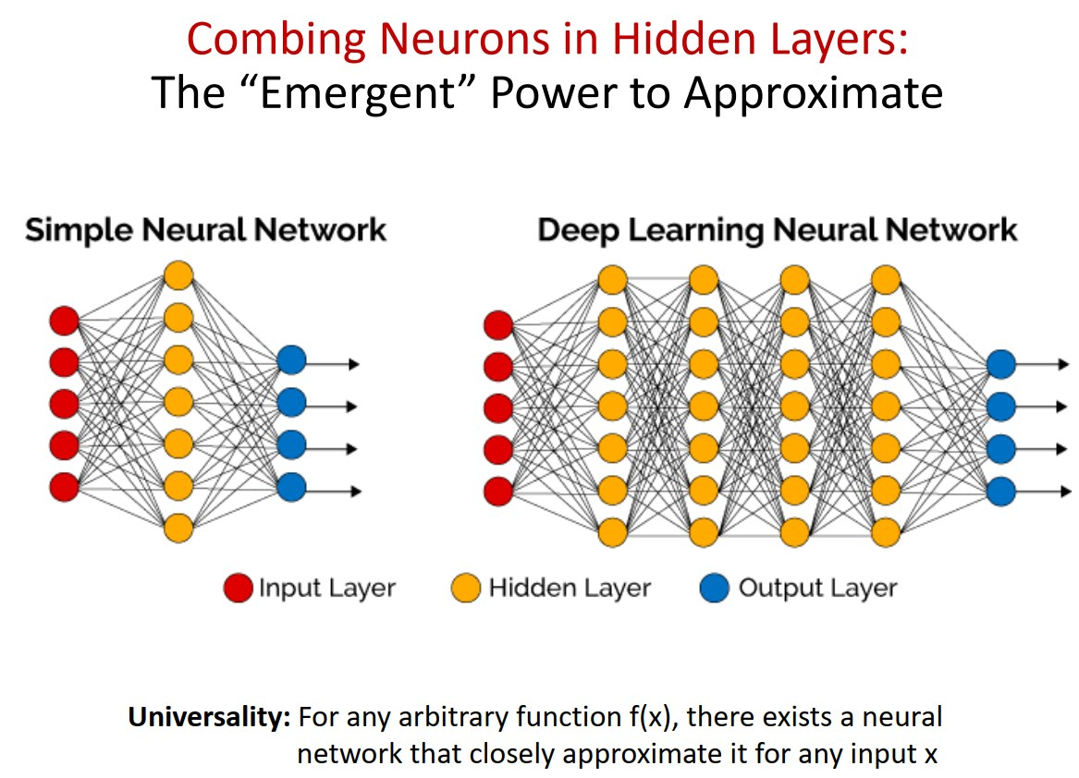
INSIDE A NEURAL NETWORK
Depth is what buys you power
Left: one hidden layer. It can only carve simple boundaries.
Right: several hidden layers. Each one recombines the last.
Layer 1 finds edges. Layer 2 finds corners. Layer 5 finds faces.
Nobody programmed that hierarchy — it emerges from training.
Universality: for any function f(x), there exists a neural network that approximates it closely.
Machine Learning · Course 5777 · Anna Levant PhD
46

Slide 47
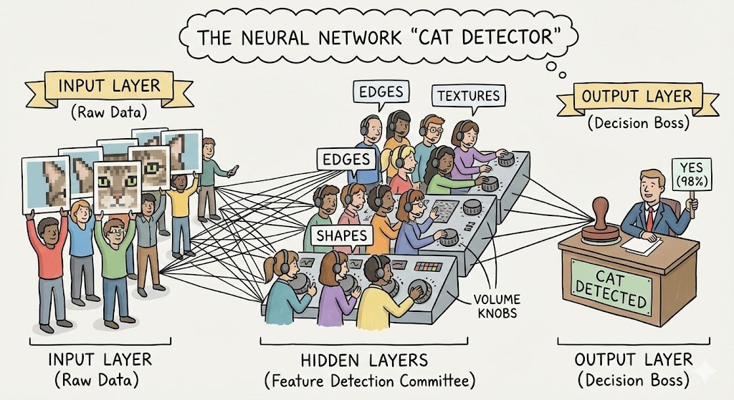
INSIDE A NEURAL NETWORK
A committee that learns who to listen to
Row 1 · Input layer
They make no decisions. They just present the raw data — the pixels.
Row 2 · Hidden layers
Each member has one narrow job. “I only care about vertical lines in the top left.” “I only care about orange in the middle.”
Row 3 · Output layer
The boss listens to everyone in Row 2 and makes the call: yes, it's a cat, or no, it isn't.
THE VOLUME KNOBS (WEIGHTS)
Cartoon concept widely used in CS231n-style teaching material.
Training is nothing but turning millions of those knobs, a little at a time, until the committee's verdict matches reality.
Machine Learning · Course 5777 · Anna Levant PhD
47

Slide 48
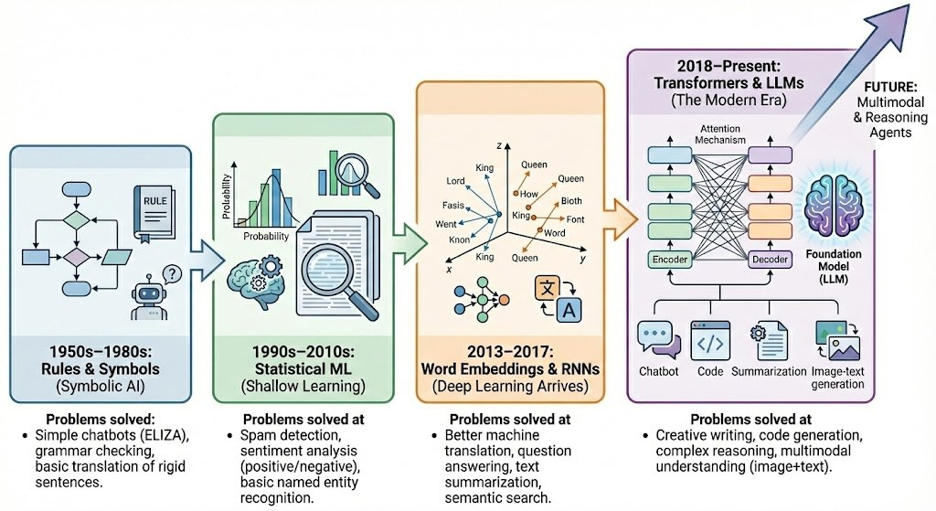
WHERE THE FIELD WENT
NLP: from grammar rules to language models
1950s–1980s
1990s–2010s
2013–2017
2018–now
Rules and symbols
Statistical NLP
Word embeddings, RNNs
Transformers and LLMs
Hand-written grammars. Rigid, brittle translation.
Counting co-occurrences. Spam filters, basic entity recognition.
Words become vectors. Sentiment, translation, summarisation.
Open generation, reasoning, question answering.
Machine Learning · Course 5777 · Anna Levant PhD
48

Slide 49
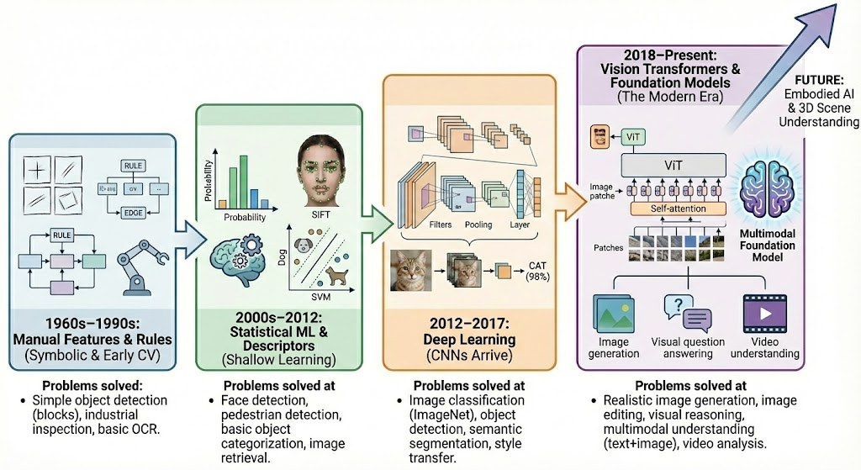
WHERE THE FIELD WENT
Computer vision: the same story, different data
1960s–1990s
2000s–2012
2013–2017
2018–now
Manual features and rules
Statistical ML, descriptors
Deep learning (CNNs)
Vision transformers, foundation models
Simple object detection, industrial inspection, basic OCR.
Face and pedestrian detection, image retrieval.
Image classification, detection, semantic segmentation.
Realistic generation, image editing, multimodal reasoning.
Machine Learning · Course 5777 · Anna Levant PhD
49

Slide 50
PART V
FROM RECOGNISING TO CREATING
Generative AI
The models stop answering and start producing
Machine Learning · Course 5777 · Anna Levant PhD
50

Slide 51
GENERATIVE AI
What makes a model “generative”?
Generative AI produces new content — text, images, audio, video or code — that follows the patterns of its training data without copying it.
DISCRIMINATIVE
GENERATIVE
Sorts what already exists
Produces what doesn't exist yet
Input: a thing. Output: a label or a number.
“Is this spam?” “What is in this photo?”
Learns the boundary between classes.
Input: a prompt or a seed. Output: a new artefact.
“Write this.” “Draw this.” “Animate this.”
Learns the distribution the data was drawn from.
Same networks, same training machinery. The difference is what you ask the model to predict.
Machine Learning · Course 5777 · Anna Levant PhD
51

Slide 52
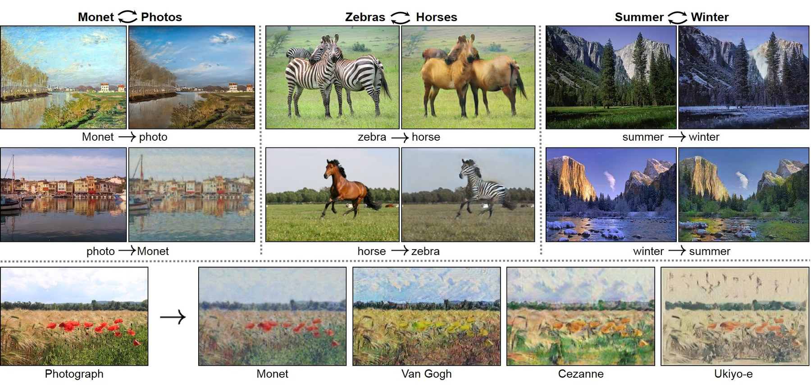
GENERATIVE AI · EXAMPLES
Image to image: translating between worlds
THE TRICK
No matched pairs
There is no photo of the exact scene Monet painted. The model learns the two styles separately and maps between them.
WHY IT WORKS
Round-trip consistency
Convert a photo to a Monet and back again. If you don't get the original photo, the model is penalised.
CycleGAN — Zhu et al., 2017
Machine Learning · Course 5777 · Anna Levant PhD
52

Slide 53
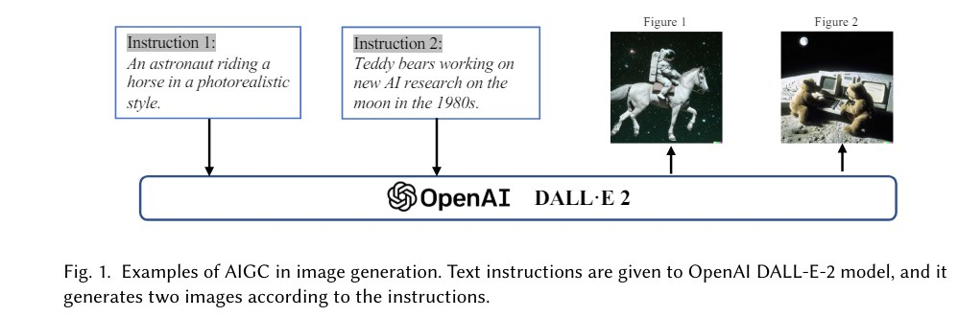
GENERATIVE AI · EXAMPLES
Text to image: a sentence becomes a picture
From “A Comprehensive Survey of AI-Generated Content (AIGC): A History of Generative AI from GAN to ChatGPT”
Two instructions
Two images each
Nothing was copied
“An astronaut riding a horse in a photorealistic style.” — and a second, quite different one.
The model does not retrieve. It samples, so the same prompt gives different pictures.
No astronaut has ever ridden a horse. The model composes concepts it learned separately.
Machine Learning · Course 5777 · Anna Levant PhD
53

Slide 54
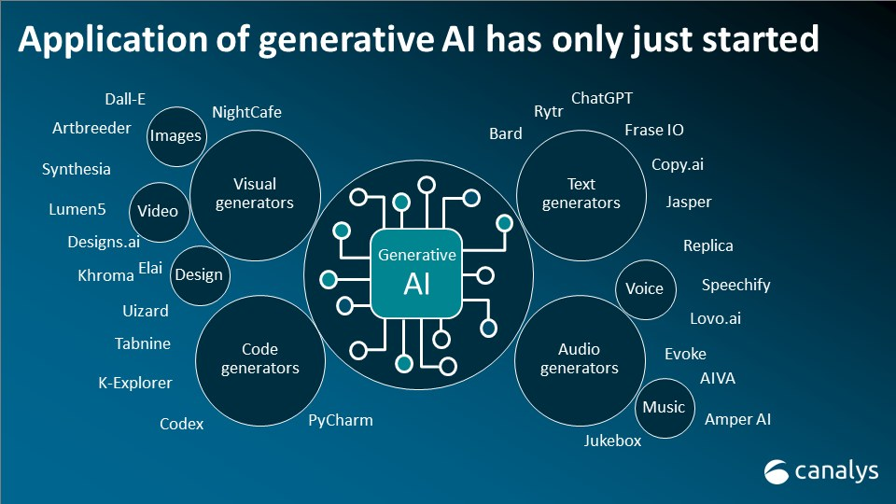
GENERATIVE AI · LANDSCAPE
The application space has only just started
Text, image, code, audio, video and 3D — all at once.
Most of these companies did not exist five years ago.
Most of them are a thin layer on a handful of base models.
Which is why understanding the base models is worth your time.
Canalys
Machine Learning · Course 5777 · Anna Levant PhD
54

Slide 55
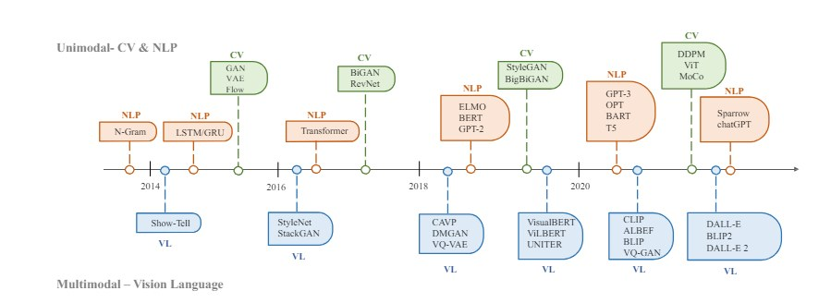
GENERATIVE AI · LANDSCAPE
How fast this actually happened
From “A Comprehensive Survey of AI-Generated Content (AIGC): A History of Generative AI from GAN to ChatGPT”
Two parallel tracks — vision and language — that converge into multimodal models at the right-hand edge.
Machine Learning · Course 5777 · Anna Levant PhD
55

Slide 56
OPEN PROBLEMS
What deep learning still gets wrong
01
02
03
Data dependency
Interpretability
Generalisation
Large labelled datasets are expensive, slow to build, and often quietly unrepresentative.
In medicine and finance, “the model said so” is not an acceptable explanation.
Excellent on data resembling training data. Fragile the moment conditions shift.
04
05
06
Compute and energy
Robustness
Bias and fairness
Training costs real money and real electricity, which limits who gets to participate.
Tiny, imperceptible changes to an input can flip the output entirely.
A model trained on biased data will reproduce that bias, confidently and at scale.
Every one of these is an open research area. Several of them are also regulatory questions.
Machine Learning · Course 5777 · Anna Levant PhD
56

Slide 57
RECAP · Q&A
Four things to take away
01
The shift
02
Three questions
We stopped writing rules and started supplying examples. That is the whole idea of machine learning.
Supervised asks “what is the label?” Unsupervised asks “what is the structure?” Reinforcement asks “what should I do next?”
03
Why now
04
What's next
Data, GPUs and open frameworks arrived together. The mathematics was mostly already there.
Generative models create rather than classify — and inherit every open problem of the models beneath them.
Questions?
rapanya@gmail.com
Machine Learning · Course 5777 · Anna Levant PhD
57

Slide 58
MACHINE LEARNING · COURSE 5777
Thank you.
See you at Lecture 2.
Anna Levant PhD

