Slide 1
MACHINE LEARNING · COURSE 5787
Regression
Predicting a number — from one feature, from many, and from the neighbours
Lecture 2
Anna Levant PhD

Slide 2
WHERE WE ARE
Block one, module one
01
Regression
02
Classification
03
Unsupervised
Linear, multiple, polynomial, k-NN
Predicting a category
PCA and clustering
YOU ARE HERE
Last lecture we said machine learning replaces a hand-written rule with examples. Regression is the first place we actually do it.
Supervised
The answer is a number
Judged on new data
Every example carries the right answer.
Not a category. That is what makes it regression.
Fitting the training points is easy. Generalising is the job.
Machine Learning · Course 5787 · Anna Levant PhD
2

Slide 3
AGENDA
What we'll cover today
01
Simple linear regression
02
How good is the model?
One feature, one line, and what the two numbers mean.
Residuals, MSE and R² — the honest scorecard.
03
Multiple regression
04
Feature importance
Many features at once, and the response plane.
Which feature actually matters — and why raw coefficients lie.
05
Polynomial regression
06
k-NN regression
When a line is not enough, and the overfitting trap.
A method with no equation at all. Just neighbours.
Machine Learning · Course 5787 · Anna Levant PhD
3

Slide 4
PART I
ONE FEATURE, ONE LINE
Simple linear regression
The whole of machine learning, in miniature
Machine Learning · Course 5787 · Anna Levant PhD
4

Slide 5
SIMPLE LINEAR REGRESSION
Regression asks “how much?”
CLASSIFICATION
REGRESSION
Which one?
How much?
The answer comes from a fixed list. Spam or not spam. Duck or not duck. Cat, dog or horse.
The answer is a number on a continuous scale. ₪1,240,000. 37.2 °C. 614 ice creams.
House price
Tomorrow's demand
Heating oil used
Patient's blood pressure
from size, district, age
from today's sales and the weather
from temperature and insulation
from age, weight, medication
Every one of these has a right answer that is a number — and a history of examples to learn it from.
Machine Learning · Course 5787 · Anna Levant PhD
5

Slide 6
SIMPLE LINEAR REGRESSION
The same shape, in six different fields
MEDICINE
REAL ESTATE
AGRICULTURE
Drug dose → blood pressure drop
Apartment size → price
Rainfall → crop yield
How much does each extra milligram lower it?
How much is another square metre worth?
How many extra tonnes per hectare per 10 mm?
RETAIL
ENERGY
MANUFACTURING
Advertising spend → sales
Outside temperature → electricity use
Machine age → defect rate
How many shekels back for each shekel spent?
How much more air conditioning per degree?
How fast does quality drift as equipment ages?
In every one, the slope is the answer someone is actually paying for. That is why regression is the workhorse of applied statistics.
Machine Learning · Course 5787 · Anna Levant PhD
6

Slide 7
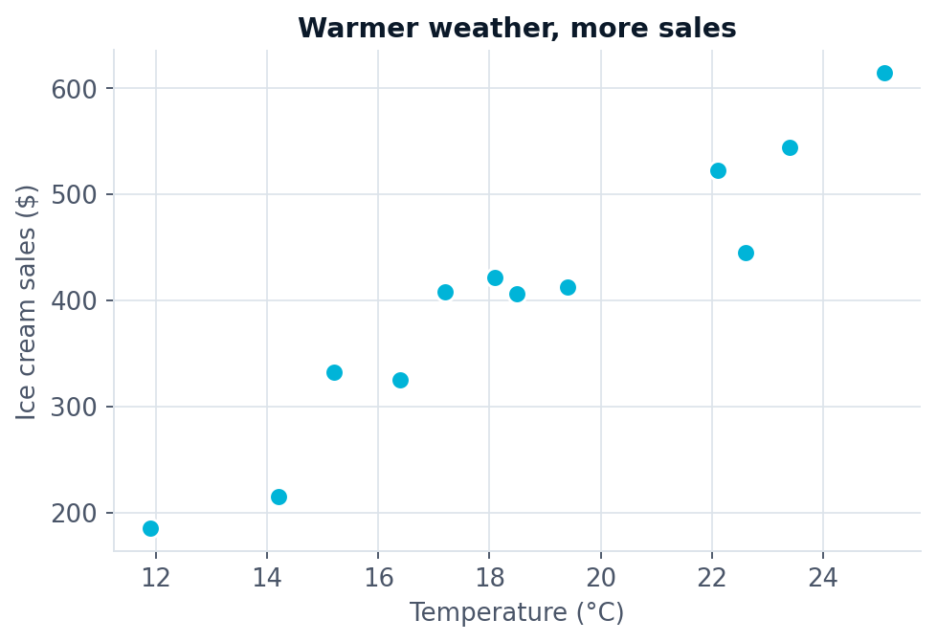
SIMPLE LINEAR REGRESSION · EXAMPLE
Ice cream sales and the weather
Twelve days. For each day we recorded the temperature and how much ice cream we sold.
THE DATA
x = temperature
y = sales
Before fitting anything, plot it. The shape of the cloud tells you whether a line is even a sensible idea.
Warmer weather, more sales. The relationship looks straight — so a straight line is worth trying.
Machine Learning · Course 5787 · Anna Levant PhD
7

Slide 8
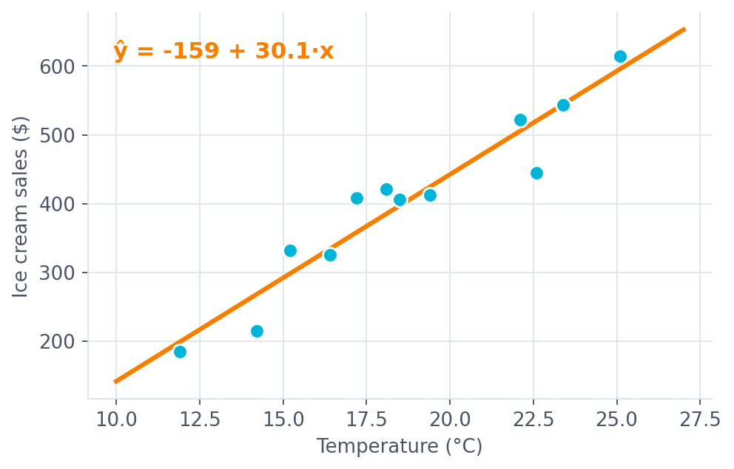
SIMPLE LINEAR REGRESSION
Two numbers describe the whole line
THE MODEL
ŷ = β₀ + β₁ x
β₀ intercept
Where the line crosses the y-axis. Sales at 0 °C — here, a number with no real meaning.
β₁ slope
How much y changes when x goes up by one. Here: about $30 more sales per extra degree.
ε noise
Everything the line cannot explain. Holidays, rain, a broken freezer.
Training this model means choosing β₀ and β₁. That is the entire task.
Machine Learning · Course 5787 · Anna Levant PhD
8

Slide 9
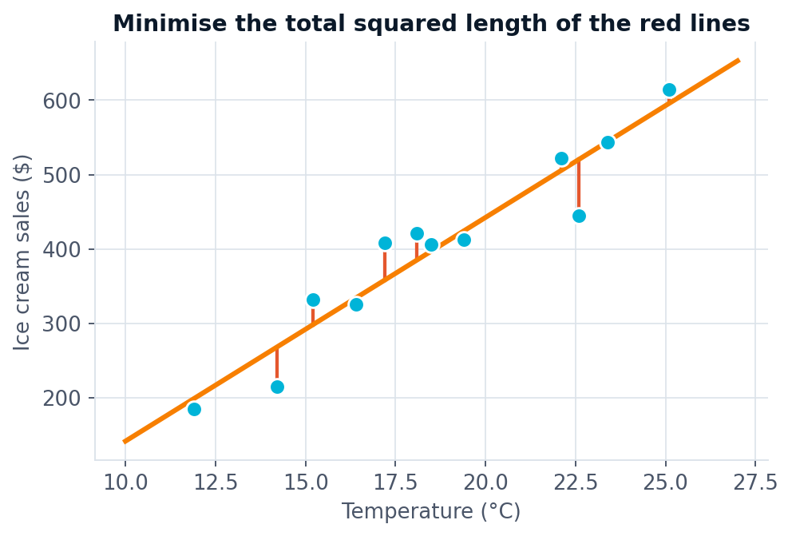
SIMPLE LINEAR REGRESSION
Which line? The one with the smallest errors
For each point, measure the vertical gap to the line.
Square it — so being too high and too low both count as wrong.
Add up all the squares.
Choose the line that makes that total as small as possible.
LEAST SQUARES
S = Σ ( yᵢ − ŷᵢ )²
Why squared and not absolute? Because squaring makes S smooth, and a smooth function can be minimised with calculus.
Machine Learning · Course 5787 · Anna Levant PhD
9

Slide 10
SIMPLE LINEAR REGRESSION
There is an exact answer
Set the derivative of S with respect to each coefficient to zero, solve the two equations, and the best line falls out.
THE SLOPE
THE INTERCEPT
β₁ = [ n·Σ(xᵢ yᵢ) − Σxᵢ · Σyᵢ ] / [ n·Σxᵢ² − (Σxᵢ)² ]
β₀ = ȳ − β₁ x̄
Closed form
Always the same
In practice
Unlike most models in this course, linear regression does not need iterative optimisation. One formula, one answer.
Run it twice on the same data and you get identical coefficients. No randomness anywhere.
You will never type this. scikit-learn's LinearRegression().fit(X, y) does it in one line.
Enjoy this while it lasts. From neural networks onward, there is no formula — only gradient descent.
Machine Learning · Course 5787 · Anna Levant PhD
10

Slide 11
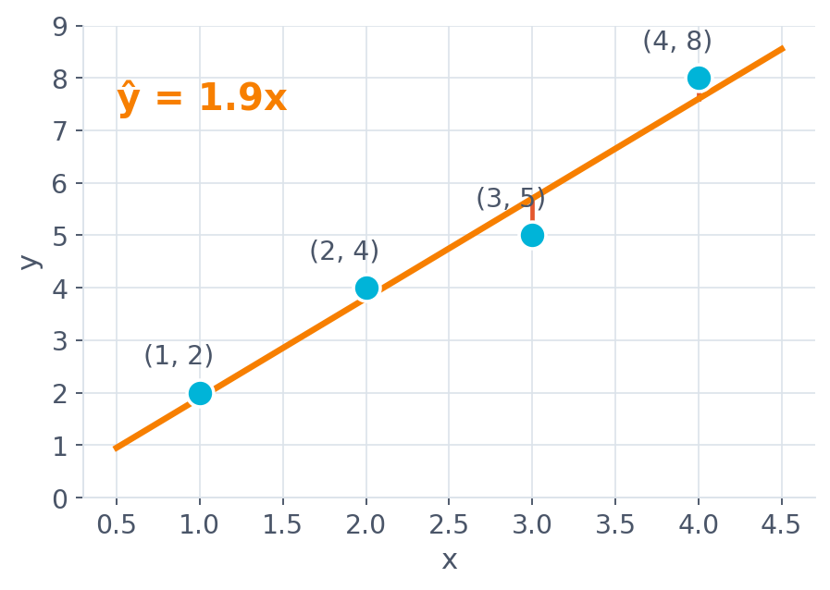
SIMPLE LINEAR REGRESSION · WORKED EXAMPLE
Let's fit a line by hand
Four points. We will compute β₁ and β₀ with nothing but arithmetic.
x
1
2
3
4
Σx = 10
y
2
4
5
8
Σy = 19
x·y
2
8
15
32
Σxy = 57
x²
1
4
9
16
Σx² = 30
SLOPE, WITH N = 4
β₁ = [4(57) − (10)(19)] / [4(30) − 10²] = 38/20 = 1.9
β₀ = ȳ − β₁x̄ = 4.75 − 1.9(2.5) = 0.0
Machine Learning · Course 5787 · Anna Levant PhD
11

Slide 12
GRADIENT DESCENT
So why would we ever not use the formula?
The closed form is exact, fast and final — for linear regression. It is also almost the last time you will see one.
01
02
03
Most models have no formula
It stops scaling
Data may not fit in memory
Logistic regression, neural networks, almost everything after this lecture. Setting the derivative to zero gives equations nobody can solve on paper.
The formula needs to invert a k×k matrix — roughly k³ operations. At ten thousand features that is a serious computation, repeated every fit.
The formula needs every row at once. Gradient descent can learn from one batch at a time, which is how models train on data too large to hold.
So we need a method that finds the minimum without solving for it — one that works on any model we can differentiate.
Linear regression is the perfect place to learn it, because here we already know the right answer to check against.
Machine Learning · Course 5787 · Anna Levant PhD
12

Slide 13
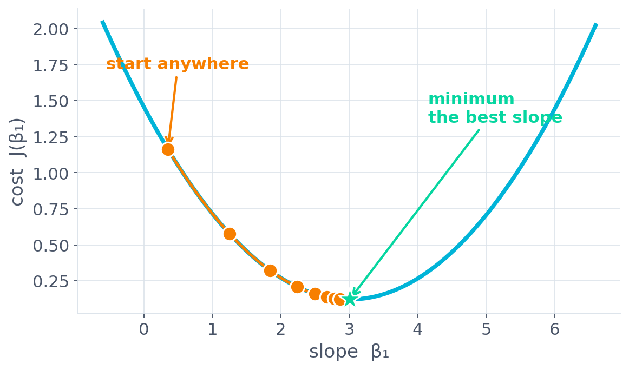
GRADIENT DESCENT · THE IDEA
Stand on a hill in fog and walk downhill
The cost J is a function of the coefficients.
Plot it and you get a bowl with one lowest point.
You cannot see the whole bowl — only the slope under your feet.
So take a small step in the steepest downhill direction.
Repeat until the ground is flat.
THE DERIVATIVE IS THE SLOPE
That is the whole trick. The derivative tells you which way is downhill, and how steep it is.
Every point on the orange path is one iteration. The steps shrink automatically — near the bottom the slope is gentle.
Machine Learning · Course 5787 · Anna Levant PhD
13

Slide 14
GRADIENT DESCENT · THE RULE
One line of mathematics, repeated
THE UPDATE, FOR EVERY COEFFICIENT
FOR LINEAR REGRESSION, THE TWO DERIVATIVES ARE
βⱼ ← βⱼ − α · ∂J/∂βⱼ
∂J/∂β₀ = (2/n) Σ ( ŷᵢ − yᵢ )
∂J/∂β₁ = (2/n) Σ ( ŷᵢ − yᵢ ) xᵢ
βⱼ
the coefficient we are improving
α
the learning rate — how big a step to take
UPDATE BOTH TOGETHER
Compute both derivatives from the current coefficients first, then update. Never feed a half-updated β₀ into β₁.
∂J/∂βⱼ
the slope of the cost in that direction
Start from any guess. Repeat until the coefficients stop changing.
−
minus, because we want to go down, not up
Machine Learning · Course 5787 · Anna Levant PhD
14

Slide 15
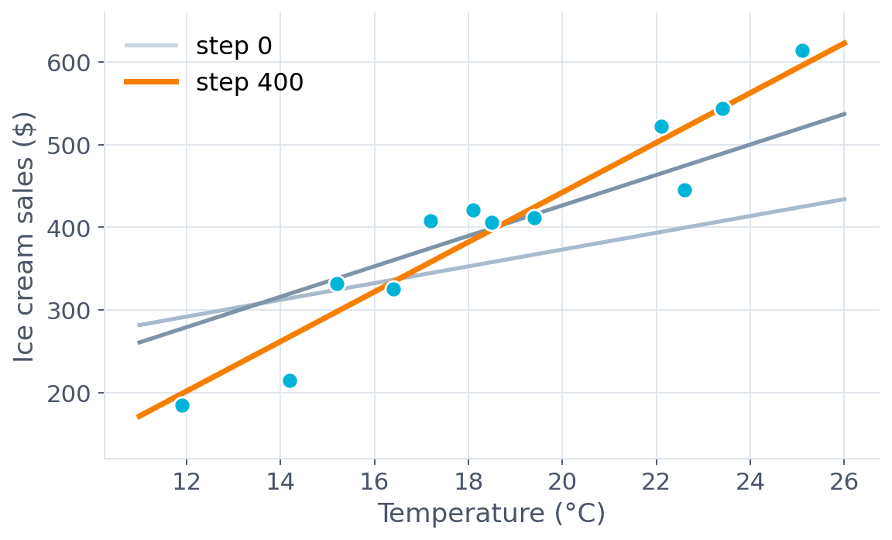
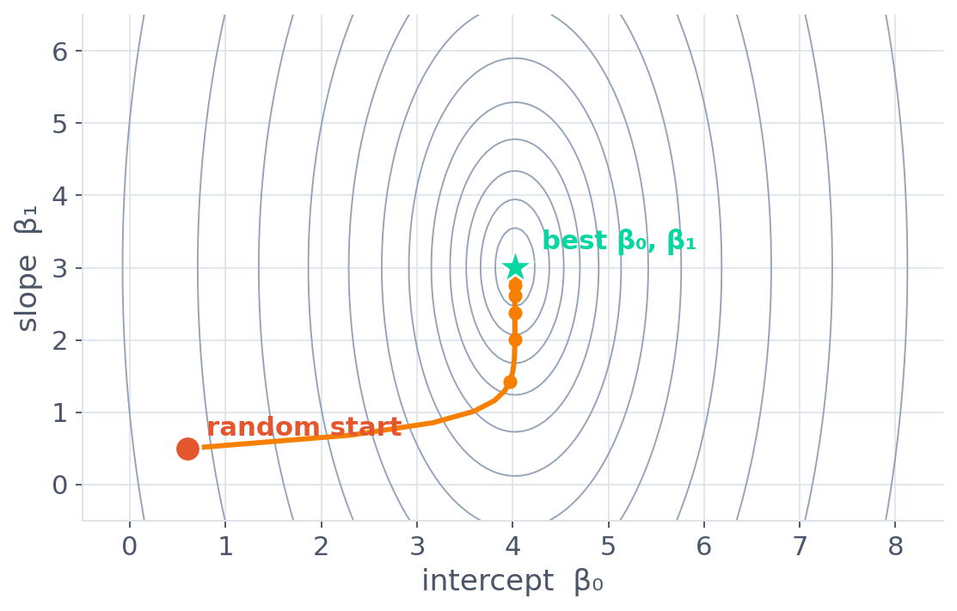
GRADIENT DESCENT · IN MOTION
Watching the line find its place
THE SAME RUN, IN DATA SPACE
THE SAME RUN, IN COEFFICIENT SPACE
The first guess is a poor line. Each step tilts and shifts it closer to the points.
Each ring is a level of equal cost. The path runs downhill to the centre.
Machine Learning · Course 5787 · Anna Levant PhD
15

Slide 16
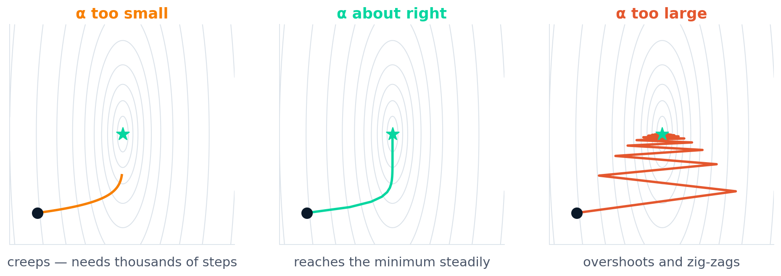
GRADIENT DESCENT · THE ONE SETTING
α is the only thing you have to choose
Too small
About right
Too large
Every step is tiny. It converges to the right answer eventually — but it may take thousands of iterations you do not have time for.
Large steps far from the minimum, small steps near it. Reaches the bottom in tens of iterations.
Each step overshoots to the far side of the valley. The cost zig-zags, and can grow without bound.
Machine Learning · Course 5787 · Anna Levant PhD
16

Slide 17
GRADIENT DESCENT
How much data per step?
Batch
Stochastic (SGD)
Mini-batch
All n rows, every step
One row at a time
A small group, say 32 or 256
Smooth, steady descent. Every step is expensive, and the whole dataset must fit in memory.
Very cheap steps, very noisy path. The noise can actually help escape poor regions in complex models.
The compromise, and what essentially every neural network in this course will use.
SO WHICH, FOR LINEAR REGRESSION?
Use the formula. It is exact and instant.
We learned gradient descent here not because linear regression needs it, but because linear regression is the only model simple enough to watch it work — and because every model from the neural network lecture onward depends on it completely.
Feature scaling matters here too: if one feature is far larger than another, the bowl becomes a narrow ravine and descent crawls.
Machine Learning · Course 5787 · Anna Levant PhD
17

Slide 18
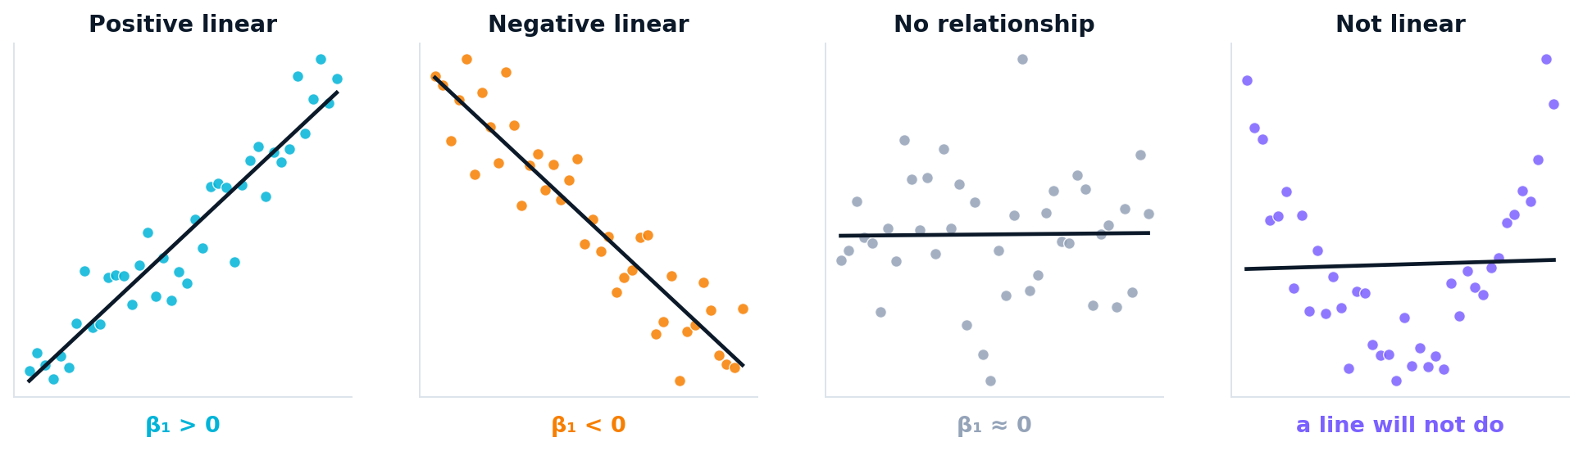
SIMPLE LINEAR REGRESSION
What the slope is telling you
β₁ > 0
β₁ < 0
β₁ ≈ 0
Curved
y rises with x
y falls as x rises
x tells you nothing
a line is the wrong tool
The fourth case is the dangerous one: least squares will happily hand you a line, and the line will be meaningless.
Machine Learning · Course 5787 · Anna Levant PhD
18

Slide 19
QUIZ 1
In the ice cream data, temperature has…
a
A negative impact on sales — the slope is below zero.
b
A positive impact on sales — the slope is above zero.
c
No impact on sales — the slope is essentially zero.
Machine Learning · Course 5787 · Anna Levant PhD
19

Slide 20
QUIZ 1 · ANSWER
(b) — the slope is about +30 sales per degree
a
A negative slope would mean sales fall as it gets warmer. The scatter clearly rises from left to right.
NO
b
β₁ ≈ +30. Each extra degree is associated with about $30 more in sales. The cloud of points rises.
CORRECT
c
A zero slope would show as a flat, shapeless band. Here the trend is strong and unmistakable.
NO
Machine Learning · Course 5787 · Anna Levant PhD
20

Slide 21
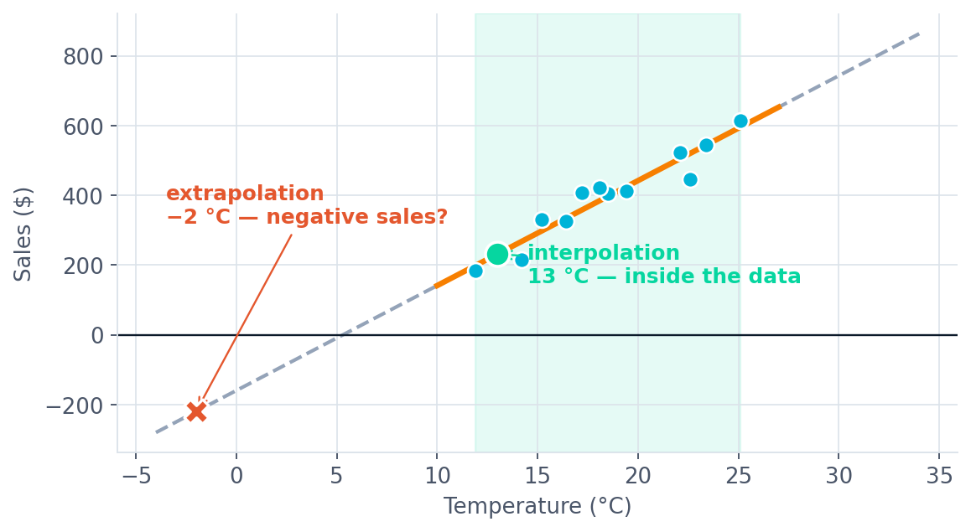
SIMPLE LINEAR REGRESSION · PREDICTION
Inside the data is safe. Outside is not.
INTERPOLATION
Predicting inside the range
13 °C sits comfortably between the coldest and warmest days we observed. The model has evidence.
EXTRAPOLATION
Predicting outside the range
At −2 °C the line predicts negative sales. The mathematics is fine. The answer is nonsense.
A model knows nothing beyond the data it saw. Predict inside the range, or be prepared to be embarrassed.
Machine Learning · Course 5787 · Anna Levant PhD
21

Slide 22
QUIZ 2
Is it a good idea to use this model to predict sales at −2 °C?
a
True — the model gives an answer, so we can use it.
b
False — −2 °C is far outside the observed range.
Machine Learning · Course 5787 · Anna Levant PhD
22

Slide 23
QUIZ 2 · ANSWER
(b) — and the model even predicts negative sales
a
Getting an answer is not the same as getting a good answer. A linear model will extrapolate to infinity without complaint.
NO
b
Our data runs from about 12 °C to 25 °C. At −2 °C the line drops below zero — a physically impossible number of ice creams.
CORRECT
Machine Learning · Course 5787 · Anna Levant PhD
23

Slide 24
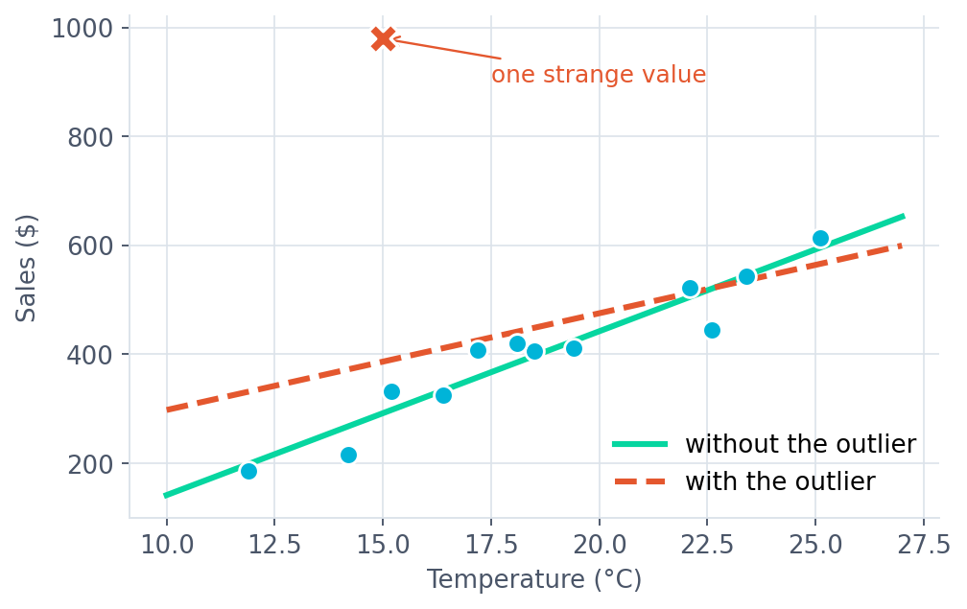
SIMPLE LINEAR REGRESSION · CAUTION
One strange point can move the whole line
Squaring the errors is what makes least squares solvable — and also what makes it fragile.
An error of 10 counts 100. An error of 100 counts 10,000.
So a single far-away point can outweigh every other point combined.
WHAT TO DO
Look before you fit
Plot the data. Investigate outliers rather than deleting them — sometimes the strange point is the most interesting one.
Never trust a fitted line you have not seen plotted against its data.
Machine Learning · Course 5787 · Anna Levant PhD
24

Slide 25
PART II
THE HONEST SCORECARD
How good is the model?
Residuals, MSE and R²
Machine Learning · Course 5787 · Anna Levant PhD
25

Slide 26
HOW GOOD IS THE MODEL?
The residual is what the model missed
Observed value minus predicted value. One residual per data point — the part of the answer your line failed to capture.
RESIDUAL
εᵢ = yᵢ − ŷᵢ
Residuals should look like noise
Structure means a missing pattern
This is a free diagnostic
If the model has captured the real pattern, what remains should be structureless — no trend, no curve, no fan shape.
A curve in the residuals says the true relationship is not a line. A widening fan says the noise grows with x.
It costs one plot and tells you more about model validity than any single number can.
Before you quote any accuracy number, plot the residuals. It is the cheapest sanity check in statistics.
Machine Learning · Course 5787 · Anna Levant PhD
26

Slide 27
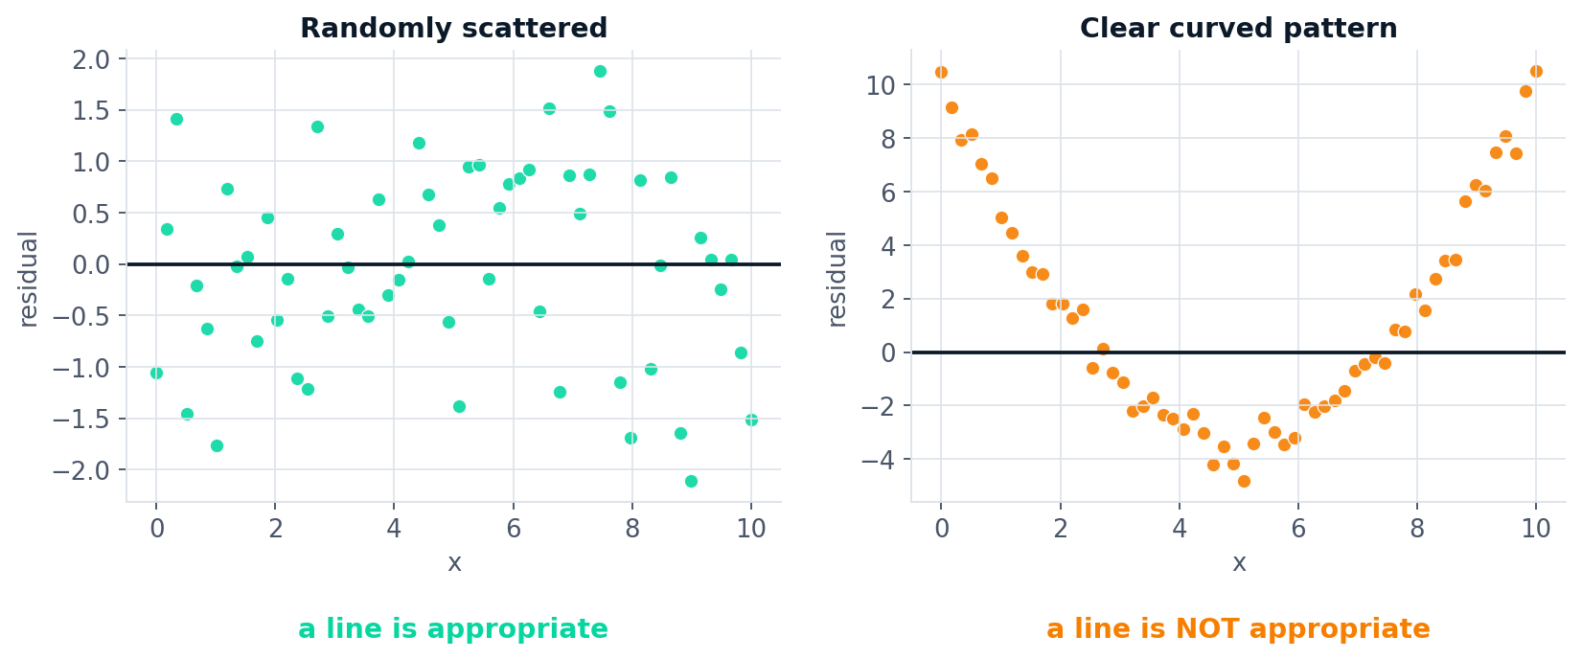
HOW GOOD IS THE MODEL?
Reading a residual plot
LEFT — RANDOMLY SCATTERED
RIGHT — CLEAR CURVATURE
No pattern, roughly constant spread, centred on zero. A straight line was the right choice.
The residuals bend. The model is systematically wrong in the middle and at the edges. Use a curve, not a line.
Machine Learning · Course 5787 · Anna Levant PhD
27

Slide 28
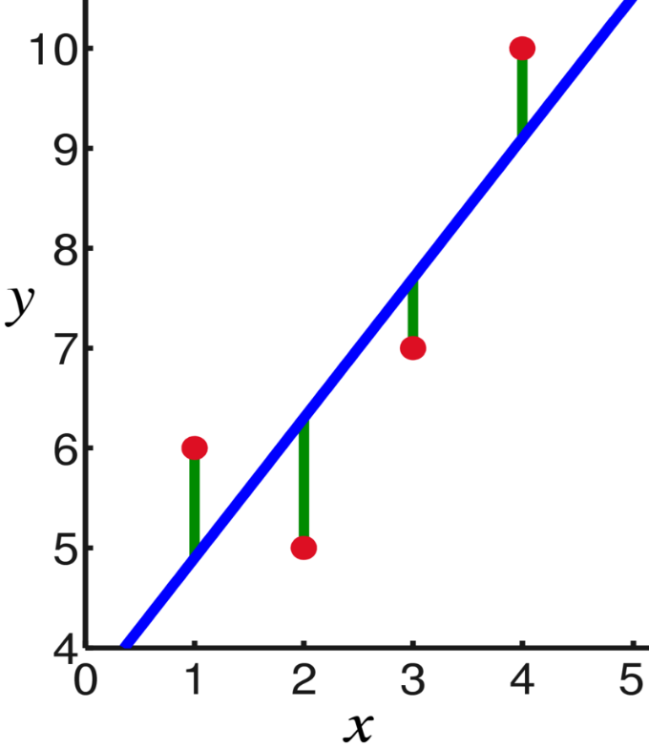
HOW GOOD IS THE MODEL? · MEASURE 1
Mean squared error
The average squared miss, across every point.
Zero means perfect. There is no upper limit.
Units are the square of y — here, dollars squared.
Take the square root (RMSE) to get back to dollars.
MSE
MSE = (1/n) Σ ( yᵢ − ŷᵢ )²
Good for comparing
Bad for judging alone
Punishes big misses
Two models on the same data — lower MSE wins.
Is an MSE of 2,400 good? Impossible to say without knowing the scale of y.
Because of the square, one terrible prediction hurts more than many small ones.
MSE answers “how far off are we?” — but not “is this model any good?” For that we need R².
Machine Learning · Course 5787 · Anna Levant PhD
28

Slide 29

HOW GOOD IS THE MODEL? · MEASURE 2
R²: Splitting the variation in y
SST total
How far each point sits from the mean of y. The variation we started with.
SSE
SSR explained
SSR
Ȳ
How far the fitted line sits from the mean. The variation the model captured.
SSE left over
How far each point sits from the line. The variation still unexplained.
SST = SSR + SSE
COEFFICIENT OF DETERMINATION
R² = SSR / SST = 1 − SSE / SST
Machine Learning · Course 5787 · Anna Levant PhD
29

Slide 30
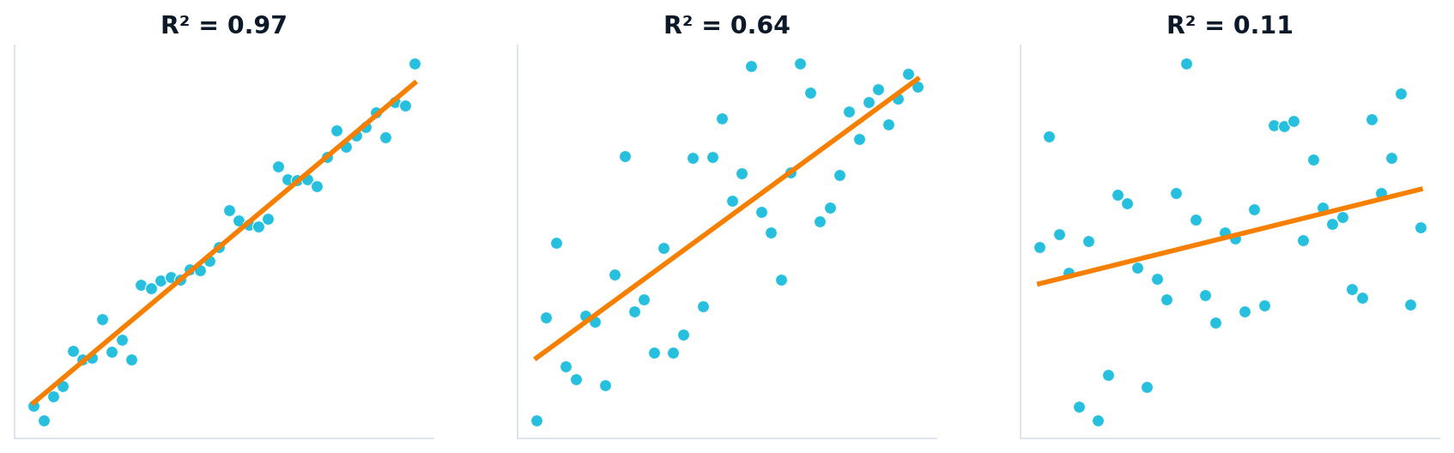
HOW GOOD IS THE MODEL? · MEASURE 2
R²: the share of the variation you explained
Runs from 0 to 1 — a proportion, not an amount.
R² = 0.85 means the model accounts for 85% of the variation in y.
Unitless, so it can compare models across different problems.
Says nothing about whether the line is the right shape.
COEFFICIENT OF DETERMINATION
R² = SSR / SST = 1 − SSE / SST
Same underlying relationship in all three — only the noise changes. R² measures how tightly the points hug the line.
Machine Learning · Course 5787 · Anna Levant PhD
30

Slide 31
HOW GOOD IS THE MODEL? · WORKED EXAMPLE
Scoring the ice cream model
Twelve days, the fitted line ŷ = −159.5 + 30.1x. Here is every number we defined, computed on the real data.
SST
SSR
SSE
R²
174,755
160,219
14,536
0.92
total variation in sales
explained by temperature
still unexplained
SSR ÷ SST
MSE
1,211
dollars squared — hard to interpret
RMSE
$35
the square root: our typical miss, in real dollars
Temperature explains 92% of the variation in sales, and on a typical day we are about $35 out. Both numbers are worth quoting.
Machine Learning · Course 5787 · Anna Levant PhD
31

Slide 32
HOW GOOD IS THE MODEL?
What counts as a “good” R² depends on the field
Physics, chemistry
Engineering, biology
Economics, psychology
0.90 – 0.99
0.60 – 0.90
0.10 – 0.30
Controlled conditions, precise instruments. A low R² usually means a mistake in the experiment.
Real systems with real noise. Good models, imperfect measurement.
Human behaviour. Explaining 20% of the variation can be a genuinely valuable result.
There is no universal threshold.
Anyone who tells you “R² must be above 0.8” has not asked what you are modelling. Compare against what is achievable in your domain, and against the simplest model you could have used instead.
Machine Learning · Course 5787 · Anna Levant PhD
32

Slide 33
QUIZ 3
A model has R² = 0.95 but its residual plot shows a clear U-shape. What do you conclude?
a
The model is excellent — R² is very high.
b
The model captures most of the variation but has the wrong shape.
c
R² must have been calculated incorrectly.
Machine Learning · Course 5787 · Anna Levant PhD
33

Slide 34
QUIZ 3 · ANSWER
(b) — a high R² does not make a line the right shape
a
R² only measures how much variation is explained. It cannot detect that the model is systematically wrong in a pattern.
NO
b
Both things are true at once. The line is close to the points overall, but it is bending away from them in a predictable way — a curve would do better.
CORRECT
c
Nothing is wrong with the arithmetic. This combination is common, and it is exactly why we look at residual plots as well as numbers.
NO
Machine Learning · Course 5787 · Anna Levant PhD
34

Slide 35
PART III
MORE THAN ONE FEATURE
Multiple regression
From a line to a plane, and beyond
Machine Learning · Course 5787 · Anna Levant PhD
35

Slide 36
MULTIPLE REGRESSION
If you had to guess someone's height…
…which would you rather be told?
1 feature
2 features
3 features
4 features
Weight only
Weight + gender
Weight + gender + income
… + favourite number
Useful. Heavier people tend to be taller — but only loosely.
Much better. Gender explains a large part of what weight alone could not.
Slightly better again. Income correlates weakly with height through nutrition.
No better. But no worse either — the model can simply give it a coefficient near zero.
More information rarely hurts a linear model — a useless feature just gets a coefficient near zero. Which is exactly why we need a way to tell useful features from useless ones.
That question — which features matter — is Part IV of today's lecture.
Machine Learning · Course 5787 · Anna Levant PhD
36

Slide 37
MULTIPLE REGRESSION · EXAMPLE
How much heating oil will a house use?
A single-family home in January. We want to estimate gallons of heating oil from two things we can measure in advance.
y
Oil used
x₁
Average temperature
x₂
Insulation
gallons, in January
degrees Fahrenheit
inches of thermal insulation
THE FITTED MODEL
Oil = 562.2 − 5.4 · Temperature − 20.0 · Insulation
−5.4
Each extra degree of outside temperature is associated with about 5.4 fewer gallons — holding insulation fixed.
−20.0
Each extra inch of insulation is associated with about 20 fewer gallons — holding temperature fixed.
Machine Learning · Course 5787 · Anna Levant PhD
38

Slide 38
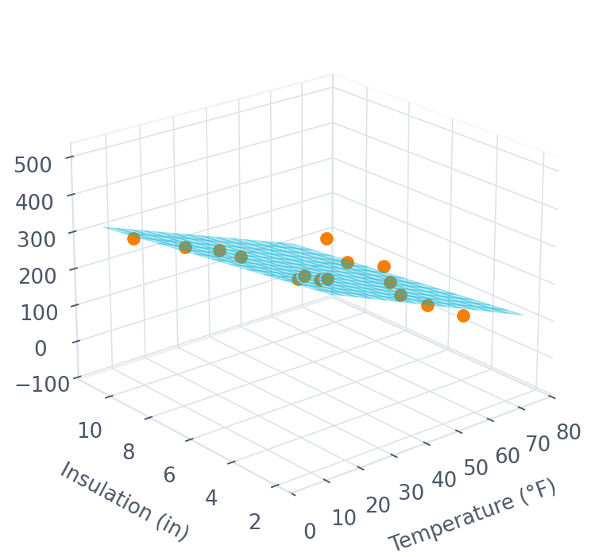
MULTIPLE REGRESSION
A line becomes a plane
THE MODEL
ŷ = β₀ + β₁x₁ + β₂x₂ + … + βₖxₖ
One feature → a line in 2D.
Two features → a plane in 3D.
k features → a hyperplane we cannot draw.
The mathematics does not change at all — only the number of coefficients.
Each β answers: if this feature rises by one unit and everything else stays fixed, how much does y move?
Machine Learning · Course 5787 · Anna Levant PhD
37

Slide 39
MULTIPLE REGRESSION
R² always goes up. That is a problem.
Add any feature — even a completely random one — and R² will never decrease. So R² cannot tell you whether the extra feature was worth adding.
(a)
Oil ~ Temperature
one feature
ADJUSTED R²
R²ₐₑⱼ = 1 − (1 − R²) · (n − 1)/(n − k − 1)
(b)
Oil ~ Insulation
one feature
(c)
Oil ~ Temperature + Insulation
two features
It charges rent
It can go down
Use it to compare
Every extra feature k pushes the adjusted value down. A feature must earn its place.
Add a useless feature and adjusted R² falls — which is exactly the signal you wanted.
Between models with different numbers of features, compare adjusted R², never plain R².
Machine Learning · Course 5787 · Anna Levant PhD
39

Slide 40
PART IV
WHICH FEATURE ACTUALLY MATTERS?
Feature importance
The question everyone asks about a model
Machine Learning · Course 5787 · Anna Levant PhD
40

Slide 41
FEATURE IMPORTANCE
The trap: coefficients are not importances
In the heating oil model, insulation's coefficient (−20.0) is almost four times bigger than temperature's (−5.4). So insulation matters more — right?
No. The two features are measured in completely different units.
Temperature
9 °F to 73 °F
Insulation
3 in to 10 in
ranges over roughly 65 °F across our houses
ranges over only 7 inches across our houses
A coefficient says “per one unit”. If one unit means something very different for each feature, the coefficients cannot be compared.
Machine Learning · Course 5787 · Anna Levant PhD
41

Slide 42
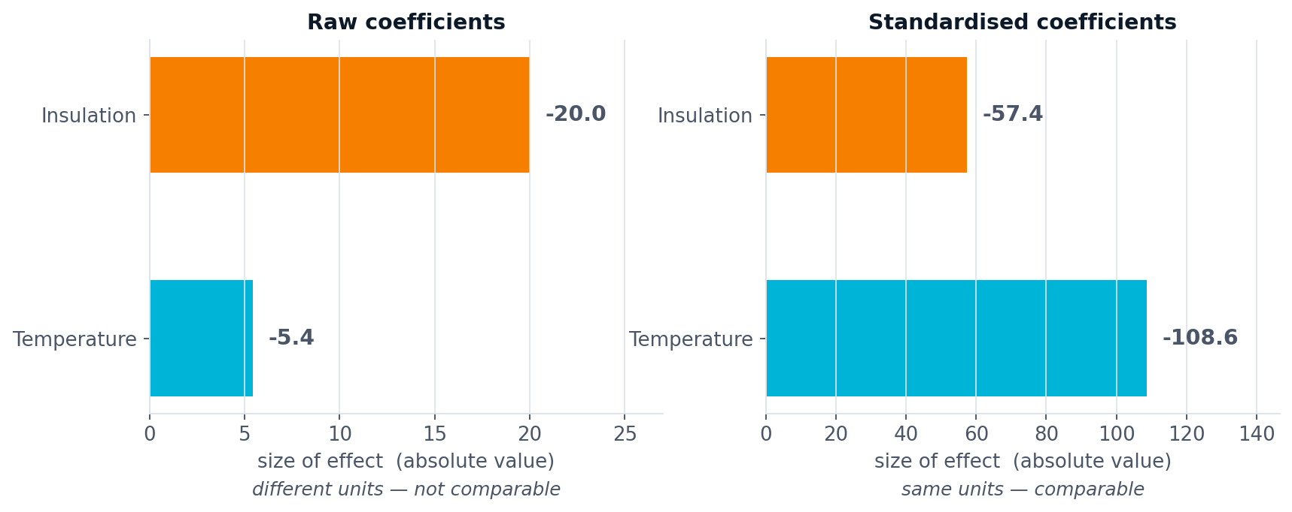
FEATURE IMPORTANCE · METHOD 1
Put every feature on the same scale first
WHAT WE DO
WHAT CHANGES
WHY IT FLIPPED
Rescale each feature to mean 0 and standard deviation 1, then refit. Now every coefficient means “per one standard deviation”.
The ranking flips. Temperature (−108.6) turns out to matter roughly twice as much as insulation (−57.4).
Temperature varies far more between houses. A feature that barely moves cannot explain much, however large its per-unit effect.
Machine Learning · Course 5787 · Anna Levant PhD
42

Slide 43
FEATURE IMPORTANCE · METHODS 2 AND 3
Two more ways to ask the same question
Permutation importance
Drop-column importance
Shuffle one feature's column and refit nothing
Remove the feature and retrain from scratch
Measure the model's error normally.
Randomly shuffle one feature's values, breaking its link to y.
Measure the error again. The increase is that feature's importance.
Works for any model — trees, networks, anything.
Fit the full model, record its score.
Remove one feature, refit, record the score again.
The drop in score is that feature's contribution.
The most honest method — and the most expensive.
Standardised coefficients only work for linear models. Permutation importance works for every model you will meet this year.
Machine Learning · Course 5787 · Anna Levant PhD
43

Slide 44
FEATURE IMPORTANCE
Three ways importance will mislead you
01
Correlated features share credit
If two features carry the same information, the model can split the effect between them arbitrarily — or give one all the credit and the other none. Neither result means the ignored feature is useless.
02
Important is not causal
Ice cream sales predict drownings very well. Removing ice cream will not save anyone. The model found a pattern, not a mechanism.
03
Importance is model-specific
It tells you what this model relies on — not what matters in the world. Fit a different model and the ranking can change.
Feature importance is a hypothesis generator, not a verdict. It tells you where to look next — not what is true.
Machine Learning · Course 5787 · Anna Levant PhD
44

Slide 45
PART V
WHEN A LINE IS NOT ENOUGH
Polynomial regression
Curves, and the trap that comes with them
Machine Learning · Course 5787 · Anna Levant PhD
45

Slide 46
POLYNOMIAL REGRESSION
The residuals told us a line was wrong
Recall the curved residual plot from Part II. That curve is the model telling you it is the wrong shape — and pointing at the fix.
LINEAR MODEL
POLYNOMIAL MODEL OF DEGREE M
ŷ = β₀ + β₁x
ŷ = β₀ + β₁x + β₂x² + … + βₘxᴹ
THE KEY INSIGHT
Polynomial regression is still linear regression.
We are not inventing a new algorithm. We create a new feature x₂ = x², hand it to the same LinearRegression, and it fits a curve. “Linear” means linear in the coefficients β — not linear in x.
Same solver, same closed-form solution, same code. Only the columns of X have changed.
Machine Learning · Course 5787 · Anna Levant PhD
46

Slide 47
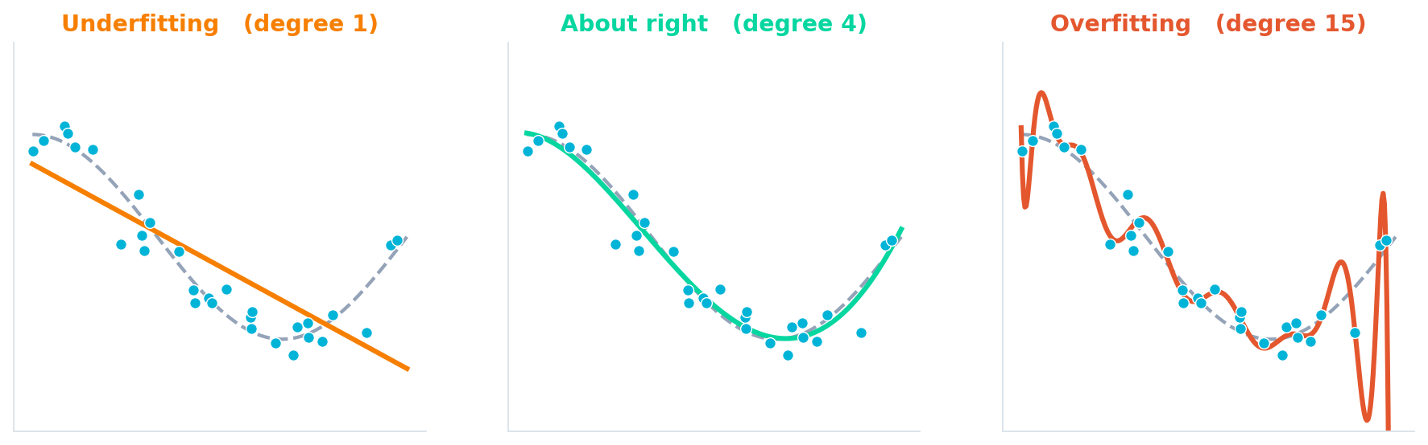
POLYNOMIAL REGRESSION · THE TRAP
Too simple, about right, and far too clever
Underfitting
About right
Overfitting
The model is too rigid to follow the shape. It is wrong on the training data and wrong on new data — high bias.
Close to the truth without chasing individual points. This is what you are aiming for.
The curve passes near every training point by wiggling wildly. Perfect on training data, useless on new data — high variance.
Machine Learning · Course 5787 · Anna Levant PhD
47

Slide 48
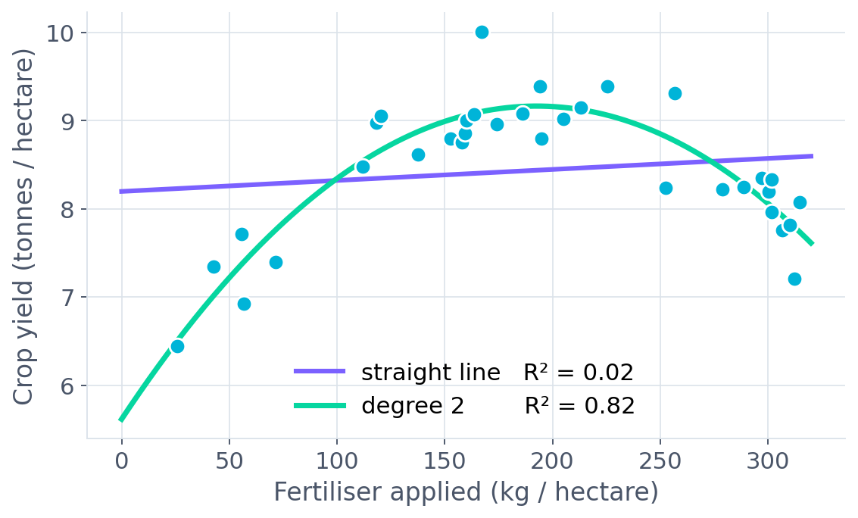
POLYNOMIAL REGRESSION · WORKED EXAMPLE
Too much fertiliser burns the crop
Yield rises with fertiliser — then falls again. A straight line cannot represent “more is better, until it isn't”.
STRAIGHT LINE
R² = 0.02
Essentially zero. The line concludes fertiliser does almost nothing.
DEGREE 2
R² = 0.82
The curve finds the peak — and tells the farmer where to stop.
Same data, same algorithm, one extra column x². The difference between a useless model and a useful one.
Machine Learning · Course 5787 · Anna Levant PhD
48

Slide 49
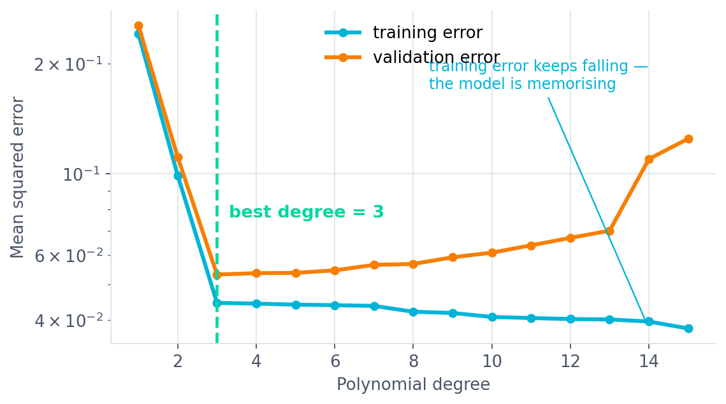
POLYNOMIAL REGRESSION
Choosing the degree, without guessing
Fit every degree from 1 upward.
Score each one on the training set and on held-out data.
Training error falls forever — it always will.
Validation error falls, then turns and rises.
Choose the degree at the turn.
THIS IS WHY WE SPLIT THE DATA
Lecture 1 said never test on what you trained on. This plot is what that rule is for — without a validation set you would pick degree 15.
The gap between the two curves is overfitting made visible.
Machine Learning · Course 5787 · Anna Levant PhD
49

Slide 50
QUIZ 4
Your polynomial model scores R² = 0.999 on training data and R² = 0.31 on the test set. What happened?
a
The test set must be corrupted — rerun the split.
b
The model is overfitting — the degree is too high.
c
The model is underfitting — raise the degree further.
Machine Learning · Course 5787 · Anna Levant PhD
50

Slide 51
QUIZ 4 · ANSWER
(b) — a textbook overfitting signature
a
A large train–test gap is almost never a data problem. It is the single most common symptom in applied machine learning.
NO
b
Near-perfect on data it has seen, poor on data it has not. The model memorised the training points, including their noise.
CORRECT
c
Underfitting looks the opposite way: poor scores on both sets. Raising the degree here would make things considerably worse.
NO
Machine Learning · Course 5787 · Anna Levant PhD
51

Slide 52
PART VI
A METHOD WITH NO EQUATION
k-NN regression
Sometimes the neighbours already know the answer
Machine Learning · Course 5787 · Anna Levant PhD
52

Slide 53
K-NN REGRESSION
Forget the equation. Ask the neighbours.
Every model so far assumed a shape — a line, a plane, a curve — and then found the best coefficients for it. k-NN assumes nothing.
01
02
03
04
Store the data
›
A new x arrives
›
Take the k nearest
›
Average their y
There is no training step. The model is the dataset.
Measure the distance from it to every stored point.
Keep the k closest examples. Discard the rest.
That average is the prediction. Done.
You met this in Lecture 1 as a classifier — vote among the neighbours. For regression we average them instead of voting.
The same distance formula you saw for k-NN classification does all the work here too.
Machine Learning · Course 5787 · Anna Levant PhD
53

Slide 54
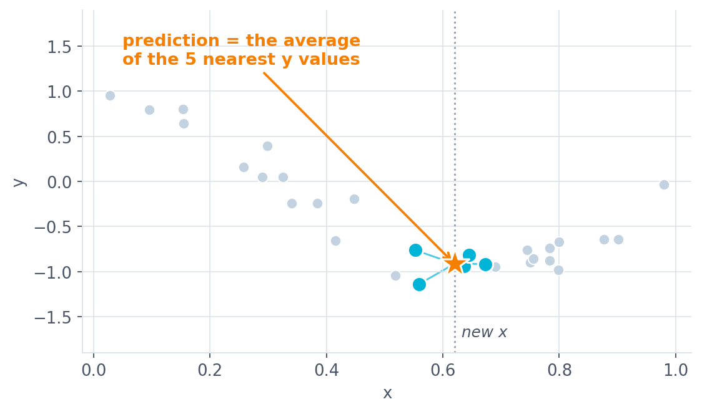
K-NN REGRESSION
One prediction, step by step
The dotted line marks the new x we want a prediction for.
The five blue points are its nearest neighbours.
The star is their average y — that is the prediction.
No coefficients were estimated. Nothing was fitted.
THE COST
Fast to train, slow to predict
Training takes no time at all. But every single prediction requires measuring distance to the entire dataset.
Machine Learning · Course 5787 · Anna Levant PhD
54

Slide 55
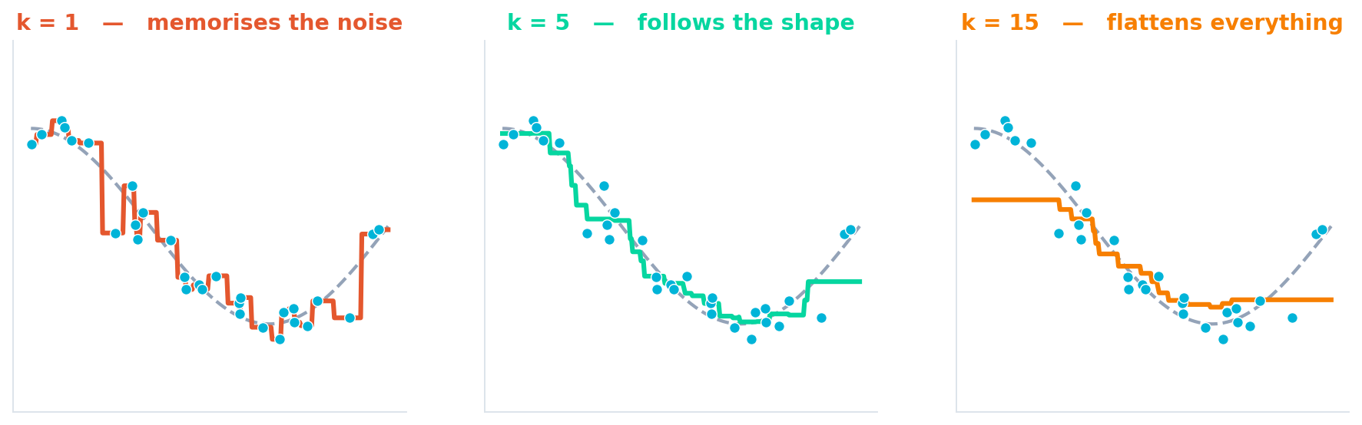
K-NN REGRESSION
k controls how smooth the answer is
k = 1
k = 5
k = 15
Copies the nearest point exactly, noise and all. Zero training error, terrible on new data. This is overfitting.
Averages away most of the noise while still following the real shape. About right here.
Averages over so many points that the curve flattens toward the global mean. This is underfitting.
Machine Learning · Course 5787 · Anna Levant PhD
55

Slide 56
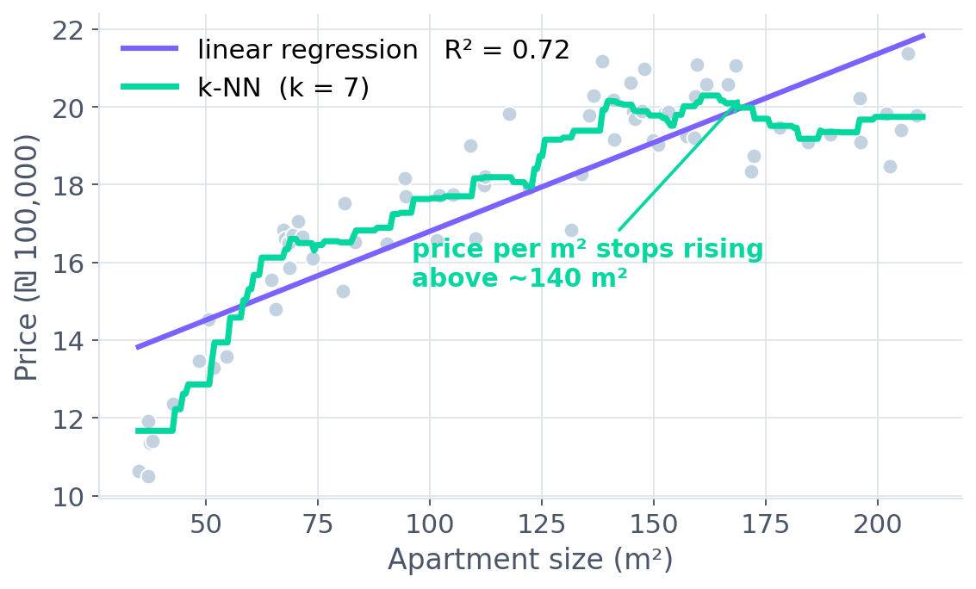
K-NN REGRESSION · WORKED EXAMPLE
Apartment prices stop rising in a straight line
Seventy apartments: size against price.
Below 70 m², each extra metre adds a lot.
Between 70 and 140 m², it adds less.
Above 140 m², it adds almost nothing.
WHY K-NN WINS HERE
Three regimes, one dataset
The line has to average across all three and is wrong in all three. k-NN just asks the nearest seven apartments — which are in the same regime.
This is what “no assumed shape” buys you. Nobody had to notice the two kinks or write them down.
Machine Learning · Course 5787 · Anna Levant PhD
56

Slide 57
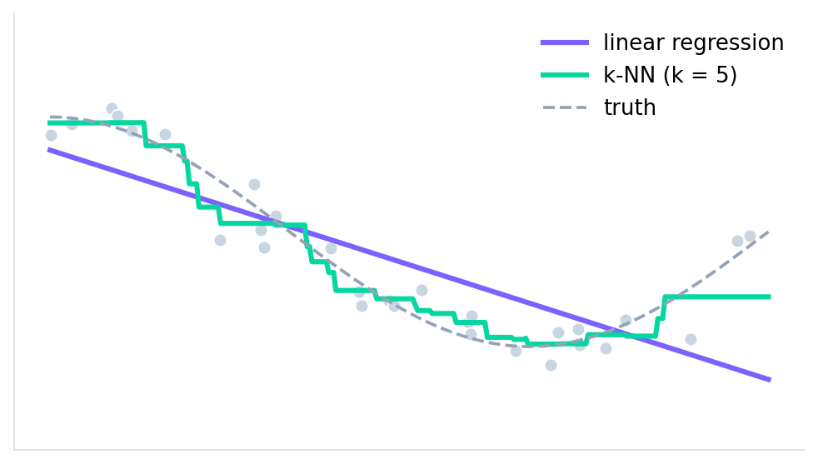
K-NN REGRESSION
So which one should you use?
LINEAR REGRESSION HERE
Confidently wrong
The data curves; the line cannot. It is too rigid to represent the truth no matter how much data you give it.
K-NN HERE
Follows the shape
It has no idea what a cosine is. It simply lets nearby points speak for their neighbourhood — and that is enough.
Neither is “better”. They fail in opposite directions — which is exactly why it is worth knowing both.
THE TRADE-OFF IN ONE LINE
Linear regression assumes a shape and gives you readable coefficients. k-NN assumes nothing and gives you no explanation at all.
Machine Learning · Course 5787 · Anna Levant PhD
57

Slide 58
K-NN REGRESSION
Parametric and non-parametric
PARAMETRIC
NON-PARAMETRIC
Learn a fixed set of numbers
Keep the data itself
Linear, multiple and polynomial regression. Once trained, the data can be thrown away — the coefficients are the whole model. Small memory, fast predictions, strong assumptions.
k-NN. The model grows with the dataset and makes no assumption about shape. Flexible, memory-hungry, and slow at prediction time.
Reach for linear regression when
you want to explain the result, the relationship looks straight, or you have few data points.
Reach for k-NN when
the relationship is clearly not straight, you have plenty of data, and you do not need to explain why.
Always, for k-NN
scale your features first. Otherwise the feature with the biggest numbers dominates the distance.
Machine Learning · Course 5787 · Anna Levant PhD
58

Slide 59
RECAP · Q&A
Five things to take away
01
One idea, three dressings
02
Numbers plus pictures
Simple, multiple and polynomial regression are the same algorithm. Only the columns of X change.
MSE and R² summarise; the residual plot diagnoses. Never quote one without looking at the other.
03
Coefficients are not importances
04
Flexibility cuts both ways
Standardise before you compare. Temperature beat insulation only after rescaling.
Degree 15 fits the training data perfectly and predicts nothing. The validation curve finds the turn.
05
Some models have no equation
k-NN stores the data and averages the neighbours. No shape assumed, no coefficients to read.
Questions?
Next: classification
Machine Learning · Course 5787 · Anna Levant PhD
59

Slide 60
MACHINE LEARNING · COURSE 5787
Thank you.
See you at Lecture 3 — classification.
Anna Levant PhD

