Slide 1
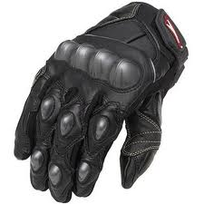
SMART GLOVE
By
Aniruddh Gawade
Siddesh Gad
Shawn D’Souza

Slide 2


Communication Barrier
???
?

Slide 3
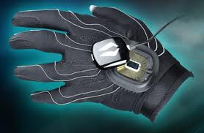
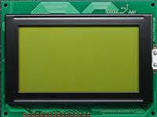
MAIN COMPONENTS
Hand Glove
Portable Display Device

Slide 4
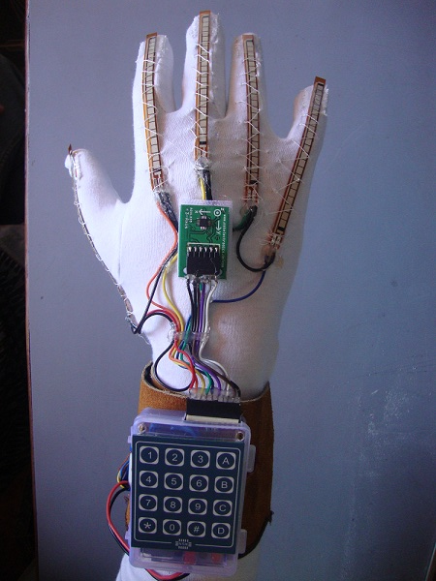
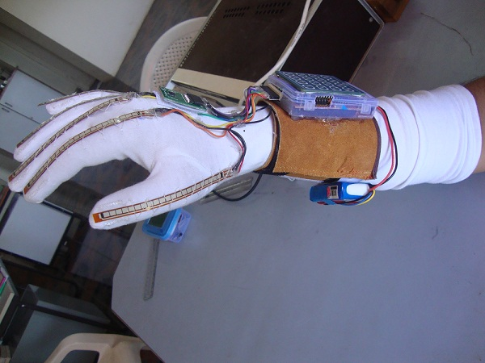
Prototype

Slide 5

Language standards to follow
ASL ( Character based )
BSL ( Word based )

Slide 6
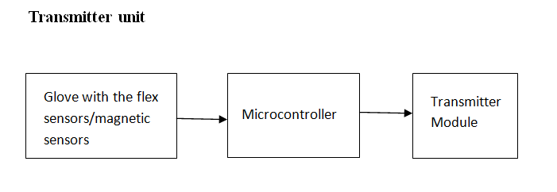
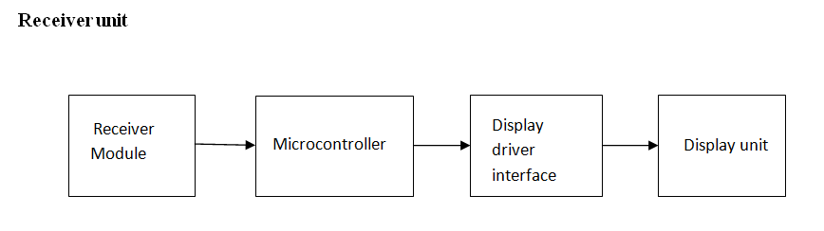
mechanism

Slide 7
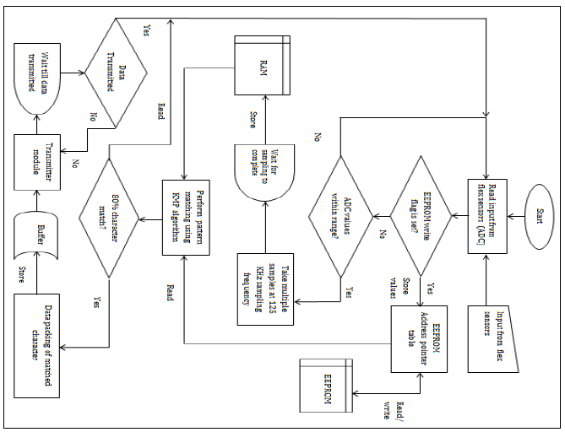
Block Diagram Of Transmitter

Slide 8
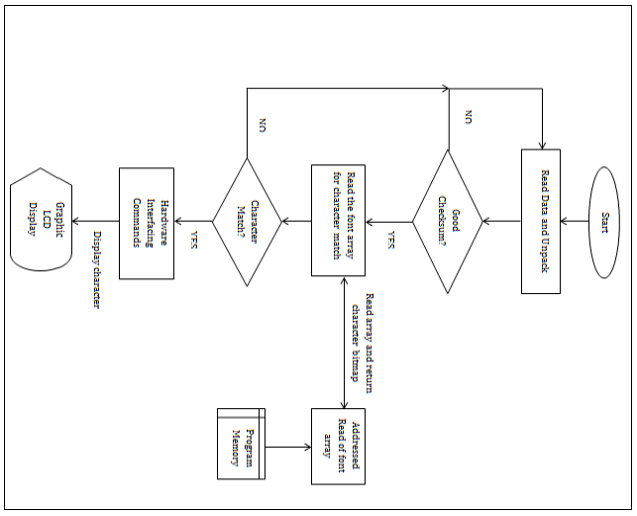
Block Diagram Of Receiver

Slide 9
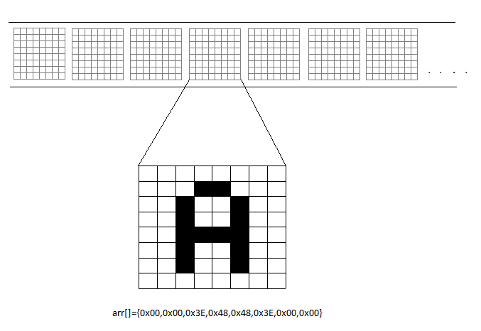
Alphabet value(x10)={150,100,100,100,100},{150,151,100,100,99},{…

Slide 10
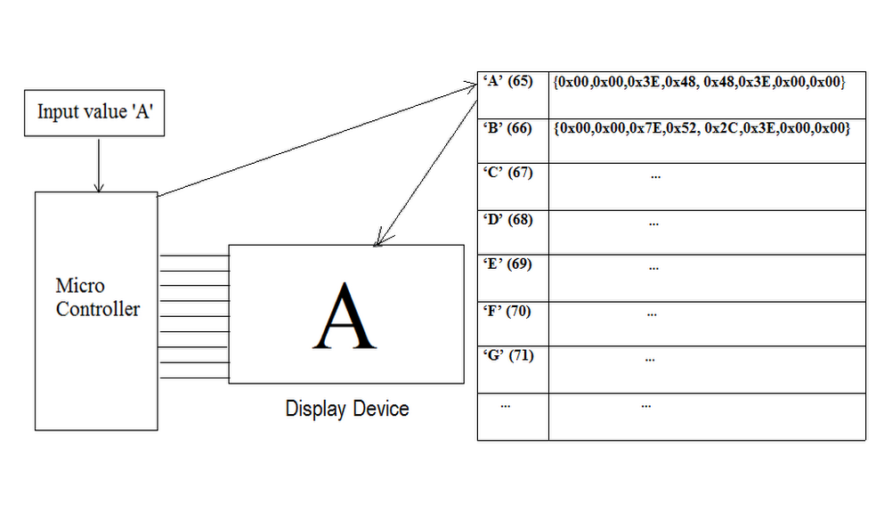
Display Device

Slide 11
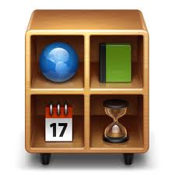
modes of operation
Text mode
Keyboard and Mouse mode
Appliance control mode
Robot control mode

Slide 12


Keyboard and mouse mode
For the keyboard, normal characters are matched and sent through the serial port to the computer.
A driver software application will then put the strings received into a text file.
For the mouse mode, the accelerometer in the glove sends the X-Y values to a mapping function.
This is then sent to a PS2 mouse controller IC EM 84510F which then drives the mouse pointer on the screen.
For right and left clicks, the flex sensors are used.

Slide 13

Wireless remote control
A sign is allotted to each appliance.
User teaches the unit which signs are for which device.
When he does the same sign the next time, pattern matching is done and that device is switched on/off correspondingly.

Slide 14
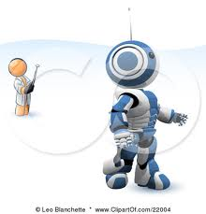
Robot control mode
The accelerometer in the glove can be used to control a robot.
The robot can be the users wheelchair etc. that he need to control.
The X-Y values are sent to a mapping function which then checks for a preset threshold to give the respective commands.
With just the tilt of the hand, the robot can be made to move forward, back, left or right

Slide 15

Hardware used
Flex sensors: 6 (five for the fingers and one for the wrist)
Microcontroller: Atmega 32 for the receiver (40 pin with 32KB flash EEPROM, 2KB RAM, 4 Ports I/O, 1KB EEPROM).
Atmega 328 for the transmitter (28 pin with 32KB flash EEPROM, 2KB RAM, 3 Ports I/O, 1KB EEPROM, 6 ADC inputs)
Transmitter & receiver module: CC2500
Display device: 128*64 Graphic LCD
Batteries: Li-Polymer batteries (3*3.7V battery pack)

Slide 16
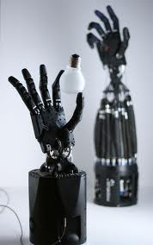
Future scope
More Interactive display on the portable screen
Robotic arm controlling (handling dangerous material)
3D Gaming & learning
Artificial prosthesis
Military applications

Slide 17

references
www.arduino.cc
flex sensor datasheet (pdf version)
Atmega 32 microcontroller datasheet by Atmel Corporations (pdf version)
Atmega 328 microcontroller datasheet by Atmel Corporations (pdf version)
KS0108B Graphic LCD driver datasheet (pdf version)
LCD-128G064E Graphic LCD datasheet (pdf version)
Avr Studio Software Tutorial by Sepehr Naimi
Tuxgraphics AVR C-programming tutorial (http://tuxgraphics.org/electronics)
C Programming for Microcontrollers- Quick Start Guide: The Next Generation by Joe Pardue
www.en.wikipedia.org

Slide 18
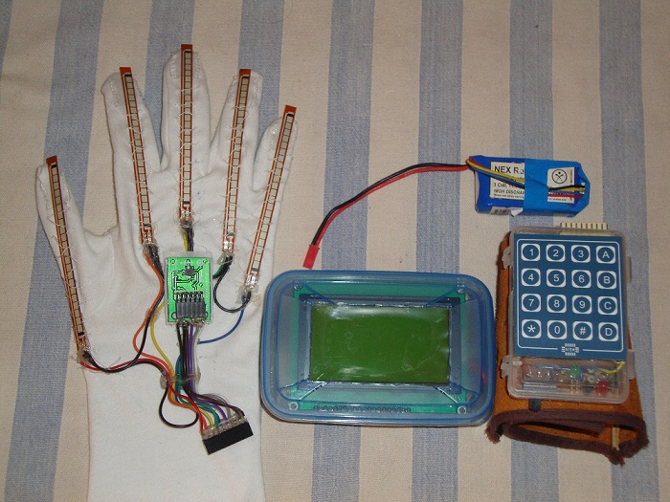
THANK YOU

Slide 20
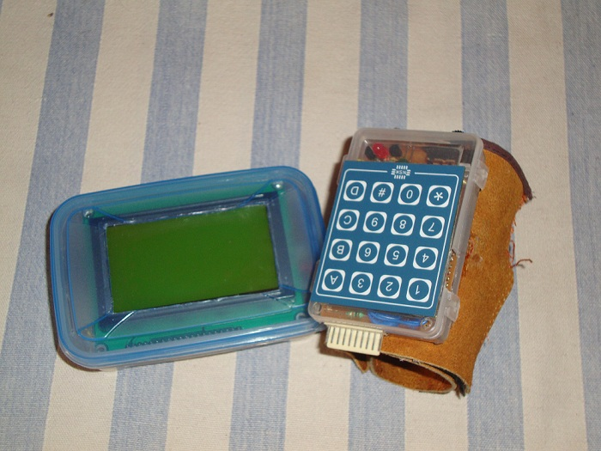

Slide 21
