Slide 1
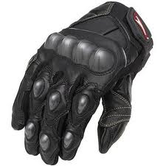
SMART GLOVE
By
Aniruddh Gawade
Siddesh Gad
Shawn D’Souza

Slide 2


Communication Barrier
???
?

Slide 3
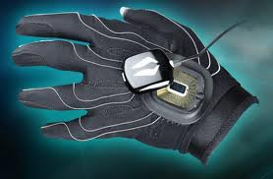
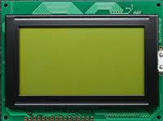
MAIN COMPONENTS
Hand Glove
Portable Display Device

Slide 4
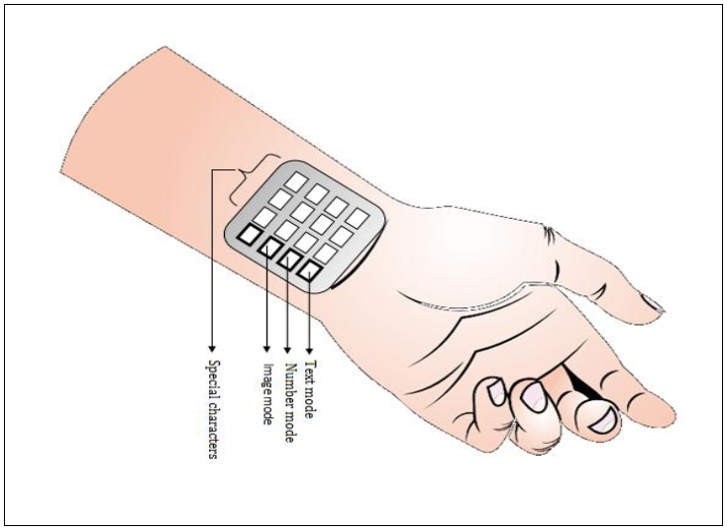
Prototype
User wears gloves on which is mounted the flex sensors
As the signs are made, the the voltage across the flex sensor is converted to digital values by the ADC of the microcontroller.
Multiple samples are taken to improve the probability of a match for a character.
The sampled values are then pattern matched against reference values taking into account the error factor and the probability of matches.
We use the ‘Cornering’ algorithm to center down the values
Digital value from 5 fingers (x10 = 50 values) ={150,100,100,100,100},{150,151,100,100,99},{…

Slide 5
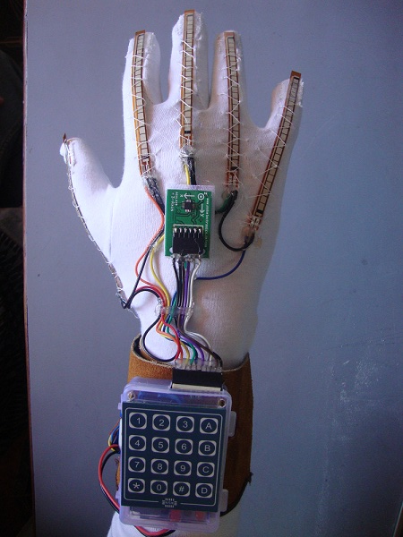
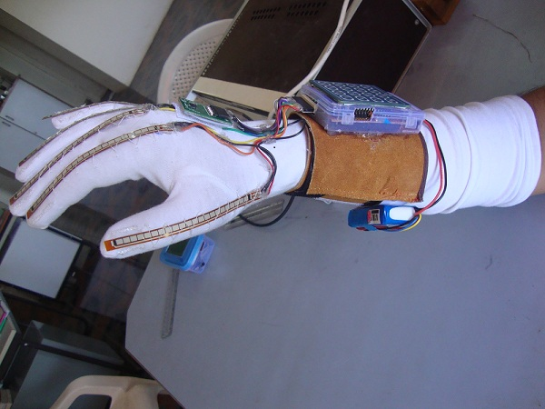
Prototype

Slide 6
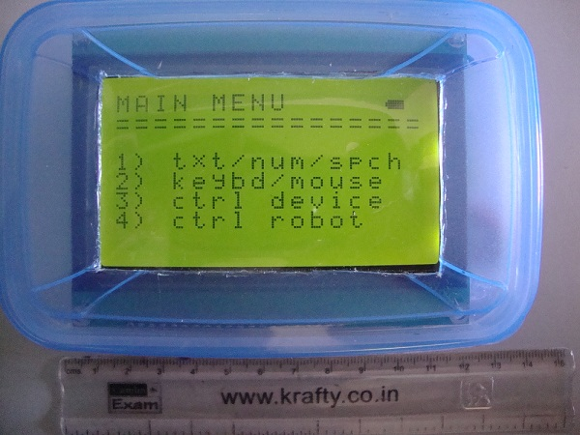
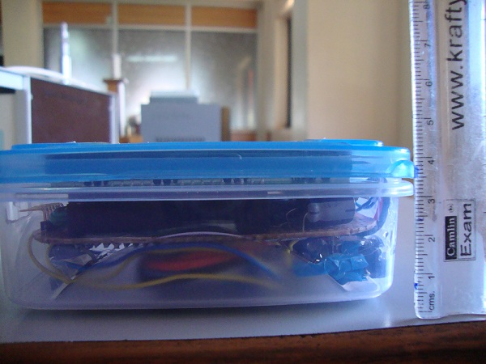

Slide 7

Language standards to follow
ASL ( Character based )
BSL ( Word based )

Slide 8
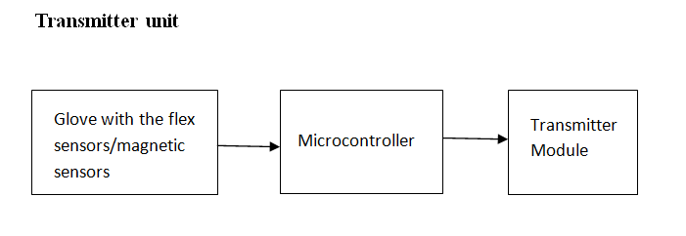
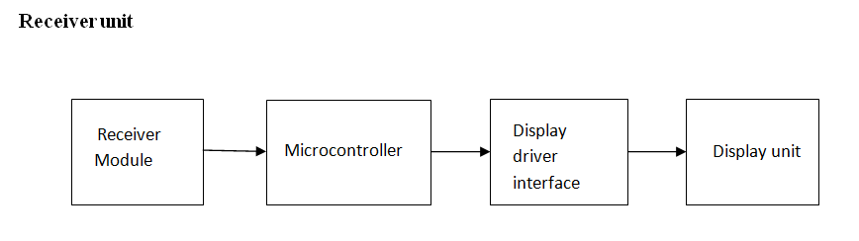
mechanism

Slide 9
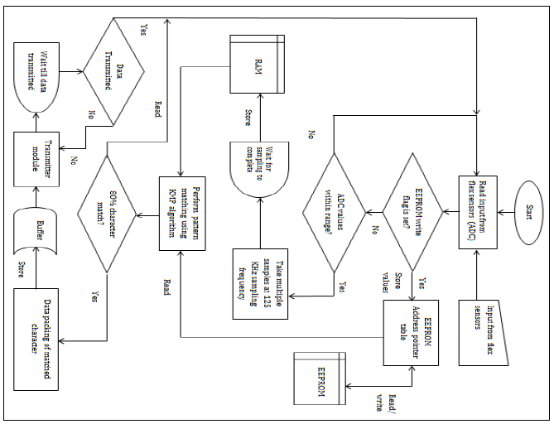
Block Diagram Of Transmitter

Slide 10
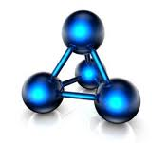
Knuth-Morris-Pratt
KMP algorithm.
Search Values
150
150
150
100
100
150
100
100
100
100
120
150
100
100
100
100

Slide 11
Knuth-Morris-Pratt
KMP algorithm.
Search Values
150
150
150
100
100
150
100
100
100
100
120
150
100
100
100
100

Slide 12
Knuth-Morris-Pratt
KMP algorithm.
Search Values
150
150
150
100
100
150
100
100
100
100
120
150
100
100
100
100
150
100
100
100
100

Slide 13
Knuth-Morris-Pratt
KMP algorithm.
Search Values
150
150
150
100
100
150
100
100
100
100
120
150
100
100
100
100
150
100
100
100
100

Slide 14
Knuth-Morris-Pratt
KMP algorithm.
Search Values
150
150
150
100
100
150
100
100
100
100
120
150
100
100
100
100
150
100
100
100
100
150
100
100
100
100

Slide 15
Knuth-Morris-Pratt
KMP algorithm.
Search Values
150
150
150
100
100
150
100
100
100
100
120
150
100
100
100
100
150
100
100
100
100
150
100
100
100
100

Slide 16
Knuth-Morris-Pratt
KMP algorithm..
Search Values
150
150
150
100
100
150
100
100
100
100
120
150
100
100
100
100
150
100
100
100
100
150
100
100
100
100

Slide 17
Knuth-Morris-Pratt
KMP algorithm.
Search Values
150
150
150
100
100
150
100
100
100
100
120
150
100
100
100
100
150
100
100
100
100
150
100
100
100
100
150
100
100
100
100

Slide 18
Knuth-Morris-Pratt
KMP algorithm.
Search Values
150
150
150
100
100
150
100
100
100
100
120
150
100
100
100
100
150
100
100
100
100
150
100
100
100
100
150
100
100
100
100

Slide 19
Knuth-Morris-Pratt
KMP algorithm.
Search Values
150
150
150
100
100
150
100
100
100
100
120
150
100
100
100
100
150
100
100
100
100
150
100
100
100
100
150
100
100
100
100

Slide 20
Knuth-Morris-Pratt
KMP algorithm.
Search Values
150
150
150
100
100
150
100
100
100
100
120
150
100
100
100
100
150
100
100
100
100
150
100
100
100
100
150
100
100
100
100

Slide 21
Knuth-Morris-Pratt
KMP algorithm.
Pattern found.
Search Values
150
150
150
100
100
150
100
100
100
100
120
150
100
100
100
100
150
100
100
100
100
150
100
100
100
100
150
100
100
100
100

Slide 22
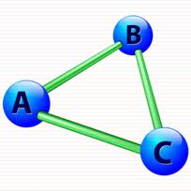
Cornering ALGORITHM
Pass 1: Multiple sampling is done and an average is taken so as to reduce the noise irregularities in the input.
Pass 2: In this we first take a wide error factor say ±30 and find out which character sample matches the reference values with an 80% or more probability using Knuth Morris Pratt Algorithm. If there is only one match then the character is the match and the function will return its ASCII value.
Pass 3: If there is a tie of more than one character then all the matched characters are stored in an array. then the error factor is decremented and high probable matched characters from pass 1are again pattern matched against the sampled values. If one match is found it is returned as the character.
Pass 4: Pass 2 is repeated for a decreased error factor. It is done till the proper match is found and the error reaches a certain threshold value.
Pass 5: if no match is found it return -1.

Slide 23

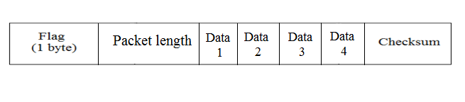
Data Packet
Data 1: command byte
Data 2: matched character
Data 3 and 4: reserved for mouse X-Y transmission
Value of ‘A’

Slide 24
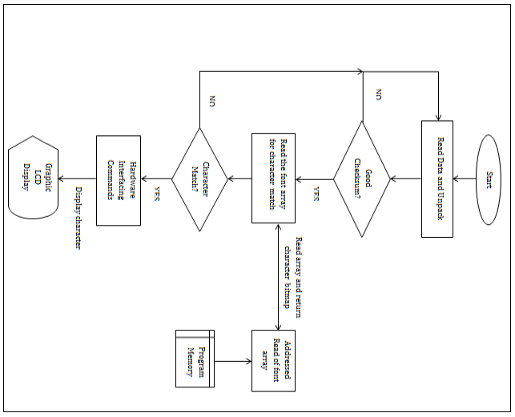
Block Diagram Of Receiver

Slide 25
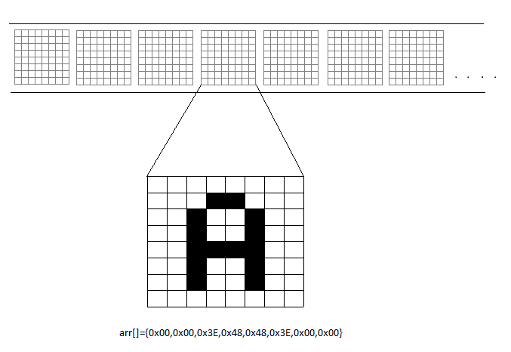
Alphabet value(x10)={150,100,100,100,100},{150,151,100,100,99},{…

Slide 26
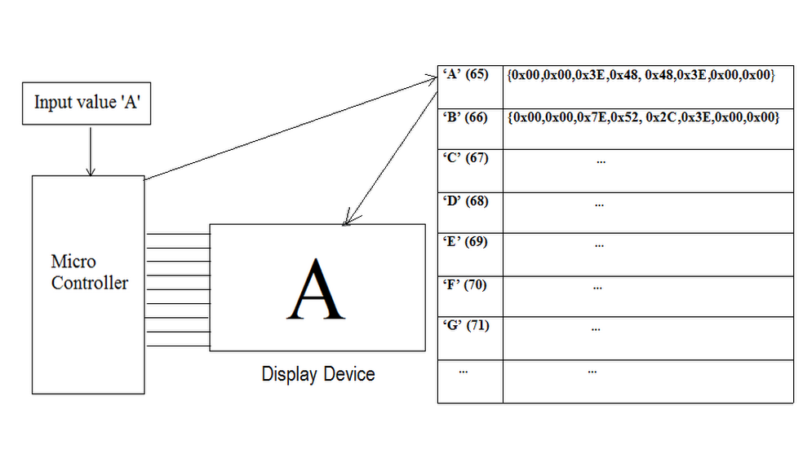
Display Device

Slide 27
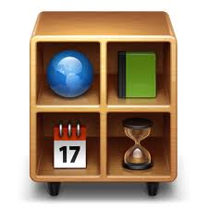
modes of operation
Text mode
Keyboard and Mouse mode
Appliance control mode
Robot control mode

Slide 28


Keyboard and mouse mode
For the keyboard, normal characters are matched and sent through the serial port to the computer.
A driver software application will then put the strings received into a text file.
For the mouse mode, the accelerometer in the glove sends the X-Y values to a mapping function.
This is then sent to a PS2 mouse controller IC EM 84510F which then drives the mouse pointer on the screen.
For right and left clicks, the flex sensors are used.

Slide 29

Wireless remote control
A sign is allotted to each appliance.
User teaches the unit which signs are for which device.
When he does the same sign the next time, pattern matching is done and that device is switched on/off correspondingly.

Slide 30
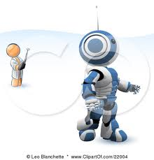
Robot control mode
The accelerometer in the glove can be used to control a robot.
The robot can be the users wheelchair etc. that he need to control.
The X-Y values are sent to a mapping function which then checks for a preset threshold to give the respective commands.
With just the tilt of the hand, the robot can be made to move forward, back, left or right

Slide 31

SYSTEM ANALYSIS
The bend resistance offered by the flex sensor ranges from 45KΩ to 125KΩ. This gives a potential difference across the flex sensor of around 2.5V to 3.676V respectively. (When connected with a voltage divider with 45KΩ to Vcc and the flex sensor to Gnd.)
This gives an 8-bit ADC value range from 128 to 188 respectively. ( when the Aref pin is tied to Vcc)
For graphic display, we require around 2KB or more of RAM for proper operation and display to the graphic LCD.
For wrist movement sensing an accelerometer will enhance the performance if mounted in the palm of the hand glove.
Character match is much faster and more accurate if multiple sampling techniques are adopted.

Slide 32
Image display is only possible if the bitmap is read straight from the flash memory of the microcontroller instead of storing is as ‘data’ on the RAM. If stored on the RAM, since each image is 1KB, the microcontroller runs out of RAM space fast, and this leads to loss of the important data values from the RAM (as those values are overwritten)
Each character is of 8 x 8 pixels. This gives 16 characters per line and 8 such lines.
The graphic display is divided into two halves of 64 x 64 pixels this giving a combined resolution of 128 x 64 pixels. Each half is controlled by a separate KS0108 chip. Hence we have CS1 and CS2 for selecting each half of the display.

Slide 33

Hardware used
Flex sensors: 6 (five for the fingers and one for the wrist)
Microcontroller: Atmega 32 for the receiver (40 pin with 32KB flash EEPROM, 2KB RAM, 4 Ports I/O, 1KB EEPROM).
Atmega 328 for the transmitter (28 pin with 32KB flash EEPROM, 2KB RAM, 3 Ports I/O, 1KB EEPROM, 6 ADC inputs)
Transmitter & receiver module: CC2500
Display device: 128*64 Graphic LCD
Batteries: Li-Polymer batteries (3*3.7V battery pack)

Slide 34
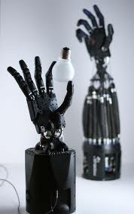
Future scope
More Interactive display on the portable screen
Robotic arm controlling (handling dangerous material)
3D Gaming & learning
Artificial prosthesis
Military applications

Slide 35

references
www.arduino.cc
flex sensor datasheet (pdf version)
Atmega 32 microcontroller datasheet by Atmel Corporations (pdf version)
Atmega 328 microcontroller datasheet by Atmel Corporations (pdf version)
KS0108B Graphic LCD driver datasheet (pdf version)
LCD-128G064E Graphic LCD datasheet (pdf version)
Avr Studio Software Tutorial by Sepehr Naimi
Tuxgraphics AVR C-programming tutorial (http://tuxgraphics.org/electronics)
C Programming for Microcontrollers- Quick Start Guide: The Next Generation by Joe Pardue
www.en.wikipedia.org

Slide 36
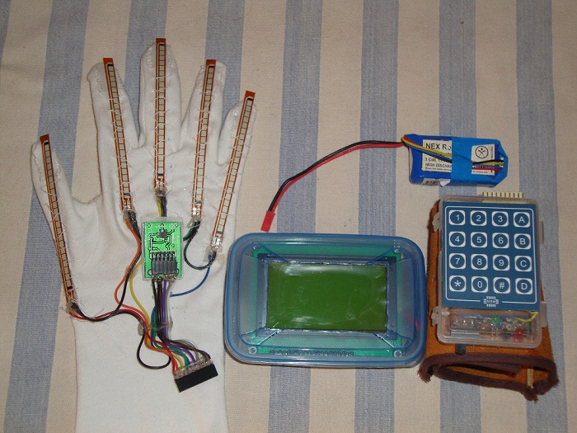
THANK YOU

Slide 38
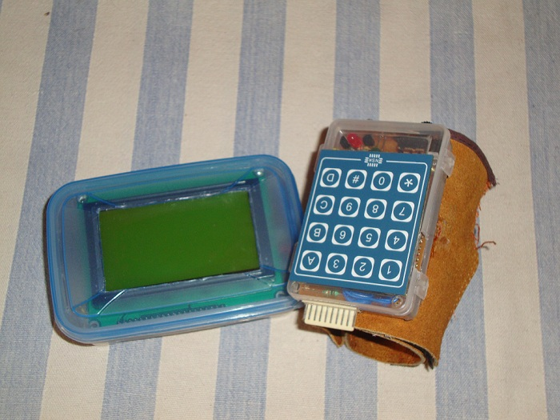

Slide 39
