Slide 1
Computational Methods Final Project: AGB-WD Binary Mass Transfer
Zach diermyer
Github link: https://github.com/zrd7527/ASTP720.git

Slide 2
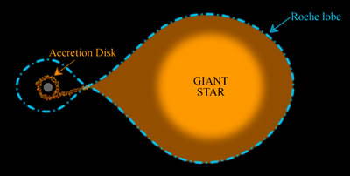
Background
If 2 stars are in a binary orbit, mass can be transferred between them
Mass is transferred when one star (or both) fill their “Roche Lobe”
The “Roche Lobe” is an area surrounding a star where material is gravitationally bound to that star (ref. 1)

Slide 3

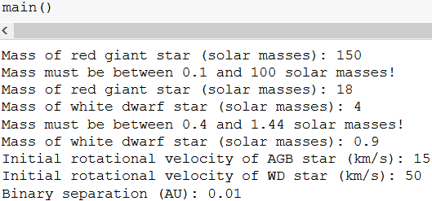
User Inputs
My code is interactive!
It requires a lot of inputs and gives warnings if the inputs are outside of normal physical values

Slide 4

Creating an array of “Star Particles”
A variable called resolution is used to build up the star (integrating dm)
A resolution of 0.01 corresponds to each “star particle” having a mass of 0.01 solar masses
My code builds the star with these by adding shells containing many particles

Slide 5

Solving the Gravitational Potential
Once the array is built, the potential from each star is found for shells of the giant star
Any outer shells with a greater potential from the white dwarf star are transferred

Slide 6
Exchange of Mass and Angular Momentum
The total transferred mass is added to the white dwarf star
The transferred angular momentum is used to find the new rotational velocity of each star

Slide 7
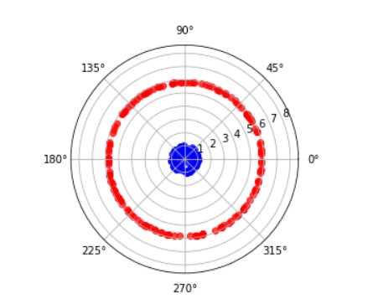
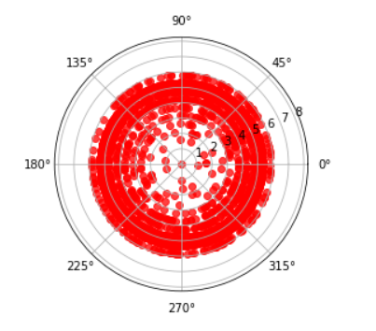
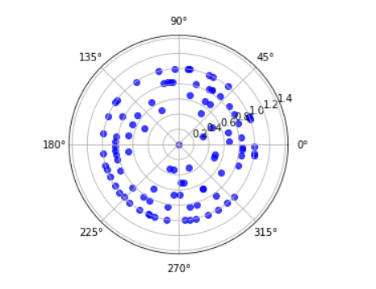
Simulation
For my simulation I used the radial dimension of each star particle to project the stars onto 2D polar coordinates
The red giant star is shown in red and the white dwarf in blue
The last plot shows the outer layers of the AGB star that are transferred to the white dwarf

Slide 8

Future Updates: Algorithm
My code would benefit greatly from a tree structure
The star particle cluster is currently just a clunky 2D array
A tree containing branches for each shell of the star and a leaf for each particle would be much more efficient than an array.

Slide 9
Future Updates: Accuracy and Simulation
The system only has 1 time step; having intermediate time steps would increase accuracy
My code does not consider orbital velocity or change in orbital separation
The mass transfer is lossless
Entire shells are removed for the mass transfer
The simulation is not 3D

Slide 10
Questions?

Slide 11
References
Paczynski, B. (1971). "Evolutionary Processes in Close Binary Systems". Annual Review of Astronomy and Astrophysics. 9: 183–208. Bibcode:1971ARA&A...9..183P. doi:10.1146/annurev.aa.09.090171.001151.
Hayashi, C. Evolution of stars of small mass in the pre-main sequence stages. Prog. Thoer. Phys. (1963)
Karttunen, H. Fundamental Astronomy. Springer-Verlag Berlin Heidelburg (2007)
Keeton, K.: Principles of Astrophysics. Springer New York Heidelburg Dordrecht London, New York (2014)
Nakano, T.: Pre-main Sequence Evolution and the Hydrogen-Burning Minimum Mass. 50 Years of Brown Dwarfs, Astrophysics and Space Science Library Volume 401 (2014)

