Slide 1

COVID-19 Impact On Middle Class
An Initiative By ☺

Slide 2

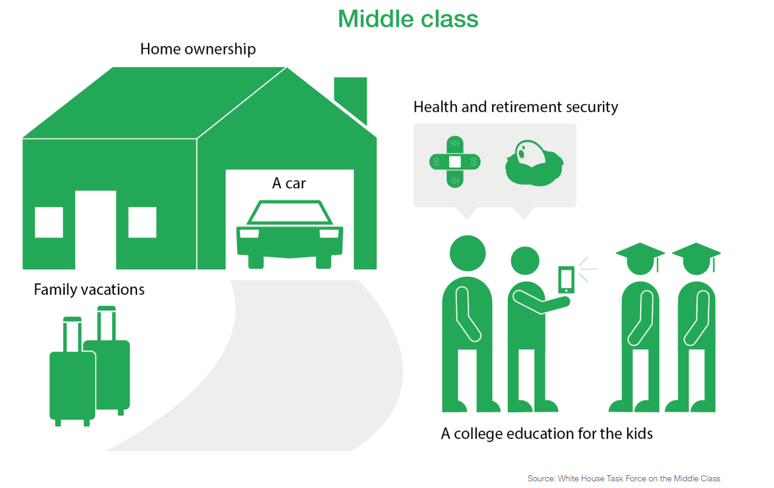
Who is Middle Class?
Middle Class
Lower
Middle
Upper
Poor
 | Salary Range Per Month After TDS
Class | Minimum | Maximum
Lower Middle Class | 15000 per month | 50000
Middle Middle Class | 51000 | 100000
Upper Middle Class | 100001 | 200000 per month
Rich
Middle Class Synonyms
Family Man, Common Man, Ordinary People,
Aspiring Citizen, Stragglers, Thrivers, Savings Man,
Emotional, Impulsive, Patriotic, Nationalist,
Materialistic, Conservative, Diligent,
Law Obedient Citizen, Populace, Plain Folks,
Educated Class, Working Class, White Colour Class,
Gurgaon Guys, Bangloreans, Delhites, Mumbaikars,
Chennaihites, Pune Man, Start-up guys, Spiritual,
Not loving 9 to 5 guyz, Tax-Payer, TDS Guyz etc !!!
Middle Class Consists of:
Husband, Wife, 2 kids, 1 pet
1 Car Loan
1 House Loan
2 Credit Card
1 Salary
https://money.cnn.com/infographic/economy/what-is-middle-class-anyway/index.html

Slide 3
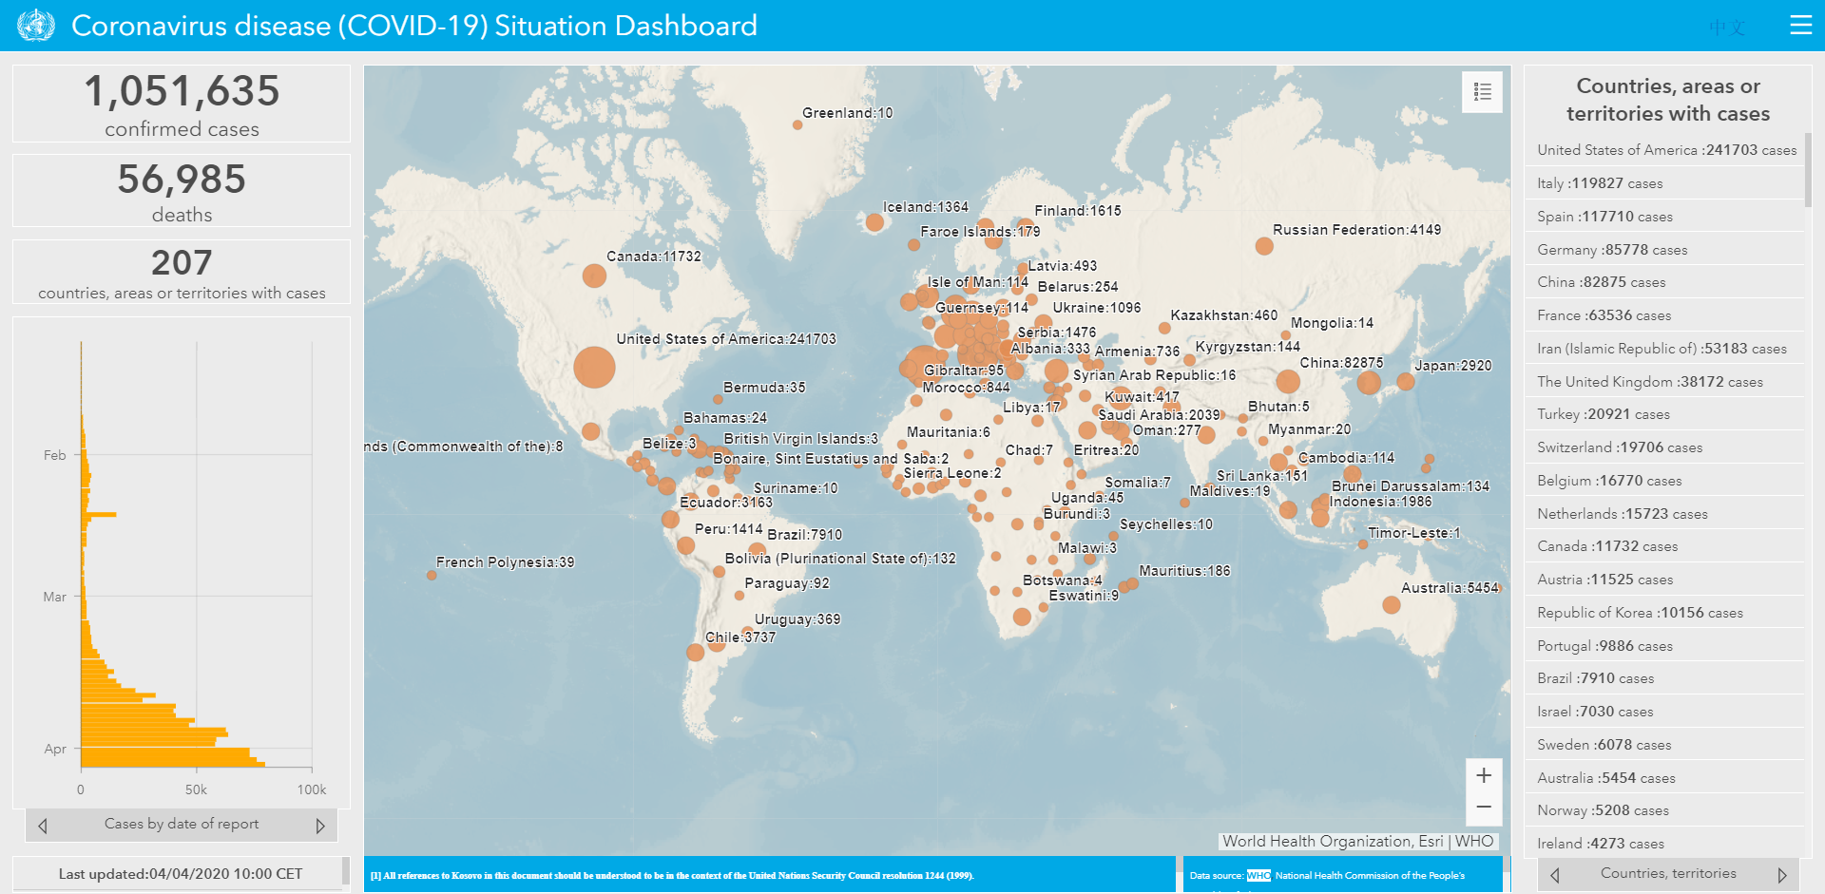
COVID-19 | Insufferable & Inevitable | World wise As of 4th April

Slide 4
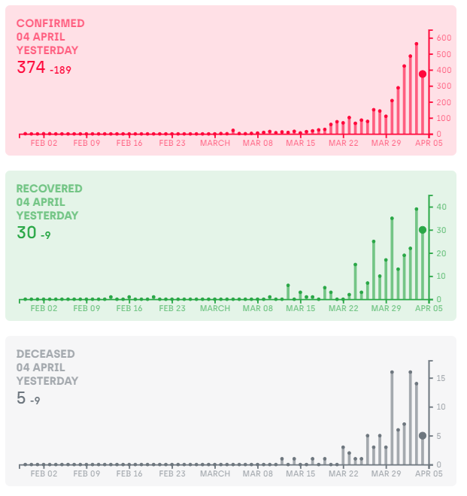
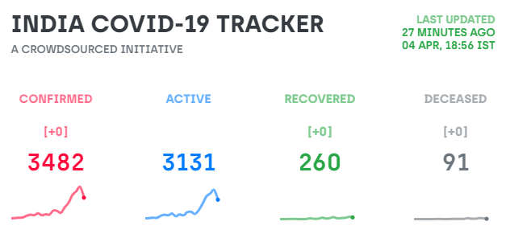
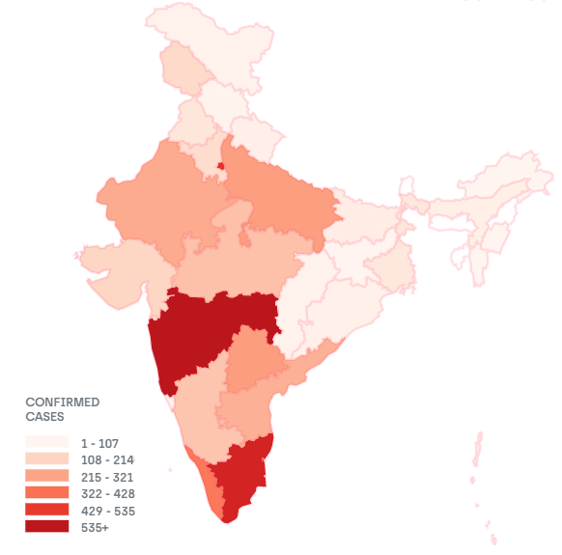
COVID-19 | covid19india.org

Slide 5
Middle Class Expense & Job Type | Yes, we need Help ☹
Jobs We do:
Shopkeepers, Software Engineer, BPO, ITES, Banking Staff, Clerk, Pvt Teacher, MBBS Doctors, Nursing Staff, Police Man, Armed Personnel, Delivery Man, Staff at Shop, Staff at Mall, Staff at Hospitals, Staff in Cyber Cities, Start-Up Entrepreneurs, Intrapreneurs, Hotel Industry Staff, Self Business, Art People(Music, Painting, Writing, Singing, Dancing, Trainer), Media Professionals, Receptionist, Airport/Airline/Aircraft Support Staff, Transportation(Bus, Train, Metro, Uber, Ola, Auto), Automobile Industry Staff, Self Employed, Journalists, Struggling Comedians, Thriving TV Actors, Artisans etc etc ☹
Now let’s say you are saving 10K Monthly and 30K Quarterly.
After every 3 months; there is either a festive seasons or summer vacation or winter vacation or Hospital needs or kids admission or Home Town Visit
Possible expense once in a quarter
Shopping, Home Town Visit, Festive Expense, New Electronics, Movies, Dinning etc cost you somewhere 15K
Fact:
A middle class can have sustainable liquidity of 60K Annually while earning 1 Lakh per month
Cash Reserve:
Monthly 50K → Annual Saving NIL or 50K
Monthly 1 Lakh → Annual Saving 60K
Monthly 2 Lakh → Annual Saving 2 Lakh

Slide 6
Gratitude
Let me take a moment to express my gratitude towards the Doctors, Police man, Nursing Staff, Hospital Support Staff and Towards each and every one of them working during this difficult time.
At the same note, I appreciate all the steps taken by our Honourable Prime Minister &
Honourable Delhi Chief Minister.
Stay Home, Stay Safe, Think More, Learn More, Be Thankful, Be Grateful, Be More ☺

Slide 7
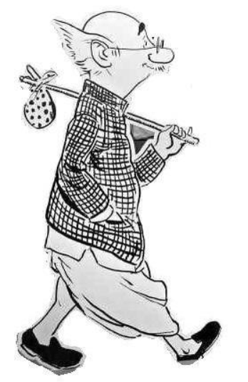
Middle Class | Key Pain Points
We need Help as well but it seems we are most ignored species.
2019 was year of stand-up… alas 2020 is the year of Sit-Down-Stay-Home
Family Related Stress, Anxiety and Worry: If anything goes wrong ? You are on your self
Job Cuts, Cost Saving, Relocation, job changes, or Unpaid Leaves, Deduction
Tax Burden: Feb & March had been the month of Deductions
Moratorium Offered was paradox: It is as good as ugly

Slide 8
Middle Class | Appeal to Governance
Central Governance:
Please have a transparent Robinhood model: Taking donation from rich and giving it to the poor.
Let’s classify them at least in these difficult. We should know who are donors(Rich) and who are the receivers(Poor).
Definition rich and poor is categorized at individual level.. Let’s publish the data in real time. We should know who are the beneficiary.
Please donate as much as you can… but keep in mind helping some one you know and if he is in need… Help him first.
Since Celebrity and rich has minimum reach to ground, they prefer to donate but as a middle class we are in regular touch of needy and poor… Help them first and then donate.
Please have inclusive policy..& Please don’t ignore common man, tax payer, all caste, all religion. Please don’t grant any specific amount to specific people
Please create a framework to manage this catostrophy once for all.. Let’s spend on creating or setting more hospital on NPA’s premises or govt lands, let’s setup R&D Centre district wise to generate meaningful job.
Please spend on considering the light and fight on for next 6 month.
Delhi Governance:
Thanks for all your inclusive policies, which includes each and every Delhites as beneficiary. Thanks for not diversifying us on the based caste, religion and income group.
My Appeal:
Please promote the Govt School based education among middle class.
Middle class in emotional, social and impulsive… they send their kids to pvt school because what other will say.
This is the right moment… admission are open please create some awareness through media to send the kid or take admission in govt school for 2020.
At least this catastrophic year can bring this change. Middle class can save enough amount by sending kids to the govt school and can continue keep at maid @ house or staff @ shop.

Slide 9
Middle Class | What’s needed?
Whatever, I have said… for anything wrong in anyone’s context I’m sorry.
My Intent is only middle class biased…. Its neither politically nor state governance wise driven.
This is not scare people or spread any panic; rather a informed readiness among middle class wilderness.
Sole Intention: Middle class do need help and they are not sustainable enough to stay healthy in the system.
I will emphasize on only one point… Please have inclusive & transparent policy.
We need to defy death and earn bread for next 8 months.
I will upload these content online and will continue to run this every Sunday now on wards to elaborate middle class pain point and effective framework to deal with it.
I need a small help in all of you earning in the range of 15k to 2Lakh monthly to fill a form… without providing any personal detail. No phone, No Id but just one No duplicates.

Slide 10
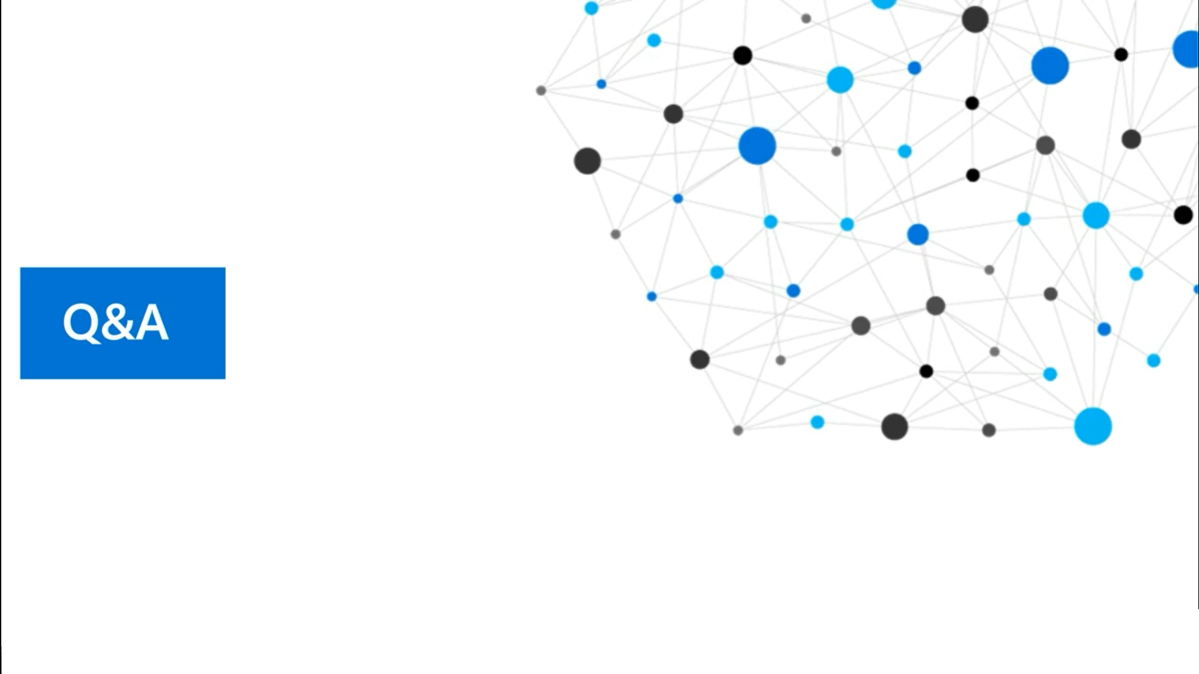

Slide 11
