Slide 1
DATA PIPELINE
Credit risk data pipeline:
bronze → silver → gold
24
4
monthly snapshots, Jan 2023 – Dec 2024
raw source feeds unified
overview
1 / 10

Slide 2
01 · PROBLEM & SCOPE
What the pipeline needs to produce
A model-ready dataset to predict early-stage loan default, rebuilt monthly and safe to join without leaking future information into a feature snapshot.
source | content
lms | loan management system — loan-level repayment / DPD history
clickstream | behavioral features (fe_1–fe_20)
attributes | demographics: age, occupation, SSN
financials | income, credit lines, balances, payment history
The label (good/bad) and the features must describe two different points in time for the same loan — features as of origination behavior, label as of a fixed observation window later.
Design consequence
The pipeline is split into two parallel gold outputs — a label store and a feature store — joined only at the very end, on loan id.
scope
2 / 10

Slide 3

02 · ARCHITECTURE
A medallion layout, rebuilt monthly
Bronze holds raw, unmodified snapshots; silver applies cleaning and typing; gold applies business logic and joins. Every layer is partitioned by snapshot date and re-derivable from the layer below it.
RAW
lms_loan_daily
BRONZE
SILVER
GOLD · LABEL STORE
lms
loan_daily
dpd ≥ 30 @ mob = 6
ETL
ETL
ETL
from loan_daily only
feature_clickstream
clickstream
clickstream
ETL
ETL
JOIN ON
loan_id
features_financials
financials
financials
GOLD · FEATURE STORE
ETL
ETL
ETL
joined + banded
features_attributes
attributes
attributes
financials, attributes, clickstream
ETL
ETL
as-is, per snapshot
typed, validated
architecture
3 / 10

Slide 4
03 · BRONZE LAYER
Bronze: capture first, interpret later
Each monthly backfill run writes every source, for every snapshot date, into its own partition
Why raw-and-immutable
Implementation
• Replayable: silver/gold logic can be rewritten and rerun against the same bronze history without re-touching source systems
• Auditable: a value that looks wrong downstream can always be traced to exactly what arrived
• Decouples ingestion cadence from cleaning-logic changes — the two evolve independently
• One directory per source (bronze/lms, bronze/feature_clickstream, …)
• Backfill loop iterates the 24 snapshot dates and calls a per-source, per-date processing function
• CSV in, Parquet-ready DataFrame out — schema-on-read, no dropped columns
bronze layer
4 / 10

Slide 5
04 · SILVER LAYER
Silver: make messy fields trustworthy
1. Normalize where intent is unambiguous.
2. Otherwise, NULL
field | problem observed | silver-layer rule
Age | Stray characters, unrealistic values | Strip non-digits, take leading 1–2 digits, null if >100
Occupation | Placeholder "_______" | Map sentinel → null
SSN | Malformed values mixed with valid | Regex-validate ###-##-####, else null
Annual_Income | Underscore-padded numerics, outliers | Strip underscores, cast double, null outside 0–200k
Num_Bank_Accounts / Interest_Rate | Implausible counts / rates | Domain caps (e.g. rate ≤ 34%), else null
Credit_History_Age | Free text: "22 Years and 1 Months" | Regex-extract years+months → single numeric field
Amount_invested_monthly / Balance | Sentinel strings ("__10000__", 21-digit negative) | Exact-match sentinel → null, else strip padding & cast
Type_of_Loan | Null exactly where customer has 0 loans | Null → explicit "No Loan" (cross-checked vs Num_of_Loan)
silver layer
5 / 10

Slide 6
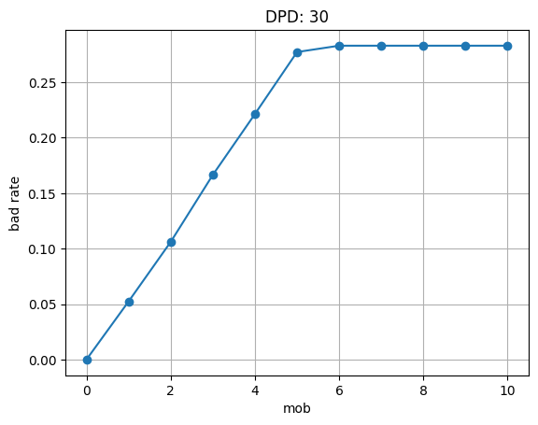
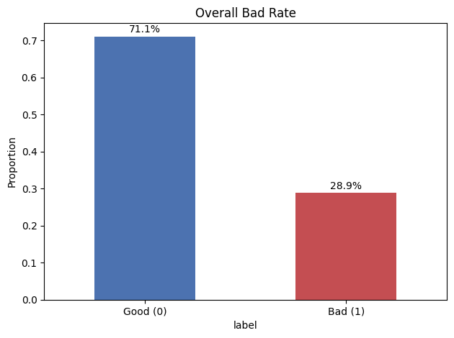
05 · GOLD LAYER - LABEL ENGINEERING
Defining “bad”: DPD ≥ 30 at MOB 6
The label needs a fixed observation window so every loan is judged on comparable footing.
The bad rate climbs steeply through mob 1–5, then flattens from mob 6 onward — the earliest month at which a loan's outcome is settled. mob = 6 is used as the label observation point, balancing early availability against label stability.
Label rule
label = 1 if dpd ≥ 30 by mob = 6, computed only from the silver loan_daily table, restricted to loans with enough installments observed.
resulting label distribution, gold label store
Why it matters
bad rate vs. month-on-book (mob), dpd threshold = 30
A ~29% bad rate needs class-aware evaluation downstream
labels
6 / 10

Slide 7
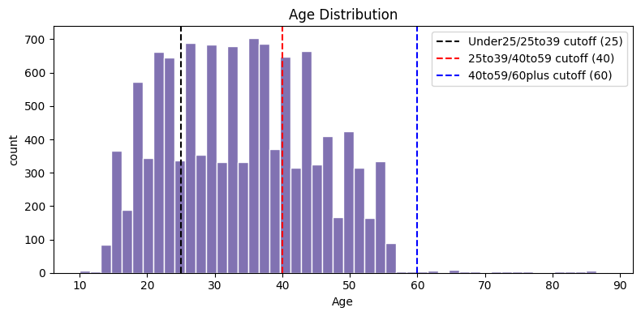
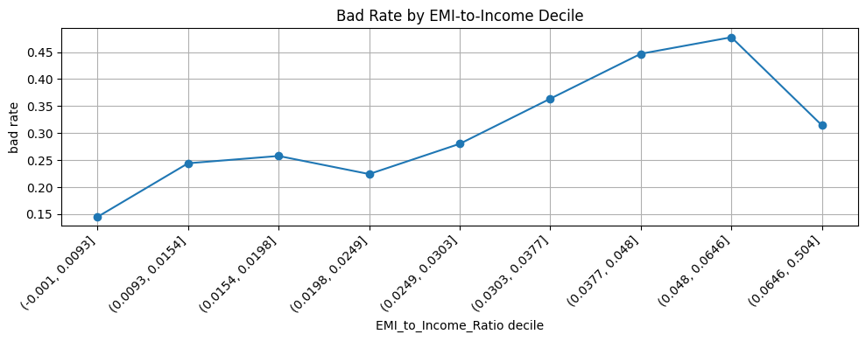
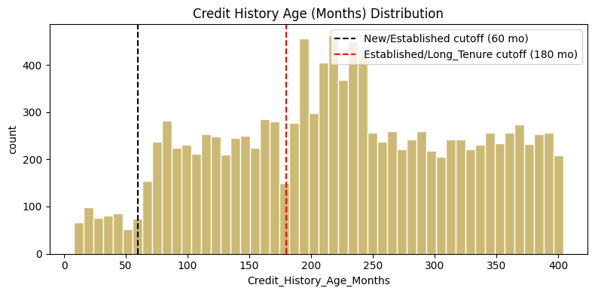
06 · FEATURE ENGINEERING & VALIDATION
Banding continuous fields, then checking the bands against risk
Cutoffs were placed against the real distribution, then each cut was checked against realized bad rate.
bad rate rises across EMI-to-income deciles
Engineered ratios
EMI_to_Income_Ratio, Debt_to_Income_Ratio left unbanded — decile checks (above) show the signal is monotonic and would be lost by coarse banding.
Age / Credit_History_Band
Age bands at 25/40/60; credit history at 60/180 months based on actual distribution to gain meaningful representation
7 / 10

Slide 8
07 · THE JOIN
Join key: loan_id
The gold label store and gold feature store are built independently and combined exactly once, at analysis/training time.
Why not join on snapshot_date? The feature store snapshot describes a customer's state at origination; the label store snapshot describes an outcome six months later. Joining on date would silently align a feature row with a label it didn't cause leading to leakage.
Enforced instead
• Join key is the loan's identity, loan_id, stable across both stores
• Row counts are logged before and after the join to catch silent fan-out or drop
join logic
8 / 10

Slide 9
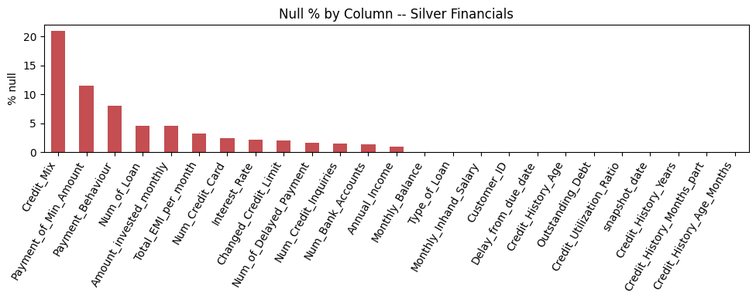
08 · DATA QUALITY
Missingness is measured, not hidden
Null rates are computed per column, per silver table, and nulls are deliberately preserved rather than imputed at this layer.
21%
12%
Credit_Mix null — the largest gap in financials
Payment of Min Amount null
Nulls are left as nulls in silver and gold rather than mean/mode-filled. Imputation strategy depends on the downstream model.
null % by column — silver financials
data quality
9 / 10

