Slide 1
End-to-end credit-risk ML pipeline
Bronze
raw snapshots
Silver
cleaned tables
CS608 | Prepared by Koh We Kiat
Singapore Management University | October 2026
Gold
ready for ML
Notes:
Purpose: show how raw monthly loan snapshots become monitored default predictions. Structure: design choices (slides 3-6), monitoring results (7-8), operating rules (9) and deployment fit (10).

Slide 2
A monthly pipeline now trains, scores and monitors a loan-default model with no manual steps
0.860
0.79–0.81
22 of 47
AUC on later-dated held-out loans at training
AUC on four unseen cohorts, scored without clickstream inputs
Numeric features arrive empty for Sep–Dec 2024 loans (clickstream customers missing)
The question
Will a new loan be 30+ days past due six months after it starts? An early answer lets credit teams price, limit or review risky loans.
What we built
A bronze, silver, gold datamart, an XGBoost model bank, monthly scoring, and drift and performance monitoring, all scheduled in Airflow.
What needs attention
Clickstream features are empty for loans from Jul 2024 (no matching customers). This drives the score PSI of about 4 and may explain part of the AUC gap.
Notes:
Headline: OOT AUC 0.860 at training; 0.79-0.81 on four unseen cohorts. Clickstream features are empty for loans from Jul 2024 (22 of 47 features), which drives the score PSI of about 4. This is a data feed fault, not model drift.

Slide 3








Data flows through bronze, silver and gold, then through train, score and monitor stages
RAW
BRONZE
SILVER
lms_loan_daily
lms
loan_daily
GOLD · LABEL STORE
dpd ≥ 30 @ mob = 6
from loan_daily only
JOIN ON
loan_id
ETL
ETL
ETL
feature_clickstream
clickstream
clickstream
ETL
ETL
GOLD · FEATURE STORE
joined + banded
financials, attributes, clickstream
features_financials
financials
financials
ETL
ETL
ETL
features_attributes
attributes
attributes
ETL
ETL
as-is, per snapshot
typed, validated
ML PIPELINE
gold stores
Train
model_bank
Inference
model_predictions
Monitor
model_monitoring
XGBoost, 12 + 2 month window
scores new loans monthly
PSI, CSI and AUC
label + feature
one pickle per training date
gold table
gold table
Gold features feed training and inference; gold labels feed training and the AUC check in monitoring
One Airflow DAG runs every stage monthly with backfill, one run at a time. Gates skip dates where features or models do not exist yet, failed tasks retry once, and every stage re-runs safely because each writes its own dated partition.
Notes:
Design choice: bronze keeps data as received, silver cleans and types it once, gold holds one label store and one feature store that every ML stage reads. One Airflow DAG runs all stages monthly with backfill, one run at a time; gates skip dates without features or models; failed tasks retry once; each stage writes its own dated partition so reruns are safe.

Slide 4
Data is cleaned once in silver, then shaped into one leak-free feature row per loan
Clean (silver)
Engineer (gold features)
Label and guard (gold labels)
Placeholder junk such as "_" or "!@9#%8" becomes null
Impossible values become null (age over 100, over 10 bank accounts)
"5 Years and 3 Months" becomes 63 months
Names and SSNs are dropped before modelling
One row per loan, built at origination
Ratios of EMI, debt, balance and investment to income
Bands for age, credit history and utilisation
Clickstream: 6-month pre-application average; no customers match from Jul 2024
Dropped as redundant after correlation clustering: Monthly_Inhand_Salary, Post_EMI_Slack, Loan_Type_Diversity
Bad = 30+ days past due at 6 months on book
Labels and features join on loan_id, never on date
The run stops if under 95% of labels have features
Joins are checked for fan-out and empty partitions
Leakage control: a loan’s features are frozen at origination, and its label is only read six months later.
Notes:
Cleaning happens once in silver. Features are built at origination and frozen; the label (30+ days past due at 6 months on book) is only read six months later, which prevents leakage. Labels and features join on loan_id, never on date. Redundant features were dropped after correlation clustering.

Slide 5
One tuned XGBoost model, validated on a later time window than it was trained on
Train / test: 12 months
OOT
0.860
Labels Jul 2023 – Jun 2024; 80/20 split, grouped by customer
OOT labels Jul – Aug 2024; model date 1 Sep 2024
AUC on the out-of-time window (Gini 0.72)
Preprocessing and tuning
Why XGBoost
Numbers scaled and categories one-hot encoded, fitted on training data only
Search: 10 random hyperparameter draws × 3 customer-grouped folds, scored by AUC
L1/L2 penalties keep the model simple
Best model is saved with its OOT results and monitoring reference
Captures non-linear risk interactions
Handles numeric and categorical inputs together
Small and fast enough to retrain monthly
Notes:
Training window is 12 months with a customer-grouped 80/20 split, then a 2-month out-of-time window. Preprocessing is fitted on training data only. Tuning is 10 random draws x 3 customer-grouped folds; shallow trees and L1/L2 penalties keep the model simple. Limitation: only one model family was tuned; a logistic-regression baseline is the next step.

Slide 6
Every month’s new loans are scored by stored models and written to a gold predictions table
Model artefact (one file per training date)
Predictions gold table
Fitted model and its preprocessor
Feature list and train, test and OOT dates
Hyperparameters, AUC and Gini per split
Reference distributions for monitoring: feature bins, score bins, OOT ROC
datamart/gold/model_predictions/<model>/<model>_predictions_<snapshot>.parquet
loan_id, Customer_ID, snapshot_date
model_name and model_predictions (probability of default)
One partition per model per month; reruns overwrite only their own
Scoring rule
Each month scores the loans originated that month with every model trained before it. A model trained in the same run scores its own month only after training finishes, so no job reads a half-written artefact.
Notes:
Each training date produces one artefact (model, preprocessor, feature list, metrics and the monitoring reference), written to a temp file then renamed so it is never half-written. Each month scores the loans originated that month with every earlier model, into one gold partition per model per month.

Slide 7
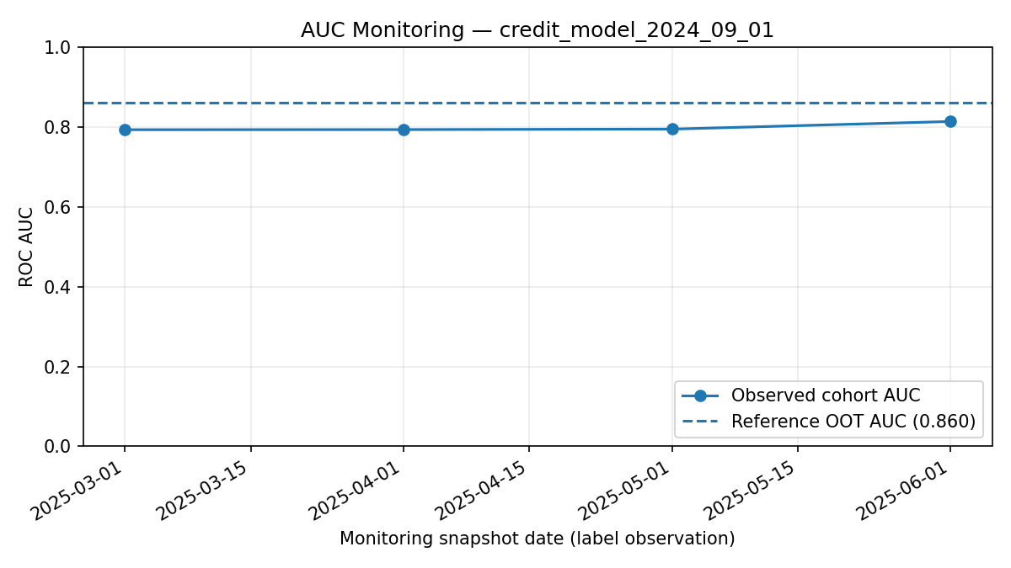
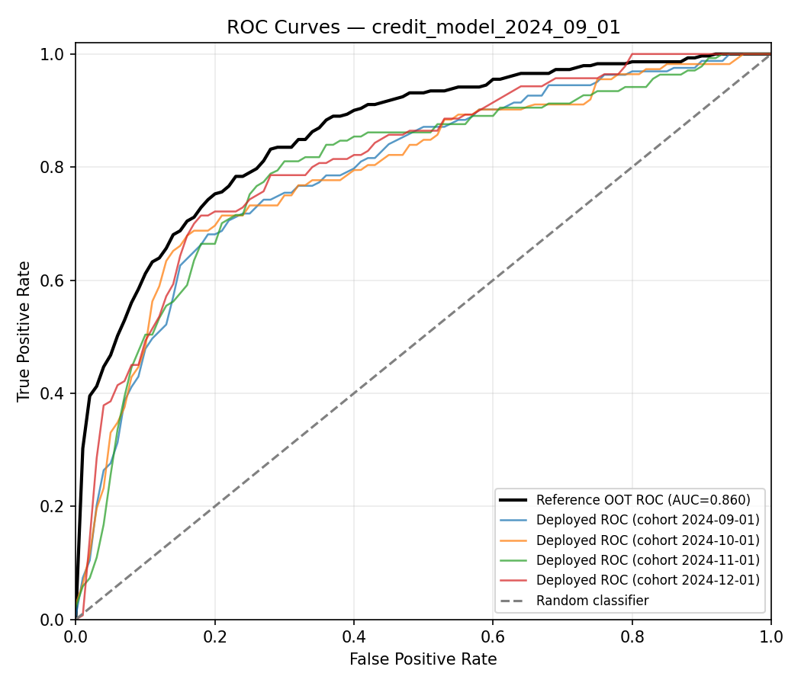
Even with clickstream inputs missing, AUC holds near 0.80 on unseen loans, below the 0.86 reference
AUC: chance a defaulting loan is scored above a good one
Four unseen cohorts score about 0.79–0.81 against 0.860, with no downward trend; the missing inputs may explain part of the gap
Deployed ROC curves sit mostly below the reference curve
Notes:
Read AUC as the chance a defaulting loan is scored above a good one. Four unseen cohorts score 0.79-0.81 against the 0.860 reference with no downward trend. The deployed ROC curves sit below the reference; the missing clickstream inputs may explain part of the gap.

Slide 8
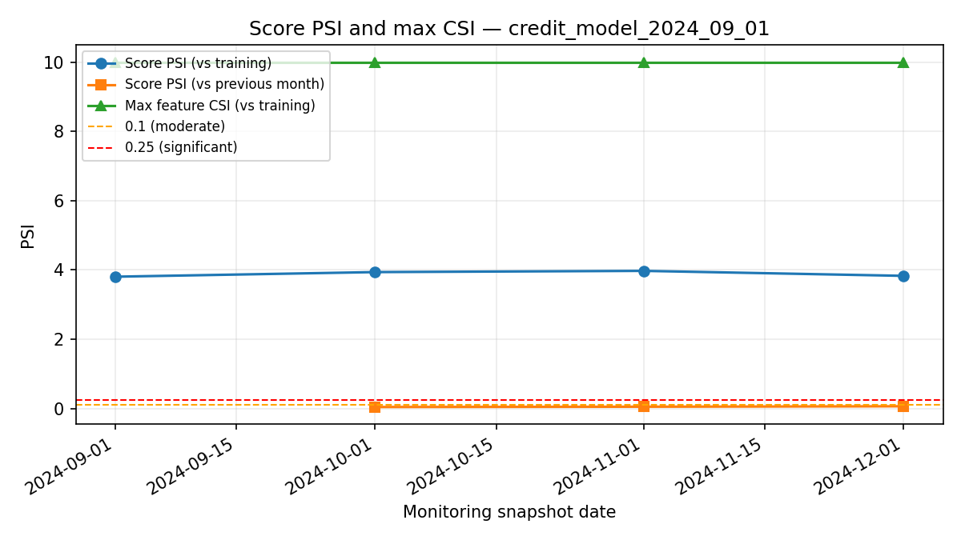
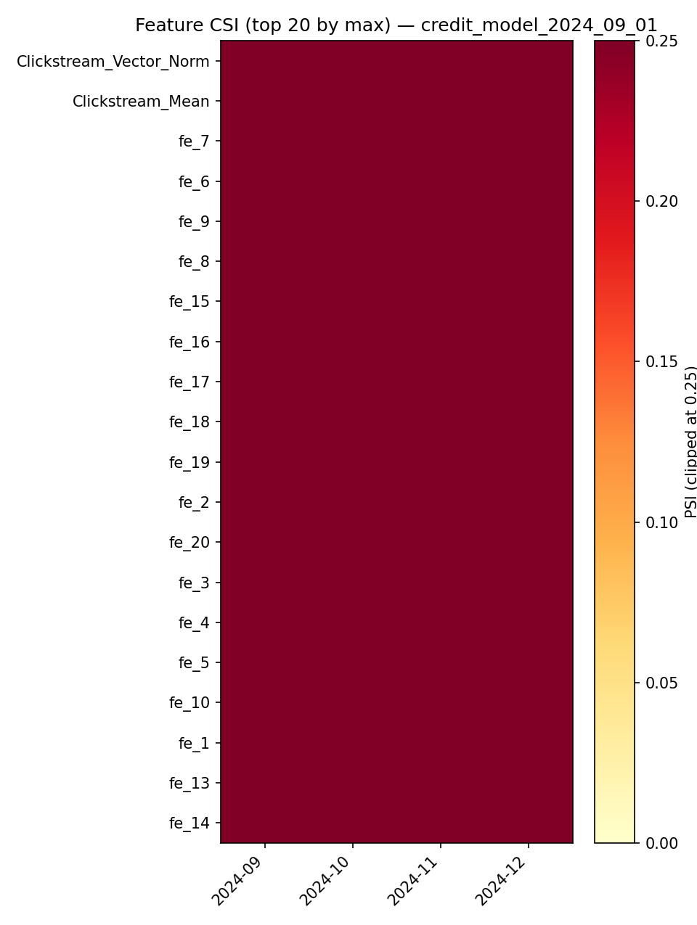
A data feed fault, not model drift, explains the score PSI: clickstream features are empty for new loans
PSI (score shift) and CSI (feature shift): below 0.10 stable, 0.10–0.25 watch, above 0.25 act
The top 20 features by CSI are all clickstream features; the 22 empty ones now read the maximum CSI (10) every month
Score PSI vs training (3.8–4.0) is driven by those nulls; month-on-month PSI stays low because the fault is constant
Colour scale clipped at 0.25; empty clickstream features plot at the top
Notes:
PSI measures score shift and CSI measures feature shift. Score PSI versus training is 3.8-4.0 because clickstream features are empty; month-on-month PSI stays low because the fault is constant. The heatmap's top 20 features by CSI are all clickstream features, and the max CSI reads 10 each month. This points to a feed fault to fix, not a reason to retrain.

Slide 9
Draft SOP: monthly traffic-light checks decide when to investigate, retrain or roll back
Signal | Green: no action | Amber: investigate | Red: retrain or roll back
AUC vs 0.860 reference* | Within 0.03 | 0.03–0.08 below | More than 0.08 below
Max feature CSI | Below 0.10 | 0.10–0.25 | Above 0.25
Score PSI vs last month | Below 0.10 | 0.10–0.25 | Above 0.25
Missing-rate rise vs training | Under 0.5 | n/a | Above 0.5: pause scoring, fix feed
1 Detect
Monthly DAG writes metrics and plots
2 Triage
Owner decides: data fault or real drift (5 days)
3 Retrain
Train a challenger on a fresh 12 + 2 month window
4 Validate
Shadow-score challenger; AUC ≥ champion once labels mature
5 Promote
Keep prior model; rollback = rescore with it
Notes:
Traffic-light rules turn the monitoring metrics into actions. Latest read: data quality red, max feature CSI red, AUC amber. The AUC bands are proposed; PSI, CSI and missing-rate cut-offs are those coded in the monitor. Steps: detect, triage within 5 days, retrain a challenger, validate against the champion, promote with rollback by rescoring with the prior model.

Slide 10
Monthly batch fits today; release new models in shadow first
Shadow: challenger scores the same loans (recommended)
The pipeline already scores each month with every earlier model, so no new infrastructure. Compare AUC once 6-month labels mature.
Serving mode
Monthly batch on Airflow (current): fits a monthly credit cycle; simple, auditable, backfillable
Model registry (e.g. MLflow): add when several models need staged promotion
Real-time API: only if loans are decided instantly; adds latency, uptime and security duties
Canary: a small share of new loans is decided by the challenger
Tests the real decision path, but needs a decision engine that can split loans, and exposes live credit decisions to an unproven model.
A/B test: random split of loans between champion and challenger
Gives causal evidence, but about 500 loans a month and a 6-month label lag make it slow and low-powered, and splitting customers raises fairness questions.
Recommendation: stay on batch and shadow every challenger; promote when it beats the champion, rollback = rescore with the prior model.
Notes:
Serving: monthly batch on Airflow fits a monthly credit cycle and is simple, auditable and backfillable; add a model registry when several models need staged promotion; a real-time API is only needed for instant decisions. Release strategy is separate: shadow means the challenger scores the same loans with no effect on decisions, and is compared with the champion once 6-month labels mature. Canary and A/B tests change live decisions, need a decision engine that can split loans, and are slow and low-powered here (about 500 loans a month, 6-month label lag). Recommendation: stay on batch, shadow first, then promote; rollback is rescoring with the prior model.

