Slide 1

Rossman stores sales Analysis
Zhijie Ren
EMSE6992

Slide 2
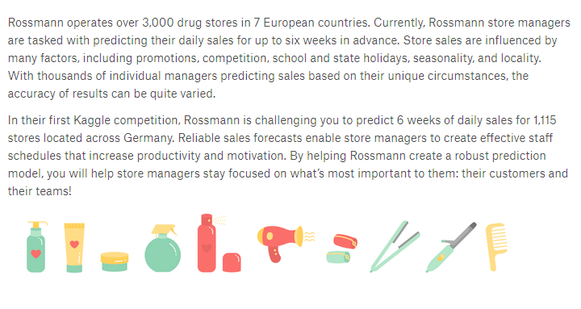

Slide 3
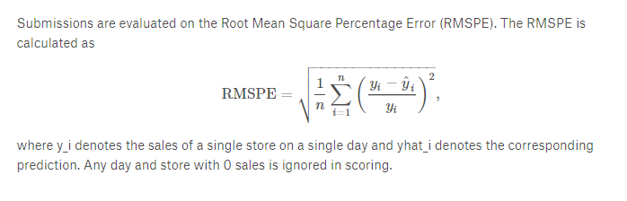

Slide 4
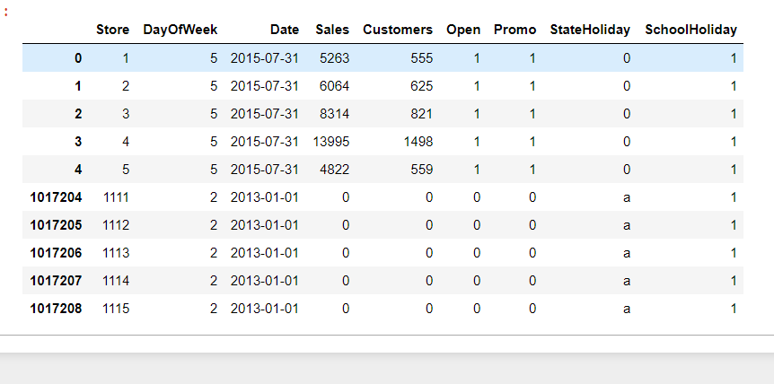
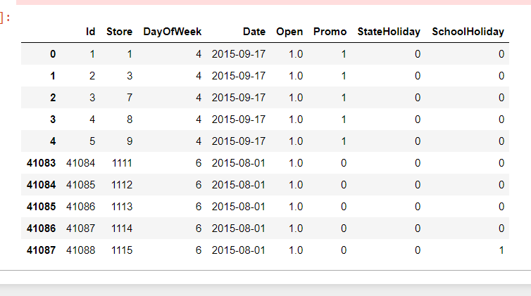
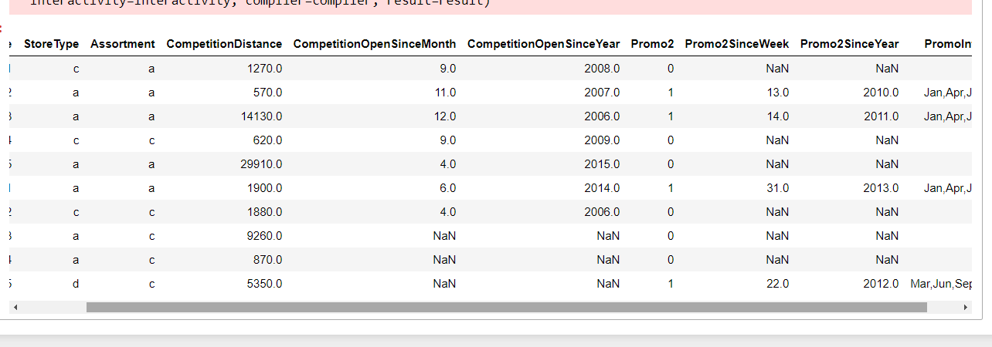

Slide 5
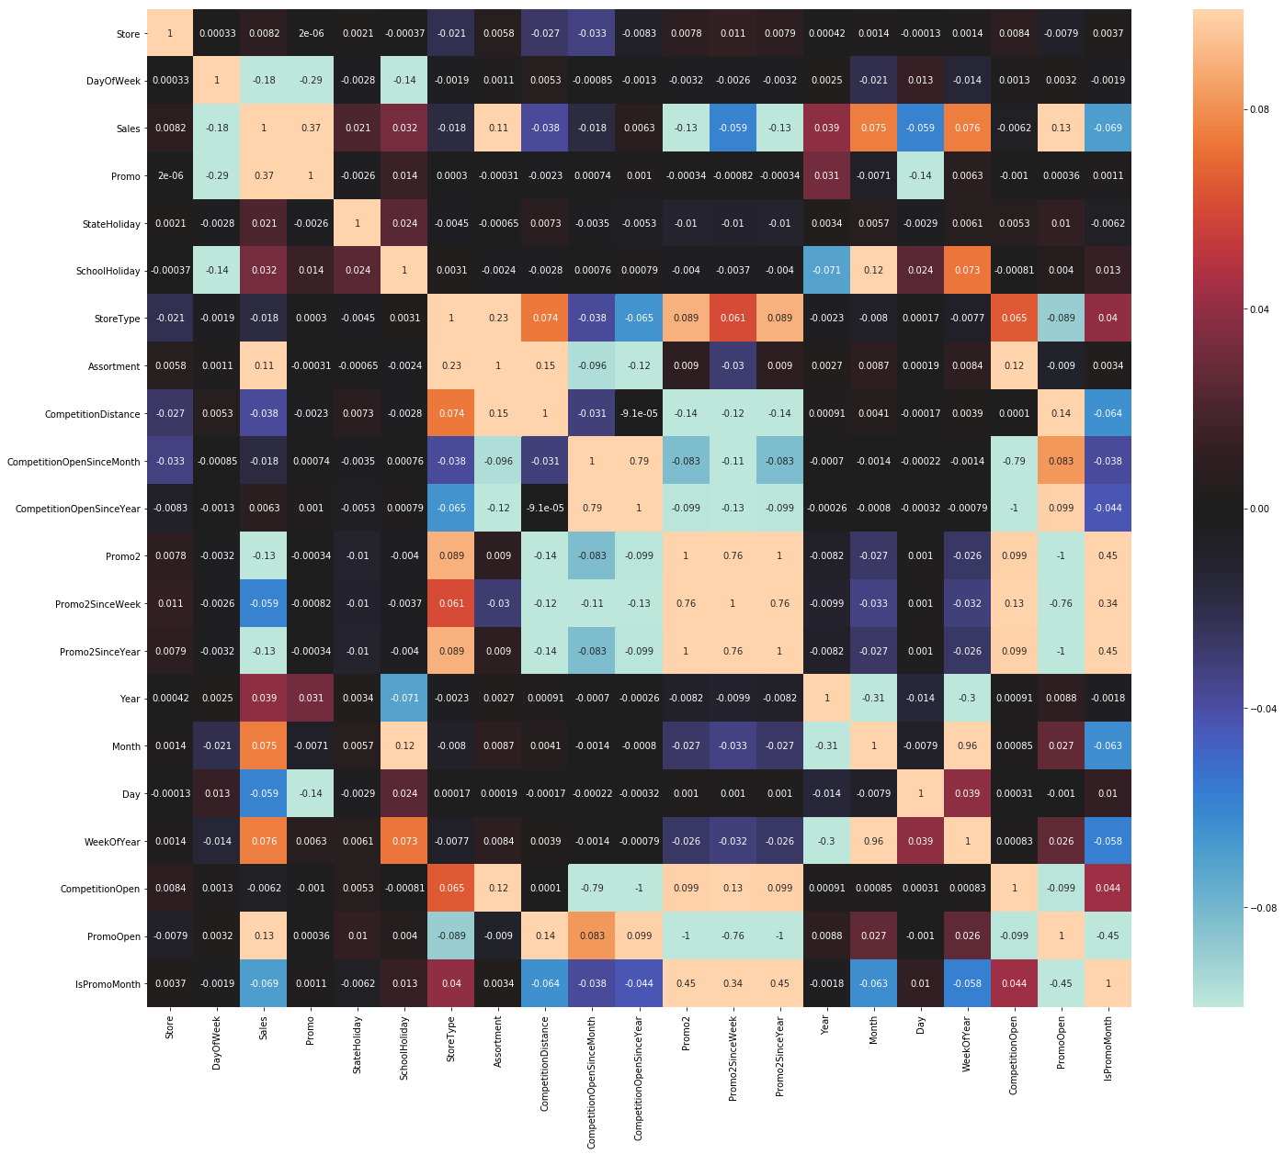

Slide 6
Calulate the opening time of the store’s competitor and the store’s promo time
data['CompetitionOpen'] = 12 * (data.Year - data.CompetitionOpenSinceYear) + (data.Month - data.CompetitionOpenSinceMonth) data['PromoOpen'] = 12 * (data.Year - data.Promo2SinceYear) + (data.WeekOfYear - data.Promo2SinceWeek) / 4.0 data['CompetitionOpen'] = data.CompetitionOpen.apply(lambda x: x if x > 0 else 0) data['PromoOpen'] = data.PromoOpen.apply(lambda x: x if x > 0 else 0)
month2str = {1:'Jan', 2:'Feb', 3:'Mar', 4:'Apr', 5:'May', 6:'Jun', 7:'Jul', 8:'Aug', 9:'Sept', 10:'Oct', 11:'Nov', 12:'Dec'} data['monthStr'] = data.Month.map(month2str) data.loc[data.PromoInterval == 0, 'PromoInterval'] = '' data['IsPromoMonth'] = 0 for interval in data.PromoInterval.unique(): if interval != '': for month in interval.split(','): data.loc[(data.monthStr == month) & (data.PromoInterval == interval), 'IsPromoMonth'] = 1

Slide 7
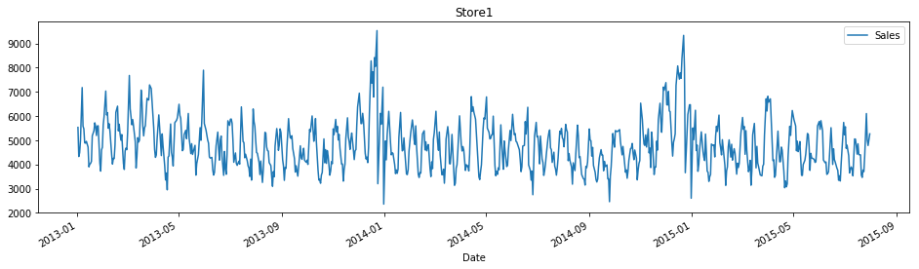

Slide 8
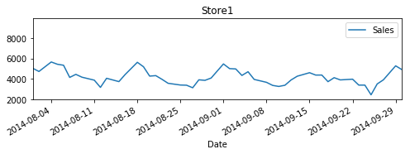

Slide 9
XGBoost
params = {"objective": "reg:linear",
"booster" : "gbtree",
"eta": 0.03,
"max_depth": 10,
"subsample": 0.9,
"colsample_bytree": 0.7,
"silent": 1, "seed": 10 }
num_boost_round = 6000
dtrain = xgb.DMatrix(ho_xtrain, ho_ytrain)
dvalid = xgb.DMatrix(ho_xtest, ho_ytest)
watchlist = [(dtrain, 'train'), (dvalid, 'eval’)]
print("Train a XGBoost model")
start = time()
gbm = xgb.train(params, dtrain, num_boost_round, evals=watchlist, early_stopping_rounds=100, feval=rmspe_xg, verbose_eval=True)
end = time()
print('Training time is {:2f} s.'.format(end-start))

Slide 10
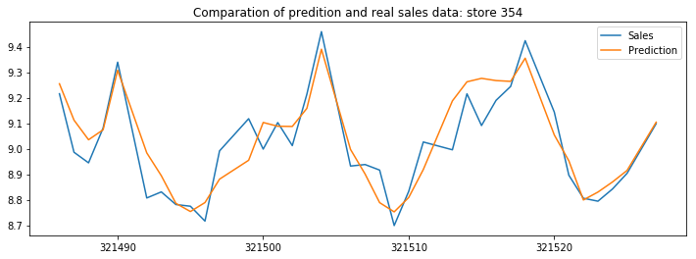
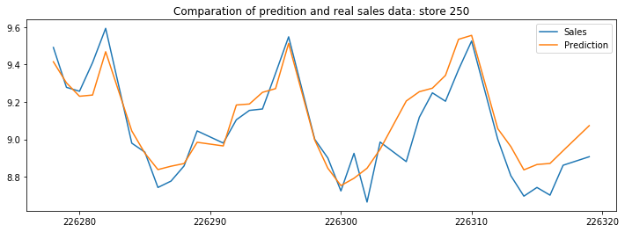
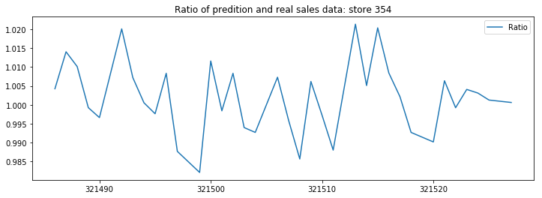
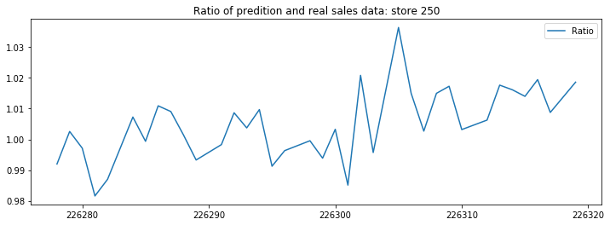

Slide 11
