Slide 1
Domain Driven Design
Daniel Połaczański
Szymon Kowal
Tomasz Dubikowski
07.02.2014
Notes:
<numer>

Slide 2
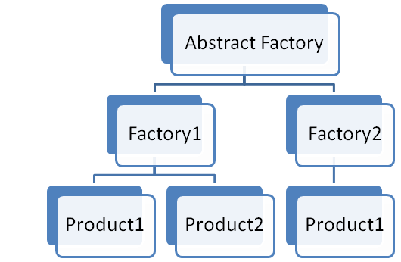
Factories
Entities and Aggregates can often be large and complex – too complex to create in the constructor of the root entity. In fact trying to construct a complex aggregate in its constructure is in contradiction with what often happens in the domain itself, where things are created by other things (like electronics get created in on assembly lines). It is like having the printer build itself.
Factories are used to encapsulate the knowledge necessary for object creation, and they are especially useful to create Aggregates. When the root of the Aggregate is created, all the objects contained by the Aggregate are created along with it, and all the invariants are enforced.
It is important for the creation process to be atomic. If it is not, there is a chance for the creation process to be half done for some objects, leaving them in an undefined state.

Slide 3
Factories
Factory Method
Abstract Factory
It is an object method which contains and hides knowledge necessary to create another object.
This is very useful when a client wants to create an object which belongs to an Aggregate.
The solution is to add a method to the Aggregate root, which takes care of the object creation, enforces all invariants, and returns a reference to that object, or to a copy of it.
There are times when the construction of an object is more complex, or when the creation of an object involves the creation of a series of objects. For example: the creation of an Aggregate.
Hiding the internal construction needs of an Aggregate can be done in a separate Factory object which is dedicated to this task.
When creating a Factory, we are forced to violate an object’s encapsulation, which must be done carefully.

Slide 4
Factories
@DomainFactory
public class OrderFactory{
@Inject
Private RebatePolicyFactory rebatePolicyFactory;
@Inject
Private InjectorHelper injector;
public Order createOrder(Client client) throws OrderCreationException {
checkIfclientCanPerformPurchase(client);
Order order=new Order(client, Money.ZERO, OrderStatus.DRAFT);
injector.injectDependencies(order);
RebatePolicy rebatePolicy = rebatePolicyFactory.createRebatePolicy();
order.setRebatePolicy(rebatePolicy);
addGratis(order, client);
return order;
}

Slide 5
Factories
public class Forum extends Entity {
...
public Discussion startDiscussion( // !!! Ubiquotus language
DiscussionId aDiscussionId,
Author anAuthor,
String aSubject) {
if (this.isClosed()) { // !!! Guard
throw new IllegalStateException("Forum is closed.");
}
Discussion discussion = new Discussion(
this.forumId(),
aDiscussionId,
anAuthor,
aSubject);
DomainEventPublisher.instance().publish(new DiscussionStarted(...)); // !!! Event
return discussion;
}
}

Slide 6

Repository
The purpose of repository is to encapsulate all the logic needed to obtain object references.
The domain objects won’t have to deal with the infrastructure to get the needed references to other objects of the domain. They will just get them from the Repository and the model is regaining its clarity and focus.
When an object is created, it may be saved in the Repository, and retrieved from there to be used later. If the client requested an object from the Repository, and the Repository does not have it, it may get it from the storage. Either way, the Repository acts as a storage place for globally accessible objects.

Slide 7
Repositories
How to setup?
And more…
- For each type of object that needs global access, create an object that can provide the illusion of an in-memory collection of all objects of that type
- Setup access through a well-known global interface
- Provide methods to add and remove objects, which will encapsulate the actual insertion or removal of data in the data store.
- Provide methods that select objects based on some criteria and return fully instantiated objects, thereby encapsulating the actual storage and query technology
- The Repository interface may contain methods used to perform some supplementary calculations like the number of objects of a certain type
- It can be noted that the implementation of a repository can be closely liked to the infrastructure, but that the repository interface will be pure domain model.
- The repository may cache objects locally, but most often it needs to retrieve them from a persistent storage

Slide 8
Repositories
public class JpaOrderRepository extends GenericJpaRepositoryForBaseEntity<Order> implements OrderRepository{
@Inject Private RebatePolicyFactory rebatePolicyFactory;
@Inject Private InjectorHelper injector;
@Inject DomainEventPublisher eventPublisher;
public void persist(Order order) {
super.persist(order);
eventPublisher.publish(new OrderCreatedEvent(order.getEntityId())); // !! Events
}
Public Order load(OderId orderId) {
Order order = super.load(orderId);
injector.injectDependencies(order);
order.setRebatePolicy(rebatePolicyFactory.createRebatePolicy()); // !! Dependencies
return order;
}
Public OderId nextIdentity(){ // !! generating ID
return new OrderId(UUID.randoumUUID());
}
}

Slide 9

Services
When designing the domain, not everything belongs to a known domain entity. But we needit
Money transfer should be in sending account or receiving account?
Service is a stateless. It’s purpose is to provide functionaly for the domain. It encapsulates complex processes, dealing with multiple entites. Service usually becomes a point of connection for many objects.
There is noneed to push every operation into domain objects

Slide 10
Services
Important
Service -rule of thumb
Three principles
1. The operation performed by the Service refers to a domain concept which does not naturally belong to an Entity / ValueObject / Aggregate.
2. The operation performed refers to other objects in the domain.
3. The operation is stateless.
- Perform a significant business process
- Transform a domain object from one composition to another
- Calculate a Value requiring input from more than one domain object
- overusing services –> anemic model !

Slide 11
Services
package com.saasovation.identityaccess.domain.model.identity;
public interface AuthenticationService {
public UserDescriptor authenticate(
TenantId aTenantId,
String aUsername,
String aPassword);
}
public class BusinessPriorityCalculator {
public BusinessPriorityCalculator() {
super();
}
public BusinessPriorityTotals businessPriorityTotals(
…

Slide 12

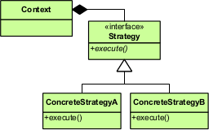
Policies
Policies are an abstraction in the domain, covering possibility of choosing between alternative ways of doing the same thing
Tax calculation differs between countries
Rabate calculation is constantly changing
Policies are used to make algorithms interchangeable.
Use of stategy design pattern

