Slide 1
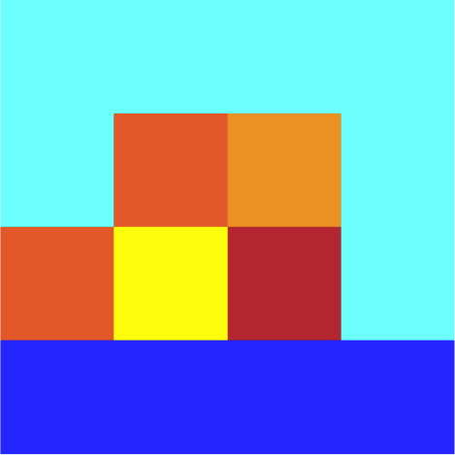
Image resizing!
Say we want to increase the size of an image…
This is a beautiful image of a sunset… it’s just very small…

Slide 2
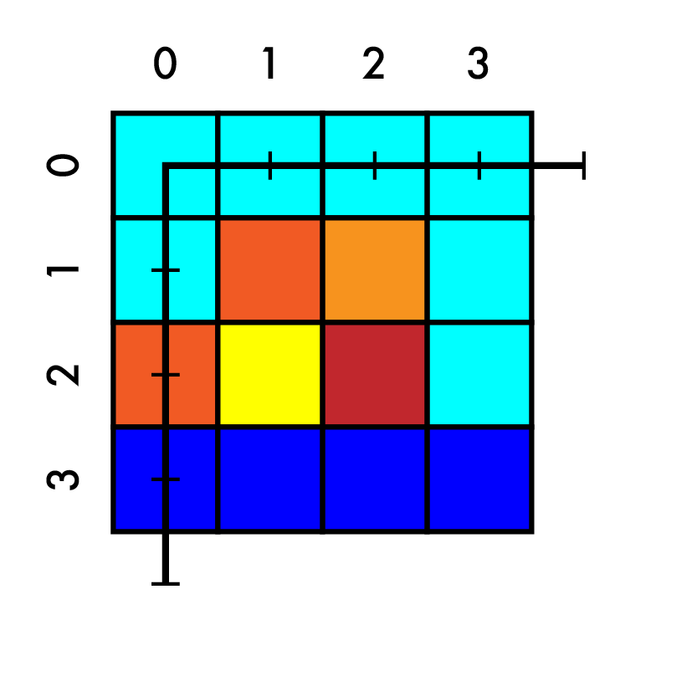
Image resizing!
Say we want to increase the size of an image…
This is a beautiful image of a sunset… it’s just very small…
Say we want to increase size 4x4 -> 7x7

Slide 3
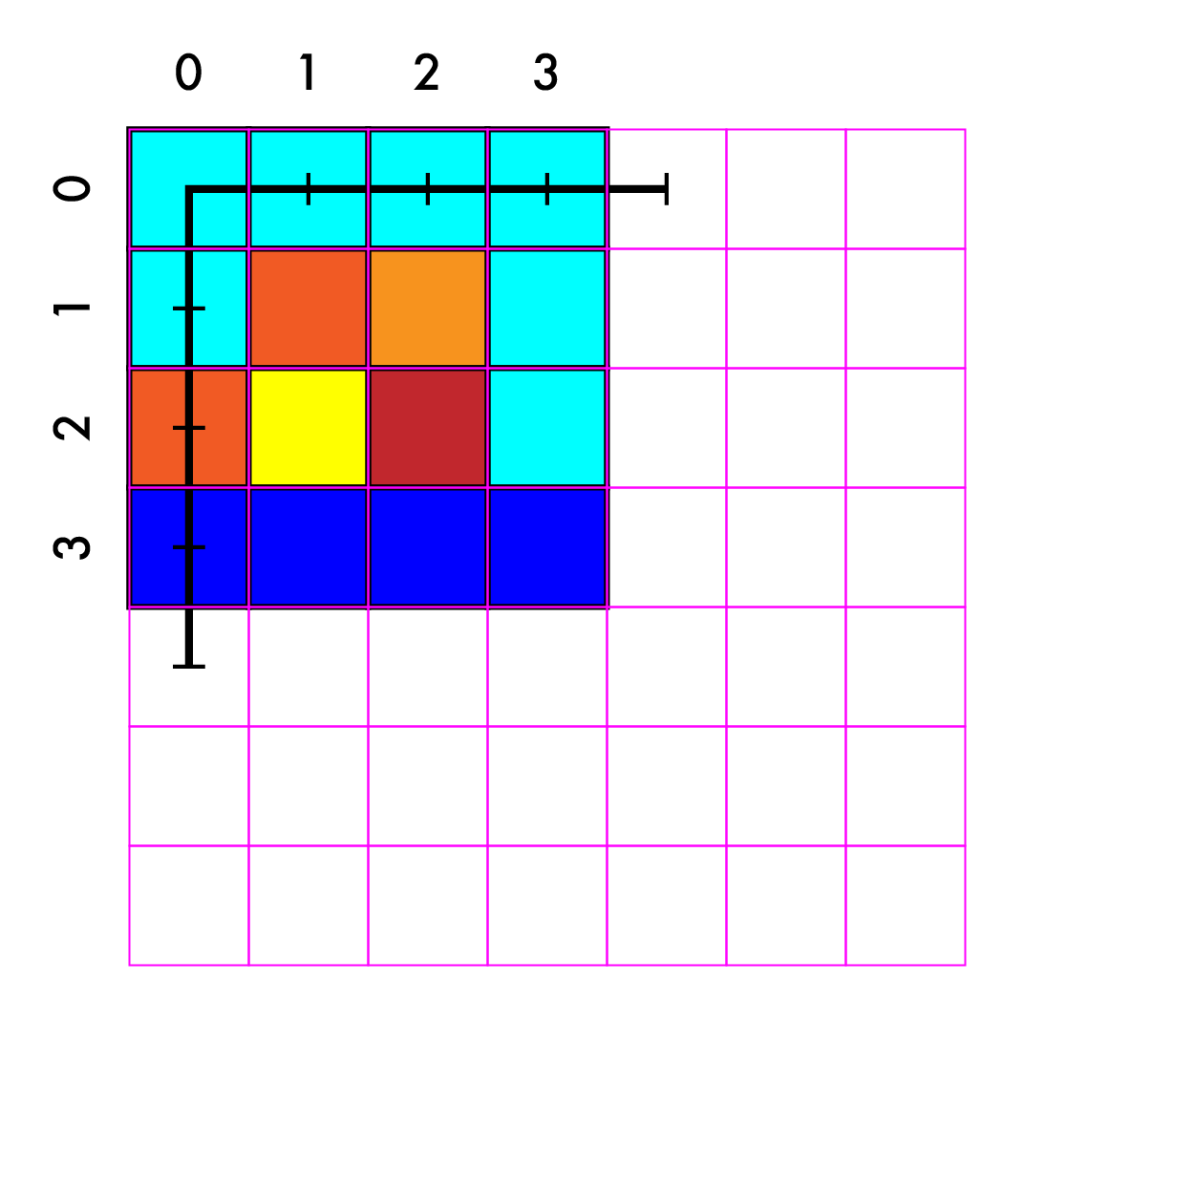
Resize 4x4 -> 7x7
Create our new image

Slide 4
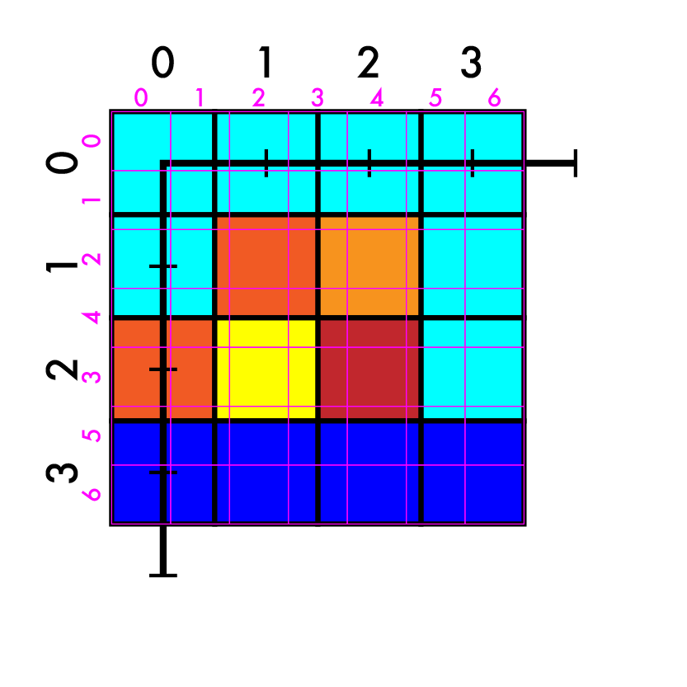
Resize 4x4 -> 7x7
Create our new image
Match up coordinates

Slide 5
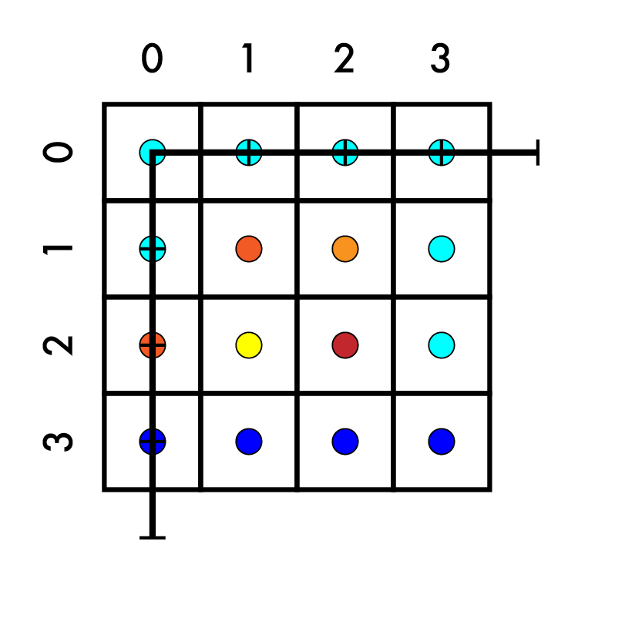
Resize 4x4 -> 7x7
Create our new image
Match up coordinates

Slide 6
Resize 4x4 -> 7x7
Create our new image
Match up coordinates
(-0.5, -0.5)
(3.5, 3.5)

Slide 7
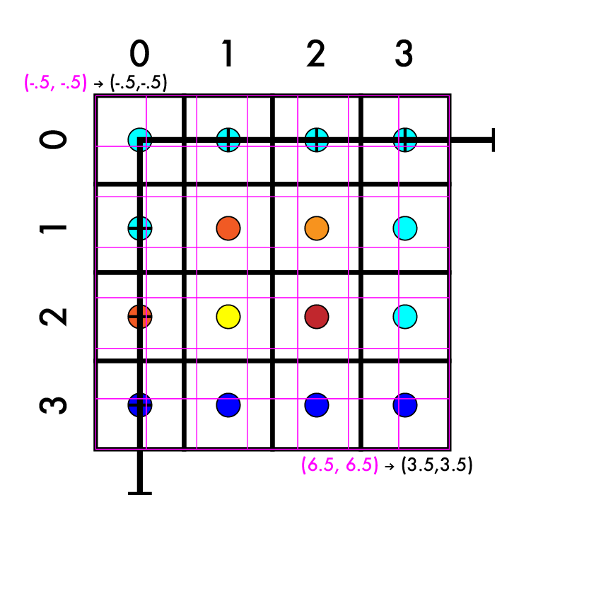
Resize 4x4 -> 7x7
Create our new image
Match up coordinates
System of equations
aX + b = Y
a*-.5 + b = -.5
a*6.5 + b = 3.5

Slide 8
Resize 4x4 -> 7x7
Create our new image
Match up coordinates
System of equations
aX + b = Y
a*-.5 + b = -.5
a*6.5 + b = 3.5
a*7 = 4

Slide 9
Resize 4x4 -> 7x7
Create our new image
Match up coordinates
System of equations
aX + b = Y
a*-.5 + b = -.5
a*6.5 + b = 3.5
a*7 = 4
a = 4/7

Slide 10
Resize 4x4 -> 7x7
Create our new image
Match up coordinates
System of equations
aX + b = Y
a*-.5 + b = -.5
a*6.5 + b = 3.5
a = 4/7

Slide 11
Resize 4x4 -> 7x7
Create our new image
Match up coordinates
System of equations
aX + b = Y
a*-.5 + b = -.5
a*6.5 + b = 3.5
a = 4/7
a*-.5 + b = -.5

Slide 12
Resize 4x4 -> 7x7
Create our new image
Match up coordinates
System of equations
aX + b = Y
a*-.5 + b = -.5
a*6.5 + b = 3.5
a = 4/7
a*-.5 + b = -.5
4/7*-1/2 + b = -1/2

Slide 13
Resize 4x4 -> 7x7
Create our new image
Match up coordinates
System of equations
aX + b = Y
a*-.5 + b = -.5
a*6.5 + b = 3.5
a = 4/7
a*-.5 + b = -.5
4/7*-1/2 + b = -1/2
-4/14 + b = -7/14

Slide 14
Resize 4x4 -> 7x7
Create our new image
Match up coordinates
System of equations
aX + b = Y
a*-.5 + b = -.5
a*6.5 + b = 3.5
a = 4/7
a*-.5 + b = -.5
4/7*-1/2 + b = -1/2
-4/14 + b = -7/14
b = -3/14

Slide 15
Resize 4x4 -> 7x7
Create our new image
Match up coordinates
System of equations
aX + b = Y
a*-.5 + b = -.5
a*6.5 + b = 3.5
a = 4/7
b = -3/14

Slide 16
Resize 4x4 -> 7x7
Create our new image
Match up coordinates
4/7 X - 3/14 = Y

Slide 17
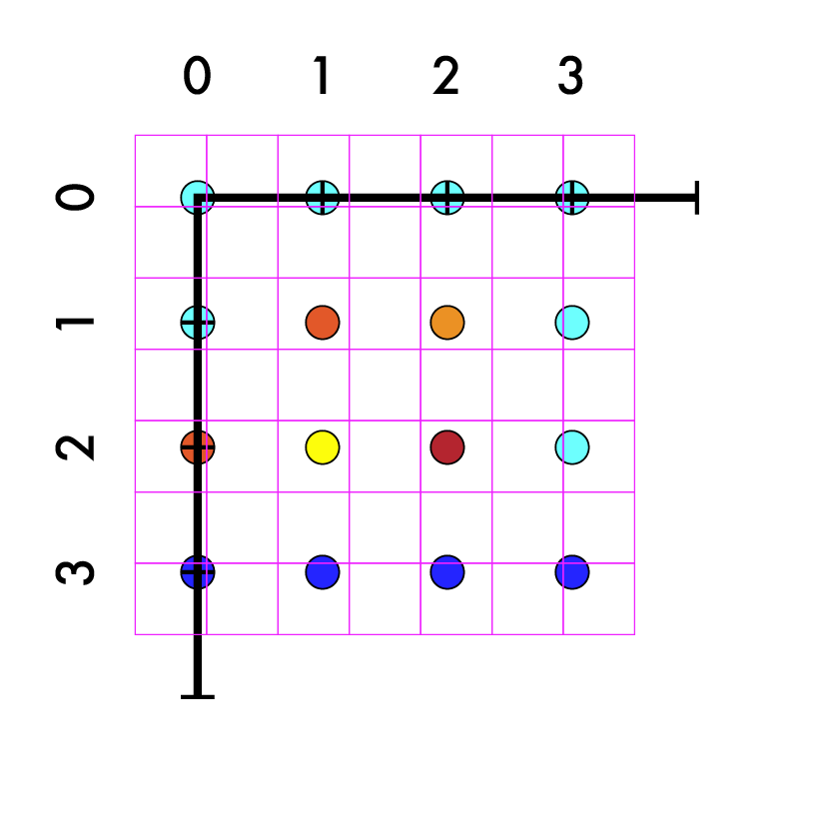
Resize 4x4 -> 7x7
Create our new image
Match up coordinates
4/7 X - 3/14 = Y

Slide 18
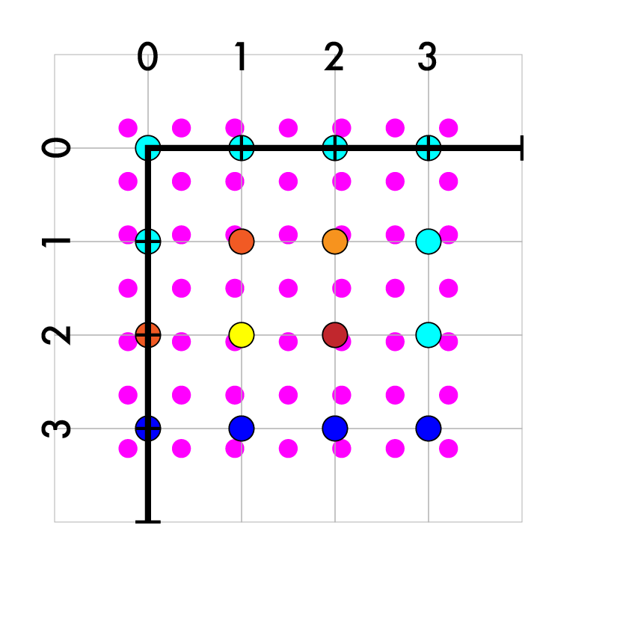
Resize 4x4 -> 7x7
Create our new image
Match up coordinates
4/7 X - 3/14 = Y
Iterate over new pts

Slide 19
Resize 4x4 -> 7x7
Create our new image
Match up coordinates
4/7 X - 3/14 = Y
Iterate over new pts
Map to old coords

Slide 20
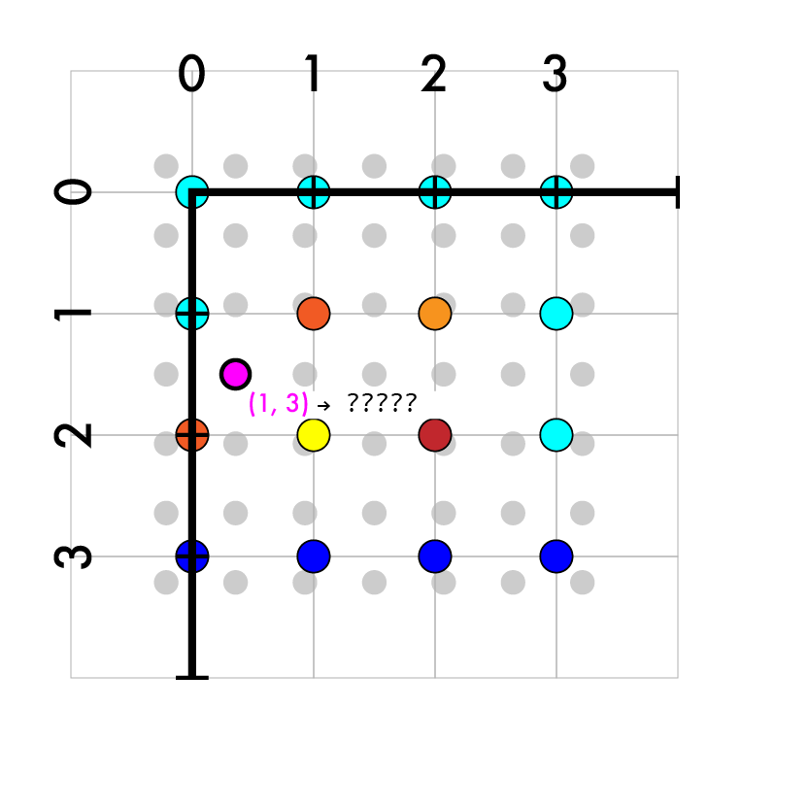
Resize 4x4 -> 7x7
Create our new image
Match up coordinates
4/7 X - 3/14 = Y
Iterate over new pts
Map to old coords
(1, 3)

Slide 21
Resize 4x4 -> 7x7
Create our new image
Match up coordinates
4/7 X - 3/14 = Y
Iterate over new pts
Map to old coords
(1, 3)
4/7*1 - 3/14
4/7*3 - 3/14

Slide 22
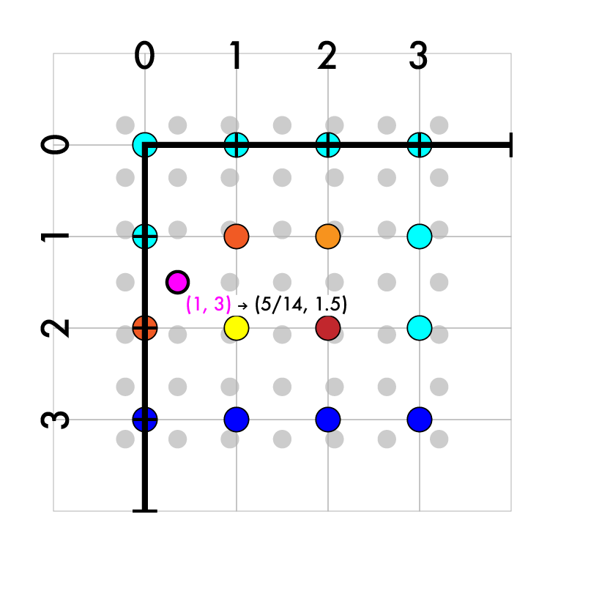
Resize 4x4 -> 7x7
Create our new image
Match up coordinates
4/7 X - 3/14 = Y
Iterate over new pts
Map to old coords
(1, 3)
4/7*1 - 3/14
4/7*3 - 3/14
(5/14, 7/14)

Slide 23
Resize 4x4 -> 7x7
Create our new image
Match up coordinates
4/7 X - 3/14 = Y
Iterate over new pts
Map to old coords
(1, 3) -> (5/14, 7/14)

Slide 24
Resize 4x4 -> 7x7
Create our new image
Match up coordinates
4/7 X - 3/14 = Y
Iterate over new pts
Map to old coords
(1, 3) -> (5/14, 7/14)
Interpolate old values

Slide 25
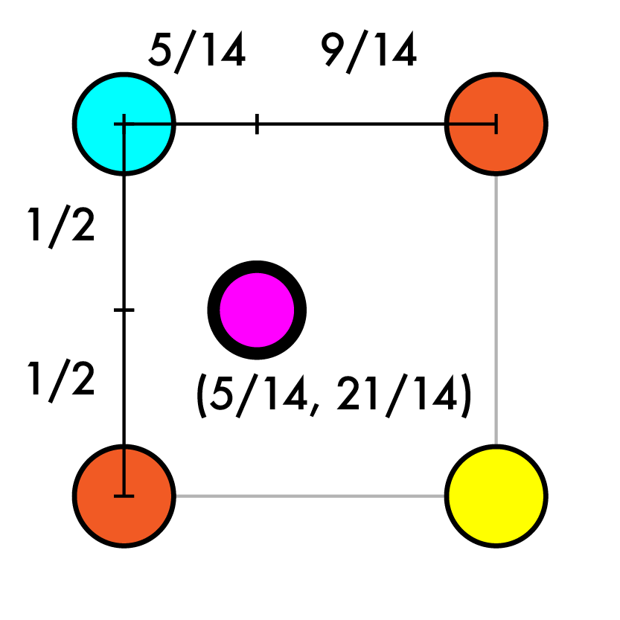
Resize 4x4 -> 7x7
Create our new image
Match up coordinates
4/7 X - 3/14 = Y
Iterate over new pts
Map to old coords
(1, 3) -> (5/14, 7/14)
Interpolate old values

Slide 26
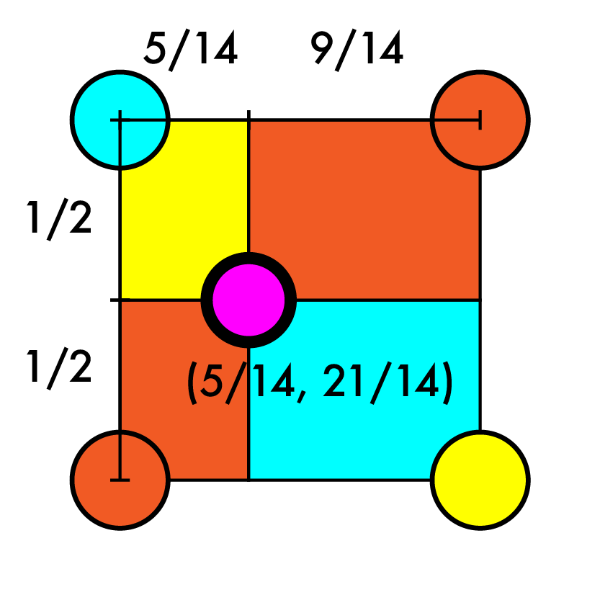
Resize 4x4 -> 7x7
Create our new image
Match up coordinates
4/7 X - 3/14 = Y
Iterate over new pts
Map to old coords
(1, 3) -> (5/14, 7/14)
Interpolate old values
Size of opposite rects

Slide 27
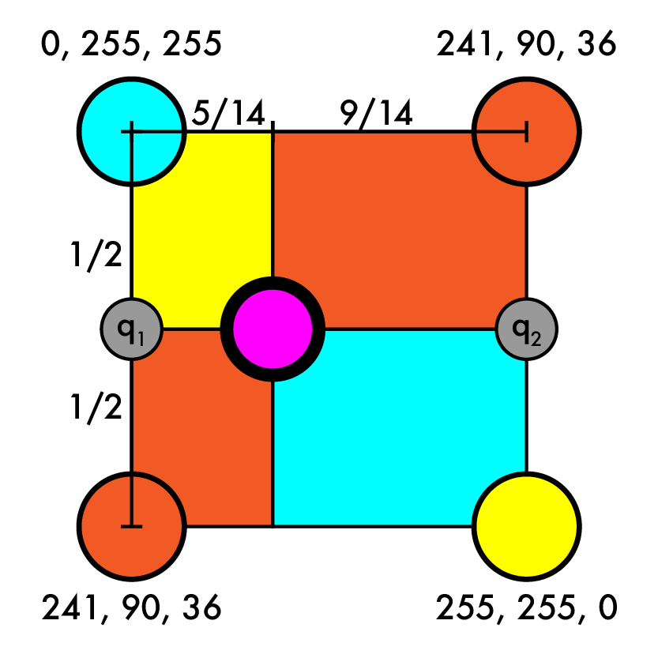
Resize 4x4 -> 7x7
Create our new image
Match up coordinates
4/7 X - 3/14 = Y
Iterate over new pts
Map to old coords
(1, 3) -> (5/14, 7/14)
Interpolate old values
Size of opposite rects
OR find q1 and q2, then interpolate between them

Slide 28
Resize 4x4 -> 7x7
Create our new image
Match up coordinates
4/7 X - 3/14 = Y
Iterate over new pts
Map to old coords
(1, 3) -> (5/14, 7/14)
Interpolate old values
q1 = r1, g1, b1
r1 = .5*0 + .5*241
g1 = .5*255 + .5*90
b1 = .5*241 + .5*36

Slide 29
Resize 4x4 -> 7x7
Create our new image
Match up coordinates
4/7 X - 3/14 = Y
Iterate over new pts
Map to old coords
(1, 3) -> (5/14, 7/14)
Interpolate old values
q1 = r1, g1, b1
r1 = .5*0 + .5*241
g1 = .5*255 + .5*90
b1 = .5*241 + .5*36

Slide 30
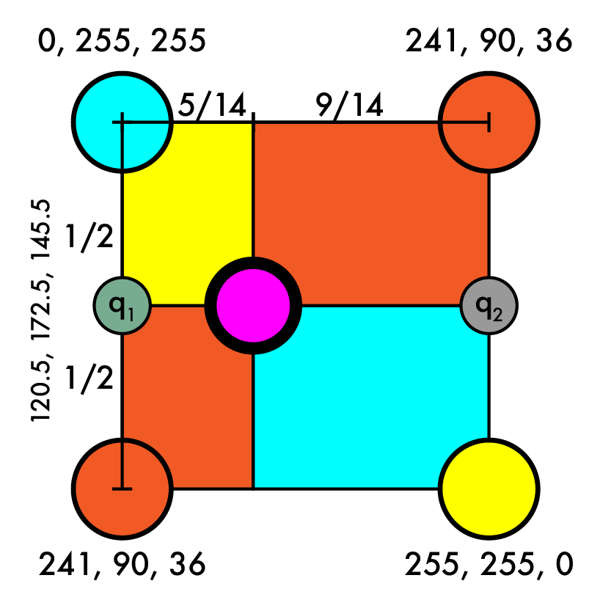
Resize 4x4 -> 7x7
Create our new image
Match up coordinates
4/7 X - 3/14 = Y
Iterate over new pts
Map to old coords
(1, 3) -> (5/14, 7/14)
Interpolate old values
q1 = (120.5, 172.5, 145.5)
q2 = r2, g2, b2

Slide 31
Resize 4x4 -> 7x7
Create our new image
Match up coordinates
4/7 X - 3/14 = Y
Iterate over new pts
Map to old coords
(1, 3) -> (5/14, 7/14)
Interpolate old values
q1 = (120.5, 172.5, 145.5)
q2 = r2, g2, b2

Slide 32
Resize 4x4 -> 7x7
Create our new image
Match up coordinates
4/7 X - 3/14 = Y
Iterate over new pts
Map to old coords
(1, 3) -> (5/14, 7/14)
Interpolate old values
q1 = (120.5, 172.5, 145.5)
q2 = r2, g2, b2
r2 = .5*241 + .5*255
g2 = .5*90 + .5*255
b2 = .5*36 + .5*0

Slide 33
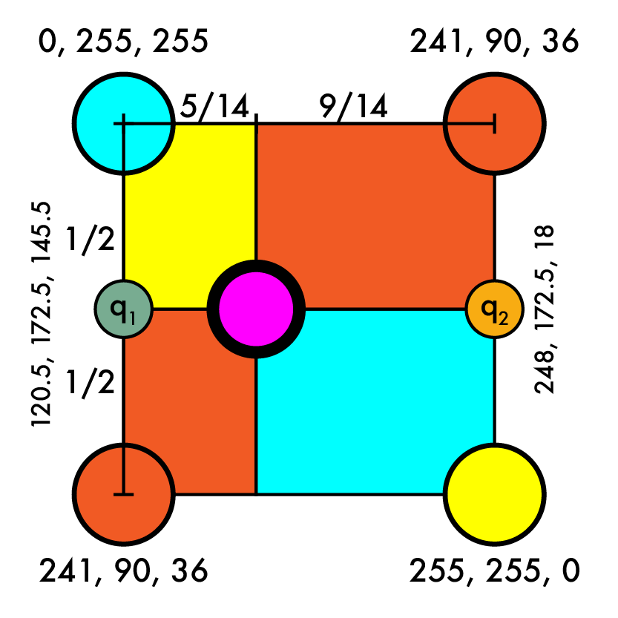
Resize 4x4 -> 7x7
Create our new image
Match up coordinates
4/7 X - 3/14 = Y
Iterate over new pts
Map to old coords
(1, 3) -> (5/14, 7/14)
Interpolate old values
q1 = (120.5, 172.5, 145.5)
q2 = (248, 172.5, 18)

Slide 34
Resize 4x4 -> 7x7
Create our new image
Match up coordinates
4/7 X - 3/14 = Y
Iterate over new pts
Map to old coords
(1, 3) -> (5/14, 7/14)
Interpolate old values
q1 = (120.5, 172.5, 145.5)
q2 = (248, 172.5, 18)
q = r, g, b
w = 9/14*w1 + 5/14 w2

Slide 35
Resize 4x4 -> 7x7
Create our new image
Match up coordinates
4/7 X - 3/14 = Y
Iterate over new pts
Map to old coords
(1, 3) -> (5/14, 7/14)
Interpolate old values
q1 = (120.5, 172.5, 145.5)
q2 = (248, 172.5, 18)
q = r, g, b
w = 9/14*w1 + 5/14 w2
r = 9/14*120.5 + 5/14*248
g = 9/14*172.5 + 5/14*172.5
b = 9/14*145.5 + 5/14*18

Slide 36
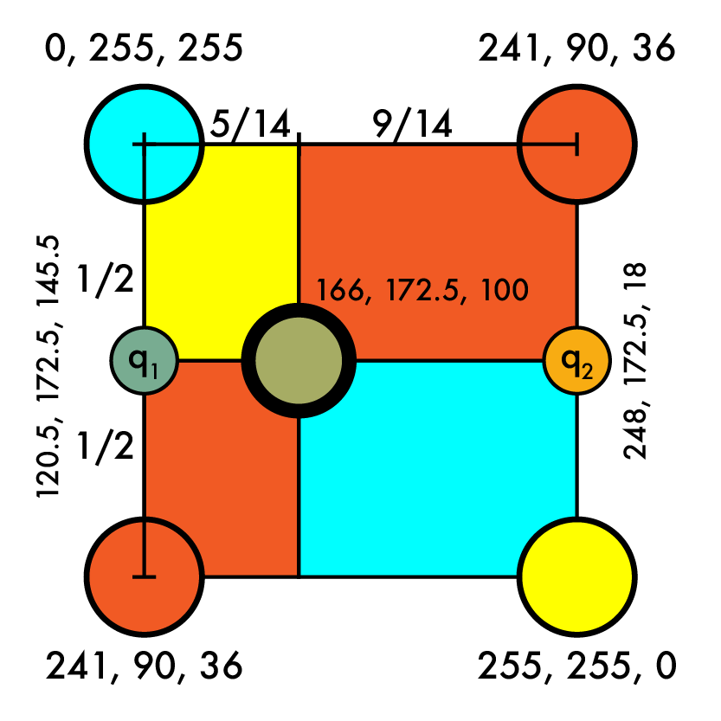
Resize 4x4 -> 7x7
Create our new image
Match up coordinates
4/7 X - 3/14 = Y
Iterate over new pts
Map to old coords
(1, 3) -> (5/14, 7/14)
Interpolate old values
q1 = (120.5, 172.5, 145.5)
q2 = (248, 172.5, 18)
q = (166, 172.5, 100)

Slide 37
Resize 4x4 -> 7x7
Create our new image
Match up coordinates
4/7 X - 3/14 = Y
Iterate over new pts
Map to old coords
(1, 3) -> (5/14, 7/14)
Interpolate old values
q = (166, 172.5, 100)

Slide 38
Resize 4x4 -> 7x7
Create our new image
Match up coordinates
4/7 X - 3/14 = Y
Iterate over new pts
Map to old coords
(1, 3) -> (5/14, 7/14)
Interpolate old values
q = (166, 172.5, 100)

Slide 39
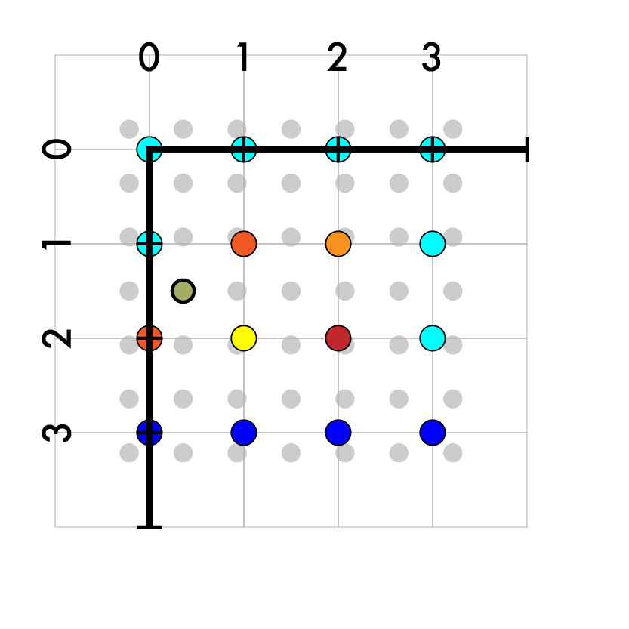
Resize 4x4 -> 7x7
Create our new image
Match up coordinates
4/7 X - 3/14 = Y
Iterate over new pts
Map to old coords
(1, 3) -> (5/14, 7/14)
Interpolate old values
q = (166, 172.5, 100)

Slide 40
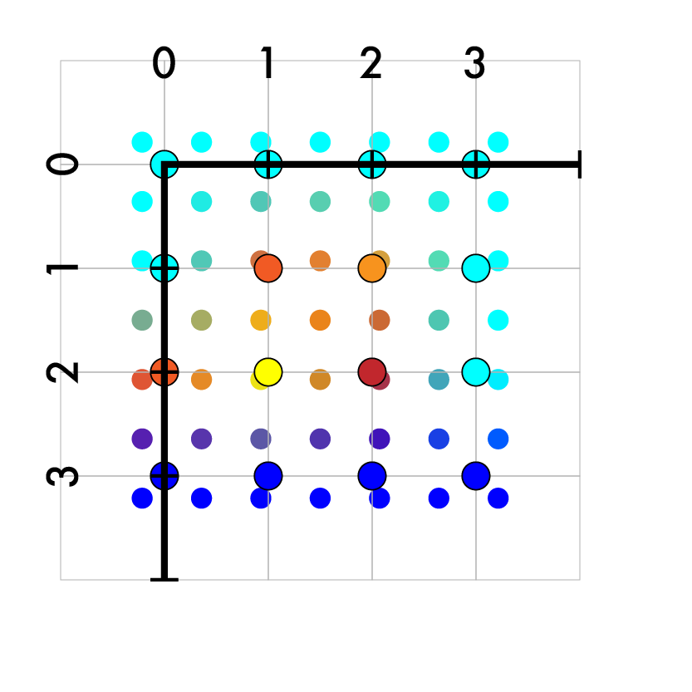
Resize 4x4 -> 7x7
Create our new image
Match up coordinates
4/7 X - 3/14 = Y
Iterate over new pts
Map to old coords
(1, 3) -> (5/14, 7/14)
Interpolate old values
q = (166, 172.5, 100)
Fill in the rest

Slide 41
Resize 4x4 -> 7x7
Create our new image
Match up coordinates
4/7 X - 3/14 = Y
Iterate over new pts
Map to old coords
(1, 3) -> (5/14, 7/14)
Interpolate old values
q = (166, 172.5, 100)
Fill in the rest
On outer edges use padding!

Slide 42
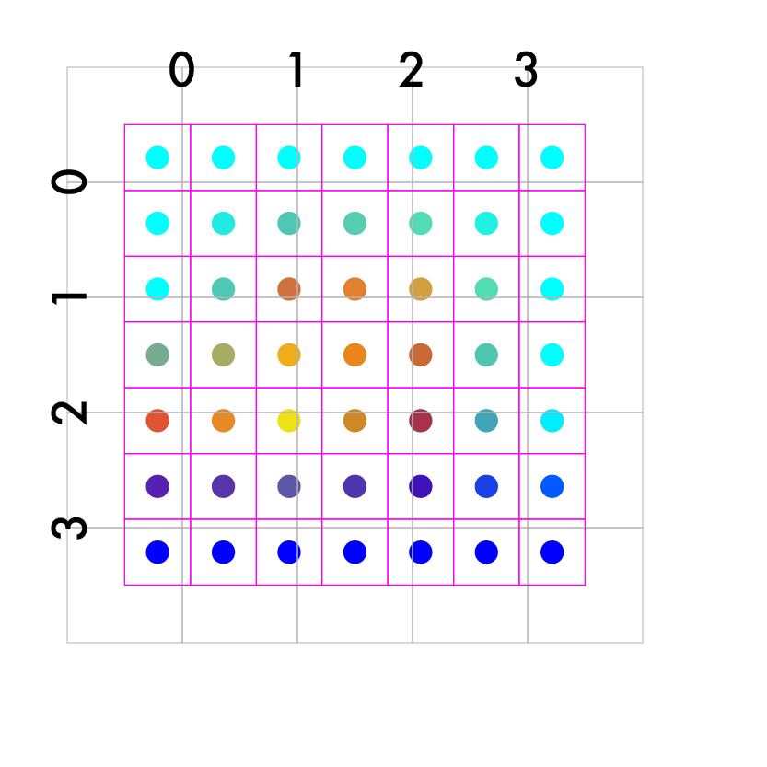
Resize 4x4 -> 7x7
Create our new image
Match up coordinates
4/7 X - 3/14 = Y
Iterate over new pts
Map to old coords
(1, 3) -> (5/14, 7/14)
Interpolate old values
q = (166, 172.5, 100)
Fill in the rest

Slide 43
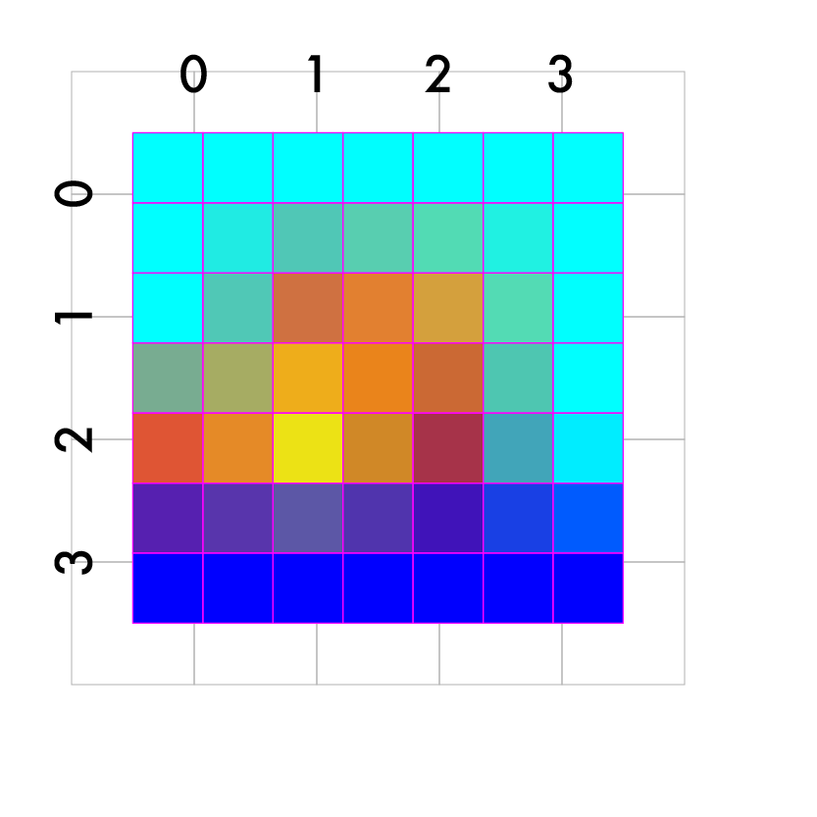
Resize 4x4 -> 7x7
Create our new image
Match up coordinates
4/7 X - 3/14 = Y
Iterate over new pts
Map to old coords
(1, 3) -> (5/14, 7/14)
Interpolate old values
q = (166, 172.5, 100)
Fill in the rest

