Slide 1
Automated road and footpath extraction in Nakivale, Uganda
By Zachary Mondschein

Slide 2
Refugee Settlements in Uganda
Uganda hosts 1.4 million refugees
The earliest refugee camps were settled in the 1960s
Refugee population increased 10x between 2012-2017
Refugee settlements in Uganda are unique
Notes:
Refugee settlements in Uganda are unique!
Settlement layouts adhere to predefined UNHCR settlement planning protocols
The boundaries of the camp are not absolute boundaries, and structures, infrastructure and agricultural plots are commonly established alongside or beyond the boundary.
It is also common for refugee populations to only occupy a portion of the area demarcated by the settlement boundary

Slide 3
Mapping Infrastructure in Nakivale
Road and footpath networks form the backbone of settlement life:
Markets
Access to water
Agricultural plots
Maps of these networks are incomplete, they appear to have not been updated for some years:
Notes:
Despite these settlements housing so many people, many of whom who have been there for more than 5 years, our existing maps of these regions and our understanding of how they develop and change over time is lacking. This is the so-called data disparity that plague some of our least “seen” places.

Slide 4
Road Detection In the Tropical Agrarian Context
Missing road data limits our ability to develop quantitative models to understand the where’s, why’s and how’s of refugee lives
Settlement expansion and land use
Manual digitization is slow and costly, so I’m taking advantage of this course to pilot an automated road detection workflow
Why should we care??
Supports food security and humanitarian planning!
Contribute to representational equity in geospatial data (closing data gaps)
There is a technical motivation as well! There have been few attempts to do these kinds of projects in rural agrarian settings.
Can we fine-tune general purpose vision models (e.g. a U-Net pretrained on ImageNet) or models trained on urban road data to our low-resource humanitarian context.
Notes:
Member’s from my lab visited Nakivale and some other refugee settlements this summer and observed that the existing OSM data is incomplete.
This is of interest to our lab, because we’ve recently been launching a project aimed to better understanding the economies of these places, which is largely predicated on agriculture. Our ultimate interests are two-fold, the first is disambiguating surrounding agricultural fields that are being tending by refugees to those that belong to host country nationals. The second goal is the estimate average commute times.
We are planning on employing an undergraduate to begin digitize roads manually, however this process is slow and costly. We’ll have to be particularly careful about designing protocols to ensure standardization of practices.

Slide 5
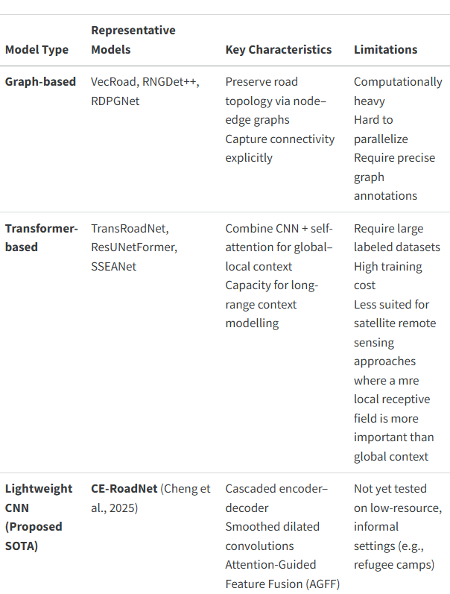
Deep Learning for Road Extraction
Where do we stand? What is the state-of-the-art?
Notes:
Here I’ve listed some of the state-of-the-art approaches, their advantages and their downsides.

Slide 6

Anticipated Methods (overview)
Fine-tune a pretrained U-Net (ResNet-34 encoder) on 50 cm Maxar imagery. [https://github.com/amaha7984/Road-Extraction-with-Advanced-Deep-Learning-Model]
Combine OSM roads with manual annotations of missing paths.
Prioritize labeling AOIs around population centers and cultivated fields.
Loss=λ1x​BCE​+λ2x​Dice​+λ3​xclDice​
Post processing to vectorize the road mask and snap them based on some sensitivity threshold to ensure sound topology.
Notes:
Prioritize…because we care about where people are and where the fields are
Loss function to balances class imbalance and preserves road topology
BCE – pixel wise classification loss that measures predicted and observed BCE(p,y)=−[ylog(p)+(1−y)log(1−p)]
Dice – measure of spatial overlap between two sets, encourages smooth regions
clDice – centerline dice, a topologically aware version of Dice loss. I don’t really understand this yet, lambda3 could be zero (lol)

Slide 7
Anticipated Methods (detailed)
Acquire and tile up maxar imagery (stored on HPC)
Align maxar imagery with OSM layer, define AOI(s)
512 × 512 px patches at maxar 0.5m = 256 × 256m coverage per patch
Can label 200-500 patches (maybe). Plan to annotate lines in QGIS and then buffer to create mask
80/10/10 or 70/15/15 train/test/validation split

Slide 8
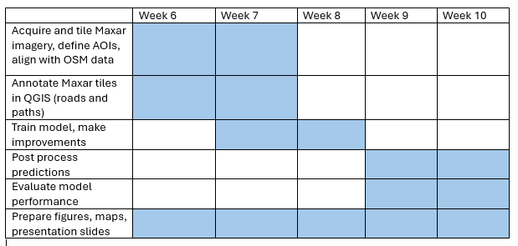
Proposed Schedule

Slide 9
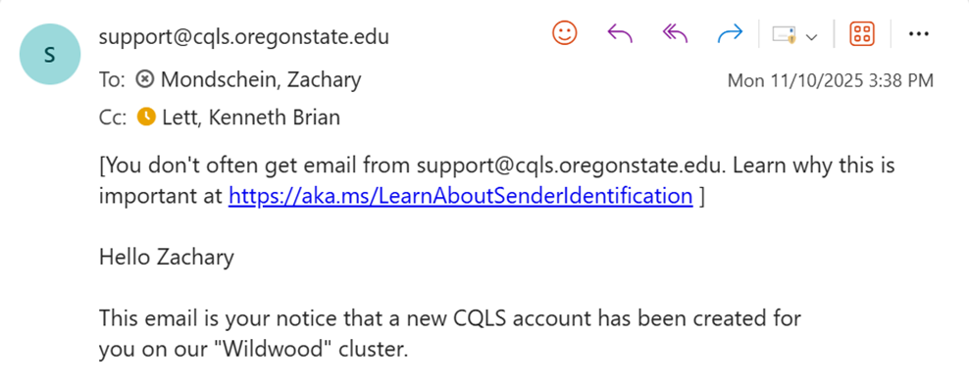
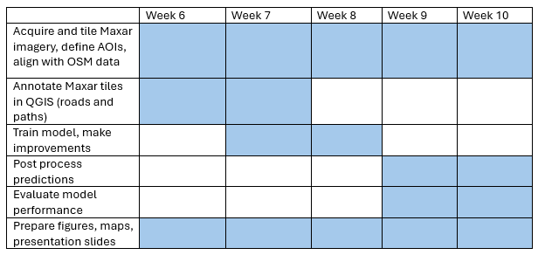
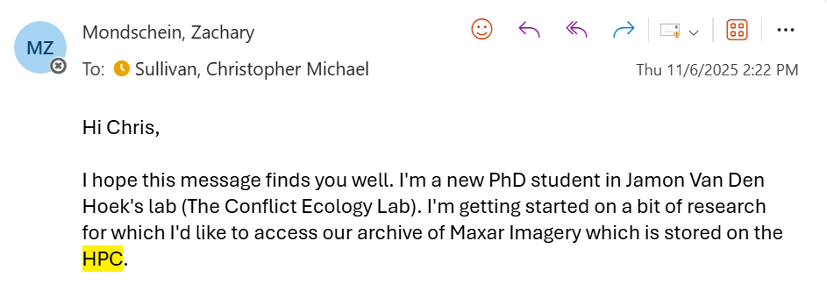
















Actual Schedule
Notes:
WHAT ACTUALLY HAPPENED:
My first mistake: I didn’t account for the time it would take to get set up on the HPC, which caused delays in acquiring the Maxar imagery.
In the meantime, I started creating road annotations over high resolution basemaps in QGIS. I made it through about 40 of my proposed 200-500 patches in this first week before I gave up and decided to just rely on the weak OSM annotations for the model (upon Jamon’s suggestion). At this point I was still somewhat optimistic about getting everything done at this point…and then I got sick!
You’ll notice that leaves us about 2 weeks behind schedule already going into Week 8. It’s become clear that I’ve bitten off more than I can chew. I haven’t started getting acquainted with the Maxar imagery yet, and I’m unfamiliar with how it is organized on the HPC. I’ve used some SSH for cloud computing workflows, but I’m otherwise on my own trying to figure out the HPC. Someone has reached out to offer a 1-hour training session on how to get started, but they don’t respond to my email when I try to schedule a meeting time.
I have a conversation with a lab mate (Zhanpei Fang) who does a lot of work using the HPC and she sends me a few helpful files. This gets me back on track, but I’ve resigned myself to the fact that I won’t have anything resembling a model to present to you for my final presentation.

Slide 10

So What Did We Learn?

Slide 11
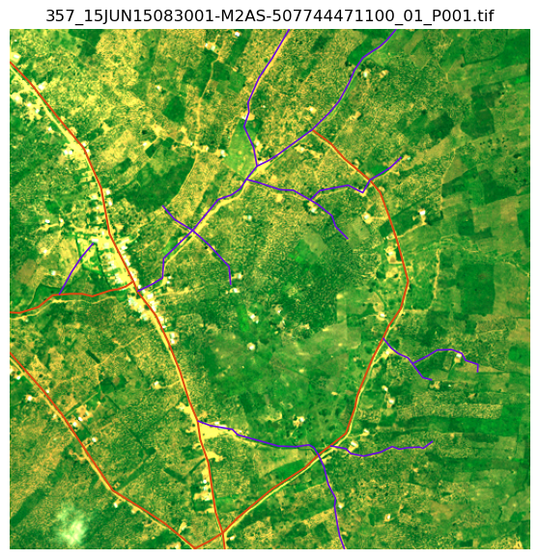
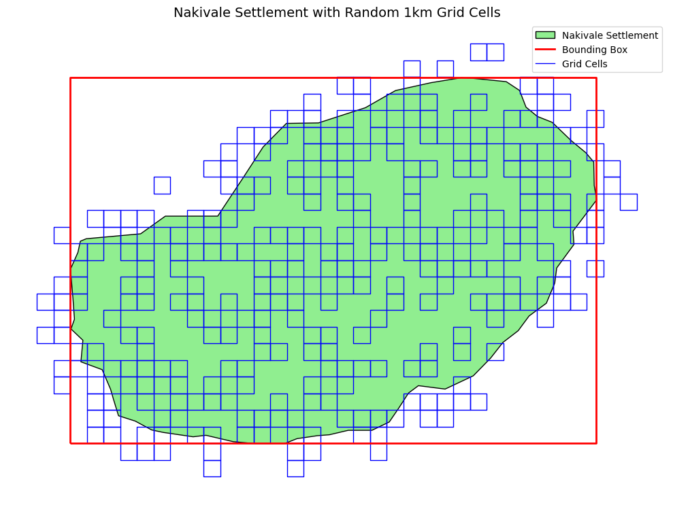
Results
Notes:
So what did I actually do?
I’ve acquired 42GB of Maxar imagery in the form of 1km x 1km grid cells randomly distributed throughout the study area.
I’ve assigned a cloudiness score to each of my Maxar chips, and filtered chips based on cloudiness score.
I’ve started doing QC on remaining Maxar chips.
I’ve overlaid my OSM roads and footpath data with the Maxar chips.
What did I learn?
1. Got a real solid understanding of our Maxar image archive, how the files are organized and index, and what the various metadata files are doing.
2. I learned how to connect to the HPC. I used salloc to get an interactive compute node and used tmux to manage multiple terminals and detach and re attach to a terminal.
What’s left to do? There’s plenty.

Slide 12
Acknowledgements

