Slide 1
Detecting Morphological Change and Permanence in Refugee Settlements
By Zachary Mondschein
Keywords: ‘Refugee Settlements’, ‘Displacement’, ‘Machine Learning’, ‘Rural’, ’Urban Morphology’, ‘Change detection’

Slide 2
Refugee Settlements in Uganda
Uganda hosts 1.4 million refugees
The earliest refugee camps were settled in the 1960s
Refugee population increased 10x between 2012-2017
Refugee settlements in Uganda are unique
Notes:
Refugee settlements in Uganda are unique!
Settlement layouts adhere to predefined UNHCR settlement planning protocols
The boundaries of the camp are not absolute boundaries, and structures, infrastructure and agricultural plots are commonly established alongside or beyond the boundary.
It is also common for refugee populations to only occupy a portion of the area demarcated by the settlement boundary

Slide 3
How do Refugee Camps Change?
Research Questions:
How do intra-settlement morphologies evolve during the initial establishment period of a refugee settlement?
How do settlements continue to change once they are established?
Can we classify a refugee settlements level of establishment using morphological and spectral signatures?
How do the rates and types of morphological changes differ between different parts of a refugee settlement?
Refugee camps are generally constructed with economic considerations mind, using cheap building materials and basic design configuration (Gupta et al., n.d.).
The quality of ephemerality is embedded in this conception of a refugee camp; however, many refugee camps have persisted for decades, transitioning into more permanent settlements (Alqub & Matar, 2025).
Notes:
Despite these settlements housing so many people, many of whom who have been there for more than 5 years, our existing maps of these regions and our understanding of how they develop and change over time is lacking. This is the so-called data disparity that plague some of our least “seen” places.

Slide 4
Reconceptualizing geographies of displacement
Why should we care??
Supports humanitarian planning and hazard mitigation
Contribute to representational equity in geospatial data (closing data gaps)
There is a technical motivation as well! There have been few attempts to do these kinds of projects in rural agrarian settings.
Notes:
Member’s from my lab visited Nakivale and some other refugee settlements this summer and observed that the existing OSM data is incomplete.
This is of interest to our lab, because we’ve recently been launching a project aimed to better understanding the economies of these places, which is largely predicated on agriculture. Our ultimate interests are two-fold, the first is disambiguating surrounding agricultural fields that are being tending by refugees to those that belong to host country nationals. The second goal is the estimate average commute times.
We are planning on employing an undergraduate to begin digitize roads manually, however this process is slow and costly. We’ll have to be particularly careful about designing protocols to ensure standardization of practices.

Slide 5
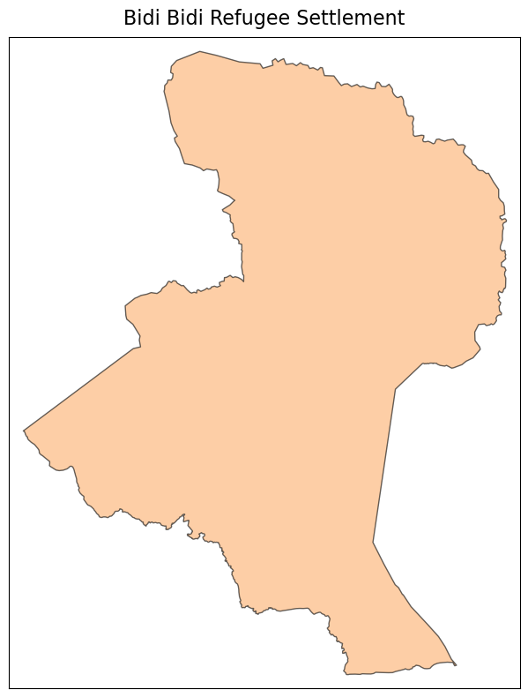
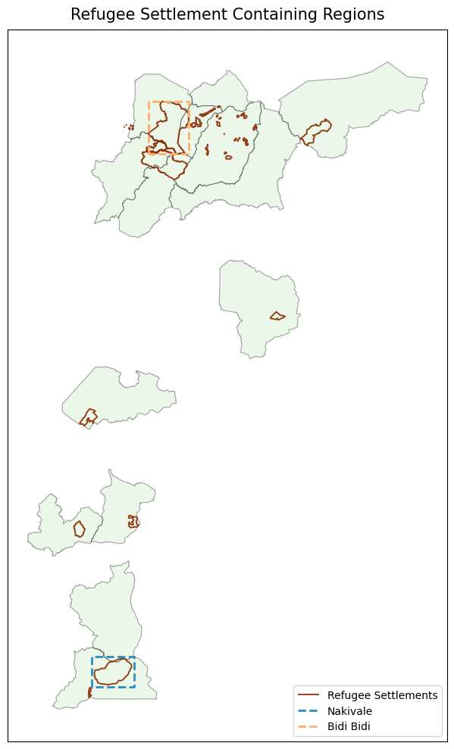
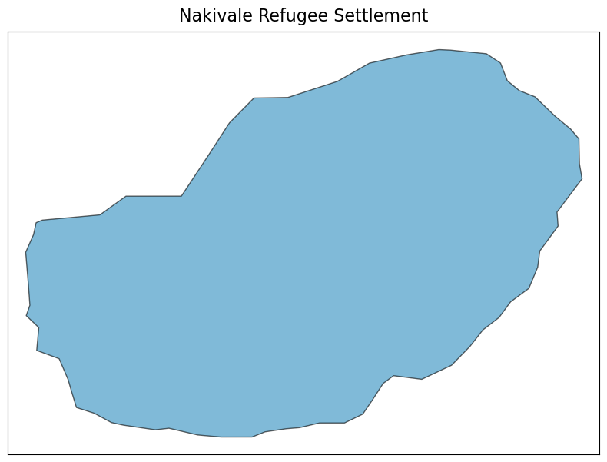
Study Site

Slide 6
Anticipated Methods (overview)
Fine-tune a pretrained U-Net (ResNet-34 encoder) on 50 cm Maxar imagery.
Combine OSM building footprints with manual annotations of building footprints.
Apply model to multi-temporal imagery to produce annual building footprint maps
Post processing to vectorize the segmented image based on sensitivity threshold to ensure sound topology.
Match building footprint instances across years, perform object-based (vector based) change detection
Compare the changes observed within and across settlements.
Notes:
Prioritize…because we care about where people are and where the fields are
Loss function to balances class imbalance and preserves road topology
BCE – pixel wise classification loss that measures predicted and observed BCE(p,y)=−[ylog(p)+(1−y)log(1−p)]
Dice – measure of spatial overlap between two sets, encourages smooth regions
clDice – centerline dice, a topologically aware version of Dice loss. I don’t really understand this yet, lambda3 could be zero (lol)

Slide 7
Anticipated Results
Yearly building footprint dataset for Nakivale and Bidi Bidi refugee settlements (shapefiles)
F1 = 0.8-0.9, Some qualitative assessment of accuracy and connectivity
Annual spatial metrics for refugee settlement built up areas
Vector-based change detection maps

Slide 8
Proposed Schedule

Slide 9
Proposed Budget

Slide 10
Funding Sources
LC/LUC, Research Opportunities in Space and Earth Sciences (ROSES)
Agency: NASA – National Aeronautics and Space Administration
Description: The Land Cover/Land Use Change (LCLUC) Program advances earth science by funding projects that use satellite data to understand how land cover and use change over time. Projects map change and investigate how changes affect human, natural and climatic systems. LCLUC is a subcall of ROSES, the Research Opportunities in Space and Earth Sciences, NASA’s omnibus funding call.
Confronting Hazards, Impacts, and Risks for a Resilient Planet (CHIRRP)
Agency: National Science Foundation (NSF)
Description: CHIRRP funds research focused on understanding and forecasting hazards and developing strategies that strengthen community resilience. CHIRRP projects engage community partners, and support the development of Earth System Science approaches that advance knowledge of hazards impact and risk.

Slide 11
Acknowledgements

