Slide 1







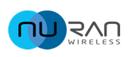



PARTENARIATS
Clients, partenaires, Projets
Global Wireless Integrated Technologies
it’s Time to Act, it’s Time to do Better
Page 13

