Slide 1

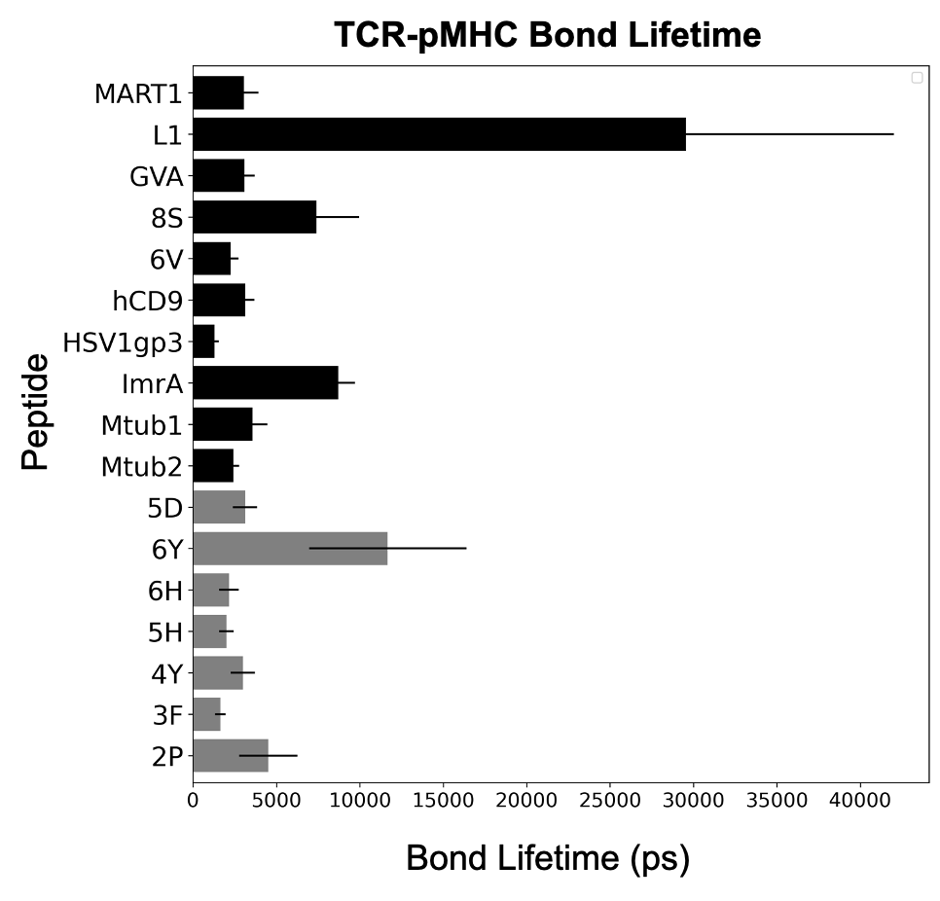
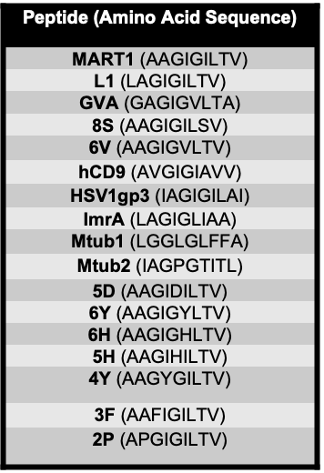
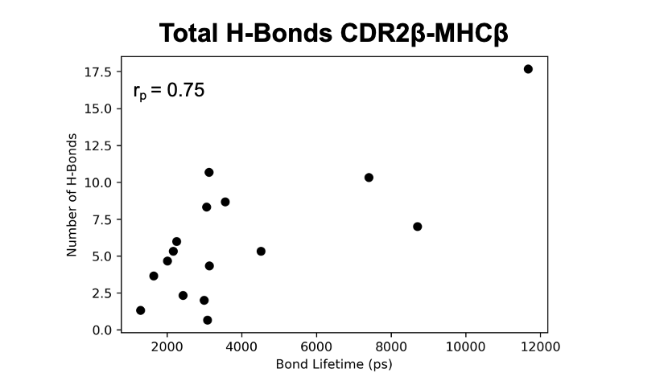
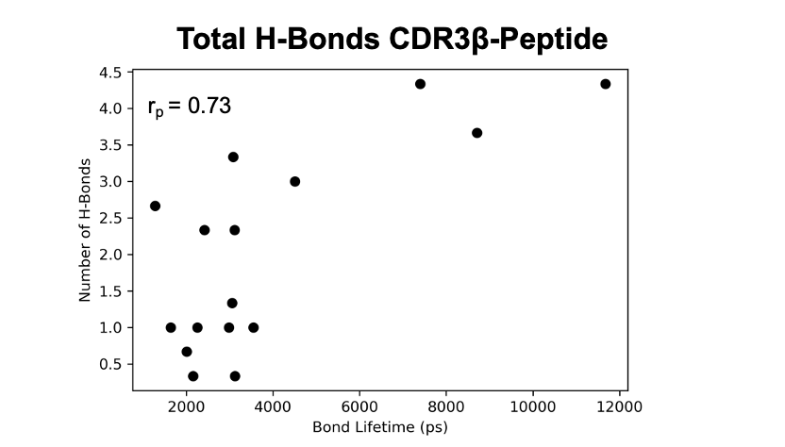
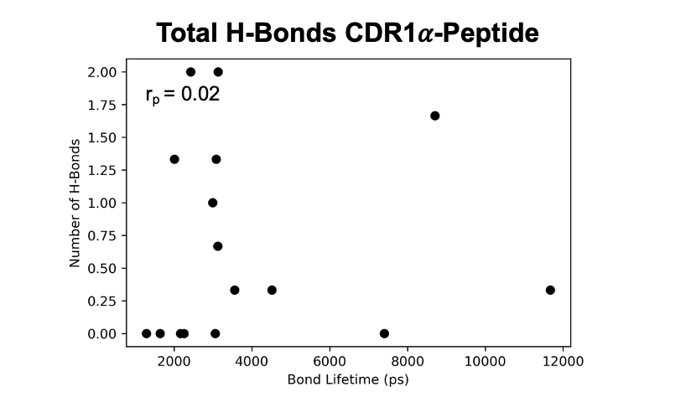
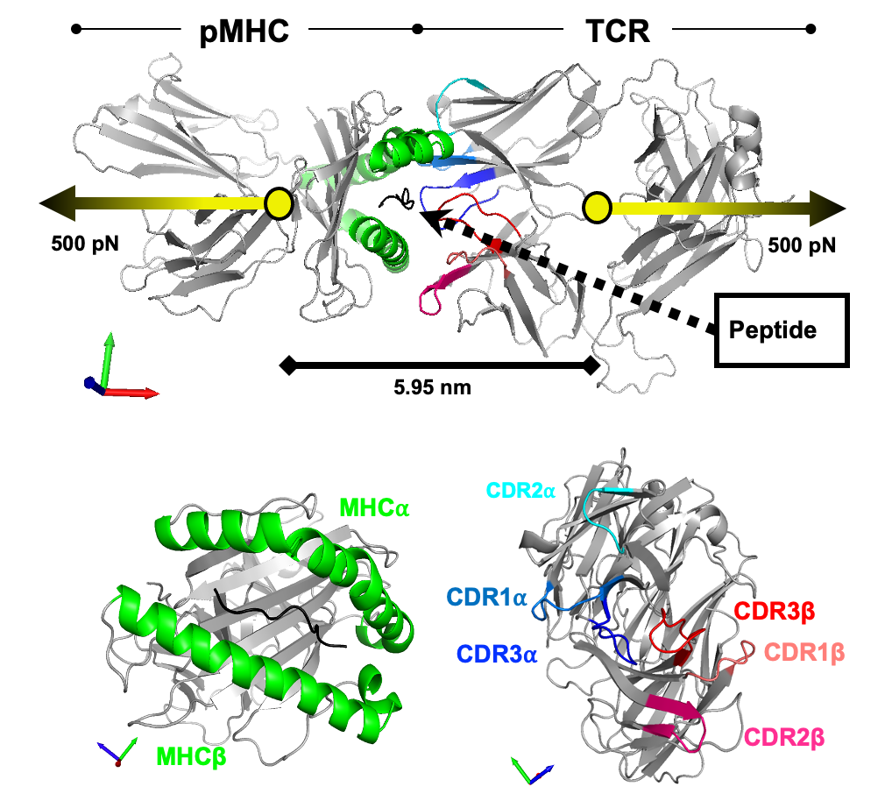
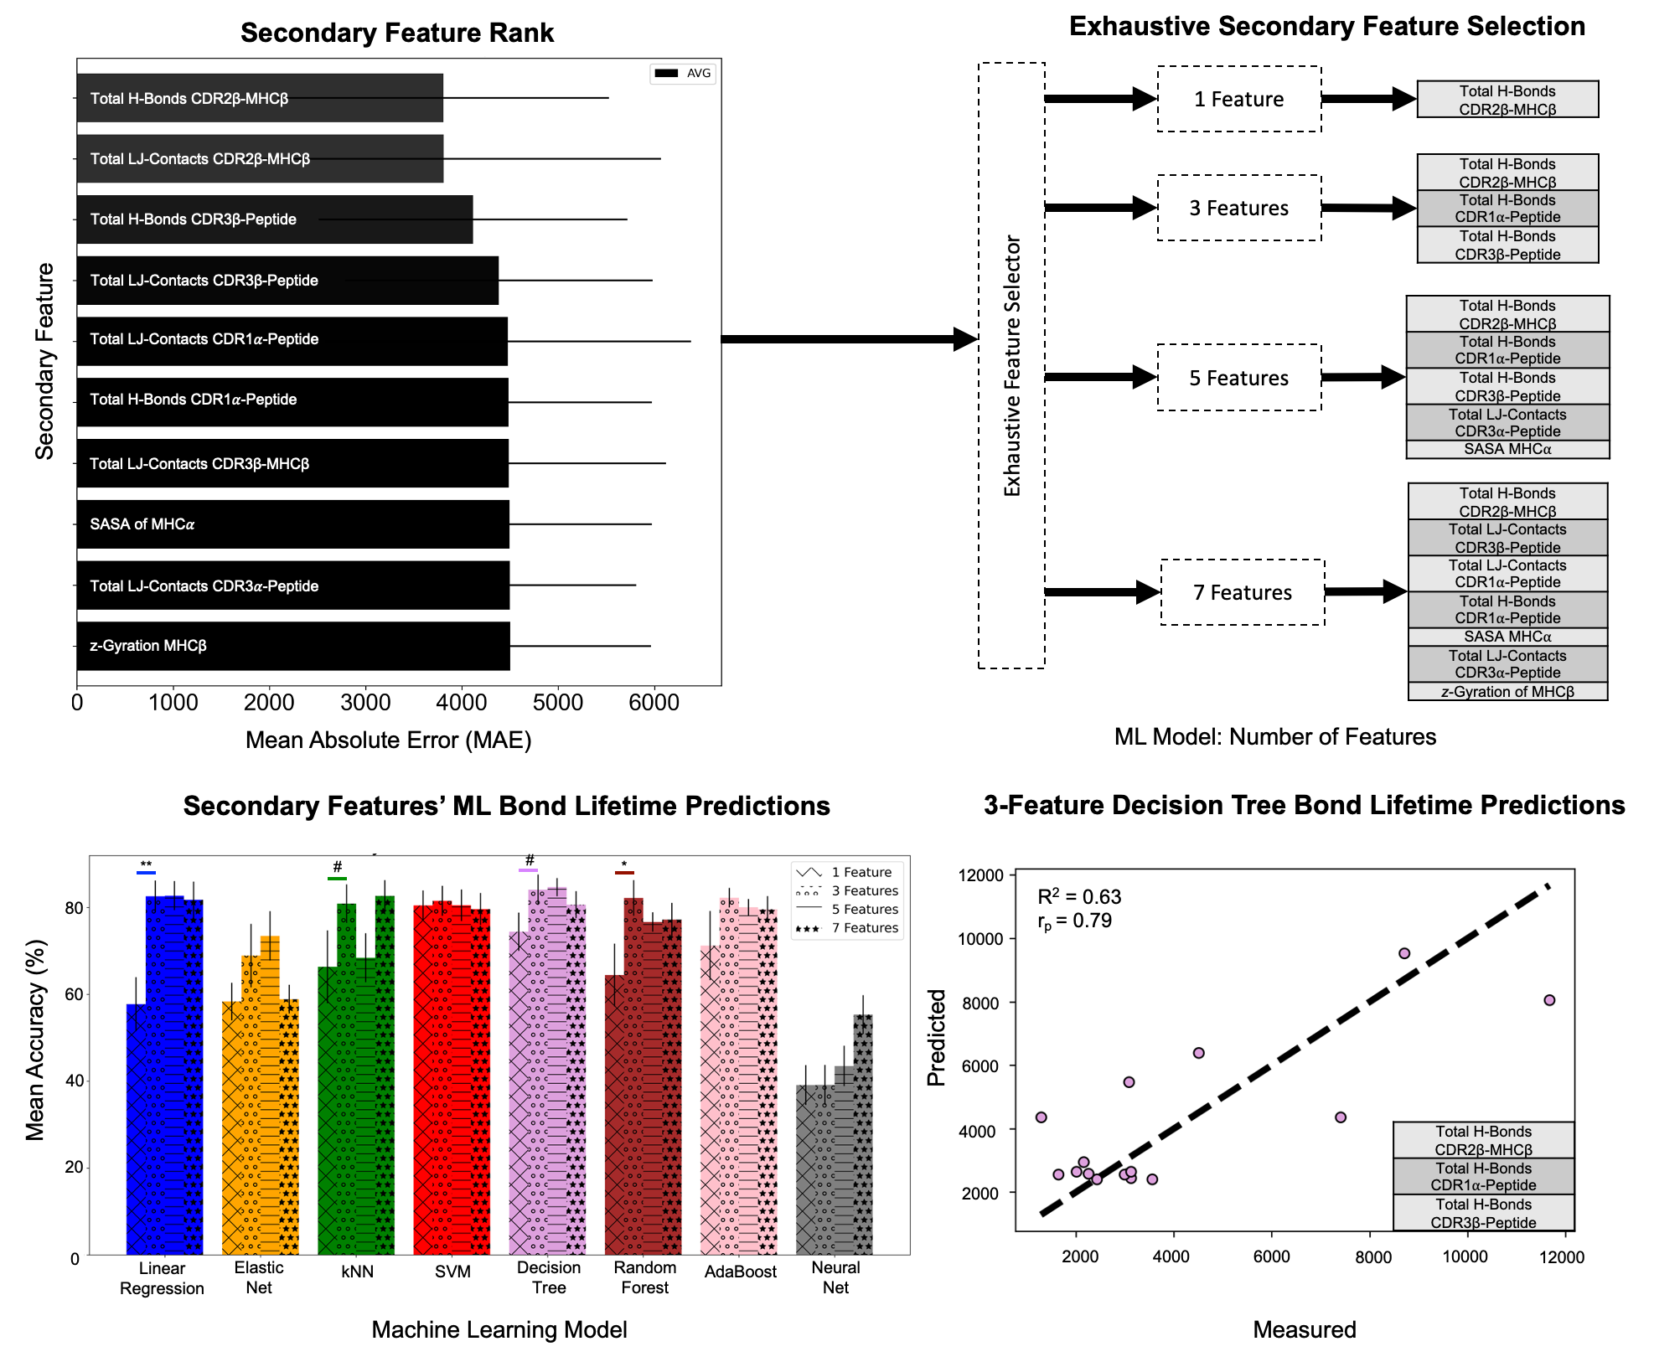
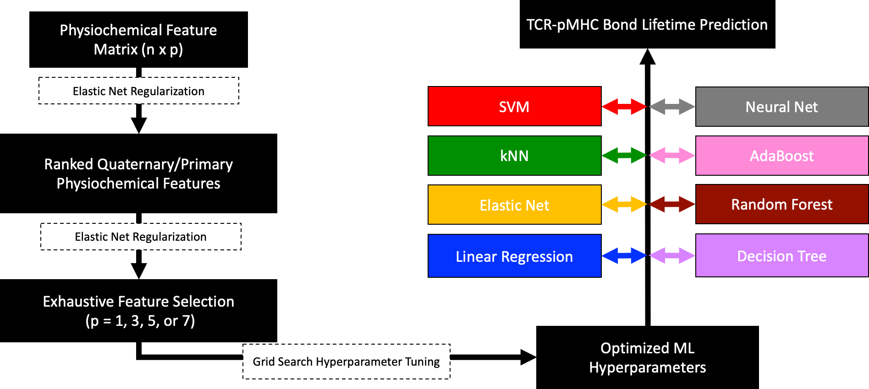

T Cell Receptor Non-Equilibrium Kinetics
Zachary Rollins², Ilias Tagkopoulos³, Roland Faller², Steven C. George¹
Department of Biomedical Engineering¹, Department of Chemical Engineering², Department of Computer Science³
University of California, Davis
INTRODUCTION
RESULTS
RESULTS
Quantitative descriptors that predict T Cell Receptor immunogenicity remain elusive
Experimental evidence suggests non-equilibrium kinetics (i.e., force-dependent bond lifetime) correlate with immunogenicity
We aim to identify a computational strategy to design T Cell Receptors
Here, we employ Steered Molecular Dynamics and Machine Learning to uncover the physiochemical features that determine TCR dissociation kinetics
METHODS
Fig. 1 – TCR-pMHC bond lifetime for set of peptides
Fig. 3 – Pearson correlation of machine learning selected secondary physiochemical features
CONCLUSIONS
TCR CDR2β region hydrogen bonding with MHC was the best ranked feature and selected in all exhaustive feature sets in predicting TCR-pMHC bond lifetime
TCR CDR1𝛼 region hydrogen bonding with peptide was selected over CDR3⍺ in exhaustive search for features that predict bond lifetime
TCR CDR3β region hydrogen bonding with peptide is important in predicting bond lifetime
ACKNOWLEDGMEMENTS
We would like to acknowledge collaborators at UC Davis and the members of the George Lab. Funding by start-up from UC Davis Department of Biomedical Engineering.
REFERENCES
Fig. 2 – Machine learning approach to identify secondary physiochemical features that determine bond lifetime
Zhu, C., et al. 2013. Immunol Rev. 251: 49-64.
Limozin, L., et al. 2019. Proc Natl Acad Sci U S A 116: 16943-16948.
Rollins, Z., et al. 2021 in Review Sci. Rep.

