Slide 1
带图片版式的标题
副标题
Notes:
<number>

Slide 3
Internet of Things
物联网

Slide 4
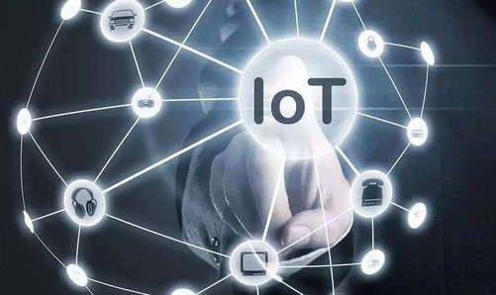
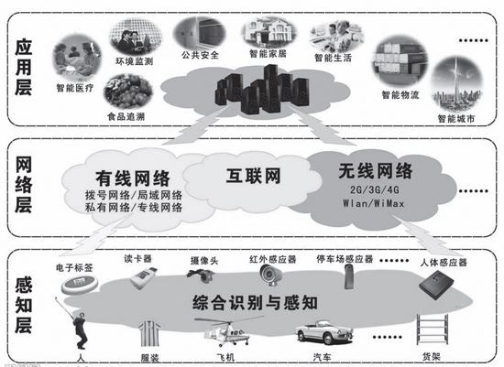
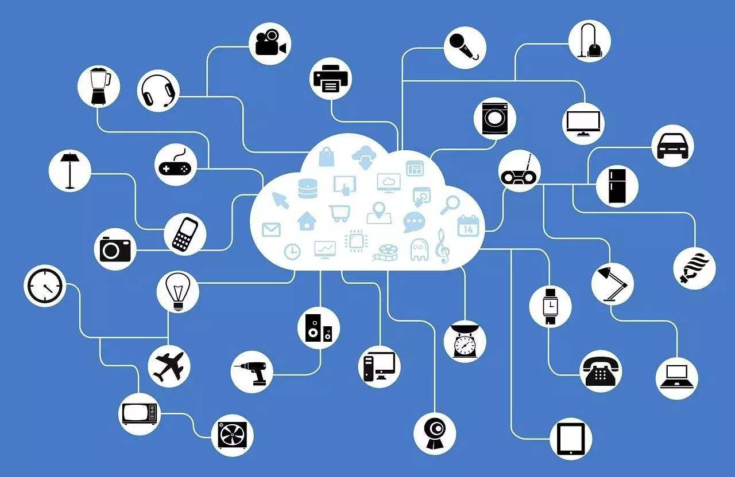
Internet of Things

Slide 5
What is Internet of Things
The Internet of things, simply speaking, is a sensor network. It is a network structure that combines Internet technology and communication equipment to realize the interconnection of everything. The working principle of the Internet of things is to put information sensing chips in the objects, and realize the interconnection of information when there is no network through the sensing technology on the chip. It is an important development direction of computer.

Slide 6
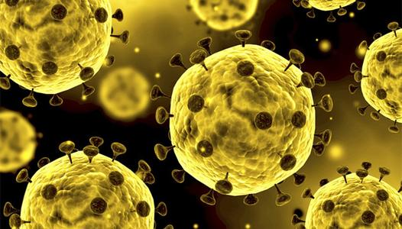
IoT helps us fight against disease
At present, there is a very typical representative. The current global challenge of COVID-19 pandemic[pænˈdemɪk] has surpassed the provincial, radical, conceptual, spiritual, social, and pedagogical [ˌpɛdəˈgɒdʒɪkəl] boundaries. Internet of Things (IoT) enabled healthcare system is useful for proper monitoring of COVID-19 patients, by employing an interconnected network. This technology helps to increase patient satisfaction and reduces readmission rate in the hospital.

Slide 7
Internet of Things and 5-g
For the development of the Internet of things, the biggest problem is to meet the large demand. First of all, for the better and faster development of the Internet of things, there must be a complete and standard network system to support the development of its work; for the network communication technology, there are higher requirements, which need the full coverage of mobile terminals and communication technology. Under the premise of the comprehensive promotion and coverage of 5g communication technology, the Internet of things will be further promoted and developed, and the whole market needs the support of network system.

Slide 8
IoT changes our life
IoT has improved our day today quality lives by major technical changes. IoT makes our life easier by use of multiple technologies and different kinds of applications. It provides augmentation and automation. It helps us save time and money, improve decision making, find usage in variety of applications. IoT’s different application domains are healthcare, home automation, smart city, smart grid, smart vehicles, transportation, smart parking, smart infrastructure, industrial, manufacturing, business, governance, supply chain, logistics, education, agriculture and mining. IoT has multiple advantages.

Slide 9
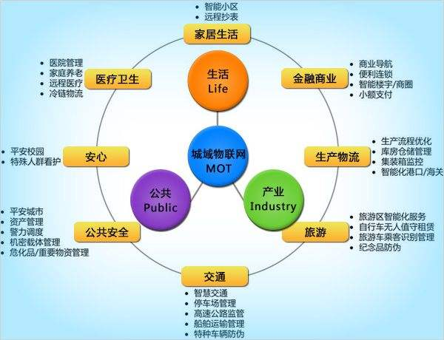
IoT changes our life

