Slide 1

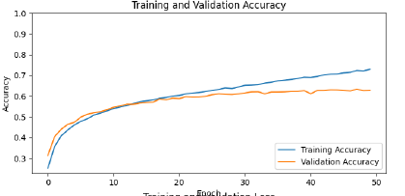
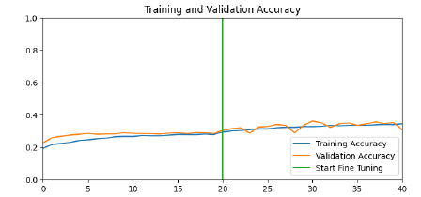
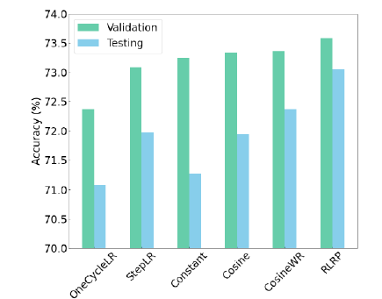
Emotional Recognition Using Convolutional Neural Networks
Zaris Ovidiu Neamtiu
Motivation
Greatly enhance user experience.
Assist medics in recognizing potential patterns for mental illnesses.
Assist people with mental health issues by providing real-time feedback.
Greatly improve the efficacy of marketing practices.
Accuracy
The model achieved 63.2% accuracy on the validation set. Accuracy has been brought up to 63.4% by way of data augmentation.
Compares nicely to state of the art, which, on the same dataset, achieved an accuracy of approximately 73%.
Experiments, comparisons
In comparing the previously mentioned model, I tried to train MobileNetV2, which is a model trained by Google performing image classification by way of transfer learning.
This hasn’t been a particularly fruitful endeavor, the retrained model has achieved an accuracy of 30%, which, after fine tuning, turned to a whopping 34%.
Looking at the bright side of things, this highlights the efficacy of the other model. ☺
Proposed approach
Convolutional neural network, trained on the FER-2013 dataset, that can interpret feelings in real-time, either by way of a supplied video, or straight from the feed of the webcam.

