Slide 1
E3 - Word Representations
Arthur Nürnberg, 04/11/2024

Slide 2
Today’s objectives
Understand:
what Tokenization is
how the BPE Tokenization works
how words are represented in Natural Language Processing
how different Embedding models work

Slide 3
Tokenization

Slide 4
What is Tokenization?
Breaking down text into smaller units called tokens
Words, subwords, characters or symbols
Learned from a large corpora of text

Slide 5
Role of Tokenization in Language Models
Foundation for Language Understanding
Impacts Handling of unknown words
Influences Embedding Quality
Notes:
Neural Networks only understand math, specifically vectors
If there are Out-of-Bag words that have not been seen by the tokenizer, that’s a problem.
Poor tokenization can lead to:
Loss of meaning Increased computational load

Slide 6
Poor Tokenization leads to
Loss of Meaning
Increased computational load
Reduced model performance
Notes:
Neural Networks only understand math, specifically vectors
If there are Out-of-Bag words that have not been seen by the tokenizer, that’s a problem.
Poor tokenization can lead to:
Loss of meaning Increased computational load due to an increased token count, sequence length, memory usage and suboptimal context representation

Slide 7
Neural Networks are awesome!

Slide 8
[Neural][ Networks] [ are] [ awesome][!]
Notes:
Sometimes the exclamation mark is included
Why are the whitespaces included in the token?
Separation between words and word parts
Separation between word as subword and singular word
Reconstruction more easily done in inference

Slide 9
Word-Level Tokenization
Easy to implement using basic string operations (regex)
Tokens are meaningful words, better to interpret
May not handle contractions well
Struggles with OOB-Words
Notes:
OOB - Out-Of-Bag - example will be shown later

Slide 10
Word-Level Tokenization
Notebook Exercise

Slide 11
[N][e][u][r][a][l][ ][N][e][t][w][o][r][k][s][ ][a][r][e][ ][a][w][e][s][o][m][e][!]

Slide 12
Character-Level Tokenization
Every character is known, eliminating OOB issues.
Useful for complex languages
Higher computational costs
Loss of meaning in word
Notes:
OOB - Out-of-Bag - when (sub-)words are not yet in the vocab

Slide 13
Character-Level Tokenization
Notebook Exercise

Slide 14
Grundstücks­verkehrs­genehmigungs­zuständigkeits­übertragungs­verordnung
or
Pneumonoultramicroscopicsilicovolcanoconiosis
Notes:
Real estate transfer authorisation ordinance
8
Pneumonoultramicroscopicsilicovolcanoconiosis
80 characters
Show both Words in Tiktokenizer

Slide 15
Solution: Subword-Level Tokenization
Compromise between Word and Character Tokenization
Subword tokenization techniques like Byte Pair Encoding
Handle OOV words and morphological complexity

Slide 16
The BPE Tokenization
Tokenizes text into most most common subwords
Starting with simple character tokenization
Searching for the most common pair
Combining the most common pair into a new token
Repeat 3. And 4. until a certain stopping criterion, e. g. maximum vocabulary size or a certain minimum amount of pairs
Compact Representation, Flexibility and multilingual

Slide 17
Byte-Pair-Encoding Tokenization
Notebook Exercise

Slide 18
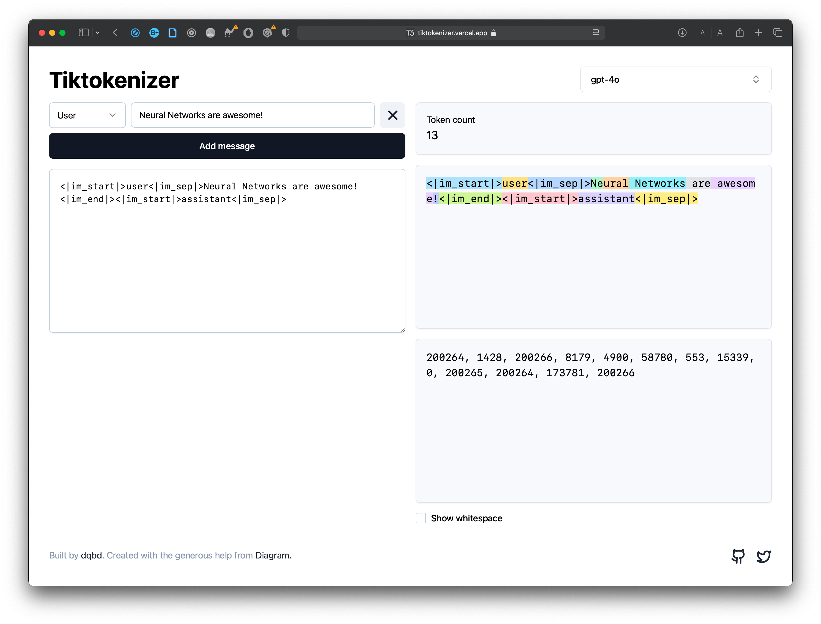
https://tiktokenizer.vercel.app

Slide 19
Understanding Tokenization improves our ability to design and train effective language models.

Slide 20
Word Embeddings

Slide 21
How are Word Embeddings represented?
Each Token has a unique id in the vocabulary
Multi-dimensional vector with up to thousands of dimensions
Notes:
We use 100 for the embedding dimension later
But today’s embeddings go up to 12288 for GPT-4

Slide 22
One-Hot Encoding
Binary vectors which represent categorical data
Each category is represented by a vector of length equal to the number of unique categories, with one element set to 1 and all other set to 0
Example: [„cat“,“dog“,“fish“,“bird“] -> [1,0,0,0], [0,1,0,0], [0,0,1,0], [0,0,0,1]
Usage in NLP models for CBOW, n-grams and NNs
Very simple and efficient for small datasets and categories
High dimensionality with increasingly vocabulary size
No semantic information, relationship or similarities encoded
Notes:
One-Hot Encoding did not work well with bigger and bigger vocab sizes
Therefore more sophisticated word embeddings like Word2Vec, GloVe came into play.

Slide 23
Word Embeddings are high dimensional vectors.
Each dimension represents an “aspect“ or a “category“ of a word
Or semantic (meaning) as well as syntactic (structure) properties
ALSO: Encoding attention and contextual relationship between tokens
Analogy: Each dimension is a sensory channel like (color, texture, shape)
Facilitating mathematical operations
Increasing embedding size -> model can learn more complex patterns
Notes:
Facilitates Mathematical operations with vectors for simple addition and multiplication with vectors and matrices
Can be calculated in parallel by
GPUs with CUDA by NVIDIA,
TPUs (Google, 2016) as well as
NPUs (generally developed for efficient calculation of neural networks) on smaller devices, phones
We have NO IDEA which dimension represents what

Slide 24
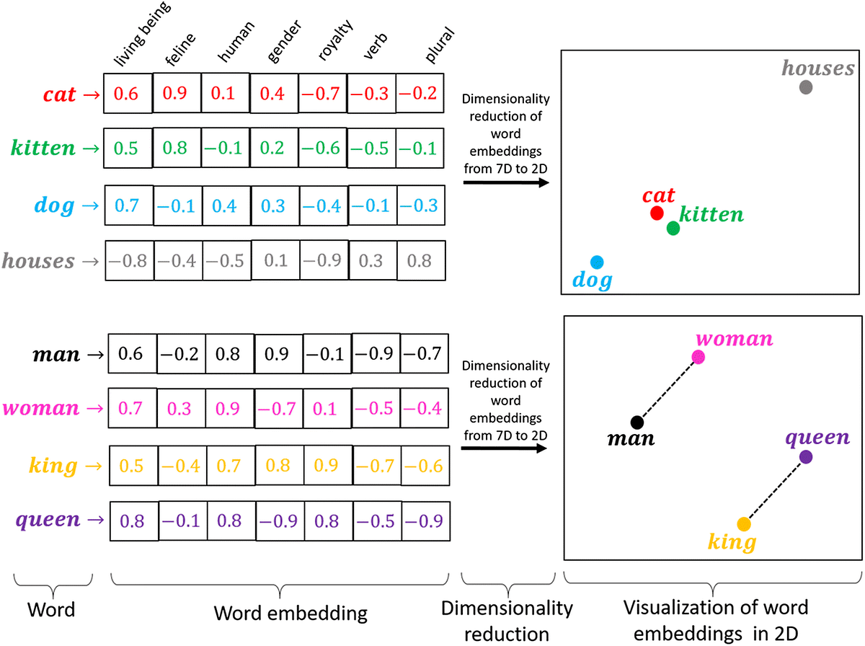
https://medium.com/@hari4om/word-embedding-d816f643140

Slide 25
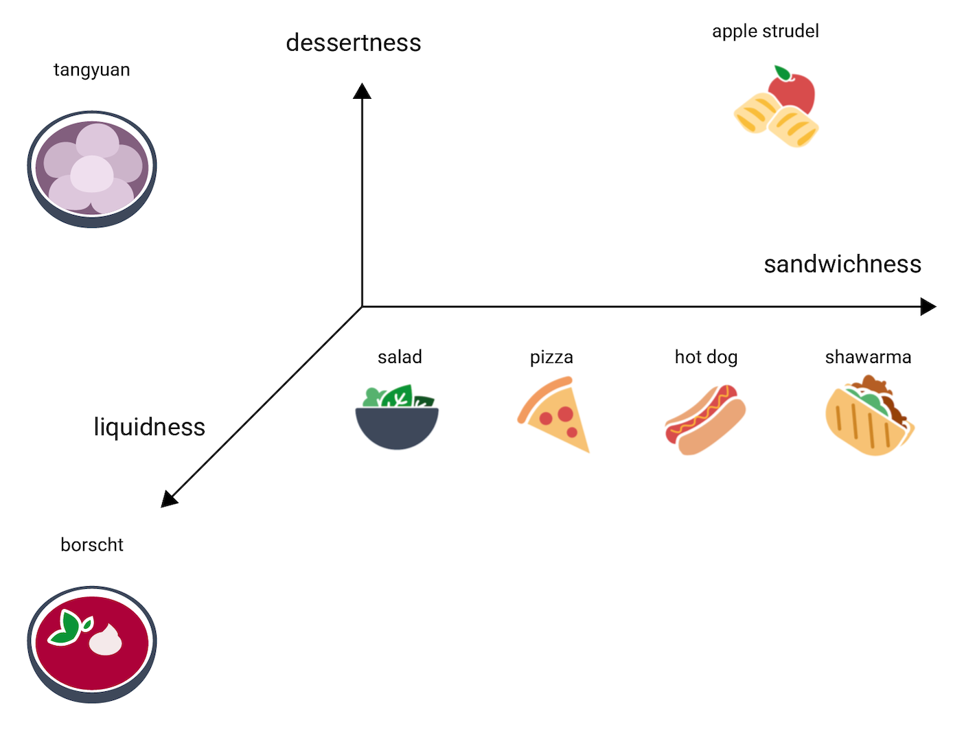
https://developers.google.com/machine-learning/crash-course/embeddings/embedding-space?hl=en
Notes:
Each axis describes some attribute, aspect or category of a word
Down projected to 3D, very simple example
Usually 1000s of dimensions for embedding vectors

Slide 26
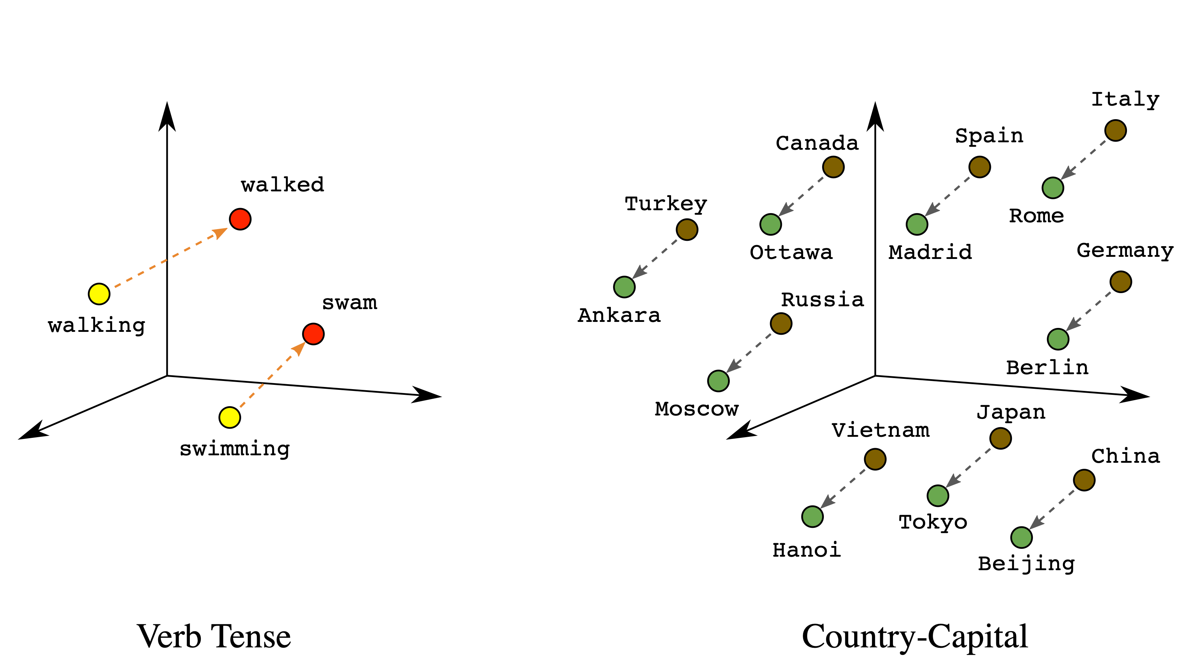
https://developers.google.com/machine-learning/crash-course/embeddings/embedding-space?hl=en
Notes:
The distance from king to queen

Slide 27
Why do we need Word Embeddings?
Numerical Representation of Words for ML models
Capturing semantic relationships
Dimensionality Reduction from One-Hot Encodings
Flexibility and Transferability across different NLP applications
Notes:
Different NLP Tasks:
Text Classification
Machine Translation
Question Answering
Information Retrieval and Search Engines

Slide 28
What are Word Embeddings used for?
Understanding similar words
Sorting texts
Spotting Names and Places
Translating Languages
Answering Questions
Notes:
Understanding Similar Words: They help computers figure out which words mean similar things.
Sorting Texts: They make it easier for computers to organize and classify different types of text.
Spotting Names and Places: Word embeddings help computers find names of people, organizations, or locations in a text.
Translating Languages: They assist in translating words from one language to another more accurately.
Answering Questions: They help systems find relevant answers by understanding the meaning of words in questions and documents.

Slide 29
Word Embedding Techniques

Slide 30
How does GloVe work?
GLobal Vectors for Word Representation
Instead of local, global contextual information is used
Co-Occurence Matrix is used to describe how often words occur together
Less amount of weight to more distant words
Backpropagating with loss function
Notes:
OOB - Out-of-Bag - when (sub-)words are not yet in the vocab

Slide 31

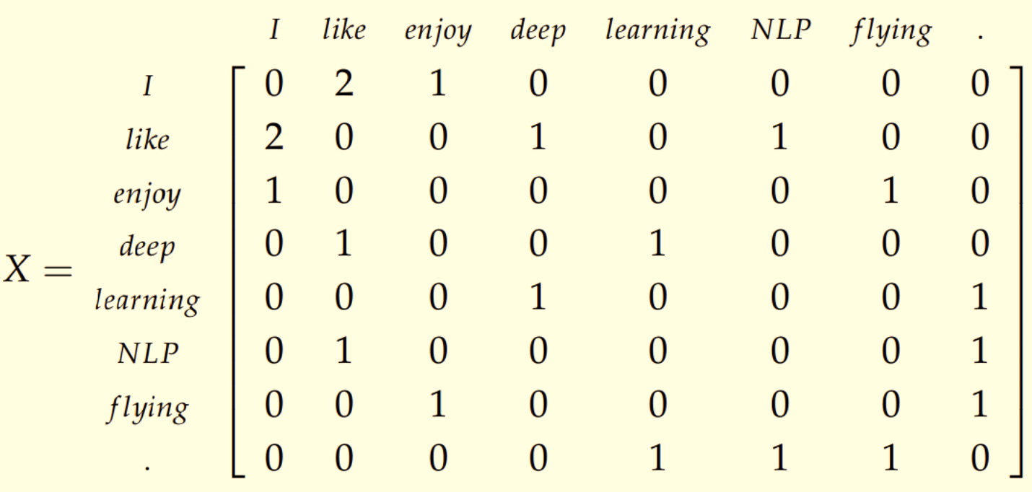

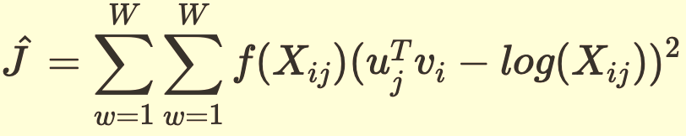
Loss Function:
https://jramkiss.github.io/2019/08/21/word-embeddings/
Notes:
Sum in the beginning: Going through all possible word pairs.
X_ij: The Co-Occurence Matrix
f(X_ij) = min(1,(X_ij/x_max)^alpha) is the : Weighted Matrix to reduce influence of rare/often occurring pairs
alpha and x_max: hyperparameters which control the scaling of the weighting
u_j and v_i: the embeddings for the words j and i
u^T_j*v_i: prediction for the logarithmized co-occurence matrix
So u^T_jv_i - log(X_ij))^2 is the squared difference between prediction and actual log value. This is then done for all entries in the matrix and backpropagated

Slide 32
How does Word2Vec work?
Algorithm for creating word embeddings in a continuous vector space
Similar words are closer in space
Two Architectures - CBOW and Skip-Gram
Delivering meaningful vector representations; very efficient and scalable
Notes:
Word2Vec creates word embeddings in a continuous vector space
calculates the average of all the left and right context words and then gives that to a NN
Skip-Gram

Slide 33
How does Continuous Bag of Words (CBOW) work?
CBOW combines context words from left and right to an average vector which serves as input for target word prediction
The context words are first passed as an input to an embedding layer
The word embeddings are then passed to a lambda layer where we average out the word embeddings
embeddings are passed into a dense Softmax Layer predicting target word
Loss is computed and backpropagated
Notes:
Word2Vec creates word embeddings in a continuous vector space
calculates the average of all the left and right context words and then gives that to a NN
Skip-Gram

Slide 34
How does Skip-Gram work?
Given a target word, the context words are predicted
Positive and negative input samples are input
Skip-Gram inputs one-hot-encoded embedding with vocab size length
Multiplied with embedding matrix (vocab x embed_dim)
Multiplied with second embedding matrix (embed_dim x vocab)
Output: Probability Distribution of embeddings being in context
Cross-Entropy Loss and Backpropagation
Notes:
Makes the model aware of the contextually relevant words

Slide 35
Word2Vec Embeddings
Notebook Exercise

Slide 36
Word embeddings convert words into high-dimensional vectors that capture their meaning for ML models.

Slide 37
Main Ideas
Tokenization splits text into characters, subwords, or words, called tokens.
The Byte-Pair Encoding subword tokenization that converts the most frequent pairs of characters into new tokens, improving model efficiency and flexibility.
Word Embeddings are high-dimensional vectors that represent word meanings in a compressed format for Machine Learning.
Notes:
Neural Networks only understand math, specifically vectors
If there are Out-of-Bag words that have not been seen by the tokenizer, that’s a problem.
Poor tokenization can lead to:
Loss of meaning Increased computational load

