Slide 1
模拟社会 Simulation society
zrx

Slide 2
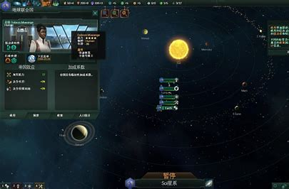
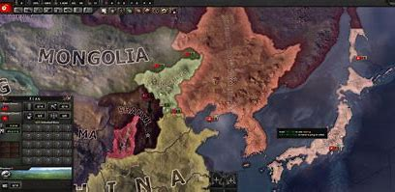
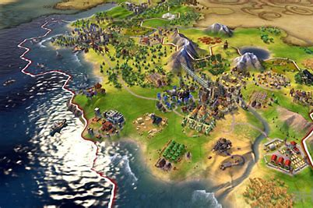
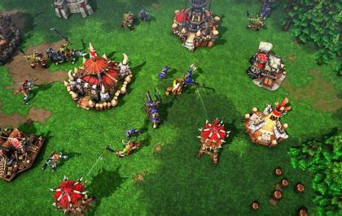
模拟经营游戏Business simulation game

Slide 3
如何描述社会的运转？
可否用模拟的方法简单量化社会的运作方式？
How to describe the functioning of society?
Can simulation be used to easily quantify how society works？
从一个小问题切入：税收对各阶层的影响，废止农业税是否是必然？
Starting with a small question: the impact of the tax on all classes？Is the abolishment of the agricultural tax be inevitable?

Slide 4

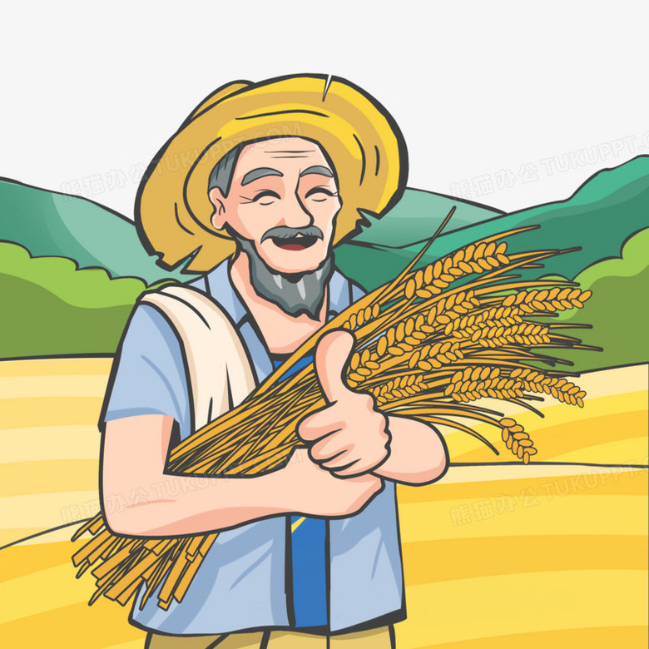

食物 FOOD
公务员
civil servant
产品 PRODUCT
税收 TAX
①
②
商人businessman
工人worker
农民
farmer

Slide 5
三个参数描绘个体 Three parameters
食物FOOD：农民生产，必需品，可储存，作为货币。
Farmers produce, necessities, can be stored, as money.
产品PRODUCT：工人生产，必需品，奢侈品，可储存。
Workers produce, necessities, luxuries, can be stored.
满意度SATISFACTORY：每单位时间根据个体拥有的食物、产品进行计算。储量过低会降低满意度。同阶层内储量最低者也会降低满意度。满意度过低或过高会导致犯罪（不从事生产，降低周围人的满意度）Each unit of time is calculated according to the food and products owned by the individual. Low reserves can reduce satisfaction. Those with the lowest reserves in the same class also reduce satisfaction. Too low or too high satisfaction can lead to crime (not engaging in production, reducing the satisfaction of those around you)

Slide 6
税收TAX
根据农民、工人和商人每年收入*不同的税率计算税额。
公务员工资和国库储备从税收中出。
由玩家设置
The tax is calculated based on the annual income * different tax rate of farmers, workers and businessmen.
Civil servants' salaries and state reserves come out of taxes.
Set by the player

Slide 7
经济学ECONOMICS
商人采用集合定价从工人处购买商品，之后固定价格卖给公务员，竞价方式卖给农民。
商人采用竞价方式从农民购买食物，之后固定价格卖给公务员，集合定价方式卖给工人。
Businessman used collective pricing to buy goods from workers, fixed prices to sell to civil servants, and bidding to farmers.
Merchants bought food from farmers by bidding, sold it to civil servants at fixed prices, and sold it to workers at collective pricing.

