Slide 1
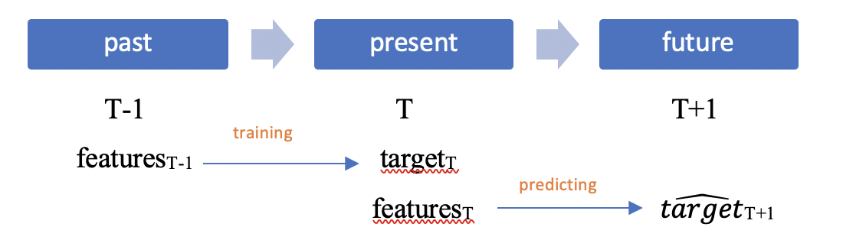
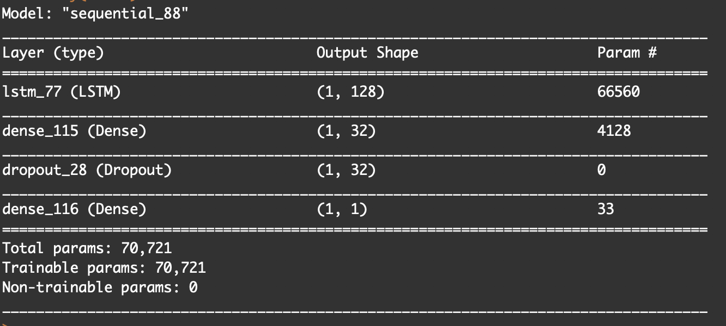
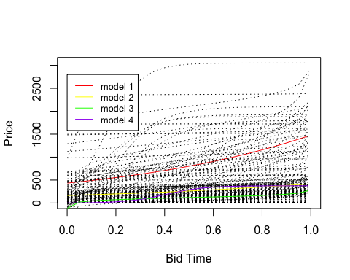

OBJECTIVE
Forecasting the online auction outcome
Background – Online auction has been one of the most popular methods to buy and sell items online. Forecasting the auction outcome is beneficial to all auction parties.
RESULTS
$$MAE=\frac{\sum_{i=1}^{n}{|yi−\hat{y}i|}}{n}$$
Feature | Method | Testing MAE
Static features | Multiple Linear Regression | 110.296938
 | KNN | 89.9072
Static features+Dynamic features | Multiple Linear Regression | 67.37456
 | KNN | 85.78306
 | XGBoost | 11.8855213
 | LSTM Neural Network | 102.7578
DATA CURATION AND ANALYSIS
The dataset contains both time series and cross-sectional data.
CONCLUSIONS
Follow On Work/Lessons Learned:
Our baseline model using ML models to predict the end-price with static features did not perform satisfactorily with a testing MAE of 110.29693. Adding the on-going information can reduce the MAE to 11.8855213.
The LSTM Neural Network did not return the best result.
An ensemble of unsupervised clustering results and linear regression might have higher predictive capabilities. My future works also includes the practical application of auction predicting models that helps the buyers making bidding decisions.
Each auction has a sequence of bidding history
10681 observations and 9 variables, 627 auctions in total
The timestamp is generated by user activities, where events are not equally spaced
Auction price- second highest bid+ increment
Static information vs evolving information
Modeling discrete bidding price to a smoothing curve using methods such as Spline, GAM

