Slide 1
Math 642 Introduction to Machine Learning Lecture 11: Bayesian Learning
Some of the figures in this presentation are taken from "An Introduction to Statistical Learning, with applications in R" (Springer, 2013) with permission from the authors: G. James, D. Witten, T. Hastie and R. Tibshirani
This material is protected by copyright law. It is being provided to you in connection with Math 642 and as an accommodation during the current international health crisis. It may be used only by you for purposes of Math 642, and you may not copy, download or otherwise redistribute it for any other purpose.

Slide 2
Class Schedule
Lec | Date | Lecture | Due
1 | Jan 15 | Intro, Linear Regression, Bias and Variability
2 | Jan 22 | Unsupervised Learning: Clustering, Principle Comp. Analysis | Hwk 1
3 | Jan 29 | KNN Regression, Cross Validation, Bootstrap | Hwk 2
4 | Feb 5 | Ridge Regression, LASSO, Principle Components Regression | Hwk 3
5 | Feb 12 | Extreme Nonlinear: Step Functions, Splines, Gradient Descent | Hwk 4, Project Plan
6 | Feb 19 | Classification, Logistic Regression, Discriminant Analysis | Hwk 5
7 | Feb 26 | Max Margin Classifiers, Support Vector Machines | Hwk 6, Plan Revision
 | Mar 4 | Mid Term Exam
 | Mar 11 | Spring Break
8 | Mar 18 | Tree-Based Methods | Hwk 7
9 | Mar 25 | Neural Networks | Hwk 8
10 | Apr 1 | Neural Networks, Convolutional NN, Deep Learning | Hwk 9
11 | Apr 8 | Bayesian Analysis, Project Presentations | Hwk 10
12 | Apr 15 | Bayesian Belief Networks, Project Presentations | Final Project Due
13 | Apr 22 | Ethics of Machine Learning, Project Presentations, Exam Prep | Hwk 11
 | Apr 29 | Study Day
 | May 6 | Final Exam

Slide 3
Machine Learning Taxonomy
Statistical Learning
Outcomes
No Outcomes
Supervised
Unsupervised
Quantitative
Estimation
Outcome
is a Number
Outcome
is a Class
Classification
Clustering
Principal
Components
Logistic Regression
Parametric
Estimation
Non-Parametric
Estimation
Bayesian Belief Network
LDA/QDA
y = f(x)
non-equation
based
KNN Classification
Linear Regression
Common Elements
Cross Validation
Feature Selection
Gradient Descent
Bootstrap
Boosting
KNN Regression
SVM
Ridge Regression
Clustering
Decision Trees
LASSO
Decision Trees
Neural Nets
Splines
Time Series
Bayesian Modeling
Bayesian Modeling

Slide 4
Review

Slide 5
Convolution in 1 Dimension
2
1
0
g(x-k)
where k = 0
f(k)
k
0 1 2 3 4 5 6
(f*g)(x)=$\int_{−∞}^{∞}{f\left(k\right)g\left(x−k\right)dk}$

Slide 6
Convolution in 1 Dimension
2
1
0
g(x-k)
where k = 5
f(k)
k
1
0
0 1 2 3 4 5 6
k
0 1 2 3 4 5 6
(f*g)(x)=$\int_{−∞}^{∞}{f\left(k\right)g\left(x−k\right)dk}$

Slide 7
R Convolution Example

Slide 8
R Convolution Example

Slide 9
2-Dimensional Convolution
A 2-D convolution works like the 1-D case. Assume the data was scaled for an average of 0 and std deviation of 1 before doing the convolution. Assume the convolution set any result smaller than 0.8 = 0.
**
=
Kernel
Image
Result
(f**g)(x,y)=$\int_{−∞}^{∞}{\int_{−∞}^{∞}{f\left(k,m\right)g\left(x−k,y−m\right)dk dm}}$

Slide 10
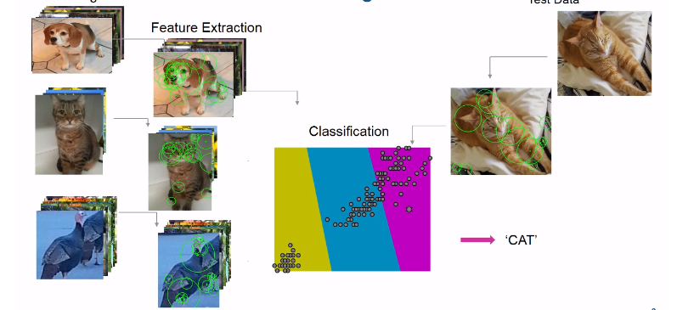
Clustering Based on Convolution Filters

Slide 11
Transfer Learning
Goal – Use a pre-trained CNN to handle a new situation, without having a full dataset
Typically you alter the last layer
You might make the last layer fully connected
You might up the learning rate
You might change the max # epochs
You can add pooling layers
Basically you are taking a model that can already “see” and making it recognize a new object
Usually you can set the learning parameter per layer, so you can have the final layer(s) adjust quickly while keeping the original CNN stable.

Slide 12
Problems with Neural Networks
The Number 1 practical problem with Neural Networks: They need lots (and lots, think tens of thousands or millions) of curated data in order to train the model
Finding the right architecture is an art not a science
The final model is a black box that is difficult to explain, both in how you got the model and how it works
What are the main things your model uses to come up with a classification?
Therefore not great if you are looking for insight

Slide 13
Bayesian Learning
Reference:
Doing Bayesian Data Analysis: A Tutorial with R, JAGS, and Stan, 2nd Addition
John K. Kruschke
https://www.elsevier.com/books/doing-bayesian-data-analysis/kruschke/978-0-12-405888-0

Slide 14
2 Different Approaches: Frequentist vs Bayesian
There are some subtle yet important differences:
Classical (or frequentist) Approach
Sample a population n times
Construct a relationship (equation or other type of relation) between feature and outcome based on the distribution you discover in your sample
Apply this relationship to make predictions or infer things about causality
Bayesian Approach
Develop a distribution for your feature based on all knowledge you have at the time
This is called a Prior Distribution
Sample a feature (collect Data or collect Evidence)
Use the feature and the Prior Distribution to create a new distribution that reflects all of your old knowledge plus this new bit of information
This is called your Posterior Distribution

Slide 15
Advantages of Bayesian Approach
Utilizes prior knowledge
Best way to model low occurrence events
Good way to model problems that are hard to sample
Good way to model problems that are dynamic
Great way to come at a problem from a different direction

Slide 16
Frequentist vs Bayesian
When is Bayesian Analysis appropriate?
Situations where you can’t easily obtain meaningful samples
Predictions about the stock market
Election results
Cases where you are starting with significant expertise
Probability of self-driving cars in cities in the next 5 years
Low occurrence events:
Probability of nuclear war
Probability of an ebola outbreak in the US
Models in a dynamic or fast changing environment
Sports competition
Disease undergoing mutations

Slide 17
Problem Setup
Let Y be some outcome that has some distribution.
Let X be the feature(s) that you believe affects the outcome.
Given I have collected a new data point X = x, what will my outcome probably be?
________________________________________________________________
This looks a lot like what we did with regression and tree modeling. What is different about the Bayesian Approach?

Slide 18
Notation
Of course, you can’t use the same notation for Frequentist and Bayesian problem-solving.
We’re going to call the data we collect: D
We’re going to call the parameter we are trying to predict: Θ
(Basically the data we collected in regression that we called X is now D, and the things that we tried to predict that we called Y is now Θ. )

Slide 19

Probability
Start with some event A and another event B.
P(A) is the probability that event A happens.
P(B) is the probability that event B happens.
P(A,B) is the probability that both event A and event B happen.
$$P\left(A,B\right)=P(A∩B)$$
A
B

Slide 20
Conditional Probability
The conditional dependence of event A on event B is written as
P(A|B)
Which means “the probability of A happening given that B has happened”.
P(A|B) = P(A,B) / P(B) (assuming P(B) ≠ 0)
You can think of this as the probability that A happens in the case where B has a probability of 1. Visually it is the area of the intersection of A and B divided by the total area of B.
P(A|B) = P(A,B) if P(B) = 1
A
B

Slide 21
Deriving Bayes Theorem
Start with basic probability:
P(Θ=θ|D=d) = P(Θ=θ, D=d) / P(D=d) (I’m going to drop the “=θ“ and “=d”)
P(Θ |D) * P(D) = P(Θ, D)
P(D| Θ) = P(D, Θ)/P(Θ)
P(D| Θ) * P(Θ) = P(D, Θ)
Note: P(D, Θ) = P(D) P(Θ) = P(Θ, D)
U

Slide 22
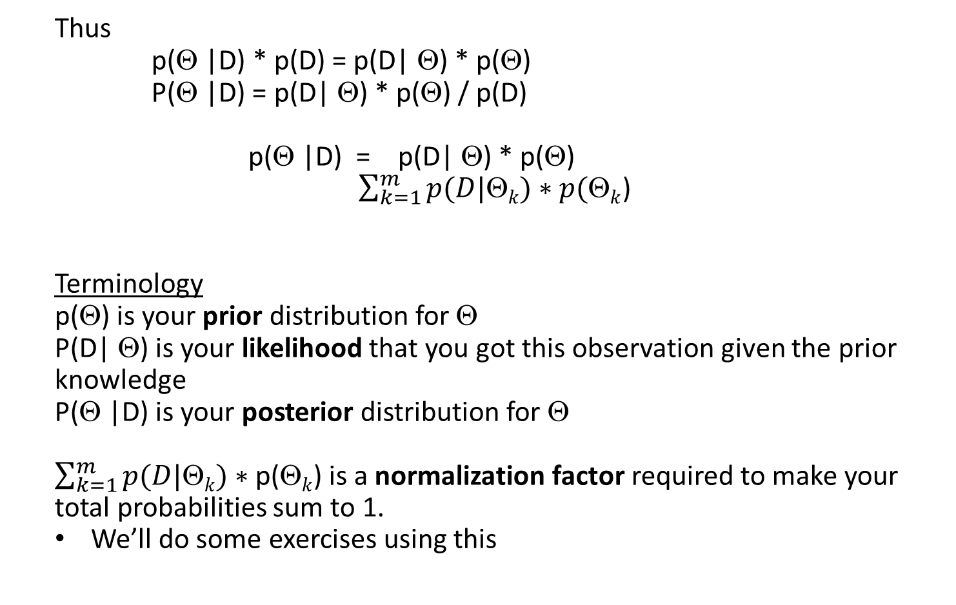
Deriving Bayes Theorem
Thus
p(Θ |D) * p(D) = p(D| Θ) * p(Θ)
P(Θ |D) = p(D| Θ) * p(Θ) / p(D)
p(Θ |D) = p(D| Θ) * p(Θ)
$\sum_{k=1}^{m}{p(D|\text{Q}k})∗p(\text{Q}k$)
Terminology
p(Θ) is your prior distribution for Θ
P(D| Θ) is your likelihood that you got this observation given the prior knowledge
P(Θ |D) is your posterior distribution for Θ
$\sum_{k=1}^{m}{p(D|\text{Q}k})∗\text{p}\text{(}\text{Q}k$) is a normalization factor required to make your total probabilities sum to 1.
We’ll do some exercises using this

Slide 23
The Prior Distribution
The prior distribution is not based on analysis of a sample. And there are no assumptions made that a sample is representative of the larger population.
The prior is based on the predictor’s beliefs. It may be subjective rather than objective.
As observations are made, the prior will be adjusted to better represent the actual distribution. Bayes analysis is an iterative process here the posterior from the last experiment becomes the prior for the next experiment.

Slide 24
The Likelihood
This term represents one or more observations that you have made. The likelihood means that, based on what you already know about the model, is this data likely?
It is also called the “marginal likelihood”.
In machine learning literature it is often called the “evidence”.

Slide 25
The Posterior Distribution
The posterior distribution is calculated from the prior distribution and the data observation. Then it becomes the prior for the next observation.
As more data is collected, the posterior becomes more and more like reality.
Later we will find that there are 2 categories of posteriors:
Those that can be readily calculated from the priors and likelihood
Those that cannot be easily calculated from the priors and likelihood

Slide 26


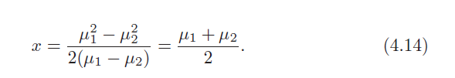
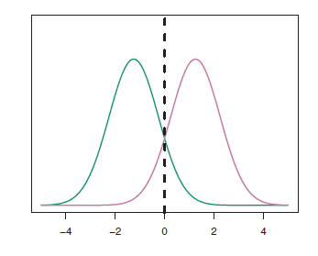
Bayes Classifier for Gaussian Distribution
When we studied Linear Discriminant Analysis, we wrote Bayes as:
Bayes is the ideal classifier if the prior distribution is normal (or Gaussian). In this case the Decision Boundary is:

Slide 27
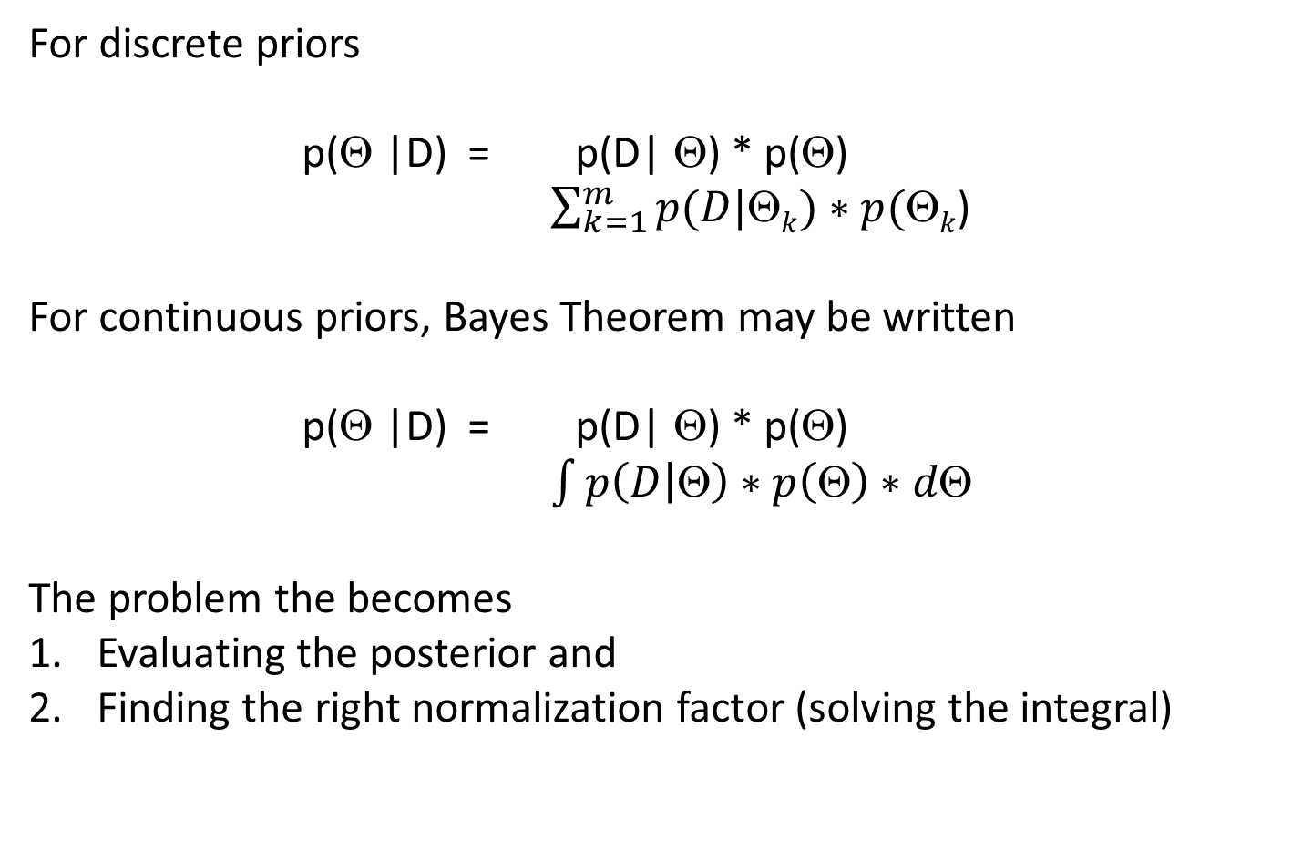
Bayes Theorem for Continuous Functions
For discrete priors
p(Θ |D) = p(D| Θ) * p(Θ)
$\sum_{k=1}^{m}{p(D|\text{Q}k})∗p(\text{Q}k$)
For continuous priors, Bayes Theorem may be written
p(Θ |D) = p(D| Θ) * p(Θ)
$\int{p\left(D | \text{Q}\right)∗p\left(\text{Q}\right)∗d\text{Q}}$
The problem the becomes
Evaluating the posterior and
Finding the right normalization factor (solving the integral)

Slide 28
Diagnostic Test
(The following example applies Bayes Theorem to diagnostic testing.)
Suppose there is a disease that affects 1 in 10,000 people.
There is a test for the disease that has a 99% hit rate (if the person has the disease, the test yields a positive 99% of the time).
The test has a false alarm rate of 5%.

Slide 29
No Missed Detections
You take the test and it comes up negative… now what is your posterior probability that you have the disease?
To answer, fill in the following table:
Since you have tested negative, you are in the bottom row. Your chance of having the disease is the marginal probability.
 | Has Disease (Θ+) | Does not have Disease (Θ-)
Positive Test (D+) | P(D+, Θ+) = P(D+ | Θ+) * P(Θ+) /∑ | P(D+, Θ−) = P(D+ | Θ−) * P(Θ−) /∑
Negative Test (D-) | P(D-, Θ+) = P(D- | Θ+) * P(Θ+) /∑ | P(D-, Θ−) = P(D- | Θ−) * P(Θ−) /∑

Slide 30
No Missed Detections
You take the test and it comes up negative… now what is your posterior probability that you have the disease?
To answer, fill in the following table:
Since you have tested negative, you are in the bottom row. Your chance of having the disease is the marginal probability.
 | Has Disease (Θ+) | Does not have Disease (Θ-)
Positive Test (D+) | P(D+, Θ+) = P(D+ | Θ+) * P(Θ+) /∑ | P(D+, Θ−) = P(D+ | Θ−) * P(Θ−) /∑
Negative Test (D-) | P(D-, Θ+) = P(D- | Θ+) * P(Θ+) /∑ | P(D-, Θ−) = P(D- | Θ−) * P(Θ−) /∑

Slide 31
No Missed Detections
With numbers:
 | Has Disease (Θ+) | Does not have Disease (Θ-)
Positive Test (D+) | P(D+, Θ+) = P(D+ | Θ+) * P(Θ+) /∑ | P(D+, Θ−) = P(D+ | Θ−) * P(Θ−) /∑
Negative Test (D-) | P(D-, Θ+) = P(D- | Θ+) * P(Θ+) /∑ | P(D-, Θ−) = P(D- | Θ−) * P(Θ−) /∑
 | Has Disease (Θ+) | Does not have Disease (Θ-)
Positive Test (D+) | 0.99 * 0.001 /∑ | 0.05 * 0.999 /∑
Negative Test (D-) | 0.01 * 0.001 /∑ | 0.95 * 0.999 /∑
∑ = 0.0509
∑ = 0.949
∑ = 0.0011
∑ = 0.989

Slide 32
No Missed Detections
If you test Negative:
 | Has Disease (Θ+) | Does not have Disease (Θ-)
Positive Test (D+) | P(D+, Θ+) = P(D+ | Θ+) * P(Θ+) /∑ | P(D+, Θ−) = P(D+ | Θ−) * P(Θ−) /∑
Negative Test (D-) | P(D-, Θ+) = P(D- | Θ+) * P(Θ+) /∑ | P(D-, Θ−) = P(D- | Θ−) * P(Θ−) /∑
 | Has Disease (Θ+) | Does not have Disease (Θ-)
Positive Test (D+) | 0.99 * 0.001 | 0.05 * 0.999
Negative Test (D-) | 0.01 * 0.001 | 0.95 * 0.999
∑ = 0.0509
∑ = 0.949
∑ = 0.0011
∑ = 0.989
 | Has Disease (Θ+) | Does not have Disease (Θ-)
Positive Test (D+)
Negative Test (D-) | 0.0000105 | 1.00000
∑ ~ 1.00001

Slide 33
Time to Panic?
You take the test and it comes up positive… now what is your posterior probability that you have the disease?
To answer, fill in the following table:
Since you have tested positive, you are in the top row. Your chance of having the disease is the marginal probability.
 | Has Disease (Θ+) | Does not have Disease (Θ-)
Positive Test (D+) | P(D+, Θ+) = P(D+ | Θ+) * P(Θ+) /∑ | P(D+, Θ−) = P(D+ | Θ−) * P(Θ−) /∑
Negative Test (D-) | P(D-, Θ+) = P(D- | Θ+) * P(Θ+) /∑ | P(D-, Θ−) = P(D- | Θ−) * P(Θ−) /∑

Slide 34
Time to panic?
If you test Positive:
 | Has Disease (Θ+) | Does not have Disease (Θ-)
Positive Test (D+) | P(D+, Θ+) = P(D+ | Θ+) * P(Θ+) /∑ | P(D+, Θ−) = P(D+ | Θ−) * P(Θ−) /∑
Negative Test (D-) | P(D-, Θ+) = P(D- | Θ+) * P(Θ+) /∑ | P(D-, Θ−) = P(D- | Θ−) * P(Θ−) /∑
 | Has Disease (Θ+) | Does not have Disease (Θ-)
Positive Test (D+) | 0.99 * 0.001 /∑ | 0.05 * 0.999 /∑
Negative Test (D-) | 0.01 * 0.001 | 0.95 * 0.999
∑ = 0.0509
∑ = 0.949
∑ = 0.0011
∑ = 0.989
 | Has Disease (Θ+) | Does not have Disease (Θ-)
Positive Test (D+) | 0.0195 | 0.9813
Negative Test (D-) | 0.01 * 0.001 | 0.95 * 0.999
∑ = 1.0008

Slide 35
Time to panic?
If you test Positive and then go in for a retest, you change prior. If you test positive the second time:
 | Has Disease (Θ+) | Does not have Disease (Θ-)
Positive Test (D+) | P(D+, Θ+) = P(D+ | Θ+) * P(Θ+) /∑ | P(D+, Θ−) = P(D+ | Θ−) * P(Θ−) /∑
Negative Test (D-) | P(D-, Θ+) = P(D- | Θ+) * P(Θ+) /∑ | P(D-, Θ−) = P(D- | Θ−) * P(Θ−) /∑
 | Has Disease (Θ+) | Does not have Disease (Θ-)
Positive Test (D+) | 0.99 * 0.0195 /∑ | 0.05 * 0.9813 /∑
Negative Test (D-) | 0.01 * 0.001 | 0.95 * 0.999
∑ = 0.06837
 | Has Disease (Θ+) | Does not have Disease (Θ-)
Positive Test (D+) | 0.282 | 0.717
Negative Test (D-) | 0.01 * 0.001 | 0.95 * 0.999
∑ = 0.996

Slide 36
No Missed Detections
If you test Positive and then go in for a retest, you change prior. If you test negative the second time:
 | Has Disease (Θ+) | Does not have Disease (Θ-)
Positive Test (D+) | P(D+, Θ+) = P(D+ | Θ+) * P(Θ+) /∑ | P(D+, Θ−) = P(D+ | Θ−) * P(Θ−) /∑
Negative Test (D-) | P(D-, Θ+) = P(D- | Θ+) * P(Θ+) )/∑ | P(D-, Θ−) = P(D- | Θ−) * P(Θ−) /∑
 | Has Disease (Θ+) | Does not have Disease (Θ-)
Positive Test (D+) | 0.99 * 0.001 | 0.05 * 0.999
Negative Test (D-) | 0.01 * 0.0195 | 0.95 * 0.9813
∑ = 0.93243
 | Has Disease (Θ+) | Does not have Disease (Θ-)
Positive Test (D+)
Negative Test (D-) | 0.000209 | 0.99975
∑ = 0.99996

Slide 37
Summary of Testing Analysis
The test was designed to detect as many people with the disease as possible. This is at the expense of a high false alarm rate.
If you test positive once, your chances of having the disease are still very low (1%). This is because the initial probability is 1 in 10,000. Thus a high false alarm rate is still the overwhelming reason for 1 positive test (99%).
After a second test, if you test positive again, your chances of having the illness go up to 28%. Still more likely it is a mistake, but now you should get examined by a physician.
However, your second test is more likely to be negative. Then you are 99% probably disease free.

Slide 38
Conjugate Functions
Happily there are several ways to solve for the posterior distribution using Bayes Theorem
Deterministically using Conjugate Functions
Numerically using Markov Chain Monte Carlo methods
Using a related tool called Bayesian Belief Networks
Let’s look at Conjugate Functions first

Slide 39
Flipping a Coin
Assume
p(heads) = θ and p(tails) = 1−θ
Then the probability of getting a particular sequence of flips would be given by the binomial sampling distribution
p(D) = θ^{h} * (1- θ)^{t}
This is true for any 2-valued outcome that is exclusive (i.e., an outcome cannot be heads and tails at the same time, notwithstanding quantum effects).
We also believe the coin is fair, so P(θ) will equal 0.5. Is it true? We’ll find out.

Slide 40
Flipping a Coin
So let’s apply Bayes theorem to this problem. Since we’re not sure if the coin is fair or not, I’m going to assign 3 discrete values for the prior distribution.
The coin is biased towards tails: assign a 0.25 chance that p(θ) = 0.25
The coin is unbiased: assign a 0.5 chance that p(θ) = 0.5
The coin is biased towards heads: Assign a 0.25 chance that p(θ) = 0.75

Slide 41
Flipping a Coin
Now we flip the coin 12 times and get 3 heads and 9 tails. Compute the posterior distribution and the expectation value for the next flip.
Compute the likelihood of getting this result, p(D), and the posterior distribution give this data.
So what would you expect to see? The Bayesian reasoning goes like this:
You initially thought the coin was fair, but you weren’t sure.
Once you collected data, it sure looks like the coin would be biased towards tails, cause you got 9 of them. Maybe your prior was wrong?
The new posterior should somehow reflect this data. The data you collected was probably not definitive, but should start to affect your belief

Slide 42
Flipping a Coin
The likelihood is computed thusly:
p(D|θ) =θ^{h} * (1- θ)^{t} for the assumed value of θ
If p is biased towards tails, then the likelihood is
(0.25) ³ * (0.75)⁹ = 0.0156 * 0.0751 = 0.00117
If p is unbiased, then the likelihood is
(0.5) ³ * (0.5)⁹ = 0.125 * 0.00195= 0.000244
If p is biased towards heads, then the likelihood is
(0.75) ³ * (0.25)⁹ = 0.421 * 0.000004 = 0.0
(note that your belief is starting to move toward a tail bias based on the data)
Are the above results probabilities? Why or why not?

Slide 43
Flipping a Coin
To compute the posterior I just multiply the likelihood times the prior model and normalize:
If p is biased towards tails, then the posterior is proportional to
likelihood * prior= 0.00117 * 0.25 = 0.0003
If p is unbiased, then the posterior is proportional to
likelihood * prior= 0.000244 * 0.5 = 0.000122
If p is biased towards heads, then the posterior is proportional to
likelihood * prior= 0.0 * 0.25 = 0
(note that now you are pretty sure the coin is not biased towards heads, but you are still not sure it is not fair)
What is the final step to convert this to a posterior?

Slide 44
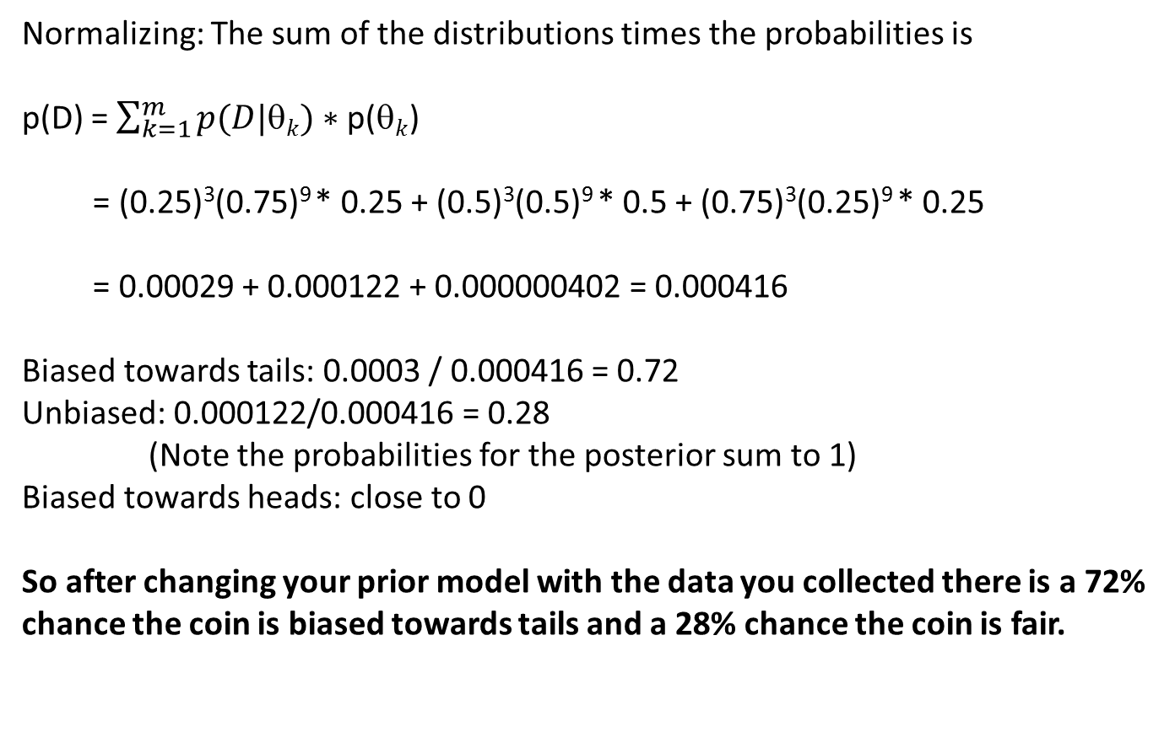
Flipping a Coin
Normalizing: The sum of the distributions times the probabilities is
p(D) = $\sum_{k=1}^{m}{p(D|\text{q}k})∗\text{p}\text{(}\text{q}k$)
= (0.25)³(0.75)⁹ * 0.25 + (0.5)³(0.5)⁹ * 0.5 + (0.75)³(0.25)⁹ * 0.25
= 0.00029 + 0.000122 + 0.000000402 = 0.000416
Biased towards tails: 0.0003 / 0.000416 = 0.72
Unbiased: 0.000122/0.000416 = 0.28
(Note the probabilities for the posterior sum to 1)
Biased towards heads: close to 0
So after changing your prior model with the data you collected there is a 72% chance the coin is biased towards tails and a 28% chance the coin is fair.

Slide 45
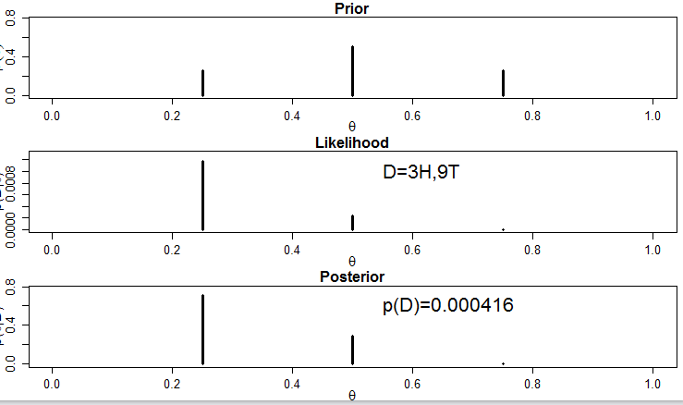
Coin Toss Problem

Slide 46
R Example of Coin Toss

Slide 47
Conjugate Functions
Many problems use prior distributions and likelihood functions that, when multiplied together, produce a posterior function that is the same form as the original prior.
Conjugate: the prior function and likelihood function are conjugate functions if the resulting posterior function is of the same form as the prior.

Slide 48
Conjugate Functions
Back to the coin problem: We know the likelihood function for a particular set of flips is
p(D|θ) = θ ^{(z)} (1-θ)^{(N-z)}
So there is no flexibility here. But we are free to pick whatever kind of prior model we want, as long as it represents our beliefs.
It turns out that the Beta distribution is conjugate with the coin toss likelihood function

Slide 49
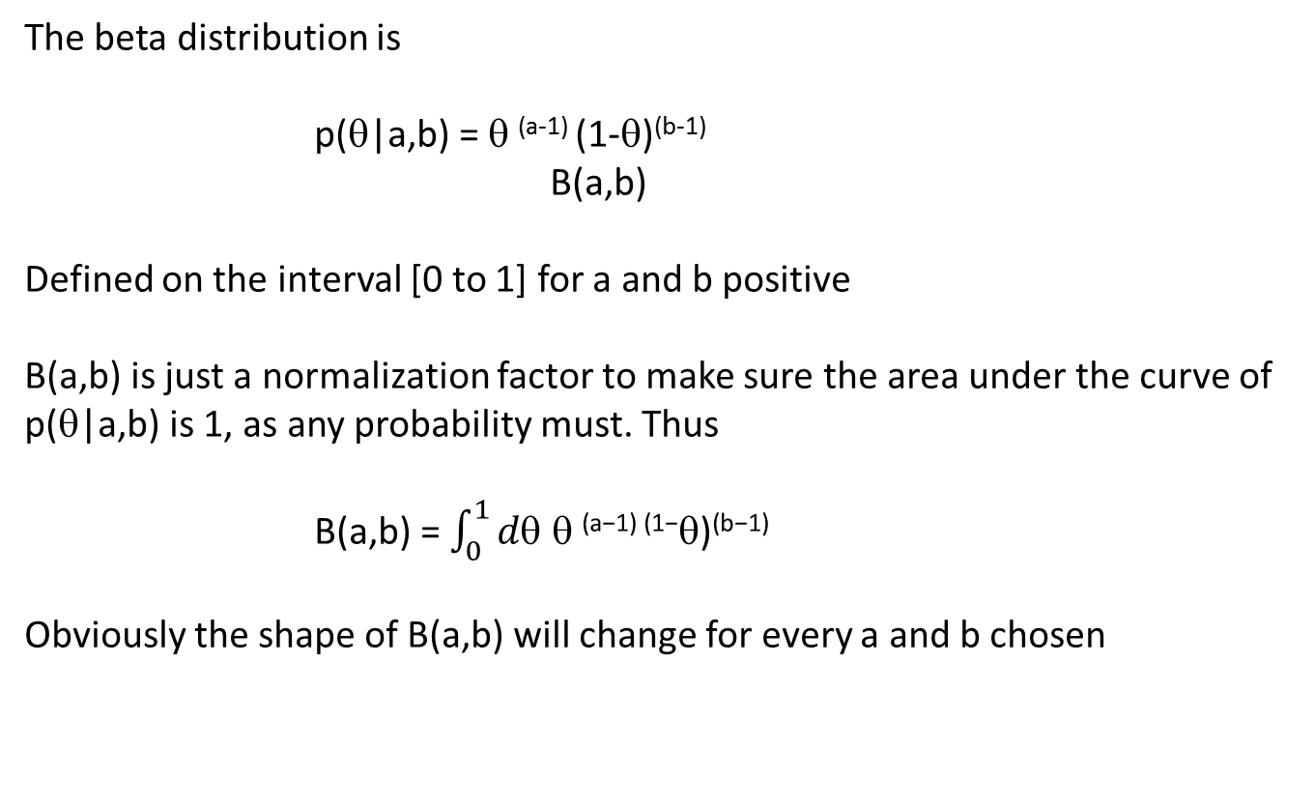
The Beta Distribution
The beta distribution is
p(θ|a,b) = θ ^{(a-1)} (1-θ)^{(b-1)}
B(a,b)
Defined on the interval [0 to 1] for a and b positive
B(a,b) is just a normalization factor to make sure the area under the curve of p(θ|a,b) is 1, as any probability must. Thus
B(a,b) = $\int_{0}^{1}{d\text{q} \text{q} \text{(}\text{a}\text{−1) (1−}\text{q}\text{)}\text{(}\text{b}\text{−1)}}$
Obviously the shape of B(a,b) will change for every a and b chosen

Slide 50
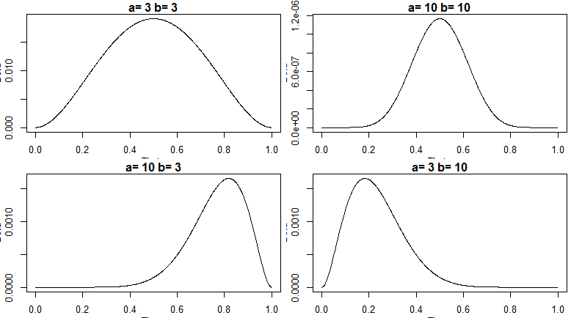
The Beta Distribution
The beta distribution depends on 2 parameters, a and b, that determine the shape. It can represent fair or biased either direction, localized or spread out.

Slide 51
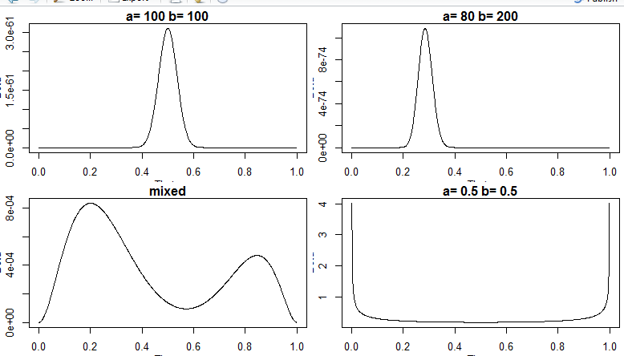
The Beta Distribution
It can be sharp centered wherever you would like it. You can combine beta functions to infer more than1 value, or use fractional a’s and b’s

Slide 52
The Beta Prior in Bayes Theorem
Use the beta distribution as the prior distribution for Bayes
p(θ|a,b) = θ ^{(a-1)} (1-θ)^{(b-1)}
B(a,b)
Look at the likelihod for the coin problem (for 1 set of flips)
p(D|θ) = θ ^{(z)} (1-θ)^{(N-z)}
It’s easy to combine the beta function as a prior to the likelihood
p(θ|a,b,N,z) = θ ^{(a-1+z)} (1-θ)^{(b-1+N-z)}
B (a+z,b+N-z)

Slide 53
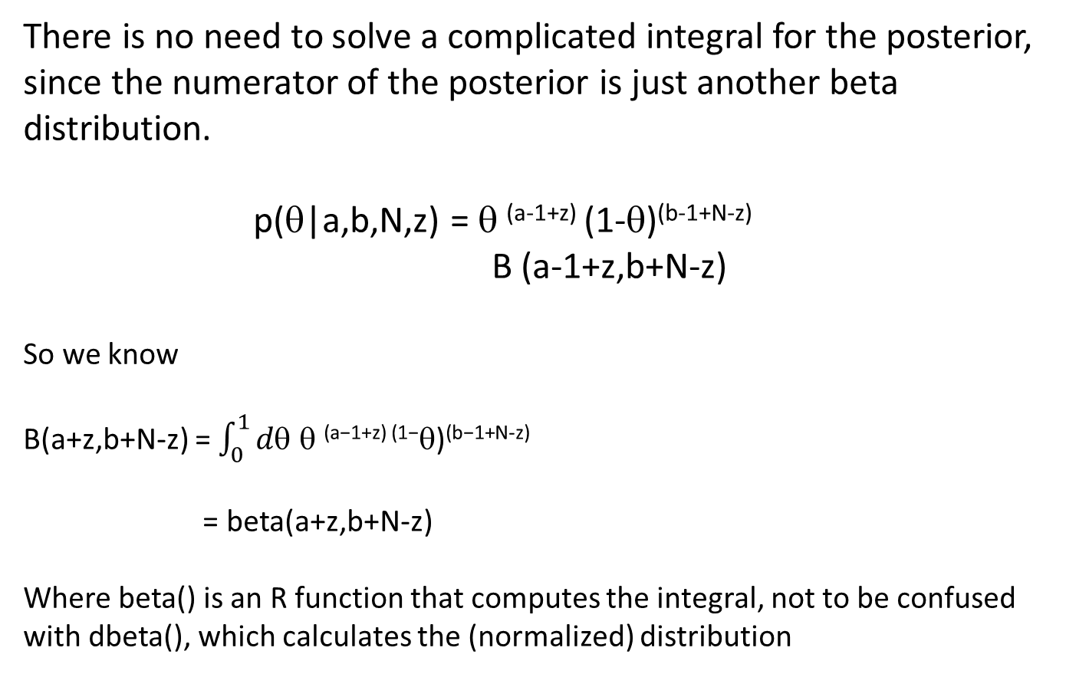
Normalization of the Posterior for Beta Distribution
There is no need to solve a complicated integral for the posterior, since the numerator of the posterior is just another beta distribution.
p(θ|a,b,N,z) = θ ^{(a-1+z)} (1-θ)^{(b-1+N-z)}
B (a-1+z,b+N-z)
So we know
B(a+z,b+N-z) = $\int_{0}^{1}{d\text{q} \text{q} \text{(}\text{a}\text{−1+}\text{z}\text{) (1−}\text{q}\text{)}\text{(}\text{b}\text{−1+}\text{N}\text{−}\text{z}\text{)}}$
= beta(a+z,b+N-z)
Where beta() is an R function that computes the integral, not to be confused with dbeta(), which calculates the (normalized) distribution

Slide 54
Putting Everything Together
p(θ|z,N) = p(z,N|θ) * p(θ)
p(z,N)
= Benoulli * beta(a,b)
Normalization Factor
= θ ^{(z)} (1-θ)^{(N-z)} * θ ^{(a-1)} (1-θ)^{(b-1)}
B (a+z,b+N-z) * p(z,N)
= θ ^{(a-1+z)} (1-θ)^{(b-1+N-z)}
B (a+z,b+N-z)
= beta(a+z, b+N-z)

Slide 55
Putting Everything Together
If the Prior distribution is a beta(a,b) and the data gives you z heads in N flips, then the posterior distribution is
beta (z+a, N-z+b).
Remarkable!

Slide 56
More Properties of Beta Distribution
The average of the beta(a,b) is
θ = a / (a + b)
(note for a = b, the average is 0.5, but for a > b, the average is biased towards 1)
Given the prior average above, the average for the posterior is
θ = (z + a) / (z + a) + (N – z + b)
= (z + a) / (N + a + b)
= [a / (a+b)] * [(a+b) / (N+a+b)] + [z/N] * [N/(N+a+b)]
= prior average * weight + Data proportion* weight

Slide 57
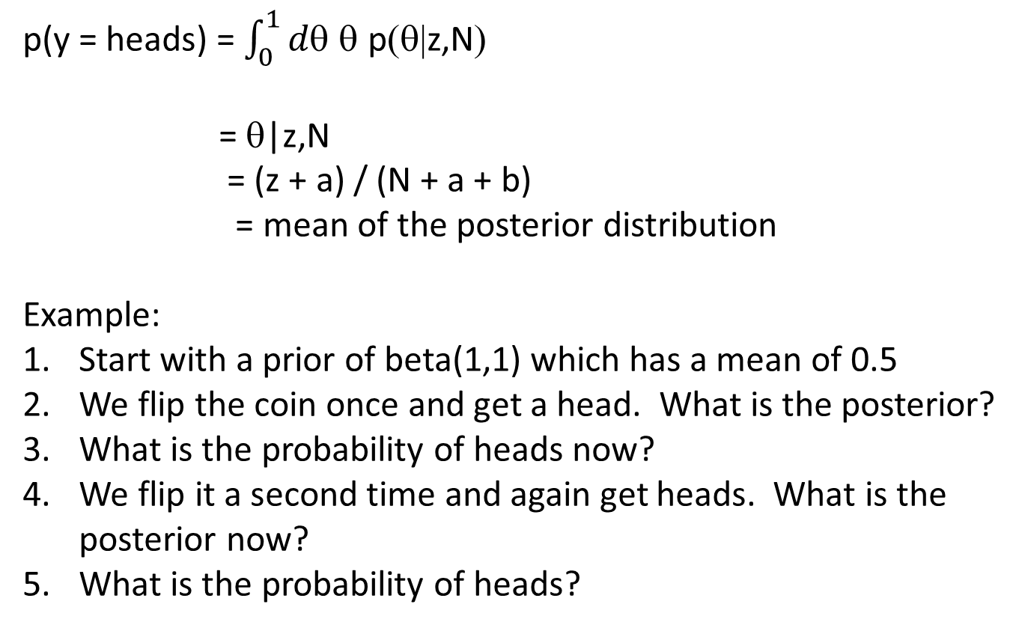
Predictions Using a Beta Prior
p(y = heads) = $\int_{0}^{1}{d\text{q} \text{q} \text{p}\text{(}\text{q}\text{|}\text{z}\text{,}\text{N}\text{)}}$
= θ|z,N
= (z + a) / (N + a + b)
= mean of the posterior distribution
Example:
Start with a prior of beta(1,1) which has a mean of 0.5
We flip the coin once and get a head. What is the posterior?
What is the probability of heads now?
We flip it a second time and again get heads. What is the posterior now?
What is the probability of heads?

Slide 58
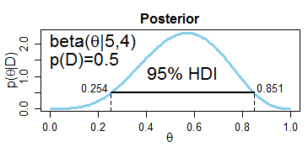
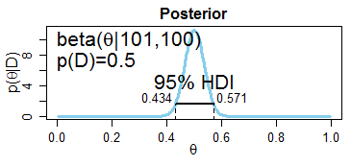
Highest Density Interval
How strong is your belief on the distribution?
HDI is the interval that spans the distribution such that every point inside the interval has a higher believability than any point outside the interval.
HDI indicates which points in the distribution that we believe in most strongly
A wide HDI indicates weak belief. Small HDI indicates a strong belief in a specific outcome.

Slide 59
R Examples of Beta Function

Slide 60
Conjugate Functions
Examples of Conjugate Functions:
Beta prior is conjugate for a binomial sampling model
Direchlet prior is conjugate for a multinomial sampling model
Gamma prior is conjugate for a Poisson sampling model
Gamma prior is conjugate for an exponential sampling model
Gamma prior is conjugate for a gamma sampling model
Normal prior is conjugate for a normal sampling model

Slide 61
Homework
No homework this week so you can work on your project.
Project is Due April 22
(but welcome earlier)
31

Slide 62
Project Discussion
31

Slide 63
Final Report
Section | Description | Pages | Points
Introduction | Why you are interested in the subject area that you selected for your project | 1 paragraph | 2
Problem Description | What problem are you trying to solve? Who is the Customer? What will be the effect on the Customer? | 1 or 2 paragraphs | 3
Objective | What is your objective | 1 or 2 sentences | 5
Data Curation | Discuss your dataset(s): was data missing/ambiguous/poor quality? What were the challenges? How did you solve them. | 2 to 4 paragraphs | 10
Unsupervised Learning Results | Look at some candidate datasets. Plot data, perform PCA, clustering, and other techniques. What did you find out about your candidate datasets? Why did you select the dataset(s) you did, and why did you select the outcome? | ½ to 1 page | 15
Supervised Analysis Results | What techniques did you try and why? (Complete results in the appendix). Which worked the best? For the best technique(s), show output and graphs. | 1 page | 30
Conclusions | Did your project meet the objectives? Why or why not? What conclusions can you draw from the results? | 1 to 2 paragraphs | 10
Follow-on Work | How could you improve your project? What would you do differently? What could be a follow-on project? What did you learn of value? | 1 paragraph | 5
Appendices | All your unsupervised and supervised analysis results. Show output for each technique you tried. | unlimited | 20

Slide 64
Grading Criteria
I’m going to follow the points on the previous table. The questions in the table are the ones I will be asking when I read the report.
I am not looking for volume. If I can’t find the answers in the report then that is a problem. Thus the more concise and complete the better.
I may give extra credit for sections that derail later section. For example, if you spent weeks or months transforming, linking, or labeling data, and this caused you to come up short on the analysis, I will give extra credit for the Data Curation part.
You can also get extra points from your presentation.

Slide 65
Presentation
I would like everyone to do a brief (5 to 10 minute) discussion of your project. Please email me with your preference (next week or the following week).
Prior to your presentation, please send me a quad chart (see next page). Then I can display your chart and you can talk to it over ZOOM.
Since we have 24 students and only 5 hours of class time left, and we have some topics to cover, please limit your presentation to 5 minutes presentation and allow some time for questions.

Slide 66
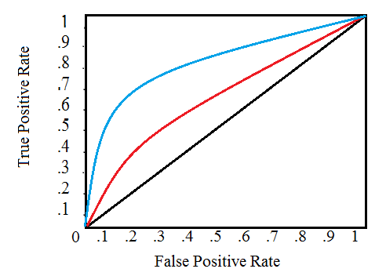
OBJECTIVE
To demonstrate the effectiveness of a medical triage decision support tool.
Background – US soldiers in the Middle East had wounds of varying degrees of severity. Local care was usually close by but more complex cases required more advanced facilities. This tool would take easy-to-obtain data and recommend facilities required for care.
RESULTS
I achieved an AUC of 0.83 with the BBN, but only .75 with the ANN.
DATA CURATION AND ANALYSIS Develop a Bayesian Belief Network (BBN)
Discretized continuous parameters
Ran correlations
Created BNN model
Created ANN for comparison
CONCLUSIONS
The AUC for the BBN was very good and I think this would be a valuable tool for the military and EMTs.
Follow On Work/Lessons Learned: There was a lot of missing and suspect data since the data was collected in a war zone. Preliminary results were great but I’d like to repeat with more data in a more controlled environment.

