Slide 1
Math 642: Introduction to Machine Learning Spring 2020 Lecture 12: Bayesian Analysis, Project Presentations
Some of the figures in this presentation are taken from "An Introduction to Statistical Learning, with applications in R" (Springer, 2013) with permission from the authors: G. James, D. Witten, T. Hastie and R. Tibshirani

Slide 2
Class Schedule
Lec | Date | Lecture | Due
1 | Jan 15 | Intro, Linear Regression, Bias and Variability
2 | Jan 22 | Unsupervised Learning: Clustering, Principle Comp. Analysis | Hwk 1
3 | Jan 29 | KNN Regression, Cross Validation, Bootstrap | Hwk 2
4 | Feb 5 | Ridge Regression, LASSO, Principle Components Regression | Hwk 3
5 | Feb 12 | Extreme Nonlinear: Step Functions, Splines, Gradient Descent | Hwk 4, Project Plan
6 | Feb 19 | Classification, Logistic Regression, Discriminant Analysis | Hwk 5
7 | Feb 26 | Max Margin Classifiers, Support Vector Machines | Hwk 6, Plan Revision
 | Mar 4 | Mid Term Exam
 | Mar 11 | Spring Break
8 | Mar 18 | Tree-Based Methods | Hwk 7
9 | Mar 25 | Neural Networks | Hwk 8
10 | Apr 1 | Neural Networks, Convolutional NN, Deep Learning | Hwk 9
11 | Apr 8 | Bayesian Analysis, Project Presentations | Hwk 10
12 | Apr 15 | Bayesian Belief Networks, Project Presentations | Final Project Due
13 | Apr 22 | Ethics of Machine Learning, Project Presentations, Exam Prep | Hwk 11
 | Apr 29 | Study Day
 | May 6 | Final Exam

Slide 3
Machine Learning Taxonomy
Statistical Learning
Outcomes
No Outcomes
Supervised
Unsupervised
Quantitative
Estimation
Outcome
is a Number
Outcome
is a Class
Classification
Clustering
Principal
Components
Logistic Regression
Parametric
Estimation
Non-Parametric
Estimation
Bayesian Belief Network
LDA/QDA
y = f(x)
non-equation
based
KNN Classification
Linear Regression
Common Elements
Cross Validation
Feature Selection
Gradient Descent
Bootstrap
Boosting
KNN Regression
SVM
Ridge Regression
Clustering
Decision Trees
LASSO
Decision Trees
Neural Nets
Splines
Time Series
Bayesian Modeling
Bayesian Modeling

Slide 4
Review from Last Week

Slide 5
2 Different Approaches: Frequentist vs Bayesian
There are some subtle yet important differences:
Classical (or frequentist) Approach
Sample a population n times
Construct a relationship (equation or other type of relation) between feature and outcome based on the distribution you discover in your sample
Apply this relationship to make predictions or infer things about causality
Bayesian Approach
Develop a distribution for your feature based on all knowledge you have at the time
This is called a Prior Distribution
Sample a feature (collect Data or collect Evidence)
Use the feature and the Prior Distribution to create a new distribution that reflects all of your old knowledge plus this new bit of information
This is called your Posterior Distribution

Slide 6
Frequentist vs Bayesian
When is Bayesian Analysis appropriate?
Situations where you can’t easily obtain meaningful samples
Predictions about the stock market
Election results
Cases where you are starting with significant expertise
Probability of self-driving cars in cities in the next 5 years
Low occurrence events:
Probability of nuclear war
Probability of an ebola outbreak in the US
Models in a dynamic or fast changing environment
Sports competition
Disease undergoing mutations

Slide 7
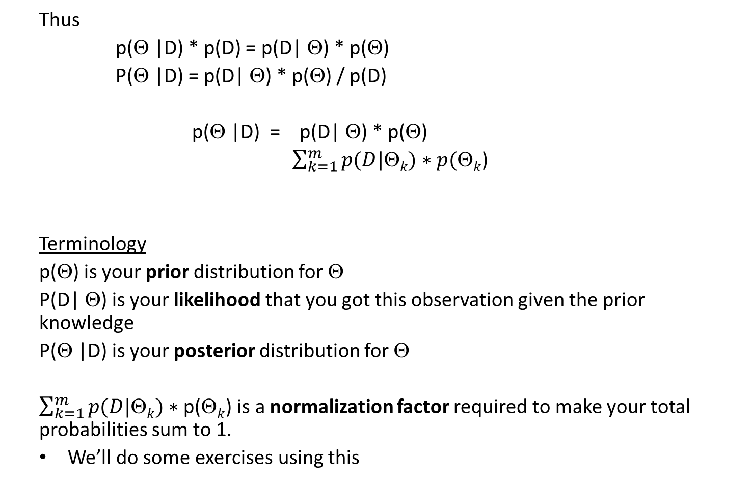
Deriving Bayes Theorem
Thus
p(Θ |D) * p(D) = p(D| Θ) * p(Θ)
P(Θ |D) = p(D| Θ) * p(Θ) / p(D)
p(Θ |D) = p(D| Θ) * p(Θ)
$\sum_{k=1}^{m}{p(D|\text{Q}k})∗p(\text{Q}k$)
Terminology
p(Θ) is your prior distribution for Θ
P(D| Θ) is your likelihood that you got this observation given the prior knowledge
P(Θ |D) is your posterior distribution for Θ
$\sum_{k=1}^{m}{p(D|\text{Q}k})∗\text{p}\text{(}\text{Q}k$) is a normalization factor required to make your total probabilities sum to 1.
We’ll do some exercises using this

Slide 8
Disease Confusion Matrix
You take the test and it comes up negative… now what is your posterior probability that you have the disease?
To answer, fill in the following table:
Since you have tested negative, you are in the bottom row. Your chance of having the disease is the marginal probability.
 | Has Disease (Θ+) | Does not have Disease (Θ-)
Positive Test (D+) | P(D+, Θ+) = P(D+ | Θ+) * P(Θ+) /∑ | P(D+, Θ−) = P(D+ | Θ−) * P(Θ−) /∑
Negative Test (D-) | P(D-, Θ+) = P(D- | Θ+) * P(Θ+) /∑ | P(D-, Θ−) = P(D- | Θ−) * P(Θ−) /∑

Slide 9
Single Test Result
If you test Negative:
 | Has Disease (Θ+) | Does not have Disease (Θ-)
Positive Test (D+) | P(D+, Θ+) = P(D+ | Θ+) * P(Θ+) /∑ | P(D+, Θ−) = P(D+ | Θ−) * P(Θ−) /∑
Negative Test (D-) | P(D-, Θ+) = P(D- | Θ+) * P(Θ+) /∑ | P(D-, Θ−) = P(D- | Θ−) * P(Θ−) /∑
 | Has Disease (Θ+) | Does not have Disease (Θ-)
Positive Test (D+) | 0.99 * 0.001 | 0.05 * 0.999
Negative Test (D-) | 0.01 * 0.001 | 0.95 * 0.999
∑ = 0.0509
∑ = 0.949
∑ = 0.0011
∑ = 0.989
 | Has Disease (Θ+) | Does not have Disease (Θ-)
Positive Test (D+)
Negative Test (D-) | 0.0000105 | 1.00000
∑ ~ 1.00001

Slide 10
Single Test Result
If you test Positive:
 | Has Disease (Θ+) | Does not have Disease (Θ-)
Positive Test (D+) | P(D+, Θ+) = P(D+ | Θ+) * P(Θ+) /∑ | P(D+, Θ−) = P(D+ | Θ−) * P(Θ−) /∑
Negative Test (D-) | P(D-, Θ+) = P(D- | Θ+) * P(Θ+) /∑ | P(D-, Θ−) = P(D- | Θ−) * P(Θ−) /∑
 | Has Disease (Θ+) | Does not have Disease (Θ-)
Positive Test (D+) | 0.99 * 0.001 /∑ | 0.05 * 0.999 /∑
Negative Test (D-) | 0.01 * 0.001 | 0.95 * 0.999
∑ = 0.0509
∑ = 0.949
∑ = 0.0011
∑ = 0.989
 | Has Disease (Θ+) | Does not have Disease (Θ-)
Positive Test (D+) | 0.0195 | 0.9813
Negative Test (D-) | 0.01 * 0.001 | 0.95 * 0.999
∑ = 1.0008

Slide 11
Double Test Result
If you test Positive and then go in for a retest, you change prior. If you test positive the second time:
 | Has Disease (Θ+) | Does not have Disease (Θ-)
Positive Test (D+) | P(D+, Θ+) = P(D+ | Θ+) * P(Θ+) /∑ | P(D+, Θ−) = P(D+ | Θ−) * P(Θ−) /∑
Negative Test (D-) | P(D-, Θ+) = P(D- | Θ+) * P(Θ+) /∑ | P(D-, Θ−) = P(D- | Θ−) * P(Θ−) /∑
 | Has Disease (Θ+) | Does not have Disease (Θ-)
Positive Test (D+) | 0.99 * 0.0195 /∑ | 0.05 * 0.9813 /∑
Negative Test (D-) | 0.01 * 0.001 | 0.95 * 0.999
∑ = 0.06837
 | Has Disease (Θ+) | Does not have Disease (Θ-)
Positive Test (D+) | 0.282 | 0.717
Negative Test (D-) | 0.01 * 0.001 | 0.95 * 0.999
∑ = 0.996

Slide 12
Double Test Result
If you test Positive and then go in for a retest, you change prior. If you test negative the second time:
 | Has Disease (Θ+) | Does not have Disease (Θ-)
Positive Test (D+) | P(D+, Θ+) = P(D+ | Θ+) * P(Θ+) /∑ | P(D+, Θ−) = P(D+ | Θ−) * P(Θ−) /∑
Negative Test (D-) | P(D-, Θ+) = P(D- | Θ+) * P(Θ+) )/∑ | P(D-, Θ−) = P(D- | Θ−) * P(Θ−) /∑
 | Has Disease (Θ+) | Does not have Disease (Θ-)
Positive Test (D+) | 0.99 * 0.001 | 0.05 * 0.999
Negative Test (D-) | 0.01 * 0.0195 | 0.95 * 0.9813
∑ = 0.93243
 | Has Disease (Θ+) | Does not have Disease (Θ-)
Positive Test (D+)
Negative Test (D-) | 0.000209 | 0.99975
∑ = 0.99996

Slide 13
Summary of Testing Analysis
The test was designed to detect as many people with the disease as possible. This is at the expense of a high false alarm rate.
If you test positive once, your chances of having the disease are still very low (1%). This is because the initial probability is 1 in 10,000. Thus a high false alarm rate is still the overwhelming reason for 1 positive test (99%).
After a second test, if you test positive again, your chances of having the illness go up to 28%. Still more likely it is a mistake, but now you should get examined by a physician.
However, your second test is more likely to be negative. Then you are 99% probably disease free.

Slide 14
Flipping a Coin
Assume
p(heads) = θ and p(tails) = 1−θ
Then the probability of getting a particular sequence of flips would be given by the binomial sampling distribution
p(D) = θ^{h} * (1- θ)^{t}
This is true for any 2-valued outcome that is exclusive (i.e., an outcome cannot be heads and tails at the same time, notwithstanding quantum effects).
We also believe the coin is fair, so P(θ) will equal 0.5. Is it true? We’ll find out.

Slide 15
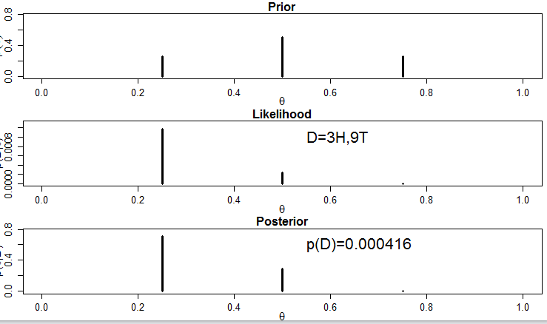
Coin Toss Problem

Slide 16
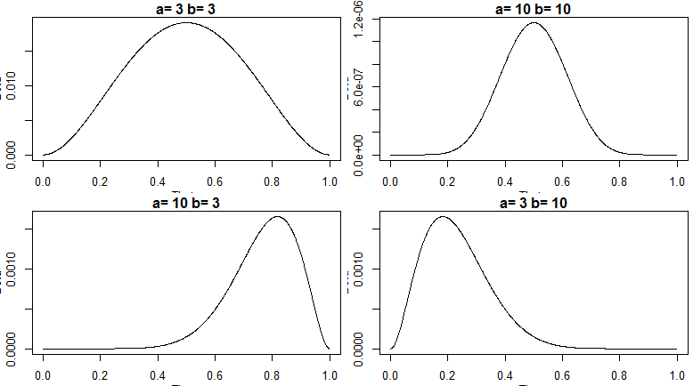
The Beta Distribution
The beta distribution depends on 2 parameters, a and b, that determine the shape. It can represent fair or biased either direction, localized or spread out.

Slide 17
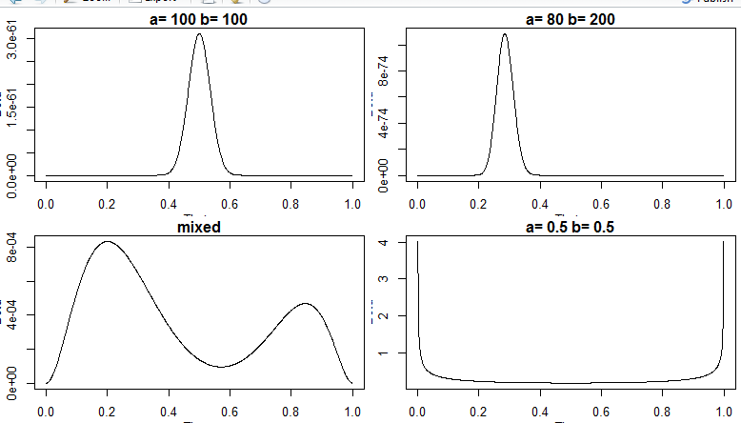
The Beta Distribution
It can be sharp centered wherever you would like it. You can combine beta functions to infer more than1 value, or use fractional a’s and b’s

Slide 18
Conjugate Functions
Happily there are several ways to solve for the posterior distribution using Bayes Theorem
Deterministically using Conjugate Functions
Numerically using Markov Chain Monte Carlo methods
Using a related tool called Bayesian Belief Networks
Let’s look at Conjugate Functions first

Slide 19
The Beta Prior in Bayes Theorem
Use the beta distribution as the prior distribution for Bayes
p(θ|a,b) = θ ^{(a-1)} (1-θ)^{(b-1)}
B(a,b)
Look at the likelihod for the coin problem (for 1 set of flips)
p(D|θ) = θ ^{(z)} (1-θ)^{(N-z)}
It’s easy to combine the beta function as a prior to the likelihood
p(θ|a,b,N,z) = θ ^{(a-1+z)} (1-θ)^{(b-1+N-z)} = beta (z+a, N-z+b)
B (a+z,b+N-z)

Slide 20
More Properties of Beta Distribution
The average of the beta(a,b) is
θ = a / (a + b)
(note for a = b, the average is 0.5, but for a > b, the average is biased towards 1)
Given the prior average above, the average for the posterior is
θ = (z + a) / (z + a) + (N – z + b)
= (z + a) / (N + a + b)
= [a / (a+b)] * [(a+b) / (N+a+b)] + [z/N] * [N/(N+a+b)]
= prior average * weight + Data proportion* weight

Slide 21
Homework 10 Review

Slide 22
Project Presentations

Slide 23
Bayesian Belief Networks

Slide 24
BBN Reference
A Bayesian Method for the Induction of Probabilistic Networks from Data
GREGORY E COOPER GFC@MED.PITT.EDU
Section of Medical Informatics, Department of Medicine
University of Pittsburgh, B50A Lothrop Hall
Pittsburgh, PA 15261
EDWARD HERSKOVITS EHH@SUMEX-AI M.STAN FORD.EDU
Noetic Systems, Incorporated
2504 Maryland Avenue
Baltimore, MD 21218
Editor: Tom Dietterich

Slide 25
BBN
“…The automated Discovery of dependency relationships.”
“The computer searches for a probabilistic network structure that has a high posterior probability given the database “

Slide 26
BBN Example
= Leaf
= Edge
Edges go from Children to Parents

Slide 27
Dyspnoea Chain Rule for Probabilities
You can use the chain rule to calculate different probabilities. For example
The total joint probability P(S, LC, B, D) would be
But if you follow the diagram, you can simplify the calculation
This brings the total possible models to be evaluated from O(2^{n}) to O(n2^{k}), where k is the maximum number of parents for a leaf. For n = 5 and k = 2 the total possible models would go from 32 to 20, a significant savings.

Slide 28
NP-hard Problems
Finding the best BBN is NP-hard, meaning it is
Nondeterministic = you can’t solve for the answer with an equation
Polynomial in time = T(n) = O(n^{k})
In fact, finding the best BBN is NP-complete, which is among the hardest NP problem.
This means that for a large BBN with 20 or 30 leaves, you can’t look at all the possible models in a reasonable time. Instead, the goal is to find a “good enough” model reasonably quickly.
How quickly depends on the use case.

Slide 29


Dyspnoea Example
There are 4 features that can be combined in any number of ways. How could we build a BBN?
We could start with finding the strongest conditional relationship between 2 features. How can we judge this?
Then we can add nodes until the model becomes too variable (until it overfits the data). How can I model a penalty for complexity? For d = # nodes, entropy index is
+ λ*d
which will be small if p is near 0 or 1 and if d is small

Slide 30
Construction BBNs
Most BBNs start with the strongest conditional relationships and add one node at a time. If the score improves you keep the node, if not you drop it and try another.
Once you get several adds in a row that don’t work you start at a different trunk and build out. This prevents selecting a local maxima that is not the overall best BNN.
There is a trade off between computation and storage. It is not efficient to keep calculating the same numbers. However, you can use up all your memory quickly. There are numerous approaches to efficiently calculating BBNs.

Slide 31
BBN Construction Recipe
Set maximum number of parents for any leaf
2. Discretize all of your features
How many levels? 2, 3, more?
Consider variances within a feature, might warrant clustering stud
3. Look for strongest correlations between variables, and start your “sapling” from there, with strongest correlations
4. Throw out features that look uncorrelated to features of interest
5. Grow BBN on leaf at a time.
6. Calculate model goodness using entropy with penalty for number of leaves. The penalty prevents overfitting.
7. If entropy goes up, remove last leaf and add a different on, then repeat steps 5 - 7

Slide 32
BBN Example 2
“A Bayesian Method for the Induction of Probabilistic Networks from Data”
by
Gregory Cooper, Depatement of Medicine, University of Pittsburg
and
Edward Herskovits, Noetic Systems, Baltimore MD

Slide 33
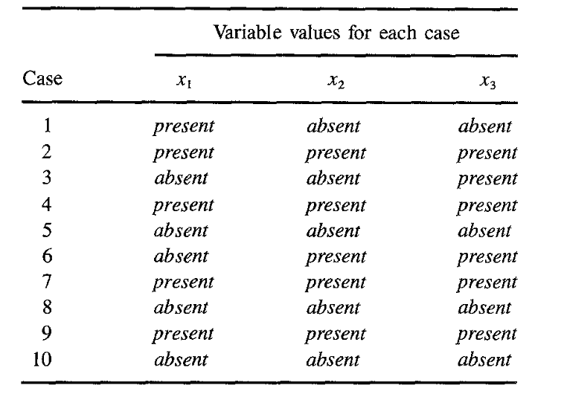
Data for the BBN

Slide 34
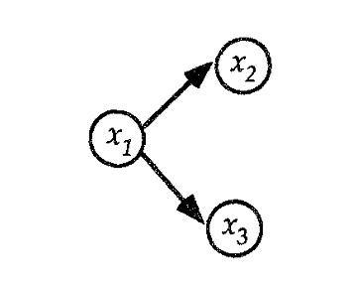
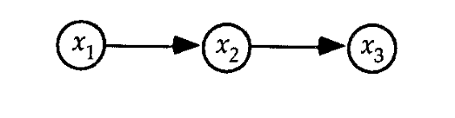
BBN Nomenclature
B_{S1}:
B_{S2}:
The model is an acyclic graph
The circles are nodes… these are also called findings
The arrows are arcs… they imply a conditional dependence between nodes
No arc implies no conditional dependence between nodes
In model 1, if you know x₂ you can predict x₃
In model 2, if you know x₁ you can predict x₃
A variable can only be predicted by its parent

Slide 35
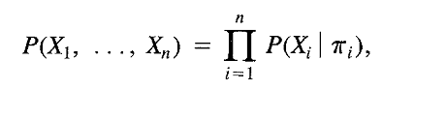
BBN
A variable can only be predicted by its parent
The parent of a variable x_{i} and be predicted by its parent(s), π_{i}

Slide 36
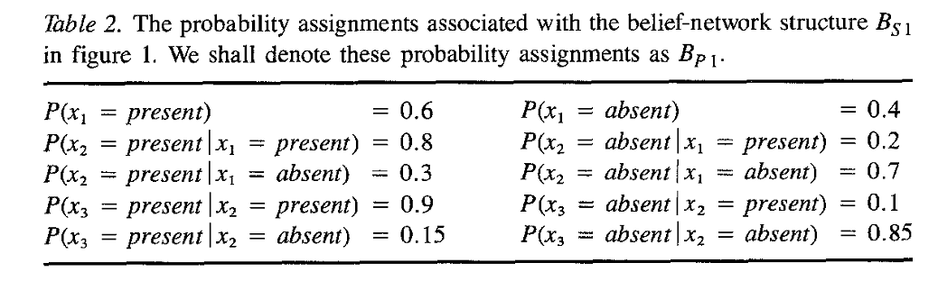
BBN
A variable can only be predicted by its parent
The parent of a variable x_{i} and be predicted by its parent(s), π_{i}
B_{S1}:

Slide 37
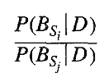
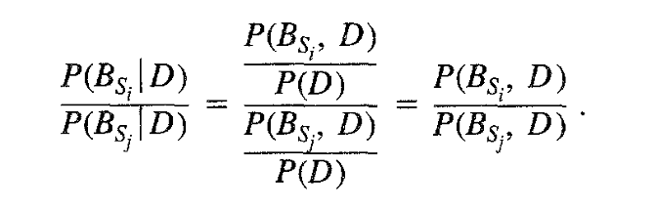
Selecting the Best BBN
So you have 2 different models and you want to find out which model is more predictive and accurate. In mathematical form, what is
Use a form of Bayes Theorem

Slide 38
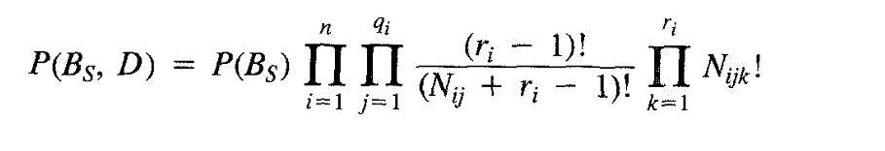
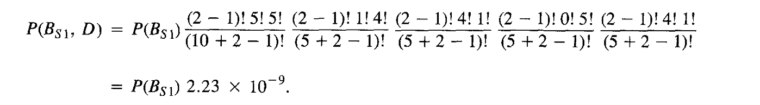
Testing BBN’s
Cooper asserts that a good measure of BBN worth is
Using the data provided for model B_{S1}
While for model 2, P(B_{S2}, D)
= P(B_{S2}) 2 x 10⁻¹⁰
Thus assuming P(B_{S1}) is just as likely a model as P(B_{S1}), then
P(B_{S1}, D) is 10 times as likely as P(B_{S2}, D)

Slide 39
To Summarize
BBNs are applications of the chain rule of probability
BBNs work with discrete variables. If you have continuous variables you need to make them discrete
The structure for a BBN is learned from data
They are excellent unsupervised or supervised models
Great for learning patterns in data
A BBN is not necessarily the best possible model, since typically it is impossible to examine every possible configuration.
Efficiencies can be realized based on heuristics (how you got to the current model you are evaluating) and memory management (so you don’t calculate the same thing over and over)

Slide 40
Homework #11 (1 of 3)
Go to CANVAS and download the three .R files :
BernBeta.txt, HDIofICDF.txt, and OpenGraphSaveGraph.txt. Put them in the same directory. Go into R and source these files (load them into the editor and source them). The function BernBeta takes a prior and calculates a posterior using the beta function. Study it and how it works. It is well commented.
Problem 1.
a) What are the inputs and outputs for BernBeta? Explain what they mean.
b) Start with a prior of beta(4,4). Use the BernBeta function to flip the coin once and get a head. What is the posterior? Show all plots and explain results.
Due April 22
31

Slide 41
Homework #11 (2 of 3)
c) Use the posterior from the previous flip as the prior for the next flip. (You can use the result from the last run - “post” - instead of c(5,4) as the input the BernBeta.) Flip the coin again and get a head again. What is the new posterior?
d) Using the posterior from the last flip, flip again and get tails. What is the new posterior?
e) Start over at b) and do three flips, but in the order T, H, H. Show the posterior after these 3 flips. How does the posterior change? Does order of the results matter?
f) Start over at b) and do three flips, but in the order T, T, H. Show the posterior after these 3 flips. How does the posterior change?
Due April 22

Slide 42
Discussion Topics for Next Week
Will AI take away jobs from humans, and thereby make the income gap worse between the “haves” and the “have nots”?
In the medical field, will AI replace intuition and empathy with “by the book” treatment, preventing lawsuits but harming patient outcomes?
Will driverless cars and airplanes become commonplace, and who will police the suppliers to make sure they are safe?
Does AI make identity theft and impersonation easier and how can social media and society as a whole deal with these problems?
Will AI be used to take freedoms away from the individual? Will it empower governments to monitor citizens beyond what is necessary?
Is defense a good use of AI, and what safeguards need to be in place?
Will we ever make computers that can think better than humans, and will that make humans obsolete? This topic includes making “designer babies” that, while human, have superior abilities due to genetic manipulation.
Overall, does the good accomplished by AI outweigh the bad?

Slide 43
Discussion Topics for Next Week
What responsibility does the AI modeler/programmer have in negative outcomes, or are negative outcomes the sole responsibility of the user?

