Slide 1
Math 642 Introduction to Machine Learning Lecture 1: Introductions, Basic Statistics, Multivariate Regression
Chris Armao, PhD
Spring 2020
Some of the figures in this presentation are taken from "An Introduction to Statistical Learning, with applications in R" (Springer, 2013) with permission from the authors: G. James, D. Witten, T. Hastie and R. Tibshirani

Slide 2
What is Statistical Learning?
Learning: The modification of behavior though practice, training, or experience
Statistical Learning: The modification of behavior by collecting and analyzing numerical data in large quantities, especially for the purpose of inferring proportions in a whole from those in a representative sample

Slide 3
How is Statistical Learning Related to Machine Learning?
This course, Statistical Learning, describes the underlying mathematics behind learning. These are general principles that can apply to human learning or to machines.
Machine Learning uses statistics, and maybe some other techniques, to process fresh data and modify behavior.
Thus, this course is general in its nature, but the application of the techniques will be machine learning applications.

Slide 4
Why Statistical Learning?
Machine learning is exploding in popularity and jobs are plentiful. Why? Because today there are 3 enablers form a perfect storm for machine learning:
High resolution sensors that are cheaper to produce
Faster computers and higher capacity computer networks
Better algorithms for learning

Slide 5
Statistical Analysis versus Machine Learning
Statistical Analysis is figuring out bulk properties based on sampling of a population
Examples
Does Lipitor lower LDL cholesterol levels?
What return can you expect from an investment in Boeing stock over 1 year?
What salary should I expect after graduating from GU with a Masters Degree in Statistics?
Machine Learning is similar but has a “so what” component: Decisions, interpretations, or predictions are made in real time
Examples
Based on chemokynes, is it time to close a crash victim’s wound?
Based on current indicators, should I buy Aerospatiale stock today?
Based on my typical workflow, what documents will I be looking for next?

Slide 6
How is Learning Related to Artificial Intelligence?
Artificial Intelligence. 1 : a branch of computer science dealing with the simulation of intelligent behavior in computers. 2 : the capability of a machine to imitate intelligent human behavior.
Artificial
Intelligence
Machine
Learning
Statistical
Learning
- Interpreting Sensor Products
- Real Time Decision Support
- Autonomous and Semi-Autonomous operations
- Sensing the Environment
- Processing Raw Sensor Data
- Communication (Speech or Displays)
- Long Term Studies and Analysis
- Some Biased or Nuanced Analyses

Slide 7
Modeling
It really all comes down to modeling… we strive to perfectly comprehend reality, but we can’t. So we create models that can help us
Understand how things work
Make predictions
Identify problems and weaknesses
Evaluate risk
Make decisions
…
In a general sense this class is about making better models that can be applied in real life

Slide 8
The Modeling Process
Create a Mathematical or Conceptual
Model for a System, with Parameters
Create an Error or Cost Function
Minimize the Error Function Using Model Parameters
Deploy Your Model and Update as Necessary
Training Data
Real-World Data

Slide 9
Making Better Models
In a general sense this class is about making better models… but what makes a model better?
It depends on the use of the model
More accurate – useful for medical diagnosis
Faster – useful for recommending a stock trade
Requiring less data – useful for rare events, like predicting nuclear war
Requiring no outcomes – useful for social network analysis
Easy to visualize – useful for explaining budget recommendations
Low false alarm rate – useful for emergency warning systems

Slide 10
Class Objectives
You will learn techniques to make better models. You will learn how to select the best modeling techniques for the situation, based on the user needs. This is a key skill to take away from this class.
You will learn how to avoid bias (models that are not flexible enough) and prevent overfitting (models that are too flexible)
You will learn how to apply these techniques using R, and how to interpret the output of R, and be exposed to other ML tools.
Finally, you will get experience designing, executing, and presenting a real-world ML project

Slide 11
Approach
We will work as a team to achieve our objectives. To be a team, I need to understand
Your objectives for this class
Problems you anticipate that may stand in the way of you learning the material
Your thoughts and insights about related material
Office hours Wednesday Evening 5:30 till 6:30
or upon request (STM G-30)
email: csa43@georgetown.edu

Slide 12
Text and Data
Text: An Introduction to Statistical Learning with Applications in R, Springer, 2013, by Gareth James, Daniela Witten, Trevor Hastie and Robert Tibshirani.
Go to the website
http://www-bcf.usc.edu/~gareth/ISL/
You will need to download the text and all datasets
The first half of this course will follow the book, although not in the same order. Homeworks in the first half of the course are taken from the book exercises, so you will need the data sets. The second half of the course will be special topics and project work.

Slide 13
Advanced Text (Not required for this Class)
Text: Elements of Statistical Learning with Applications in R, Springer, 2009, by Trevor Hastie, Robert Tibshirani, Jerome Friedman.
If you are interested, go to the website
https://web.stanford.edu/~hastie/ElemStatLearn/
This book is not required for this class, but it is a good reference for additional studies.

Slide 14
Assignments / Grades
Homework: Weekly homework assignments graded, due 1 week after assignment. Homeworks must be uploaded to blackboard, preferably before class. If they are 1 week late they are worth no more than 80%.
Exams
In-class midterm exam (Wed, 3/4, 6:30 – 7:00 PM)
In-class final exam (Wed, 5/6, 7-9 PM, https://registrar.georgetown.edu/scheduling/final-exams/
Project: Individual project to apply machine learning in a real-world setting
Final Grade: Homework 30%
Midterm exam 20%
Final exam 20%
Project 30%
Attendance/Participation TBD

Slide 15
Honor Code
Honor Code is in effect
Collaboration is encouraged for everything in this class except the in-class exams.
Homework: In order to achieve the course objectives, you must work hard and turn in your own work. Feel free to discuss the homework assignments and get help when you are stuck. But if you don’t try the homework problems on your own and think through them first you are only cheating yourself.
Project: Work with your classmates to overcome problems and get suggestions. Turn in code and text that you have done on your own.
In-Class Exams: Your work only. No notes or other unapproved tools.

Slide 16
Communications / Homework
I’ll post the powerpoint to Canvas prior to the lecture
Watch on Canvas for announcements
Submit homework over canvas using markdown
https://rmarkdown.rstudio.com/lesson-1.html
When it snows, you will get an invitation to ZOOM, and we will do the lecture virtually. We should practice once before the real thing.

Slide 17
Lectures
We will meet every Wednesday night from 6:30 till 9:00. Participation is vital to achieve our goals of learning and applying statistical learning techniques
Typical Schedule:
6:30 – 6:45 Review / Answer questions from previous lecture
6:45 – 7:50 New Material
7:50 – 8:00 Break
8:00 – 8:30 New Material and Project Discussions
8:30 – 9:00 Review Homework Due the Prior Week
(Homework more than 1 week late will be 20% off)

Slide 18
Machine Learning Taxonomy
Statistical Learning
Outcomes
No Outcomes
Supervised
Unsupervised
Quantitative
Estimation
Outcome
is a Number
Outcome
is a Class
Classification
Clustering
Principal
Components
Logistic Regression
Parametric
Estimation
Non-Parametric
Estimation
Bayesian Belief Network
LDA/QDA
y = f(x)
non-equation
based
KNN
Linear Regression
SVM
KNN
Common Elements
Cross Validation
Feature Selection
Gradient Descent
Boosting
Ridge Regression
Clustering
Trees
LASSO
Decision Trees
Bayes
Splines
Time Series
Neural Nets

Slide 19
Class Schedule
Lec | Date | Lecture | Due
1 | Jan 15 | Intro, Regression, Cross Validation
2 | Jan 22 | Feature Selection, Ridge Regression, LASSO, Principle Comp. | Hwk 1
3 | Jan 29 | Tree-Based Estimation | Hwk 2
4 | Feb 5 | Classification, Logistic Regression | Hwk 3
5 | Feb 12 | Discriminant Analysis, Support Vector Machines | Hwk 4, Project Plan
6 | Feb 19 | Tree-Based Classification Methods | Hwk 5
7 | Feb 26 | Unsupervised Learning, Principle Component Analysis | Hwk 6, Plan Revision
 | Mar 4 | Mid Term Exam
 | Mar 11 | Spring Break
8 | Mar 18 | Convolutional Neural Networks | Hwk 7
9 | Mar 25 | Convolutional Neural Networks | Hwk 8
10 | Apr 1 | Bayesian Learning | Hwk 9
11 | Apr 8 | Time Series, Miscellaneous Topics
12 | Apr 15 | Project Presentations | Final Project Due
13 | Apr 22 | Ethics of Machine Learning, Project Presentations
 | Apr 29 | Study Day
 | May 6 | Final Exam

Slide 20
Ethical Implications of Machine Learning
What are the ramifications of machine learning? Are the outcomes inevitable, or do we have choices? Will ML
Let’s revisit these questions and more once we have a better understanding of what ML is.
Take away jobs from people
Widen the gap between haves and have nots
Be used for weapons of war
Enable robots to control mankind
Eliminate kindness and compassion
Suppress freedom
Kill innovation
Create more jobs
Eliminate poverty
Cure disease
Eliminate competition for resources
Provide more time for the arts and intellectual pursuits
Promote freedom
Allow more time for creativity

Slide 21
Linear Regression

Slide 22
Notation for Samples
A dataset is a sample taken from a larger population.
There are n samples in the dataset
i is the index (subscript) for the sample number
Each sample has one or more features (x’s) and an outcome (y)
There are p features in the dataset, p can go from 1 to many thousand
j is the index for the feature number
A dataset can be made up of samples each having 1 feature and 1 outcome
(x₁ , y₁ ); (x₂ , y₂ ) …… (x_{i} , y_{i} )….. (x_{n} , y_{n} )
Or each sample each can have multiple features and 1 outcome
(x₁₁ , x₁₂ …x_{1j} …x_{1p} , y₁ ); … (x_{i1} , x_{i2} …x_{ij} … x_{ip} , y_{i} ); … (x_{n1} , x_{n2} …x_{nj} … x_{np} , y_{n} );

Slide 23
Notation for Estimated Values
Some numbers we will deal with are samples. They are observed and measured values from a larger population. They represent reality.
Other numbers we will deal with are estimates. Estimates are not real. They are predictions and/or inferences, and have statistical properties (error estimates, confidence levels, etc).
Estimated numbers have a hat to differentiate from actual numbers.
y is a prediction for the outcome given certain feature values
β is a prediction for a model coefficient given some data
^
^

Slide 24
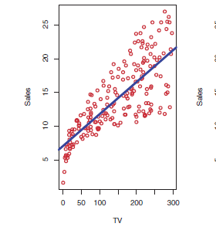
Linear Regression Models
A linear regression model assigns a coefficient or weight, β, to each feature. Usually there is also a constant term with a subscript of zero, β₀. Linear means it uses the features themselves, although in common use linear regression includes polynomials and cross terms.
A simple linear regression model with 1 feature and n samples may look like
ŷ₁ = β₀ + β₁ ∗ x₁
ŷ₂ = β₀ + β₁ ∗ x₂
‘ ‘
‘ .
‘ ‘
ŷ_{n} = β₀ + β₁ ∗ x_{n}
Note that β₀ and β₁ are the same for this model, regardless of the value of the features.
^
^
^
^
^
^
^
^

Slide 25
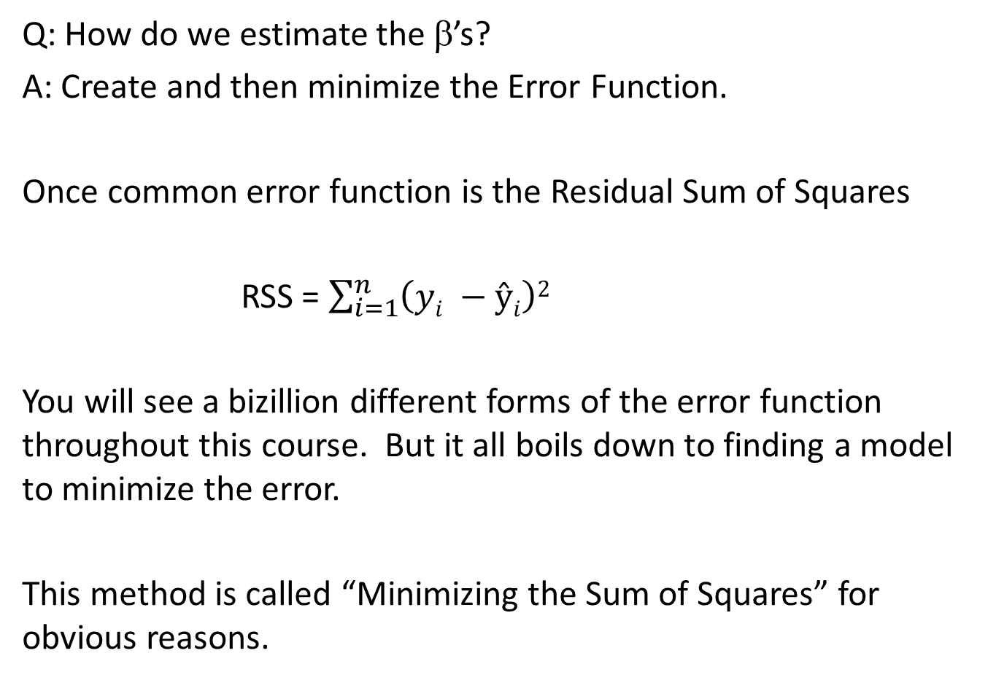
The Error Function
Q: How do we estimate the $\text{b}$’s?
A: Create and then minimize the Error Function.
Once common error function is the Residual Sum of Squares
RSS = $\sum_{i=1}^{n}{\left(yi −ŷi\right)2}$
You will see a bizillion different forms of the error function throughout this course. But it all boils down to finding a model to minimize the error.
This method is called “Minimizing the Sum of Squares” for obvious reasons.

Slide 26
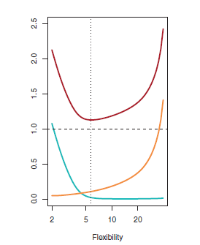

Linear Regression
Different values of the slope and y-intercept result in different errors. We need to differentiate the Error Function with respect to β₁ and β₀ simultaneously and set them to zero.
RSS = $\sum_{i=1}^{n}{\left(yi −ŷi\right)2}$
Y
J(β₀)
δ(RSS) / δβ₀ = 0
X
β₀

Slide 27
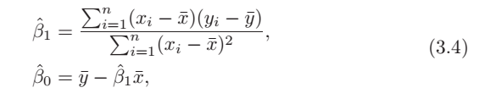
Linear Regression Solution
^
^
When you set the δ(RSS) / δβ₀ = 0 = δ(RSS) / δβ₁ you get the following result:

Slide 28
Which Features Model the Outcome?
To test H_{o}, we can calculate the t-score
A t-score that is relatively large is improbable (p value < 0.001) means we “Reject H_{o}” and that feature IS SIGNIFICANT
A t-score that is relatively small (p value > 0.1) means we “Accept H_{o}” and that feature IS NOT SIGNIFICANT
Note that just having a small β₁ does not necessarily mean to accept H₀. Rather, β₁ must be small compared to the Standard Error for β₁.

Slide 29
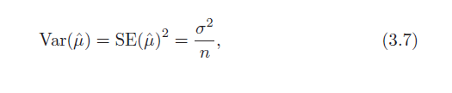

t-score
If I take many samples from a population and measure the mean, then the variance of the mean and the Standard Error are
Now I want to approximate the Standard Error due to the coefficients of my model and calculate a t-score:
The probability that my t value is as measured (give the null hypothesis is true) is the probability value, or p-value. This is what you look at to accept or reject the null hypothesis.

Slide 30
Confidence Levels
For a given estimate, the 95% confidence Level for β₀ and β₁ are approximately

Slide 31
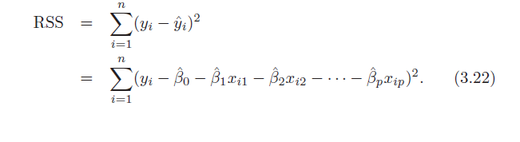
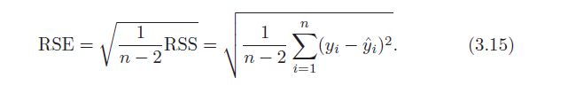
Statistical Measures of Goodness
We said before that one way to estimate the error from your model is to compute the Residual Sum of the Squares:
But what value of RSS means the model is modeling the data well? I could adjust the result for n and compute the Residual Squared Error, but that still does not tell me much about how well the model matches the data.
__

Slide 32

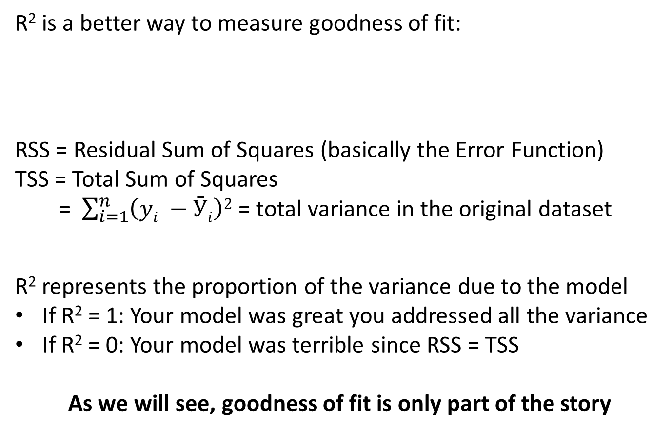
Statistical Measures of Goodness of Fit
R² is a better way to measure goodness of fit:
RSS = Residual Sum of Squares (basically the Error Function)
TSS = Total Sum of Squares
= $\sum_{i=1}^{n}{\left(yi −Ӯi\right)2}$ = total variance in the original dataset
R² represents the proportion of the variance due to the model
If R² = 1: Your model was great you addressed all the variance
If R² = 0: Your model was terrible since RSS = TSS
As we will see, goodness of fit is only part of the story

Slide 33
t-score or z-score?
Both t-score and z-score standardize your coefficient estimate to a normal distribution and calculate the number of standard deviations you are away from an expected value. In either case a low p-score means your coefficient is significant.
The t-score uses the variance of β₁ calculated from the data for the calculation. The z-score uses a known variance. For large sample set these should be the same.
Bottom line: Use the t-test for most models, unless you are in the unique situation where you already know the variance of the distributions of β₁.

Slide 34
Multi-Variate Regression

Slide 35
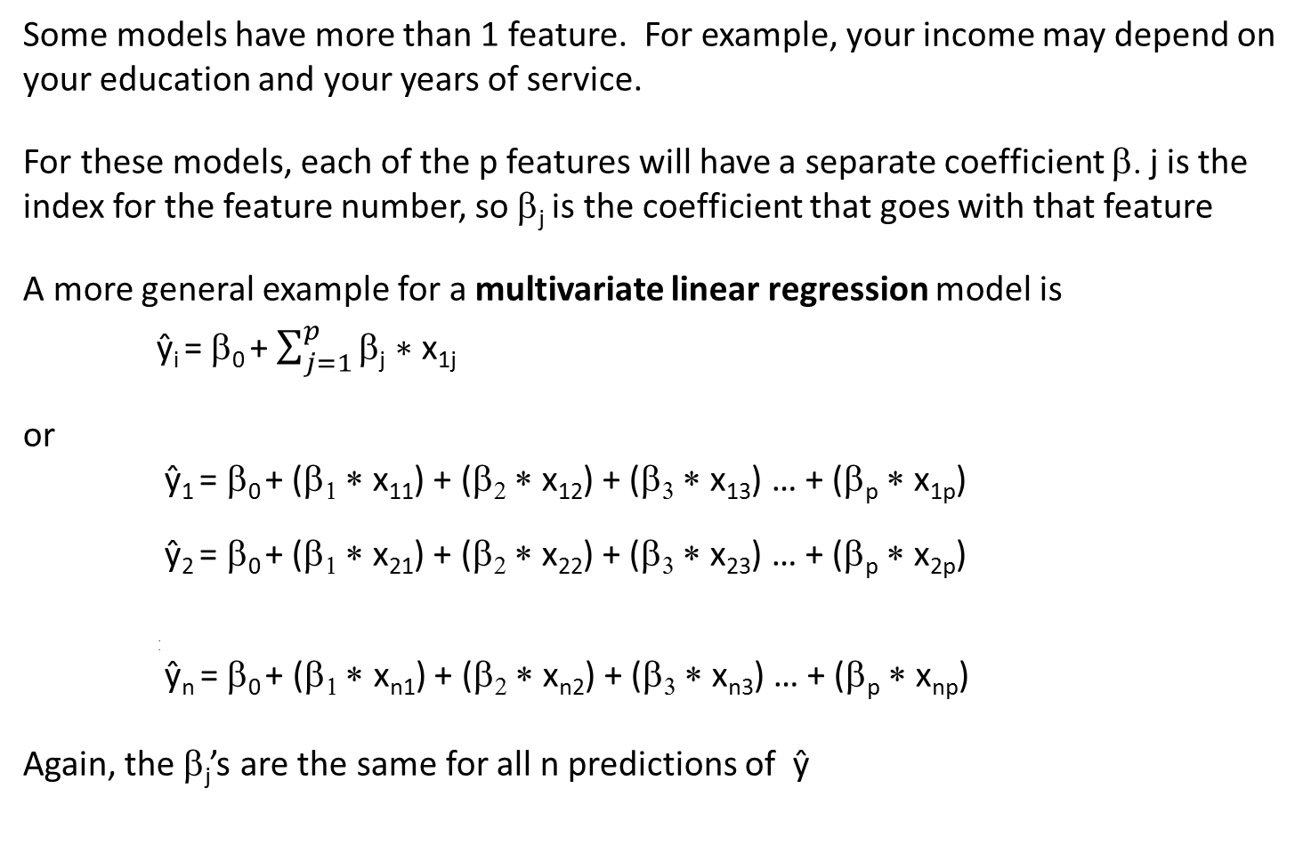
Notation for Coefficients / Weights
Some models have more than 1 feature. For example, your income may depend on your education and your years of service.
For these models, each of the p features will have a separate coefficient β. j is the index for the feature number, so β_{j} is the coefficient that goes with that feature
A more general example for a multivariate linear regression model is
ŷ_{i} = β₀ + $\sum_{j=1}^{p}{\text{b}\text{j} \text{∗} \text{x}\text{1}\text{j} }$
or
ŷ₁ = β₀ + (β₁ ∗ x₁₁) + (β₂ ∗ x₁₂) + (β₃ ∗ x₁₃) … + (β_{p} ∗ x_{1p})
ŷ₂ = β₀ + (β₁ ∗ x₂₁) + (β₂ ∗ x₂₂) + (β₃ ∗ x₂₃) … + (β_{p} ∗ x_{2p})
.
.
ŷ_{n} = β₀ + (β₁ ∗ x_{n1}) + (β₂ ∗ x_{n2}) + (β₃ ∗ x_{n3}) … + (β_{p} ∗ x_{np})
Again, the $\text{b}\text{j}$’s are the same for all n predictions of ŷ
^
^
^
^
^
^
^
^
^
^
^
^
^
^
^
^
^
^

Slide 36
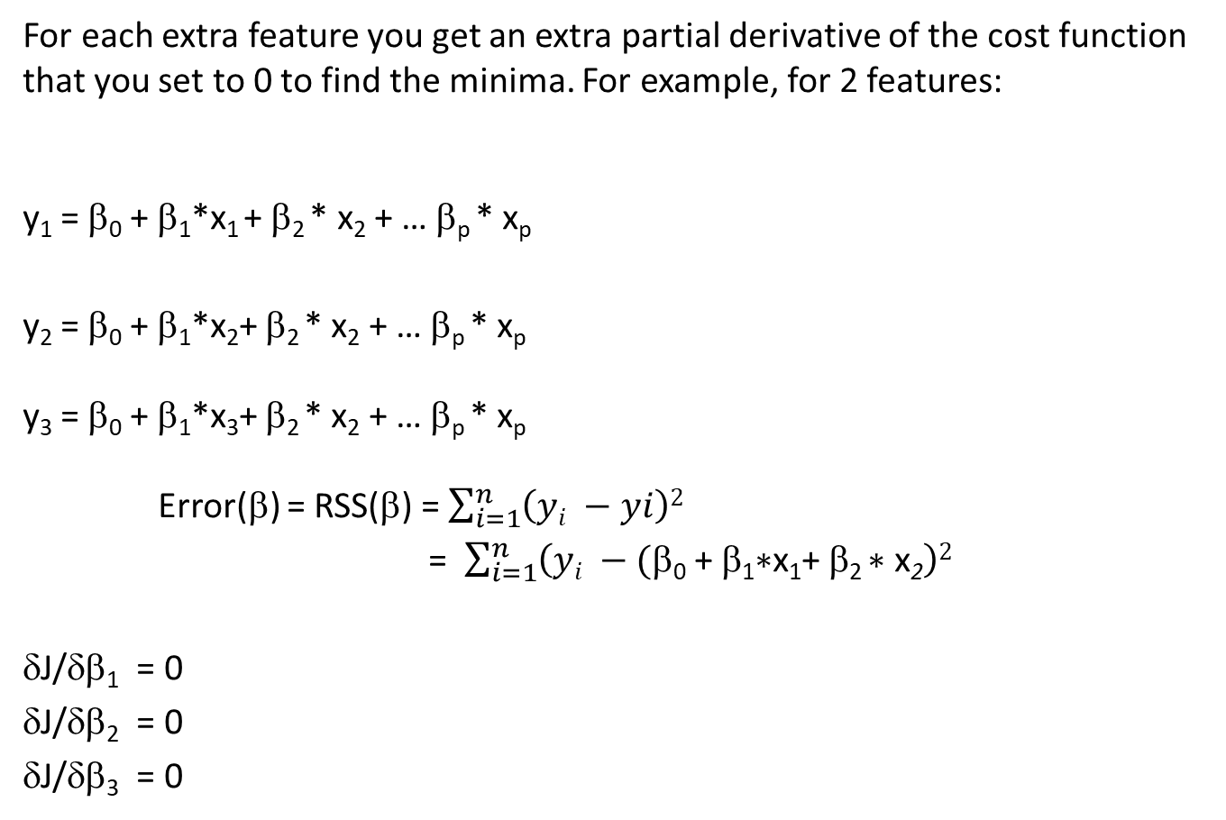
Multivariate Estimates for Regression
For each extra feature you get an extra partial derivative of the cost function that you set to 0 to find the minima. For example, for 2 features:
y₁ = β₀ + β₁*x₁ + β₂ * x₂ + … β_{p} * x_{p}
y₂ = β₀ + β₁*x₂+ β₂ * x₂ + … β_{p} * x_{p}
y₃ = β₀ + β₁*x₃+ β₂ * x₂ + … β_{p} * x_{p}
Error(β) = RSS(β) = $\sum_{i=1}^{n}{\left(yi −yi\right)2}$
= $\sum_{i=1}^{n}{\left(yi −(\text{b}\text{0}\text{ + }\text{b}\text{1}\text{∗}\text{x}\text{1}\text{+ }\text{b}\text{2 }\text{∗ }\text{x}\text{2}\right)2}$
δJ/δβ₁ = 0
δJ/δβ₂ = 0
δJ/δβ₃ = 0
^
^
^
^
^
^
^
^
^
^

Slide 37
Statistical Measures of Goodness
We said before that one way to estimate the error from your model is to compute the Residual Sum of the Squares:
But what value of RSS means the model is modeling the data well? I could adjust the result for n and compute the Residual Squared Error, but that still does not tell me much about how well the model matches the data.
__

Slide 38
Statistical Measures of Goodness of Fit
R² is a better way to measure goodness of fit:
RSS = Residual Sum of Squares (basically the Error Function)
TSS = Total Sum of Squares
= $\sum_{i=1}^{n}{\left(yi −Ӯi\right)2}$ = total variance in the original dataset
R² represents the proportion of the variance due to the model
If R² = 1: Your model was great you addressed all the variance
If R² = 0: Your model was terrible since RSS = TSS
As we will see, goodness of fit is only part of the story

Slide 39

Correlation
RSS is in some way a measure of the correlation between the feature and the outcome. Technically the correlation is
In fact (Cor)² equals R² when just looking at one feature (x) and one outcome (y). But R² is better for multiple features.

Slide 40

F Score
For the simple case of n samples and p features, we can test the correlation of all p features with the F-score (named after Fischer)
If RSS is small, F will get very large. This is a good model. Conversely, if RSS is almost equal to TSS, F will be close to 0.
F >> 1: Reject H₀, this group of features correlates to the outcome
F ≤ 1: Accept H₀, this group of features is not correlated to the outcome

Slide 41
F Score
Three more things to notice about F-score
When n is very large, a small difference between TSS and RSS is more likely to indicate your group of features models the data well
When p is very large (but not close to n) F will get smaller, indicating your model does not model the data well.
If p ~ n you are in trouble, you need to cut down the number of features.

Slide 42
R

Slide 43
R Programming Language
This course will make extensive use of R. R is an open-source programming language used for statistical computing.
The text is excellent for reviewing basic R functionality. Each chapter has a lab that I would encourage you to go through. If you are already an R expert, go right to the problems at the end of each chapter.
I also encourage you to download RStudio. RStudio is an open-source Integrated Development Environment. It has areas for code, commands and responses, and a plotting. RStudio supports debugging and other handy features.

Slide 44
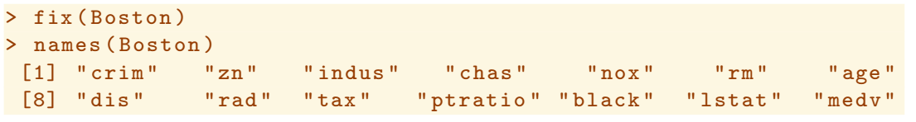
Linear Regression Using R
One of the datasets you’ll use form the book is “Boston”, a .csv with the following features:
Here’s how to calculate the coefficients for a linear regression equation that predicts the outcome medv (median value for the price of a house) using the feature lstat (percentage of low socioeconomic households in neighborhood) based on the dataset “Boston”:

Slide 45
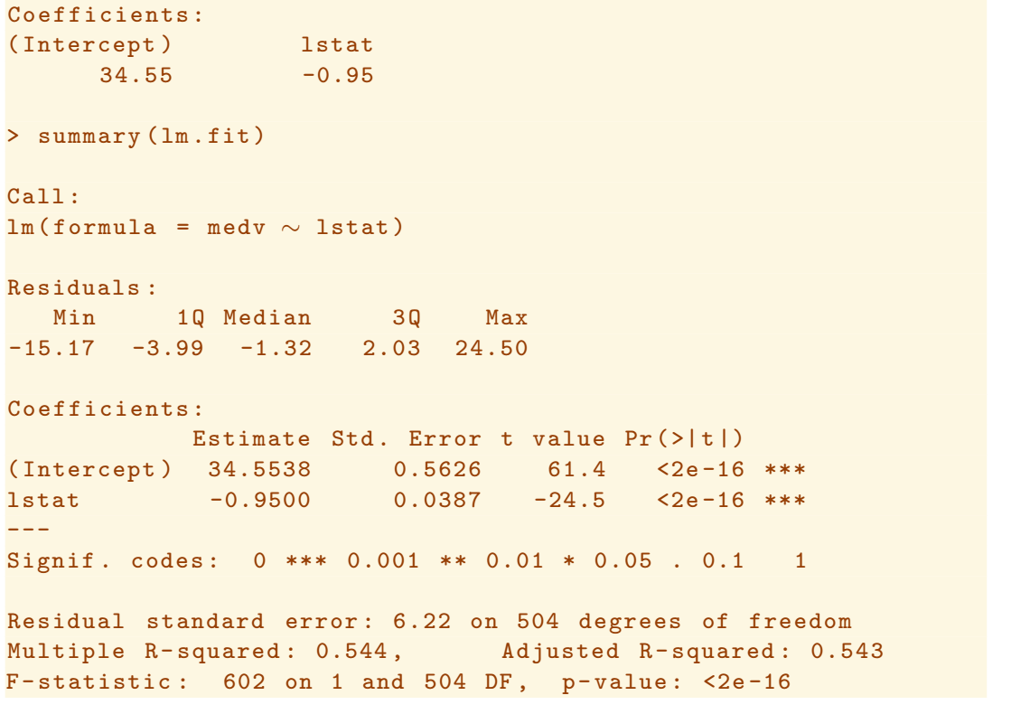
Linear Regression Using R
This is the output for the model

Slide 46
Multivariate Linear Regression in R
Multivariate Linear regression is very straightforward in R:
>linear.model = lm(medv~lstat, data= Boston)
>linear.model2 = lm(medv~tax + ptratio, data=Boston)
Note you can attach the dataset “Boston” and then leave out the data= part
To see the results,
>summary(linear.model2)

Slide 47
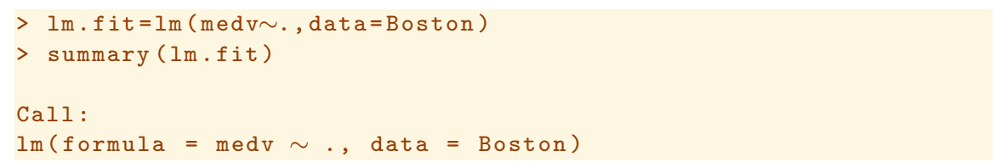
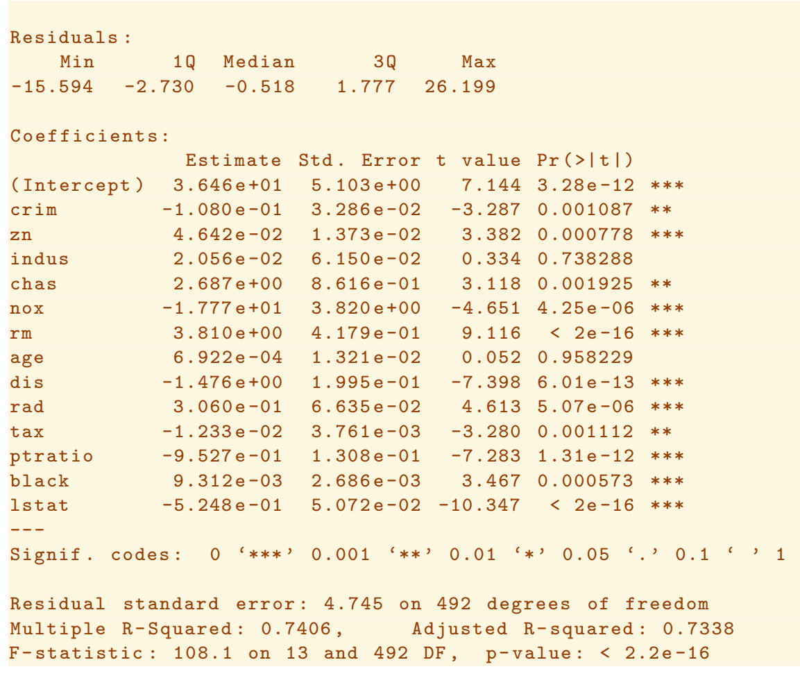
Basic Model

Slide 48
Polynomial Regression
Q: What if you have a sample that clearly shows that the outcome (y) is not linearly related to some or all of the features (x_{j}’s)?
Look at plots of all the data in the dataset D:
> pairs(D)
A: The techniques we have learned for linear regression apply to multiple features, including higher powers of x.
Write down the Error Function
Take the partial derivatives for each coefficient (β) separately
Find the β_{j}’s that gives you the minimum error (this will involve solving j+1 equations simultaneously (remember β₀)

Slide 49
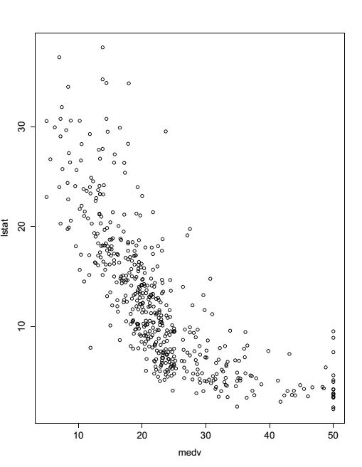
Polynomial Example – medv vs lstat
Median house value versus lstat – percent of families below some income level.

Slide 50
Polynomial Regression
Polynomial Regression in R:
To do powers explicitly using the lm function, you must use the I() function and enclose the power in the brackets
> lm.model = lm(medv~lstat + I(lstat^2) + I(lstat^3) + I(lstat^4))
Poly function will save you a lot of time
>lm.model = lm(medv~poly(lstat,4))
Note the poly function by default creates linear combinations of the higher order terms that are orthogonal to each other (i.e., independent)
You can override this feature using raw = “T”, then the higher order features themselves are your basis vectors

Slide 51
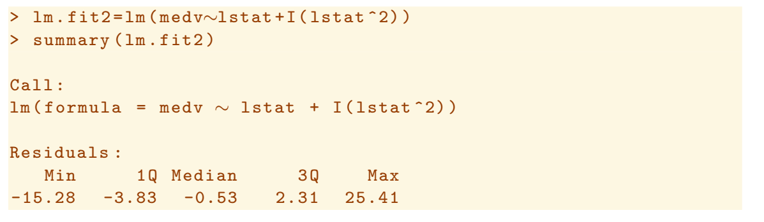
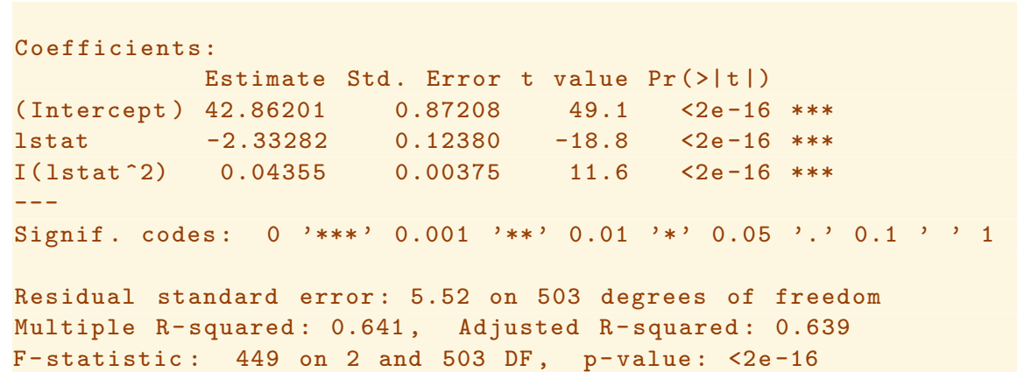
Polynomial Regression, using I() function

Slide 52
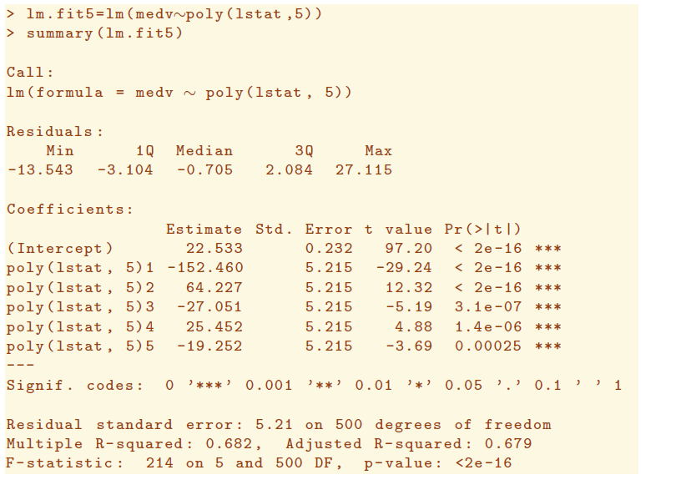
Polynomial Regression, poly() function

Slide 53
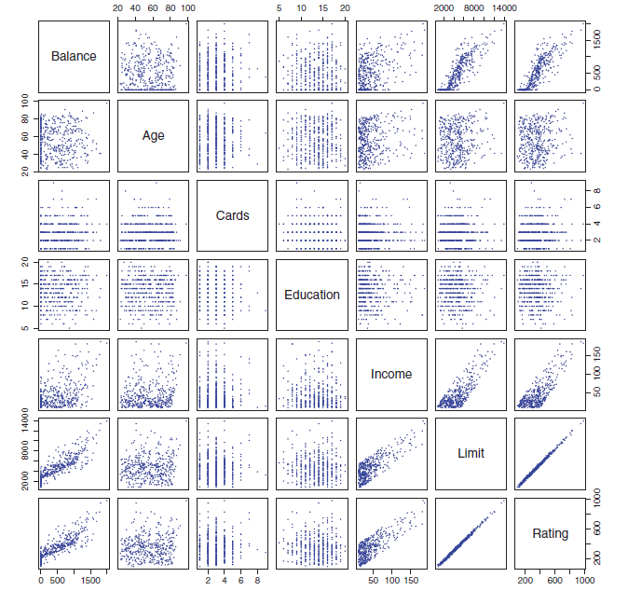
pairs()
The pairs function in R is a good way to take a look at the relationship between all your parameters

Slide 54
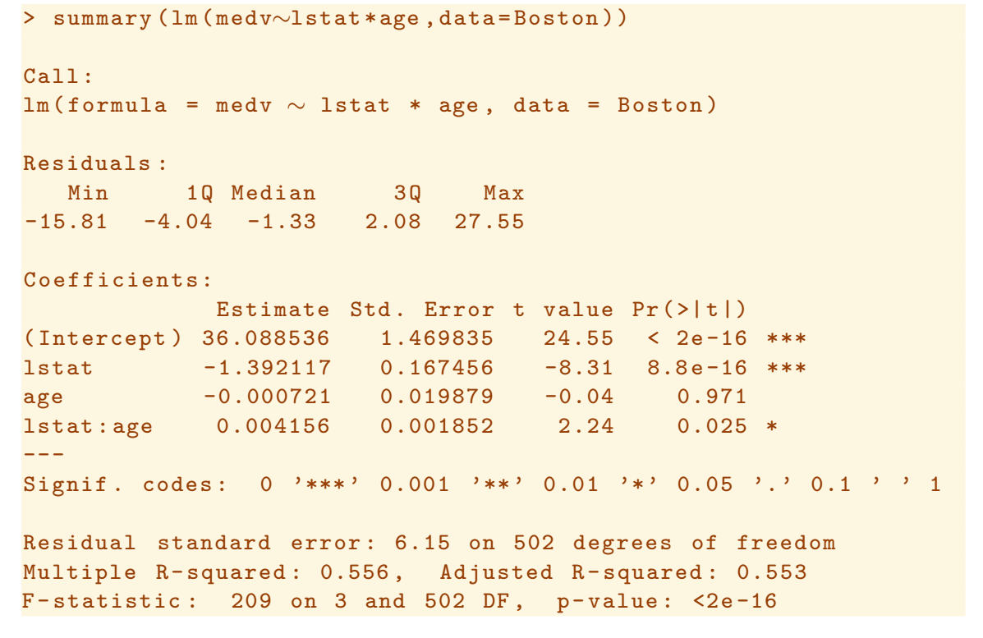
Regression Using Interaction Terms

Slide 55
Linear vs. Non-Linear Models
We don’t take the term “Linear” too literally. Instead we use “Linear” to mean “Linear in the Feature”, which could be a combination of 2 features.
What if a feature, X₂, is equal to X₁ * X₁? Technically this is a feature that is quadratic, thus not linear. But if I plot the model versus X₂ it is a line.
The same hold if X₃ is equal to X₁ * X₂? Technically this may not be linear, but if we plot the model versus X₃ it is a line.
Later we will look at splines, neural networks, and other types of models, which are considered “Non-Linear”. You will see that these models are discontinuous and extremely flexible in their design and usually used for more complicated problems.

Slide 56
Qualitative Predictors
Qualitative predictors have a discrete number of levels
If the same model predicts an outcome with significantly different accuracies at each level individually, then that qualitative predictor in significant

Slide 57
Qualitative Predictors
In this example, the parameter ShelveLoc can be Good, Bad, or Medium. The “contrasts” function can show you this. But how can you incorporate this feature into your model?

Slide 58
Qualitative Predictors

Slide 59
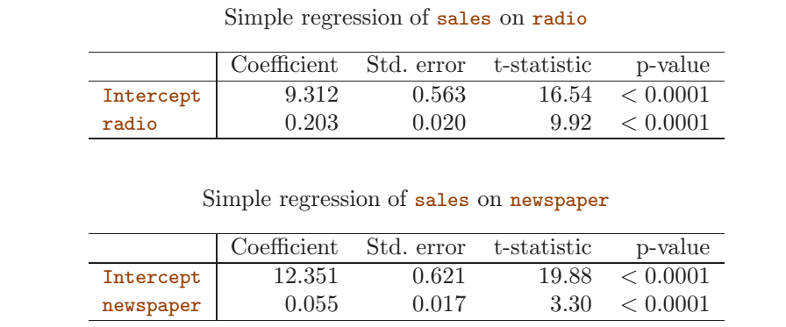
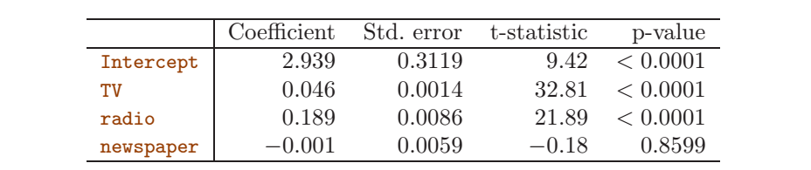
Single Regression vs Multivariate Regression
Single feature regression (above) shows that both radio and newspaper advertising improve sales (radio 203 units/$1000 and newspaper 55 units/$1000). However, a multivariate regression shows newspaper advertising is not significant.

Slide 60
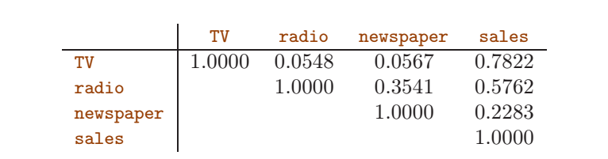
Single Regression vs Multivariate Regression
Correlation table for sales versus advertising types
Single feature regression (above) shows that both radio and newspaper advertising improve sales (radio 203 units/$1000 and newspaper 55 units/$1000). However, a multivariate regression shows newspaper advertising is not significant.
The correlation matrix shows why. While TV advertising is the best choice, radio advertising is second best.
Note that TV is not closely correlated to radio or newspaper… in markets where you spend on TV advertising, you don’t spend a lot on radio or newspaper.
However, newspaper and radio are correlated.

Slide 61
Single Regression vs Multivariate Regression
Another way of looking at this is to look at how sales and advertising are related. Sales goes up given advertising, but it only goes up so much. You can’t manufacture increases in sales so both radio and newspaper result in large increases in sales. Thus both model’s slopes can’t be large.
When considered together, you get radio contributing 189 units per $1000 and newspaper only contributing 1 unit per $1000 spent. Not a good use of advertising dollars.
Bottom line: The correlation between features can mask individual contributions.

Slide 62
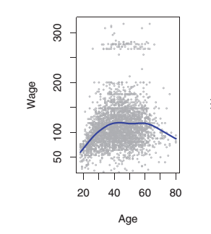
Polynomial Example – Wage vs Age

Slide 63
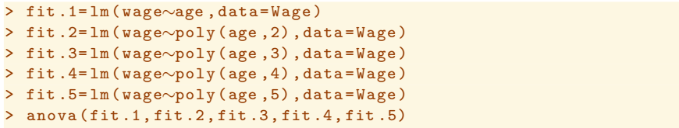
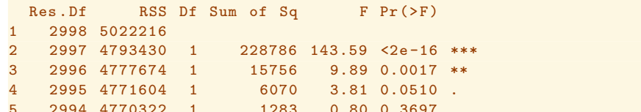
Using ANOVA to Compare Models
In order to use ANOVA to compare between models, we need to have nested models.
Nested model – the predictors in model 1 must be a subset of the predictors in model 2, model 2 a subset of 3, etc.

Slide 64
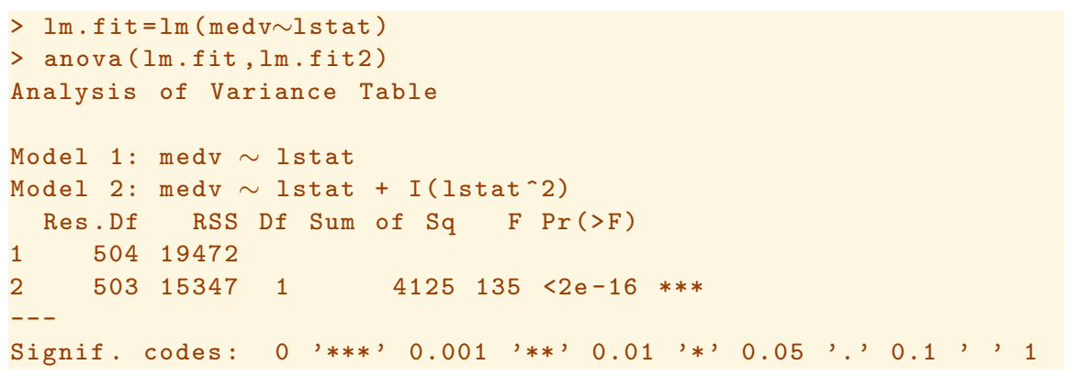
Using ANOVA to Compare Models
For ANOVA, the null hypothesis is that both models fit the data equally well. As indicated by the previous p-scores, the quadratic term improves the model. An ANOVA compares the models and the large F-score confirms the conclusion that the quadratic term improves the fit for the model.

Slide 65
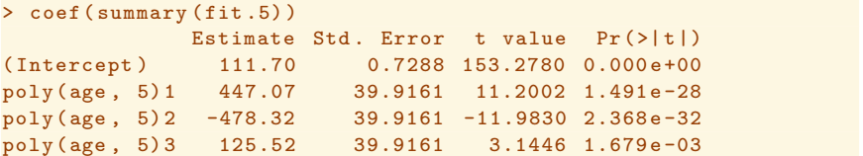
Comparing Models with Orthogonal Basis Vectors
If the features are orthogonal, you can use the lm() function itself to judge significance. The default is orthogonal

Slide 66
These will cause Your Linear Model to be “Bad”
Nonlinearity – The relationship between feature and outcome is curved. Look at residuals to see if relationship is nonlinear.
Collinearity – 2 or more features are closely correlated.
Correlated Errors – Ideally errors are random and by definition not able to be modelled. If errors are correlated with each other then the model will look better than it is. P will be artificially low, 95% conf. levels too small.
Non-Constant Variance (Heteroscedasticity, also know as Multiplicative Noise) – Errors scale with feature level. Graph of data has a funnel shape
Outliers – One or more unusually large residual(s). May affect model and estimates of model goodness.
Leverage Points – Feature samples in a dataset that are far from the rest. If dropped you get a much different model.

Slide 67
Mitigation Techniques
Error | Effect | Mitigation
Nonlinear | Good model within a certain range but regions where model is very bad | Use nonlinear technique
Collinear | Include too many features in the model making it hard to use and unstable | Drop one variable of the pair that are colinear
Correlated Errors | P values artificially low, leading to inclusion of features that are not significant. Again hard to use. | Eliminate outcomes that make the errors correlated
Heteroscedasticity | Errors vary based on the distribution of features | Scale data and use nonlinear techniques
Large Outliers | A few points can dominate the optimization | Drop outliers, but be careful. Compare predictions.
Leverage Points | A few points can dominate the optimization | Drop high leverage points, but again be careful.

Slide 68
Modeling Errors Cross validation

Slide 69
Cross Validation and Resampling Methods
Example Regression Model
Chapter 3
Bias versus Variability
Chapter 1 and 2
Cross Validation
Chapter 5
Generalize to other models
Rest of Text
We skipped Chapter 4 for now because I want to do all of the classification learning techniques at one time. And measuring how good your models are is fundamental to all of the methods, so let’s look at it now.

Slide 70
Generalized Model
Consider this generalized model for outcomes:
y_{i} = f(x_{i1}, x_{i2}, x_{i3}, …) + ε_{i} where ε_{i} is an irreducible error
Possible sources of irreducible error are
Measurement quantization or roundoff error
System noise (thermal noise)
Instrumentation malfunctions
Human error
Things you cannot measure
Our goal is to find a model that matches the data and minimizes the influence of the random error, ε_{i}

Slide 71
Model Bias
Bias is the error between our model and the data.
In some cases, a model is not flexible enough to be a good fit for certain data. For example
would a linear model in x be a good fit for modeling the temperature every hour for 1 day?
would a quadratic model in x be a good model for the price of a volatile stock every day for a month?
No, these models are too rigid.

Slide 72
Rigid vs Flexible Models
Models can be rigid or flexible.
Rigid models will not respond quickly to variations
Flexible models will respond very quickly to variations
Consider this generalized model for outcomes:
y_{i} = f(x_{i1}, x_{i2}, x_{i3}, …) + ε_{i}
According to the model above, each data point in our sample contains ε_{i}, some irreducible and un-modelable error. What happens if we model the irreducible error as well as f? Is that a problem?
Which type of model will overfit the noise, rigid or flexible?

Slide 73
Model Variability
Variability is the difference in the error if I apply the same model to many different independent datasets.
For example, I might have a set of data with a linear relationship between a feature and an outcome. But I model the data with a 5th order polynomial, modeling all the noise exactly.
If I apply this flexible model to an independent dataset, I’ll get a much different result.
This is also called overfitting the data and is very frequently done by analysts overselling their modeling capability.

Slide 74
Cross Validation
Thinking about the irreducible error:
We can never model it accurately
It may look like the real signal in the data we use to train the model, but it would not be consistent over the entire population
Q: Give that model, how would you test it against the population?
Would you:
Use the data you used to create the model and calculate the RSS?
Use an independent set of data from the same population to calculate the RSS?

Slide 75
Training Error vs Test Error
Training Error is the error you get when you run the samples you use to train the model back through the model
Decreases as you add more features (x_{j}’s, polynomial, and cross terms) to the model
If the coefficients vary significantly as you change training datasets, this can indicate “overfitting” – you are modeling noise
Test Error is the error you get when you run one or more datasets not used for training through the model
In the case of “overfitted” data, you will get large test errors compared to the training error

Slide 76
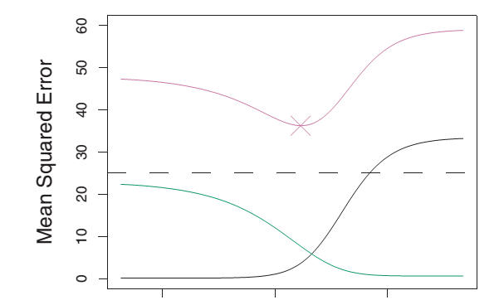
Training Error vs Test Error
Below is a graph that is typical of many models we will examine in this class. While training error can go down continually as we add complexity to a model, testing with independent data reveals that, at some point, the model is not getting better and overfitting takes over.
Test Error
Variability
Training Error or Bias
Increasing Flexibility →

Slide 77
Model Selection (how flexible should my model be?)
Summarizing the cases we considered:
If the true relationship between x and y were linear, then a linear model should do best. The higher order models (using x^2 for example) would model the noise → Called overfitting the data
More specifically, if we kept choosing new training data and retrained the model, the model would change a lot with each modeling run and would never match the testing data very well.
This is excessive variability
Such a model is “too flexible” because it can wiggle rapidly in response to noise
If the true relationship between x and y were f(x³) and we modeled by a linear model, we would not be able to follow the curve of the data
This model would be “biased” because it could never accurately model the training or the test data
Model is “not flexible enough” because it cannot bend at all

Slide 78
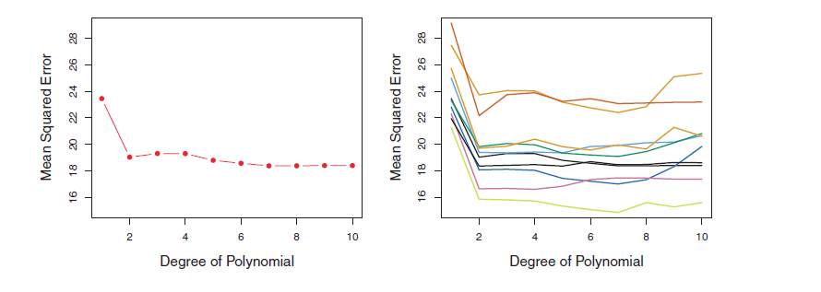
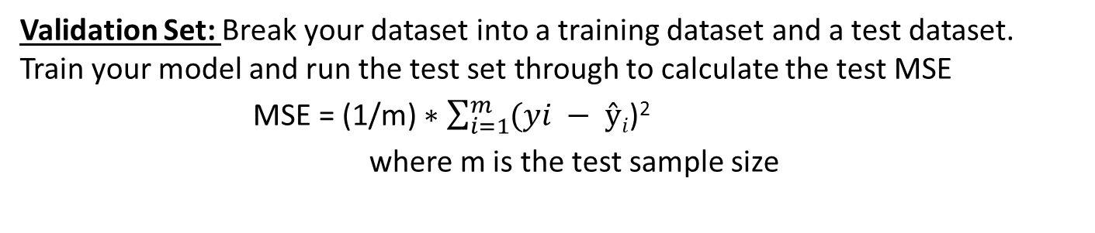
Techniques for Model Selection
Validation Set: Break your dataset into a training dataset and a test dataset. Train your model and run the test set through to calculate the test MSE
MSE = (1/m) $∗\sum_{i=1}^{m}{(yi − ŷi}$)²
where m is the test sample size
Model for mpg vs. horsepower for Left: 1 validation set,
and Right: 10 different validation sets, both m = n/2

Slide 79
Techniques for Model Selection
Leave One Out Cross Validation: Hold back one sample and use the rest of the samples for training. You have n-1 training samples. Use your hold out as the test sample and repeat for all n.
Advantages
LOOCV results in a much larger training set, and the larger the training set, the lower the bias
There is no variability in LOOCV. The result is consistent since every sample is left out one time.
Disadvantage
Computational burden, especially if n is very large

Slide 80
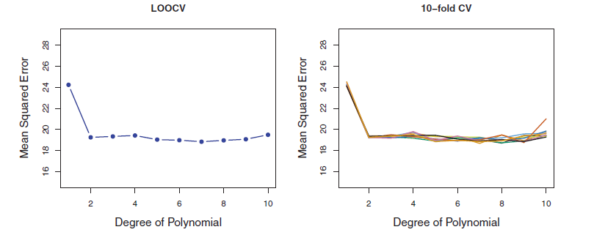
Techniques for Model Selection
K-fold Cross Validation: Divide the sample into k equal parts. Hold back one part and use the rest of the samples for training. You have n-(n/k) training samples. Use your hold out as the test sample and repeat k times.
Model for mpg vs. horsepower for left: LOOCV, and Right: 10-fold Cross Validation (i.e. m = n/10) repeated 10 times with different splits.
Note the variability for 10-fold different splits is low, and the computational burden is no too bad compared to LOOCV.

Slide 81
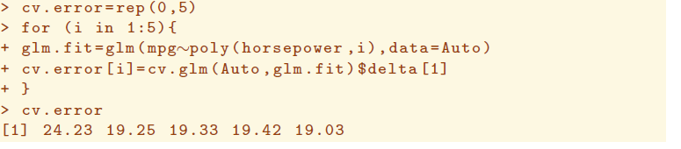
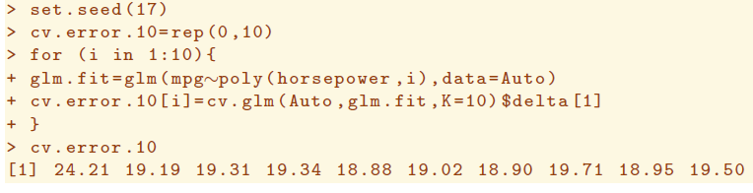
LOOCV and K-Fold Cross Validation

Slide 82
High Dimensionality
Q: Does adding more features always improve the model?
We learn the models from the sample data. For each feature, we estimate the best coefficients (smallest RSS) based on a certain amount of samples. RSS will always go down as we add more features, but as we have seen, we might only be modeling noise.
Consider: The more samples we use for training, the better estimate for each coefficient. But if p is large, we essentially have less data to estimate each β. In the limit where p = n, we would have very little information on which to base an estimate for a particular β.
When we add features, we essentially “dilute” the n across the features. For cases where the number of features is greater than n (for p > n), we no longer have enough samples to estimate the coefficients using least squares.

Slide 83
High Dimensionality
Q: So how many features should we pick for our model?
A: k-fold cross validation tells us how flexible the model needs to be. Keeping more dimensions is counter-productive.
We need the independent features with a significant effect on the outcome
If p ~ n then we need more samples
Maybe the primary features that effect the outcome (first few that contribute to RSS the most) are good enough?
If the features are not independent, maybe there is a way to combine 2 features in to 1?
Hold these thoughts for “Feature Selection” lecture

Slide 84
Homework #1 (Page 1 of 3)
Download the text
“Introduction to Statistical Learning”
and all datasets at
http://www-bcf.usc.edu/~gareth/ISL/
Due Jan 23

Slide 85
Homework #1 (Page 2 of 3)
Read the first 3 chapters and work through all the labs.
(Please do not hand the labs in, just do them on your own)
Do the following Problems:
Chapter 2 Problem 8
Chapter 2 Problem 10
Derive Equation 3.4
(expressions for linear regression coefficients)
Chapter 3 Problem 1
Chapter 3 Problem 3
Chapter 3 Problem 8
Chapter 3 Problem 15
Due Jan 23

Slide 86
Homework # 1 (page 3 of 3)
Look at these websites and pick a dataset that interests you (either from this set or one of your choosing). Be prepared to discuss during class next week.
https://archive.ics.uci.edu/ml/datasets.html
https://github.com/caesar0301/awesome-public-datasets#economics
http://libguides.geneseo.edu/c.php?g=67454&p=434785#s-lg-box-1300425
http://www.databasesports.com/

