Slide 1
Math 642 Introduction to Machine Learning Lecture 3: KNN, Cross Validation, Bootstrap
Spring 2020
Some of the figures in this presentation are taken from "An Introduction to Statistical Learning, with applications in R" (Springer, 2013) with permission from the authors: G. James, D. Witten, T. Hastie and R. Tibshirani

Slide 2
Class Schedule
Lec | Date | Lecture | Due
1 | Jan 15 | Intro, Linear Regression, Bias and Variability
2 | Jan 22 | Unsupervised Learning: Clustering, Principle Comp. Analysis | Hwk 1
3 | Jan 29 | KNN Regression, Cross Validation, Bootstrap | Hwk 2
4 | Feb 5 | Ridge Regression, LASSO, Principle Components Regression | Hwk 3
5 | Feb 12 | Extreme Nonlinear: Step Functions, Splines | Hwk 4, Project Plan
6 | Feb 19 | Classification, Logistic Regression | Hwk 5
7 | Feb 26 | Discriminant Analysis, Support Vector Machines | Hwk 6, Plan Revision
 | Mar 4 | Mid Term Exam
 | Mar 11 | Spring Break
8 | Mar 18 | Tree-Based Methods | Hwk 7
9 | Mar 25 | Neural Networks, Deep Learning | Hwk 8
10 | Apr 1 | Convolutional Neural Networks | Hwk 9
11 | Apr 8 | Bayesian Analysis | Final Project Due
12 | Apr 15 | Project Presentations | Hwk 10
13 | Apr 22 | Ethics of Machine Learning, Project Presentations
 | Apr 29 | Study Day
 | May 6 | Final Exam

Slide 3
Machine Learning Taxonomy
Statistical Learning
Outcomes
No Outcomes
Supervised
Unsupervised
Quantitative
Estimation
Outcome
is a Number
Outcome
is a Class
Classification
Clustering
Principal
Components
Logistic Regression
Parametric
Estimation
Non-Parametric
Estimation
Bayesian Belief Network
LDA/QDA
y = f(x)
non-equation
based
KNN
Linear Regression
SVM
KNN
Common Elements
Cross Validation
Feature Selection
Gradient Descent
Bootstrap
Boosting
Ridge Regression
Clustering
Decision Trees
LASSO
Decision Trees
Bayesian Analysis
Splines
Time Series
Neural Nets

Slide 4
ISLR Roadmap
KNN – Chapter 2.2.3 (skip for now) and 3.3
Cross Validation – Chapter 5
Feature Selection – Chapter 6.1

Slide 5
Review from Last Week

Slide 6
Unsupervised Learning
Supervised Learning: Optimizing a model using outcomes. The training data has known outcomes. You try to minimize the error between the known outcomes and the model predictions.
Unsupervised Learning: Creating or optimizing a model with no outcomes. The training data has NO outcomes, or you don’t know the outcomes.
Often, unsupervised learning means looking for structure or patterns in the data, so that you can develop a modeling approach for insight, predictions, classification, or estimation. Isn’t this how you should start your projects?

Slide 7
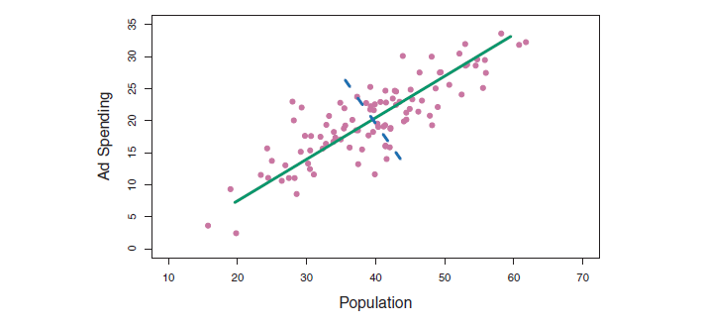
Principal Components Analysis
Where is the information in this data set?
Note that the information content is highest where there is maximum variability. Typically this is where you may want to focus given a new set of unfamiliar data

Slide 8
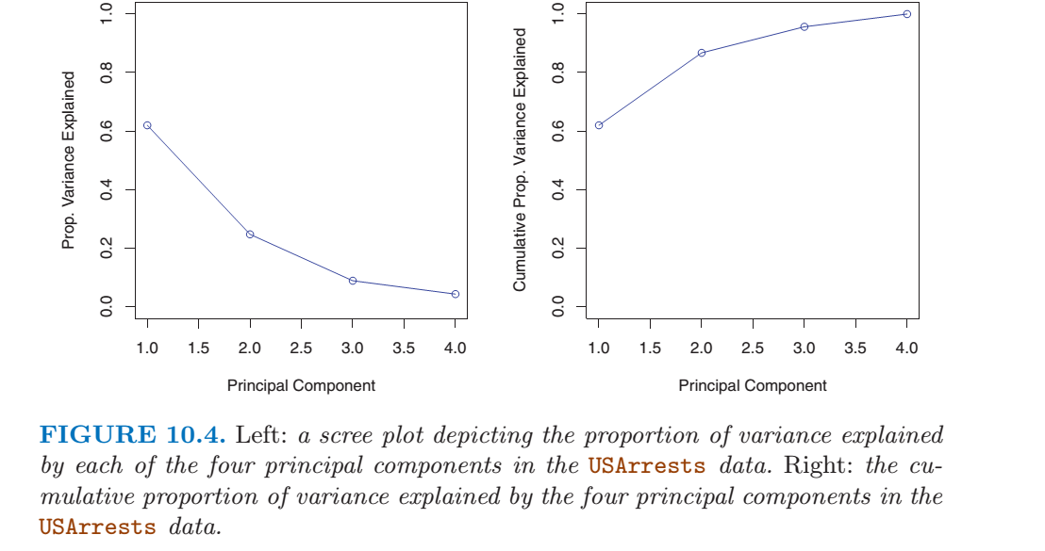
PVE

Slide 9
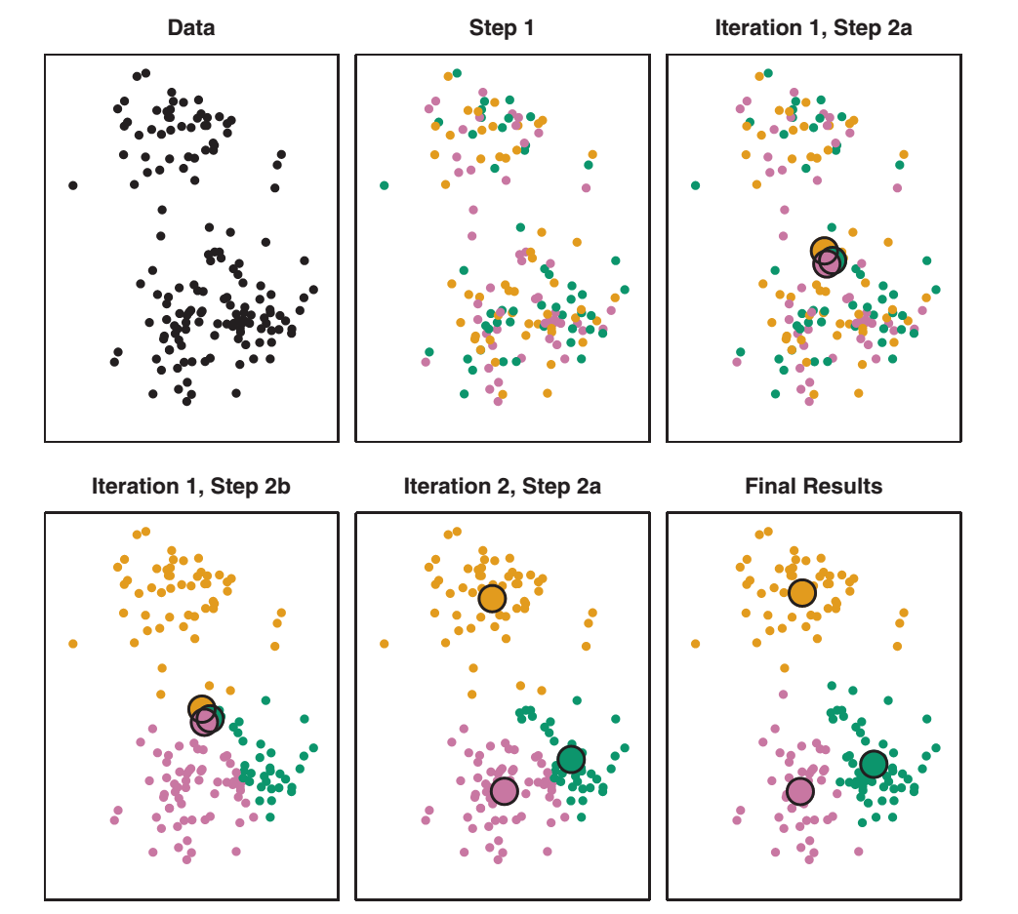
K-Means Clustering

Slide 10
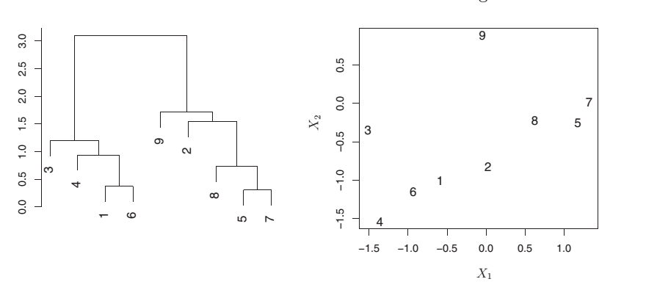
Another Hierarchical Clustering Example
This example shows that on a dendrogram, similarity must be judged based on vertical distance, not horizontal distance

Slide 11
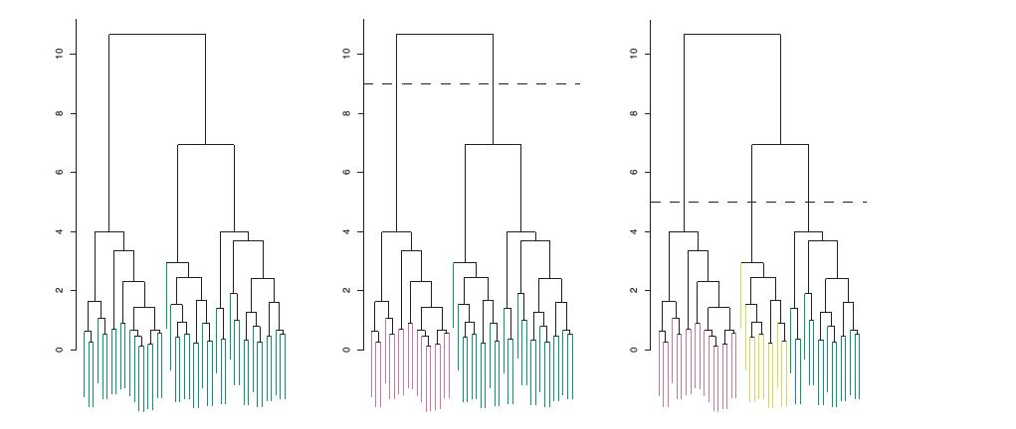
Hierarchical Clustering
You can select the number of classes you want based on your cut line

Slide 12
K Nearest Neighbors Regression Chapters 3.3 Local Regression Chapters 7.6

Slide 13
K Nearest Neighbors
This is a very intuitive method of estimating outcomes. Easy to conceptualize graphically:
Assume a value for K. K is the number of samples you use to estimate y.
Select a value for the feature(s), x_{0j,} where you want to estimate y
Find the k “closest” samples to x_{0j}
Take the average of the y_{i}’s that correspond to the k closest x_{0j}’s to get y
(where N₀ means that the x_{i}’s are closest to x₀)
^
^
^
(ISLR page 105)

Slide 14
KNN
Y
(x_{i}, y_{i})
X
K = 8
K = 3
Y
Y
^
^
y₀
y₀
X
X
x₀
x₀
8
i=1
3
i=1
^
^
y₀ = ( ∑ y_{i} )/ 8
y₀ = ( ∑ y_{i} )/ 3

Slide 15
KNN
Presupposes that you don’t have more than 1 y_{i} for each x_{i}
If you did you would need a rule for how to handle these.
Avg? Min? Max?
Euclidian Distance is between points x_{i} and x_{i+1} (assuming only 1 feature) is x_{i} – x_{i+1}
What other possibilities are there for defining “nearest”?
Every sample is weighted either 1 or 0
More advanced models like local regression use weighting to get better estimates

Slide 16
KNN in Multiple Dimensions
Y
X₁
X₂
In 2D the Euclidian distance between points $\text{x}\text{i} \text{and} \text{xi}\text{+1}$ is $\sqrt{\left(\text{x}\text{i}\text{,1 – }\text{xi}\text{+1,}1\right)2+\left(\text{x}\text{i}\text{,2– }\text{x}\text{i}\text{+1,}\text{2}\right)2}$

Slide 17
KNN in Multiple Dimensions
Y
X₁
X₂
Y
Y
-1 0 +1
-1 0 +1
-1 0 +1
-1 0 +1
X₁
X₂
Features need to be correlated to be included in your KNN model

Slide 18
KNN example in 2D
Which model is more biased? Which is more flexible?

Slide 19
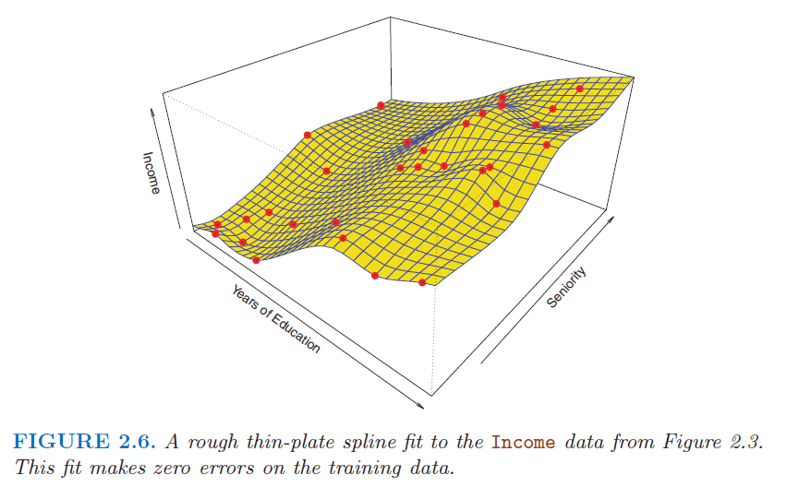
Perfect fit: k = 1
K = 1 has the most flexibility but likely to model noise closely
For linear cases, K > 1 does better; nonlinear K~1 does better
For large p, the number of samples for x_{0j} can be small, which can lead to problems

Slide 20
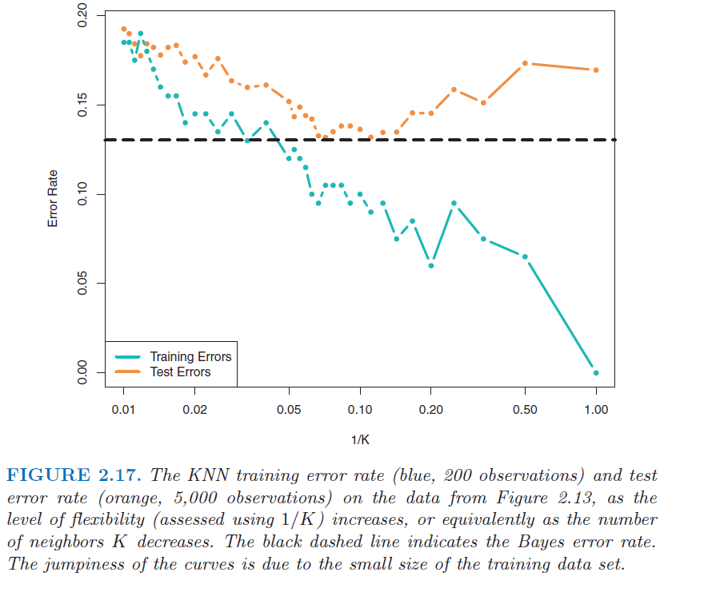
KNN Bias vs Variability

Slide 21
K = 1 versus K = 9

Slide 22
KNN compared to Linear Regression

Slide 23
The Curse of Dimensionality
KNN is a good modeling technique when p < 4. For a large number of features, KNN breaks down and regression (parametric) techniques are better.

Slide 24
KNN Pluses and Minuses
No assumption of a functional form… this is a major source of bias with regression
Rather than let the machine “learn”, you are pre-supposing you know the answer when you assume a functional form for the model
No possibility of solving for coefficients that minimize the error function
Typically requires a large n to be accurate
Not a great method of there are more than 3 or 4 features in your model
If you do use 3 or 4 features, make K larger than in the single feature case

Slide 25
Local Regression
Like K Nearest Neighbors, local regression uses only “nearby” outcomes to create a local model based on the point you want to estimate.
Unlike KNN, Local Regression does not weight all values equally. It will weight nearby samples higher and far away samples lower. Like Gravity!

Slide 26
Local Regression Algorithm

Slide 27
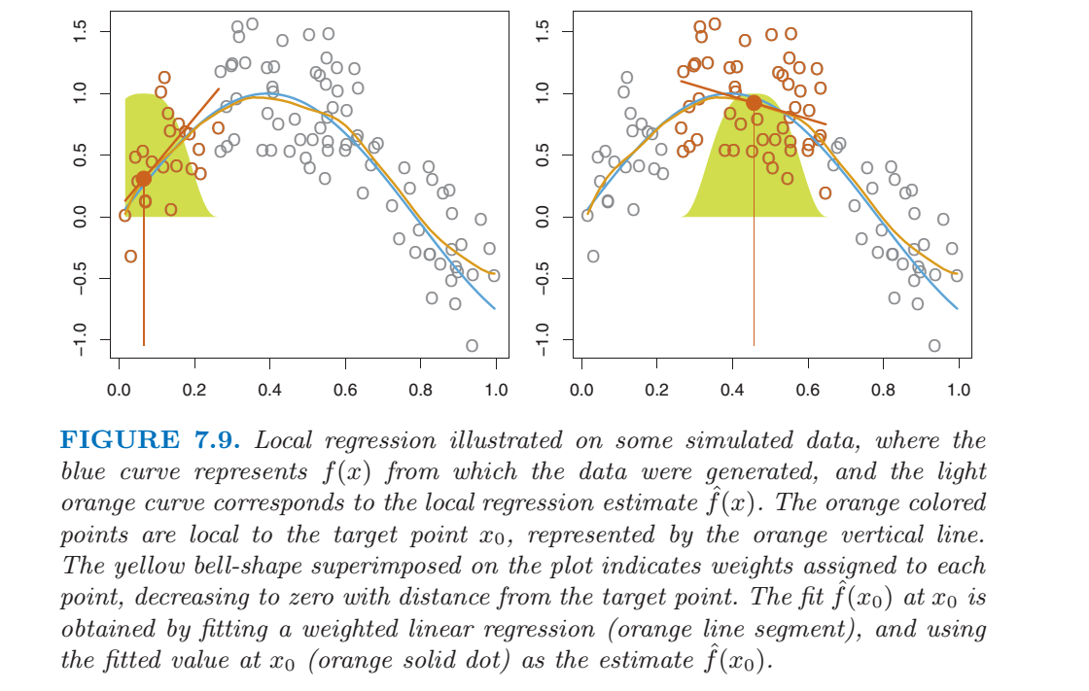
Weighting Based on Proximity

Slide 28
Local Regression in R

Slide 29
Cross Validation Chapter 5

Slide 30
Rigid vs Flexible Models
Models can be rigid or flexible.
Rigid models will not respond quickly to variations
Flexible models will respond very quickly to variations
Consider this generalized model for outcomes:
y_{i} = f(x_{i1}, x_{i2}, x_{i3}, …) + ε_{i}
According to the model above, each data point in our sample contains ε_{i}, some irreducible and un-modelable error. What happens if we model the irreducible error as well as f? Is that a problem?
Which type of model will overfit the noise, rigid or flexible?

Slide 31
Model Variability
Variability is the difference in the error if I apply the same model to many different independent datasets.
For example, I might have a set of data with a linear relationship between a feature and an outcome. But I model the data with a 5th order polynomial, modeling all the noise exactly.
If I apply this flexible model to an independent dataset, I’ll get a much different result.
This is also called overfitting the data and is very frequently done by analysts overselling their modeling capability.

Slide 32
Cross Validation
Thinking about the irreducible error:
We can never model it accurately
It may look like the real signal in the data we use to train the model, but it would not be consistent over the entire population
Q: Give that model, how would you test it against the population?
Would you:
Use the data you used to create the model and calculate the RSS?
Use an independent set of data from the same population to calculate the RSS?

Slide 33
Training Error vs Test Error
Training Error is the error you get when you run the samples you use to train the model back through the model
Decreases as you add more features (x_{j}’s, polynomial, and cross terms) to the model
If the coefficients vary significantly as you change training datasets, this can indicate “overfitting” – you are modeling noise
Test Error is the error you get when you run one or more datasets not used for training through the model
In the case of “overfitted” data, you will get large test errors compared to the training error

Slide 34
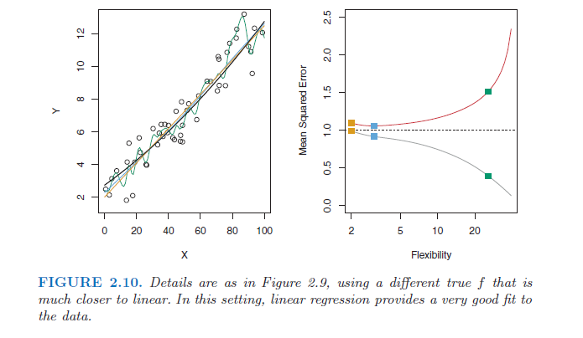
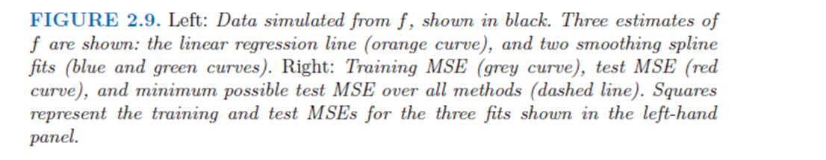
Bias Versus Variability, Linear Case
What do you think the actual noise level is for this data?
How did they find the minimum test error?

Slide 35

Bias Versus Variability, Non-Linear Case

Slide 36
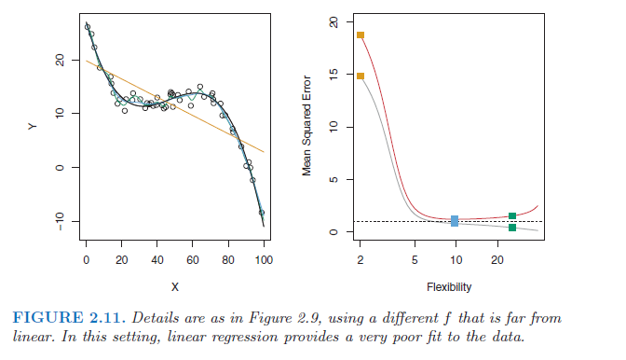
Bias Versus Variability, Another Non-Linear Case

Slide 37
Training Error vs Test Error
Below is a graph that is typical of many models we will examine in this class. While training error can go down continually as we add complexity to a model, testing with independent data reveals that, at some point, the model is not getting better and overfitting takes over.

Slide 38
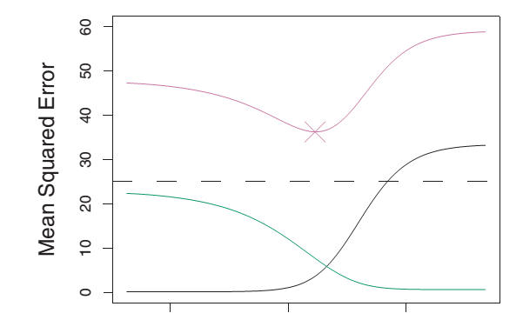
Training Error vs Test Error
Below is a graph that is typical of many models we will examine in this class. While training error can go down continually as we add complexity to a model, testing with independent data reveals that, at some point, the model is not getting better and overfitting takes over.
Test Error
Variability
Training Error or Bias
Increasing Flexibility →

Slide 39
Bias vs Variability R Example
# Create Flexible data: X1 is a feature and X2 is noise
set.seed(2)
x2 = (matrix(rnorm(50),ncol=1))*noise_level
# Create 3rd order data with some noise
#y = x1 + ((1/50)*x1^2) + ((1/(50*50))* x1^3) + x2
y = x1 + ((1/(500))* x1^3) + x2
plot(x1,y)
# create a rigid model and compare to the linear training data
model1 = lm(y~x1)
est1 = predict(model1)
plot(x1,y)
lines(x1,est1,col=2)
# Now create a flexible model and compare to the linear training data
model2 = lm(y~x1+I(x1^8)+I(x1^9)+I(x1^10))
est2 = predict(model2)
plot(x1,y)
lines(x1,est2,col=6)
# Which model is closer to the training data?
RSS1 = 0
RSS2 = 0
for(i in 1:50){
RSS1 = RSS1 + (y[i]-est1[i])^2
RSS2 = RSS2 + (y[i]-est2[i])^2
}
# Now bring in new data with noise and repeat
x3 = (matrix(rnorm(50),ncol=1))*noise_level
#y = x1 + ((1/50)*x1^2) + ((1/(50*50))* x1^3) + x3
y = x1 + ((1/(500))* x1^3) + x3
# First with the original rigid model
est1 = predict(model1)
plot(x1,y)
lines(x1,est1,col=2)
# Next with the original flexible model
est2 = predict(model2)
plot(x1,y)
lines(x1,est2,col=6)
RSS1 = 0
RSS2 = 0
for(i in 1:50){
RSS1 = RSS1 + (y[i]-est1[i])^2
RSS2 = RSS2 + (y[i]-est2[i])^2
}
# This code illustrates bias and flexibility
# Create inputs: X1 is a feature and X2 is noise
set.seed(2)
x1=matrix(50)
noise_level = 10
x2 = (matrix(rnorm(50),ncol=1))*noise_level
for(i in 1:50){
x1[i] = i
}
# Create output that is linear
y = x1 + x2
plot(x1,y)
# create a rigid model and compare to the linear training data
model1 = lm(y~x1)
est1 = predict(model1)
plot(x1,y)
lines(x1,est1,col=2)
# Now create a flexible model and compare to the linear training data
model2 = lm(y~x1+I(x1^8)+I(x1^9)+I(x1^10))
est2 = predict(model2)
plot(x1,y)
lines(x1,est2,col=6)
# Which model is closer to the training data?
RSS1 = 0
RSS2 = 0
for(i in 1:50){
RSS1 = RSS1 + (y[i]-est1[i])^2
RSS2 = RSS2 + (y[i]-est2[i])^2
}
# Now bring in new data with noise and repeat
x3 = (matrix(rnorm(50),ncol=1))*noise_level
y = x1+ x3
# First with the original rigid model
est1 = predict(model1)
plot(x1,y)
lines(x1,est1,col=2)
# Next with the original flexible model
est2 = predict(model2)
plot(x1,y)
lines(x1,est2,col=6)
RSS1 = 0
RSS2 = 0
for(i in 1:50){
RSS1 = RSS1 + (y[i]-est1[i])^2
RSS2 = RSS2 + (y[i]-est2[i])^2
}
#---------------------------------------------------------

Slide 40
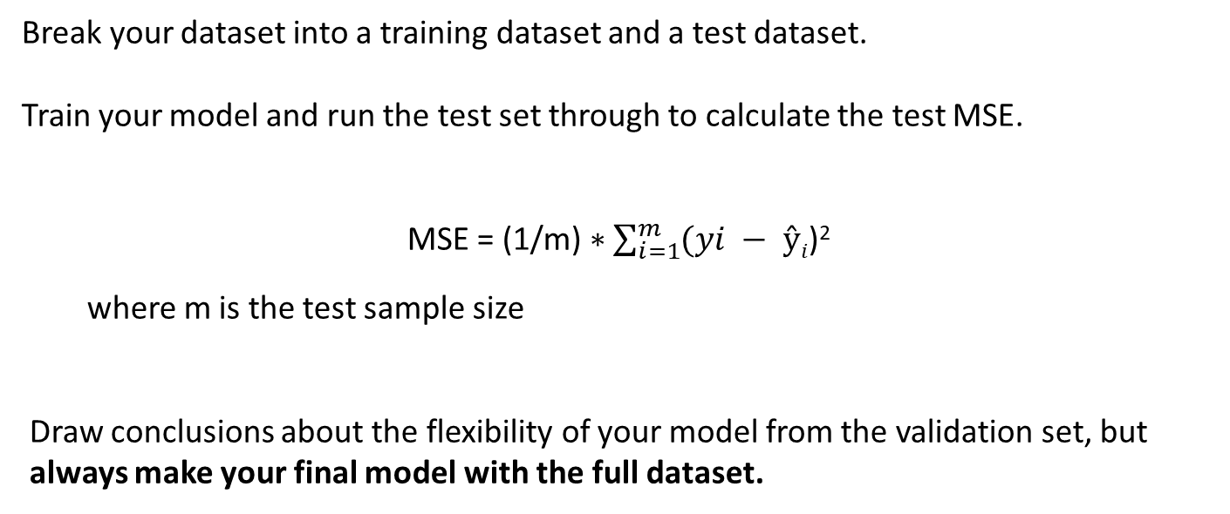
Validation Set
Break your dataset into a training dataset and a test dataset.
Train your model and run the test set through to calculate the test MSE.
MSE = (1/m) $∗\sum_{i=1}^{m}{(yi − ŷi}$)²
where m is the test sample size
Draw conclusions about the flexibility of your model from the validation set, but always make your final model with the full dataset.

Slide 41
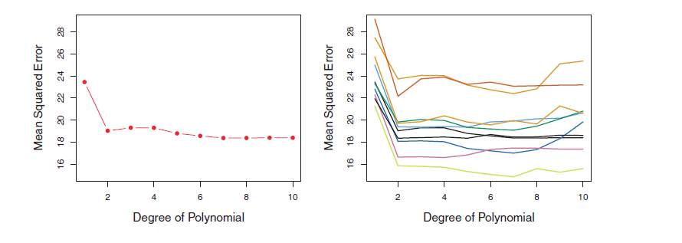
Validation Set
Model for mpg vs. horsepower
Left: 1 validation set
Right: 10 different validation sets
Both m = n/2
Note: There is lots of variability on the MSE, but all conclude that the quadratic fit is better than the linear fit, and third order isn’t a clear advantage

Slide 42
Validation Set
Generally, models tend to not perform well when n is small, and perform better when n is higher. With this in mind, how do you think the validation set approach does in estimating the MSE?
Using the full dataset, n = 100.
When holding out a validation dataset consisting of n/s samples, only n/s samples are used for training.
Thus the validation set approach tends to overestimate the RSS error.

Slide 43
Leave One Out Cross Validation
Hold back one sample and use the rest of the samples for training. You have n-1 training samples. Use your hold out as the test sample and repeat for all n. Note this addresses the tendency of the validation set to overestimate the RSS error.
Advantages
LOOCV results in a much larger training set, and the larger the training set, the lower the bias
There is no variability in LOOCV. The result is consistent since every sample is left out one time.
Disadvantage
Computational burden, especially if n is very large

Slide 44
K-Fold Cross Validation
Divide the sample into K equal parts. Hold back one part and use the rest of the samples for training. You have n-(n/K) training samples. Use your hold out as the test sample and repeat K times.
Your test error for K-fold Cross Validation is

Slide 45
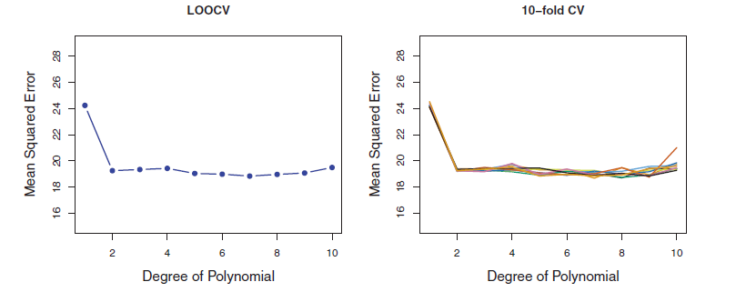
K-Fold Cross Validation
Model for mpg vs. horsepower for left: LOOCV, and Right: 10-fold Cross Validation (i.e. m = n/10) repeated 10 times with different splits.
Note the variability for 10-fold different splits is low, and the computational burden is not too bad compared to LOOCV.

Slide 46
LOOCV Compared to K-fold CV
The average of highly correlated groups is more variable that the average of non-correlated groups.
LOOCV training sets are highly correlated… almost all of the samples are the same.
K-fold cross validation data sets are less correlated than the LOOCV data sets. Therefore their results are less variable.
Given the 2 sources of error in modeling, bias and variability, K-fold CV can be optimal if you choose K correctly.

Slide 47
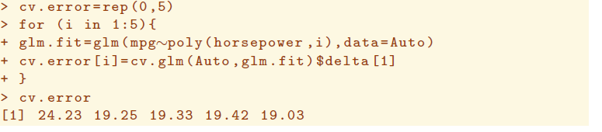
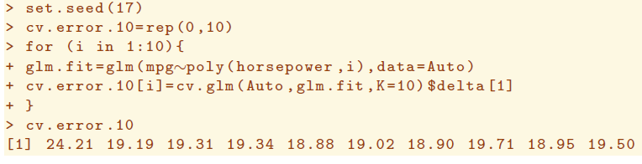
LOOCV and K-Fold Cross Validation

Slide 48
High Dimensionality
Q: Does adding more features always improve the model?
We learn the models from the sample data. For each feature, we estimate the best coefficients (smallest RSS) based on a certain amount of samples. RSS will always go down or stay the same as we add more features, but as we have seen, we might only be modeling noise.
Consider: The more samples we use for training, the better estimate for each coefficient. But if p is large, we essentially have less data to estimate each β. In the limit where p = n, we would have very little information on which to base an estimate for a particular β.
When we add features, we essentially “dilute” the n across the features. For cases where the number of features is greater than n (for p > n), we no longer have enough samples to estimate the coefficients using least squares.

Slide 49
High Dimensionality
Q: So how many features should we pick for our model?
A: K-fold cross validation tells us how flexible the model needs to be. Keeping more dimensions is counter-productive.
We need the independent features with a significant effect on the outcome
If p ~ n then we need more samples
Maybe the primary features that effect the outcome (first few that contribute to RSS the most) are good enough?
If the features are not independent, maybe there is a way to combine 2 features in to 1?
Hold these thoughts for “Feature Selection” lecture

Slide 50
The Curse of Dimensionality
More dimensions create more flexible models, leading to fitting the random noise (overfitting)
More dimensions dilute the number of samples available for modeling a particular effect
More dimensions make a model harder to interpret
More dimensions make the input data to the model harder to collect, sometimes significantly

Slide 51
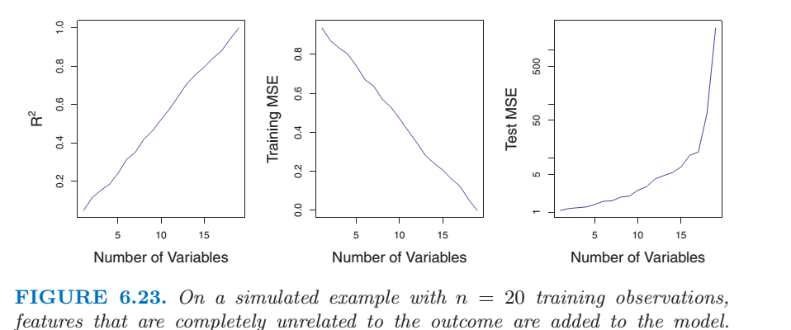
The Curse of Dimensionality
Regression works best when n >> p. When n ~ p, you don’t have enough data records to adequately sample each feature. There is no unique solution for all the coefficients using least squares.
As p → n, training MSE → 0 and test MSE → infinity
When we add features, we essentially “dilute” the n across the features.

Slide 52
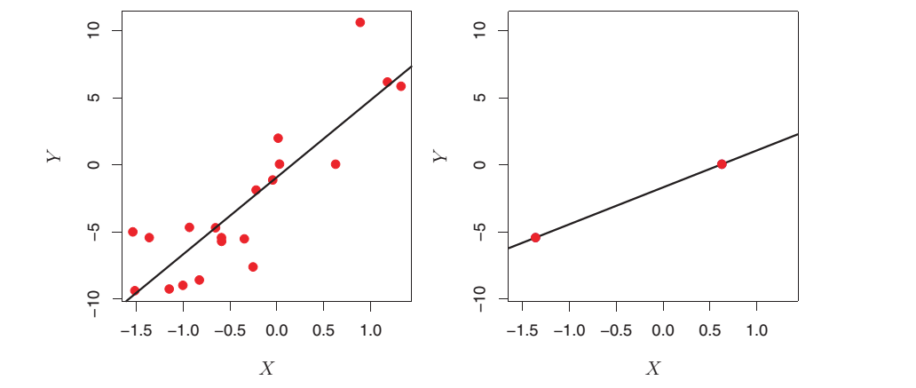
The Curse of Dimensionality
For cases where the number of features is greater than n (for p > n), we no longer have enough samples to model the effect of all the features.

Slide 53
Bootstrap
Like Cross Validation, The Bootstrap is a method based on resampling the data. In this case, you re trying to estimate the accuracy of an estimate.
This just means you are trying to estimate the variance of an estimate, of the confidence interval associated with an estimate.
Did you ever hear the phrase “pull oneself up by the bootstrap”? It doesn’t make any sense… you can’t pull yourself up without securing yourself on some external structure (grabbing onto a table to pull yourself up from the floor, for example).
Similarly, to estimate the accuracy of an estimate, you are not collecting more data, but rather using data you already have to determine something new.

Slide 54
The Bootstrap
The Bootstrap uses random sampling with replacement to create B new data sets. B can be 1000 or 10,000.

Slide 55
Bootstrap
^
^
After 1000 samples and calculations for α, calculate the average of α
Then estimate the standard error for α
The bootstrap comes up with a value of 0.087 for SE(α), which is very close to the correct answer (based on 1000 new datasets) of SE(α) = 0.083
^
^
^

Slide 56
Homework #3 (Page 1 of 2)
Read Chapter 5 of ISLR, Pages 175 through 183 (skip page 184)
Work through all of the R-labs in the text, pages 190 through 196
Do Chapter 5 Problem 3
Do Chapter 5 Problem 8
Do Chapter 5 Problem 9
Due Feb 5

Slide 57
Homework #2 (Page 2 of 3) Project Planning
For at least 1 candidate data set for your project,
construct 3 KNN models for your outcome: k=1, k=5, k=10.
Perform LOOCV and k-fold CV on each model.
Plot test error vs flexibility and select the level of flexibility you should use with your KNN models.
construct 3 linear regression models for your outcome: 1 rigid, 1 moderately flexible, and 1 very flexible.
Perform LOOCV and k-fold CV on each model.
Plot test error vs flexibility and select the level of flexibility you should use with your linear regression models.
No need to hand anything in
but include the results in your Project Plan due Week 5

Slide 58
Flexibility Optimization
The best methods of measuring modeling error is to use an independent validation set
Hold Out Set
Leave-One-Out Cross Validation
K-Fold Cross Validation
So how do we create a good model in the first place? Are there techniques to minimize overfitting using just the training data?

Slide 59
Fixes for the Curse of Dimensionality
Fixes fall into three general categories:
Pick only the features that contribute to the outcome. Eliminate some features that do not effect outcome
Best Subset
Forward and backward stepwise
LASSO
“Shrink” the effect of the features by limiting the magnitude of the coefficients
Ridge Regression (also called “Regularization”)
Combine features into a smaller set of orthogonal basis vectors
Principle Components Analysis

Slide 60
Best Subset Method
1. Start with p = 1. Calculate RSS for each of these p=1 models and select the best one based on min(RSS) or max(R²)
2. Now repeat for p = 2, p = 3, … p = p_{max}
3. Evaluate the models based on test error and select the best one
Bottom line
Can be very computationally expensive. For p features the number of possible models is 2^{p} (don’t forget the null model)
For p = 3, this is not so bad: you only have 8 models for which to evaluate training error, and 3 to cross validate
For p = 20, this is over a million models that need to be calculated and test error measured
Some image processing tasks and genetic marker tasks have thousands of features

Slide 61
Forward Stepwise
Start out with the null model (no features).
Test all the features one at a time and select the best feature (smallest RSS, highest R²) to start. That is the p=1 model.
To the p = 1 model, test the remaining features and select the best one based on RSS or R². Now you have a p=2 model.
Select the best overall model from p models using CV or metric that accounts for complexity (see next chart).

Slide 62
Forward Stepwise
Bottom line
Computationally more efficient when p is large (# models= 1 + p(p+1)/2)
For p = 20, # models = 211
Good for the case where p is larger than n (since some features need to be dropped). Better than backward stepwise for p >n.
All kinds of practical variations if you already have a model, or have so many features that you want to add groups rather than one-at-a-time
Greedy – only does what is best considering that step
Possible to miss good models on different “branches”.

Slide 63
Backward Stepwise
Start with a model that includes all of the features. Evaluate all of the p-1 models. Select the model with the best test error or best accuracy/complexity rating.
Repeat until
The cross validation results achieve some pre-determined threshold
The test error increase becomes significant, i. e., increases significantly from the previous test error
Bottom line
More computationally efficient than best subset
Not advisable when p is very large compared to n
not possible when p > n since there is no unique solution
Variations include subtracting groups of features rather than one-at-a-time

Slide 64
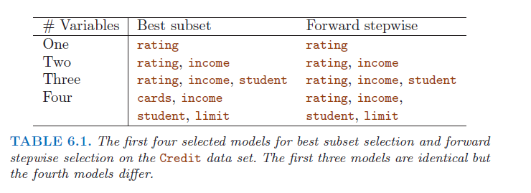
Forward vs Backward
Interesting that these 2 methods can give different answers even in simple cases
One standard error rule: if the models are within 1 standard error for the test MSE, then choose the simplest model (least features).

Slide 65




Metrics that Account for Complexity
What measures take into account both bias and variability (flexibility)?
C_{p} = Unbiased Estimate of Test MSE
AIC = Akaike Information Criterion
BIC = Bayesian Information Criterion
Adjusted R²
All include a parameter, d = number of dimensions. All include a penalty for d so that when d gets large, model “goodness” drops off.

Slide 66
Project Discussion
Finish topic selection for those who missed last class
Start to discuss the objectives of the project
Measure against the typical characteristics of a statistical learning project (see next chart)

Slide 67
How do you know it’s Machine Learning*?
Does the outcome vary based on individual preferences?
Recommender system for music or geospatial search
Does the outcome vary with time?
Stock real-time buy/sell software
Does the outcome influence a decision?
Decision support tool for closing wounds in crash victims
Is there a time-sensitive aspect to the outcome & decision?
Classifying a house as a flipping candidate
Does the outcome feed automation?
Classify a Radar return as a pedestrian
Are the features mined from social media?
Detect bias in news reporting
Are the outcomes used to optimize a quickly changing system?
Adjust traffic signals based on volume
Is the outcome to classify aberrant behavior?
Look for criminal activity in bitcoin transactions
* Based on most successful projects to date

