Slide 1
Math 642 Introduction to Machine Learning Lecture 4: Feature Selection, Ridge Regression, LASSO, Principle Components
Spring 2019
Some of the figures in this presentation are taken from "An Introduction to Statistical Learning, with applications in R" (Springer, 2013) with permission from the authors: G. James, D. Witten, T. Hastie and R. Tibshirani

Slide 2
Class Schedule
Lec | Date | Lecture | Due
1 | Jan 15 | Intro, Linear Regression, Bias and Variability
2 | Jan 22 | Unsupervised Learning: Clustering, Principle Comp. Analysis | Hwk 1
3 | Jan 29 | KNN Regression, Cross Validation, Bootstrap | Hwk 2
4 | Feb 5 | Ridge Regression, LASSO, Principle Components Regression | Hwk 3
5 | Feb 12 | Extreme Nonlinear: Step Functions, Splines | Hwk 4, Project Plan
6 | Feb 19 | Classification, Logistic Regression | Hwk 5
7 | Feb 26 | Discriminant Analysis, Support Vector Machines | Hwk 6, Plan Revision
 | Mar 4 | Mid Term Exam
 | Mar 11 | Spring Break
8 | Mar 18 | Tree-Based Methods | Hwk 7
9 | Mar 25 | Neural Networks, Deep Learning | Hwk 8
10 | Apr 1 | Convolutional Neural Networks | Hwk 9
11 | Apr 8 | Bayesian Analysis | Final Project Due
12 | Apr 15 | Project Presentations | Hwk 10
13 | Apr 22 | Ethics of Machine Learning, Project Presentations
 | Apr 29 | Study Day
 | May 6 | Final Exam

Slide 3
Machine Learning Taxonomy
Statistical Learning
Outcomes
No Outcomes
Supervised
Unsupervised
Quantitative
Estimation
Outcome
is a Number
Outcome
is a Class
Classification
Clustering
Principal
Components
Logistic Regression
Parametric
Estimation
Non-Parametric
Estimation
Bayesian Belief Network
LDA/QDA
y = f(x)
non-equation
based
KNN Classification
Linear Regression
SVM
KNN Regression
Common Elements
Cross Validation
Feature Selection
Gradient Descent
Bootstrap
Boosting
Ridge Regression
Clustering
Decision Trees
LASSO
Decision Trees
Bayesian Analysis
Splines
Time Series
Neural Nets

Slide 4
Review from Last Week

Slide 5
KNN
Y
(x_{i}, y_{i})
X
K = 8
K = 3
Y
Y
^
^
y₀
y₀
X
X
x₀
x₀
8
i=1
3
i=1
^
^
y₀ = ( ∑ y_{i} )/ 8
y₀ = ( ∑ y_{i} )/ 3

Slide 6
KNN example in 2D
Which model is more biased? Which is more flexible?

Slide 7
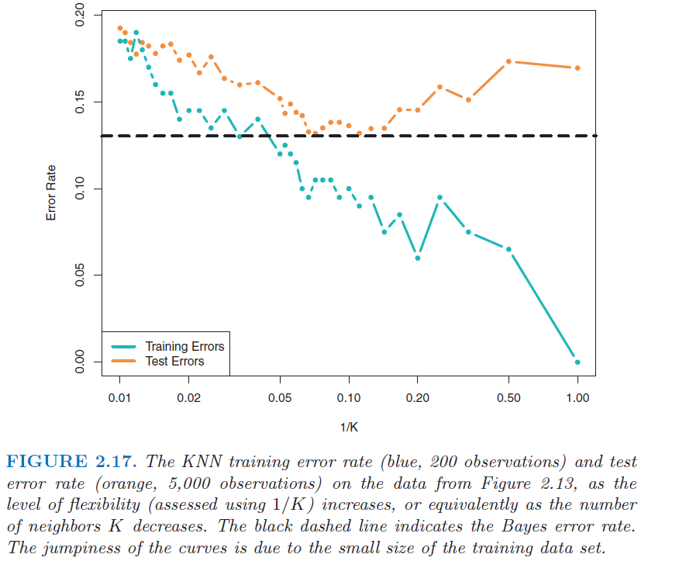
KNN Bias vs Variability

Slide 8
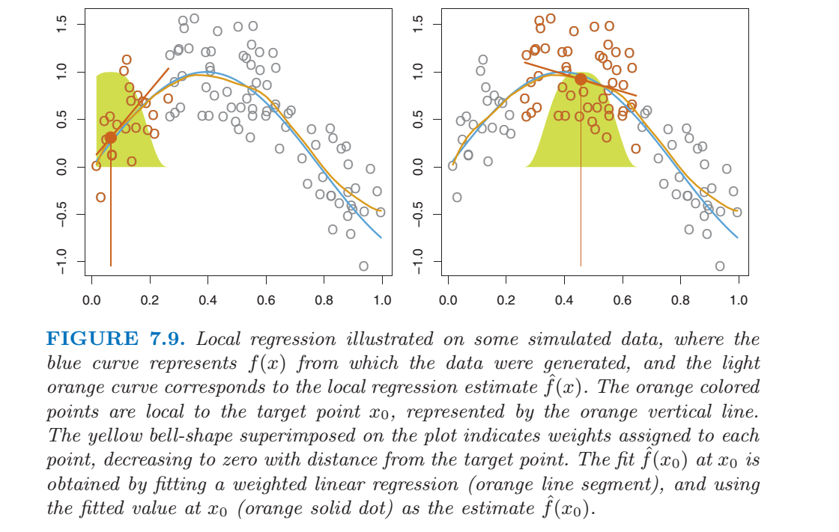
Weighting Based on Proximity

Slide 9
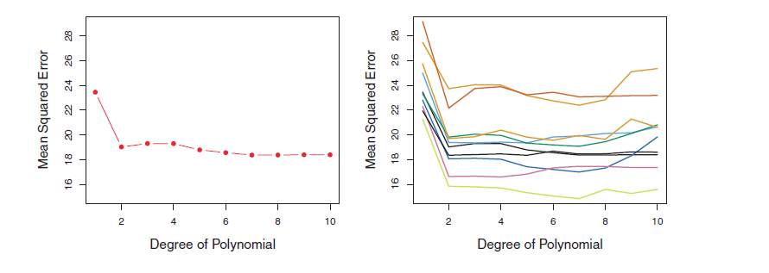
Validation Set
Model for mpg vs. horsepower
Left: 1 validation set
Right: 10 different validation sets
Both m = n/2
Note: There is lots of variability on the MSE, but all conclude that the quadratic fit is better than the linear fit, and third order isn’t a clear advantage

Slide 10
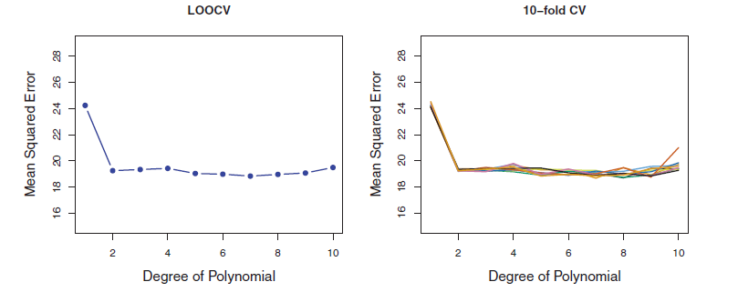
K-Fold Cross Validation
Model for mpg vs. horsepower for left: LOOCV, and Right: 10-fold Cross Validation (i.e. m = n/10) repeated 10 times with different splits.
Note the variability for 10-fold different splits is low, and the computational burden is not too bad compared to LOOCV.

Slide 11
LOOCV Compared to K-fold CV
The average of highly correlated groups is more variable that the average of non-correlated groups.
LOOCV training sets are highly correlated… almost all of the samples are the same.
K-fold cross validation data sets are less correlated than the LOOCV data sets. Therefore their results are less variable.
Given the 2 sources of error in modeling, bias and variability, K-fold CV can be optimal if you choose K correctly.

Slide 12
The Bootstrap
The Bootstrap uses random sampling with replacement to create B new data sets. B can be 1000 or 10,000.

Slide 13
Feature Selection Chapter 6.1

Slide 14
The Curse of Dimensionality
Q: Does adding more features always improve the model?
A: No. To understand why, think about how we learn the models. There reasons generally fall onto three categories:
More dimensions create more flexible models, leading to fitting the random noise (overfitting)
More dimensions dilute the number of samples available for modeling a particular effect
More dimensions make a model harder to interpret
More dimensions make the input data to the model harder to collect, sometimes significantly

Slide 15
Fixes for the Curse of Dimensionality
Fixes fall into three general categories:
Pick only the features that contribute to the outcome. Eliminate some features that do not effect outcome
Best Subset
Forward and backward stepwise
LASSO
“Shrink” the effect of the features by limiting the magnitude of the coefficients
Ridge Regression (also called “Regularization”)
Combine features into a smaller set of orthogonal basis vectors and drop the least important basis vectors
Principle Components Analysis
Partial Least Squares

Slide 16
Best Subset Method
1. Start with p = 1. Calculate RSS for each of these p=1 models and select the best one based on min(RSS) or max(R²)
2. Now repeat for p = 2, p = 3, … p = p_{max}
3. Evaluate the models based on CV and select the best one
Bottom line
Can be very computationally expensive. For p features the number of possible models is 2^{p} (don’t forget the null model)
For p = 3, this is not so bad: you only have 8 models for which to evaluate training error, and 3 to cross validate
For p = 20, this is over a million models that need to be calculated and test error measured
Some image processing tasks and genetic marker tasks have thousands of features

Slide 17
Forward Stepwise
Start out with the null model (no features).
Test all the features one at a time and select the best feature (smallest RSS, highest R²) to start. That is the p=1 model.
To the p = 1 model, test the remaining features and select the best one based on RSS or R². Now you have a p=2 model.
Select the best overall model from p models using CV or metric that accounts for complexity (see next chart).

Slide 18
Forward Stepwise
Bottom line
Computationally more efficient when p is large (# models= 1 + p(p+1)/2)
For p = 20, # models = 211
Good for the case where p is larger than n (since some features need to be dropped). Better than backward stepwise for p >n.
All kinds of practical variations if you already have a model, or have so many features that you want to add groups rather than one-at-a-time
Greedy – only does what is best considering that step
Possible to miss good models on different “branches”.

Slide 19
Backward Stepwise
Start with a model that includes all of the features. Evaluate all of the p-1 models. Select the model with the best test error or best accuracy/complexity rating.
Repeat until
The cross validation results achieve some pre-determined threshold
The test error increase becomes significant, i. e., increases significantly from the previous test error
Variations include subtracting groups of features rather than one-at-a-time
Bottom line
More computationally efficient than best subset
Not advisable when p is very large compared to n
not possible when p > n since there is no unique solution

Slide 20
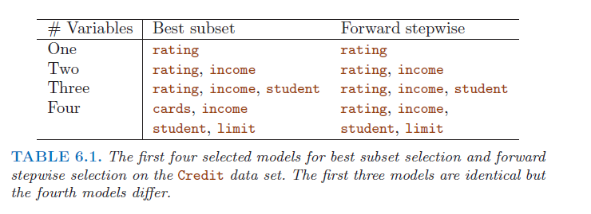
Forward vs Backward
Interesting that these 2 methods can give different answers even in simple cases
One standard error rule: if the models are within 1 standard error for the test MSE, then choose the simplest model (least features).

Slide 21




Metrics that Account for Complexity
What measures take into account both bias and variability (flexibility)?
C_{p} = Unbiased Estimate of Test MSE
AIC = Akaike Information Criterion
BIC = Bayesian Information Criterion
Adjusted R²
All include a parameter, d = number of dimensions. All include a penalty for d so that when d gets large, model “goodness” drops off.

Slide 22
Other Methods of Feature Selection
step function in R
At each step consider forward and backward options
Select best options using AIC score
step will add or drop groups of features at one time
such as multi-categorical features
Forward stagewise Regression
Starts out like forward stepwise
First feature: calculate coefficient based on RSS
calculate residuals with this model
find next feature that minimizes error based on residuals
find coefficient that minimizes error (without modifying
previous coefficients

Slide 23
Ridge Regression – Chapter 6.2.1

Slide 24
Shrinkage Methods
The previous solutions to the “Curse of Dimensionality” involve dropping one of more features.
What other way might there be to limit the flexibility of your model?
Since the coefficients represent the influence of a particular feature, what if you constrained the magnitude of certain coefficients?

Slide 25

Ridge Regression
Limits the sum of the β² to a constant (not including β₀). This has the effect of “reducing variability” of the fit.
Maintains all the same features
Maintains their relative importance
Reduces their influence
Results: Like a low-pass filter in Electrical Engineering. “Smooths out” the fit to reduce overfitting (controlled by λ)

Slide 26
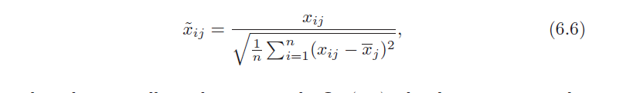
Ridge Regression
Regression coefficients from least squares are scale invariant. Thus you can change the scale of X_{j} but βj * X_{j} will not change. NOT SO WITH RIDGE REGRESSION.
You need to “standardize” the data first.
No large swings in amplitude
No big outliers
Note that Least squares is scale invariant, but Ridge Reduction is not
Consider how β’s change with the amplitude of the feature in SS, but reducing amplitude of β’s changes all of them proportionally to each other (not to the feature size)
Note β₀ is not included in the shrinkage, since it is the intercept for the model. We don’t want to change this value when limiting flexibility for the model.

Slide 27
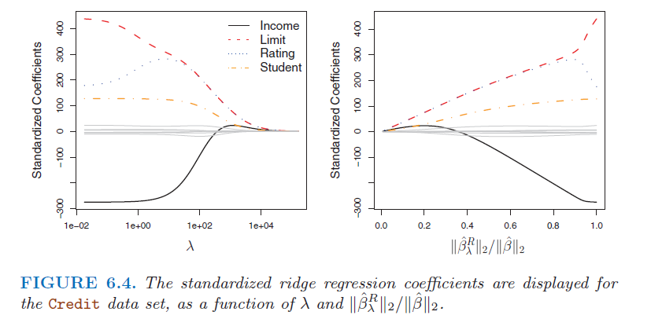
Ridge Regression
When λ = 0, there is no penalty for flexibility and the model reverts to the original solution.
When λ = infinity, the coefficients go to zero and you approach the null model.

Slide 28
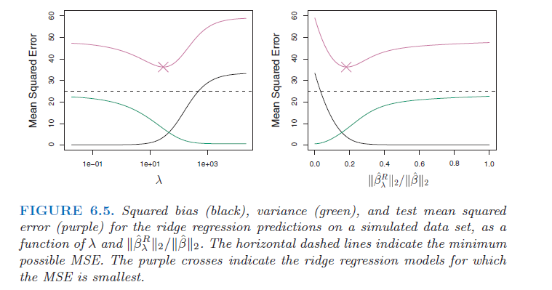
Ridge Regression
Effects of shrinkage on bias, variability, and test error

Slide 29
LASSO – Chapter 6.2.3

Slide 30

LASSO
Limits the sum of the abs(β) to a constant (not including β₀). This has the effect of “reducing variability” of the fit by eliminating some features.
Can reduce the number of features
Can change the relative importance of features
Can change influence of features
Results: Best way to smooth out the fit and reduce overfitting… but of course can increase bias if taken too far (controlled by λ)

Slide 31
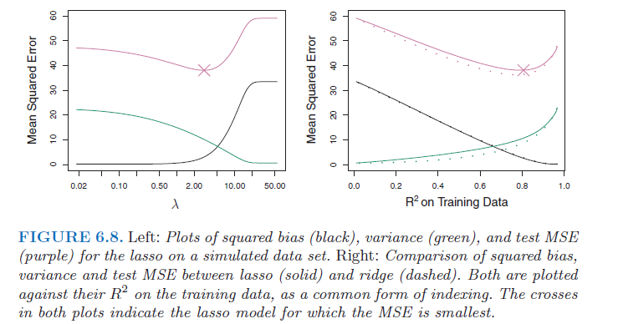
Typical LASSO results

Slide 32
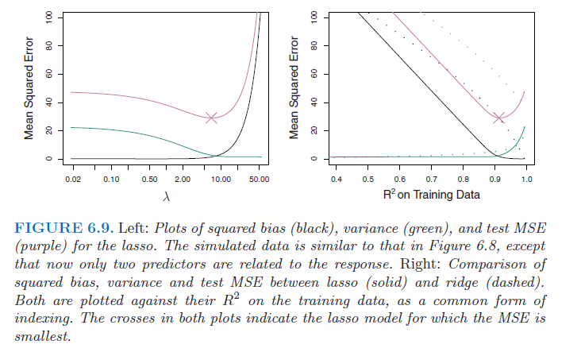
λ for RR and LASSO
The amount of smoothing or reduction in features is controlled by λ
If λ = 0, you just get the same solution as sum or squares
If λ = infinity, you get all β’s = 0 (null model)
Q: How can you select λ?
A: Calculate over a grid of λ’s and select the best model based on CV

Slide 33
Principle Component Regression – 6.3.1

Slide 34
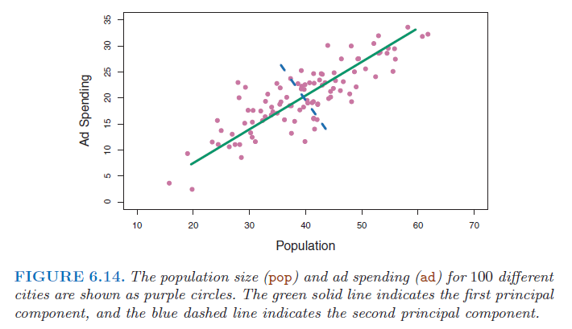
Principal Components Analysis
What is the best choice for a coordinate system based on the data?
One choice is “Ad Spending” versus “Population”
Another might be the green line versus the blue line
Note that in both cases, the coordinates (or basis vectors) are orthogonal, meaning they are independent. Then why pick one over the other?

Slide 35
Principal Components Analysis
The first choice requires both variables to be included in any “good” model
The second choice allows you to drop the second variable and still have a good model. Thus you can end up with a simpler model (fewer dimensions)
X₂
X₁

Slide 36
Principal Component Analysis
The new axes are combinations of the original axes
Linear combination means you multiply one or more of the original axes by a constant and add the result
Normal means the sum of squares for the constants is 1
Orthogonal means that the axes are independent ( mathematically it means they intersect at 90 degrees)

Slide 37
Principle Components Regression
Just like we did for linear regression, use the Z features to create a least squares model. Use K of these principle components.
The net effect is a reduction from p features to p-k features, where p-k is the number of basis vectors.
Since each basis vector accounts for a different amount of variability, you can choose when to cutoff the features based on this criteria.

Slide 38
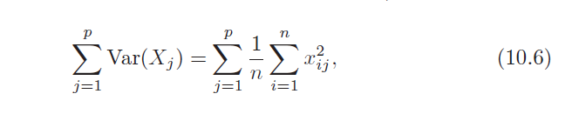
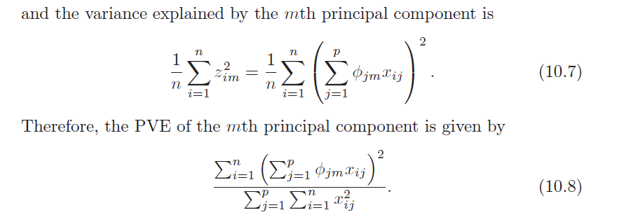
Percent of Variance Explained
Principal Component Analysis is a method of reducing dimensionality and simplifying the problem. But how do you know when to stop?
The total variance in a dataset is

Slide 39
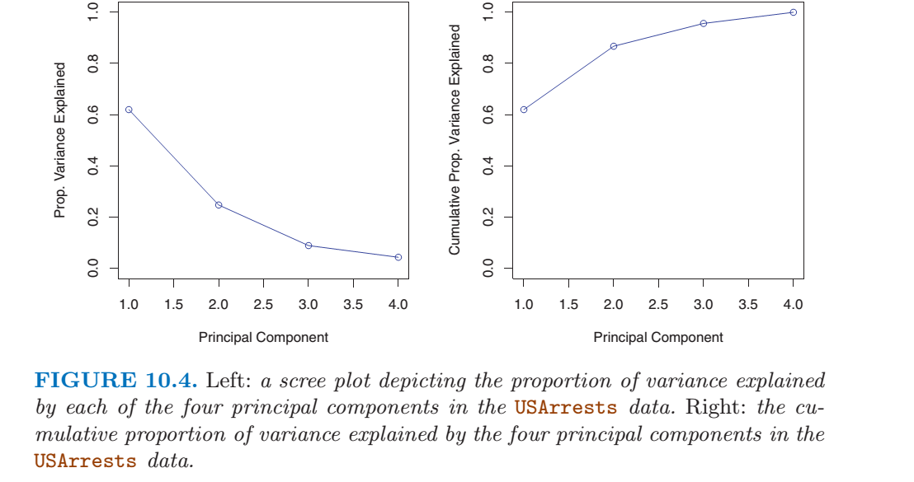
PVE

Slide 40
Principle Components vs LASSO and RR

Slide 41
Principle Components vs LASSO and RR

Slide 42
Principle Components vs LASSO and RR

Slide 43
Partial Least Squares – Chapter 6.3.2

Slide 44
Partial Least Squares
Principle Components Regression guarantees you will find the direction of greatest variance in the input data. This does not always guarantee that the principle components explain the outcome. Since PCR is unsupervised, outcomes are not considered.
For PLS:
Define linear combinations of the original features. Each coefficient is its feature’s correlation to the outcome.
Apply the model to the outcomes and create a dataset of residuals
Repeat to create the remaining

Slide 45
Which Method is Best?
It depends
*
*from Elements of Stat Learning II

Slide 46
Which Method is Best?
*
*from Elements of Stat Learning II

Slide 47
Some Ways to Think about Feature Selection
LASSO eliminates variables
When some variables are not correlated to the outcome, this is good
Adjacent models can be vastly divergent, making search difficult
RR gradually shrinks variables
When all the variables are correlated to the outcome, this is good
Adjacent models are closely related making search easier
PCR is somewhere between LASSO and RR
You can always check using full Cross Validation of all the methods
But that is best done after you have whittled the solution down to a few

Slide 48
Homework #2 (Page 2 of 3)
Read Chapter 6 of ISLR, Pages 203 - 244
Work through all of the R-labs in the text, pages 244-258
Do the following problems:
Chpt 6 Problem 1
Chpt 6 Problem 2
Chpt 6 Problem 3
Chpt 6 Prob 8 (please do all the plots as described in the lab)
Due Feb 12

Slide 49
Homework #2 (Page 3 of 3) Project
Hand in your Project Plan. Include
Topic Area
Objective
Outcome
Features
Describe Remaining Work
Appendices
Unsupervised Analysis
Supervised Analysis (if any)
Linear Regression
KNN
LASSO
RR
PCR

Slide 50
Homework #2 (Page 3 of 3) Hand in Project Plan
Please Include
Topic
Problem Description / Need
Objective
Dataset Description
Unsupervised Learning Results
Data Selection
Analysis Plan
Appendices
Linear Regression
KNN
LASSO
RR
PCR
PLS

Slide 51
Project Discussion

Slide 52
Machine Learning Project Goal
The goal of the project is to apply the concepts you are learning to real-world problems.
Some of the necessary skills include:
Listening to the Customer needs (for future reference)
Articulating project goals
Understanding the data
Selecting the appropriate analytic technique(s)
Performing quality control and error estimation
Communicating your results

Slide 53
Leading Questions
Am I happy with the topic area I have selected?
Have I found a good dataset?
Have I determined an outcome in my data?
Who is my Customer?
What s my objective?

Slide 54
How do you know it’s Machine Learning*?
Does the outcome vary based on individual preferences?
Recommender system for music or geospatial search
Does the outcome vary with time?
Stock real-time buy/sell software
Does the outcome influence a decision?
Decision support tool for closing wounds in crash victims
Is there a time-sensitive aspect to the outcome & decision?
Classifying a house as a flipping candidate
Does the outcome feed automation?
Classify a Radar return as a pedestrian
Are the features mined from social media?
Detect bias in news reporting
Are the outcomes used to optimize a quickly changing system?
Adjust traffic signals based on volume
Is the outcome to classify aberrant behavior?
Look for criminal activity in bitcoin transactions
* Based on most successful projects to date

Slide 55
Analysis Plan Specifications Topic, Problem Description, Unsupervised Learning Results, Data Selection, Analysis Plan, Supervised Learning Results, Preliminary Conclusions
Section | Description | Pages
Introduction | Why you are interested in the subject area that you selected for your project | 1 paragraph
Problem Description | What problem are you trying to solve? Who is the Customer? What will be the effect on the Customer? | ½ page
Data Description | Discuss your dataset(s): where did it come from, is data missing/ambiguous? What are the challenges | 1 or 2 paragraphs
Unsupervised Learning Results | Look at some candidate datasets. Plot data, perform PCA, clustering, and other techniques. Do you have sufficient data? What is the quality? | A few pages
Analysis Plan | What results will you need to solve the problem or answer the question? How do you plan to get them? What data conditioning will you need to do? | ½ page
Preliminary Results | Include any Supervised Learning Analysis you have done. What conclusions can you make form this work? | 1 to a few pages
Appendices | All your supervised analysis to date | unlimited

