Slide 1
Math 642 Introduction to Machine Learning Spring 2020 Lecture 7: Support Vector Machines
Some of the figures in this presentation are taken from "An Introduction to Statistical Learning, with applications in R" (Springer, 2013) with permission from the authors: G. James, D. Witten, T. Hastie and R. Tibshirani

Slide 2
Class Schedule
Lec | Date | Lecture | Due
1 | Jan 15 | Intro, Linear Regression, Bias and Variability
2 | Jan 22 | Unsupervised Learning: Clustering, Principle Comp. Analysis | Hwk 1
3 | Jan 29 | KNN Regression, Cross Validation, Bootstrap | Hwk 2
4 | Feb 5 | Ridge Regression, LASSO, Principle Components Regression | Hwk 3
5 | Feb 12 | Extreme Nonlinear: Step Functions, Splines, Gradient Descent | Hwk 4, Project Plan
6 | Feb 19 | Classification, Logistic Regression, Discriminant Analysis | Hwk 5
7 | Feb 26 | Max Margin Classifiers, Support Vector Machines | Hwk 6, Plan Revision
 | Mar 4 | Mid Term Exam
 | Mar 11 | Spring Break
8 | Mar 18 | Tree-Based Methods | Hwk 7
9 | Mar 25 | Neural Networks, Deep Learning | Hwk 8
10 | Apr 1 | Convolutional Neural Networks | Hwk 9
11 | Apr 8 | Bayesian Analysis, Project Presentations | Hwk 10
12 | Apr 15 | Time Series, Project Presentations | Final Project Due
13 | Apr 22 | Ethics of Machine Learning, Project Presentations | Hwk 11
 | Apr 29 | Study Day
 | May 6 | Final Exam

Slide 3
Machine Learning Taxonomy
Statistical Learning
Outcomes
No Outcomes
Supervised
Unsupervised
Quantitative
Estimation
Outcome
is a Number
Outcome
is a Class
Classification
Clustering
Principal
Components
Logistic Regression
Parametric
Estimation
Non-Parametric
Estimation
Bayesian Belief Network
LDA/QDA
y = f(x)
non-equation
based
KNN Classification
Linear Regression
Common Elements
Cross Validation
Feature Selection
Gradient Descent
Bootstrap
Boosting
KNN Regression
SVM
Ridge Regression
Clustering
Decision Trees
LASSO
Decision Trees
Neural Nets
Splines
Time Series
Bayesian Modeling
Bayesian Modeling

Slide 4
REVIEW

Slide 5
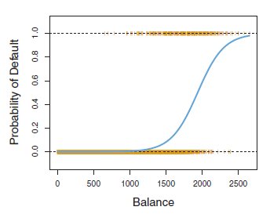
Example: Credit Card Default
It would be better to find a function that has the following characteristics:
Asymptotic to -1 and +1
Adaptable slope to reflect changes in probability

Slide 6
Logistic Function
The most basic classification model is a linear one
How do you translate a continuous quantitative response into a binary qualitative response? Use the Sigmoid Function

Slide 7
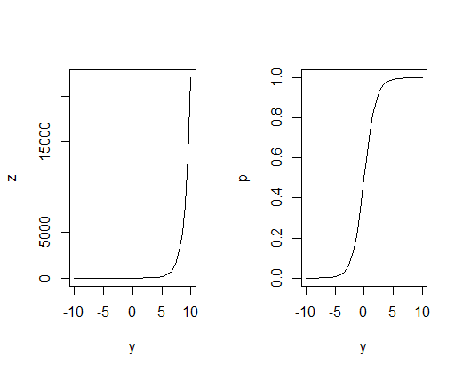
Decision Boundary
How does the Logistic function work?
Let’s say if p(x) < 0.5 we predict 0 and if p(x) ≥ 0.5 we predict 1
Thus when y < 0 we predict 0 and when y > 0 we predict 1
The Decision Boundary is at p = 0.5
^
^
^
^
p
p = 0.5
^
y
^
Predict 0
Predict 1
^

Slide 8
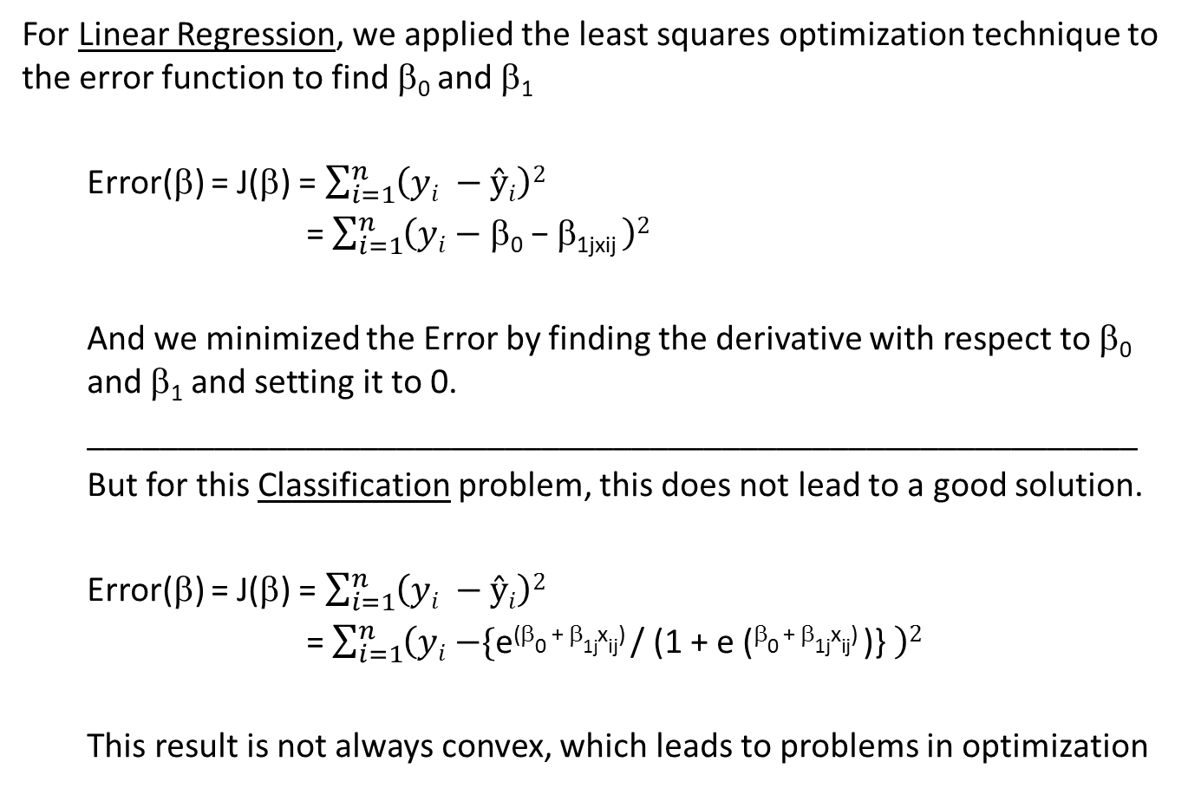
Solving for β₀ and β₁
For Linear Regression, we applied the least squares optimization technique to the error function to find β₀ and β₁
Error(β) = J(β) = $\sum_{i=1}^{n}{\left(yi −ŷi\right)2}$
= $\sum_{i=1}^{n}{\left(yi \text{− }\text{b}\text{0} \text{−} \text{b}\text{1}\text{jxij} \right)2}$
And we minimized the Error by finding the derivative with respect to β₀ and β₁ and setting it to 0.
__________________________________________________________
But for this Classification problem, this does not lead to a good solution.
Error(β) = J(β) = $\sum_{i=1}^{n}{\left(yi −ŷi\right)2}$
= $\sum_{i=1}^{n}{\left(yi \text{−}\text{\{}\text{e}\text{(}\text{b}\text{0}\text{ + }\text{b}\text{1}\text{j}\text{x}\text{ij}\text{) }\text{/ (1 + }\text{e}\text{ (}\text{b}\text{0}\text{ + }\text{b}\text{1}\text{j}\text{x}\text{ij}\text{) }\text{)}\text{\}} \right)2}$
This result is not always convex, which leads to problems in optimization
^
^

Slide 9



A Better Cost Function
Let’s “maximize the likelihood” by minimizing the cost of being wrong
J(β₀,β₁) =$\sum_{i}^{n}{ \left(−yi\right)∗\log\left(\text{p}\right)− }$ $\sum_{i}^{n}{\left(1 −yi\right)∗log(1 −{p}) }$
y_{i} = 1
y_{i} = 0
- log(p)
Cost
Cost
- log(1 - $p$)
log(p)
p
p
0 1
0 1
log(1 - $p$)

Slide 10
Assessing Classification Models
We can do Cross Validation for Classification Models
Divide our samples into training samples and test samples
Do k-fold cross validation if necessary
When we run the test samples through our models, we get the following “confusion matrix”
 |  | Actual
 |  | Default | No Default
Predicted | Default | 81 | 23
 | No Default | 252 | 9644

Slide 11
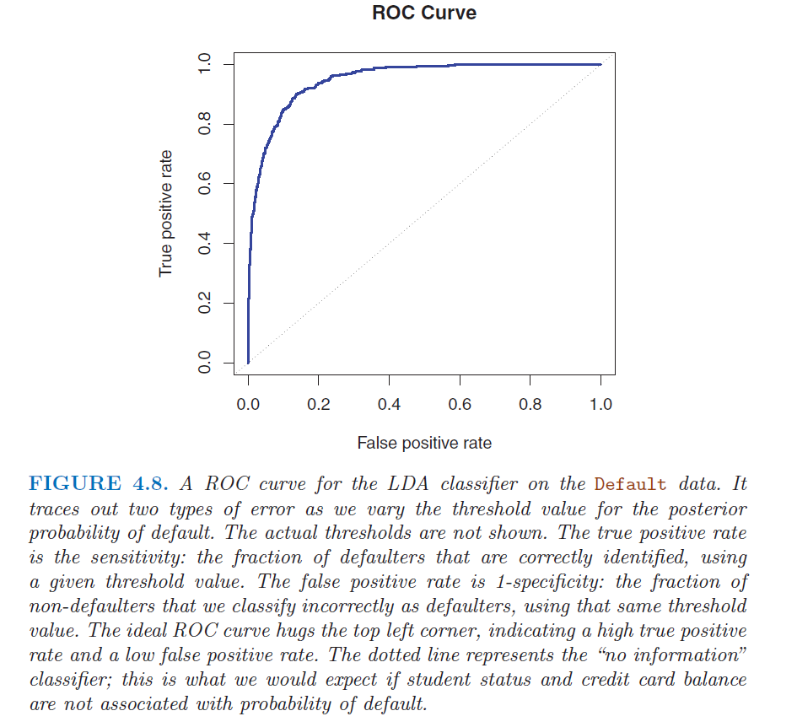
Receiving Operating Characteristic

Slide 12
Odds
If a horse is running a race, and it has a 0.25 probability of winning, what are the odds it will win?
Odds = p / (1-p) = 0.25 / 0.75 = 1 /3 = “1 win to 3 losses” or
“1 win out of 4 tries”
What about if the horse has a 0.9 probability of winning?
Odds = p / (1-p) = 0.9 / 0.1 = 9 /1 = “9 wins to 1 loss” or
“9 wins out of 10 tries”

Slide 13
Problems with Logistic Regression
When the distributions are well separated, logistic regression is not sufficiently stable
When n is small and the x’s are normally distributed, logistic regression is not sufficiently stable
Logistic regression does not handle multiple classes well
What is an alternative to Logistic Regression that is more stable and handles multiple (more than 2) classes easily?
Answer: Discrimminant Analysis

Slide 14
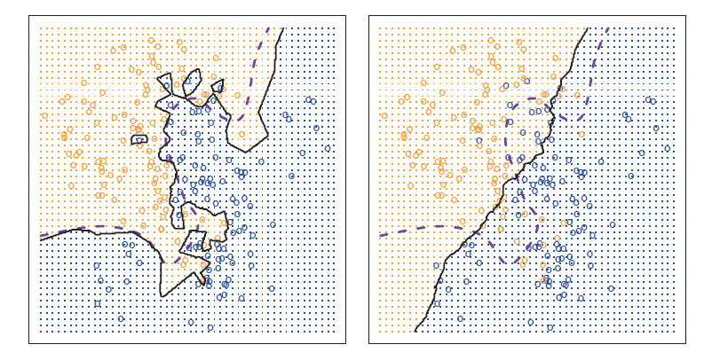
Classification with KNN
Simple method that we discussed last week when we were doing estimation works just as well for classification. Class is
Most commonly occurring class in training data in K group
K should be the number of classes + 1 to avoid ties

Slide 15


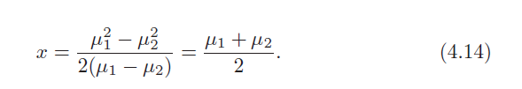
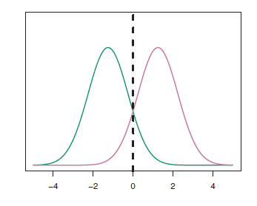
Naïve Bayes Classifier for Gaussian Distribution
With the aforementioned assumptions, the posterior is:
Bayes is the ideal classifier if the prior distribution is normal (or Gaussian) and the likelihood is normal. In this case the Decision Boundary is:

Slide 16

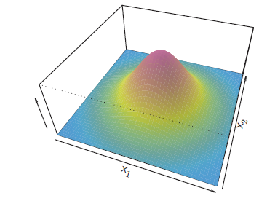
Multivariate Case: LDA for p > 1
A Gaussian function for 2 features is like a 3-D normal distribution.

Slide 17
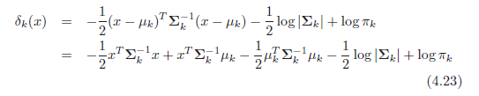
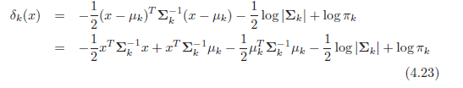
Quadratic Discriminant Analysis
Unlike LDA, QDA assumes each Gaussian-distributed class has a distinct covariance matrix. Then Bayes becomes

Slide 18
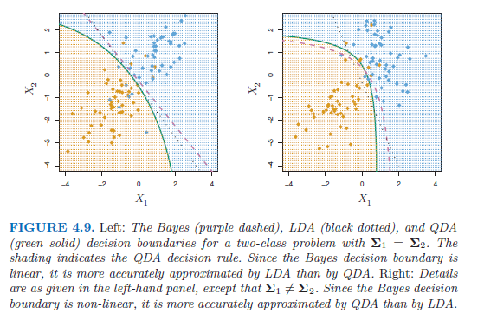
Quadratic Discriminant Analysis

Slide 19
Cross Validation with Classifiers – Chapter 5.1.5
Maximum Margin Classifier – Chapter 9.1
Support Vector Classifier – Chapter 9.2
Support Vector Machines – Chapter 9.3

Slide 20
Classification vs Numerical Estimation
Many of the concepts we have studied so far apply to classification
Classifiers have 2 general types of modeling error: bias and variability
Classifiers suffer from the “Curse of Dimensionality”
Cross validation should be used to find the right balance between training error and test error
K-fold cross validation being the preferred technique
Create a hold-out set, train your classifier, note the training error
Measure your test error with your hold-out set
Repeat for all hold-out sets
Plot training and test errors and assess your desired level of flexibility
You can use best subset, forward, and/or backward selection to determine your features
We are estimating a Probability instead of the actual outcome

Slide 21
Logistic Function
The most basic classification model is a linear one
With the standard representation as a Sigmoid Function
But the decision boundary may not always be linear. You can also use a more flexible model for nonlinear cases

Slide 22
Classifier Bias versus Flexibility

Slide 23
Classification Error
Classification error can be expressed as
And Cross Validation can be implemented by looking at training errors and test errors

Slide 24
Classifier Training versus Test Error

Slide 25
Max Margin Classifiers

Slide 26
Decision Boundary
^
To find the decision boundary, let’s find the line where y = 0
The equation for this line is X₁ + X₂ = 4
thus X₁ + X₂ – 4 = 0 is the decision boundary
so y = 1 for X₁ + X₂ – 4 > 0
and y = -1 for X₁ + X₂ – 4 < 0
₊₁
₊₁
4
3
2
1
0
X₂
₊₁
₊₁
₋₁
₋₁
₊₁
₊₁
₋₁
₋₁
0 1 2 3 4
X₁

Slide 27
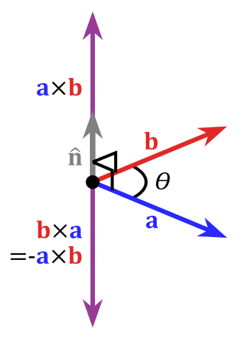
Hyperplanes
In 2 dimensions, the decision boundary is a line
In 3 dimensions, the decision boundary is a plane defined by 2 lines
Remember 2 vectors define a plane (a x b = normal to plane)

Slide 28
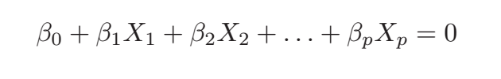
Hyperplanes*
In general, the decision boundary is a hyperplane. In D-dimensional space, a hyperplane is a flat affine subspace of dimension D-1.
In general, equation for a hyperplane is
* Read “flatland” by Edwin Abbott to get an interesting perspective on reduced dimensionality

Slide 29
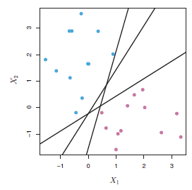
Maximum Margin Classifier
Margin is the minimum distance of the samples from the decision boundary. (This only works if the samples are completely separated by a line)
Which Decision Boundary has the largest margin? That one is the Maximum Margin Classifier

Slide 30
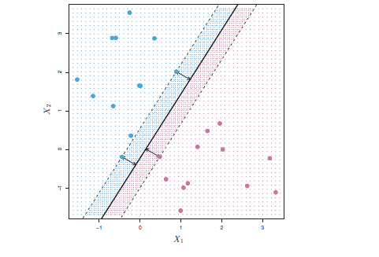
Maximum Margin Classifier
To determine the maximum margin, compute the distance of the samples from the decision boundary.
The distance must be perpendicular to the decision boundary… this is the smallest distance between the sample and the decision boundary in 360 degree directions.
90 deg

Slide 31
Maximum Margin Classifier
How many points actually affect the location and orientation of the Maximum Margin Decision Boundary?

Slide 32
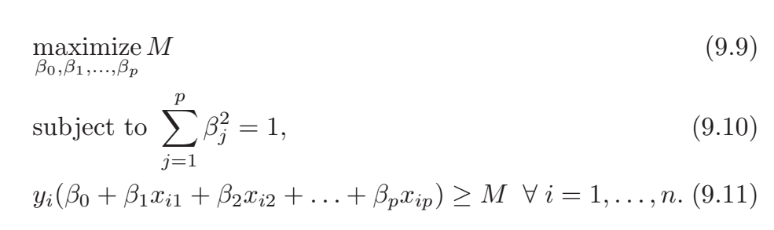
Maximum Margin Classifier
To create the maximum margin boundary for y_{i} = 1 or -1
9.11 is just the equation for the decision boundary set to equal M instead of 0. It provides a “cushion” for the boundary. 9.9 ensures the maximum M.
Do you see how in 9.11, when
y_{i} =+1 then is positive,
y_{i} =-1 then is negative.

Slide 33
Maximum Margin Classifier
Multiplying by a constant does not change the equation for the decision boundary. If β₀ + β₁ x₁ + β₁ x₁ = 0 then k(β₀ + β₁ x₁ + β₁ x₁ ) also equals 0.
9.11 sets k = 1 and ensures distance is perpendicular.

Slide 34
Example of Maximum Margin Classifier
Let’s apply the maximum margin equations to this example
Where are the possible decision boundaries for this case?
Where is the maximum margin boundary for this case? (You can do this by inspection).
What is M? Remember, the margin must be perpendicular to the decision boundary.
y = 1
4
3
2
1
0
x
x
x
X₂
x
x
x
x
y = -1
0 1 2 3 4 5
X₁

Slide 35
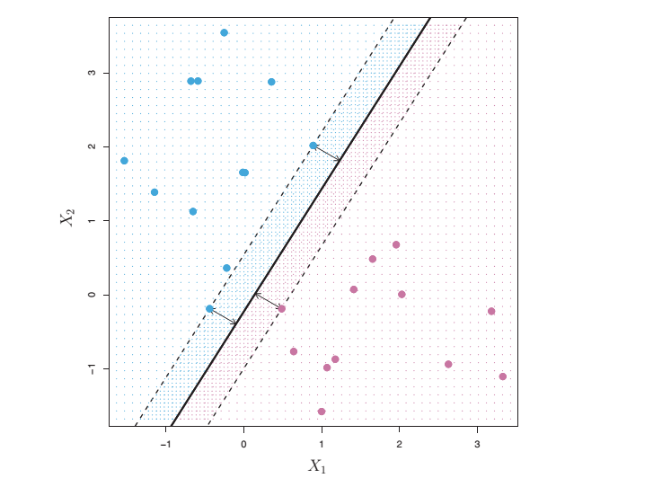
Support Vectors
A support vector is the shortest vector(s) between the sample and the maximum margin decision boundary, perpendicular to the decision boundary
Note: The decision boundary depends only on the support vectors. The other points could move around and not affect the max margin decision boundary. But if there is only one vector, and it moves, the decision boundary will move.

Slide 36
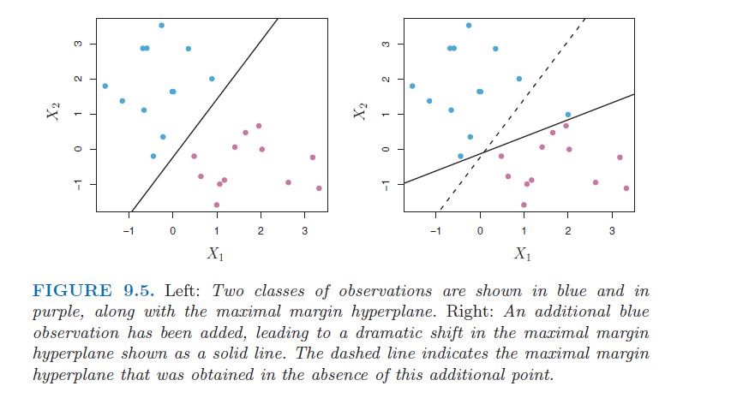
Problem with Max Margin Classifier
Problem 1: The addition of one point can cause a wild fluctuation in the Maximum Margin Decision Boundary. This is analogous to overfitting.
Also, if you think of the distance from the decision boundary as a measure of confidence, your confidence just changed radically based on one point.

Slide 37
Problem with Max Margin Classifier
Problem 2: Sometimes the data is mixed and not separable

Slide 38
Support Vector Classifier
Why is a Support Vector classifier better than a Maximum Margin Classifier?
More robust with respect to individual outliers
Better overall performance in classification
Allows for “tuning” to prevent overfitting
A Support Vector Classifier is also called a Soft Margin Classifier
(this terminology is confusing so remember the distinctions between Maximum Margin Classifier, Support Vector Classifier, Soft Margin Classifier, and Support Vector Machine)

Slide 39
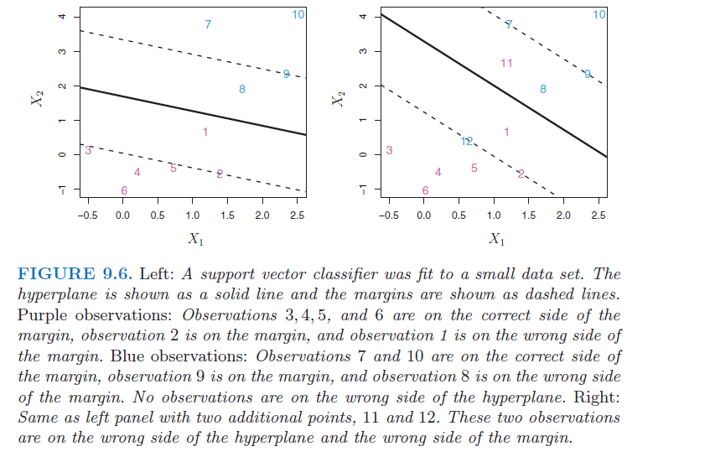
Example of a Support Vector Classifier

Slide 40
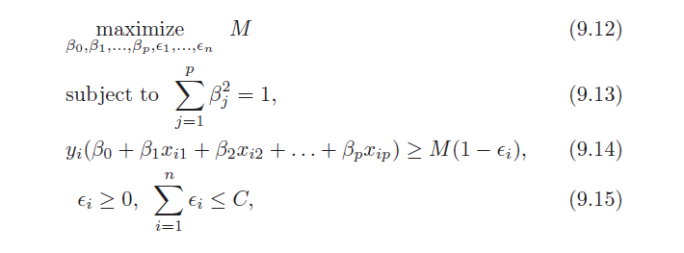
Support Vector Classifier Governing Equations
M is still the width of the margin, but it can have violations. In fact some points can be on the wrong side of the decision boundary.
ε_{i} is called the “slack” variable. If ε_{i} > 0 then that point is in the margin area; If ε_{i} > 1 then that point is on the wrong side of the decision boundary.
C is the tuning parameter. If C = 0, then the margin can have no violations; that is, all ε_{i} must be 0. Then you have a maximum margin classifier.

Slide 41
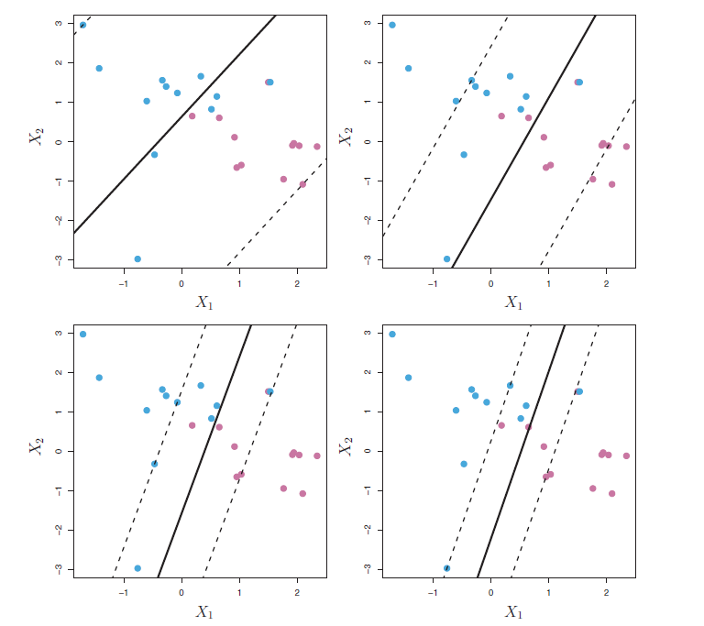
The Tuning Parameter Allocates a “Budget” for Violations
Largest C
Many Violations
Low variability
High bias
Smallest C
Few Violations
High variability
Low bias
Note: Higher C is like a larger λ for Ridge Regularization: Lower variability, lower DOF

Slide 42
Employing the Support Vector Classifier
Note that choosing C affects many aspects of the Support Vector Classifier model
C sets the limit for the number of violations allowed
Depending on C, the closest samples to the boundary can violate the margin or the boundary
For a given C, the margin size increases, and then you can set the boundary
Choose C by Cross Validation, just like you did for choosing λ in Ridge Regression

Slide 43
Key Advantages of Support Vector Classifier
Key Observation: the samples that violate the margin are the only ones that determine the decision boundary. The samples that do not violate the margin have nothing to do with the calculation of the boundary! This can have significant implications
For computational burden
If you only need to consider these samples to make your model, the number of calculations required goes way down
For robustness when new points are added
Linear Discriminant Analysis can be significantly affected by the addition of samples far from the decision boundary. Not so with Logistic Regression and Support Vector Classifiers

Slide 44
Employing the Support Vector Classifier
Important: When classifying new data, use only the decision boundary when making your classification decision.
Compare to LDA: you used all the points to calculate the mean of the distribution.
Compare to Logistic Regression: Like the Support Vector Classifier, Logistic Regression is relatively independent of points far from the margin.

Slide 45
Handling Leverage Points
As you add points that affect the decision boundary, how can you prevent “bad” points from dominating your model?
What are bad points?
Dominated by noise
Faulty measurements
Faulty recording
Misinterpetation
Can you correlate elements of the data vector for leverage points? Say you have height, body fat, and weight. They should correlate.
If you have a strong correlation between features, and you have an outlier you have reason to suspect its veracity, you can throw out the feature value and compute it. But do this with full knowledge and take responsibility.

Slide 46
The Support Vector Machine

Slide 47
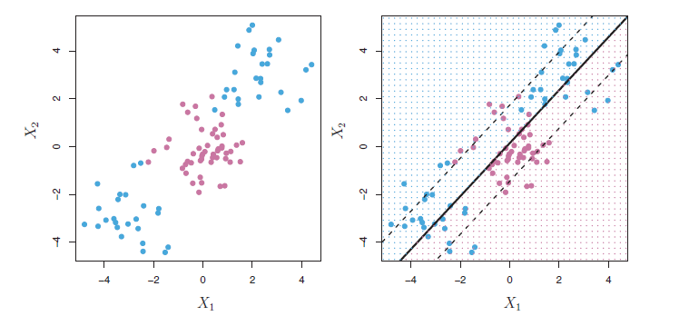
Non-Linear Decision Boundaries
The maximum margin classifier and the support vector classifier both use linear decision boundaries. How do we handle more complicated data structures?

Slide 48
Support Vector Classifiers with Non-Linear Decision Boundaries
Just like for the quantitative estimation case, we can think of many polynomial functions and interaction terms involving the features that will result in nonlinear boundaries
X₁, X₂ → X₁, X₂, X₁², X₂², X₁*X₂,
This “expanded” feature space has the effect of permitting non-linear decision boundaries
Caution: With higher dimensions you have more flexibility and
Risk of overfitting
Computational problems
Time and processing capacity
Optimization and Convergence

Slide 49
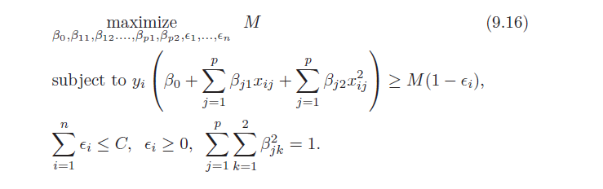
Fitting a Support Vector Classifier with Non-Linear Decision Boundaries

Slide 50

Support Vector Machine: Kernels
A kernel is a function that quantifies (measures) the similarity between 2 observations.
Kernels are the preferred method of solving a classification problem with a complicated and nonlinear decision boundary. For example,
K is a polynomial kernel, were d is a positive integer.
When a kernel is used with a Support Vector Classifier, it is called a Support Vector Machine.

Slide 51
Inner Product
The Support Vector Machine Classifier is generated by computing inner products for each sample. You might be familiar with the dot product of 2 vectors. This is an inner product in 3D.

Slide 52


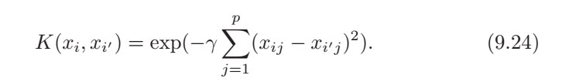
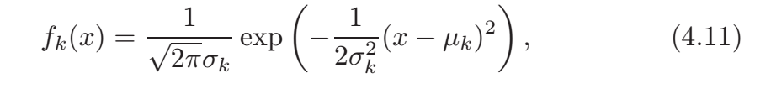
Commonly Used Support Vector Machine
Linear Kernel
Polynomial Kernel
Radial Kernel
The Gaussian Kernel is just the radial kernel with specific constants

Slide 53
Advantages of Support Vector Machines
SVM can handle complicated nonlinear decision boundaries
Only support vectors need to be considered in creating boundary which greatly reduces the required computations
Only the inner product between the basic features are required
Not full set of features (all orders, cross terms, etc)
For kernels, feature space is unlimited
Kernels can be designed to be computationally efficient

Slide 54
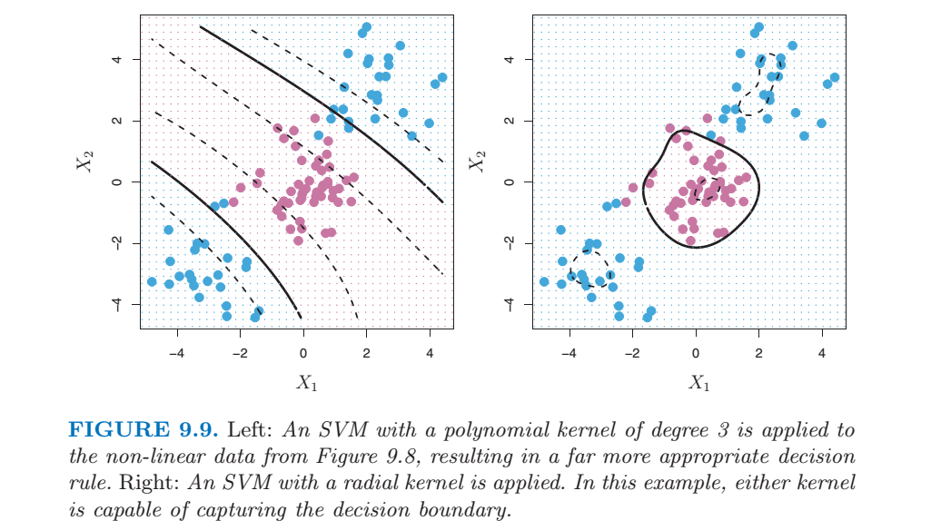
SVM Example

Slide 55
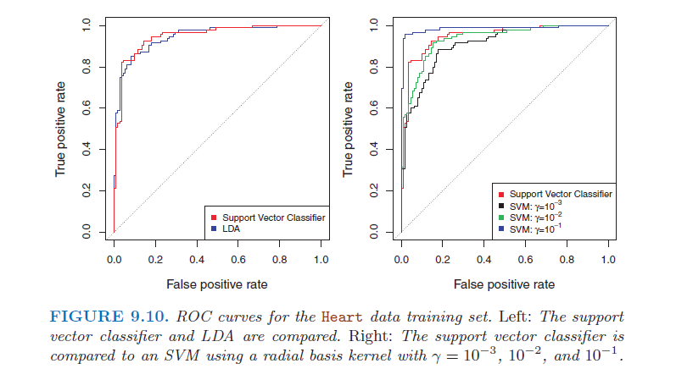
SVM Classification Performance

Slide 56
What about Multiple Classes?
Fit K SVMs to the data 2 classes at a time.
Select one class, set these values to k = 1
Code the rest of the classes to k = -1
Create this model. Repeat with a different starting class for all k classes.

Slide 57
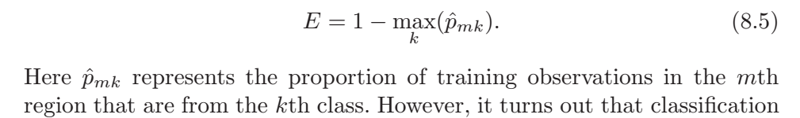
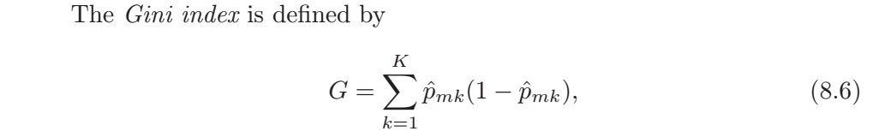
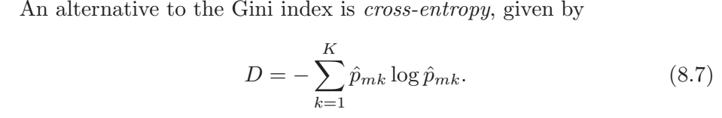
Measures of the Classification Error Rate

Slide 58
Homework #6
Read Chapter 9 of ISLR, Pages 337 – 359
Work through all of the R-labs in the text, pages 359 – 368
Do Chapter 9 Problem 3
Do Chapter 9 Problem 5
Due March 18

Slide 59
Homework #7
If the outcome for your project is a numerical estimate, create multiple classes from your outcome. For example, if you are estimating wages, break your outcome into class 1 (wage < $50k/year) and class 2 ($50k/year < wage < $100k/year) and class 3 (wage > $100k/year) .
If you are doing a classification project, use the classes you are using for your project.
Fit a logistic Regression model to your data
Fit an LDA model to your data
Fit a QDA model to your data
Fit an SVM to your data. Try a few different kernels.
For all of these models, use Cross Validation to determine the right level of flexibility
No need to hand this in now, save it for your final report

Slide 60
Midterm Exam Review

Slide 61
642 Midterm 2019
The midterm will cover the material in the text
Chapter 1 through 7 and 10
No Support Vector Machines (Chpt. 9) for this midterm
No Decision Tree Analysis (Chpt. 8) for this midterm
There will be no programming with R, but you must understand the output that we have created in the homeworks
There won’t be any questions relating to your project on the midterm
On the remote chance that my class notes disagree with the text, the text will be assumed to be correct. Depending on how bad my mistake was, I’ll probably give you credit, but it really is up to you to find any discrepancies and correct them beforehand. (That’s why you read the text after each lecture, right?)

Slide 62
Unsupervised Learning
Supervised versus unsupervised learning
Basic Familiarization using R
Plots
Pairs
Correlations
Common problems with data
Principle Components Analysis
Definition
Percent Variance Explained
K-Means Clustering
How to calculate it
Advantages/Disadvantages
Hierarchical Clustering
How to calculate it
Advantages over K-Means
When to use these techniques and how you might apply them to model building

Slide 63
Regression
Null hypothesis and rules for accepting or rejecting features
Error Function for regression and statistical measures of error
Definitions of statistical measures of errors in the text book
R printouts for regression models and what they mean
Bias and variability
Models that are too rigid or too flexible… what are the advantages and drawbacks of each type
Cross validation – how it works
Training error and test error
How to decide complexity of model
Ridge Regression and LASSO
Definitions
How parameters (such as lambda) affect results
When you would use one technique over another / strengths and weaknesses

Slide 64
Feature Selection and PCR
Best Subset, Forward, Backward
Advantages and disadvantages
When you would use one over the other
Principle Components Regression
Why use PCR for modeling
Data Preparation
Know the attributes or characteristics of the principle components (you don’t need to know how to find the linear coefficients)
What do the principle components mean
How to decide which principle components to use

Slide 65
Logistical Regression
Odds
Logit function
Bayes Classifier
LDA
QDA
KNN Classifier
Bayes Classifier
Sigmoid Function
Form
How to evaluate it
How to graph it
What it calculates
Confusion Matrix
Types of errors
ROC curve
What it means
How to construct one
How to tell a good one

