Slide 1
Math 642: Introduction to Machine Learning
Lecture 8: Decision Trees
March 18, 2020
Some of the figures in this presentation are taken from "An Introduction to Statistical Learning, with applications in R" (Springer, 2013) with permission from the authors: G. James, D. Witten, T. Hastie and R. Tibshirani

Slide 2
Class Schedule
Lec | Date | Lecture | Due
1 | Jan 15 | Intro, Linear Regression, Bias and Variability
2 | Jan 22 | Unsupervised Learning: Clustering, Principle Comp. Analysis | Hwk 1
3 | Jan 29 | KNN Regression, Cross Validation, Bootstrap | Hwk 2
4 | Feb 5 | Ridge Regression, LASSO, Principle Components Regression | Hwk 3
5 | Feb 12 | Extreme Nonlinear: Step Functions, Splines, Gradient Descent | Hwk 4, Project Plan
6 | Feb 19 | Classification, Logistic Regression, Discriminant Analysis | Hwk 5
7 | Feb 26 | Max Margin Classifiers, Support Vector Machines | Hwk 6, Plan Revision
 | Mar 4 | Mid Term Exam
 | Mar 11 | Spring Break
8 | Mar 18 | Tree-Based Methods | Hwk 7
9 | Mar 25 | Neural Networks, Deep Learning | Hwk 8
10 | Apr 1 | Convolutional Neural Networks | Hwk 9
11 | Apr 8 | Bayesian Analysis, Project Presentations | Hwk 10
12 | Apr 15 | Time Series, Project Presentations | Final Project Due
13 | Apr 22 | Ethics of Machine Learning, Project Presentations | Hwk 11
 | Apr 29 | Study Day
 | May 6 | Final Exam

Slide 3
Machine Learning Taxonomy
Statistical Learning
Outcomes
No Outcomes
Supervised
Unsupervised
Quantitative
Estimation
Outcome
is a Number
Outcome
is a Class
Classification
Clustering
Principal
Components
Logistic Regression
Parametric
Estimation
Non-Parametric
Estimation
Bayesian Belief Network
LDA/QDA
y = f(x)
non-equation
based
KNN Classification
Linear Regression
Common Elements
Cross Validation
Feature Selection
Gradient Descent
Bootstrap
Boosting
KNN Regression
SVM
Ridge Regression
Clustering
Decision Trees
LASSO
Decision Trees
Neural Nets
Splines
Time Series
Bayesian Modeling
Bayesian Modeling

Slide 4
REVIEW

Slide 5
Logistic Function
The most basic classification model is a linear one
How do you translate a continuous quantitative response into a binary qualitative response? Use the Sigmoid Function

Slide 6
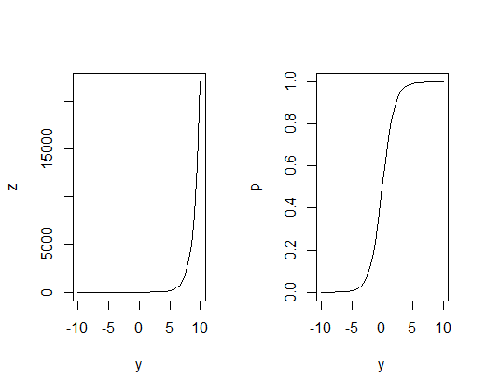
Decision Boundary
How does the Logistic function work?
Let’s say if p(x) < 0.5 we predict 0 and if p(x) ≥ 0.5 we predict 1
Thus when y < 0 we predict 0 and when y > 0 we predict 1
The Decision Boundary is at p = 0.5
^
^
^
^
p
p = 0.5
^
y
^
Predict 0
Predict 1
^

Slide 7
A Better Cost Function
Let’s “maximize the likelihood” by minimizing the cost of being wrong
J(β₀,β₁) =$\sum_{i}^{n}{ \left(−yi\right)∗\log\left(\text{p}\right)− }$ $\sum_{i}^{n}{\left(1 −yi\right)∗log(1 −{p}) }$
y_{i} = 1
y_{i} = 0
- log(p)
Cost
Cost
- log(1 - $p$)
log(p)
p
p
0 1
0 1
log(1 - $p$)

Slide 8
Assessing Classification Models
We can do Cross Validation for Classification Models
Divide our samples into training samples and test samples
Do k-fold cross validation if necessary
When we run the test samples through our models, we get the following “confusion matrix”
 |  | Actual
 |  | Default | No Default
Predicted | Default | 81 | 23
 | No Default | 252 | 9644

Slide 9
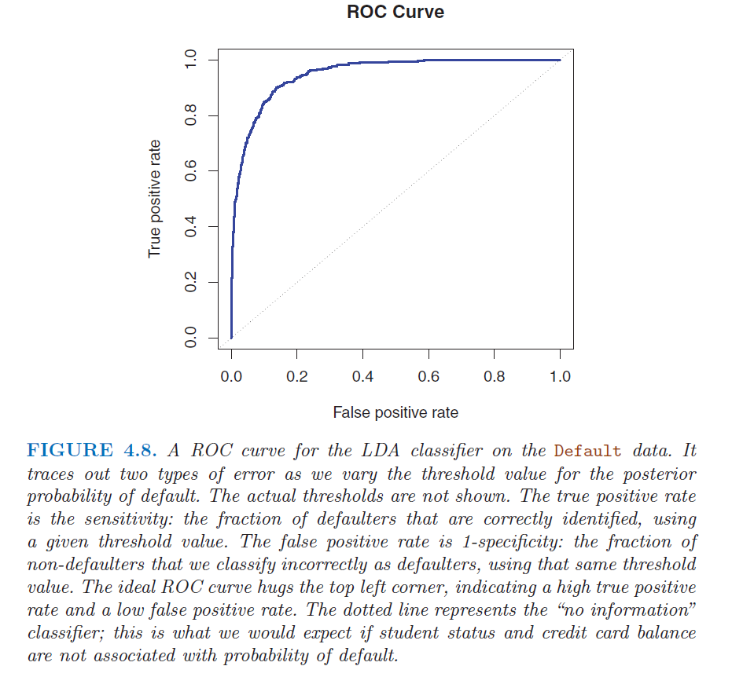
Receiving Operating Characteristic

Slide 10
Problems with Logistic Regression
When the distributions are well separated, logistic regression is not sufficiently stable
When n is small and the x’s are normally distributed, logistic regression is not sufficiently stable
Logistic regression does not handle multiple classes well
What is an alternative to Logistic Regression that is more stable and handles multiple (more than 2) classes easily?
Answer: Discrimminant Analysis

Slide 11
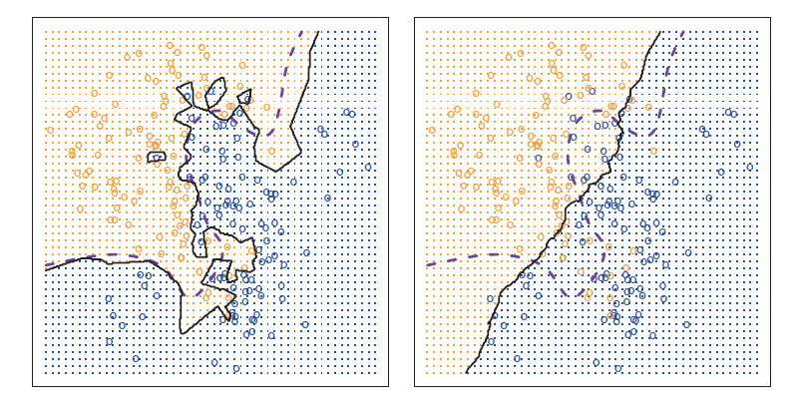
Classification with KNN
Simple method that we discussed last week when we were doing estimation works just as well for classification. Class is
Most commonly occurring class in training data in K group
K should be the number of classes + 1 to avoid ties

Slide 12


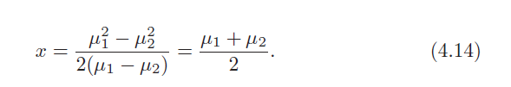
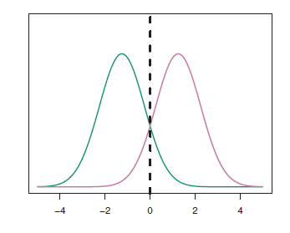
Linear Discriminant Analysis vs Bayes Classifier
With the aforementioned assumptions, the posterior is:
Bayes is the ideal classifier if the prior distribution is normal (or Gaussian) and the likelihood is normal. In this case the Decision Boundary is:

Slide 13
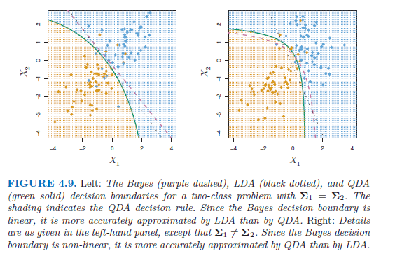
Quadratic Discriminant Analysis vs Bayes Classifier

Slide 14
Logistic Function
The most basic classification model is a linear one
With the standard representation as a Sigmoid Function
But the decision boundary may not always be linear. You can also use a more flexible model for nonlinear cases

Slide 15
Classifier Bias versus Flexibility

Slide 16
Classification Error
Classification error can be expressed as
And Cross Validation can be implemented by looking at training errors and test errors

Slide 17
Classifier Training versus Test Error

Slide 18
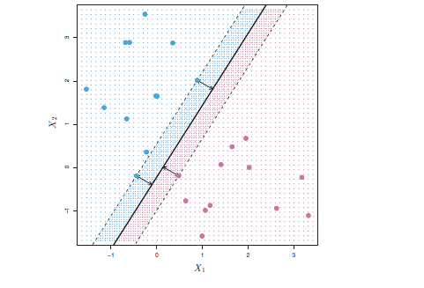
Maximum Margin Classifier
To determine the maximum margin, compute the distance of the samples from the decision boundary.
The distance must be perpendicular to the decision boundary… this is the smallest distance between the sample and the decision boundary in 360 degree directions.
90 deg

Slide 19
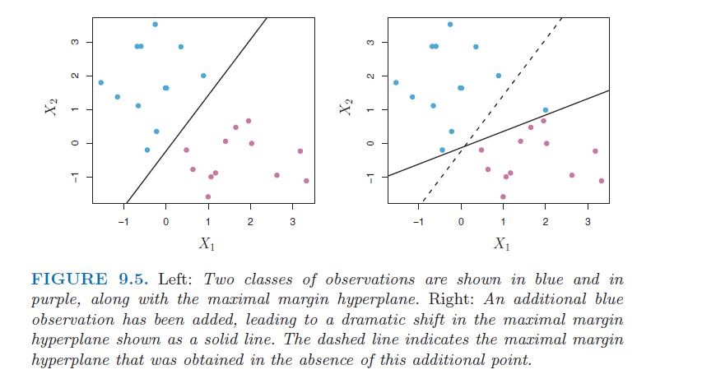
Problem with Max Margin Classifier
Problem 1: The addition of one point can cause a wild fluctuation in the Maximum Margin Decision Boundary. This is analogous to overfitting.
Also, if you think of the distance from the decision boundary as a measure of confidence, your confidence just changed radically based on one point.

Slide 20
Support Vector Classifier
Why is a Support Vector classifier better than a Maximum Margin Classifier?
More robust with respect to individual outliers
Better overall performance in classification
Allows for “tuning” to prevent overfitting
A Support Vector Classifier is also called a Soft Margin Classifier
(this terminology is confusing so remember the distinctions between Maximum Margin Classifier, Support Vector Classifier, Soft Margin Classifier, and Support Vector Machine)

Slide 21
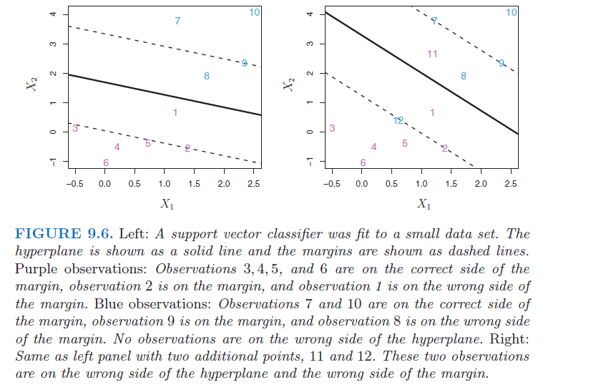
Example of a Support Vector Classifier

Slide 22
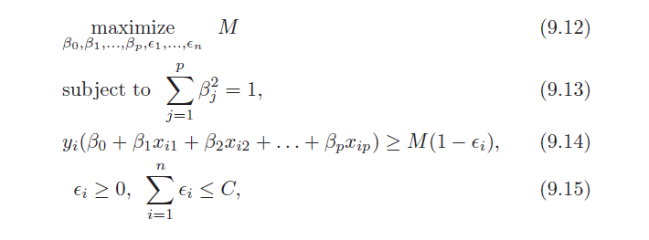
Support Vector Classifier Governing Equations
M is still the width of the margin, but it can have violations. In fact some points can be on the wrong side of the decision boundary.
ε_{i} is called the “slack” variable. If ε_{i} > 0 then that point is in the margin area; If ε_{i} > 1 then that point is on the wrong side of the decision boundary.
C is the tuning parameter. If C = 0, then the margin can have no violations; that is, all ε_{i} must be 0. Then you have a maximum margin classifier.

Slide 23
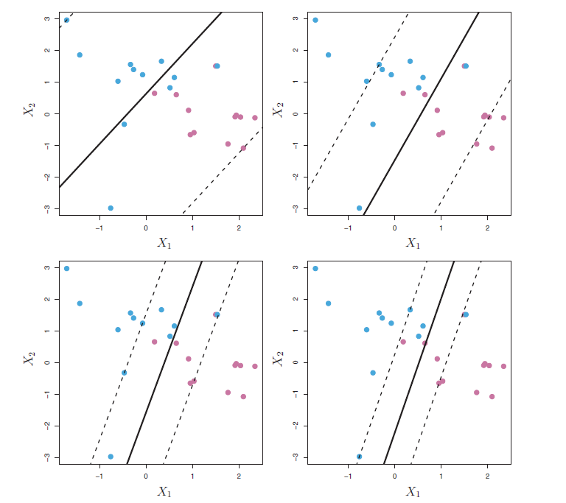
The Tuning Parameter Allocates a “Budget” for Violations
Largest C
Many Violations
Low variability
High bias
Smallest C
Few Violations
High variability
Low bias
Note: Higher C is like a larger λ for Ridge Regularization: Lower variability, lower DOF

Slide 24
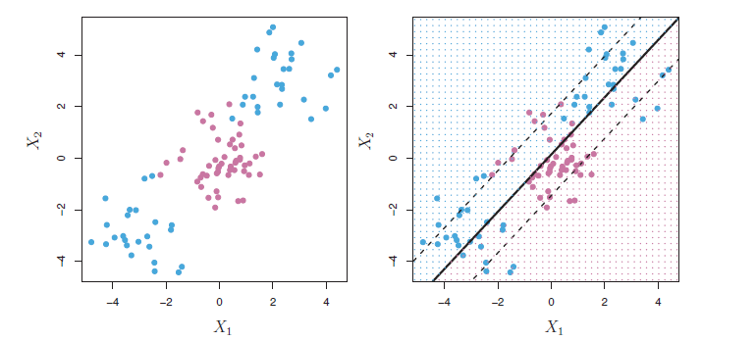
Non-Linear Decision Boundaries
The maximum margin classifier and the support vector classifier both use linear decision boundaries. How do we handle more complicated data structures?

Slide 25


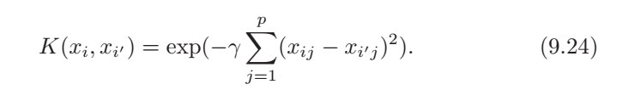
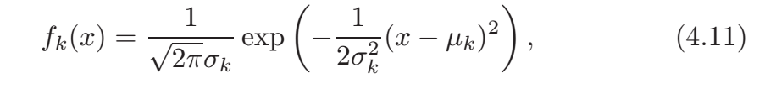
Commonly Used Support Vector Machine
Linear Kernel
Polynomial Kernel
Radial Kernel
The Gaussian Kernel is just the radial kernel with specific constants

Slide 26
Advantages of Support Vector Machines
SVM can handle complicated nonlinear decision boundaries
Only support vectors need to be considered in creating boundary which greatly reduces the required computations
Only the inner product between the basic features are required
Not full set of features (all orders, cross terms, etc)
For kernels, feature space is unlimited
Kernels can be designed to be computationally efficient

Slide 27
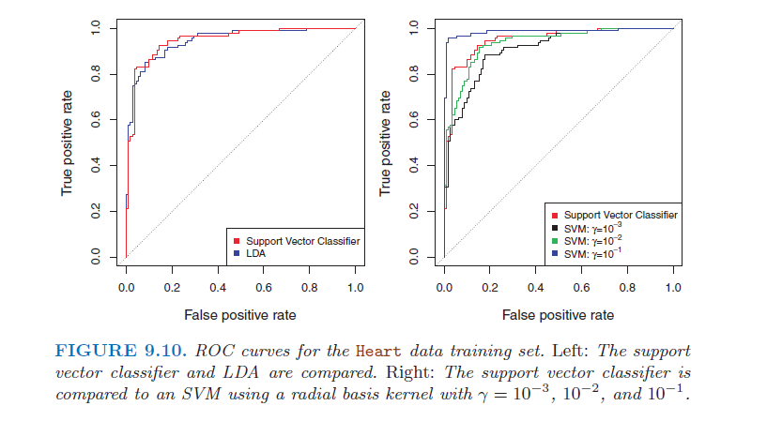
SVM Classification Performance

Slide 28
Tree-Based Analysis

Slide 29
Decision Trees
Advantages
Easy to understand
Mimics how humans think
(at least it mimics how we think we think)
Can be used for numerical estimation and classification.
Disadvantages
Typically not as accurate for numerical estimation as some prior methods like linear regression, splines
We can minimize the disadvantages using some clever techniques

Slide 30
Recursive Binary Splitting
How do we estimate things? Usually we start with the features that have the most variability first. In the case of hitters
What is the age of the player? (Salaries are usually controlled for the first few years a player is in the majors)
How many hits does the player average per year?
Then we move to less important factors
How many walks does the player average per year?
Decision tree methodology bins data in an analogous fashion

Slide 31
Recursive Binary Splitting
Assume you have multiple features.
Which feature contributes to the greatest outcome variability (i.e., which feature split results in the greatest reduction in RSS)?
Start your binning with this feature and work your way down to less impactful factors.
This is a top-down approach. (Note Hierarchical Clustering was a bottom-up approach.)

Slide 32
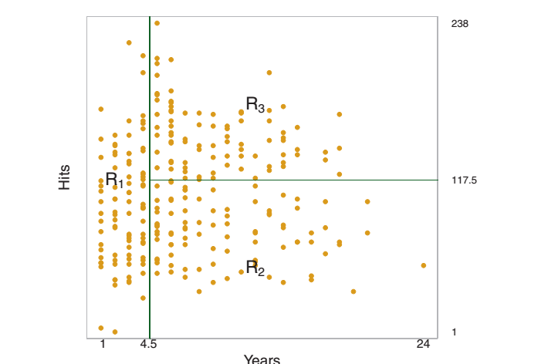
Recursive Binary Splitting
Let’s look at baseball salaries

Slide 33
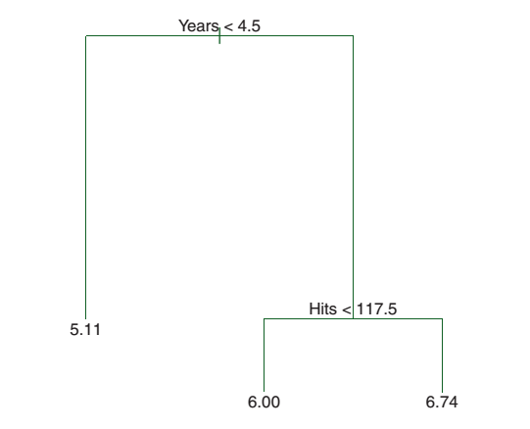
Recursive Binary Splitting
Another representation is shown below
The bottom number is your estimate for that Region. It is the mean of the outcomes in that region.
In this case, it is the average salaries for the 3 different groups of players.

Slide 34
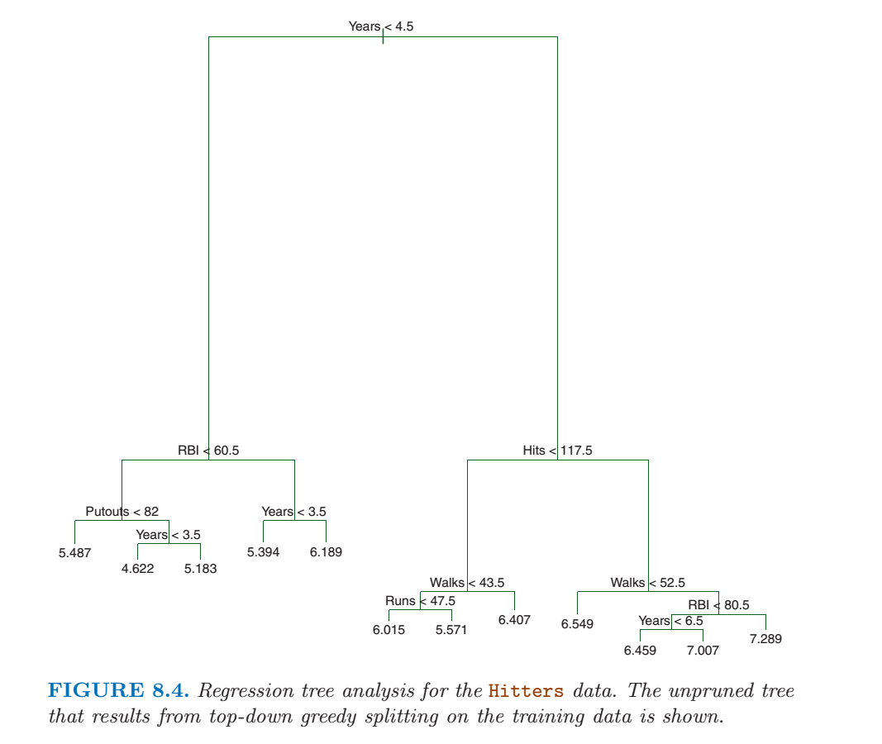
Multiple Features
The previous example used 2 features, but Decision Trees can handle many features at once. Its just harder to draw in the rectangular format.

Slide 35
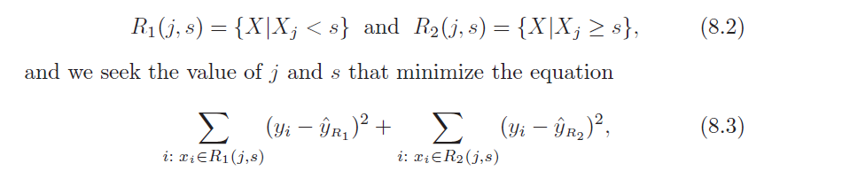
Recursive Binary Splitting
Here is the recursive method you apply to “grow your tree”:
Where
s_{j} is the cut point between regions
j is the particular feature used for designating the Region
X|X_{j} < s is the region where all the X_{j}’s are less than s
X|X_{j} >= s is the region where all the X_{j}’s are greater than or equal to s

Slide 36
Recursive Binary Splitting
Once you pick a feature, split it in 2 so the data separates evenly.
Pick the feature that contributes the most to RSS in each subgroup and repeat the splitting process
This is called top down because you start with all the data and subdivide
This is called greedy because you only consider what is best for that step, and you don’t look forward to find the best overall solution
What is the problem with greedy algorithms?

Slide 37
Recursive Binary Splitting
Once we have subdivisions, where do we stop?
Usually we stop at some pre-determined level of variability
Or when there is some minimum number of samples in a region
Once we stop, what do we use as an numerical estimate?
Usually we use the average, but you have an infinite amount of flexibility in choosing your estimate, starting with weighted averages

Slide 38
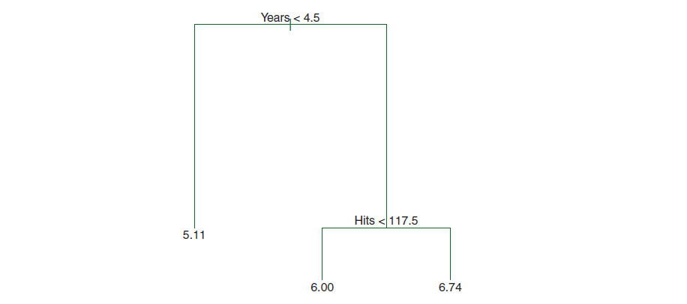
Terminology
Each division is called a Branch
Each branch point is a Node
Each branch end is called a Terminal Node or a Leaf
T is the Number of Terminal Nodes

Slide 39
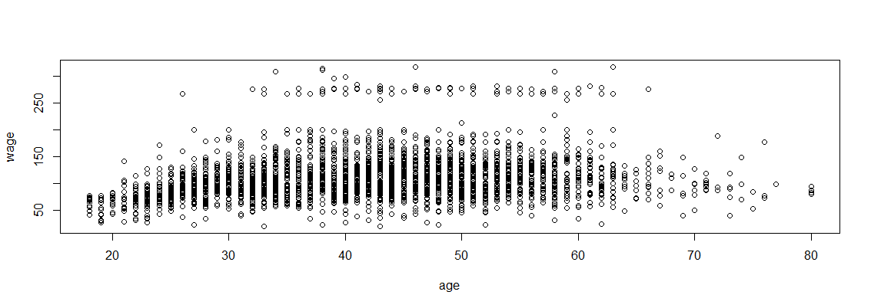
The Problem with Greedy Algorithms
Consider the Wage vs Age plot. A greedy algorithm would cut the age data at 45 to minimize the RSS. However, a smarter way to proceed would be to cut the data at 33, then cut the second region at 65.
Greedy algorithms sometimes miss better models that a more intelligent approach might find.

Slide 40
Non-Linear Decision Boundaries
There is no reason you can’t use functions instead of constants. It just complicates the results. But we’ll only consider linear boundaries for Decision Trees.

Slide 41
Bias versus Variability
Decision Trees are subject to the same trades as our regression models.
Simple models (not enough branches) have a large bias (they are inaccurate, the predictions do not match the test data)
Complex models (too many branches) have a large variance (they fit the noise, in other words overfit the data, and predictions do not match the test data)
Look at the extremes, for T = terminal nodes (Leaves):
If T = 0, your estimate is the sample average – not very accurate so the bias is typically too high
If T = n-1, you model the noise and you equal a KNN model with N = 1 so your variability is typically too high

Slide 42
Optimizing Bias versus Variability
Multivariate Regression
Too many features or an overly flexible model can lead to overfitting (fitting the noise in a sample)
Control overfitting by
Creating a model using many features
Using Ridge Regression (regularization) or LASSO
Trees
Too many branches can lead to overfitting
Control overfitting by
Creating a large tree
Cutting it back in a systematic fashion (Pruning)
Bagging

Slide 43
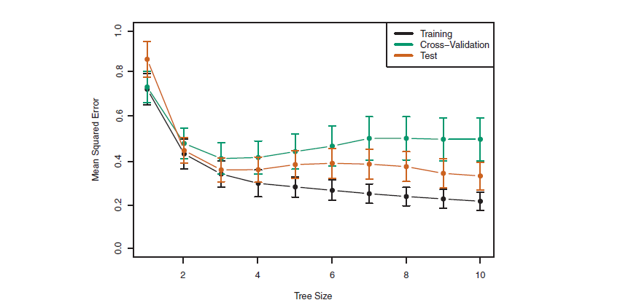
Cross Validation for Decision Trees
You can do Cross Validation with Decision Trees, just like you can for regression models. Notice
Training Error (black) continually goes down as you add leaves
Test error (orange) has a U-shape.
Cross validation error (black) overestimates the test error

Slide 44
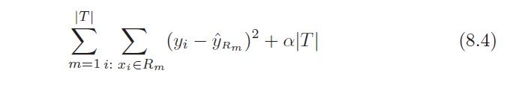
Cost Complexity Pruning
So how do you strike a balance between bias and variability with Decision Trees?
Starting from a large tree, eliminate branches using a penalty term in the Error Function proportional to the number of branches, T.
m is the region (or class)
R_{m} is the rectangle bounding that region
T is the number of terminal nodes in the Tree
α is the penalty weight parameter
As T increases, the training error will go down but the second term will increase. Note the penalty term looks like LASSO, so it will cut branches.

Slide 45
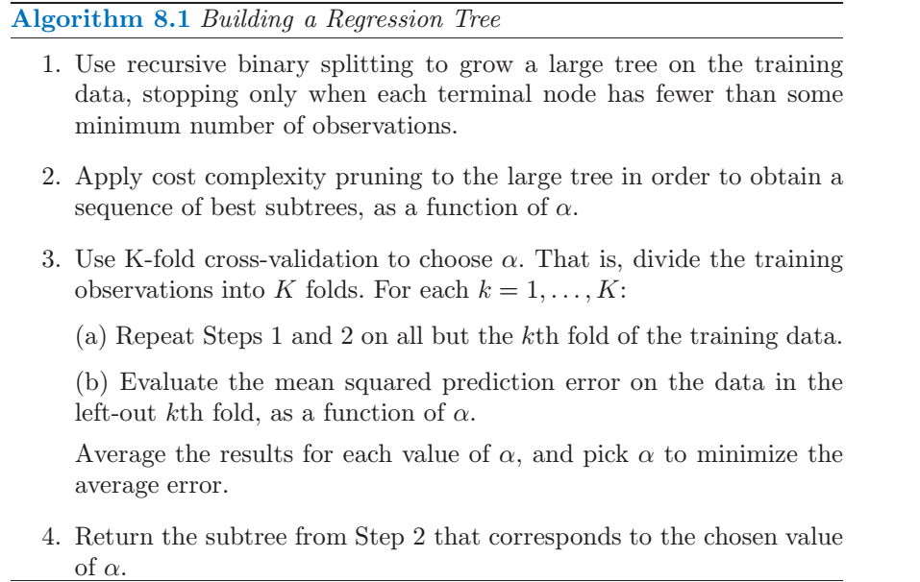
Cost Complexity Pruning

Slide 46
Pruning Example
Here are the training, cross validation, and test mean squared errors compared.
Using 6-fold Cross Validation, we held out 1 fold each time and used it for testing. At the end we went back and grew 1 tree with all the samples and calculated the test error between predictions and actuals.

Slide 47
Advantages and Disadvantages
Advantages
Trees are very intuitive. They mimic how the human mind works
Trees models can handle numerical data and class data (to be discussed)
Trees may be graphed and thus can be easily be visualized
Disadvantages
Tree models are highly variable if they are big (change a lot based on training data)
Tree models are not very accurate if they are kept small (compared to regression and other techniques)

Slide 48
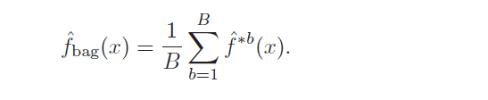
Bagging
Bagging addresses the variability between the tree models we referred to earlier. It is based on the general statistical property that each time you make an independent observation of a parameter you reduce the variability of the estimate.
You generate multiple training sets using bootstrapping (Chapter 4)
Create B training sets by bootstrapping
Create a large tree from each separate training set
No pruning – averaging will take care of any overfitting problem
Average the resulting f s
^

Slide 49
Notes of Interest
Cross Validation for Bagging:
Due to bootstrapping, you don’t use up to 1/3 of the samples when making a tree. Thus you can get a good estimate of test error by predicting samples that have been “thrown away”
Visualization of the final model:
One of the advantages of trees is their intuitive quality. You lose some of this with bagging, as now the model is a collection of different trees, with different cutoff points and in some cases different features in different combinations

Slide 50
Bagging
Primary Drawback – Because you start with the same features each time, the best choice for the first cutoff is probably the same, and so the resulting trees are probably similar, except for some later branches.
That is, the trees are highly correlated.
Q: Can you think of a means of decorrelating models?

Slide 51
Random Forest
To decorrelate bagging models: Rather than use all the features, randomly select
m = $\sqrt{p}$
features before creating tree. Then the B models will not be overly correlated.
This creates a more diverse result. The distributions for each average are more “spread out” but the resulting average considers more possibilities and thus reduces variability better.

Slide 52
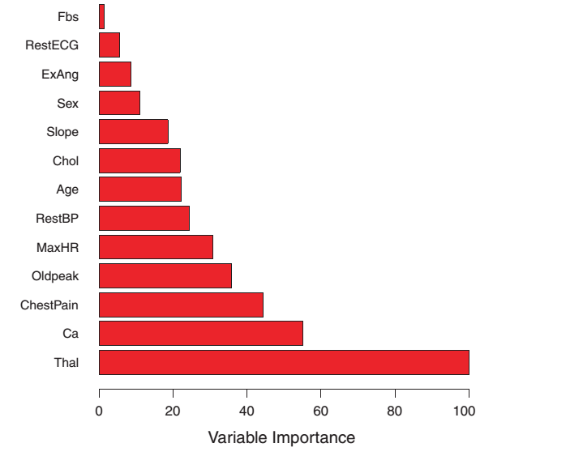
Ranking Your Features
When you average your results over a large number of different training sets, how can you represent and interpret your results?
For numerical estimation, keep track of the reduction in RSS at each step for each feature, and average the total change in RSS to judge impact.

Slide 53
Boosting
This method of growing a tree is very different from the previous “averaging” approaches. In boosting, we don’t fit the outcomes, but rather fit the residuals.
Instead of growing several large trees and averaging, we grow a tree, measure the errors, and then adjust the tree to reduce the errors.
Initialize your loop parameters
Start with a bagged tree using d splits (keep d small)
Keep track of errors (residuals) and adjust your model until residuals are small.
Similar to neural network weight calculations that we will see later.

Slide 54
Boosting Methodology

Slide 55
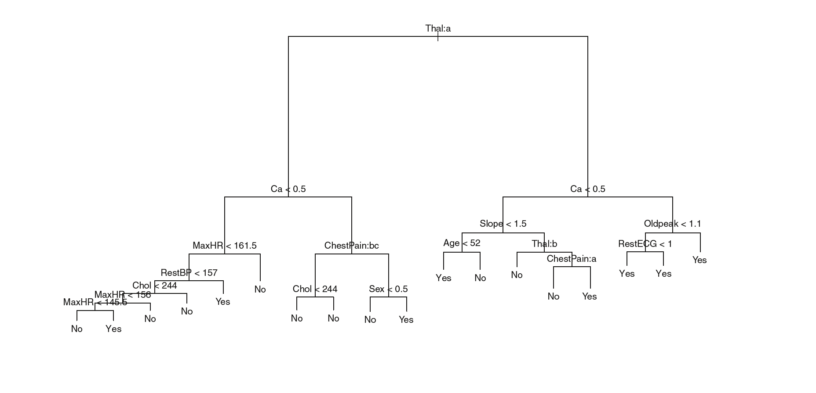
Classification Trees
You can make a Decision Tree classifier. Take the following heart attack data example:
What do you use for making cuts? You can’t compute RSS.

Slide 56

Classification Error
Which feature contributes to the greatest outcome variability (i.e., which feature split results in the smallest classification errors)?
Where p_{mk} is the proportion of training errors from the m^{th} region that are in the k^{th} class.
Classification error is best used to assess the model after it is made, but is not good for creating the model.
^

Slide 57
Better Measures of Classification Error
But the classification error given in 8.5 is not useful for growing Classification Trees. Two better measures are the Gini Index
or the entropy
These will be near zero if all the classes in the regions are the same. Both are measures of region purity.

Slide 58
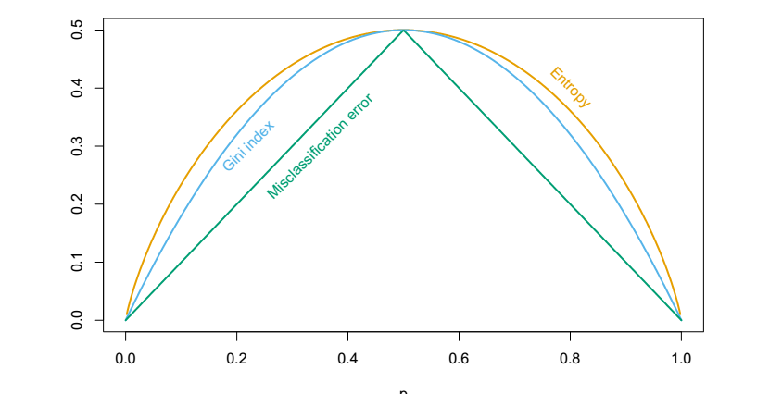
Misclassification Measures
Gini and Entropy are differentiable and thus more easily optimized computationally

Slide 59
Classifier Pruning
Prune a classifier tree according to the misclassification rate
Create the entire tree
Remove the terminal that results in the lowest misclassified outcome increase

Slide 60
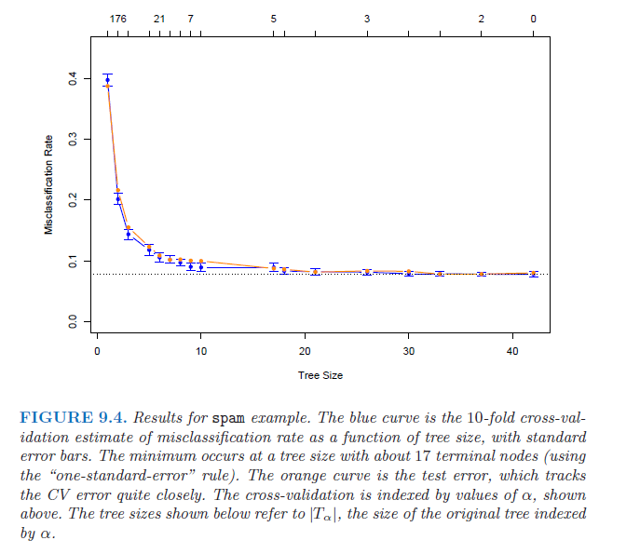
Classifier Pruning

Slide 61
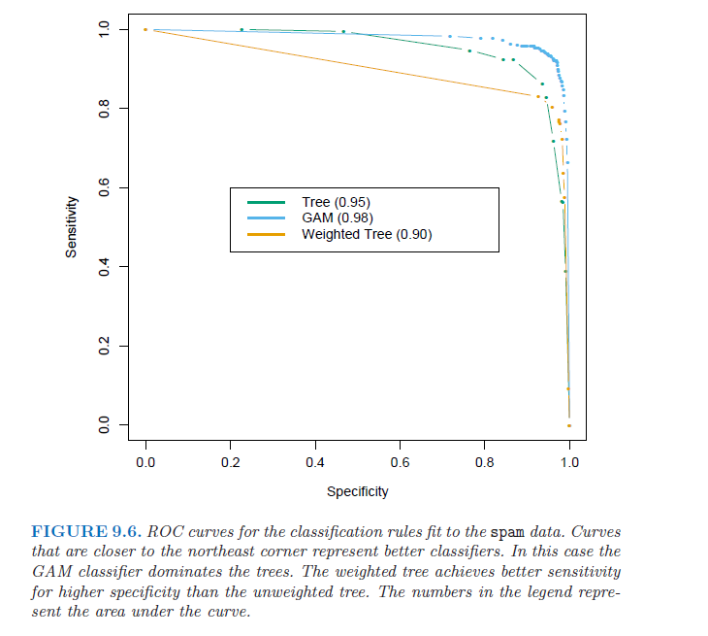
Receiver Operating Curve

Slide 62
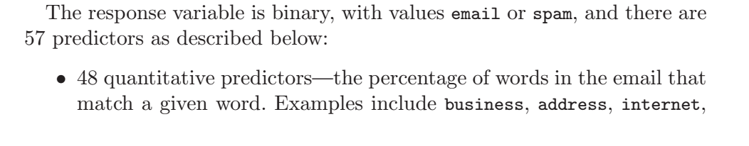
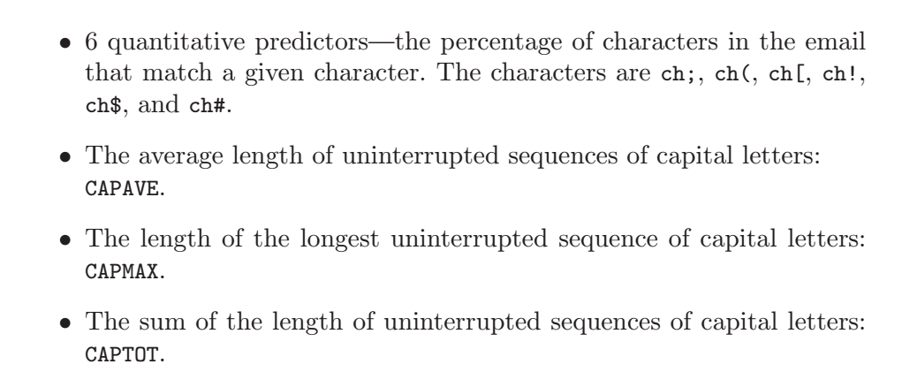
SPAM Classifier from ESL

Slide 63
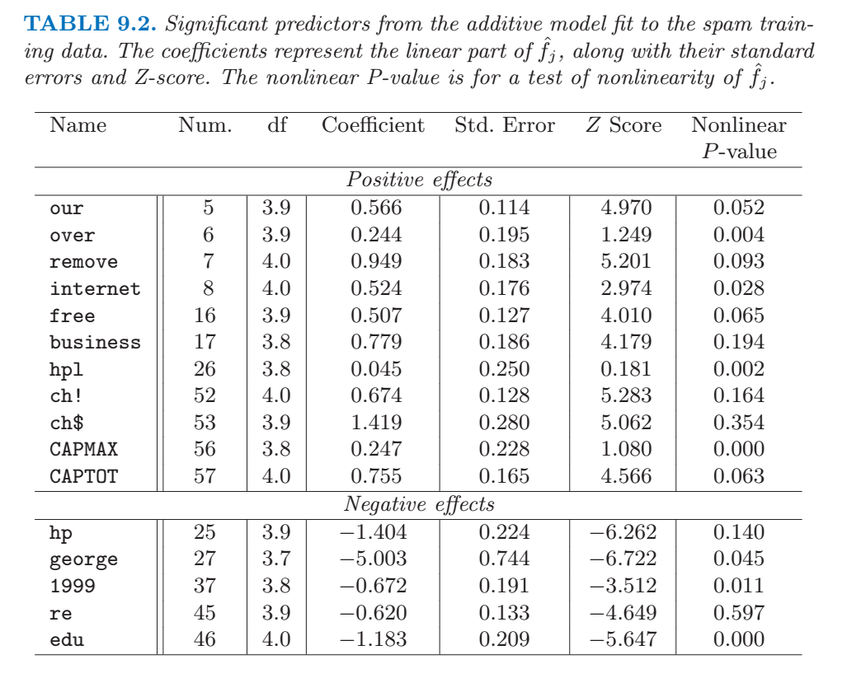
SPAM Classifier from ESL

Slide 64
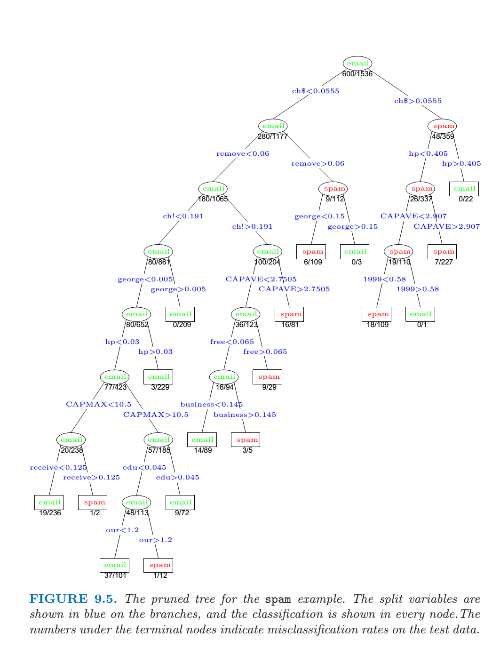
SPAM Classifier from ESL

Slide 65
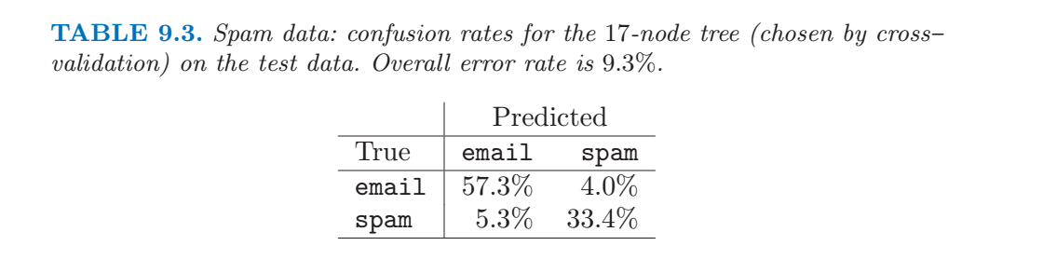
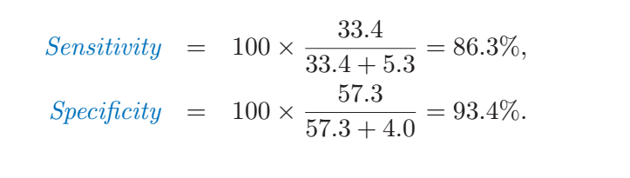
SPAM Classifier

Slide 66
Bagging for Classification Trees
You can implement bagging just like for numerical estimation. For classification, use a voting procedure to come up with the final estimate for the test sample.

Slide 67
Homework #7 (1 of 2)
Read Chapter 8 of ISLR, Pages 303 – 324
Work through all of the R-labs in the text, pages 324 – 331
Do Chapter 8 Problem 1
Do Chapter 8 Problem 4
Do Chapter 8 Problem 9
Do Chapter 8 Problem 10
Due March 25

Slide 68
Homework #7 (1 of 2)
Apply Trees to your project data. Include pruning, Random Forest, and Boosting. Compare the accuracy of the Tree Analysis to other methods you have tried on your data.
No need to hand this in now, but include it in the Appendices for your Project

