Slide 1
Math 642 Introduction to Machine Learning Spring 2020 Lecture 9: Neural Networks (part 1 of 2)
Some of the figures in this presentation are taken from "An Introduction to Statistical Learning, with applications in R" (Springer, 2013) with permission from the authors: G. James, D. Witten, T. Hastie and R. Tibshirani

Slide 2
Class Schedule
Lec | Date | Lecture | Due
1 | Jan 15 | Intro, Linear Regression, Bias and Variability
2 | Jan 22 | Unsupervised Learning: Clustering, Principle Comp. Analysis | Hwk 1
3 | Jan 29 | KNN Regression, Cross Validation, Bootstrap | Hwk 2
4 | Feb 5 | Ridge Regression, LASSO, Principle Components Regression | Hwk 3
5 | Feb 12 | Extreme Nonlinear: Step Functions, Splines, Gradient Descent | Hwk 4, Project Plan
6 | Feb 19 | Classification, Logistic Regression, Discriminant Analysis | Hwk 5
7 | Feb 26 | Max Margin Classifiers, Support Vector Machines | Hwk 6, Plan Revision
 | Mar 4 | Mid Term Exam
 | Mar 11 | Spring Break
8 | Mar 18 | Tree-Based Methods | Hwk 7
9 | Mar 25 | Neural Networks, Deep Learning | Hwk 8
10 | Apr 1 | Convolutional Neural Networks | Hwk 9
11 | Apr 8 | Bayesian Analysis, Project Presentations | Hwk 10
12 | Apr 15 | Time Series, Project Presentations | Final Project Due
13 | Apr 22 | Ethics of Machine Learning, Project Presentations | Hwk 11
 | Apr 29 | Study Day
 | May 6 | Final Exam

Slide 3
Machine Learning Taxonomy
Statistical Learning
Outcomes
No Outcomes
Supervised
Unsupervised
Quantitative
Estimation
Outcome
is a Number
Outcome
is a Class
Classification
Clustering
Principal
Components
Logistic Regression
Parametric
Estimation
Non-Parametric
Estimation
Bayesian Belief Network
LDA/QDA
y = f(x)
non-equation
based
KNN Classification
Linear Regression
Common Elements
Cross Validation
Feature Selection
Gradient Descent
Bootstrap
Boosting
KNN Regression
SVM
Ridge Regression
Clustering
Decision Trees
LASSO
Decision Trees
Neural Nets
Splines
Time Series
Bayesian Modeling
Bayesian Modeling

Slide 4
REVIEW Decision Trees

Slide 5
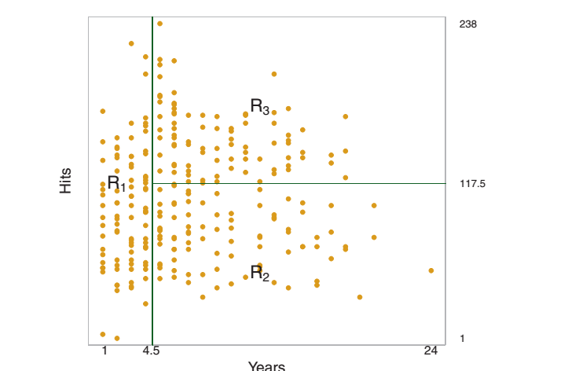
Recursive Binary Splitting
Let’s look at baseball salaries

Slide 6
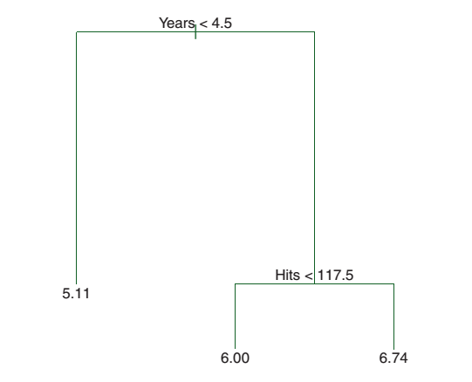
Recursive Binary Splitting
Another representation is shown below
The bottom number is your estimate for that Region. It is the mean of the outcomes in that region.
In this case, it is the average salaries for the 3 different groups of players.

Slide 7
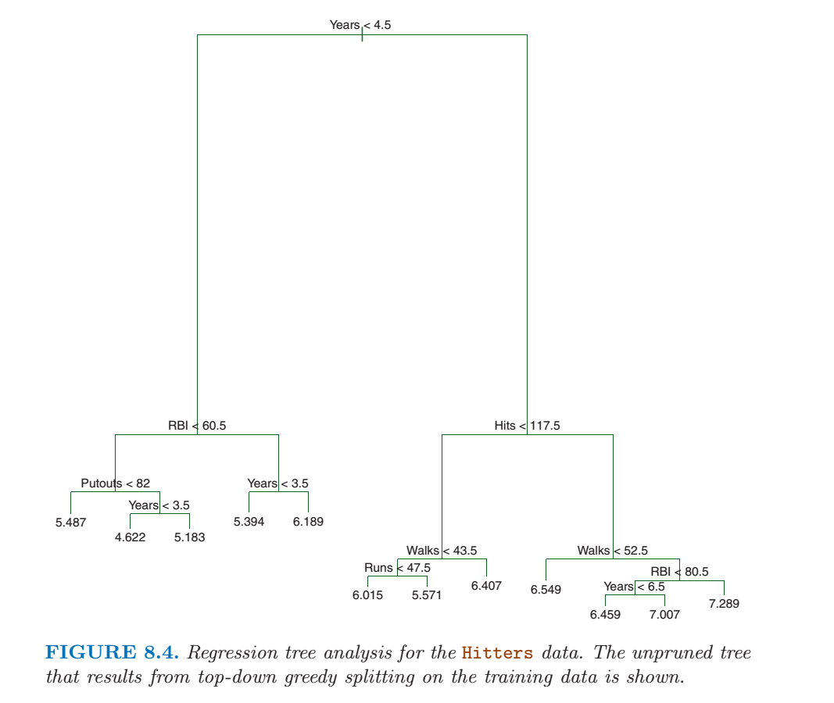
Multiple Features
The previous example used 2 features, but Decision Trees can handle many features at once. Its just harder to draw in the rectangular format.

Slide 8
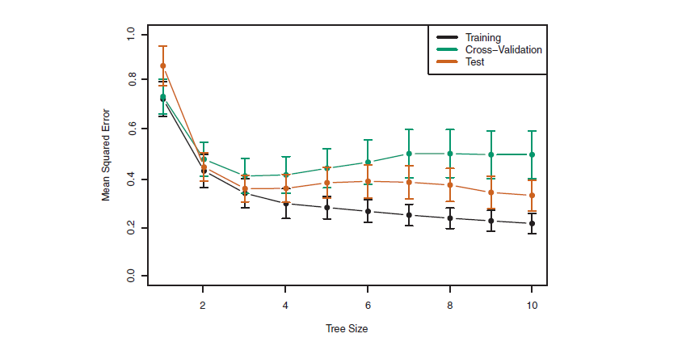
Cross Validation for Decision Trees
You can do Cross Validation with Decision Trees, just like you can for regression models. Notice
Training Error (black) continually goes down as you add leaves
Test error (orange) has a U-shape.
Cross validation error (black) overestimates the test error

Slide 9
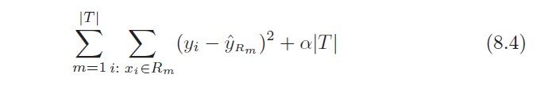
Cost Complexity Pruning
So how do you strike a balance between bias and variability with Decision Trees?
Starting from a large tree, eliminate branches using a penalty term in the Error Function proportional to the number of branches, T.
m is the region (or class)
R_{m} is the rectangle bounding that region
T is the number of terminal nodes in the Tree
α is the penalty weight parameter
As T increases, the training error will go down but the second term will increase. Note the penalty term looks like LASSO, so it will cut branches.

Slide 10
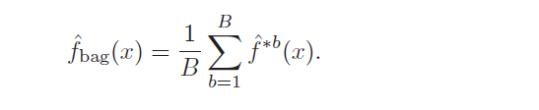
Bagging
Bagging addresses the variability between the tree models we referred to earlier. It is based on the general statistical property that each time you make an independent observation of a parameter you reduce the variability of the estimate.
You generate multiple training sets using bootstrapping (Chapter 4)
Create B training sets by bootstrapping
Create a large tree from each separate training set
No pruning – averaging will take care of any overfitting problem
Average the resulting f s
^

Slide 11
Random Forest
To decorrelate bagging models: Rather than use all the features, randomly select
m = $\sqrt{p}$
features before creating tree. Then the B models will not be overly correlated.
This creates a more diverse result. The distributions for each average are more “spread out” but the resulting average considers more possibilities and thus reduces variability better.

Slide 12
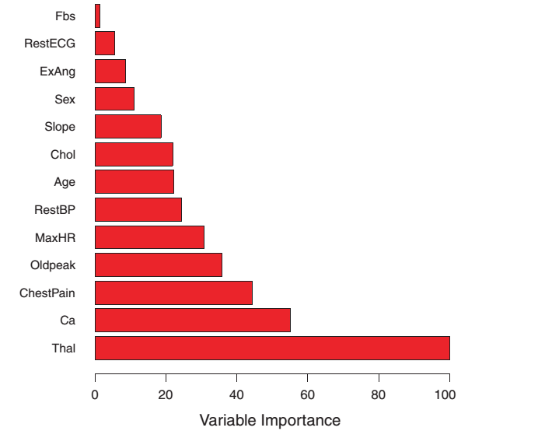
Ranking Your Features
When you average your results over a large number of different training sets, how can you represent and interpret your results?
For numerical estimation, keep track of the reduction in RSS at each step for each feature, and average the total change in RSS to judge impact.

Slide 13
Boosting
This method of growing a tree is very different from the previous “averaging” approaches. In boosting, we don’t fit the outcomes, but rather fit the residuals.
Instead of growing several large trees and averaging, we grow a tree, measure the errors, and then adjust the tree to reduce the errors.
Initialize your loop parameters
Start with a bagged tree using d splits (keep d small)
Keep track of errors (residuals) and adjust your model until residuals are small.
Similar to neural network weight calculations that we will see later.

Slide 14

Classification Error
Which feature contributes to the greatest outcome variability (i.e., which feature split results in the smallest classification errors)?
Where p_{mk} is the proportion of training errors from the m^{th} region that are in the k^{th} class.
Classification error is best used to assess the model after it is made, but is not good for creating the model.
^

Slide 15
Better Measures of Classification Error
But the classification error given in 8.5 is not useful for growing Classification Trees. Two better measures are the Gini Index
or the entropy
These will be near zero if all the classes in the regions are the same. Both are measures of region purity.

Slide 16
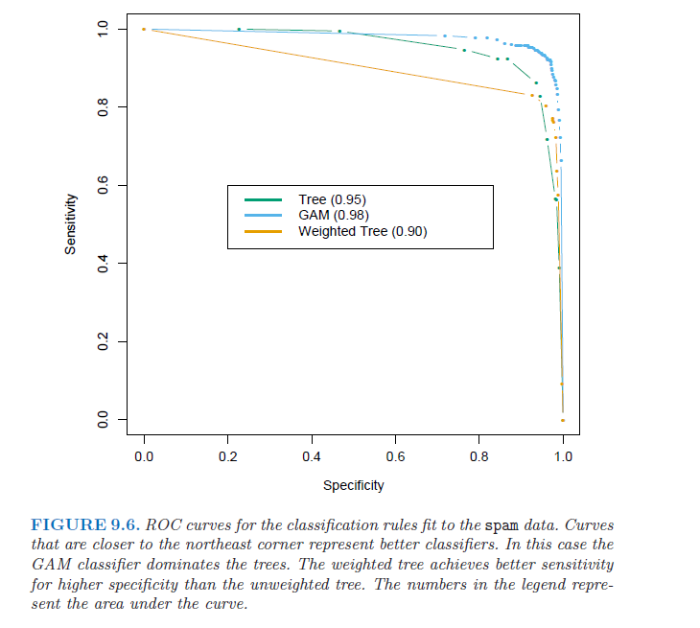
Receiver Operating Curve

Slide 17
Neural Network Resources
The Neural Network material that you need to know will be in the lecture notes.
You can read about neural networks in Elements Of Statistical Learning / Chapter 11
But you will not be responsible for any material in the ESL text.

Slide 18

The Neural Network of the Brain
Why is the brain the best learning engine?
It can survive
Ice ages / desert heat /drought
Predation from physically superior species
Attack by other humans
Under the ocean and in outer space
No species can be pre-programmed to thrive in all these environments. Learning about and adapting to conditions is the key.

Slide 19
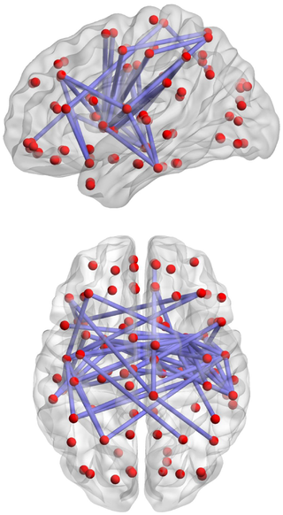
Biological Neural Network
.. a series of interconnected neurons whose activation defines a recognizable linear pathway
… potentials at the post synaptic membrane will sum up in the cell body. If the depolarization of the neuron at the axon goes above threshold an action potential will occur that travels down the axon to the terminal endings to transmit a signal to other neurons.
… On the electrophysiological level, there are various phenomena which alter the response characteristics of individual synapses … Usually the term neuroplasticity refers to changes in the brain that are caused by activity or experience.

Slide 20
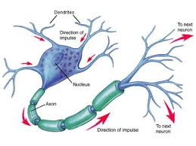
The Neuron: The Best Learning Machine
Components of the Neuron
Dendrites
Receive signals from one or more neurons
Body
Integrates inputs
Determine output (1 or 0) based on activation
Axons
Send signals to one or more neurons if activated
Synapses
Determines how much of the signal gets to the other dendrites

Slide 21
Biological versus Artificial NN
Biological
Basic unit: neuron
External Input: light, sound, heat
Within network: neurons sum signals from multiple inputs to respond 1 or 0
Synapses between neurons can be permissive or inhibitory
Network is neutral at birth and learns from experience
Positive and negative feedback reinforces or inhibits synapses
Artificial
Basic unit: node
External Input: features, images
Within network: nodes sum signals from multiple inputs to respond 1 or 0
Weights between nodes can be large or small
Network is neutral at start (weights = random) and learns from prediction errors
Back propagation
* Neural Net Computing Proposed by Turing 1948

Slide 22
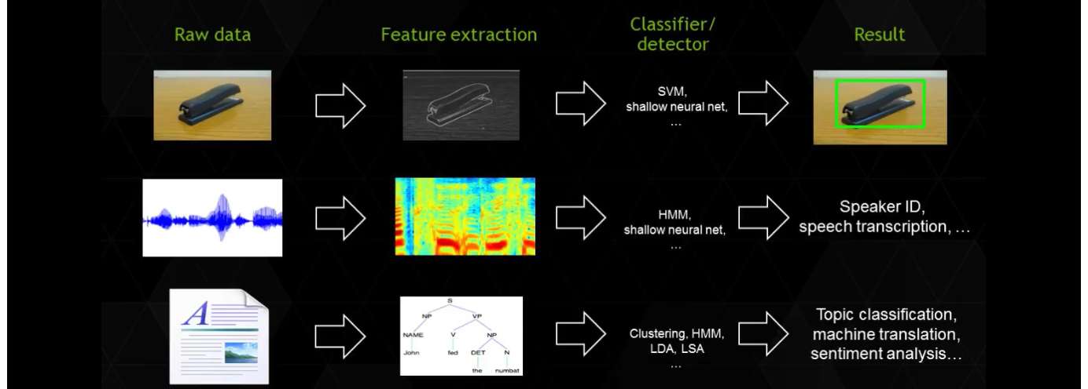
ANN Applications
ANN are good for complex classification models with lots of features and lots of outcomes for training the Neural Network.
Reference NVIDIA GPU Webinar

Slide 23
Neural Network Classifier
The next 2 lectures will develop the theory behind the neural network classifier.
A neural network is a series of interconnected logistic regression classifiers with different weights.
You randomly initialize the weights and use forward propagation to make an estimate
You compare the estimate to the actual answer
Then you use back propagation to adjust the weights to correct for any errors
Iterate many times and you have a neural network model

Slide 24
Artificial Neural Network
1
x₁
Features
x₂
⁞
x_{p}

Slide 25
Artificial Neural Network
1
y₁
Outcomes
(k classes)
x₁
Features
x₂
y₂
⁞
⁞
x_{p}
y_{k}

Slide 26
Artificial Neural Network
“a” means activation
(1 or 0) for that node
1
1
Outcomes
(k Classes)
x₁⁽¹⁾
a₁⁽²⁾
y₁⁽³⁾
Features
x₂⁽¹⁾
a₂⁽²⁾
y₂⁽³⁾
⁞
⁞
⁞
“(1)” is
the layer
x_{p}⁽¹⁾
a_{q}⁽²⁾
y₃⁽³⁾
Layer 1
Layer 2 (Hidden Layer)
Layer 3

Slide 27
Artificial Neural Network
weights
1
1
weights
Outcomes
(estimates or
Classes)
x₁⁽¹⁾
a₁⁽²⁾
y₁⁽³⁾
Features
x₂⁽¹⁾
a₂⁽²⁾
y₂⁽³⁾
⁞
⁞
⁞
x_{p}⁽¹⁾
a_{q}⁽²⁾
y_{k}⁽³⁾
Layer 1
Layer 2 (Hidden Layer)
Layer 1

Slide 28
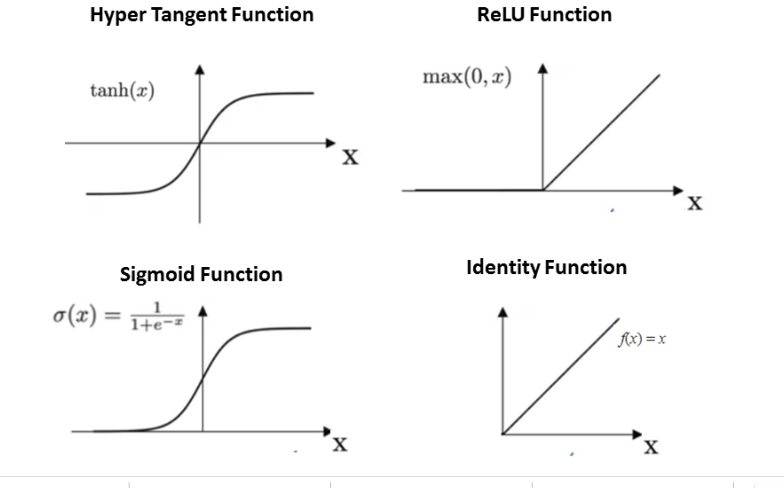
Estimation or Classification
A Neural Net can perform classification or numerical estimation. Typically the output layer is a class probability, but can also be a numerical value. We’ll look at examples of both.
Either way, the nodes in the hidden layers are activation nodes. They are either on or off. Examples of some activation functions are

Slide 29
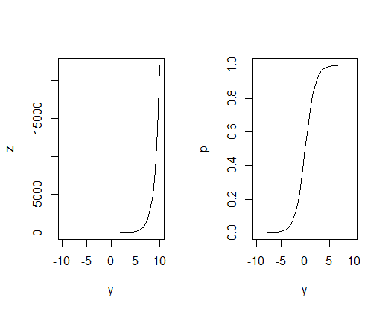
Activation
In general, there are only 2 outputs for a neuron
The output is either a “1” (electric pulse) or a “0” (no electric pulse)
The response is a sigmoid function
Sigmoid Function
a = e^{z}
1 + e^{z}
Where z = β₀ + β₁x₁ + …
ŷ=1
a
ŷ=0
^
Predict 0
Predict 1

Slide 30
Sigmoid (Logistic) Function
Use the sigmoid function to predict activation. For this section we’ll call the output of the Sigmoid Function the activation, “a”
So… our logistic model becomes
a = e^{z}
1 + e^{z}
= e^{(β}0 ^{+ β}1^{x}₁ ^{+ β}2^{x}2 ⁾
1 + e^{(β}0 ^{+ β}1^{x}₁ ^{+ β}2^{x}2 ⁾
And the activation “a” is our prediction of 1 or 0 for that node

Slide 31
Weights
The magic for neural networks is in the weights. The weights in an ANN are analogous to the resistance in the connections between neurons.
When you are born, you have billions of brain cells but few connections between them. By the time you are an adult you have countless paths burned into your brain that are repeated ever and over.
These paths are “paths of least resistance” in synapses (the space between the axon and dendrite) where chemicals are exchanged.
The lack of resistance is learned from repeated use of a particular pathway that is successful.

Slide 32
AND Gate
_{Bias}
₌ ₊₁
Q: What are the coefficients for the AND gate?
A: How about β₀ = -15, β₁ = +10, β₀ = +10.
β₀ =
x₁
_{Ŷ}
β₁ =
Ŷ = g(β₀ + β₁ * X₁+ β₂ * X₂)
x₂
β₂ =
X₁ | X₂ | Ŷ
1 | 1 | 1
1 | 0 | 0
0 | 1 | 0
0 | 0 | 0
ŷ=1
a
ŷ=0
^
Predict 0
Predict 1

Slide 33
OR Gate
₊₁
β₀ = - 20
x₁
_{Ŷ}
β₁ = 25
Ŷ = g(β₀ + β₁ * X₁+ β₂ * X₂)
x₂
β₂ = 25
X₁ | X₂ | Ŷ
1 | 1 | 1
1 | 0 | 1
0 | 1 | 1
0 | 0 | 0
ŷ=1
a
ŷ=0
^
Predict 0
Predict 1

Slide 34
NOR Gate
₊₁
β₀ = 20
x₁
_{Ŷ}
β₁ = -25
Ŷ = g(β₀ + β₁ * X₁+ β₂ * X₂)
x₂
β₂ = -25
X₁ | X₂ | Ŷ
1 | 1 | 0
1 | 0 | 0
0 | 1 | 0
0 | 0 | 1
ŷ=1
a
ŷ=0
^
Predict 0
Predict 1

Slide 35
Weights
The hidden layers no longer use the features themselves (the x’s). They use linear combinations of the node outputs from the previous layer. So we call these linear combinations of outputs to be z’s.
a₁⁽²⁾ = g( β₁₀⁽¹⁾ + β₁₁⁽¹⁾ * x₁⁽¹⁾ + β₁₂⁽¹⁾ * x₂⁽¹⁾ + β₁₃⁽¹⁾ * x₃⁽¹⁾ + … + β_{1p}⁽¹⁾ * x_{p}⁽¹⁾)
“the activation of node 1 in layer 2 is a function of the linear combination of the outputs from the previous layer”
a₁⁽³⁾ = g(Z₁ ⁽¹⁾ ) = g( β₁₀⁽²⁾ + β₁₁⁽²⁾ * a₁⁽²⁾ + β₁₂⁽²⁾ * a₂⁽²⁾ + β₁₃⁽²⁾ * a₃⁽²⁾ + … + β_{1q}⁽²⁾ * a_{q}⁽²⁾)
a₁⁽⁴⁾ = g(Z₁ ⁽³⁾ ) = g( β₁₀⁽³⁾ + β₁₁⁽³⁾ * a₁⁽³⁾ + β₁₂⁽³⁾ * a₂⁽³⁾ + β₁₃⁽³⁾ * a₃⁽³⁾ + … + β_{1p}⁽³⁾ * a_{p}⁽³⁾)
a₁^{(l-1)} = g(Z₁ ^{(l-2)} )
⁞

Slide 36
Weights
The outcomes (Y’s) are a function of the node activations (Z’s) in the last hidden layer.
Y₁^{(l)} = g(β₁₀^{(l-1)} + β₁₁^{(l-1)} * Z₁ ^{(l-1)} + β₁₂^{(l-1)} * Z₁ ^{(l-1))} + … + β_{1q}^{(l-1)} * Z_{q} ^{(l=1)})
Y₂^{(l)} = g(β₂₀^{(l-1)} + β₂₁^{(l-1)} * Z₁ ^{(l-1)} + β₂₂^{(l-1)} * Z₁ ^{(l-1))} + … + β_{2q}^{(l-1)} * Z_{q} ^{(l=1)})
Y_{k}^{(l)} = g(β_{k0}^{(l-1)} + β_{k1}^{(l-1)} * Z₁ ^{(l-1)} + β_{k2}^{(l-1)} * Z₁ ^{(l-1))} + … + β_{kq}^{(l-1)} * Z_{q} ^{(l=1)})
⁞

Slide 37
Process for Determining the Weights: Backpropagation
1. Set all weights to initial values that are random between 1 and 0
2. Calculate Y (class) for sample 1 using forward propagation
3. Calculate error (if any)
4. Adjust weights to minimize the error function using backward propagation
5. Repeat for next sample

Slide 38
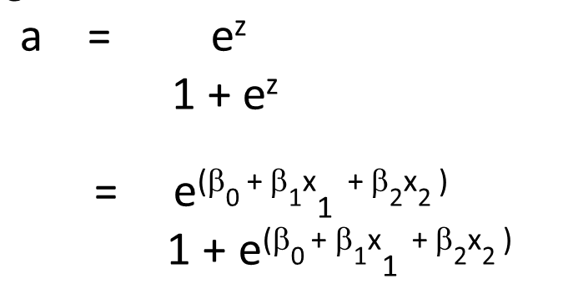
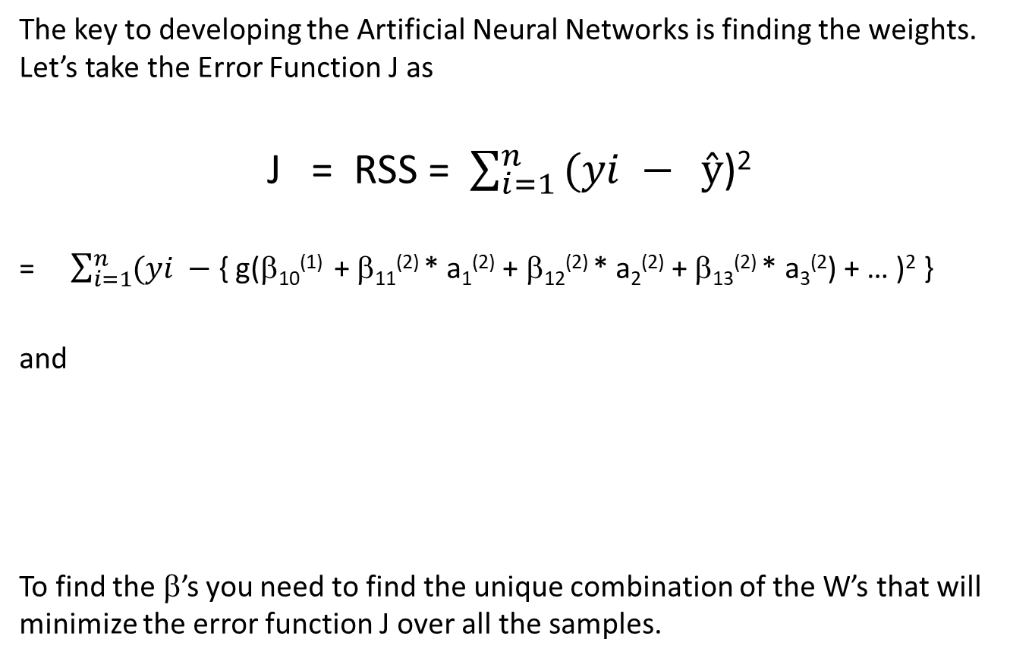
Finding the Weights
The key to developing the Artificial Neural Networks is finding the weights. Let’s take the Error Function J as
J = RSS = $\sum_{i=1 }^{n}{(yi − } ŷ$)²
= $\sum_{i=1}^{n}{(yi − }${ g(β₁₀⁽¹⁾ + β₁₁⁽²⁾ * a₁⁽²⁾ + β₁₂⁽²⁾ * a₂⁽²⁾ + β₁₃⁽²⁾ * a₃⁽²) + … )² }
and
To find the β’s you need to find the unique combination of the W’s that will minimize the error function J over all the samples.

Slide 39
Simple Example
W^{(L-1)}
W^{(L)}
y^{(L+1)}
a^{(L-1)}
a^{(L)}
y^{(L+1)} = Probability of Class
In this simple case, the outcome is
y^{(L+1)} = sigmoid(a^{(L)} * W^{(L)}) = σ(a^{(L)} * W^{(L)}) = σ(z^{(L)})
(note: because there is no bias in this example)
And the error is
J = [y - y^{(L+1)} ]² = [y - σ(z^{(L)})]²
In order to figure out how to modify W^{(L)}, we need to find δ J
δ W^{(L)}

Slide 40
Simple Example
W^{(L-1)}
W^{(L)}
a^{(L-1)}
a^{(L)}
y^{(L+1)}
y^{(L+1)} = Probability of Class
Remember the chain rule: for some function f(z), where z is a function of some other parameters x:
δ f = δ f δ z
δ x δ z δ x
*

Slide 41
Simple Example – Activation Node
W^{(L-1)}
W^{(L)}
a^{(L-1)}
a^{(L)}
y^{(L+1)}
y^{(L+1)} = Probability of Class
Using the chain rule:
δ J δ J^{(L)} δ y^{(L+1)} δ z^{(L+1)}
δ W^{(L)} δ y^{(L+1)} δ z^{(L)} δ W^{(L)}
=
*
*
δ J^{(L)}
δ y^{(L+1)}
δ z^{(L+1)}
δ W^{(L)}
= 2(y^{(L+1)}-y) = scalar
δ [a^{(L)} * W^{(L)}]
δ W^{(L)}
= a^{(L)}
=
Derivative of Sigmoid Function
So the size of the change in the error is proportional to the size of the error
This is the connection between the layers. Note each layer is dependent only the previous layer

Slide 42
Simple Example – Bias Node
1
W₀^{(L)}
a^{(L-1)}
a^{(L)}
y^{(L+1)}
W^{(L-1)}
W^{(L)}
y^{(L+1)} = Probability of Class
Using the chain rule:
δ J δ J^{(L)} δ y^{(L+1)} δ z^{(L+1)}
δ W^{(L)} δ y^{(L+1)} δ z^{(L)} δ W₀^{(L)}
=
*
*
δ J^{(L)}
δ y^{(L+1)}
δ z^{(L+1)}
δ W₀^{(L)}
= 2(y^{(L+1)}-y) = scalar
δ [1 * W₀^{(L)}]
δ W₀^{(L)}
= 1
=
Derivative of Sigmoid Function
So the size of the change in the error is proportional to the size of the error
For the bias, the derivative is just 1.

Slide 43
Backpropagation: Setup
Let’s take and example:
2 Features
1 Hidden Layer
1 Outcome (in this case a class)
1
W₀₁⁽¹⁾
1
W₀⁽²⁾
W₀₃⁽¹⁾
I skipped a few of the weights in the diagram to keep things readable
a₁⁽²⁾
W₁⁽²⁾
W₁₁⁽¹⁾
x₁⁽¹⁾
y₁⁽³⁾
W₁₂⁽¹⁾
W₂⁽²⁾
a₂⁽²⁾
W₃⁽²⁾
x₂⁽¹⁾
W₂₂⁽¹⁾
W₂₃⁽¹⁾
a₃⁽²⁾

Slide 44
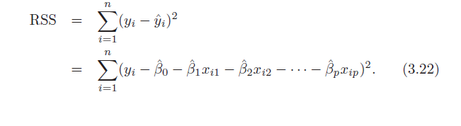
Backpropagation: Finding the Weights
The key to developing the Artificial Neural Networks is finding the weights.
Let’s take the Error Function J as
J =
To find the W’s you need to find the unique combination of the W’s that will minimize the error function J over all the samples.

Slide 45
Brief Review of Matrix Manipulation

Slide 46
Matrix Review
Question: Why are matrices important?
Answer: The matrix notation is a shorthand that is essential for many complex modeling problems that you will encounter in this course. However, the computer will do the hard work for you.
Most of what we do in this course will not require a mastery of matrix mathematics (linear algebra and linear calculus), but you need to understand what is happening when you invoke various programs to solve modeling problems.

Slide 47
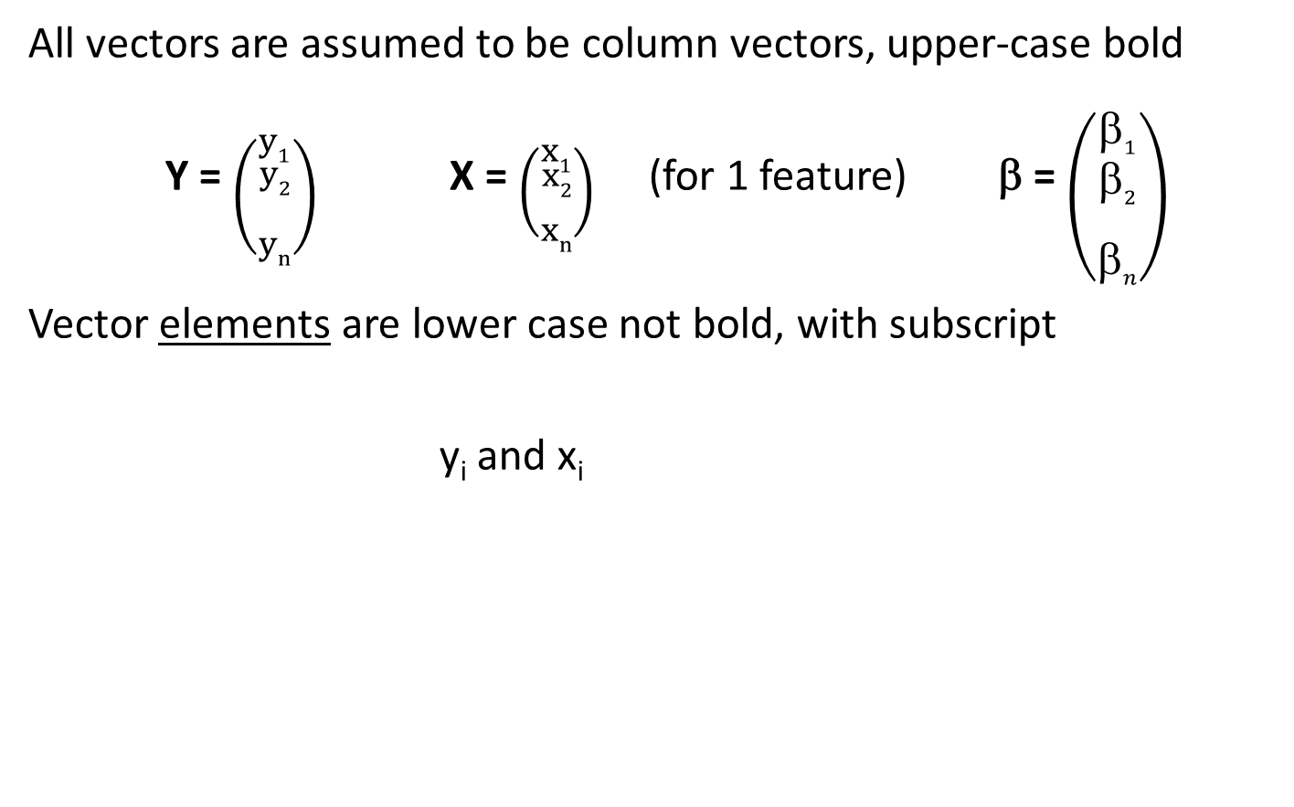
Vector Notation
All vectors are assumed to be column vectors, upper-case bold
Y = $\left({y1 \atop \begin{aligned}y2 \\ \\ yn\end{aligned}}\right)$ X = $\left({x1 \atop \begin{aligned}x2 \\ \\ xn\end{aligned}}\right)$(for 1 feature) β = $\left({\text{b}1 \atop \begin{aligned}\text{b}2 \\ \\ \text{b}n\end{aligned}}\right)$
Vector elements are lower case not bold, with subscript
y_{i} and x_{i}

Slide 48
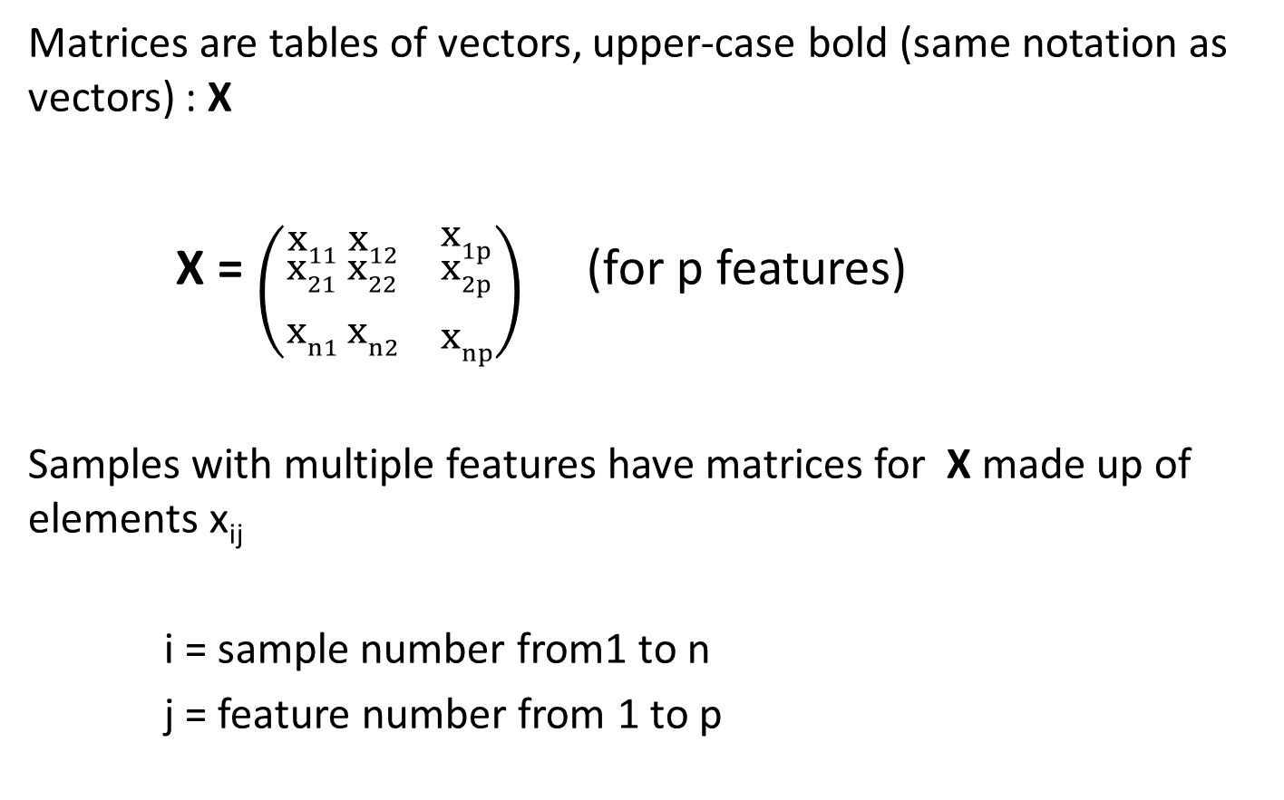
Matrix Notation
Matrices are tables of vectors, upper-case bold (same notation as vectors) : X
X = $\left({x11 \atop \begin{aligned}x21 \\ \\ xn1\end{aligned}}{x12 \atop \begin{aligned}x22 \\ \\ xn2\end{aligned}}{ \atop \begin{aligned} \\ \\ \end{aligned}}{x1p \atop \begin{aligned}x2p \\ \\ xnp\end{aligned}}\right)$(for p features)
Samples with multiple features have matrices for X made up of elements x_{ij}
i = sample number from1 to n
j = feature number from 1 to p

Slide 49
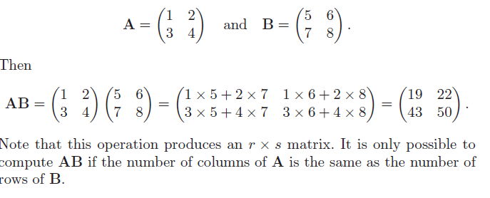
Matrix Multiplication

Slide 50
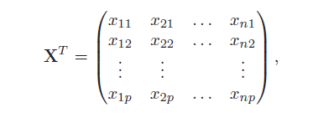
Transpose of a Matrix

Slide 51
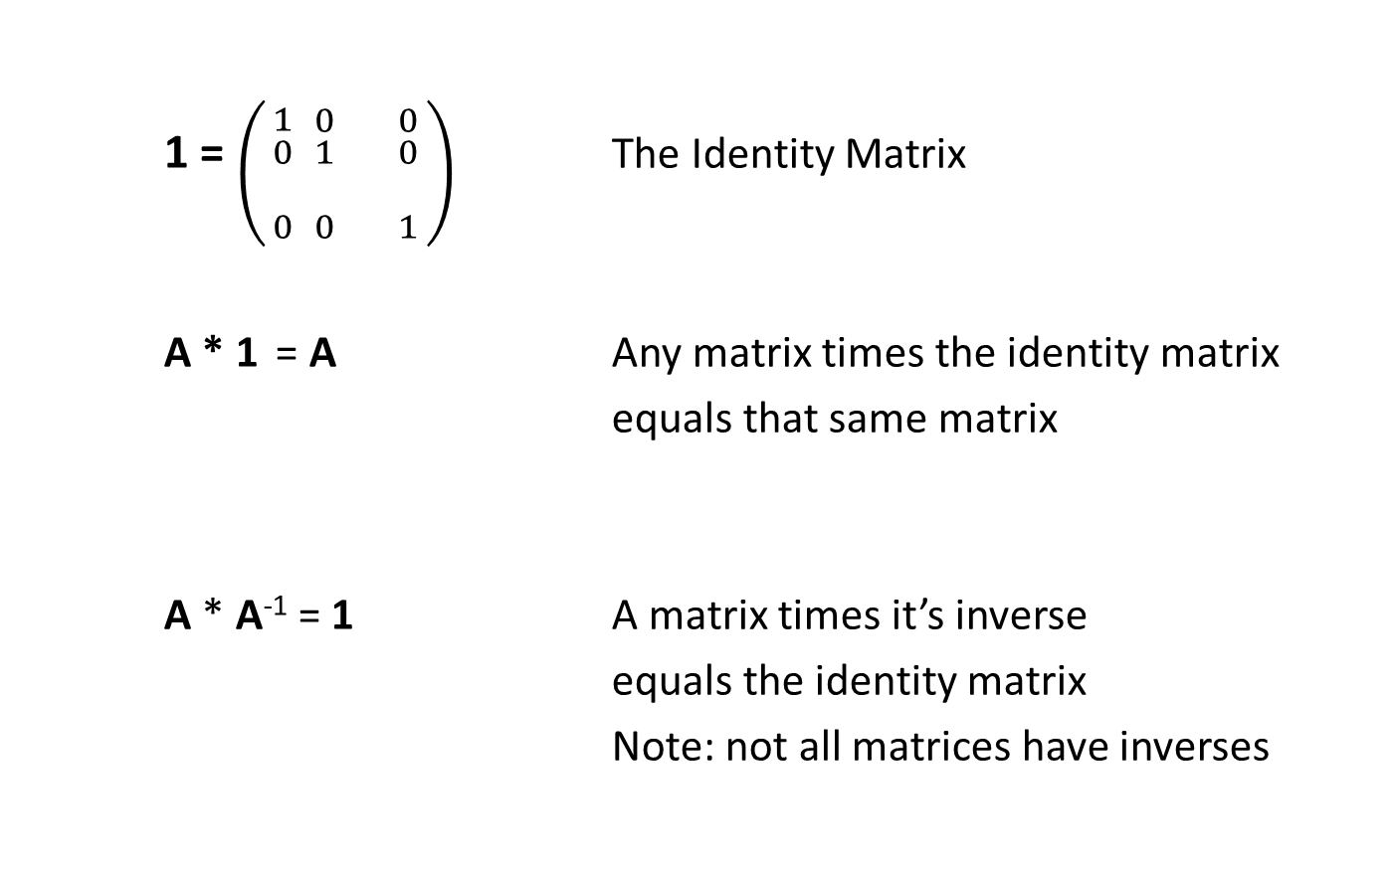
Identity Matrix and Inverse of a Matrix
1 = $\left({1 \atop \begin{aligned}0 \\ \\ 0\end{aligned}}{0 \atop \begin{aligned}1 \\ \\ 0\end{aligned}}{ \atop \begin{aligned} \\ \\ \end{aligned}}{0 \atop \begin{aligned}0 \\ \\ 1\end{aligned}}\right)$ The Identity Matrix
A * 1 = A Any matrix times the identity matrix
equals that same matrix
A * A⁻¹ = 1 A matrix times it’s inverse
equals the identity matrix
Note: not all matrices have inverses

Slide 52
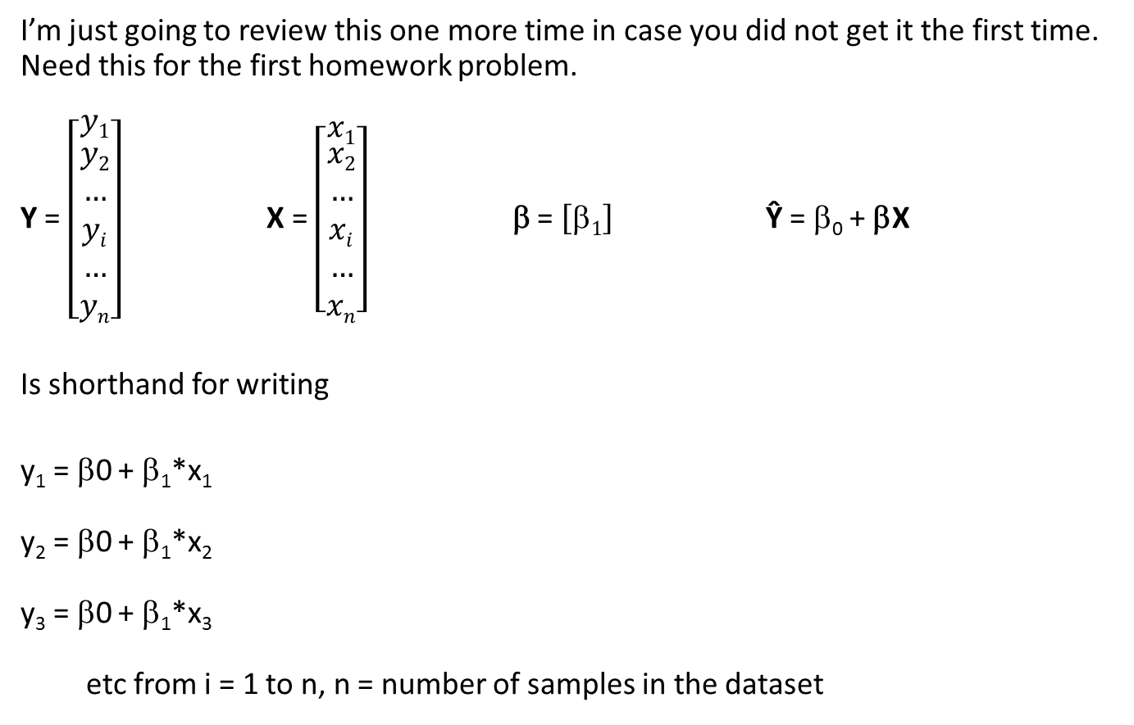
Matrix Representation for Linear Regression
I’m just going to review this one more time in case you did not get it the first time. Need this for the first homework problem.
Y = $\left[\begin{matrix}y1 \\ \begin{aligned}y2 \\ … \\ yi \\ … \\ yn\end{aligned}\end{matrix}\right]$ X = $\left[\begin{matrix}x1 \\ \begin{aligned}x2 \\ … \\ xi \\ … \\ xn\end{aligned}\end{matrix}\right]$ β = $\left[\text{b}1\right]$ Ŷ = β₀ + βX
Is shorthand for writing
y₁ = β0 + β₁*x₁
y₂ = β0 + β₁*x₂
y₃ = β0 + β₁*x₃
etc from i = 1 to n, n = number of samples in the dataset
^
^
^
^
^
^
^
^
^
^

Slide 53
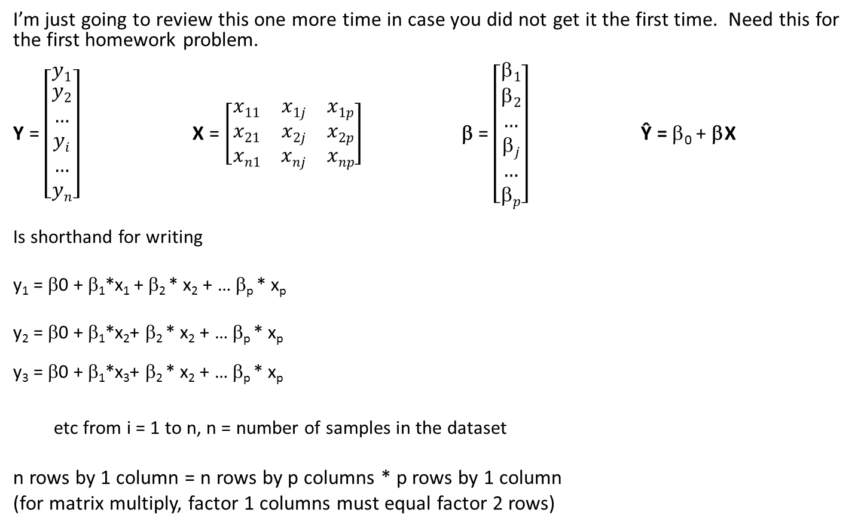
Matrix Representation for Linear Regression
I’m just going to review this one more time in case you did not get it the first time. Need this for the first homework problem.
Y = $\left[\begin{matrix}y1 \\ \begin{aligned}y2 \\ … \\ yi \\ … \\ yn\end{aligned}\end{matrix}\right]$ X = $\left[\begin{matrix}x11 & x1j & x1p \\ x21 & x2j & x2p \\ xn1 & xnj & xnp\end{matrix}\right]$ β = $\left[\begin{matrix}\text{b}1 \\ \begin{aligned}\text{b}2 \\ … \\ \text{b}j \\ … \\ \text{b}p\end{aligned}\end{matrix}\right]$ Ŷ = β₀ + βX
Is shorthand for writing
y₁ = β0 + β₁*x₁ + β₂ * x₂ + … β_{p} * x_{p}
y₂ = β0 + β₁*x₂+ β₂ * x₂ + … β_{p} * x_{p}
y₃ = β0 + β₁*x₃+ β₂ * x₂ + … β_{p} * x_{p}
etc from i = 1 to n, n = number of samples in the dataset
n rows by 1 column = n rows by p columns * p rows by 1 column
(for matrix multiply, factor 1 columns must equal factor 2 rows)
^
^
^
^
^
^
^
^
^
^
^
^
^
^
^
^

Slide 54
Backpropagation: Setup
Let’s take and example:
2 Features
1 Hidden Layer
1 Outcome (in this case a class)
1
W₀₁⁽¹⁾
1
W₀⁽²⁾
W₀₃⁽¹⁾
I skipped a few of the weights in the diagram to keep things readable
a₁⁽²⁾
W₁⁽²⁾
W₁₁⁽¹⁾
x₁⁽¹⁾
y₁⁽³⁾
W₁₂⁽¹⁾
W₂⁽²⁾
a₂⁽²⁾
W₃⁽²⁾
x₂⁽¹⁾
W₂₂⁽¹⁾
W₂₃⁽¹⁾
a₃⁽²⁾

Slide 55
Backpropagation: Finding the Weights
W₀⁽²⁾
W₀₁⁽¹⁾
W₀₂⁽¹⁾
W₀₃⁽¹⁾
W₁⁽²⁾
W⁽¹⁾ =
W₁₁⁽¹⁾
W₁₂⁽¹⁾
W₁₃⁽¹⁾
W⁽²⁾ =
W₂⁽²⁾
W₂₁⁽¹⁾
W₂₂⁽¹⁾
W₂₃⁽¹⁾
Layer 1
W₃⁽²⁾
Layer 2
δJ / δW⁽¹⁾ =
δJ / δW⁽²⁾ =
δJ / δW₀⁽²⁾
δJ / δW₀₁⁽¹⁾
δJ / δW₀₂⁽¹⁾
δJ / δW₀₃⁽¹⁾
δJ / δW₁⁽²⁾
δJ / δW₁₁⁽¹⁾
δJ / δW₁₂⁽¹⁾
δJ / δW₁₃⁽¹⁾
δJ / δW₂⁽²⁾
δJ / δW₂₁⁽¹⁾
δJ / δW₂₂⁽¹⁾
δJ / δW₂₃⁽¹⁾
δJ / δW₃⁽²⁾
55

Slide 56
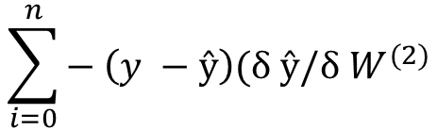

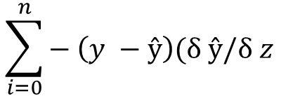
Backpropagation: Differentiating the J’s
δJ / δW⁽²⁾ = δ { }
δW⁽²⁾
= { ⁾ }
= { ) (δz / δW⁽²⁾) }
$\sum_{i=0}^{n}{{\left(\frac{1}{2}\right)\left(y −ŷ\right)}^{2}}$
$$\sum_{i=0}^{n}{{− \left(y −ŷ\right)(δ ŷ/δ W}^{(2)}}$$
$$\sum_{i=0}^{n}{{− \left(y −ŷ\right)(δ ŷ/δ z}^{}}$$

Slide 57
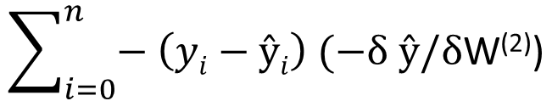
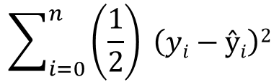
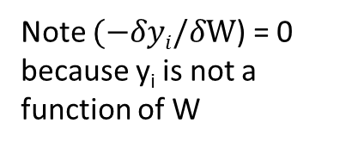
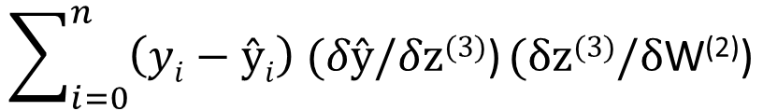
Backpropagation: Differentiating the J’s
δJ / δW⁽²⁾ = δ { } / δW⁽²⁾
=
=
Each term in a sum can be differentiated separately, so I’ll drop the summation sign and pick it up later.
$$\sum_{i=0}^{n}{\left(\frac{1}{2}\right) \left(yi−ŷi\right)2}$$
½ is just an arbitrary constant that will go away in the next step
$$\sum_{i=0}^{n}{− \left(yi−ŷi\right) (−δ ŷ/δ\text{W}\text{(2)}\text{)}}$$
Note $(−δyi/δ\text{W}\text{)}$ = 0 because y_{i} is not a function of W
$$\sum_{i=0}^{n}{\left(yi−ŷi\right) (δŷ/δ\text{z}\text{(3)}\text{)}}(δ\text{z}\text{(3)}/δ\text{W}\text{(2)}\text{)}$$

Slide 58
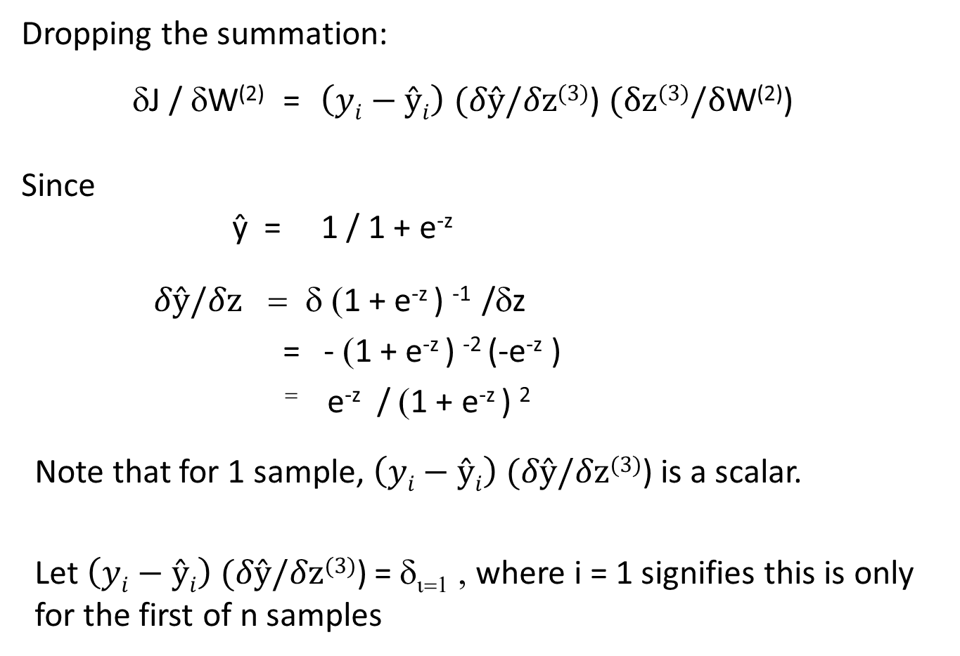
Backpropagation: Differentiating the J’s
Dropping the summation:
δJ / δW⁽²⁾ = $\left(yi−ŷi\right) (δŷ/δ\text{z}\text{(3)}\text{)}$ $(δ\text{z}\text{(3)}/δ\text{W}\text{(2)}\text{)}$
Since
ŷ = 1 / 1 + e^{-z}
$δŷ/δ\text{z}$ = δ (1 + e^{-z} ) ⁻¹ /δz
= - (1 + e^{-z} ) ⁻² (-e^{-z} )
⁼ e^{-z} / (1 + e^{-z} ) ²
Note that for 1 sample, $\left(yi−ŷi\right) (δŷ/δ\text{z}\text{(3)}\text{)}$ is a scalar.
Let $\left(yi−ŷi\right) (δŷ/δ\text{z}\text{(3)}\text{)}$ = δ_{ι=1} , where i = 1 signifies this is only for the first of n samples

Slide 59
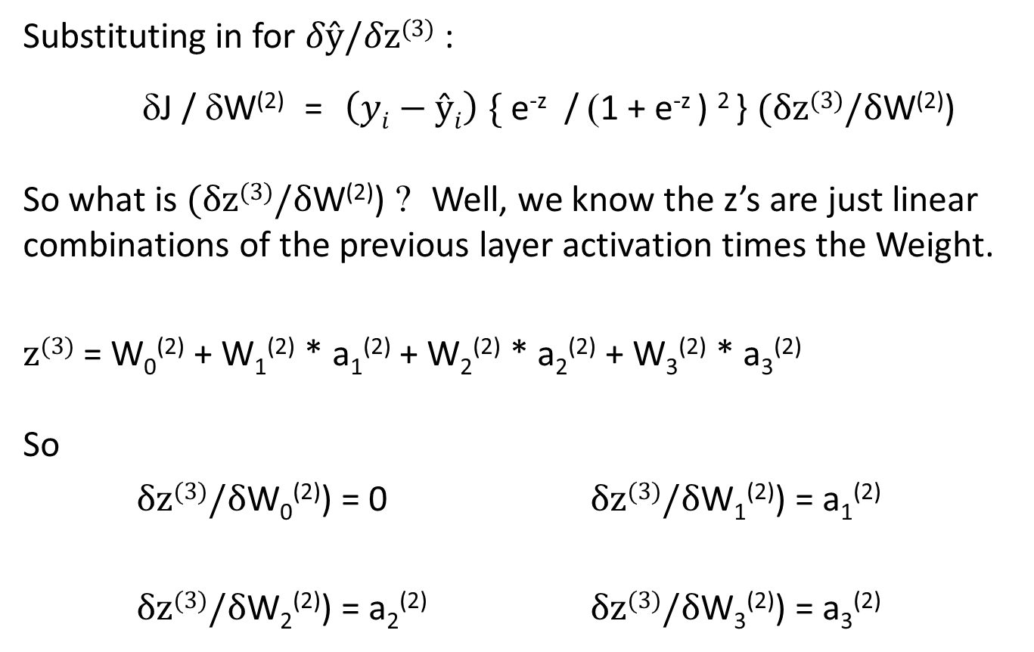
Backpropagation: Differentiating the J’s
Substituting in for $δŷ/δ\text{z}\text{(3)}$ :
δJ / δW⁽²⁾ = $\left(yi−ŷi\right) \text{\{ }\text{e}\text{−}\text{z}\text{ / }\text{(}\text{1 + }\text{e}\text{−}\text{z}\text{ ) 2 \}}$ $(δ\text{z}\text{(3)}/δ\text{W}\text{(2)}\text{)}$
So what is $(δ\text{z}\text{(3)}/δ\text{W}\text{(2)}\text{)}$ ? Well, we know the z’s are just linear combinations of the previous layer activation times the Weight.
$\text{z}\text{(3)}$ = W₀⁽²⁾ + W₁⁽²⁾ * a₁⁽²⁾ + W₂⁽²⁾ * a₂⁽²⁾ + W₃⁽²⁾ * a₃⁽²⁾
So
$δ\text{z}\text{(3)}/δ\text{W}\text{0}\text{(2)}\text{)}\text{ = 0}$ $δ\text{z}\text{(3)}/δ\text{W}\text{1}\text{(2)}\text{) = }$a₁⁽²⁾
$δ\text{z}\text{(3)}/δ\text{W}\text{2}\text{(2)}\text{) = }$a₂⁽²⁾ $δ\text{z}\text{(3)}/δ\text{W}\text{3}\text{(2)}\text{) = }$a₃⁽²⁾

Slide 60
Backpropagation: Differentiating the J’s
In matrix form a⁽²⁾ W⁽²⁾ = z⁽³⁾
W₀⁽²⁾
W₁⁽²⁾
a_{i=1}⁽²⁾ =
1
a₁⁽²⁾
a₂⁽²⁾
a₃⁽²⁾
W⁽²⁾ =
z⁽³⁾ =
z₀⁽³⁾
W₂⁽²⁾
W₃⁽²⁾

Slide 61
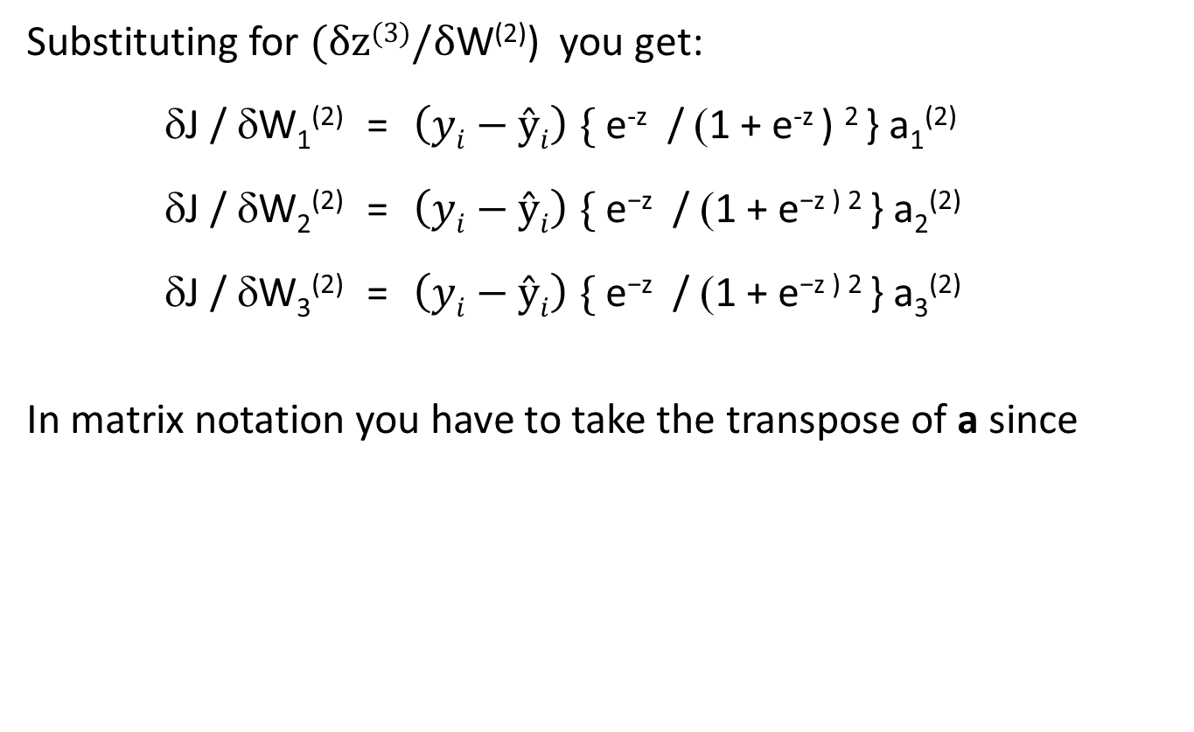
Backpropagation: Differentiating the J’s
Substituting for $(δ\text{z}\text{(3)}/δ\text{W}\text{(2)}\text{)}$ you get:
δJ / δW₁⁽²⁾ = $\left(yi−ŷi\right) \text{\{ }\text{e}\text{−}\text{z}\text{ / }\text{(}\text{1 + }\text{e}\text{−}\text{z}\text{ ) 2 \} }\text{a}\text{1}\text{(2)}$
δJ / δW₂⁽²⁾ = $\left(yi−ŷi\right) \text{\{ }\text{e}\text{−}\text{z}\text{ / }\text{(}\text{1 + }\text{e}\text{−}\text{z}\text{ ) 2 \} }\text{a}\text{2}\text{(2)}$
δJ / δW₃⁽²⁾ = $\left(yi−ŷi\right) \text{\{ }\text{e}\text{−}\text{z}\text{ / }\text{(}\text{1 + }\text{e}\text{−}\text{z}\text{ ) 2 \} }\text{a}\text{3}\text{(2)}$
In matrix notation you have to take the transpose of a since
δJ / δW₀⁽²⁾
1
δJ / δW₁⁽²⁾
a₁⁽²⁾
δJ / δW⁽²⁾ =
[a_{i=1}⁽²⁾]^{T} =
δ⁽³⁾_{ι=1} is a scalar
δJ / δW₂⁽²⁾
a₂⁽²⁾
δJ / δW₃⁽²⁾
a₃⁽²⁾

Slide 62
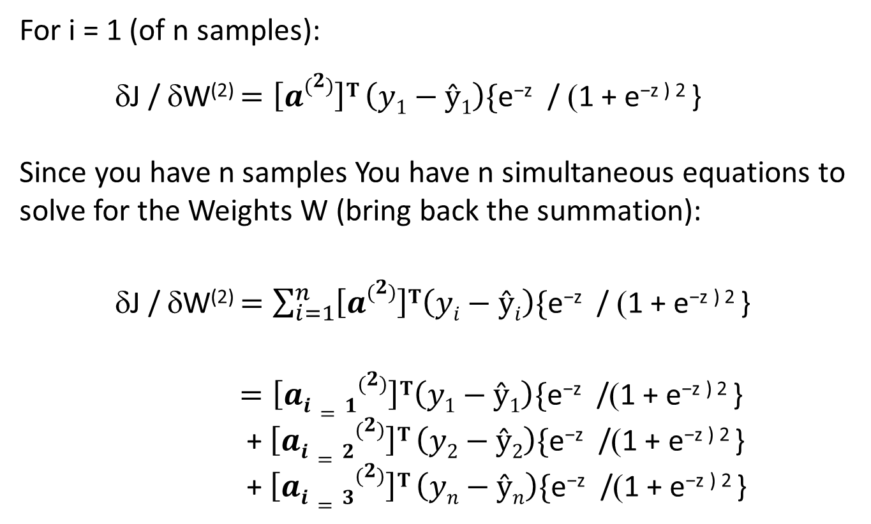
Backpropagation: Putting it Together for Sample 1
For i = 1 (of n samples):
δJ / δW⁽²⁾ $=\left[a\left(2\right)\right]T \left(y1−ŷ1\right)\text{\{}\text{e}\text{−}\text{z}\text{ / }\text{(}\text{1 + }\text{e}\text{−}\text{z}\text{ ) 2 \}}$
Since you have n samples You have n simultaneous equations to solve for the Weights W (bring back the summation):
δJ / δW⁽²⁾ $=\sum_{i=1}^{n}{\left[a\left(2\right)\right]T\left(yi−ŷi\right)\text{\{}\text{e}\text{−}\text{z}\text{ / }\text{(}\text{1 + }\text{e}\text{−}\text{z}\text{ ) 2 \}} }$
$=\left[ai=1\left(2\right)\right]T\left(y1−ŷ1\right)\text{\{}\text{e}\text{−}\text{z}\text{ /}\text{(}\text{1 + }\text{e}\text{−}\text{z}\text{ ) 2 \}}$
+ $\left[ai=2\left(2\right)\right]T \left(y2−ŷ2\right)\text{\{}\text{e}\text{−}\text{z}\text{ /}\text{(}\text{1 + }\text{e}\text{−}\text{z}\text{ ) 2 \}}$
+ $\left[ai=3\left(2\right)\right]T \left(yn−ŷn\right)\text{\{}\text{e}\text{−}\text{z}\text{ /}\text{(}\text{1 + }\text{e}\text{−}\text{z}\text{ ) 2 \}}$

Slide 63
Backpropagation: Putting it Together for n Samples
In matrix notation:
So you end up with each row in δJ / δW⁽²⁾ corresponding to a single hidden node in a hidden layer with all of your n samples. At a given point in the iteration all your samples add up to tell you to adjust your weight “up” or “down” at that node.
δJ / δW₀⁽²⁾
1
1
…
1
δ⁽³⁾₁
δJ / δW₁⁽²⁾
δ⁽³⁾₂
=
a₁₁⁽²⁾
a₁₂⁽²⁾
a_{1n}⁽²⁾
δJ / δW⁽²⁾ =
…
δJ / δW₂⁽²⁾
δ⁽³⁾₃
a₂₁⁽²⁾
a₂₂⁽²⁾
…
a_{2n}⁽²⁾
.
.
.
δJ / δW₃⁽²⁾
a₃₁⁽²⁾
a₃₂⁽²⁾
…
a_{3n}⁽²⁾
δ⁽³⁾_{n}

Slide 64
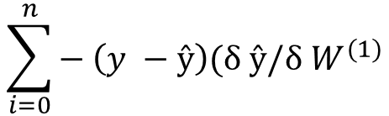

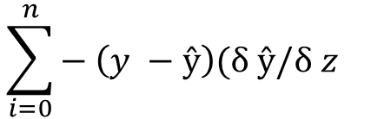
Backpropagation: Input Layer
The input layer is much that same with a few twists and turns.
δJ / δW⁽¹⁾ = δ { }
δW⁽¹⁾
= δ { ⁾ }
= δ { ) (δz / δW⁽¹⁾) }
$\sum_{i=0}^{n}{{\left(\frac{1}{2}\right)\left(y −ŷ\right)}^{2}}$
$$\sum_{i=0}^{n}{{− \left(y −ŷ\right)(δ ŷ/δ W}^{(1)}}$$
$$\sum_{i=0}^{n}{{− \left(y −ŷ\right)(δ ŷ/δ z}^{}}$$

Slide 65
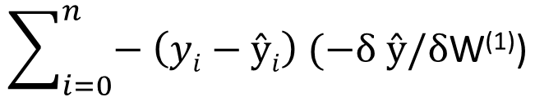
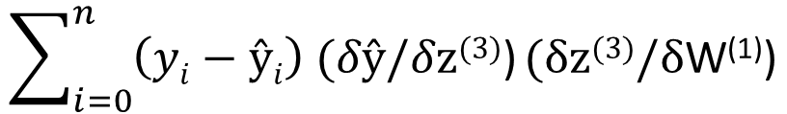
Backpropagation: Input Layer
δJ / δW⁽¹⁾ = δ { } / δW⁽¹⁾
=
=
Each term in a sum can be differentiated separately, so I’ll drop the summation sign and pick it up later.
$$\sum_{i=0}^{n}{\left(\frac{1}{2}\right) \left(yi−ŷi\right)2}$$
½ is just an arbitrary constant that will go away in the next step
$$\sum_{i=0}^{n}{− \left(yi−ŷi\right) (−δ ŷ/δ\text{W}\text{(}\text{1}\text{)}\text{)}}$$
Note $(−δyi/δ\text{W}\text{)}$ = 0 because y_{i} is not a function of W
$$\sum_{i=0}^{n}{\left(yi−ŷi\right) (δŷ/δ\text{z}\text{(}\text{3}\text{)}\text{)}}(δ\text{z}\text{(}\text{3}\text{)}/δ\text{W}\text{(}\text{1}\text{)}\text{)}$$

Slide 66
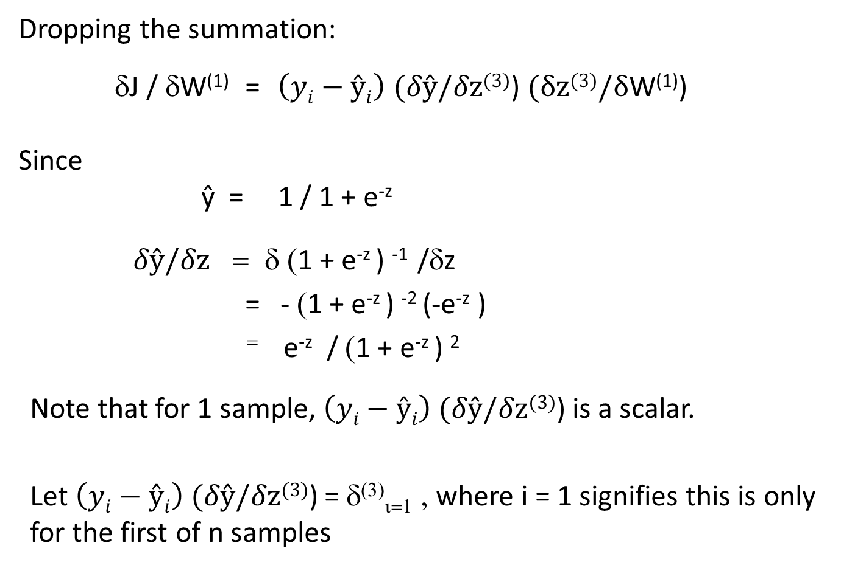
Backpropagation: Input Layer
Dropping the summation:
δJ / δW⁽¹⁾ = $\left(yi−ŷi\right) (δŷ/δ\text{z}\text{(3)}\text{)}$ $(δ\text{z}\text{(3)}/δ\text{W}\text{(}\text{1}\text{)}\text{)}$
Since
ŷ = 1 / 1 + e^{-z}
$δŷ/δ\text{z}$ = δ (1 + e^{-z} ) ⁻¹ /δz
= - (1 + e^{-z} ) ⁻² (-e^{-z} )
⁼ e^{-z} / (1 + e^{-z} ) ²
Note that for 1 sample, $\left(yi−ŷi\right) (δŷ/δ\text{z}\text{(3)}\text{)}$ is a scalar.
Let $\left(yi−ŷi\right) (δŷ/δ\text{z}\text{(3)}\text{)}$ = δ⁽³⁾_{ι=1} , where i = 1 signifies this is only for the first of n samples

Slide 67
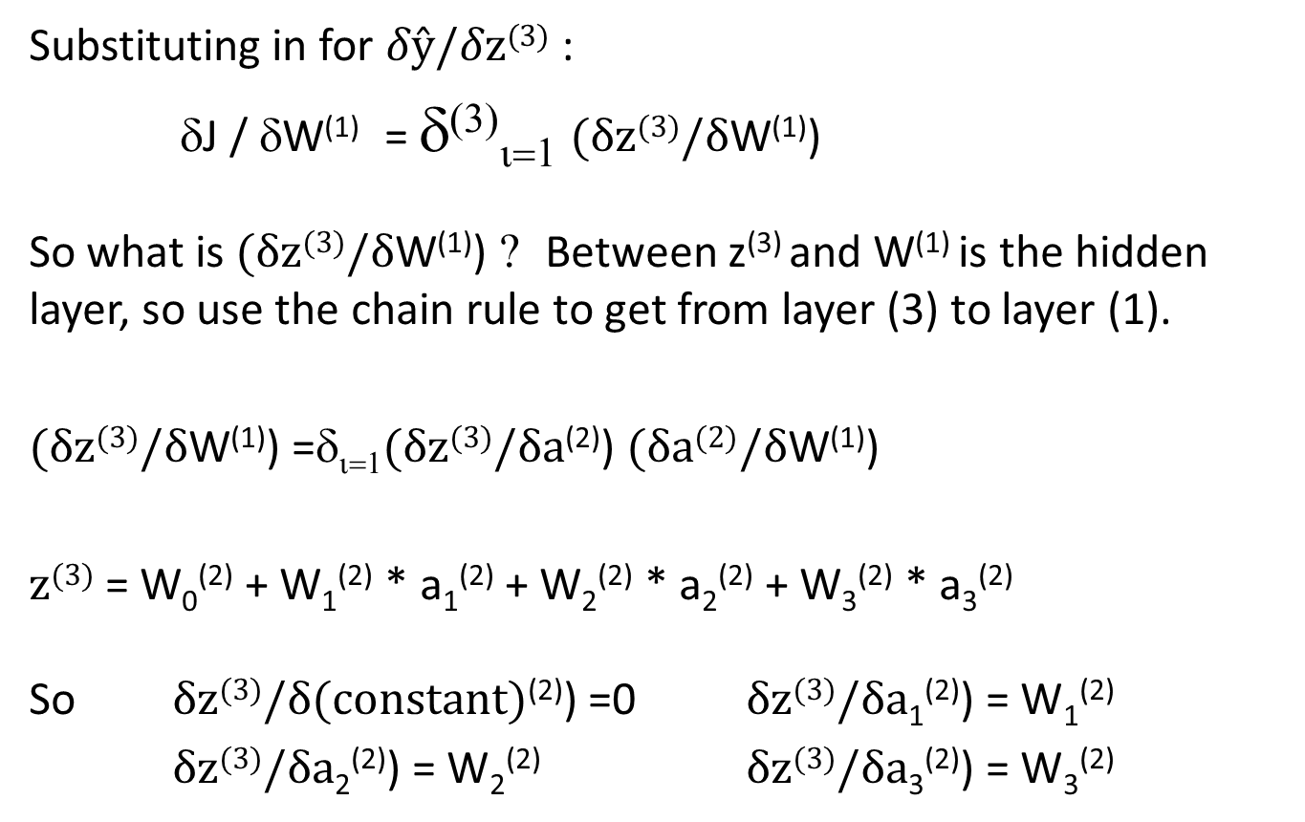
Backpropagation: Input Layer
Substituting in for $δŷ/δ\text{z}\text{(3)}$ :
δJ / δW⁽¹⁾ = δ⁽³⁾_{ι=1} $(δ\text{z}\text{(3)}/δ\text{W}\text{(}\text{1}\text{)}\text{)}$
So what is $(δ\text{z}\text{(3)}/δ\text{W}\text{(}\text{1}\text{)}\text{)}$ ? Between z⁽³⁾ and W⁽¹⁾ is the hidden layer, so use the chain rule to get from layer (3) to layer (1).
$(δ\text{z}\text{(3)}/δ\text{W}\text{(1)}\text{)}$ =δ_{ι=1}$(δ\text{z}\text{(3)}/δ\text{a}\text{(}\text{2}\text{)}\text{)}$ $(δ\text{a}\text{(}\text{2}\text{)}/δ\text{W}\text{(1)}\text{)}$
$\text{z}\text{(3)}$ = W₀⁽²⁾ + W₁⁽²⁾ * a₁⁽²⁾ + W₂⁽²⁾ * a₂⁽²⁾ + W₃⁽²⁾ * a₃⁽²⁾
So $δ\text{z}\text{(3)}/δ\text{(}\text{constant}\text{)}\text{(2)}\text{)}\text{ =0}$ $δ\text{z}\text{(3)}/δ\text{a}\text{1}\text{(2)}\text{) = }\text{W}$₁⁽²⁾
$δ\text{z}\text{(3)}/δ\text{a}\text{2}\text{(2)}\text{) = }\text{W}$₂⁽²⁾ $δ\text{z}\text{(3)}/δ\text{a}\text{3}\text{(2)}\text{) = }\text{W}$₃⁽²⁾

Slide 68
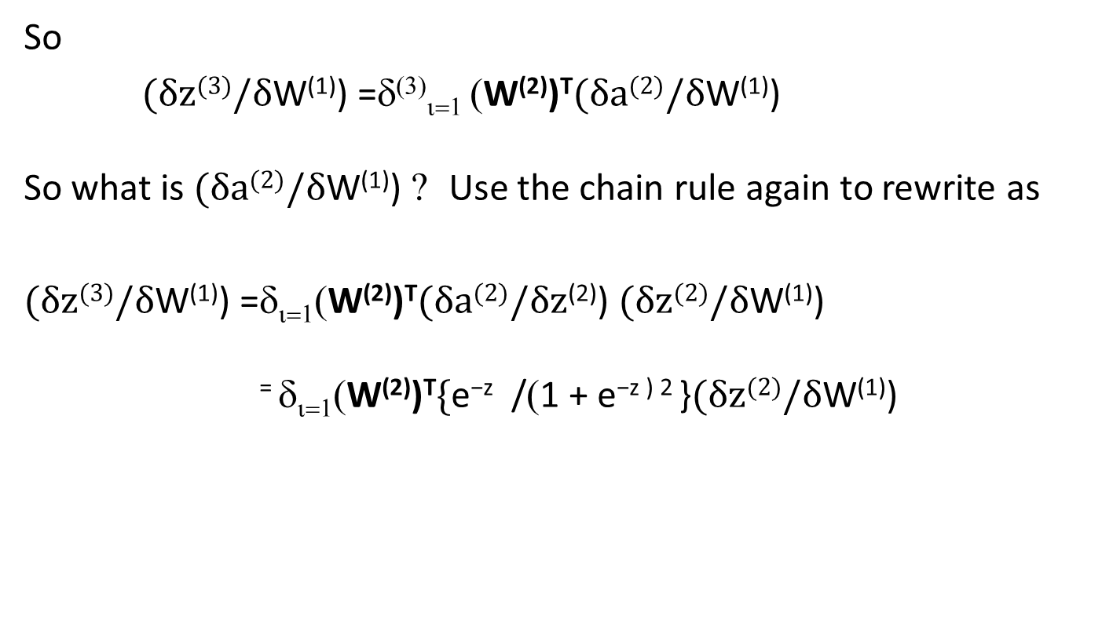
Backpropagation: Input Layer
So
$(δ\text{z}\text{(3)}/δ\text{W}\text{(1)}\text{)}$ =δ⁽³⁾_{ι=1} (W⁽²⁾)^{T}$(δ\text{a}\text{(2)}/δ\text{W}\text{(1)}\text{)}$
So what is $(δ\text{a}\text{(}\text{2}\text{)}/δ\text{W}\text{(}\text{1}\text{)}\text{)}$ ? Use the chain rule again to rewrite as
$(δ\text{z}\text{(3)}/δ\text{W}\text{(1)}\text{)}$ =δ_{ι=1}(W⁽²⁾)^{T}$(δ\text{a}\text{(2)}/δ\text{z}\text{(}\text{2}\text{)}\text{)}$ $(δ\text{z}\text{(2)}/δ\text{W}\text{(1)}\text{)}$
⁼ δ_{ι=1}(W⁽²⁾)^{T}$\text{\{}\text{e}\text{−}\text{z}\text{ /}\text{(}\text{1 + }\text{e}\text{−}\text{z}\text{ ) 2 \}}(δ\text{z}\text{(2)}/δ\text{W}\text{(1)}\text{)}$

Slide 69
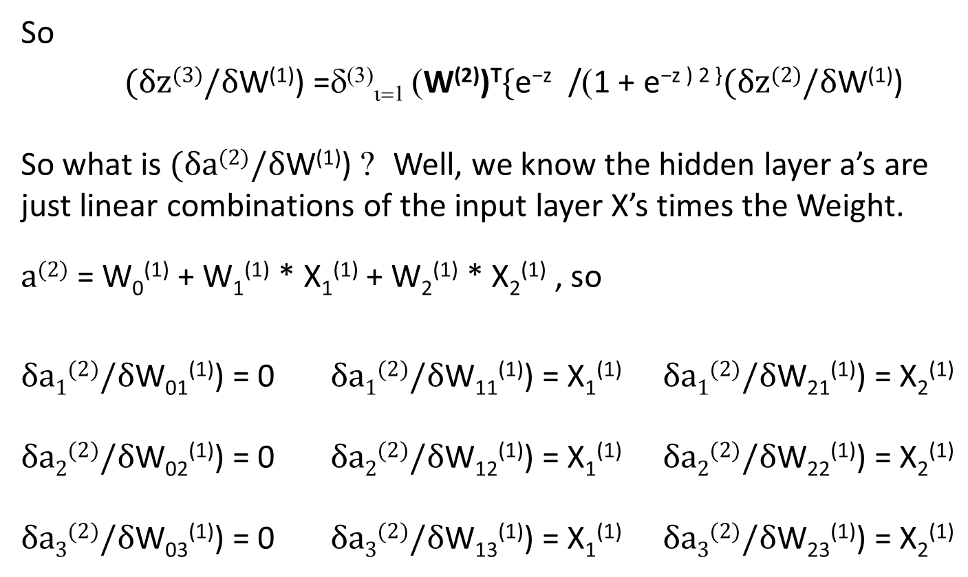
Backpropagation: Input Layer
So
$(δ\text{z}\text{(3)}/δ\text{W}\text{(1)}\text{)}$ =δ⁽³⁾_{ι=1} (W⁽²⁾)^{T}$\text{\{}\text{e}\text{−}\text{z}\text{ /}\text{(}\text{1 + }\text{e}\text{−}\text{z}\text{ ) 2 \}}(δ\text{z}\text{(2)}/δ\text{W}\text{(1)}\text{)}$
So what is $(δ\text{a}\text{(}\text{2}\text{)}/δ\text{W}\text{(}\text{1}\text{)}\text{)}$ ? Well, we know the hidden layer a’s are just linear combinations of the input layer X’s times the Weight.
$\text{a}\text{(}\text{2}\text{)}$ = W₀⁽¹⁾ + W₁⁽¹⁾ * X₁⁽¹⁾ + W₂⁽¹⁾ * X₂⁽¹⁾ , so
$δ\text{a}\text{1}\text{(}\text{2}\text{)}/δ\text{W}\text{0}\text{1}\text{(}\text{1}\text{)}\text{) = 0}$ $δ\text{a}\text{1}\text{(}\text{2}\text{)}/δ\text{W}\text{1}\text{1}\text{(}\text{1}\text{)}\text{) = }\text{X}$₁⁽¹⁾ $δ\text{a}\text{1}\text{(}\text{2}\text{)}/δ\text{W}\text{2}\text{1}\text{(}\text{1}\text{)}\text{) = }\text{X}$₂⁽¹⁾
$δ\text{a}\text{2}\text{(2)}/δ\text{W}\text{0}\text{2}\text{(1)}\text{) = 0}$ $δ\text{a}\text{2}\text{(2)}/δ\text{W}\text{1}\text{2}\text{(1)}\text{) = }\text{X}$₁⁽¹⁾ $δ\text{a}\text{2}\text{(2)}/δ\text{W}\text{2}\text{2}\text{(1)}\text{) = }\text{X}$₂⁽¹⁾
$δ\text{a}\text{3}\text{(2)}/δ\text{W}\text{0}\text{3}\text{(1)}\text{) = 0}$ $δ\text{a}\text{3}\text{(2)}/δ\text{W}\text{1}\text{3}\text{(1)}\text{) = }\text{X}$₁⁽¹⁾ $δ\text{a}\text{3}\text{(2)}/δ\text{W}\text{2}\text{3}\text{(1)}\text{) = }\text{X}$₂⁽¹⁾

Slide 70
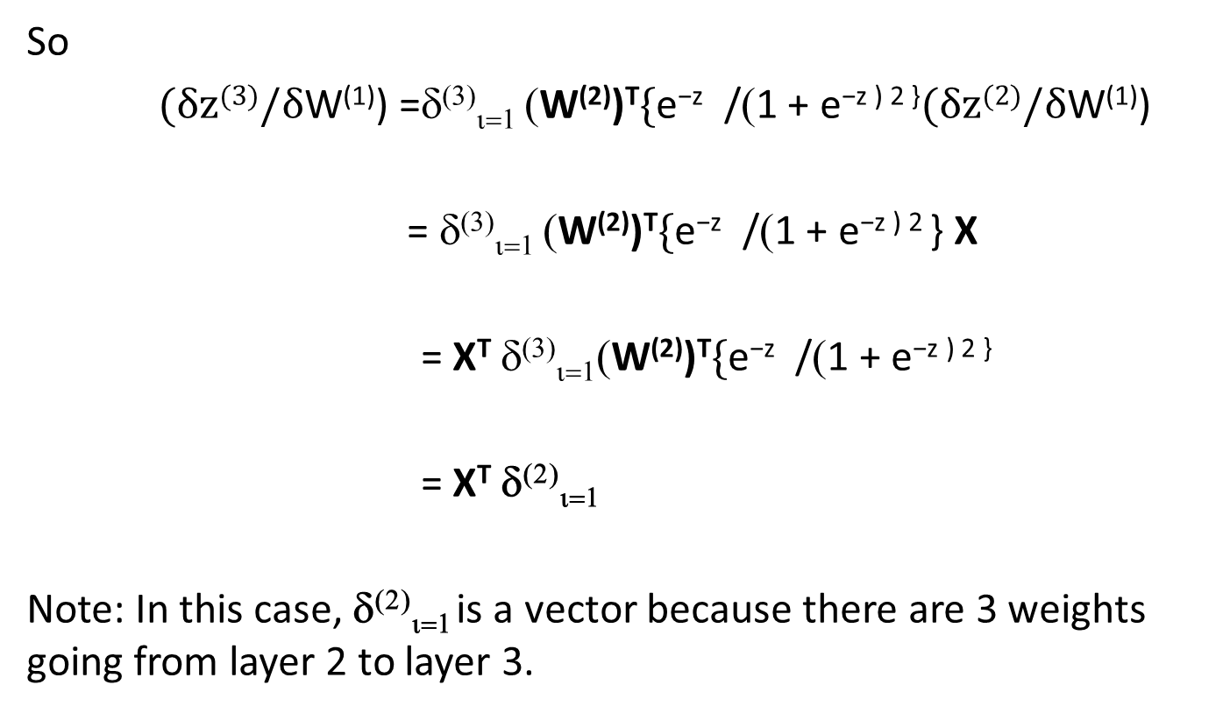
Backpropagation: Input Layer
So
$(δ\text{z}\text{(3)}/δ\text{W}\text{(1)}\text{)}$ =δ⁽³⁾_{ι=1} (W⁽²⁾)^{T}$\text{\{}\text{e}\text{−}\text{z}\text{ /}\text{(}\text{1 + }\text{e}\text{−}\text{z}\text{ ) 2 \}}(δ\text{z}\text{(2)}/δ\text{W}\text{(1)}\text{)}$
= δ⁽³⁾_{ι=1} (W⁽²⁾)^{T}$\text{\{}\text{e}\text{−}\text{z}\text{ /}\text{(}\text{1 + }\text{e}\text{−}\text{z}\text{ ) 2 \}}$ X
= X^{T} δ⁽³⁾_{ι=1}(W⁽²⁾)^{T}$\text{\{}\text{e}\text{−}\text{z}\text{ /}\text{(}\text{1 + }\text{e}\text{−}\text{z}\text{ ) 2 \}}$
= X^{T} δ⁽²⁾_{ι=1}
Note: In this case, δ⁽²⁾_{ι=1} is a vector because there are 3 weights going from layer 2 to layer 3.

Slide 71
Backpropagation for the Inner Layer
δJ / δW₀₁⁽¹⁾
δJ / δW₀₂⁽¹⁾
δJ / δW₀₃⁽¹⁾
δJ / δW⁽¹⁾ =
δJ / δW₁₁⁽¹⁾
δJ / δW₁₂⁽¹⁾
δJ / δW₁₃⁽¹⁾
δJ / δW₂₁⁽¹⁾
δJ / δW₂₂⁽¹⁾
δJ / δW₂₃⁽¹⁾
1
1
…
1
δ₁⁽³⁾₁
δ₂⁽³⁾₁
δ₃⁽³⁾₁
=
δ₁⁽³⁾₂
δ₂⁽³⁾₂
δ₃⁽³⁾₂
X₁₁⁽¹⁾
X₁₂⁽¹⁾
X_{1n}⁽¹⁾
…
δ₂⁽³⁾₃
δ₃⁽³⁾₃
δ₁⁽³⁾₃
X₂₁⁽¹⁾
X₂₂⁽¹⁾
…
X_{2n}⁽¹⁾
.
.
.
.
.
.
.
.
.
δ₁⁽³⁾_{n}
δ₂⁽³⁾_{n}
δ₃⁽³⁾_{n}

Slide 72
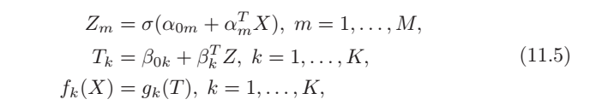
Backpropagation*
Call the sigmoid function σ
For K classes and M features
Z’s are the activations using the linear combinations of the features
T’s use weighted combinations of Z’s. They are the hidden layers
G can be the identity function or the “softmax” function
* From “Elements of Statistical Learning”. See reference material on blackboard.

Slide 73
Backpropagation*
Notice: If σ = 1, then the entire neural net is just a linear regression chain
* From “Elements of Statistical Learning”. See reference material on blackboard.

Slide 74
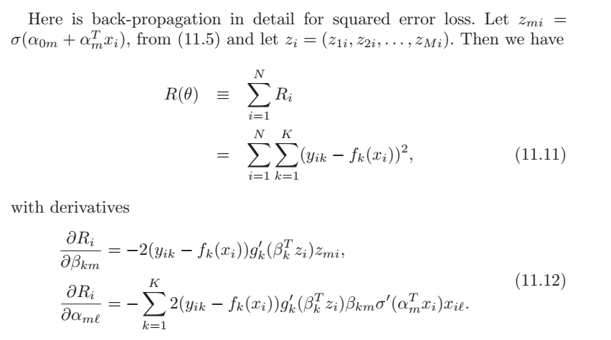
Backpropagation*
* From “Elements of Statistical Learning”. See reference material on blackboard.

Slide 75
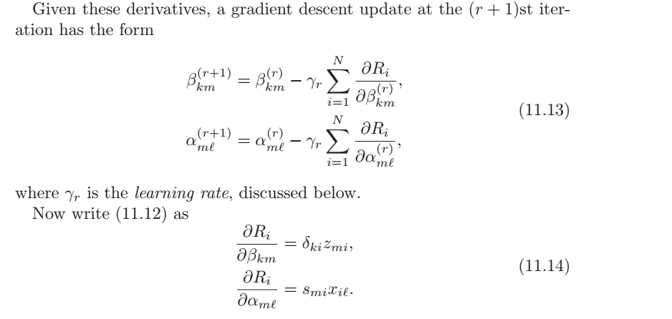
Backpropagation*
* From “Elements of Statistical Learning”. See reference material on blackboard.

Slide 76
Autonomous Driving Video
https://www.youtube.com/watch?v=jet4vwPUfh8
https://www.youtube.com/watch?v=0qVOUD76JOg&ebc=ANyPxKrkhStZLZKuuDFgiBRB5QMs_uxV5qbwvEzsG-GlzOAlAy10mMjLJXcuzh6hyRbOSsfUNF_NwK1EykPR5XmoX87uwJqSlA&nohtml5=False

Slide 77
Homework #9 (1/2)
Problem 1
Repeat the neural network classification example below with the Weekly dataset provided in ISLR. Comment on the results.
library(ISLR)
library(nnet)
Smtrain <- sample(1:1250,1000)
Smtest <- setdiff(1:1250,Smtrain)
ideal <- class.ind(Smarket$Direction)
SmANN = nnet(Smarket[Smtrain,-9],ideal[Smtrain,],size=10,softmax=TRUE)
#summary(SmANN)
table(predict(SmANN,Smarket[Smtest,-9],type="class"),Smarket[Smtest,]$Direction)
Due April 1

Slide 78
Homework #9 (2/2)
Read some basic articles on neural networks
Work on your projects
Continue Data preparation and analysis
Apply a neural network in R to your project data

Slide 79
"A neural network is the second best way to solve any problem. The best way is to actually understand the problem,"

