Slide 1

Using Deep Learning to accelerate molecular additive design for perovskite interface
Group 9
May. 5th, 2026
Notes:
Hello everyone. Today our group will present our work on using machine learning to accelerate the discovery of molecular additives for perovskite solar cell interfaces. Our aim is to outline a simplified, data-driven workflow that can rapidly identify promising molecules for passivation.

Slide 2
Outline
Background and data processing
Model and training strategy
Results and mechanistic analysis
Special cases, attention, limitations
Notes:
Our workflow begins with an initial search across a large molecule database, followed by high-throughput calculations to estimate binding potential. We then perform Gaussian-based quantum calculations to extract electronic descriptors, which are used as inputs. After training, the model highlights top candidates for further electronic analysis and final experimental validation.

Slide 3
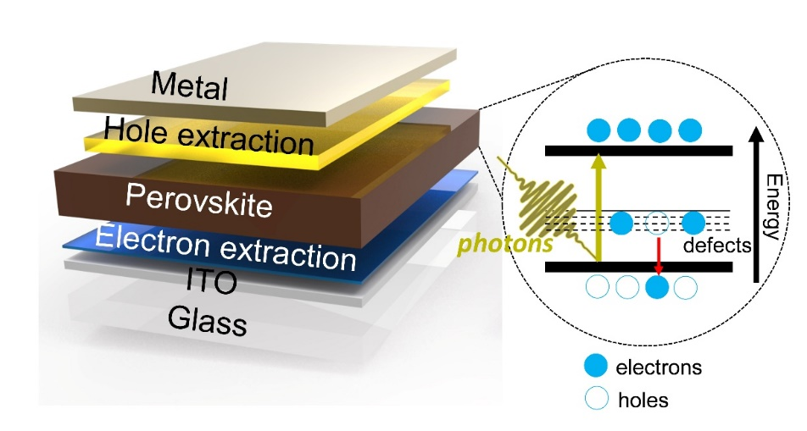
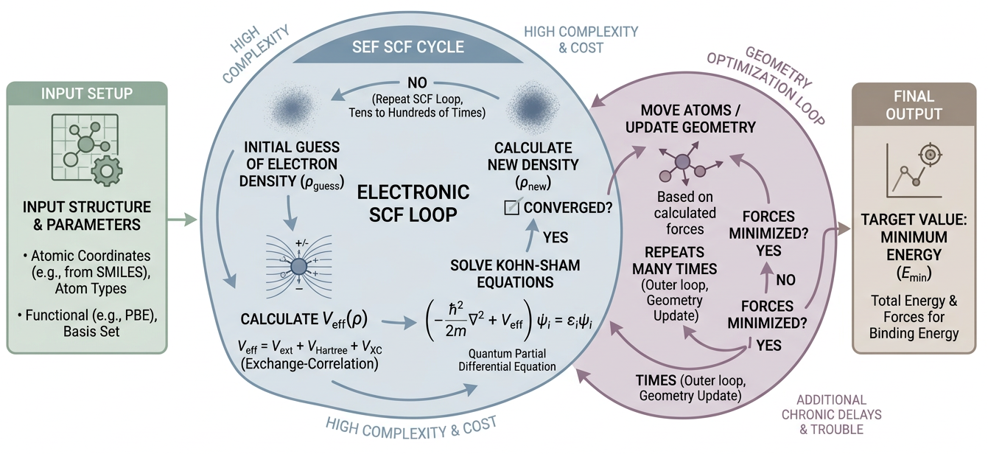
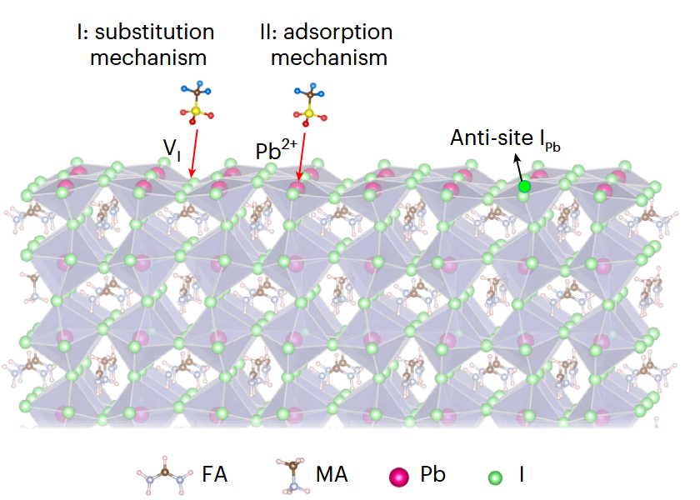
Introduction
Traditional route
Candidate molecular
DFT Calculation
Binding energy
Screening
DFT Calculation Workflow
Schematic of perovskite solar cell
Nat. Mater. 22, 1507–1514 (2023).
Notes:
Although perovskite solar cells have achieved remarkable efficiency, surface defects remain a major source of non-radiative losses and instability. Introducing small functional molecules at the interface is an effective strategy to suppress these defects, but the experimental screening is inefficient. Machine learning allows us to learn the relationship between molecular properties and binding energy, enabling fast selection of candidates.

Slide 4
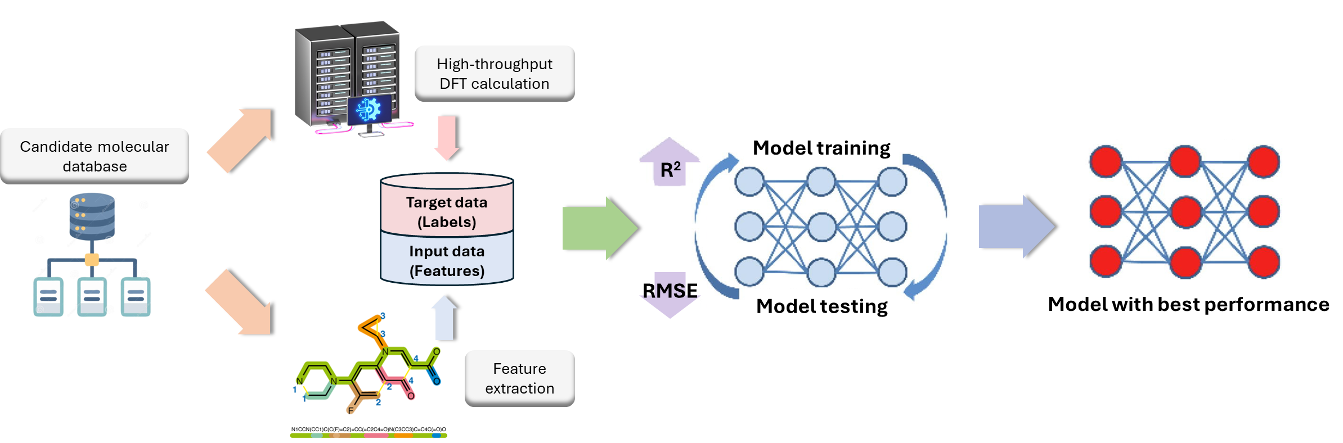
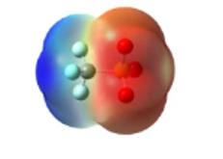
Objective
ML-assisted route
Find candidate materials
Predicate DFT result
Supervised Learning Formulation
INPUT ‘X’
SMILES string
Loss
Metric
Metric
Metric
MODEL Objective
learn f(SMILES) -> binding energy
MSE
RMSE
MAE
R²
LABEL ‘Y’
Binding energy
on normalized y
lower is better
robust error
higher is better
Notes:
Our workflow begins with an initial search across a large molecule database, followed by high-throughput calculations to estimate binding potential. We then perform Gaussian-based quantum calculations to extract electronic descriptors, which are used as inputs. After training, the model highlights top candidates for further electronic analysis and final experimental validation.

Slide 5
Data screening
Screening tiers
5 million
PubChem database
8,027
Charge = -1 anions
5
7,169
Exist as Li/Na/K salts
5
650
2< non-hydrogen atoms <5
5
572
Molecular weight < 70
5
207
Hydrogen Bond Acceptor Count ≠ 0
5
Notes:
The purpose of this workflow is to move efficiently from millions of possible compounds to a small, realistic set of high-value additives. To achieve that, we designed a tiered filtering strategy. Starting from roughly five million molecules in PubChem, we filtered by charge state, chemical constraints, atomic composition, molecular weight, and hydrogen-bonding ability. Each step removes unqualified molecules, gradually shrinking the search space while enriching promising candidates for interface engineering and device testing.

Slide 6
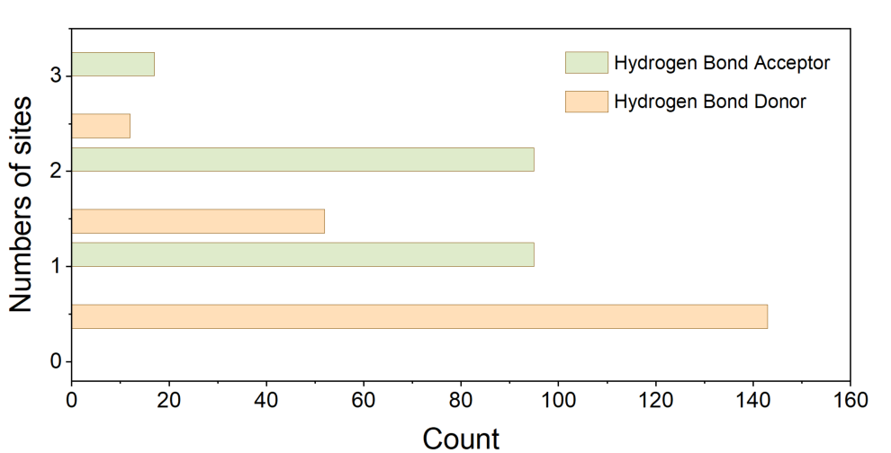
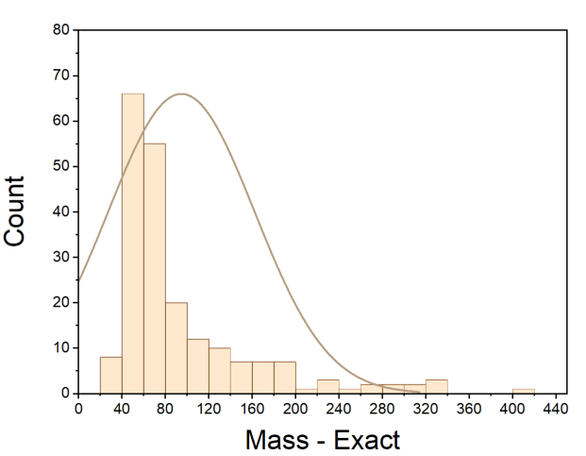
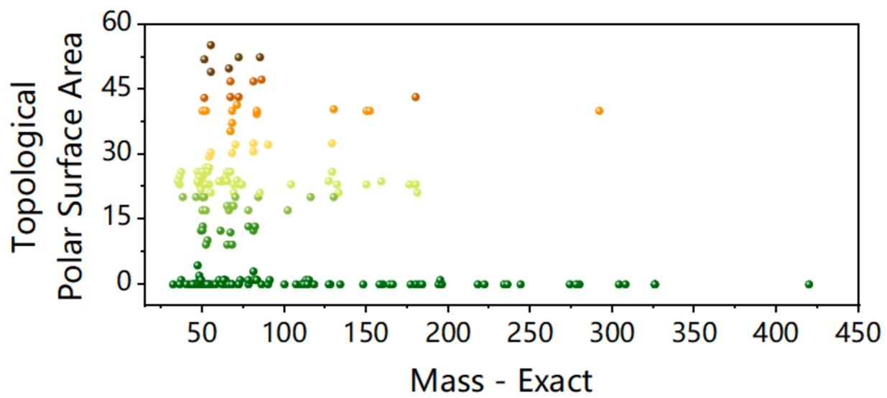
Feature Distribution and Design Space
Figure 2. Counts of H-bond donors and acceptors
Most molecules have 1–2 H-bond acceptor sites but no donors, indicating a design bias toward neutral Lewis base ligands for Pb²⁺ defect passivation.
Figure 1. Distribution of molecular size
Figure 3. Exact Mass vs. Polar Surface Area
Many molecules are moderately polar (TPSA ≈ 5-30), while about 1/3 are non-polar (TPSA = 0), giving a diverse size–polarity design space for binding-energy prediction.
Most molecules are small to medium-sized, with exact mass mainly between 40 and 100 Da.
Notes:
On this slide, we visualize the feature distribution and design space of our candidate passivation molecules.
Figure 1 shows molecular size. Most molecules are small to medium-sized, with exact mass mainly between about 50 and 100 Daltons, which is suitable for forming compact passivation layers.
Figure 2 shows hydrogen-bond donors and acceptors. Most molecules have one or two acceptor sites but almost no classical donors, reflecting a design bias towards neutral Lewis-base ligands that coordinate under-coordinated lead ions without introducing many protic groups.
Figure 3 plots exact mass against topological polar surface area. These axes define a size–polarity design space. We cover both non-polar and moderately polar molecules across a range of sizes, so the model can learn how binding energy depends on a combination of contact area and polarity at the perovskite interface.

Slide 7
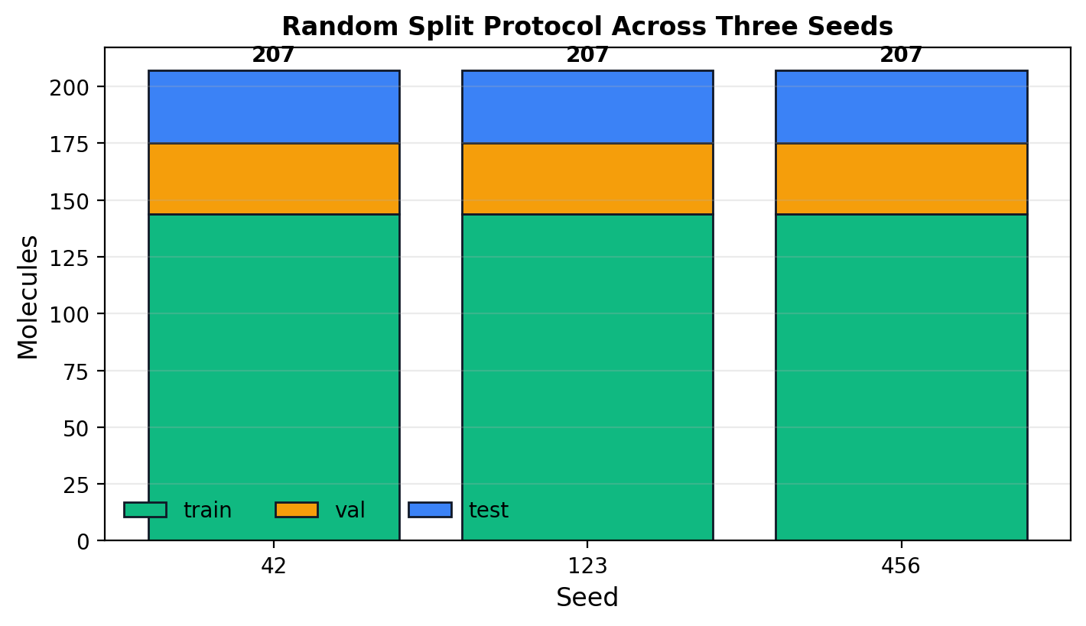
Data Cleaning and Splitting
Training-ready preprocessing avoids label leakage.
Raw properties
Energy labels
Clean merge
Split / tokenize
Formula, SMILES, MW, HBA/HBD, TPSA
Energy_AB, Energy_8H, Energy_min
Remove missing / invalid records
Train-val-test + ChemBERTa tokenizer
No leakage principle
Random split counts
Label normalization is computed from training statistics only. Validation and test sets are held out for model selection and final evaluation.

Slide 8
Outline
Background and data processing
Model and training strategy
Results and mechanistic analysis
Special cases, attention, limitations
Notes:
Our workflow begins with an initial search across a large molecule database, followed by high-throughput calculations to estimate binding potential. We then perform Gaussian-based quantum calculations to extract electronic descriptors, which are used as inputs. After training, the model highlights top candidates for further electronic analysis and final experimental validation.

Slide 9
ChemBERTa Regression Architecture
THE HONG KONG UNIVERSITY OF SCIENCE AND TECHNOLOGY
Key Setup
SMILES
Input:
SMILES string
C
9
=
C
C
N
...
Tokenizer
Target:
Energy_min binding energy
ChemBERTa Encoder
Model:
ChemBERTa encoder + regression head
[CLS]
[CLS] Molecular Representation
Task type:
supervised regression
Regression Head
Predicted Binding Energy
ChemBERTa provides pretrained molecular SMILES representations.
9

Slide 10
SMILES Augmentation: Invariance to String Serialization
THE HONG KONG UNIVERSITY OF SCIENCE AND TECHNOLOGY
Key Points
SMILES variant 1
C1=CC=CC=N1
One molecule can have multiple valid SMILES strings.
During training: canonical SMILES -> randomized equivalent SMILES
SMILES variant 2
N1=CC=CC=C1
same molecule
same Energy_min label
The binding-energy label stays unchanged.
SMILES variant 3
Goal: reduce sensitivity to arbitrary SMILES ordering
C=1C=NC=CC=1
Augmentation changes the input view, not the supervised target.
10

Slide 11
Two-Stage Supervised Fine-Tuning
THE HONG KONG UNIVERSITY OF SCIENCE AND TECHNOLOGY
Stage 1: head warm-up
LR
Freeze the ChemBERTa encoder and train only the regression head.
ChemBERTa Encoder
Regression Head
Learning rates
smaller LR for ChemBERTa backbone
Stage 2: task adaptation
LR
larger LR for regression head
Unfreeze the ChemBERTa encoder and fine-tune encoder plus regression head.
ChemBERTa Encoder
Regression Head
Stage 1 learns the supervised energy scale; Stage 2 adapts the molecular representation.
11

Slide 12
Controlled Experimental Design
THE HONG KONG UNIVERSITY OF SCIENCE AND TECHNOLOGY
Method
Purpose
3 seeds x 5 folds = 15 runs per method
No Aug + Two-stage
Baseline without SMILES augmentation
No Aug vs Aug: effect of SMILES augmentation
Aug + Two-stage
Final method
Stage1-only vs Two-stage: need for encoder adaptation
Aug + Stage1-only
Tests whether frozen ChemBERTa features are sufficient
Stage2-only vs Two-stage: role of Stage 1 warm-up
Aug + Stage2-only
Tests whether Stage 1 warm-up is useful
These controlled comparisons test why each training component matters.
12
12

Slide 13
Outline
Background and data processing
Model and training strategy
Results and mechanistic analysis
Special cases, attention, limitations
Notes:
Our workflow begins with an initial search across a large molecule database, followed by high-throughput calculations to estimate binding potential. We then perform Gaussian-based quantum calculations to extract electronic descriptors, which are used as inputs. After training, the model highlights top candidates for further electronic analysis and final experimental validation.

Slide 14
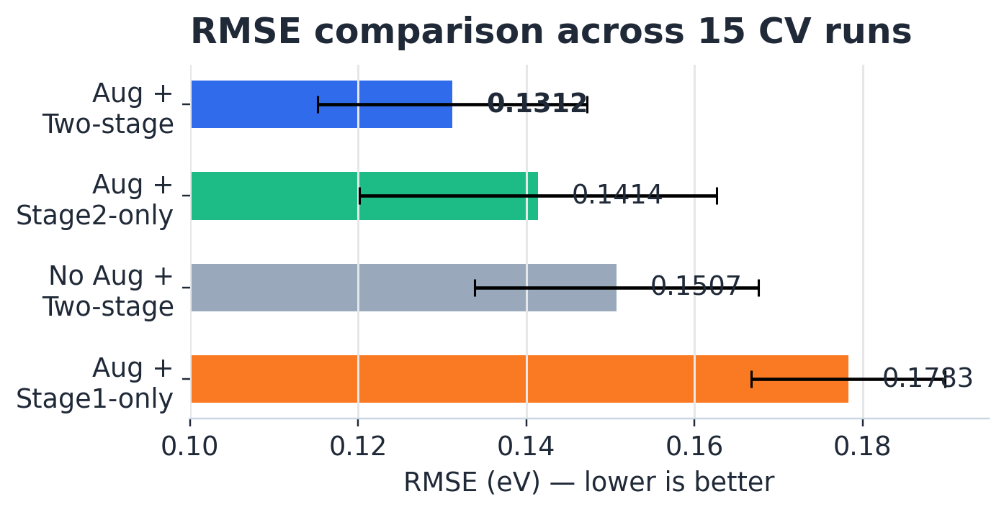
Four Main Experiment Results
Four controlled methods evaluated over 15 runs each (3 seeds × 5 folds).
Method | RMSE ↓ | MAE ↓ | R² ↑
No Aug + Two-stage | 0.1507 ± 0.0169 | 0.1182 ± 0.0137 | 0.4020 ± 0.1972
Aug + Two-stage | 0.1312 ± 0.0160 | 0.1042 ± 0.0132 | 0.5345 ± 0.1869
Aug + Stage1-only | 0.1783 ± 0.0115 | 0.1441 ± 0.0106 | 0.1802 ± 0.1717
Aug + Stage2-only | 0.1414 ± 0.0212 | 0.1111 ± 0.0150 | 0.4479 ± 0.2487
Main result
Aug + Two-stage achieves the lowest RMSE and MAE and the highest R² among the controlled CV experiments. The final method is not just the best average result. It improves both accuracy and robustness across folds

Slide 15
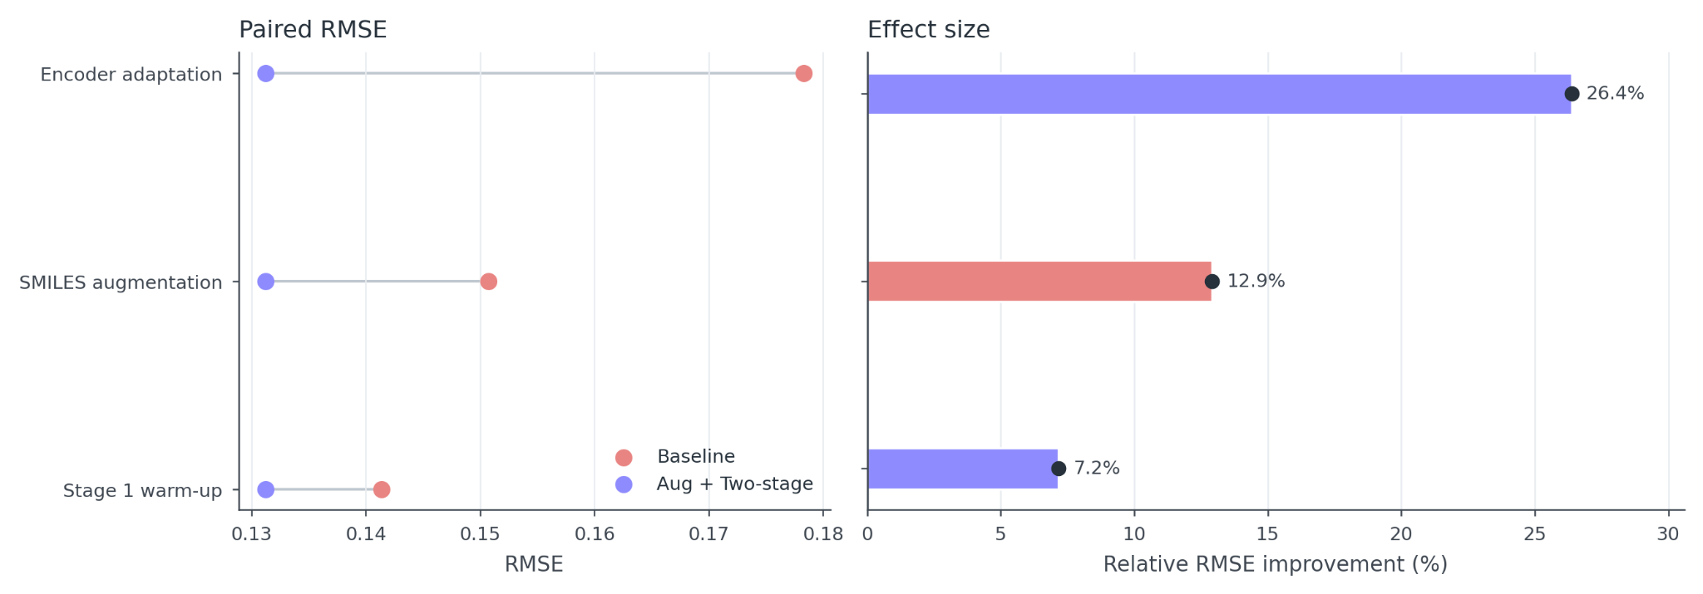
What Each Component Contributes
Component-level ablations explain why the final method works.
Encoder adaptation
26.39%
15/15
SMILES augmentation
12.92%
15/15
Stage-1 warm-up
7.17%
12/15
Core insight
The largest gain comes from encoder adaptation, meaning frozen pretrained embeddings are not enough. Augmentation consistently helps by improving robustness. Stage-1 warm-up gives a smaller stabilization effect.

Slide 16
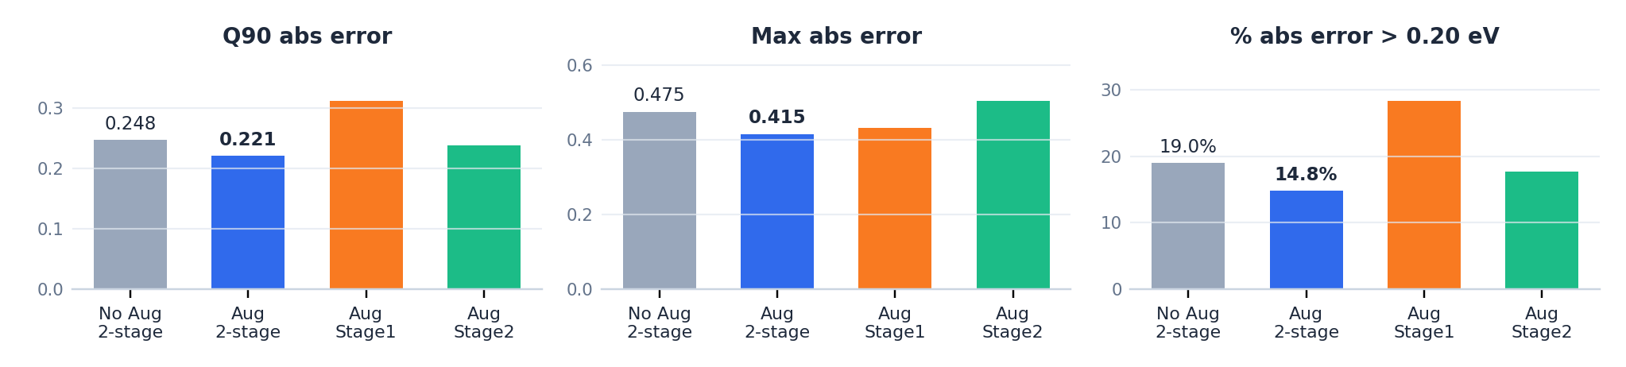
Error Tail Analysis
Reliability depends on reducing high-error cases, not only improving the average.
Method | Q90 abs error | Max abs error | % abs error > 0.20 eV
No Aug + Two-stage | 0.2476 | 0.4751 | 18.96%
Aug + Two-stage | 0.2210 | 0.4153 | 14.79%
Aug + Stage1-only | 0.3127 | 0.4325 | 28.33%
Aug + Stage2-only | 0.2383 | 0.5048 | 17.71%
The final method reduces high-error tail cases, which matters for screening reliability and not only average accuracy. For molecular screening, average RMSE is not enough. We also care about high-error predictions, because a few large mistakes may mislead candidate selection.
Interpretation

Slide 17
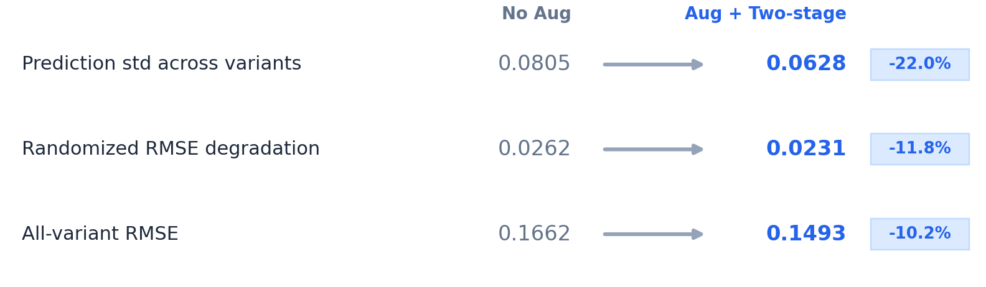
SMILES Robustness Probe
Direct test of whether augmentation reduces sensitivity to equivalent SMILES strings.
Probe setup
Model | Prediction std across variants | Randomized RMSE degradation | All-variant RMSE
No Aug + Two-stage | 0.0805 | 0.0262 | 0.1662
Aug + Two-stage | 0.0628 | 0.0231 | 0.1493
Same molecule
Equivalent randomized SMILES
Same Energy_min label
Measure prediction stability
Mechanistic interpretation
The augmented model is less sensitive to equivalent SMILES representations, directly supporting the proposed augmentation mechanism. This robustness probe is post-hoc evidence using matched checkpoints, not a new full CV training experiment

Slide 18
Outline
Background and data processing
Model and training strategy
Results and mechanistic analysis
Special cases, attention, limitations
Notes:
Our workflow begins with an initial search across a large molecule database, followed by high-throughput calculations to estimate binding potential. We then perform Gaussian-based quantum calculations to extract electronic descriptors, which are used as inputs. After training, the model highlights top candidates for further electronic analysis and final experimental validation.

Slide 19
Special Case Analysis
Failures concentrate in chemically unusual ionic or halogen-containing species.
SMILES | Mean abs error
[B-]OC.[Na+] | 0.3580
[Li+].[O-]I | 0.2952
[BH3-]I.[Na+] | 0.2919
[B][C-]=N.[Na+] | 0.2655
CO[O-].[Na+] | 0.2626
[B]=[N-].[K+] | 0.2476
C[CH-]N.[Rb+] | 0.2304
C[CH][CH2-].[Rb+] | 0.2182
C([O-])I.[Na+] | 0.2087
[Li+].C[NH-] | 0.2059
SMILES | Mean abs error
Cl[I-]Cl.[K+] | 0.0217
[Li+].C1C[CH-]1 | 0.0248
[CH2][O-].[K] | 0.0259
C=C=[N-].[Na+] | 0.0270
C(=N)=[N-].[Na+] | 0.0279
[Li+].C=[C-]Br | 0.0302
[Li+].[B]C=[CH-] | 0.0307
[Li+].N(O)[O-] | 0.0328
[O-]Cl.[Na+] | 0.0332
[BH3-]O.[K+] | 0.0357
Notes:
分析了效果最好的模型预测的结果绝对误差大于0.2的Special Case进行分析。
Ionic pairs, Highly charged, non-neutral structures
Presence of atypical chemical elements/groups (e.g., boron-based anions, halogens：[O-]I、[BH3-]I)

Slide 20
Special Case Analysis
Failures concentrate in chemically unusual ionic or halogen-containing species.
Case type | Formula | SMILES | Mean abs error
Largest-error failure | CH₃BNaO | [B-]OC.[Na+] | 0.3580
Halogen failure | ILiO | [Li+].[O-]I | 0.2952
Additional high-error failure | BH₃INa | [BH3-]I.[Na+] | 0.2919
Low-error success contrast | Cl₂IK | Cl[I-]Cl.[K+] | 0.0217
Interpretation
Remaining errors are not random; they reveal a limitation of SMILES-only ChemBERTa for unusual charged metal-containing chemistry.
Notes:
分析了效果最好的模型预测的结果绝对误差大于0.2的Special Case进行分析。

Slide 21
Attention Visualization
Attention is useful for qualitative inspection, but not causal proof.
What attention checks
Failure interpretation
Whether the model attends to chemically meaningful tokens such as charge, metal, halogen, oxygen, boron, or nitrogen.
In failure cases, attention may identify important tokens but still produce inaccurate energies, suggesting representation limitations.
Attention evidence ≠ causal explanation
Academic caution
Use attention as qualitative support for error analysis, not as proof that a token caused the prediction.

Slide 22
Limitations and Future Improvements
The project should be evaluated by correct formulation and critical reasoning, not only scores.
Limitation | Why it matters | Future improvement
Small dataset | Higher overfitting and fold variance | Collect more molecules; nested CV
SMILES-only representation | May miss 3D and ionic interaction geometry | Add graph or 3D/geometric features
Computed proxy label | Energy_min is not direct device performance | Validate with experiments or multi-task labels
Metadata in predictions | Case mapping relies on row order | Save CID and SMILES in prediction outputs

Slide 23
Conclusions
1. Correct deep learning formulation
2. Justified model strategy
3. Main empirical finding
The project is supervised molecular regression: SMILES input, Energy_min target, continuous prediction, MSE training, and RMSE/MAE/R² evaluation.
ChemBERTa is appropriate because the input is a molecular sequence and pretraining is valuable under small-data conditions.
SMILES augmentation plus two-stage fine-tuning gives the best CV result: RMSE 0.1312 eV, MAE 0.1042 eV, R² 0.5345.

Slide 24
Thanks!
LYU Xinyi, LIU Zesen, XU Fangjian, SUN Tiantian

