Slide 1

Using ML to accelerate molecular additive design for perovskite interface
Group 5
Nov. 25th, 2025
Notes:
Hello everyone. Today our group will present our work on using machine learning to accelerate the discovery of molecular additives for perovskite solar cell interfaces. Our aim is to outline a simplified, data-driven workflow that can rapidly identify promising molecules for passivation.

Slide 2
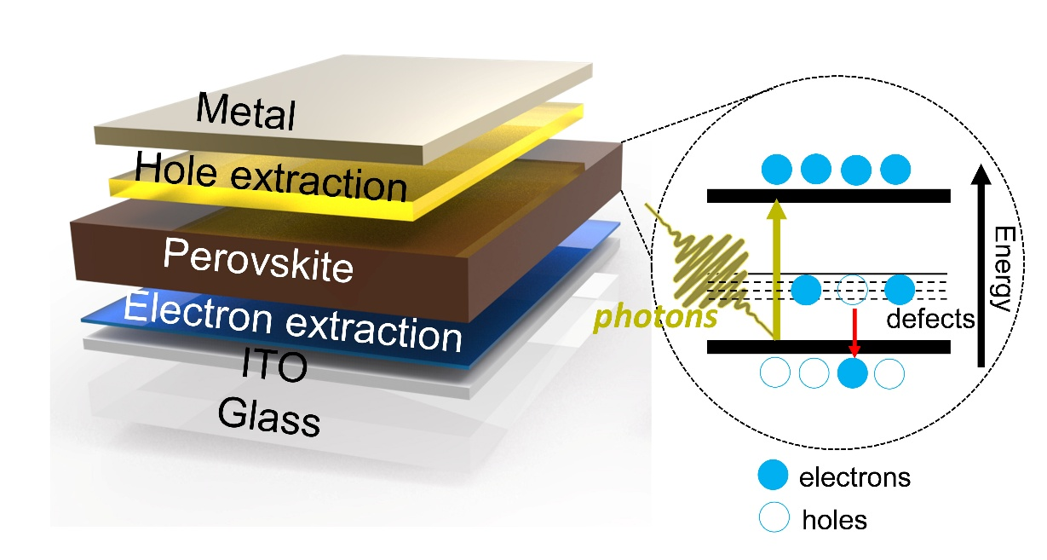
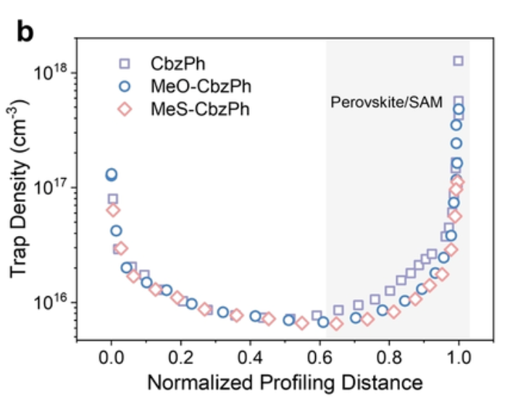
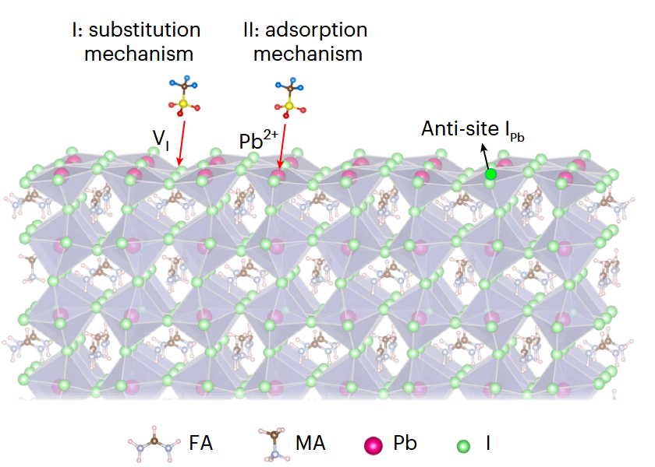
Introduction
Challenges of perovskite solar cells:
Long-term stability
Photoelectronic convert efficiency
A main reason:
The low formation energy and immigration of point defects.
Nat. Mater. 22, 1507–1514 (2023).
Notes:
Although perovskite solar cells have achieved remarkable efficiency, surface defects remain a major source of non-radiative losses and instability. Introducing small functional molecules at the interface is an effective strategy to suppress these defects, but the experimental screening is inefficient. Machine learning allows us to learn the relationship between molecular properties and binding energy, enabling fast selection of candidates.

Slide 3
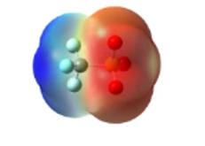
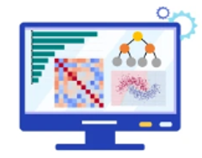
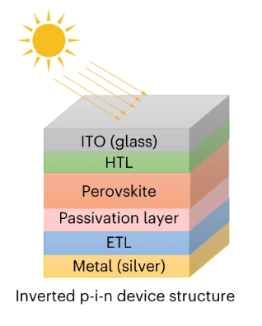
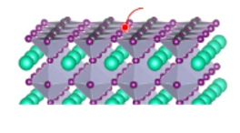
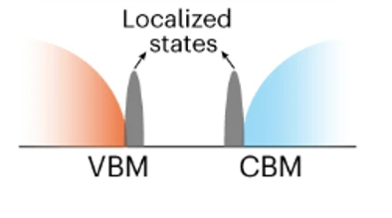
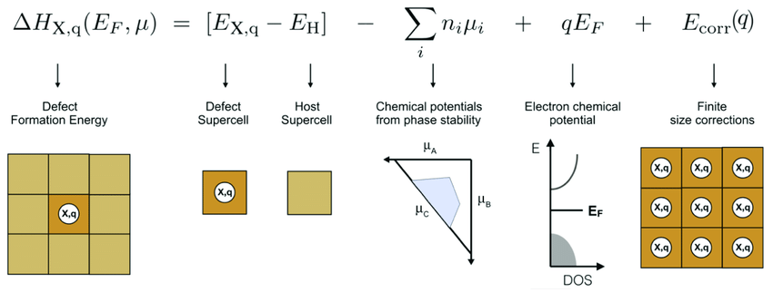
Workflow
Gaussian calculations as ML inputs
ML training
Materials screening from database
High-throughput surface binding energy calculations
8 potential candidates (3 bifunctional candidates)
Surface band edge electronic structures
Defect formation energy calculations
New PV device with improved performance
Characterization: SEM, PL intensity
Experimental p-i-n devices measurement
（PCE, V_{OC}, J_{SC}, FF)
Notes:
Our workflow begins with an initial search across a large molecule database, followed by high-throughput calculations to estimate binding potential. We then perform Gaussian-based quantum calculations to extract electronic descriptors, which are used as inputs. After training, the model highlights top candidates for further electronic analysis and final experimental validation.

Slide 4
Data screening
Screening tiers
5 million
PubChem database
8,027
Charge = -1 anions
1
7,169
Exist as Li/Na/K salts
2
650
2< non-hydrogen atoms <5
3
572
Molecular weight < 70
4
414
Hydrogen Bond Acceptor Count ≠ 0
5
Notes:
The purpose of this workflow is to move efficiently from millions of possible compounds to a small, realistic set of high-value additives. To achieve that, we designed a tiered filtering strategy. Starting from roughly five million molecules in PubChem, we filtered by charge state, chemical constraints, atomic composition, molecular weight, and hydrogen-bonding ability. Each step removes unqualified molecules, gradually shrinking the search space while enriching promising candidates for interface engineering and device testing.

Slide 5



Dataset Overview
Table 1. Summary of molecular dataset
Item | Description
Molecules | 414 candidate molecules
Target label | Binding energy (eV) between molecule and the perovskite surface
Application | Screening passivation agents for perovskite surface defects
Input features | 33 raw descriptors; a selected subset is used for training
Structural identifiers
SMILES, InChI, molecular formula
→
uniquely define molecular connectivity and composition.
Physicochemical descriptors
Exact mass → captures size and steric fit on the surface.
Topological Polar Surface Area (TPSA) → describes polarity and hydrogen-bonding potential.
Interaction-related
counting descriptors
H-bond acceptor / donor sites
→
indicate the number and flexibility of potential binding sites for under-coordinated Pb²⁺ defects.
Notes:
I will briefly introduce the dataset we use to train our prediction model.
This dataset contains 414 candidate molecules, each labelled with the binding energy to the perovskite surface.
We group our descriptors into three chemistry-meaningful categories.
Structural identifiers like SMILES and InChI uniquely define molecular connectivity and composition.
Physicochemical descriptors, such as exact mass and TPSA, capture molecular size, steric fit and polarity, which directly affect how the molecule interacts with the surface.
And interaction-related counting descriptors – mainly H-bond acceptor/donor sites and rotatable bonds – approximate the number and flexibility of potential binding sites for under-coordinated Pb²⁺ defects.

Slide 6
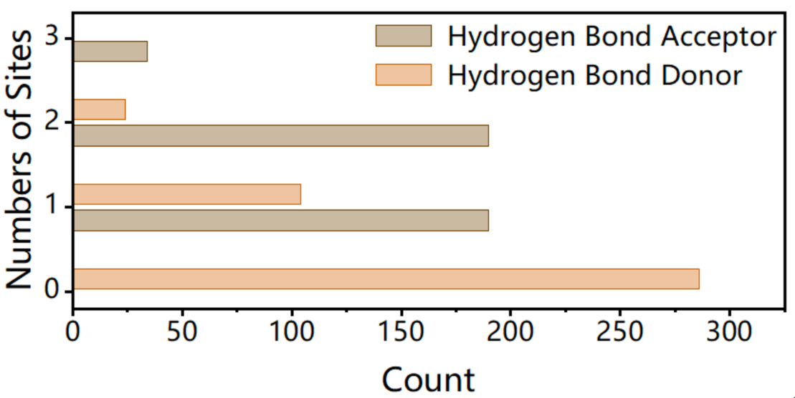
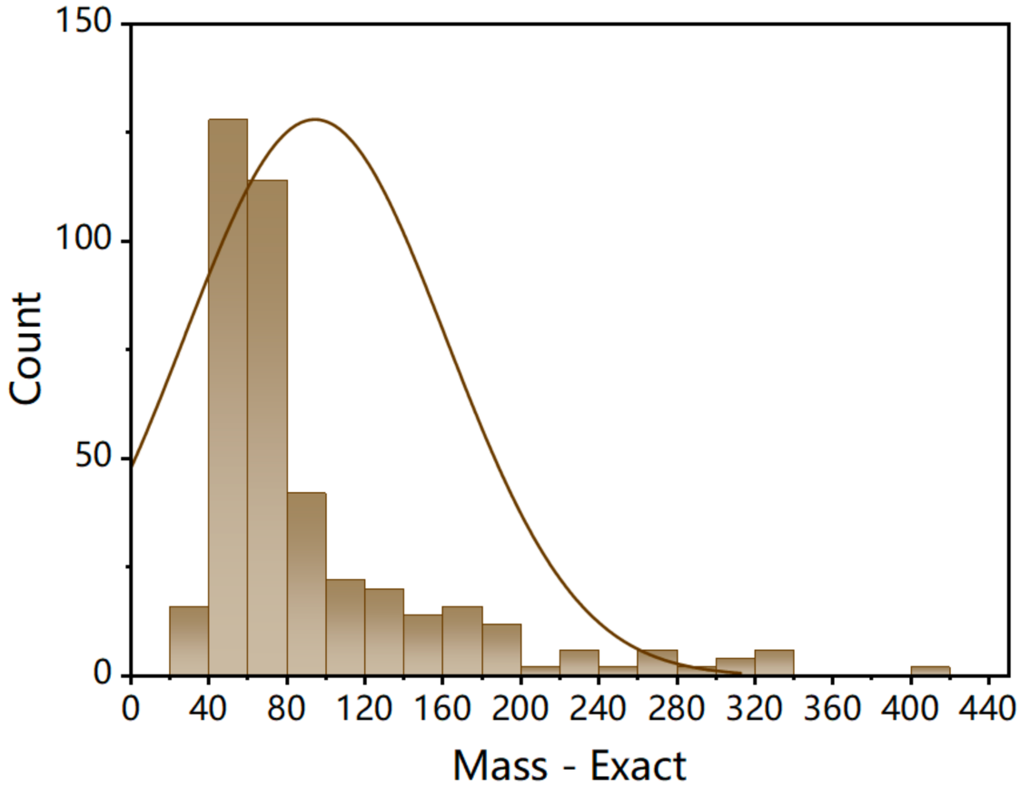
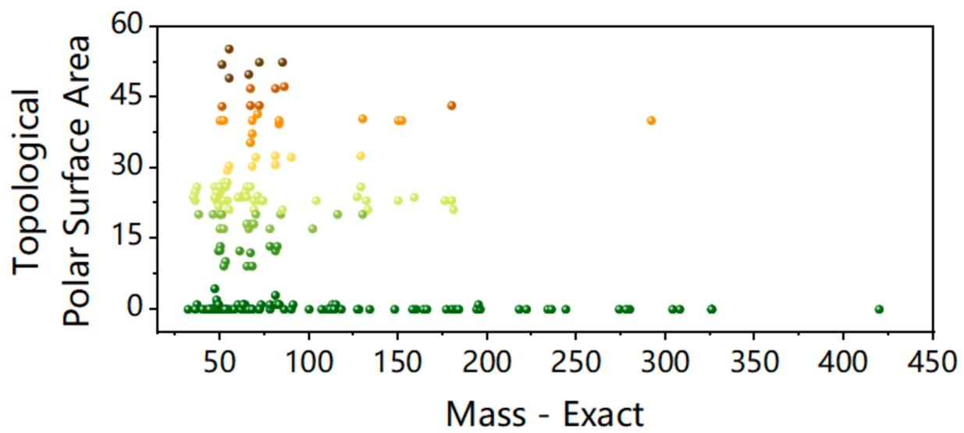
Feature Distribution and Design Space
Figure 2. Counts of H-bond donors and acceptors
Most molecules have 1–2 H-bond acceptor sites but no donors, indicating a design bias toward neutral Lewis base ligands for Pb²⁺ defect passivation.
Figure 1. Distribution of molecular size
Figure 3. Exact Mass vs. Polar Surface Area
Many molecules are moderately polar (TPSA ≈ 5-30), while about 1/3 are non-polar (TPSA = 0), giving a diverse size–polarity design space for binding-energy prediction.
Most molecules are small to medium-sized, with exact mass mainly between 40 and 100 Da.
Notes:
On this slide, we visualize the feature distribution and design space of our candidate passivation molecules.
Figure 1 shows molecular size. Most molecules are small to medium-sized, with exact mass mainly between about 50 and 100 Daltons, which is suitable for forming compact passivation layers.
Figure 2 shows hydrogen-bond donors and acceptors. Most molecules have one or two acceptor sites but almost no classical donors, reflecting a design bias towards neutral Lewis-base ligands that coordinate under-coordinated lead ions without introducing many protic groups.
Figure 3 plots exact mass against topological polar surface area. These axes define a size–polarity design space. We cover both non-polar and moderately polar molecules across a range of sizes, so the model can learn how binding energy depends on a combination of contact area and polarity at the perovskite interface.

Slide 7
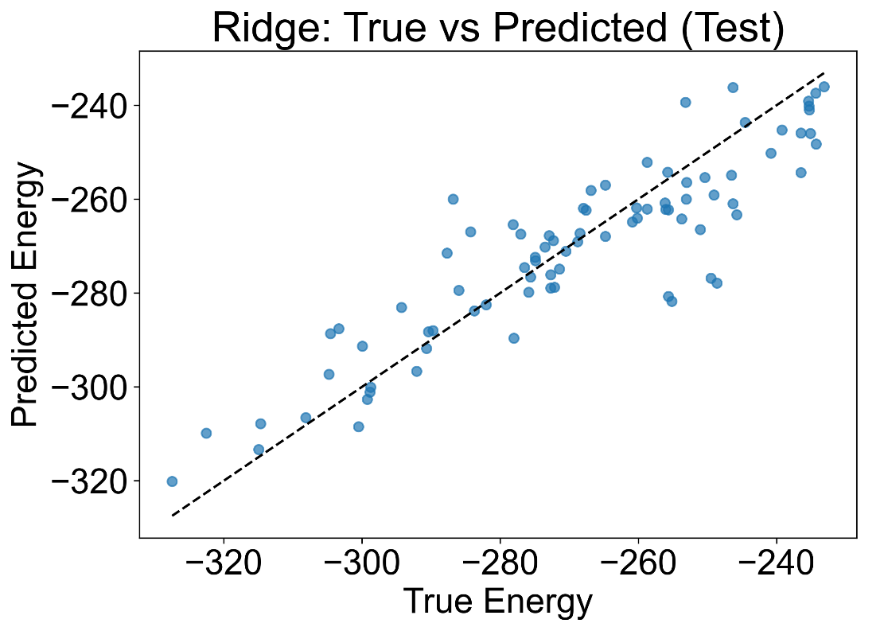
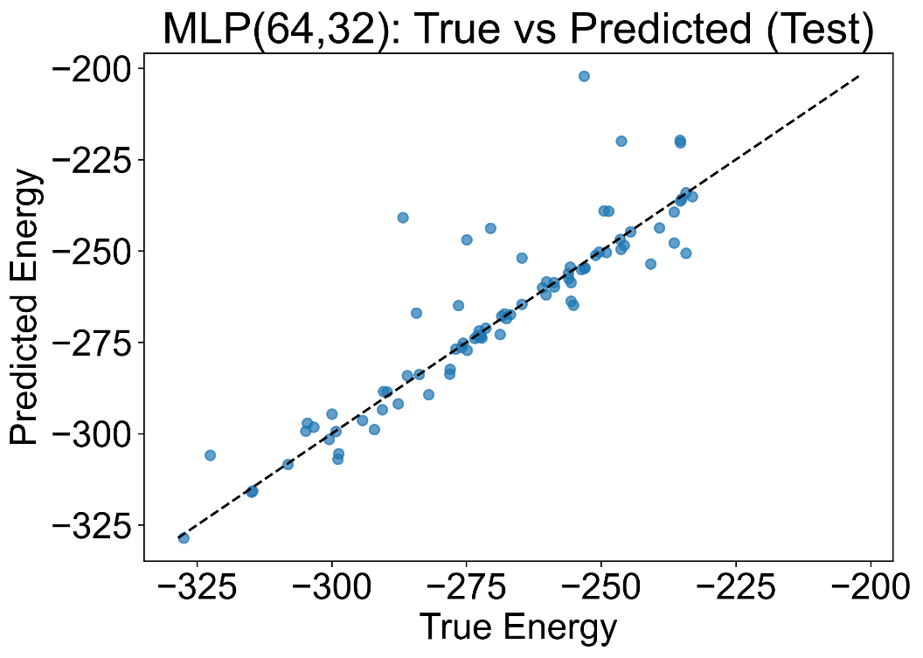
Model Construction for Energy Prediction
Linear Regression
Multilayer Perceptron
Input Features
(33 descriptor)
Linear layer
W·x+b
Output
Binding Energy
Input Layer
(33 descriptor)
Hidden layer 1
Output layer
Binding Energy
Hidden layer 2
-1.47
-1.60
-1.60
-1.73
-1.73
-1.86
-1.86
-2.00
-2.00
Test set
Test set
-2.13
R² = | 0.80
-2.13
R² = | 0.78
-1.86
-1.73
-1.47
-2.13
-2.00
-1.60
-1.60
-2.13
-2.00
-1.86
-1.73
-1.60
Dataset split: 50% train, 30% validation, 20% test
Activation: ReLU, Optimizer: Adam
Notes:
Here I will introduce how we build models to predict the binding energy between the molecule and the perovskite surface.
Our dataset contains classical molecular descriptors. We always use the same split: about fifty percent for training, thirty percent for validation, and twenty percent for testing. This keeps the comparison between models fair.
First, we build a linear baseline with Ridge regression.
All numerical features are standardized. Then we apply Ridge, which is just linear regression with L two regularization to reduce overfitting.
Even with this simple model, we reach a test R squared of about zero point eight.
So a basic linear model already captures most of the variance in binding energy and gives us a strong, stable baseline.
Second, we test a shallow multilayer perceptron.
The network has two hidden layers with ReLU activation and is trained with the Adam optimizer.
On the test set, the MLP reaches an R squared of around zero point seven eight, which is slightly below Ridge, and during training we can see clear overfitting.
This suggests that, with our data size, simply adding more nonlinearity does not automatically improve performance.

Slide 8
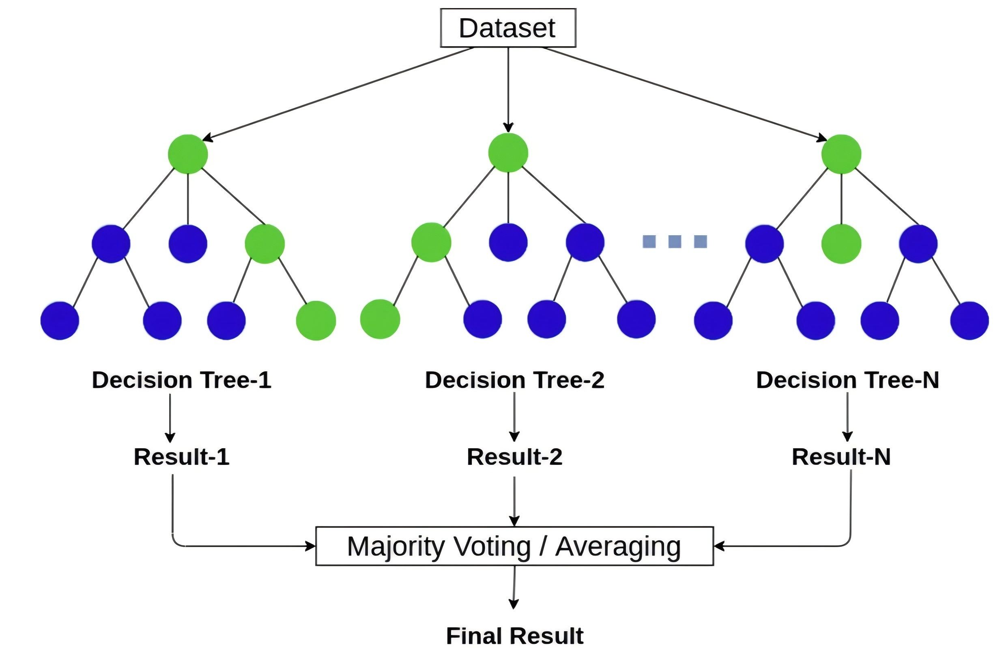
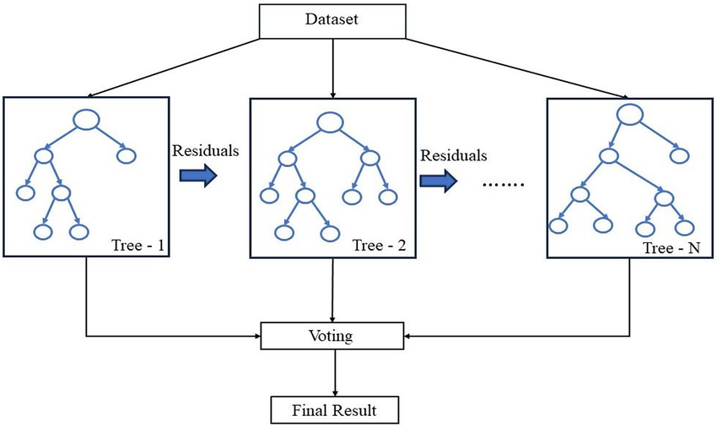
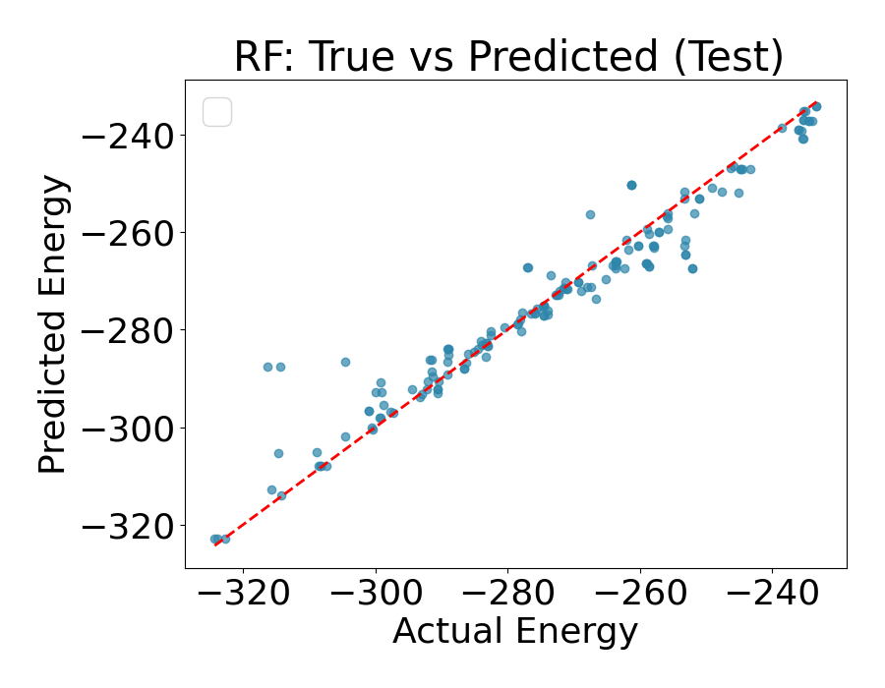

Model Construction for Energy Prediction
Table 2. Model performance on different models
Random Forest Regression
Model Performance
-1.60
Test set
-1.60
Test set
-1.73
-1.73
-1.86
-1.86
-2.00
-2.00
R² = MSE = | 0.938 29.61
R² = MSE = | 0.948 4.12
-2.13
-2.13
-2.13
-2.00
-1.86
-1.73
-1.60
-2.13
-2.00
-1.86
-1.73
-1.60
Split | MAE | MSE | RMSE | R²
train | 0.483 | 0.367 | 0.606 | 0.995
val | 1.542 | 3.452 | 1.858 | 0.962
test | 1.678 | 4.124 | 2.031 | 0.948
Feature Selection: 17 molecular descriptors
Dataset split: 50% train, 30% validation, 20% test
Decision tree: 100
Notes:
we then move to Random Forest regression model, with about one hundred decision trees, using bootstrapping and random feature subsets at each split.
Random Forest can capture complex non-linear interactions between molecular features and binding energy, but in our case it is unstable, with a higher mean squared error.
Because of this, we then switch to XGBoost, that builds trees sequentially to correct residual errors.it can gives more consistent feature importance.
So XGboost reach a test R squared of around zero point nine five, and shows that ensemble tree methods is effective choice for this binding energy prediction task.

Slide 9
Model Evaluation for Energy Prediction
Model Comparation
Test set | Ridge | MLP | Random Forest | XGBoost
MAE | 7.74 | 5.74 | 3.334 | 1.678
MSE | 105.40 | 117 | 29.61 | 4.124
RMSE | 10.26 | 10.82 | 5.441 | 2.031
R² | 0.80 | 0.78 | 0.938 | 0.948
Summary of Model Recommendations
1. Molecule Design Guidance:
Ridge Regression.
2. High-Accuracy Prediction:
XGBoost.
3. Recommended Approach:
A Hybrid Strategy
Performance
1. Enable a Closed-Loop Design Pipeline
2. Achieve High Accuracy and Strong Generalization.
3. Accelerates Discovery.
Notes:
In this task, four machine learning models were trained and systematically compared on a test set using four evaluation metrics on the left.​ ​
Results reveal a clear hierarchy. XGBoost led with superior performance, showing excellent accuracy and generalization by capturing 95% of target energy variance. Random Forest ranked second with double errors.​ ​
Ridge regression underperformed, confirming non-linear molecular feature-energy relationships unsuited to linear models. Surprisingly, MLP ranked last, maybe due to shallow depth and poor hyperparameters.​ ​
The task aims to link multi-dimensional structural parameters from molecular data to binding energies. For max accuracy in high-throughput screening, XGBoost and Random Forest offers robust and solid results. Ridge Regression provides interpretability and linear trends for design guidance, while MLP is not recommended.​
​
As for deployment, we could combine the XGBoost for precision and Ridge Regression for insights, balancing accuracy and chemistry in molecular discovery workflows.​

Slide 10
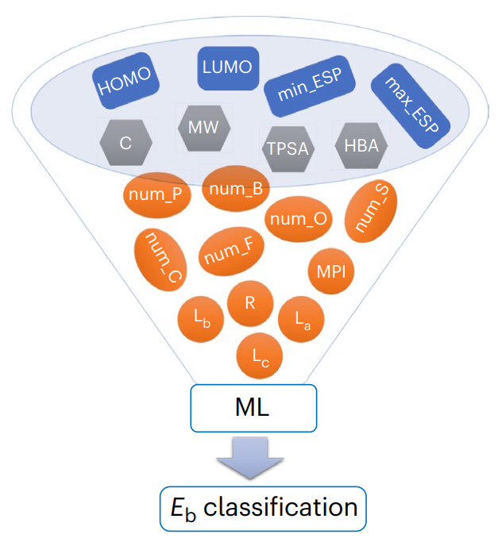
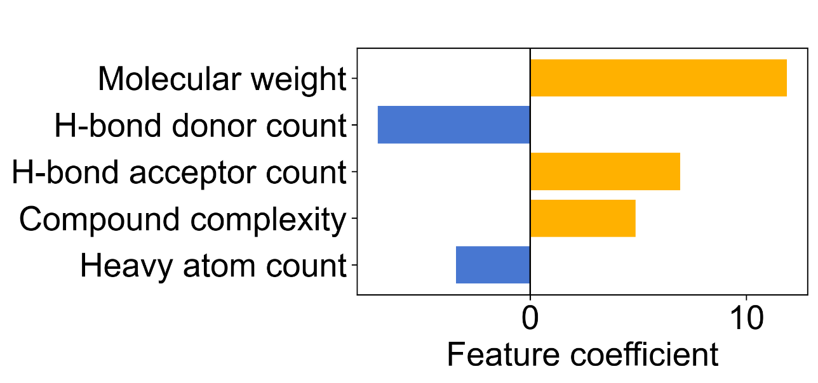
Molecule Feature Contribution
Model Input
Feature coefficient
Mono
Comp
aro_ring
heavyatom
R_bond
HDonr
HAcpt
Tauto
Molecular size and complexity
Strongest positive effect on binding energy.
Hydrogen-bonding polarity
More H-bond acceptors stabilize binding
MFP
Ring
IsoAt
Coval
Model favors more complex and acceptor-rich structures
Notes:
We further analyzed the relationship between features in molecular structure data and binding energy. ​
​
Molecular size dominates as the strongest positive driver, followed by the number of hydrogen bond acceptors and compound complexity. This indicates that larger molecules rich in acceptor sites are conducive to forming lower binding energies. ​
​
Hydrogen bond donors and heavy atom count rank higher among negatively correlated features, suggesting that molecules with these characteristics are unsuitable for use as molecular passivation materials. ​
​
Most other common descriptors—such as aromatic proportion and rotatable bonds—show coefficients close to zero after accounting for size and acceptor count, providing almost no additional explanatory power. ​
​
Based on this, we can infer that, according to the training results of the existing model, we should employ molecules with more complex structures and more hydrogen bond acceptors as passivation materials in experiments.​

Slide 11
Molecule Selection
Sodium hypochlorite
m = 73.95
H-bond donor count: 0
H-bond acceptor count: 1
Compound complexity: 4.8
Heavy atom count: 3
binding energy: -1.573 eV
Sodium chlorate
m = 106.44
H-bond donor count: 0
H-bond acceptor count: 3
Compound complexity: 6
Heavy atom count: 6
binding energy: -1.638 eV
Sodium tetrafluoroborate
m = 109.79
H-bond donor count: 0
H-bond acceptor count: 5
Compound complexity: 8.8
Heavy atom count: 6
binding energy: -1.688 eV

Slide 12
Device Performance
Pristine
0 10 20 30
Pristine
NaClO
Current density (mA/cm²)
NaClO
NaClO₃
NaClO₃
PL intensity (a.u.)
NaBF₄
NaBF₄
700 800 900
0 0.4 0.8 1.2
Wavelength (nm)
Voltage (V)
22 24 26 28
 | V_{oc} (V) | Jsc (mA/cm²) | FF (%) | PCE (%)
Pristine | 1.18 | 25.36 | 83.30 | 24.92
NaClO | 1.19 | 25.31 | 84.72 | 25.51
NaClO₃ | 1.19 | 25.65 | 84.42 | 25.77
NaBF₄ | 1.19 | 25.67 | 84.43 | 25.79
PCE (%)
Pristine NaClO NaClO₃ NaBF₄

Slide 13
Thanks!
LYU Xinyi, YANG Changyu, XIE Lifang, TANG Jiahong, YU Wenjian

