Slide 1
Debugging Parallel Build Dependency Errors
Zach Salzbank
Reliable Software E6121
Fall 2012

Slide 2
Outline
Problem
Solution
Implementation
Demo
Challenges
Improvements

Slide 3
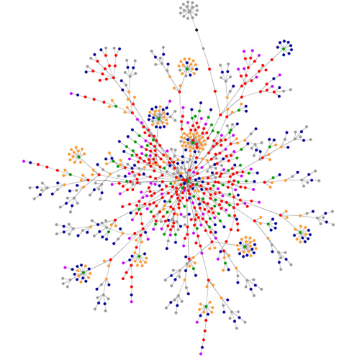
Problem
Complex software →
Many dependencies
Sequential builds are slow
Debugging sequential builds
        is difficult; Parallel builds
        are even harder
Multiple build systems: make, gyp, scons, etc...

Slide 4
Solution
Determine dependencies of a successful build
  Create tool to visualize dependencies of:
        Build processes
        Generated files
Use failed build output and dependencies to debug

Slide 5
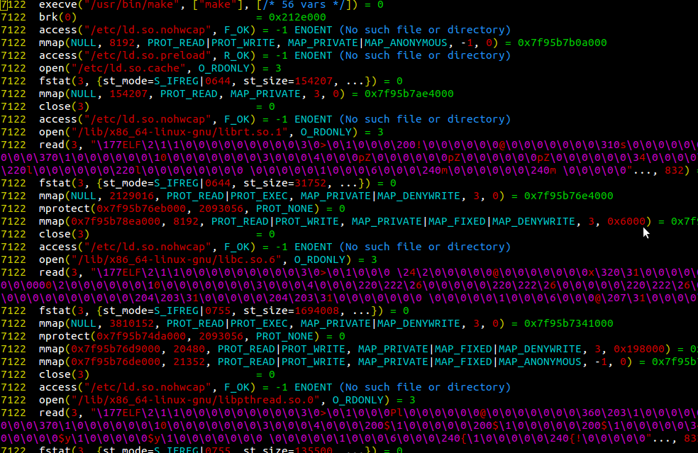
Implementation – Part 1
Capture file operations
during successful build
with strace
Parse output to determine
dependencies
Important operations are:
    open, read, write, rename

Slide 6
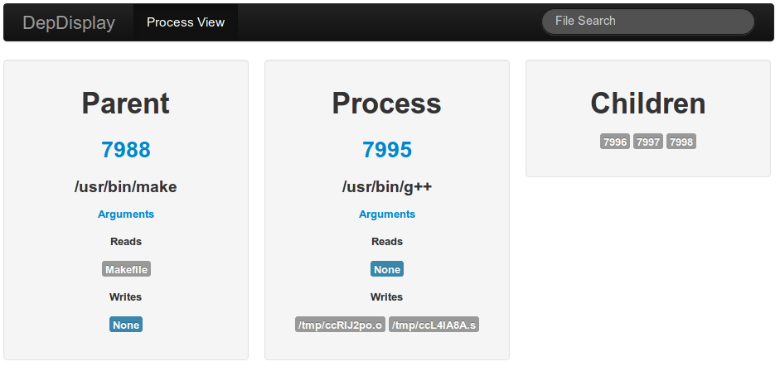
Implementation – Part 2
Determine what files are important
        Don't care about shared system files
        Care about files in the CWD
  Show all dependencies in easy to use interface

Slide 7
Demonstration

Slide 8
Challenges
Parsing strace output when multiple processes are occuring simultaneously
Determining if file is important
Lots of information to display

Slide 9
Improvements
Processing strace output is slow
Create rules for builds from discovered dependencies

Slide 10
Questions?

