Slide 1
CS171 Tutorial4 HW2 Optional Part
YiHeng Wu

Slide 2
-1. About HW1 Check

Slide 3
About HW1 Check
“.obj” 文件中的顶点和法向量数量不一定是一样的
顶点数据的插值在光栅化的时候进行
光栅化在片段着色器之前
LearnOpenGL 教各位的 Phong lighting 是在世界坐标系做的
“FragPos” 和 “Normal” 这两个变量是在世界坐标系的

Slide 4
About HW1 Check
“.obj” 文件中的顶点和法向量数量不一定是一样的
顶点数据的插值在光栅化的时候进行
光栅化在片段着色器之前
LearnOpenGL 教各位的 Phong lighting 是在世界坐标系做的
“FragPos” 和 “Normal” 这两个变量是在世界坐标系的
If you still don‘t understand them, study hard…

Slide 5
0. HW2 Optional Part

Slide 6
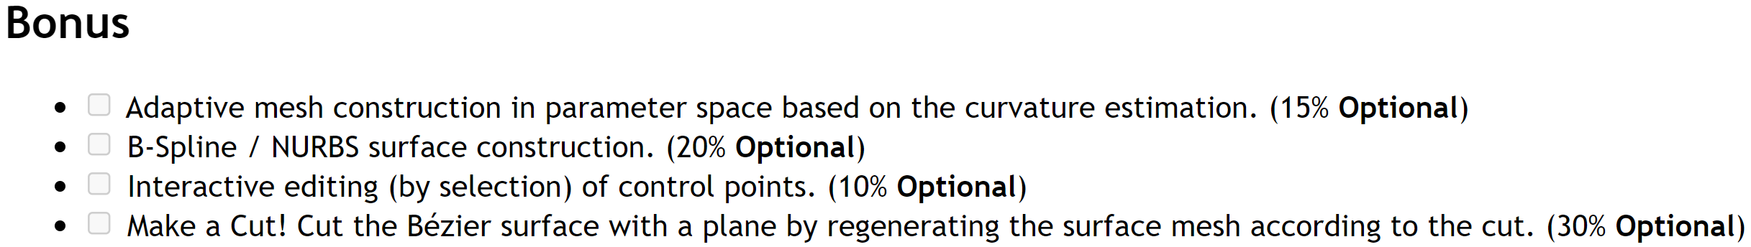
HW2 Optional Part
B-Spline is easy

Slide 7
HW2 Optional Part
B-Spline is easy
“Adaptive” and “Cut” may require triangulation…

Slide 8
HW2 Optional Part
B-Spline is easy
“Adaptive” and “Cut” may require triangulation…
I know little about “Interactive”…

Slide 9
1. Triangulation

Slide 10

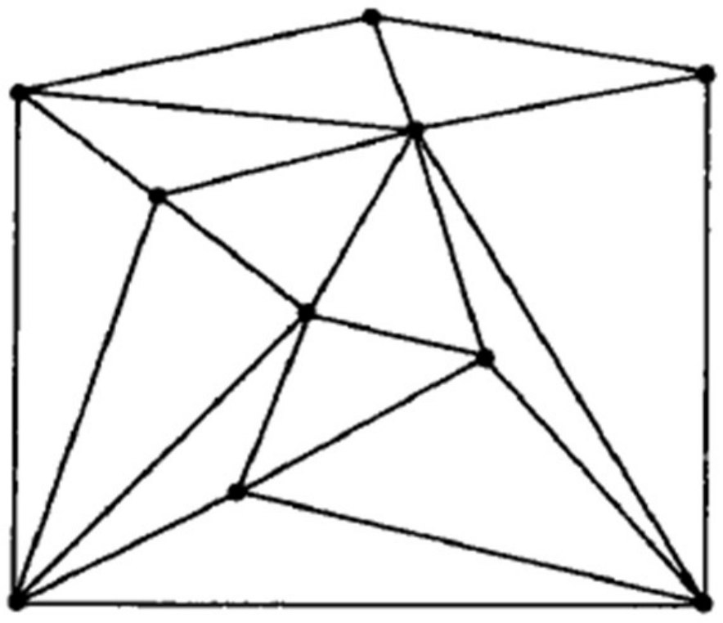
Triangulation
What is a triangulation?

Slide 11
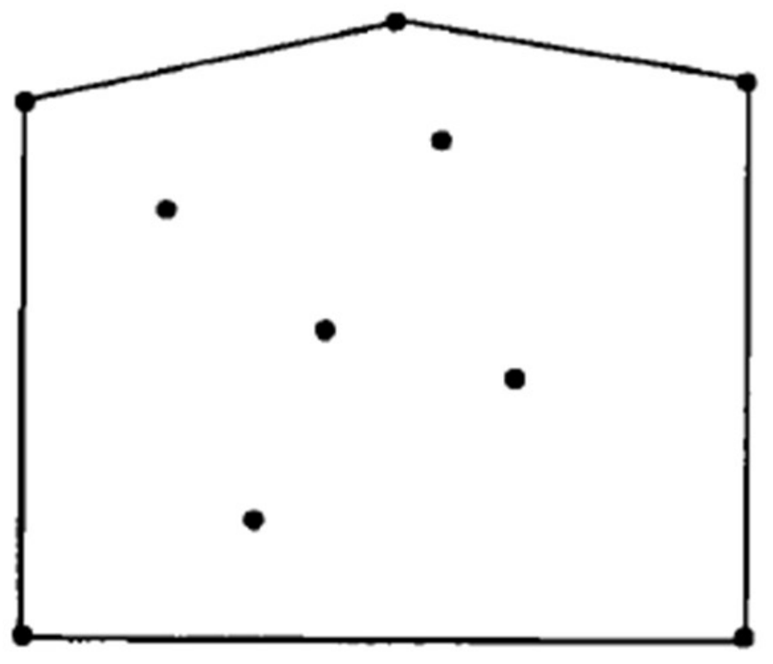
Triangulation
What is a triangulation?
Algorithm
Convex Hull (凸包)

Slide 12
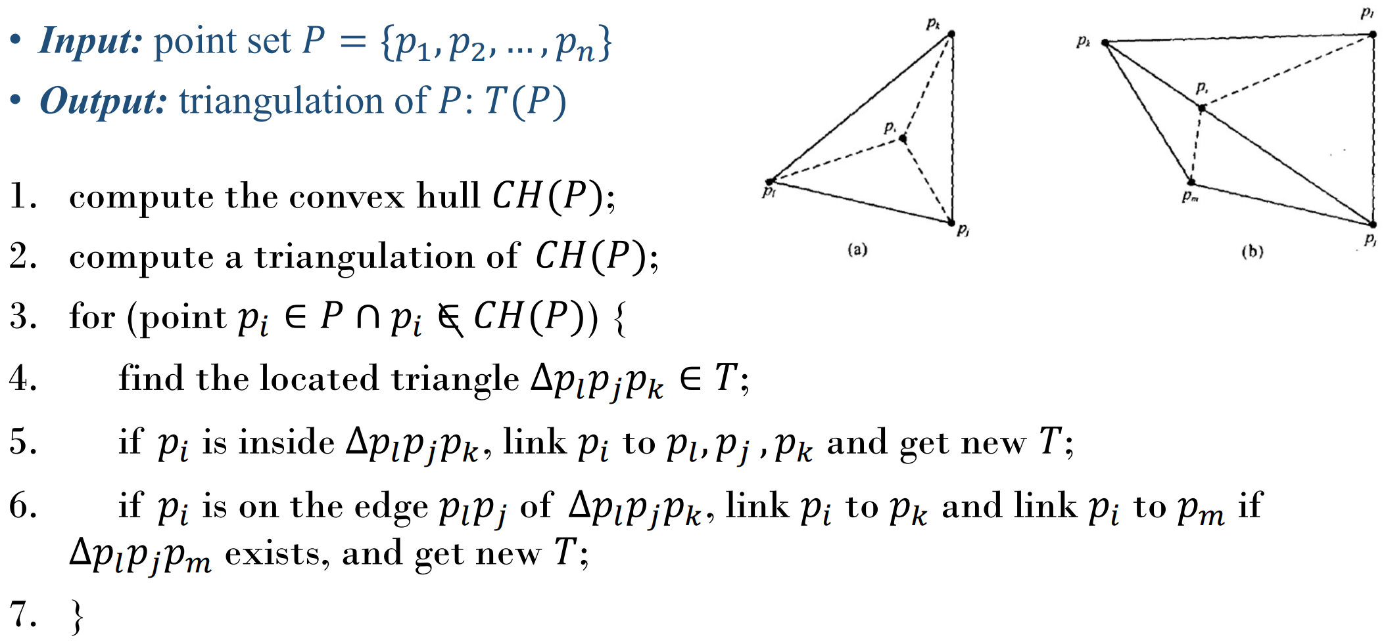
Triangulation
What is a triangulation?
Algorithm

Slide 13
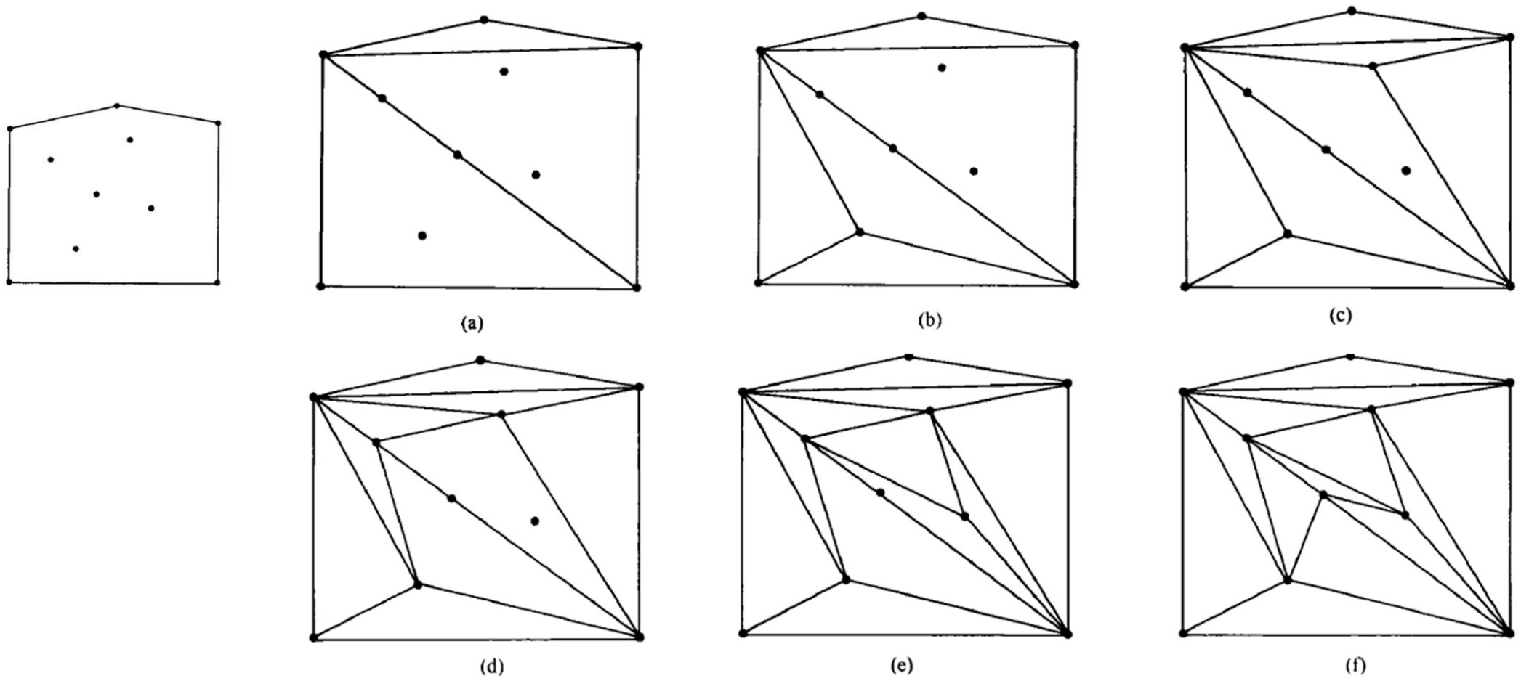
Triangulation
What is a triangulation?
Algorithm
Example

Slide 14
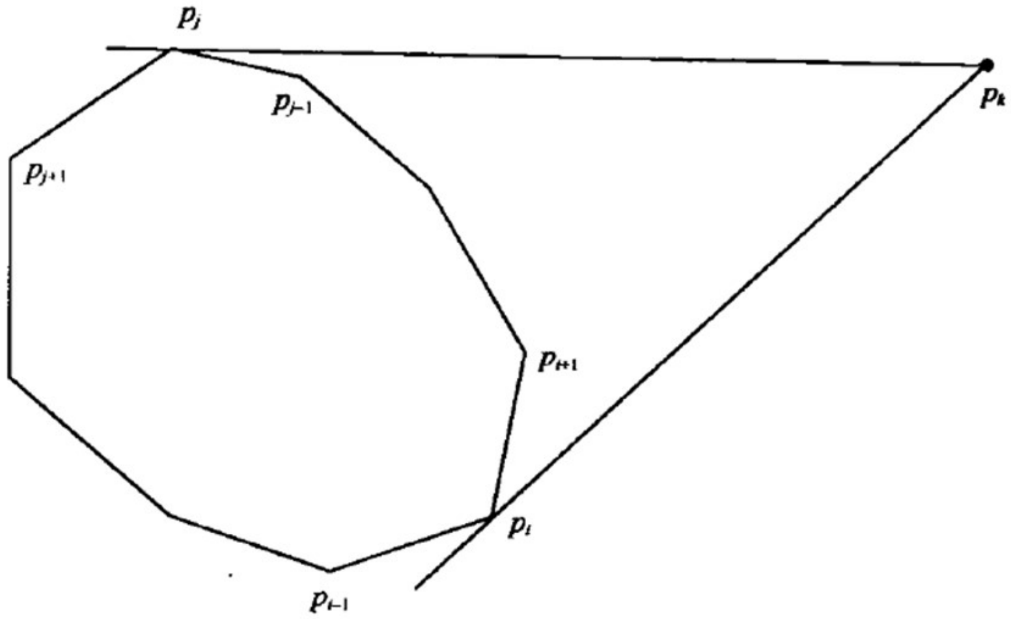
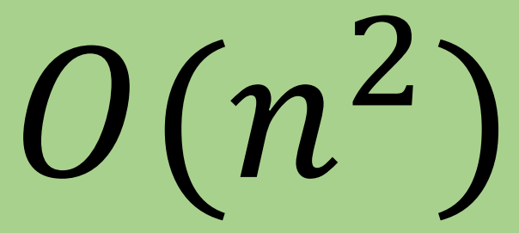
Triangulation
What is a triangulation?
Algorithm
Example
Convex Hull
Simplest algorithm: Incremental

Slide 15
2. Delauny Triangulation

Slide 16
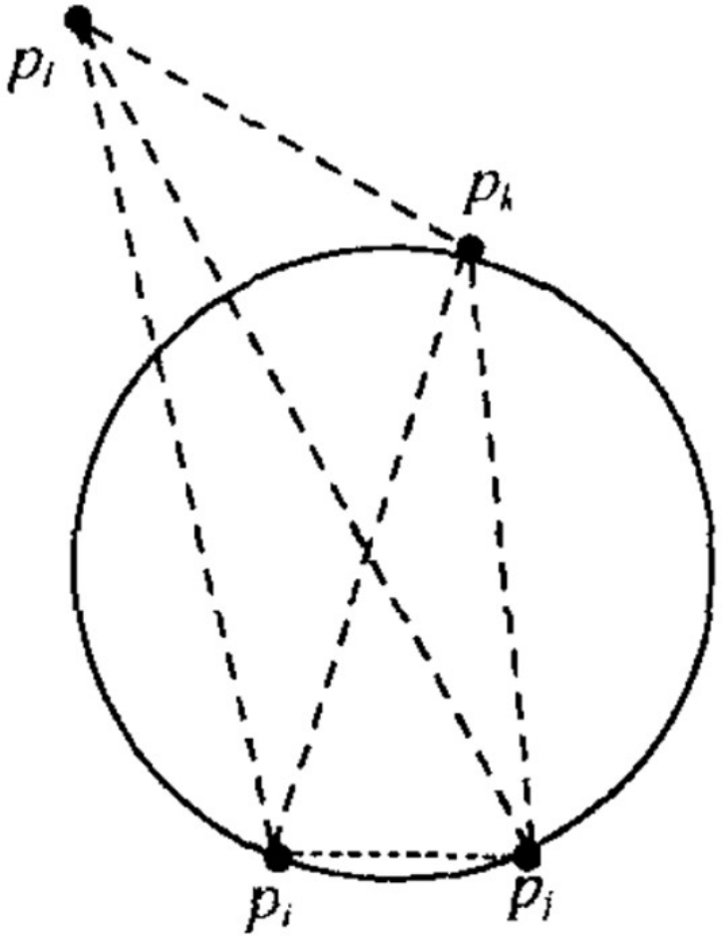
Delauny Triangulation
What is Delauny triangulation?

Slide 17
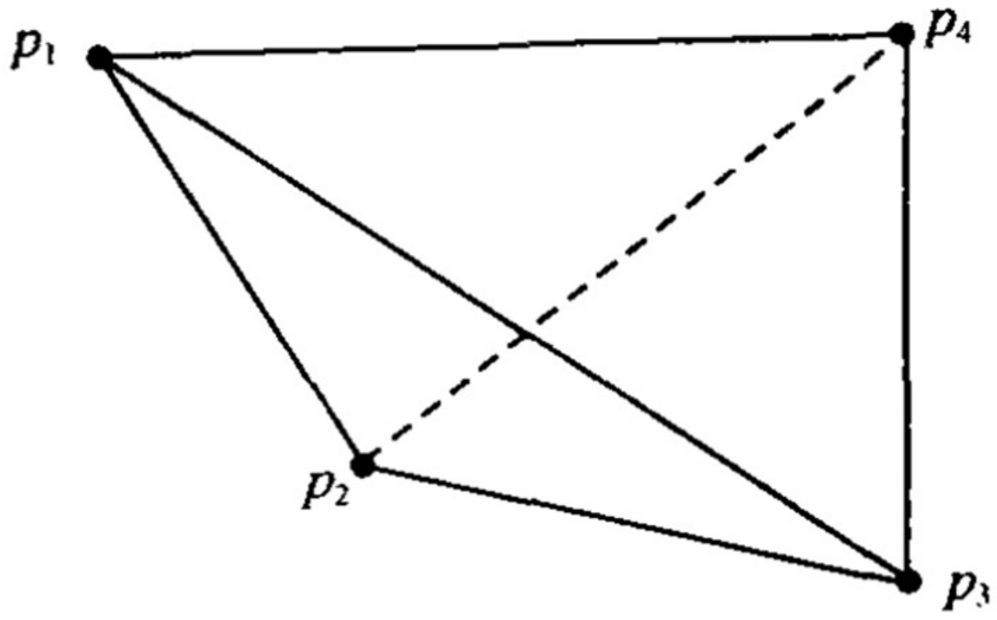
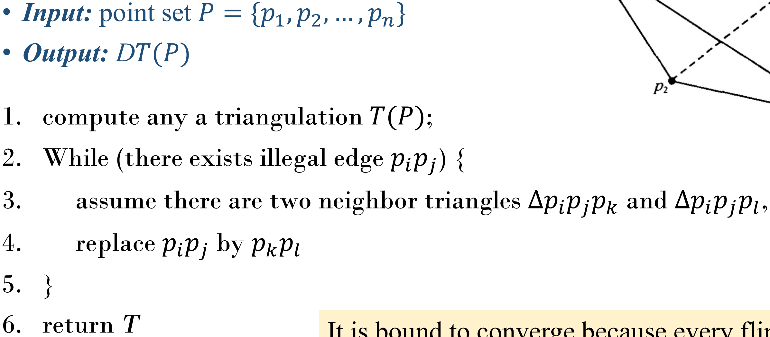
Delauny Triangulation
What is Delauny triangulation?
Edge flipping algorithm

Slide 18
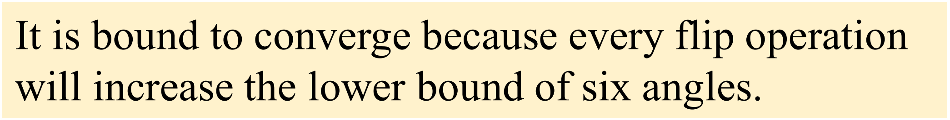
Delauny Triangulation
What is Delauny triangulation?
Edge flipping algorithm

Slide 19
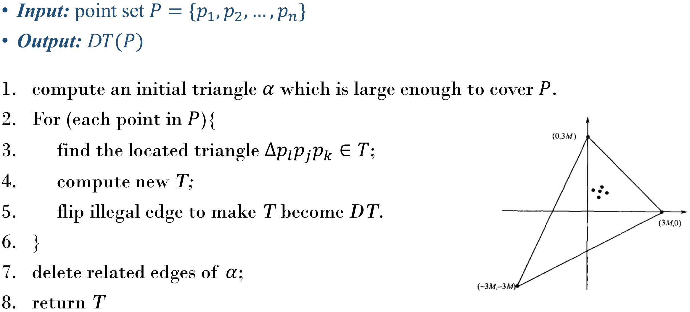
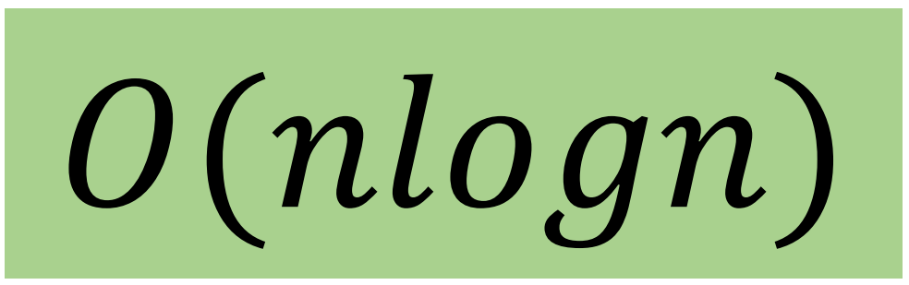
Delauny Triangulation
What is Delauny triangulation?
Edge flipping algorithm
Optimize

Slide 20
3. Constrained Delaunay Triangulation

Slide 21
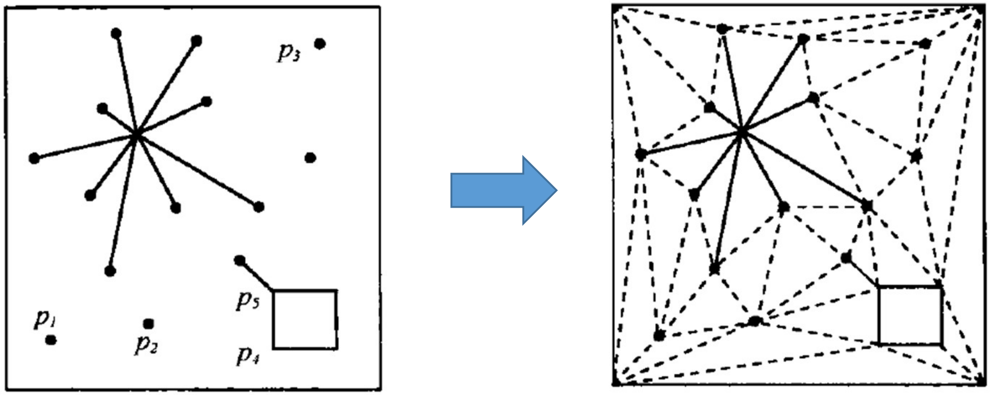
Constrained Delauny Triangulation
What is Constrained Delauny triangulation?

Slide 22
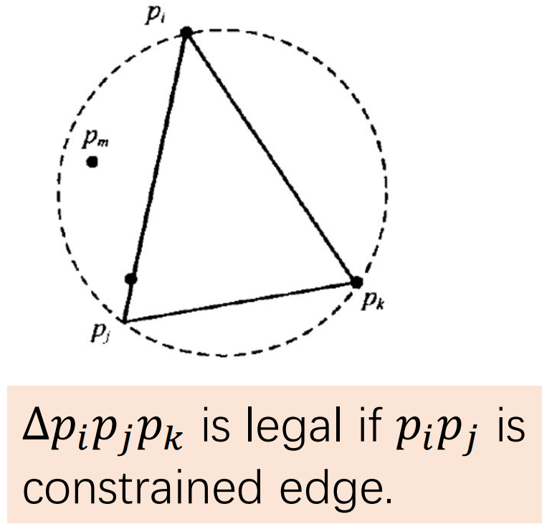
Constrained Delauny Triangulation
What is Constrained Delauny triangulation?

Slide 23
4. Hints for “Interactive”

Slide 24
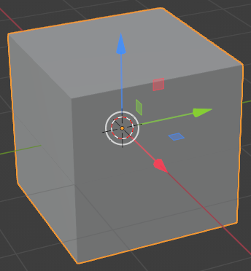
Hints for “Interactive”
What means “Interactive”?
Option1: Drag xyz arrows

Slide 25
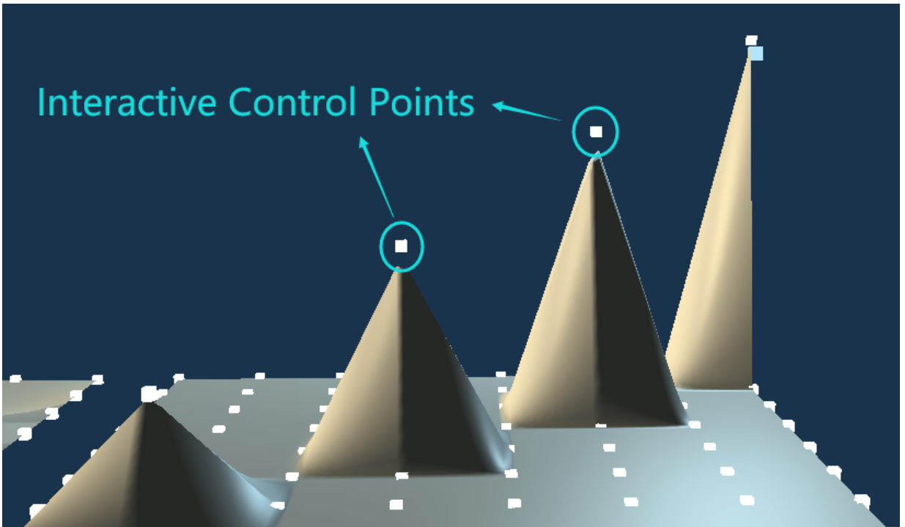
Hints for “Interactive”
What means “Interactive”?
Option1: Drag xyz arrows
Option2: Drag points within a plane

Slide 26
Hints for “Interactive”
What means “Interactive”?
Implementation
What is a ray?
direction
origin

Slide 27
Hints for “Interactive”
What means “Interactive”?
Implementation
What is a ray?
Ray generation
from camera
to where?

Slide 28
Hints for “Interactive”
What means “Interactive”?
Implementation
What is a ray?
Ray generation
Ray casting
Ray-triangle
Ray-cube
Ray-sphere

Slide 29
Thank You

