Slide 1
Bounding Volume Hierarchies
YiHeng Wu

Slide 2
-1. HW3

Slide 3
HW3
2 weeks for HW3, HW4
1 week for HW5

Slide 4
HW3
2 weeks for HW3, HW4
1 week for HW5
Ray tracing is not easy, start early!

Slide 5
0. Bounding Volume Hierarchies (BVH)

Slide 6
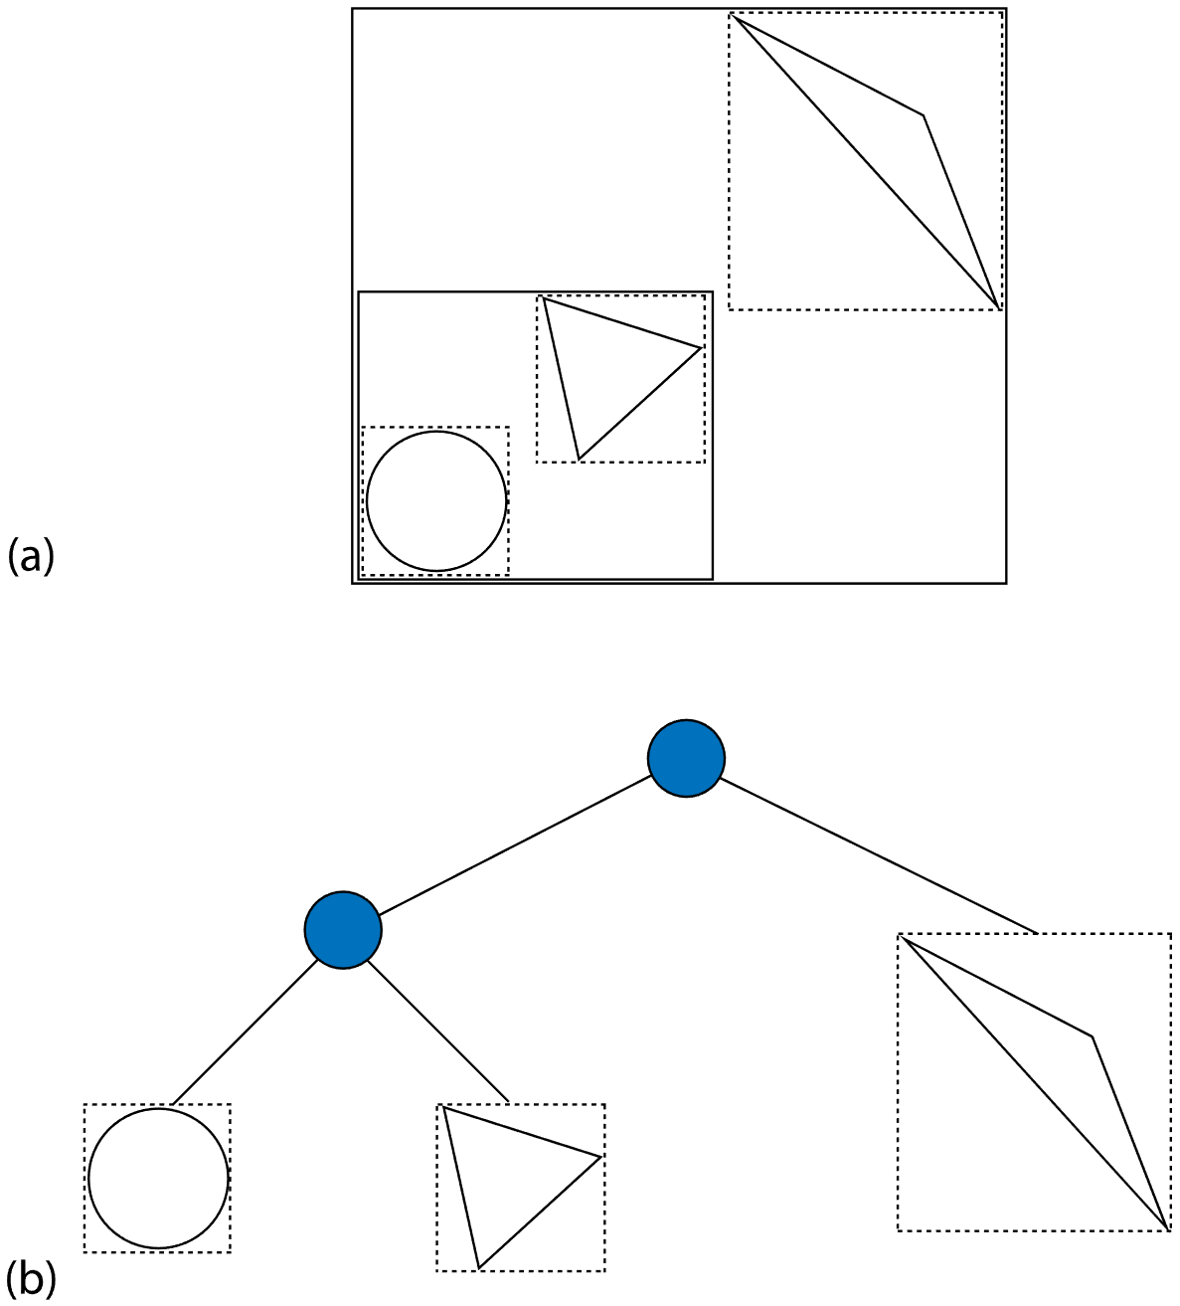
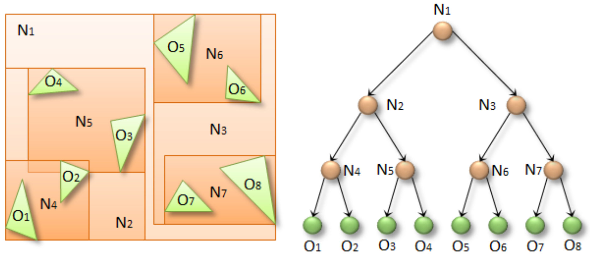
Bounding Volume Hierarchies (BVH)
What is a BVH?
Option1: each element is a triangle, sphere, rectangle, or, …
Option2: each element is a triangle

Slide 7
Bounding Volume Hierarchies (BVH)
What is a BVH?
Option1: each element is a triangle, sphere, rectangle, or, …
Option2: each element is a triangle
Mostly use Option2 for offline rendering

Slide 8
Bounding Volume Hierarchies (BVH)
What is a BVH?
Each element is a triangle
How to write an efficient BVH?
Hello World
Morton code
SAH
Compress and linearize
Wide (Octal) BVH
BVH with displacement mapping

Slide 9
1. Hello World

Slide 10
Hello World
Input
class Vertex { Vector3f position; Vector3f normal; Vector2f uv; }; std::vector<Vertex> vertices; // vbo std::vector<Vector3u> triangles; // ebo

Slide 11
Hello World
Input
Framework
class BVH { public: void Build(const std::vector<Vertex>& new_vertices, const std::vector<Vector3u>& new_triangles) { ... } private: BVHNode* nodes;
... };

Slide 12
Hello World
Input
Framework
constexpr float INF = std::numeric_limits<float>::infinity(); struct RayCastResult { RayCastResult() : t(INF) { }
RayCastResult(float t) : t(t) { } float t; ... }; bool RayCast(const BVH& bvh, const Ray& ray, RayCastResult& result) { ... }

Slide 13
Hello World
Input
Framework
Naïve BVHNode
triangles.size() == 0 for interior nodes
triangles.size() > 0 for leaf nodes
struct BVHNode { AABB bound; BVHNode* left, * right; std::vector<Vector3u> triangles; };

Slide 14
Hello World
class BVH { public: void Build(const std::vector<Vertex>& new_vertices, const std::vector<Vector3u>& new_triangles) {
std::vector<Vector3u> triangles_copy = new_triangles; Build(new_vertices, triangles_copy, nodes); } private: void Build(const std::vector<Vertex>& vertices, std::vector<Vector3u>& triangles, BVHNode*& node) { // set this node = newNode(vertices, triangles); // split unsigned axis = SelectAnAxisToDivide(); std::vector<Vertex3u> triangles_left, triangles_right; DivideToLeftAndRightPart(vertices, triangles,
triangles_left, triangles_right); // build left and right Build(vertices, triangles_left, node->left); Build(vertices, triangles_right, node->left); } };
Input
Framework
Naïve BVHNode
Naïve Build()

Slide 15
Hello World
bool RayCast(const BVHNode* node, const Ray& ray, RayCastResult& result) { // empty node if (!node) return false; // not hit AABB if (!RayCast(node->bound, ray)) return false; // recursive test bool hit = false; if (node->IsLeaf()) { // leaf node for (const Vector3u& triangle : node->triangles) { if (RayCast(triangle, ray, result)) { ... // record something into `result` } } } else { // interior node if (RayCast(node->left, ray, result)) hit = true; if (RayCast(node->right, ray, result)) hit = true; } return hit; }
Input
Framework
Naïve BVHNode
Naïve Build()
Naïve RayCast()

Slide 16
Hello World
struct BVHNode { AABB bound; BVHNode* left, * right; std::vector<Vector3u> triangles; };
Input
Framework
Naïve BVHNode
Naïve Build()
Naïve RayCast()
How to know which object?
struct BVHNode { AABB bound; BVHNode* left, * right; unsigned triangles_start,
triangles_end; };

Slide 17
Hello World
struct BVHNode { AABB bound; BVHNode* left, * right; std::vector<Vector3u> triangles; };
Input
Framework
Naïve BVHNode
Naïve Build()
Naïve RayCast()
How to know which object?
But, enough for CG1!
struct BVHNode { AABB bound; BVHNode* left, * right; unsigned triangles_start,
triangles_end; };

Slide 18
2. Morton Code

Slide 19
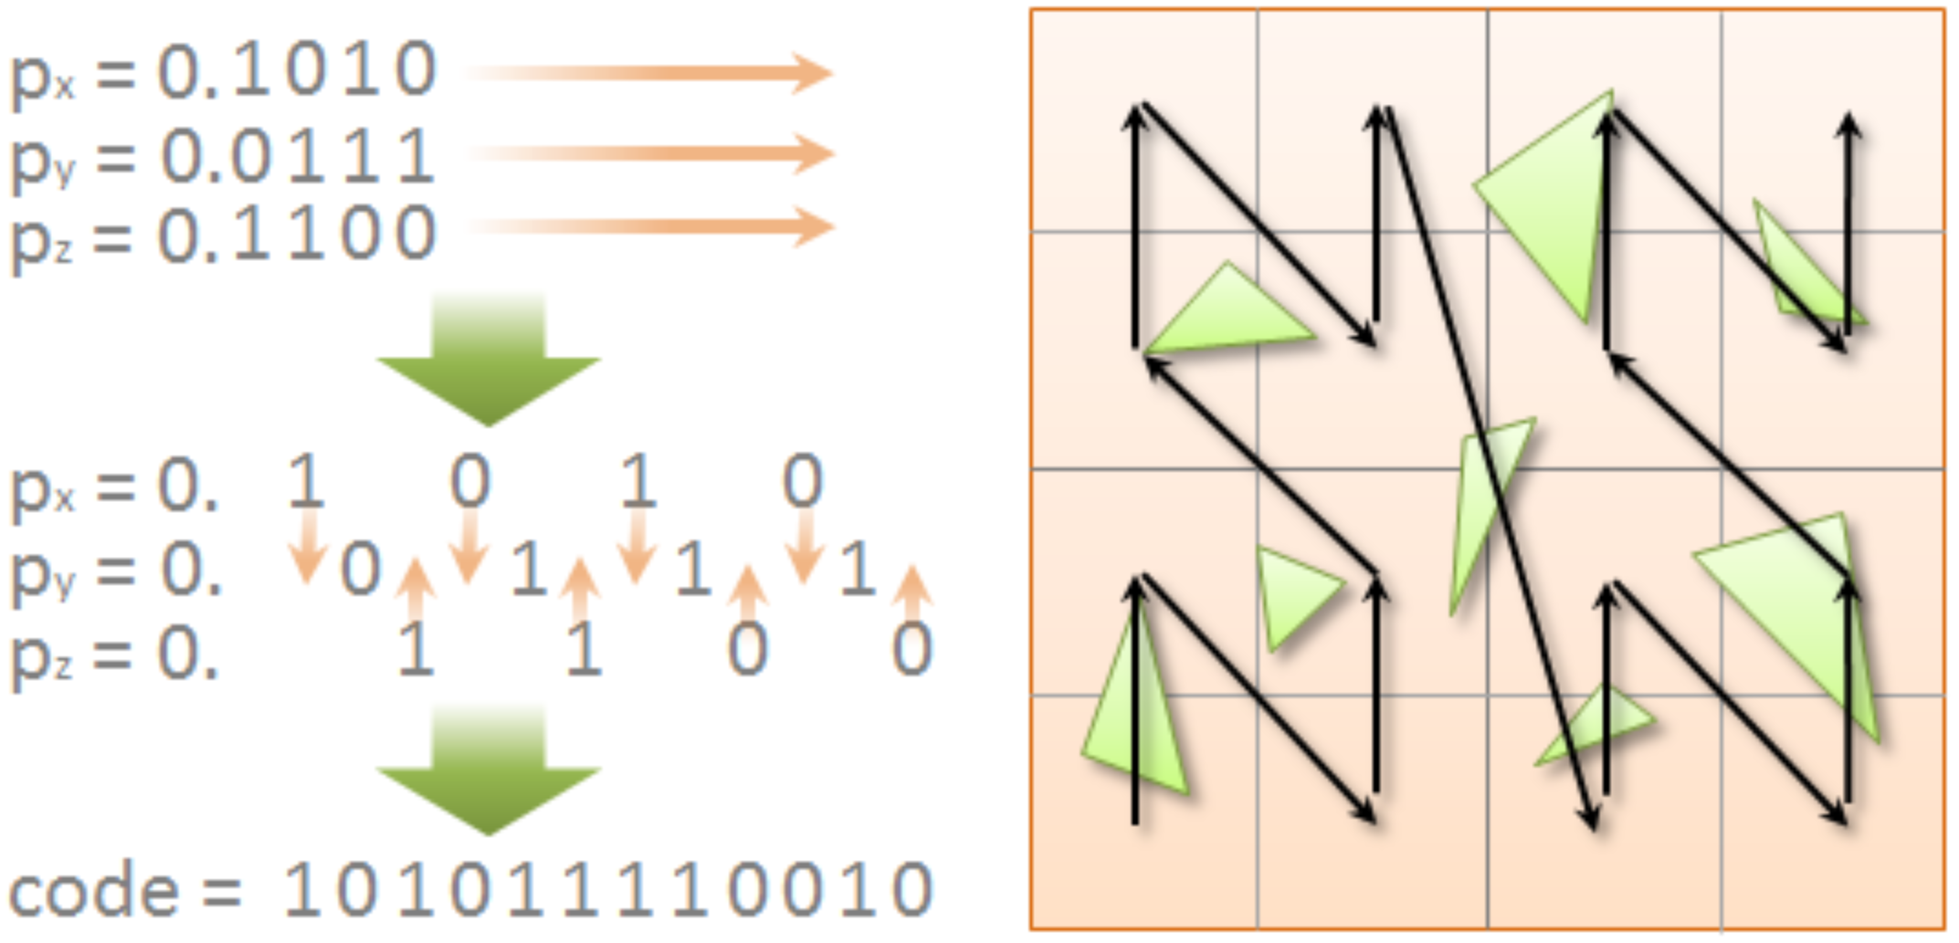
Morton Code
What is and how to generate Morton code?

Slide 20
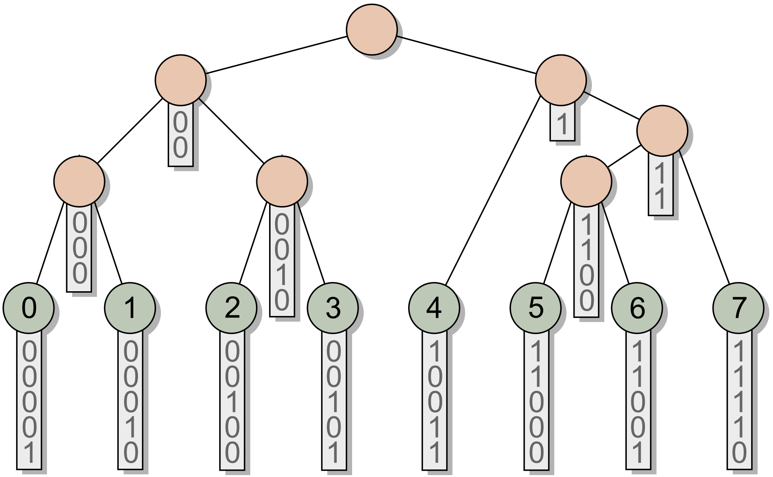
Morton Code
What is and how to generate Morton code?
How to build a BVH with Morton code?
Find the “split point”
Thinking Parallel, Part I: Collision Detection on the GPU | NVIDIA Technical Blog

Slide 21
Morton Code
What is and how to generate Morton code?
How to build a BVH with Morton code?
Make it parallel
[2012] Maximizing Parallelism
in the Construction of BVHs, Octrees, and k-d Trees

Slide 22
3. Surface Area Heuristic (SAH)

Slide 23
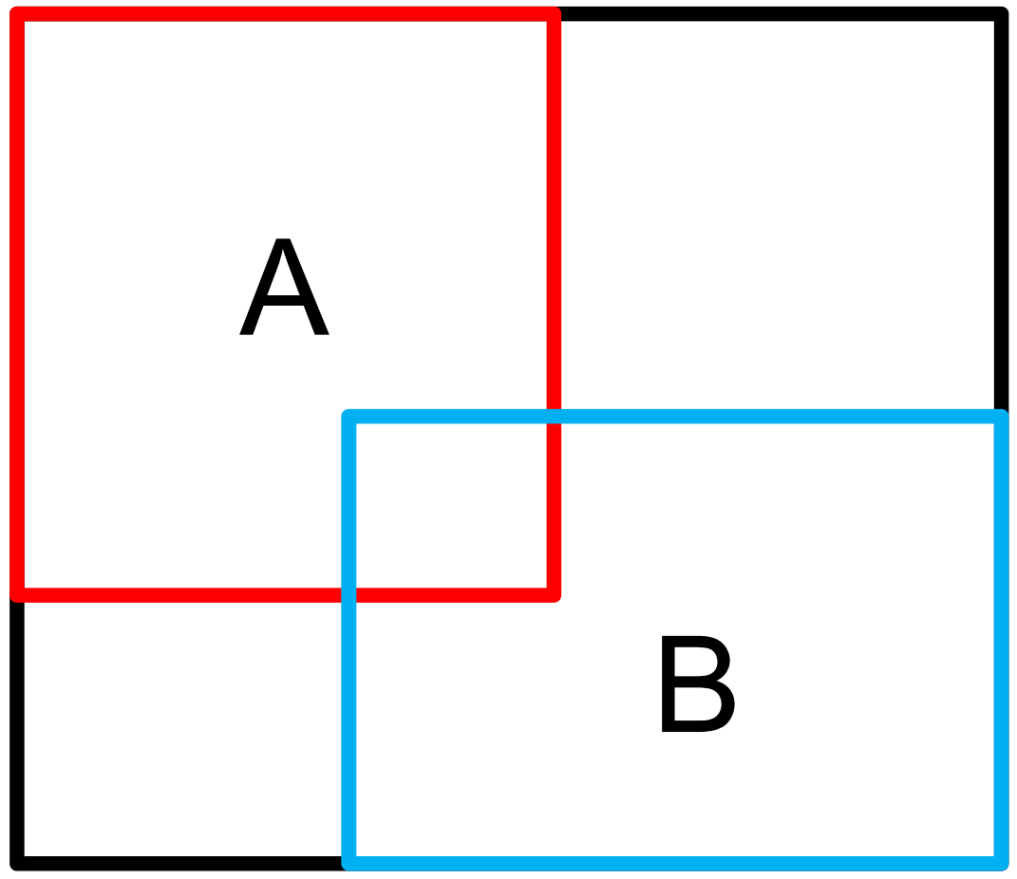
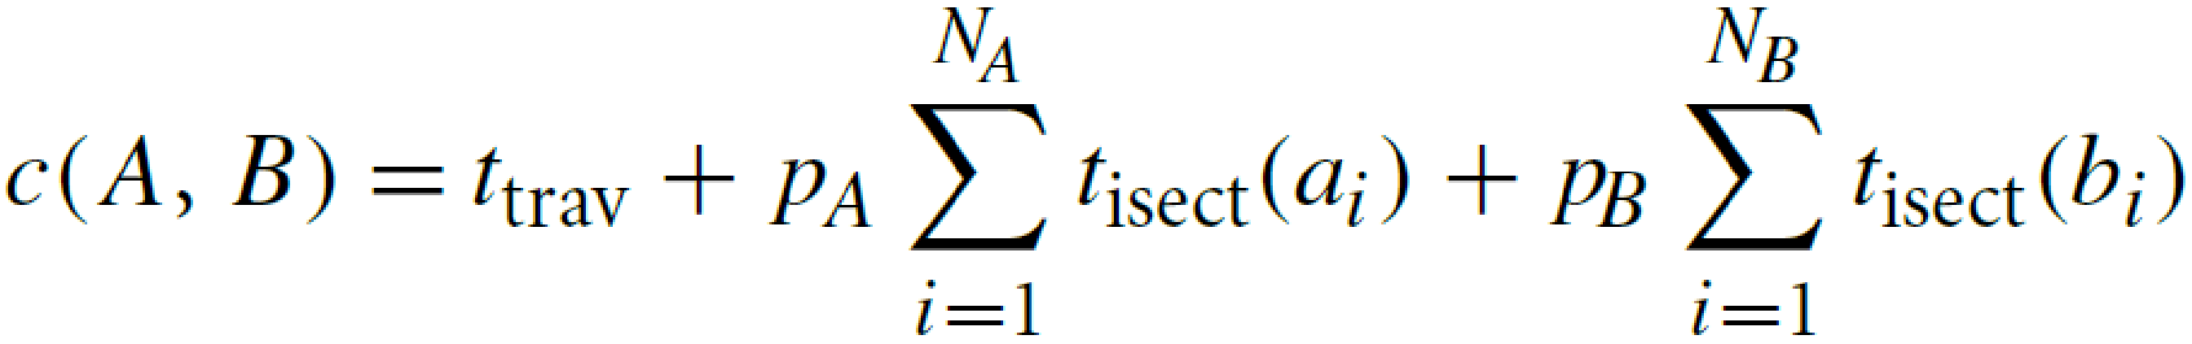
Surface Area Heuristic (SAH)
What is SAH?

Slide 24
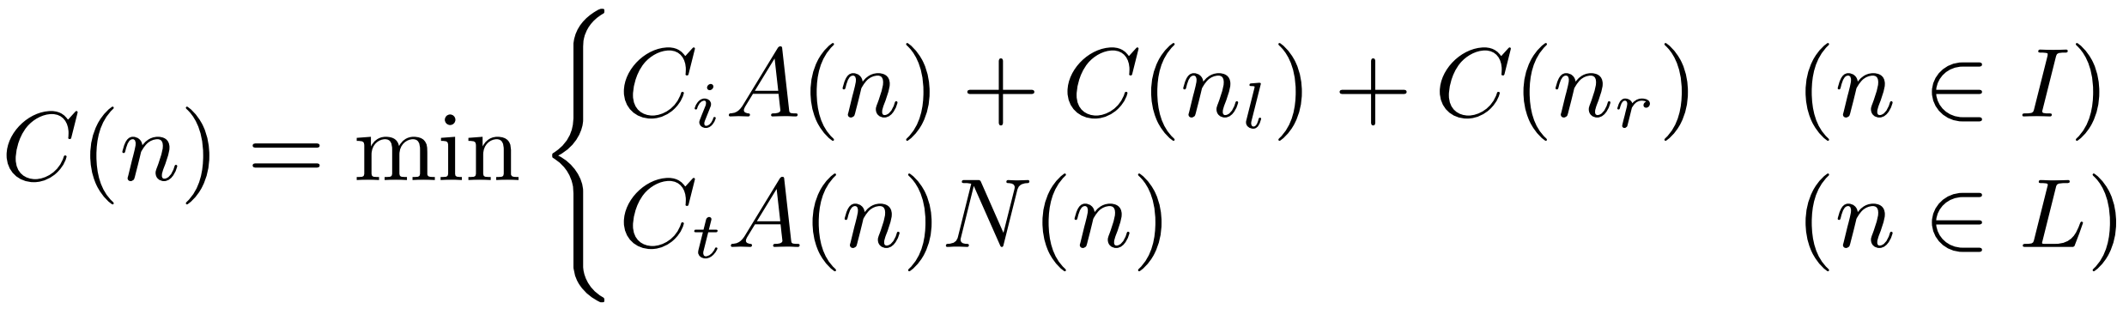
Surface Area Heuristic (SAH)
What is SAH?
Actually no one uses the first equation…

Slide 25
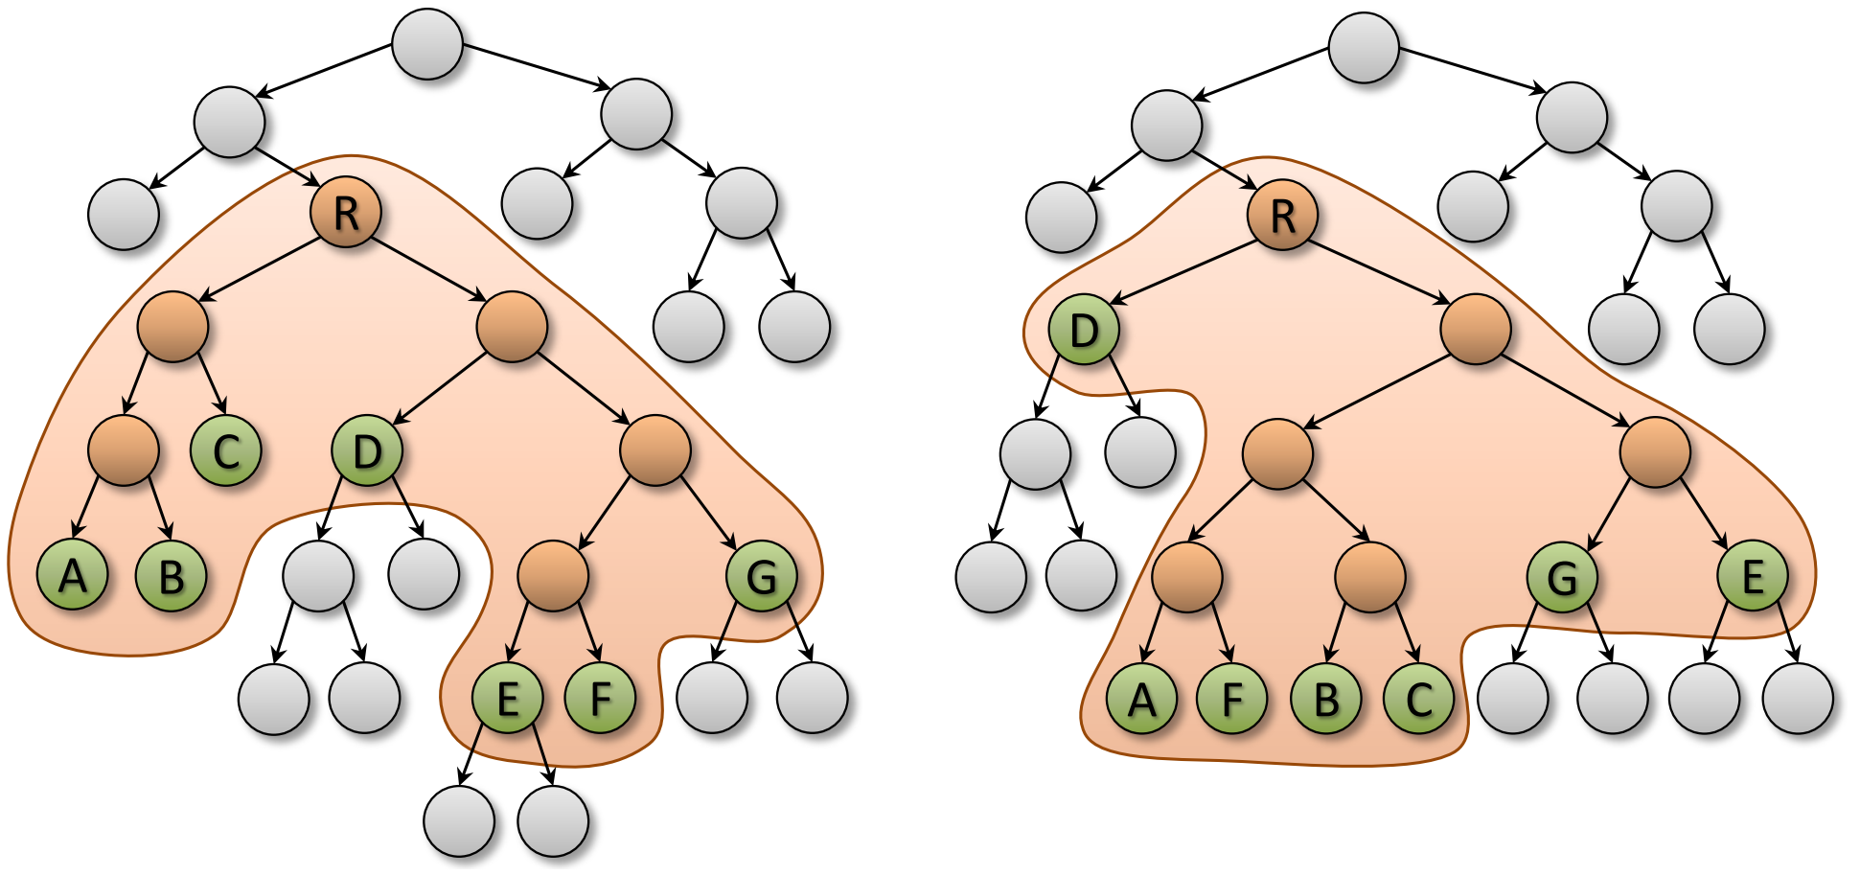
Surface Area Heuristic (SAH)
What is SAH?
How to implement?
[2013] Fast Parallel Construction of
High-Quality Bounding Volume Hierarchies

Slide 26
Surface Area Heuristic (SAH)
What is SAH?
How to implement?
[2013] Fast Parallel Construction of
High-Quality Bounding Volume Hierarchies
Pipeline:
Step1: [2012] Maximizing Parallelism…
Step2: [2013] Fast…High-Quality…

Slide 27
4. Compress and Linearize

Slide 28
Compress and Linearize
Compress BVHNode
struct BVHNode { AABB bound; BVHNode* left, * right; std::vector<Vector3u> triangles; };

Slide 29
Compress and Linearize
Compress BVHNode
struct BVHNode { AABB bound; BVHNode* left, * right; std::vector<Vector3u> triangles; };
struct BVHNode { AABB bound; union { unsigned left; unsigned triangle_start; }; union { unsigned right; unsigned triangle_end; }; };

Slide 30
Compress and Linearize
Compress BVHNode
Linearize BVHNodes
DFS order
std::vector<BVHNode> nodes;

Slide 31
Compress and Linearize
Compress BVHNode
Linearize BVHNodes
DFS order
struct BVHNode { AABB bound; union { unsigned left; unsigned triangle_start; }; union { unsigned right; unsigned triangle_end; }; };
std::vector<BVHNode> nodes;

Slide 32
5. Wide (Octal) BVH

Slide 33
Wide (Octal) BVH
Why octal, why not binary?
Memory accesses are much more expensive than computation on GPU

Slide 34
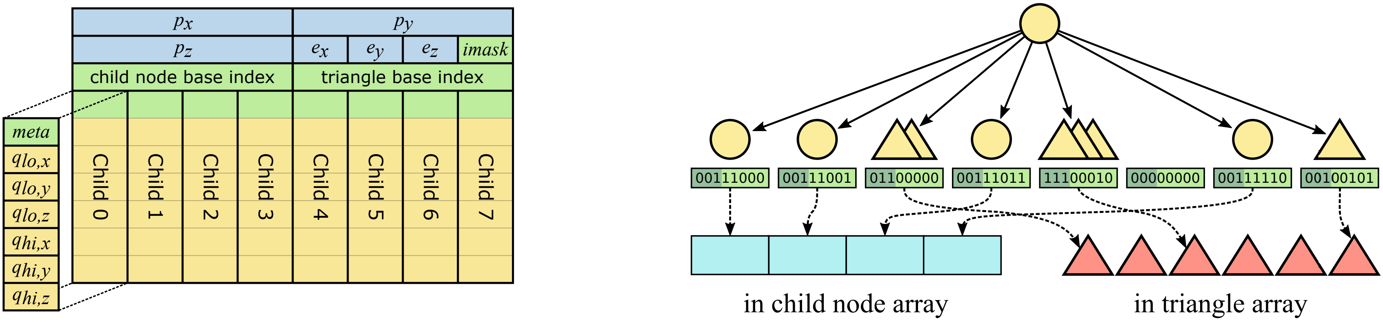
Wide (Octal) BVH
Why octal, why not binary?
Memory accesses are much more expensive than computation on GPU
How to implement?
[2017] Efficient Incoherent Ray Traversal
on GPUs Through Compressed Wide BVHs

Slide 35
Wide (Octal) BVH
Why octal, why not binary?
Memory accesses are much more expensive than computation on GPU
How to implement?
[2017] Efficient Incoherent Ray Traversal
on GPUs Through Compressed Wide BVHs
Pipeline:
Step1: [2012] Maximizing Parallelism…
Step2: [2013] Fast…High-Quality…
Step3: [2017] …Compressed Wide BVHs

Slide 36
6. BVH with Displacement Mapping

Slide 37
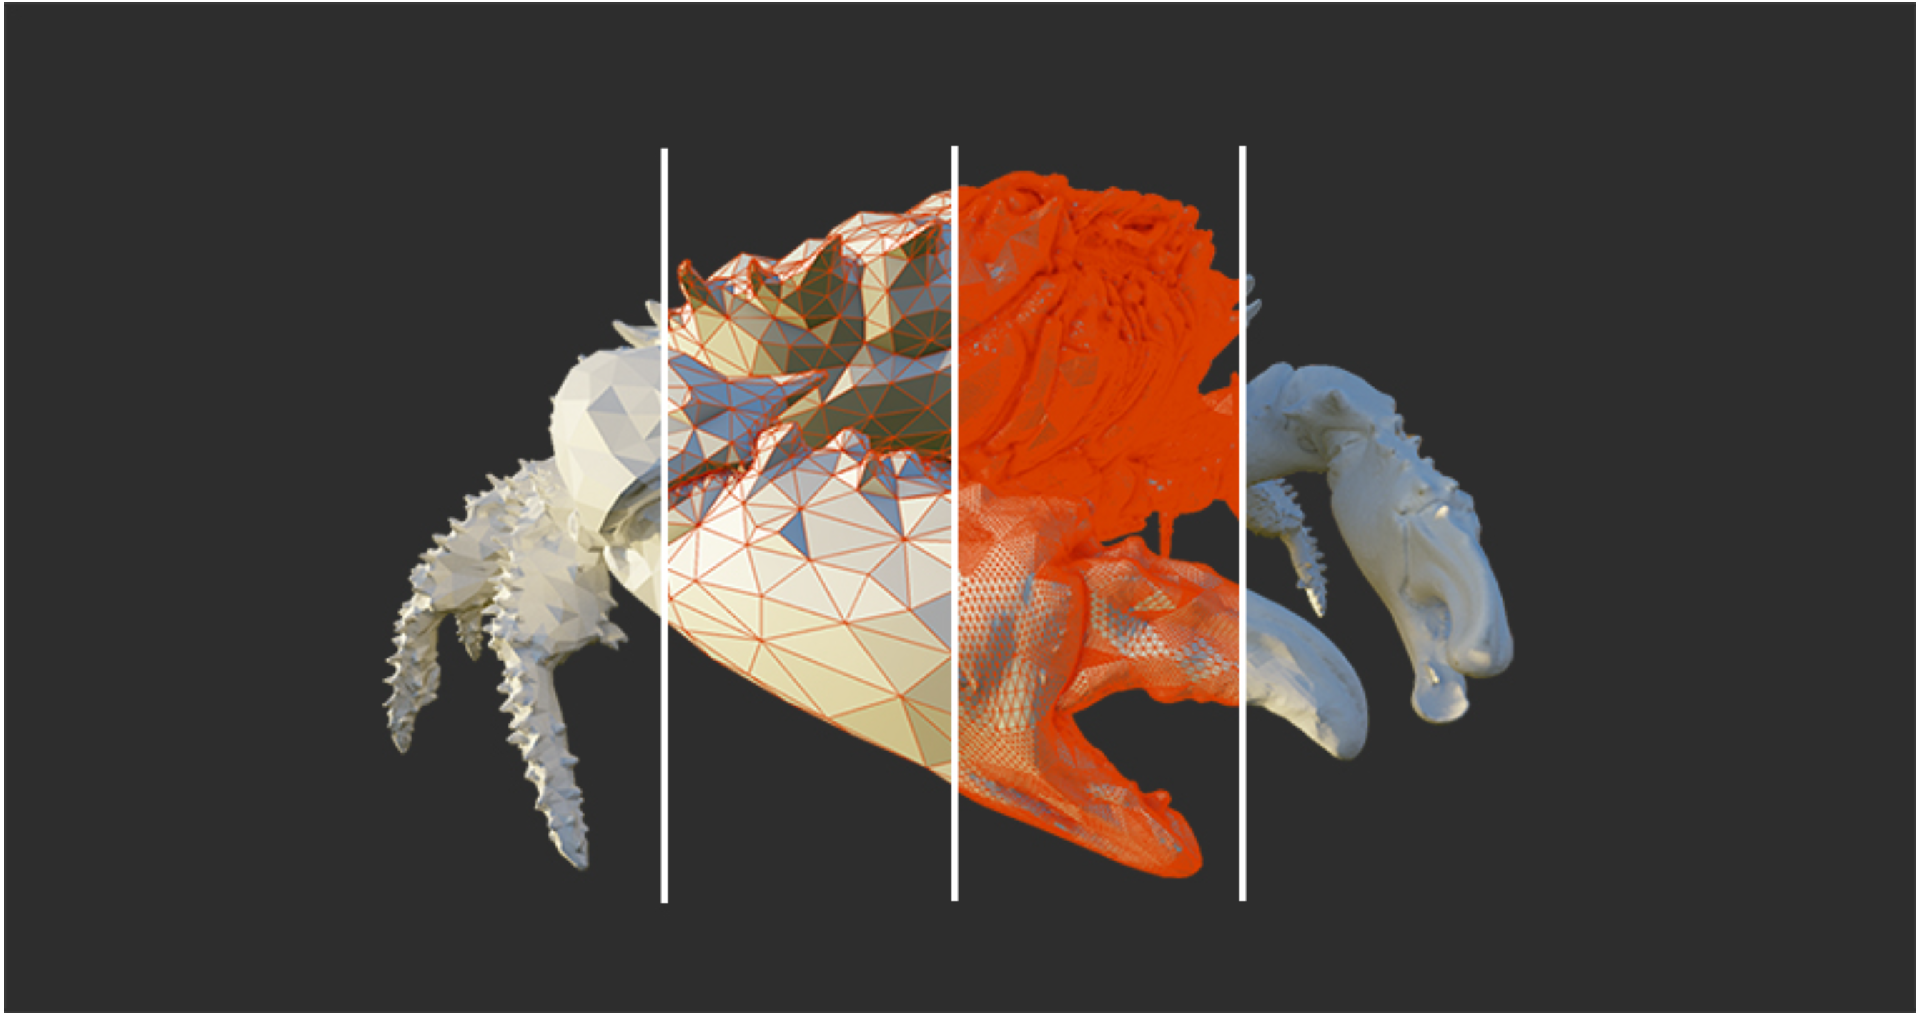
BVH with Displacement Mapping
What…?
[2021] Tessellation-Free Displacement Mapping for Ray Tracing
Nvidia Ada Lovelace

Slide 38
7. Summary

Slide 39
Summary
How to write an efficient BVH?
Step1: Morton code (2012)
Step2: SAH (2013)
Step3: Wide (Octal) BVH (2017)
Step4: BVH with displacement mapping (2021)
(Step5: Many other great papers)

Slide 40
Summary
How to write an efficient BVH?
Step1: Morton code (2012)
Step2: SAH (2013)
Step3: Wide (Octal) BVH (2017)
Step4: BVH with displacement mapping (2021)
(Step5: Many other great papers)
For CG1
Step0: Hello World

Slide 41
Summary
How to write an efficient BVH?
Step1: Morton code (2012)
Step2: SAH (2013)
Step3: Wide (Octal) BVH (2017)
Step4: BVH with displacement mapping (2021)
(Step5: Many other great papers)
For CG1
I don’t want to write it…
NVIDIA OptiX™ 光线追踪引擎 | NVIDIA Developer
But, some drawback

Slide 42
Thank You

