Slide 1
CS182 Introduction to Machine Learning, Fall 2023 Discussion3
Zhan-Wang Mao
maozhw@shanghaitech.edu.cn
November 2, 2023

Slide 2
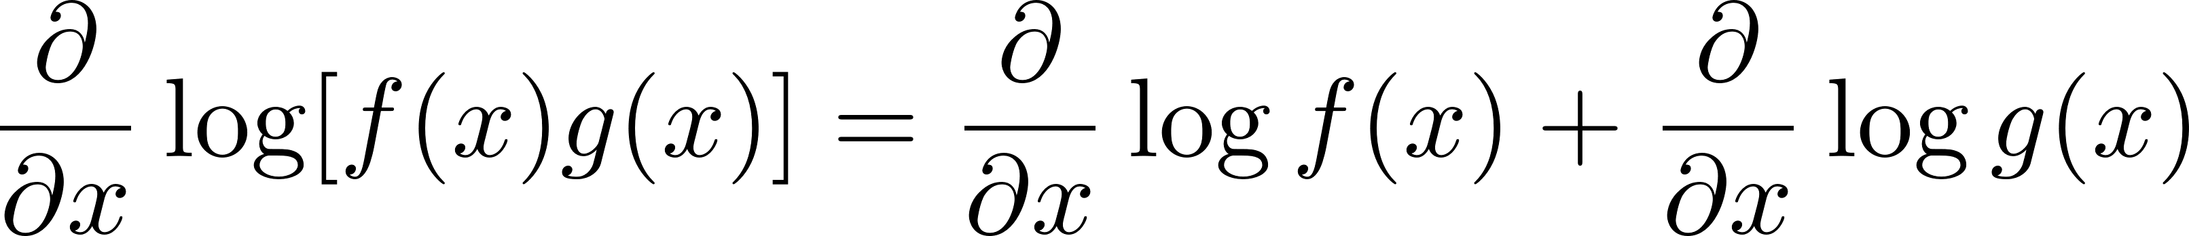
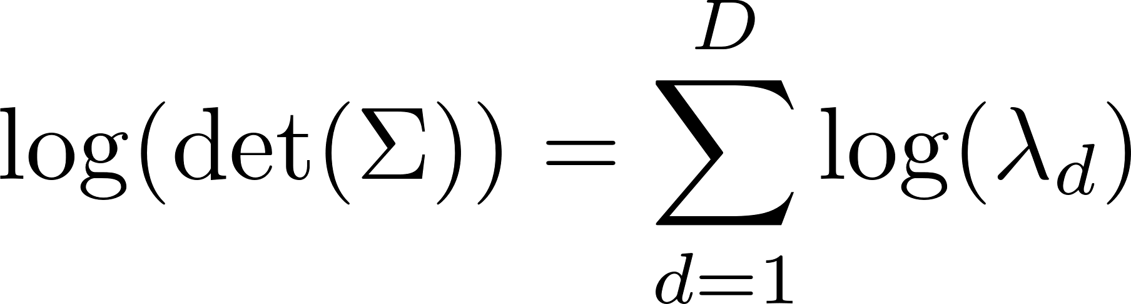
The Log-Sum-Exp Trick
In statistical modeling and machine learning, we often work in a logarithmic scale
Multiplying small numbers
Differentiation
Example: Multivariate Normal
https://gregorygundersen.com/blog/2020/02/09/log-sum-exp/

Slide 3
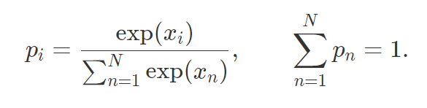
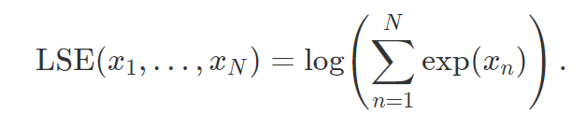

The Log-Sum-Exp Trick
Normalize an $N$-vector $x$ of log probabilities $x_{i}=\log{p_{i}}$
Exponentiating might result in underflow or overflow
Log-Sum-Exp operator

Slide 4
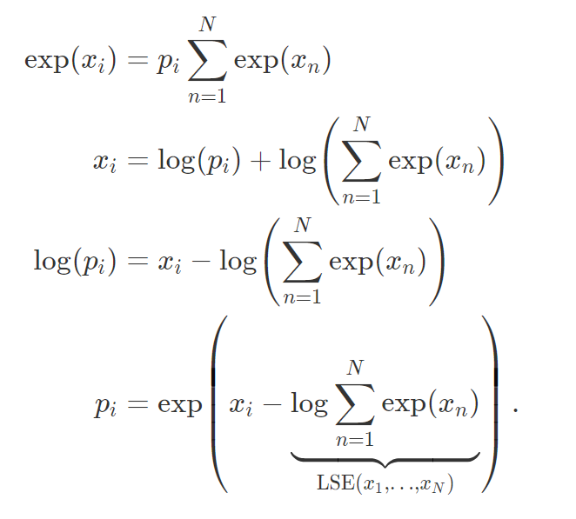
The Log-Sum-Exp Trick
Perform the normalization using the Log-Sum-Exp operator
Does it really helps?

Slide 5
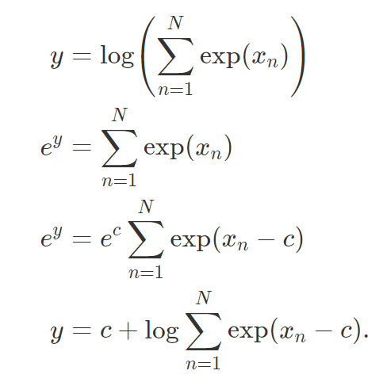


The Log-Sum-Exp Trick
Shift the values in the exponent by an arbitrary constant $C$
Largest term as the reference

Slide 6



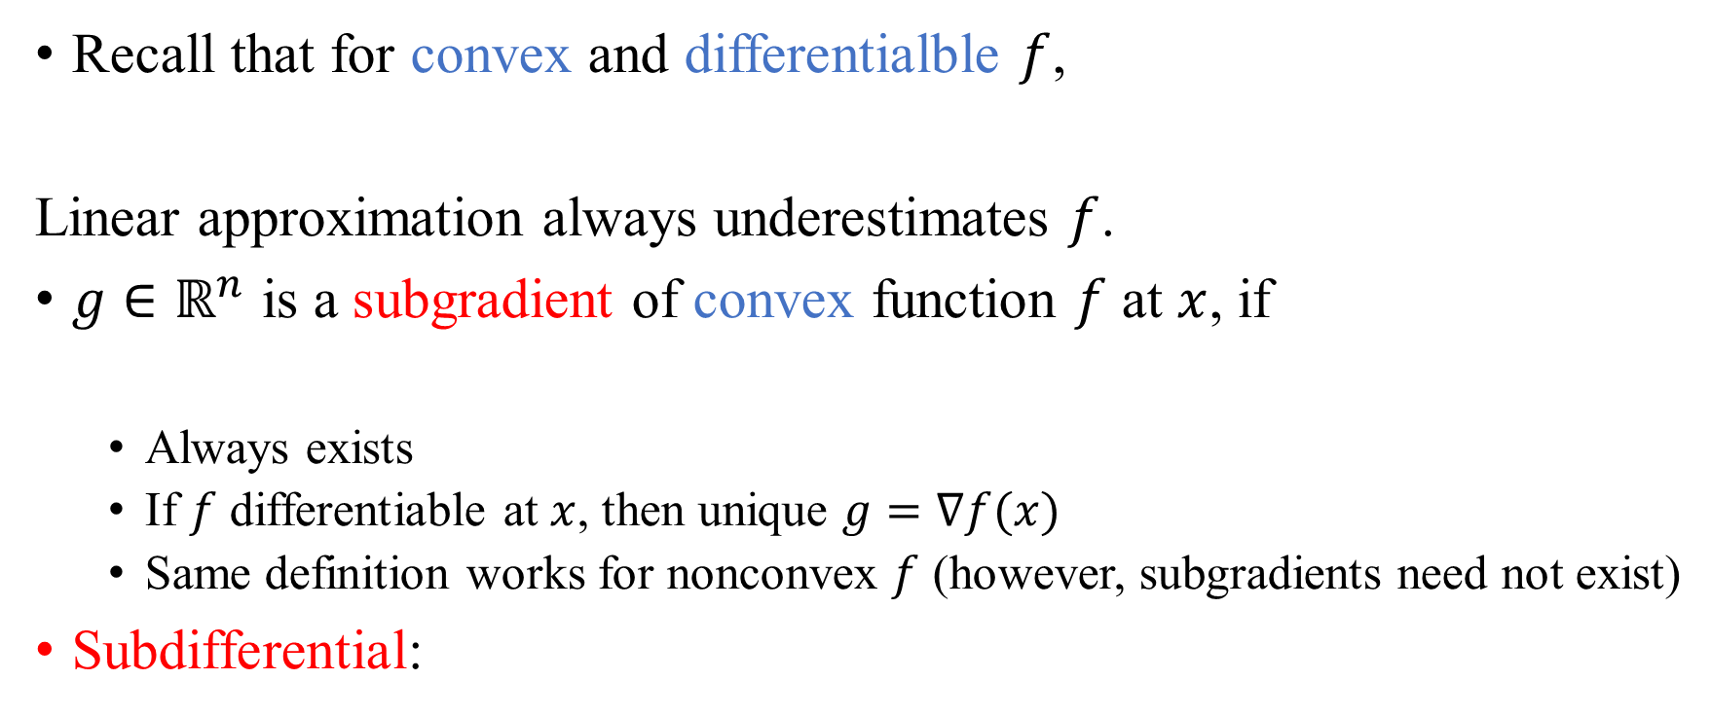
Subgradients
Recall that for convex and differentialble $f$,
Linear approximation always underestimates $f$.
$g∈ℝ^{n}$ is a subgradient of convex function $f$ at $x$, if
Always exists
If $f$ differentiable at $x$, then unique $g=∇f(x)$
Same definition works for nonconvex $f$ (however, subgradients need not exist)
Subdifferential:
https://www.stat.cmu.edu/~ryantibs/convexopt/lectures/subgrad.pdf

Slide 7
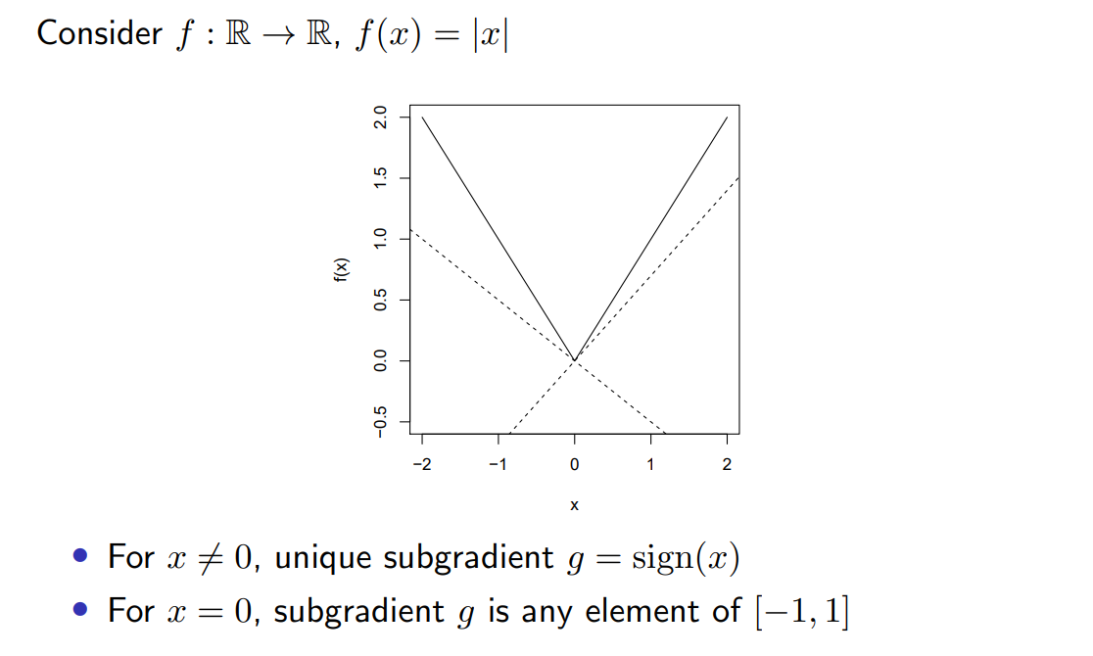
Examples of Subgradients

Slide 8
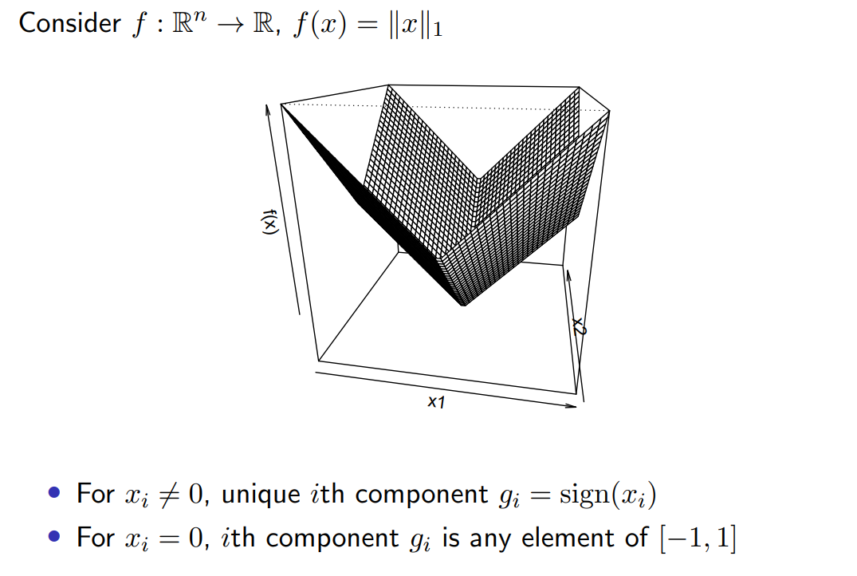
Examples of Subgradients

Slide 9




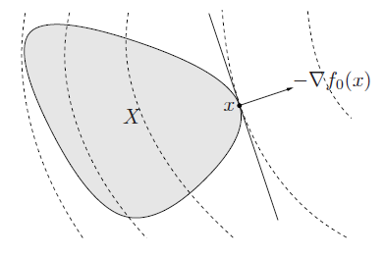



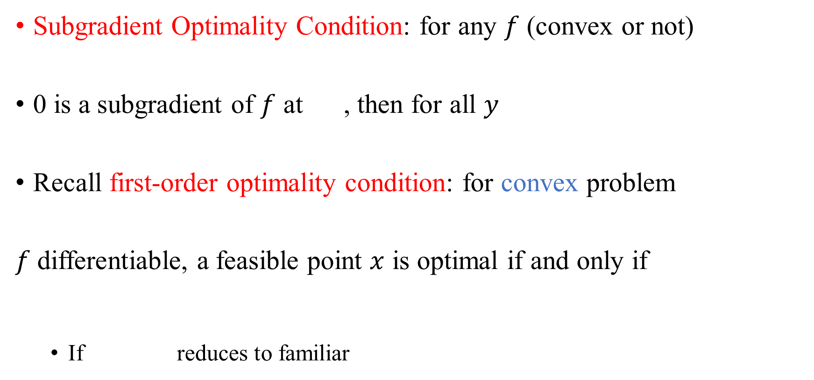
Optimality Condition
Subgradient Optimality Condition: for any $f$ (convex or not)
0 is a subgradient of $f$ at , then for all $y$
Recall first-order optimality condition: for convex problem
$f$differentiable, a feasible point $x$ is optimal if and only if
If reduces to familiar

Slide 10
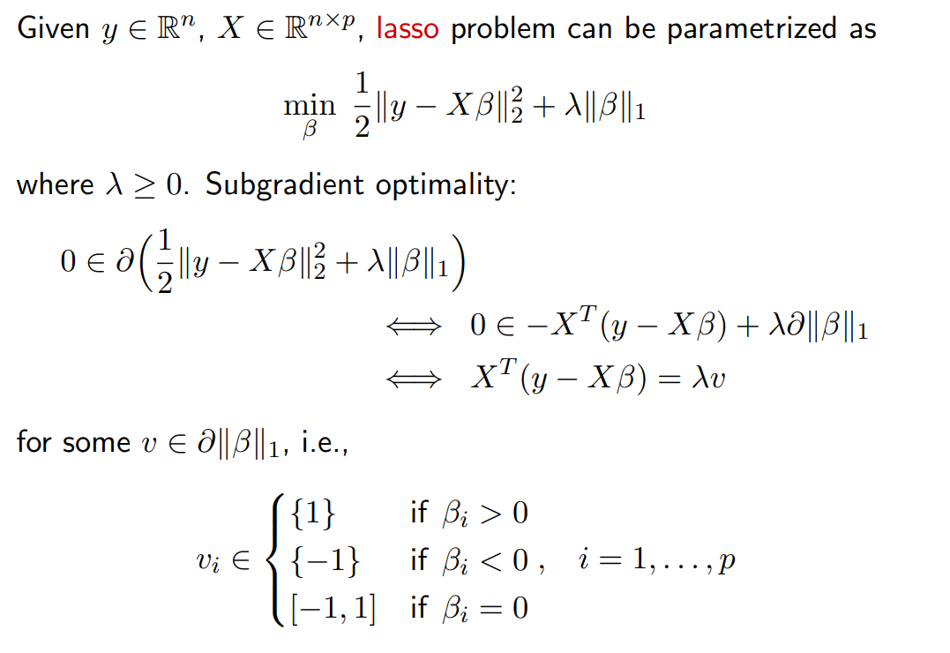
Lasso Optimality

Slide 11
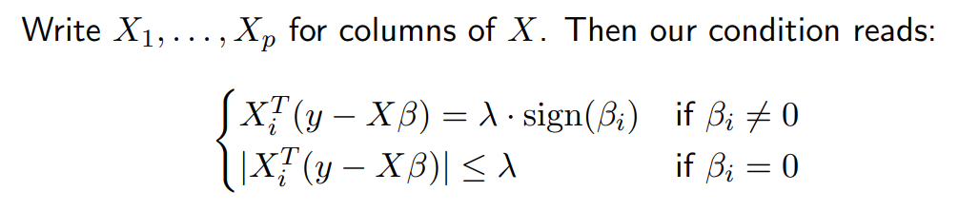
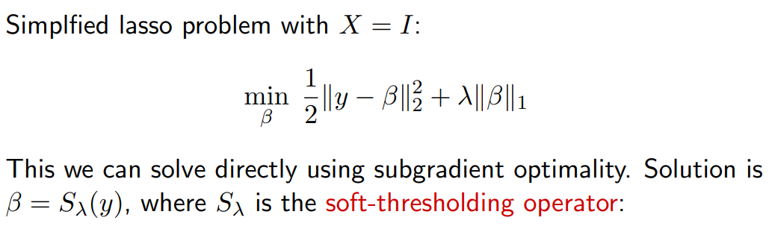
Lasso Solution*

Slide 12
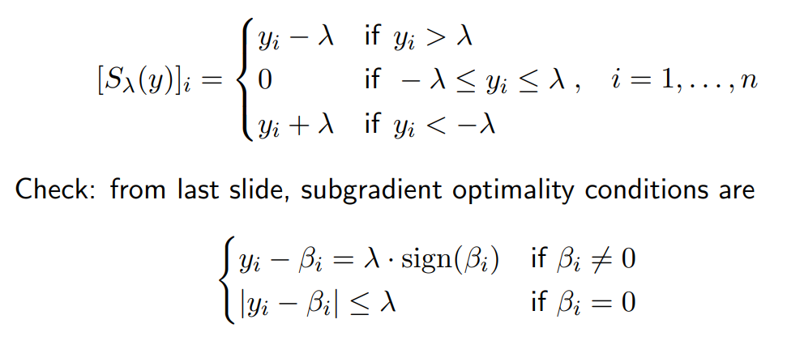
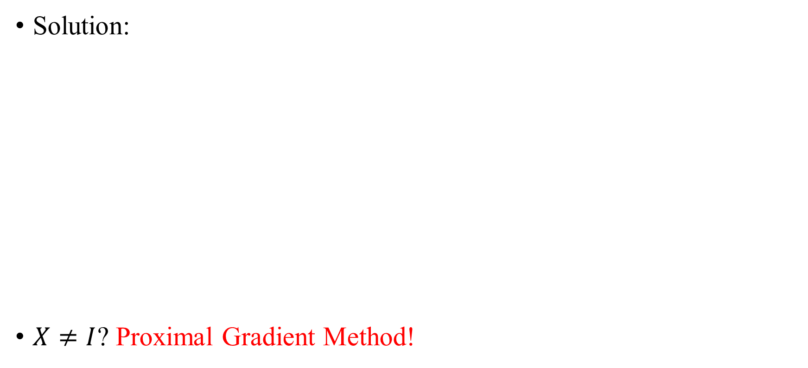

Lasso Solution*
Solution:
$X≠I$? Proximal Gradient Method!
$$β_{i}=$$

Slide 13
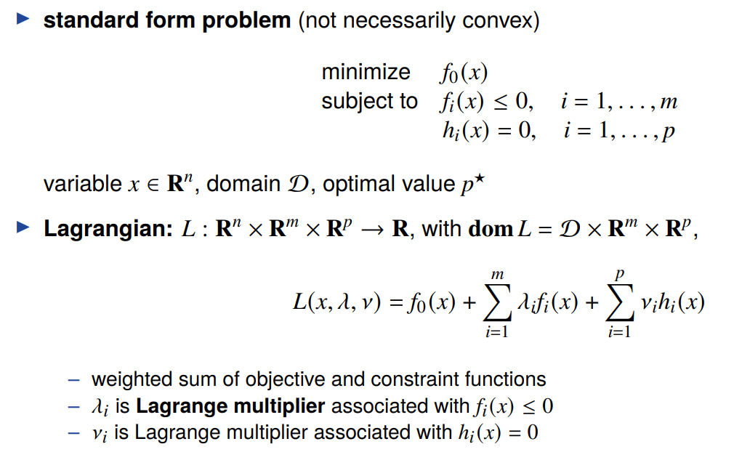
Lagrangian
https://web.stanford.edu/class/ee364a/lectures/duality.pdf

Slide 14
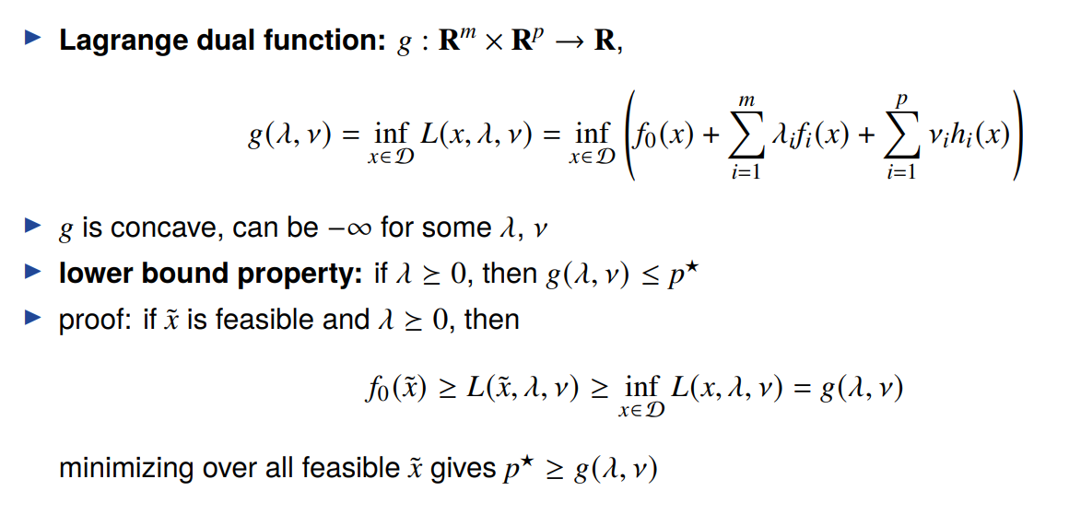
Lagrange Dual Function

Slide 15
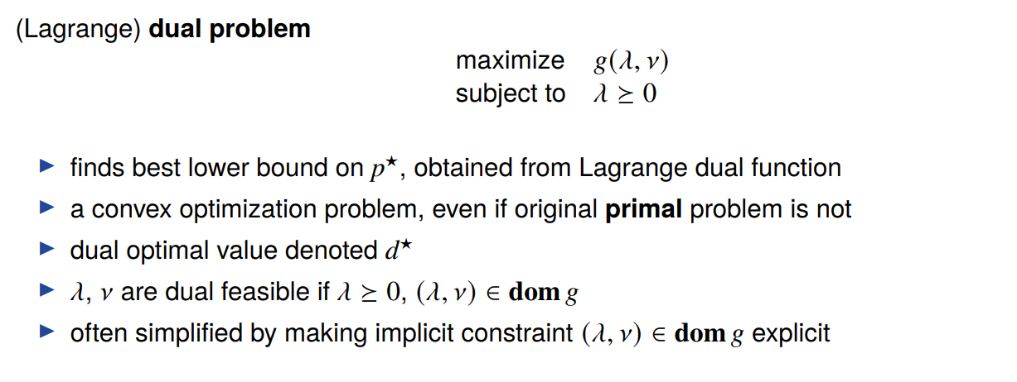
The Lagrange Dual Problem

Slide 16
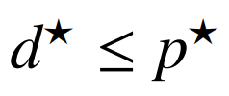

Weak and Strong Duality
Weak Duality:
Always holds
Strong Duality:
Does not hold in general
(Usually) hold for convex problems
Conditions that guarantee strong duality in convex problems are called constraint qualifications
Slater’s Condition: strong duality hold for a convex problem if it is strictly feasible, i.e.,

Slide 17
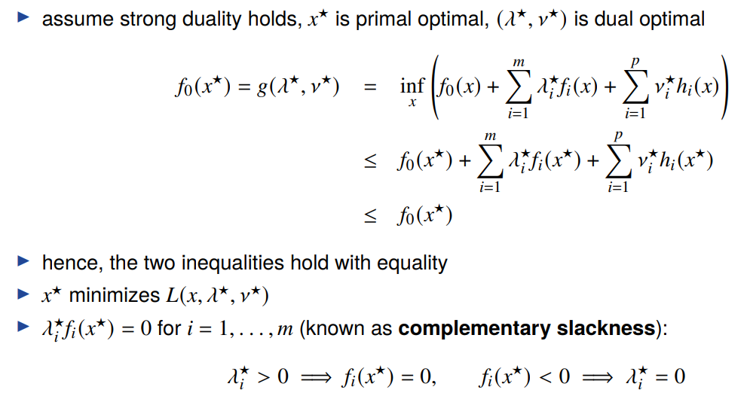
Complementary Slackness

Slide 18
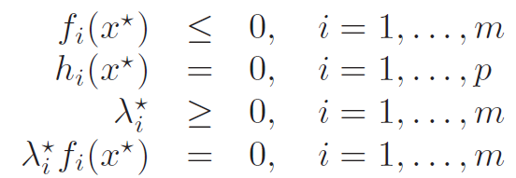
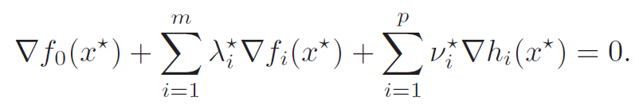
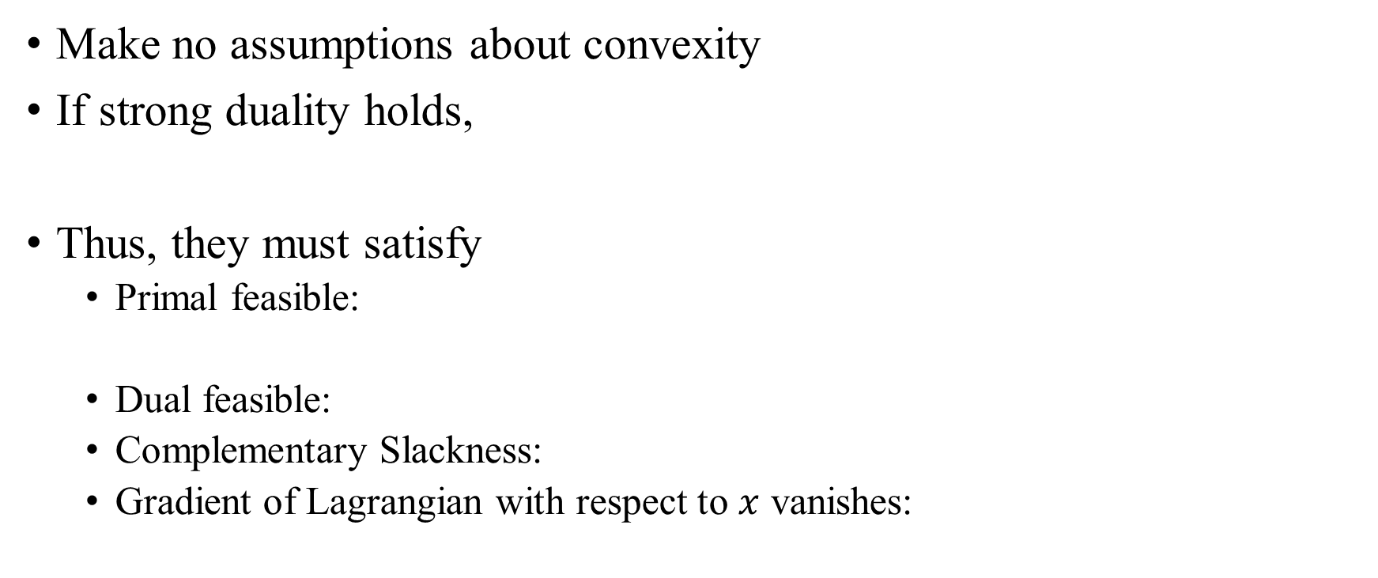
Karush-Kuhn-Tucker (KKT) Conditions
Make no assumptions about convexity
If strong duality holds,
Thus, they must satisfy
Primal feasible:
Dual feasible:
Complementary Slackness:
Gradient of Lagrangian with respect to $x$ vanishes:

Slide 19
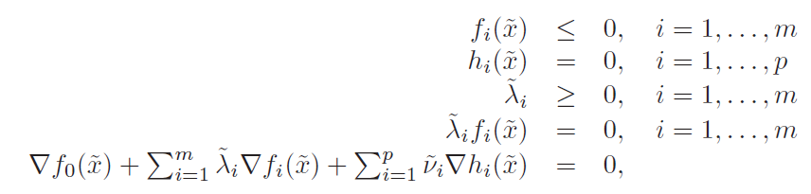



KKT Conditions for Convex Problems
When the primal problem is convex, KKT conditions are also sufficient
Assume
Then
From Complementary Slackness:
From last condition and convexity:
If Slater’s condition is satisfied, then
$⇔$ KKT conditions

Slide 20
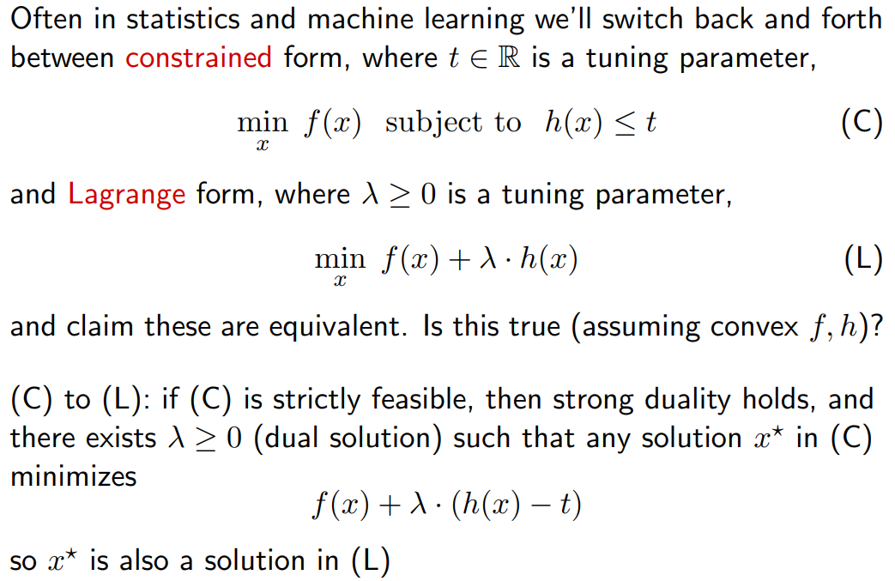
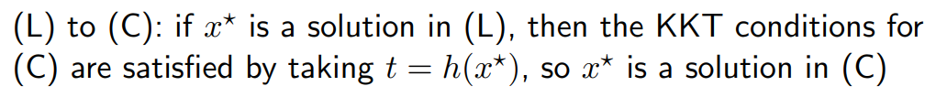
Constrained and Lagrange Forms

