Slide 1
SI100B Tutorial #2
Fall 2021

Slide 2
Topics
Diodes
BJT
MOSFET
Photoresistor
Solar Panel

Slide 3
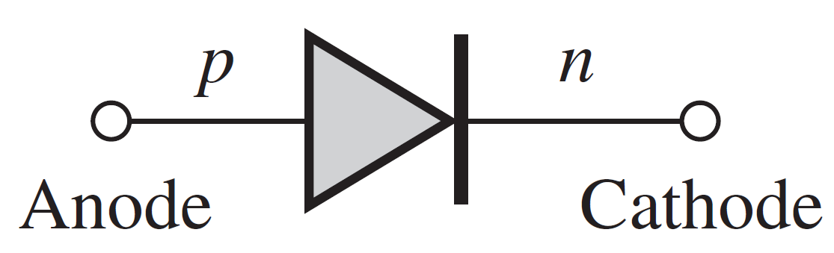
Diode
A K
正极（阳极） 负极（阴极）

Slide 4
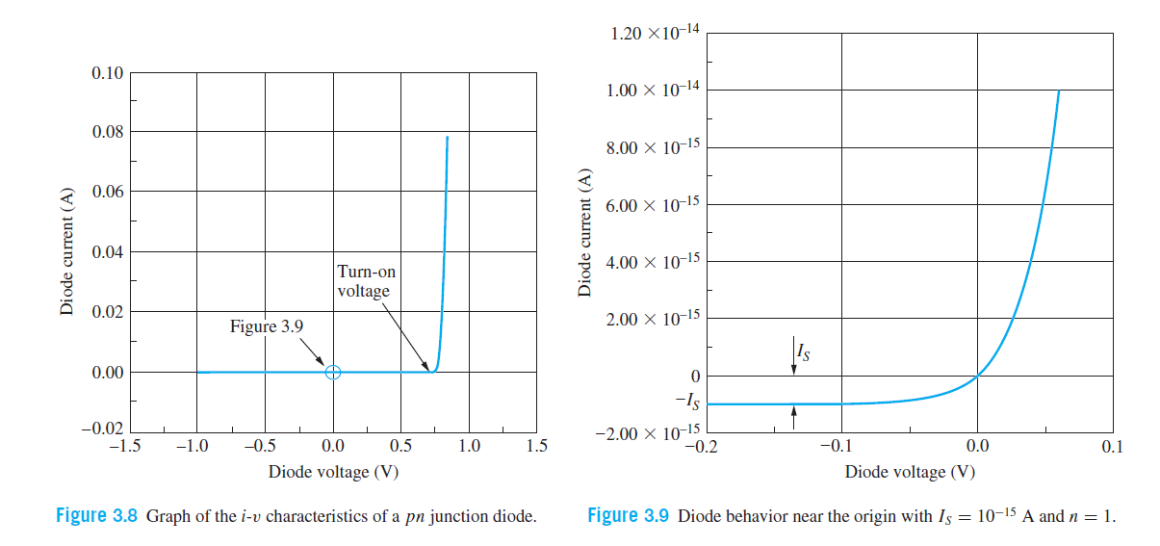
I-V Characteristics

Slide 5
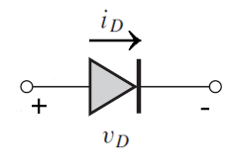
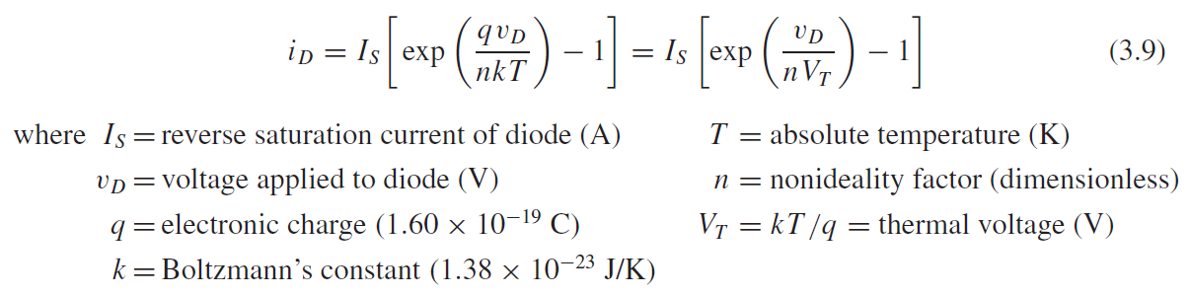
Mathematical model
VT = 25.9mV at room temperature
Usually n = 1

Slide 6
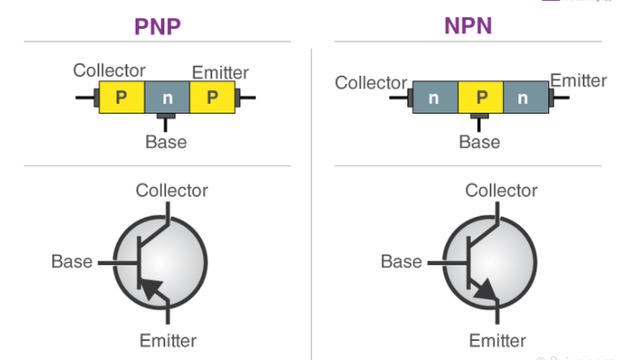
Bipolar junction transistors (BJT)
集电极
基极
发射极

Slide 7
Bipolar junction transistors(BJT)

Slide 8
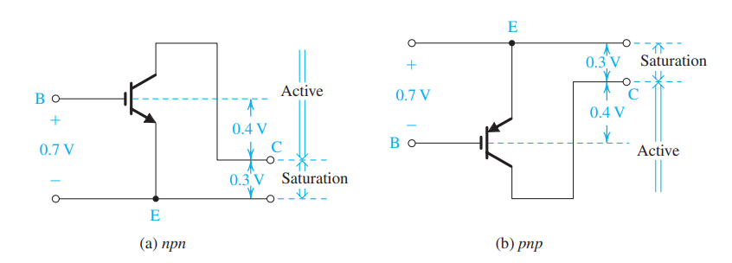
Bipolar junction transistors(BJT)
放大区
饱和区

Slide 9
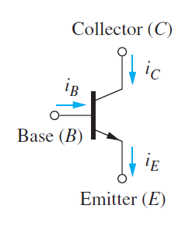
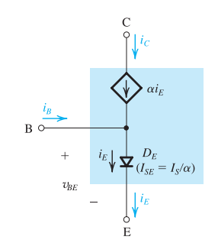
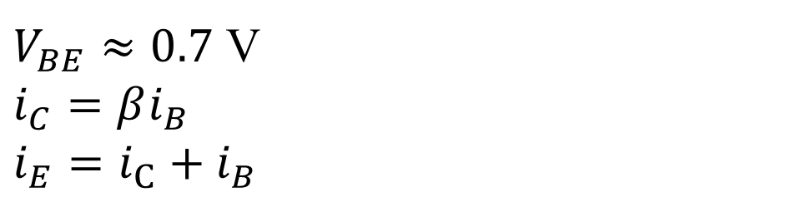
Mathematical model in active mode
$V_{BE}≈0.7$ V
$i_{C}=βi_{B}$
$i_{E}=i_{C}+i_{B}$

Slide 10
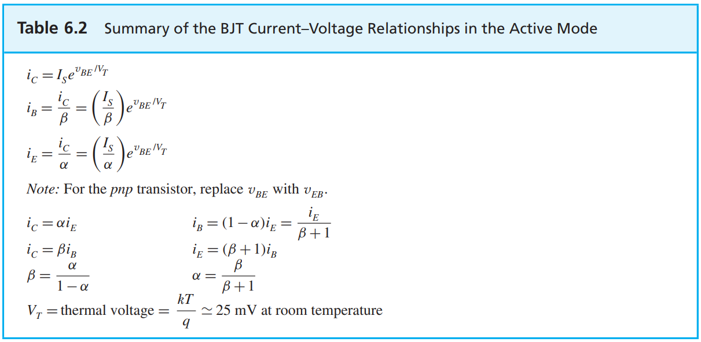
BIPOLAR JUNCTION TRANSISTORS(BJT)

Slide 11
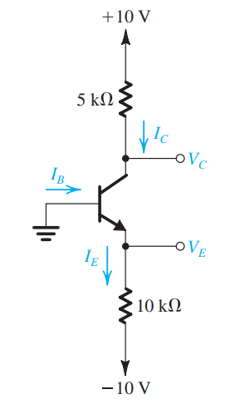
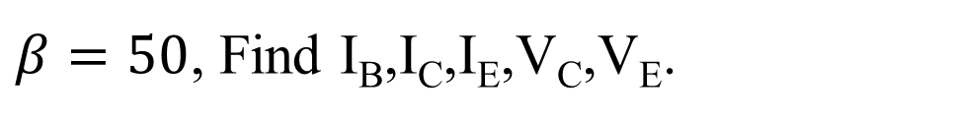
BJT example
$β=50$, Find I_{B},I_{C},I_{E},V_{C},V_{E}.

Slide 12
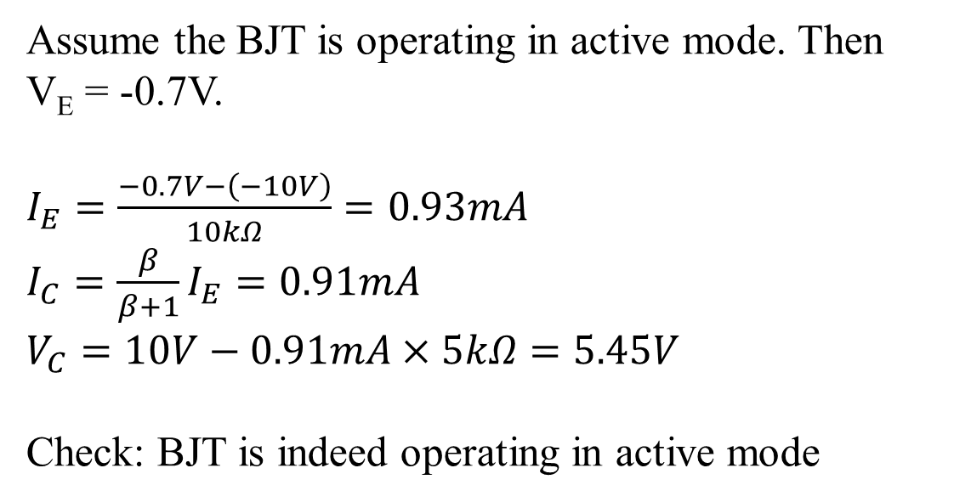
BJT example
Find I_{B},I_{C},I_{E},V_{C},V_{E}.
Assume the BJT is operating in active mode. Then
V_{E} = -0.7V.
$I_{E}=\frac{−0.7V−\left(−10V\right)}{10kΩ}=0.93mA$
$I_{C}=\frac{β}{β+1}I_{E}=0.91mA$
$V_{C}=10V−0.91mA×5kΩ=5.45V$
Check: BJT is indeed operating in active mode

Slide 13
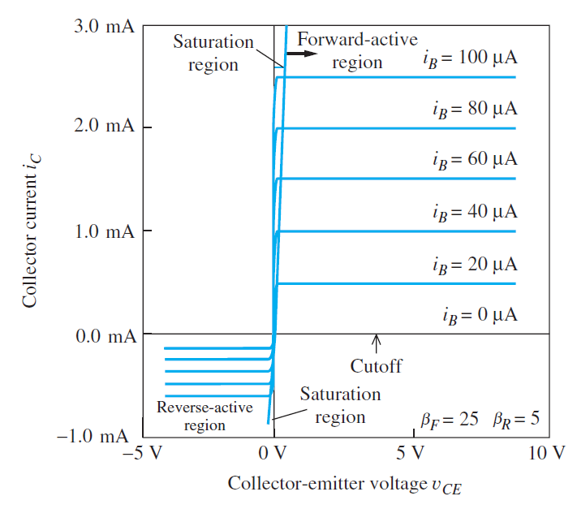
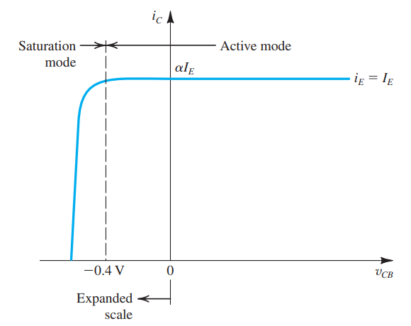
BJT I-V characteristic

Slide 14
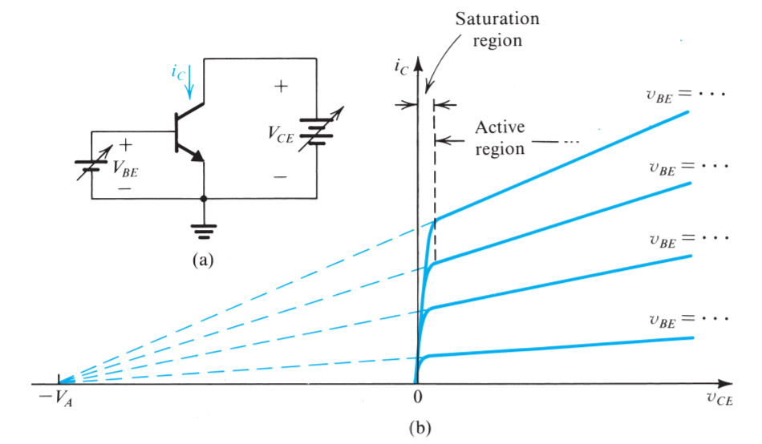
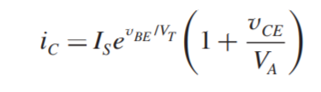
Early Effect(BJT)
V_{A} = Early Voltage
Collector current without early effect
Otherwise mentioned, assume V_{SB}=0.

Slide 15
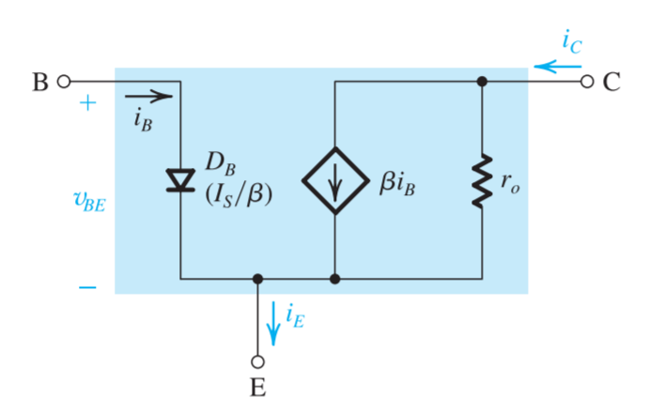

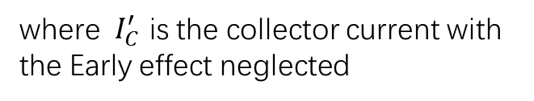
Early Effect(BJT)
Equivalent circuit model in active mode with Early effect
$$r_{o}=\frac{V_{A}}{Ic^{′}}$$
where $I_{C}^{′}$ is the collector current with the Early effect neglected
Otherwise mentioned, assume V_{SB}=0.

Slide 16
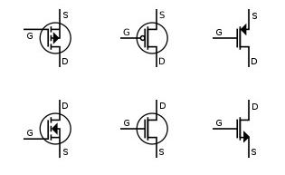
MOSFET
PMOS
NMOS
漏极（Drain）
栅极（Gate）
源极（Source）

Slide 17
MOSFET

Slide 18
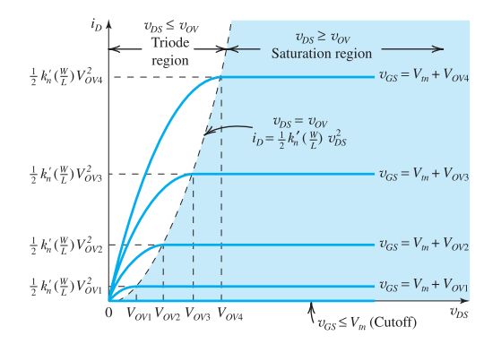
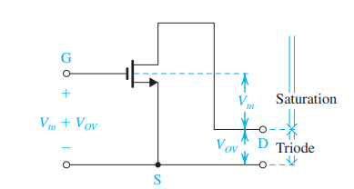
MOSFET
饱和区
线性区

Slide 19
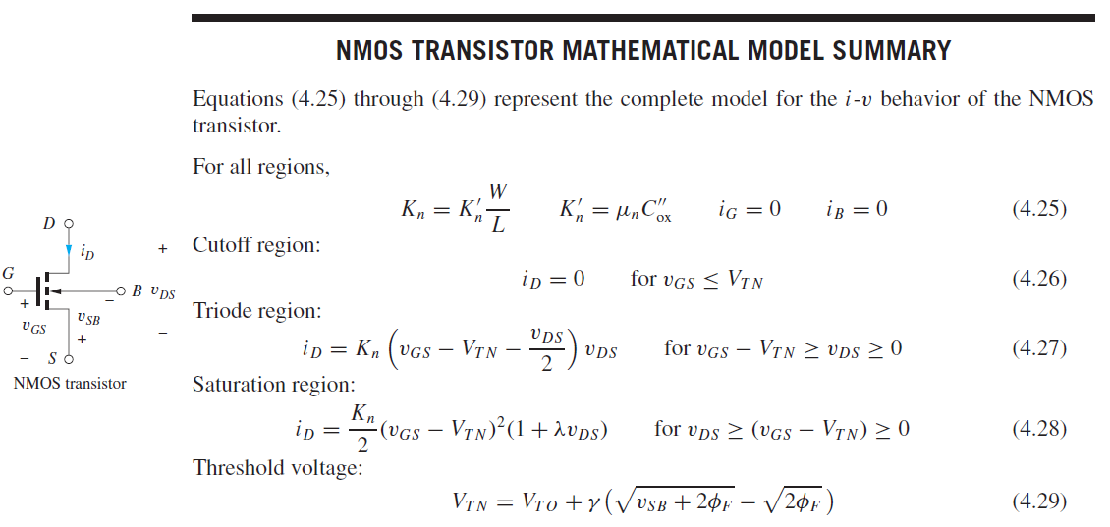
MOSFET
Otherwise mentioned, assume V_{SB}=0.

Slide 20
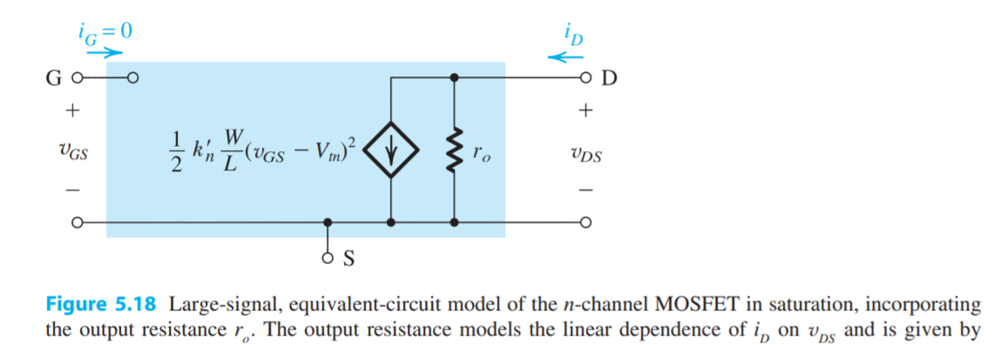

Channel length modulation effect(MOSFET)
Same as Early effect.
$$r_{o}= \frac{1}{λI_{D}}=\frac{V_{A}}{I_{D}}$$
Otherwise mentioned, assume V_{SB}=0.

Slide 21
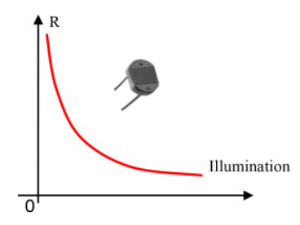
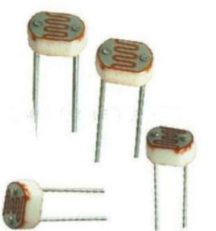
Photoresistor
Resistance increase 5000% when there is no illumination

Slide 22
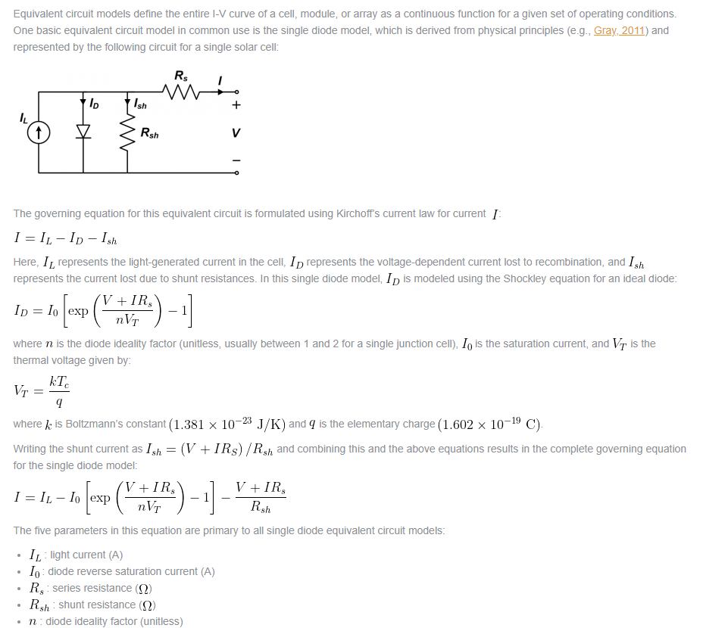
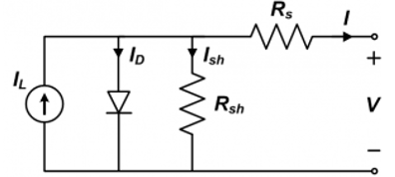
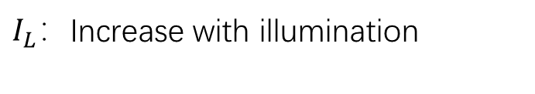
Solar Panel
$I_{L}$：Increase with illumination

Slide 23
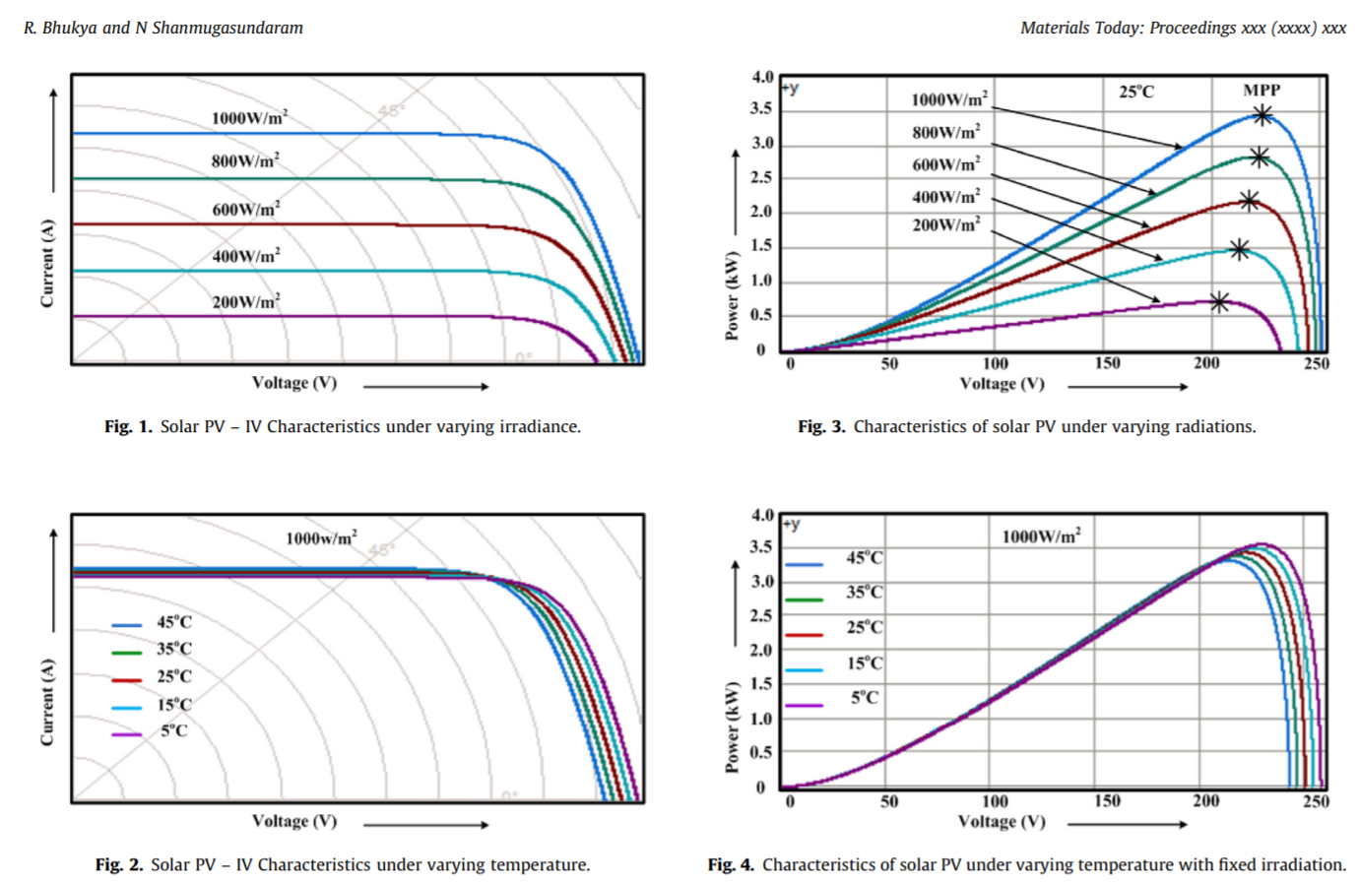
Solar Panel

Slide 24
Recommended reading materials
Adel S. Sedra, Kenneth C. Smith - Microelectronic Circuits-Oxford University Press (2014)

